Slide 1

Exploring the Relationship Between Health Metrics and Heart Disease
Presented by:- Huzefa Chhatriwala

Slide 2
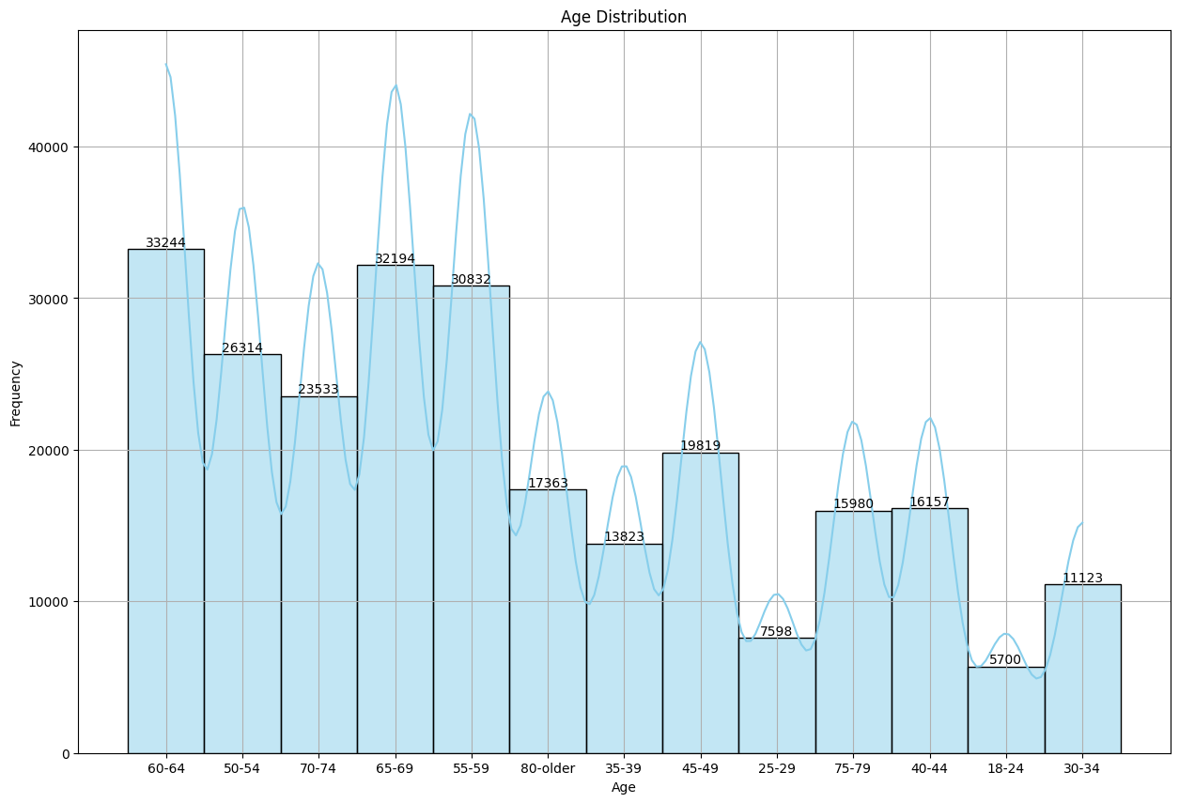
Age Analysis
Key Observations:
Peak Frequency: The highest frequency is observed in the age 60-64, with 33,244 records. This indicates that this age group is the most represented in the dataset.
Distribution Pattern: The age distribution shows a peak between ages 55 and 69, with frequencies gradually decreasing as age increases.

Slide 3
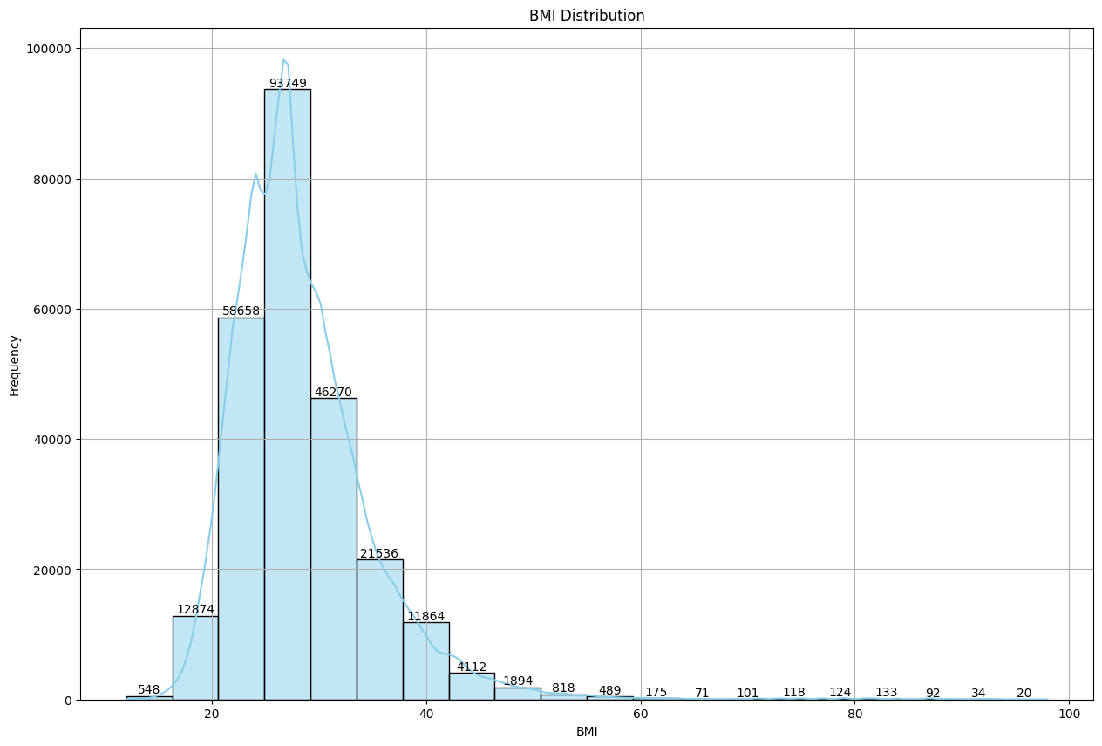
BMI Analysis
Key Observations:
High Concentration: The majority of individuals have BMI values clustered around 10-20, with the highest frequency observed in the 15-20 BMI range.
Tapering Off: The number of individuals decreases significantly in higher BMI ranges, with the frequency of individuals in the higher bins being much lower.
Sparse Data: BMI ranges above 60 show significantly fewer individuals, indicating that extreme values are less common.
Conclusion:
The BMI distribution graph highlights that most individuals fall within a moderate BMI range, with a steep decline in frequency as BMI values increase. This distribution is crucial for understanding the overall health and body weight trends within the population.

Slide 4
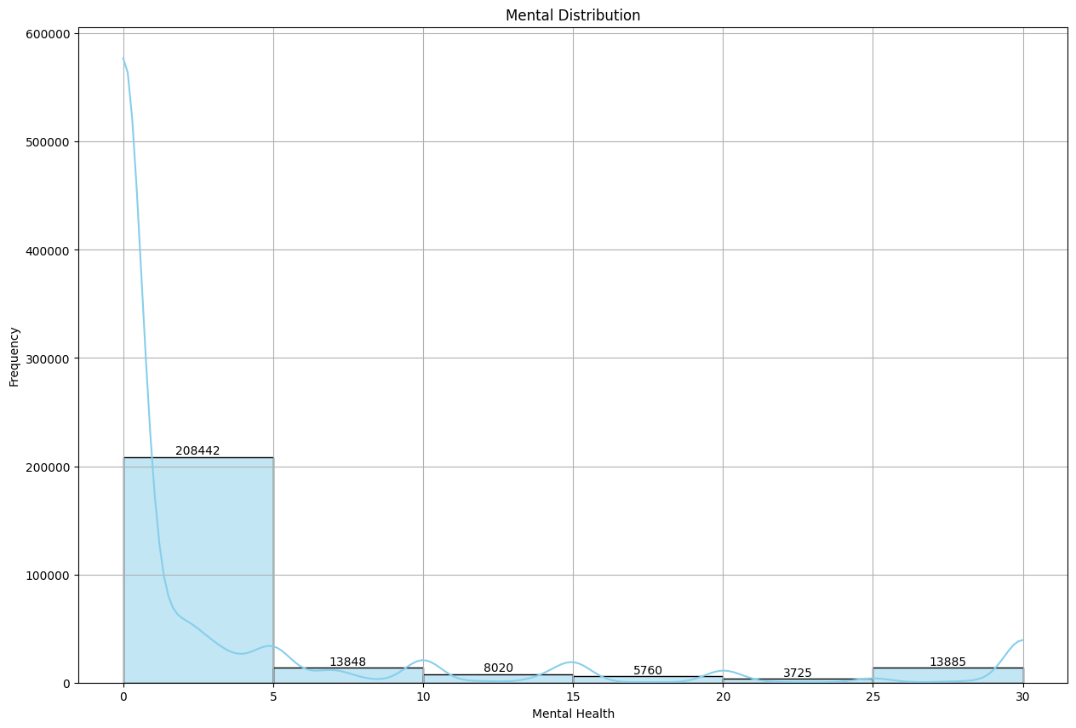
Mental Health Analysis
Key Observations:
High Concentration: The majority of individuals report between 1 and 5 mental health days, with the highest frequency observed in this range.
Decrease in Frequency: There is a notable decrease in the number of individuals reporting mental health days as the range increases, with fewer individuals reporting 11-15 and 16-20 days.
Slight Increase in Higher Range: There is a slight increase in frequency in the 26-30 mental health days range, though this bin still contains fewer individuals compared to the lowest range.
Conclusion:
The mental health days distribution graph indicates that most individuals report a low number of mental health days. The frequency decreases as the number of mental health days increases, with a small rise in the highest bin. This distribution provides insights into the overall mental health trends and the prevalence of more extreme mental health challenges within the population.

Slide 5
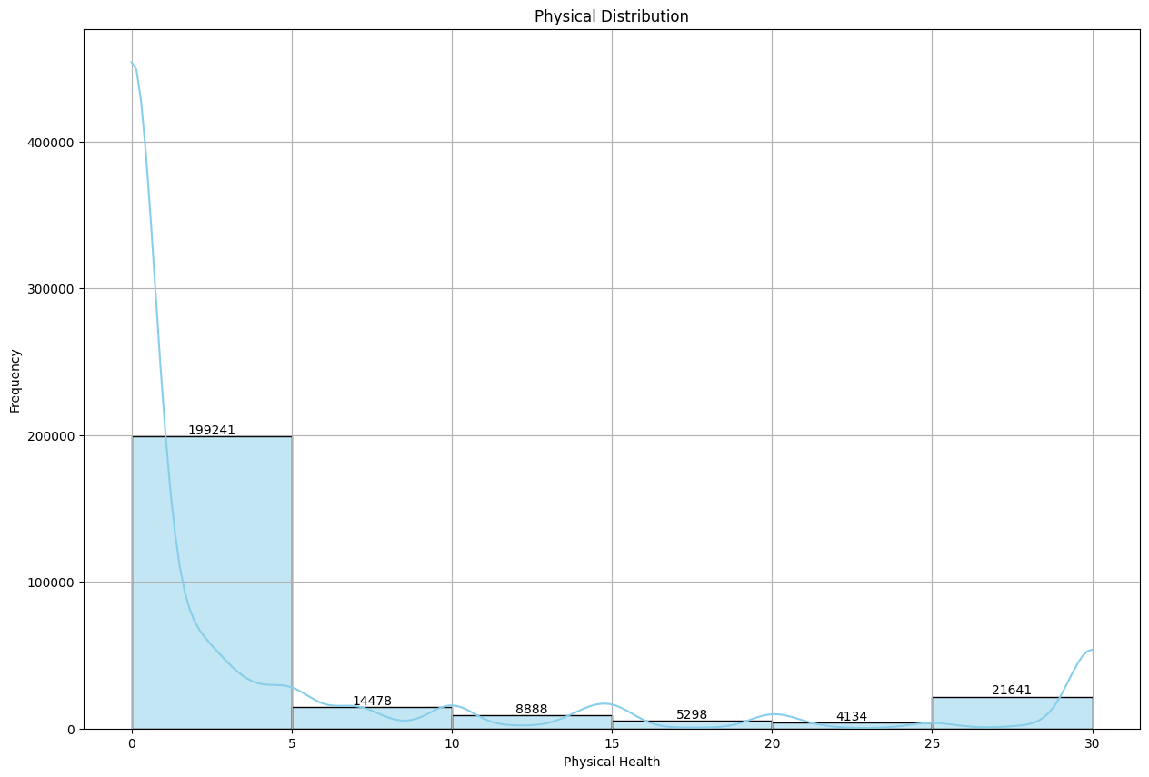
Physical Health Analysis
Key Observations:
High Concentration: The majority of individuals report between 1 and 5 physical health days, with the highest frequency observed in this range.
Decrease in Frequency: There is a noticeable decrease in the number of individuals reporting physical health days as the range increases, with fewer individuals reporting 11-15 and 16-20 days.
Slight Increase in Higher Range: There is a noticeable increase in the frequency of individuals reporting 26-30 physical health days compared to the previous bins.
Conclusion:
The physical health days distribution graph indicates that most individuals report a low number of physical health days. The frequency decreases as the number of physical health days increases, with a small rise in the highest bin. This distribution highlights the prevalence of physical health challenges and provides insights into how these challenges are distributed across the population.

Slide 6
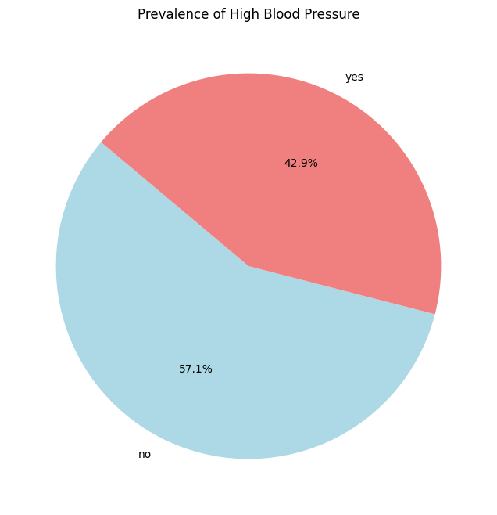
High Blood Pressure
A higher percentage of individuals without heart disease have high blood pressure compared to those with heart disease.
The percentage of high blood pressure is slightly lower among individuals with heart disease, suggesting that while high blood pressure is common, it does not always correlate directly with heart disease prevalence.
Conclusion:
While high blood pressure is a prevalent condition, its direct impact on heart disease prevalence is complex. Further analysis may be needed to understand underlying factors and relationships between high blood pressure and heart disease.

Slide 7
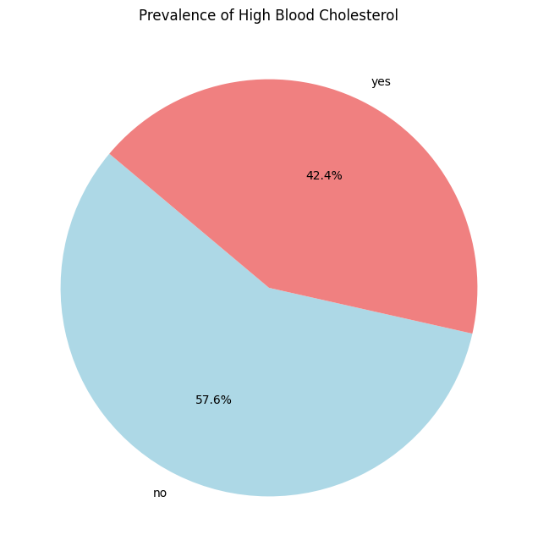
High Blood Cholesterol
A higher percentage of individuals without heart disease have high blood cholesterol compared to those with heart disease.
The prevalence of high blood cholesterol is lower among individuals with heart disease, indicating that high cholesterol is a common condition among those without heart disease.
Conclusion:
The data reveals that while high blood cholesterol is prevalent in both groups, it is more common among individuals without heart disease. This suggests that high cholesterol, like high blood pressure, is a significant health issue but may not directly correlate with heart disease incidence.

Slide 8
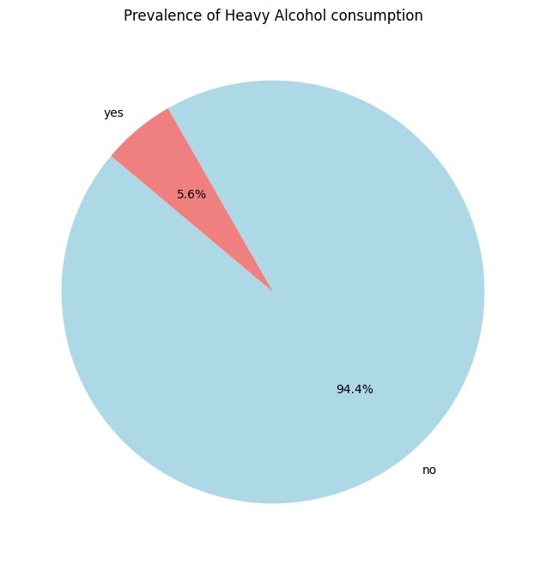
Heavy Alcohol Consumption
Heavy alcohol consumption is notably low among individuals with heart disease, representing only 5.6% of the population.
The vast majority (94.4%) of individuals without heart disease do not engage in heavy alcohol consumption.
Conclusion:
The data suggests that heavy alcohol consumption is rare among individuals with heart disease. This could imply that heavy drinking is not a major factor in the population with heart disease, or it may indicate that individuals with heart disease are less likely to engage in heavy drinking. Further investigation into other lifestyle factors might be beneficial.

Slide 9
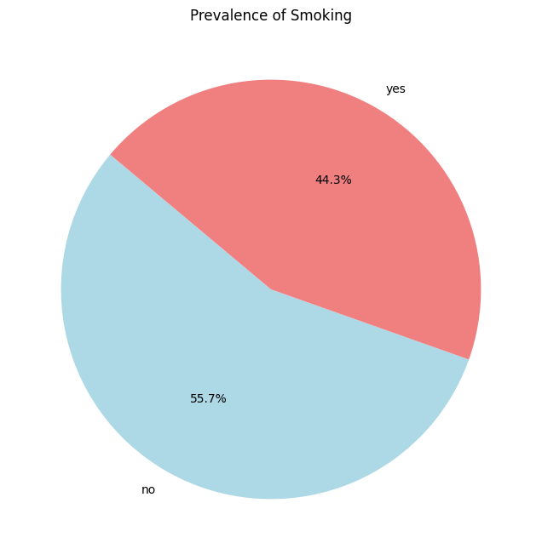
Smoking
Smoking is a significant factor in the population with heart disease, with 44.3% of individuals reporting smoking.
A slight majority of 55.7% of individuals without heart disease also smoke, suggesting that smoking is prevalent across both groups.
Conclusion:
The data shows that smoking is relatively common among both individuals with and without heart disease. This suggests that smoking may be a risk factor for heart disease but is not the only determinant. Further analysis could investigate the correlation between smoking intensity and heart disease outcomes.

Slide 10
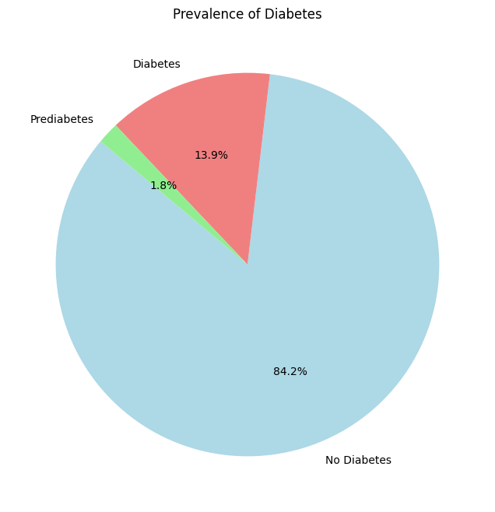
Diabetes
The majority of individuals, 84.2%, do not have diabetes, indicating a lower prevalence of diabetes in the dataset.
A notable 13.9% of individuals are classified as diabetic, suggesting a higher risk of developing diabetes in the near future.
Only 1.8% of individuals are Pre-diabetic, reflecting a relatively small portion of the population with confirmed Pre-diabetes.
Conclusion:
The data highlights that while the prevalence of diabetes is significant, a very low portion of the population is at risk of developing diabetes, as evidenced by the prediabetic rate. This suggests the need for preventive measures and health monitoring for those in the prediabetic category.

Slide 11
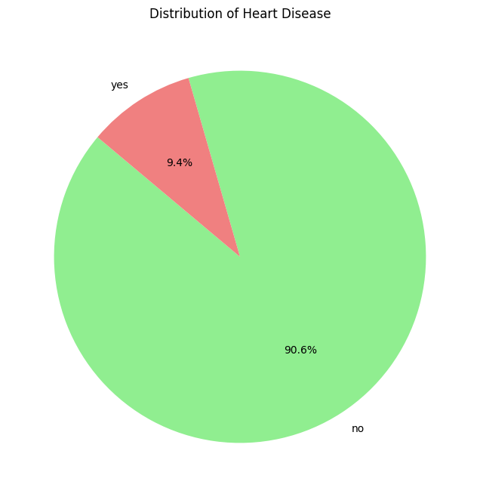
Heart Disease
A significant majority of 90.6% of individuals do not have heart disease, indicating a lower prevalence of heart disease within the dataset.
Only 9.4% of individuals are reported to have heart disease, which suggests that heart disease is relatively less common in this population.
Conclusion:
The low prevalence of heart disease (9.4%) in the dataset highlights a healthier population with fewer cases of heart disease. However, ongoing monitoring and preventive measures are essential for the 9.4% who are affected.

Slide 12
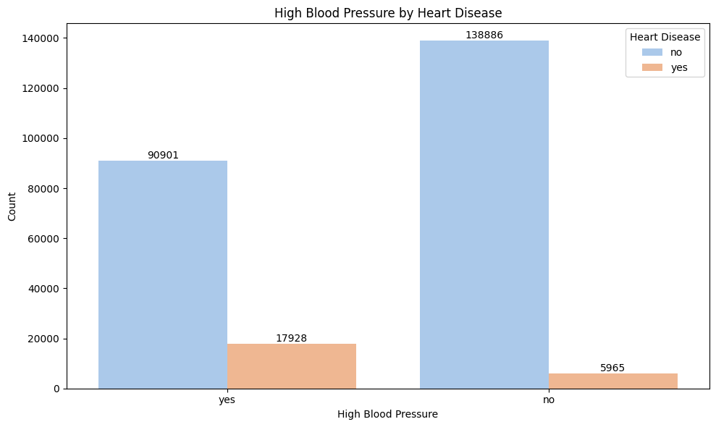
High Blood Pressure vs Heart Disease
Among individuals with heart disease, a higher percentage (16.5%) have high blood pressure compared to those without heart disease (30.0%). This indicates a significant prevalence of high blood pressure among individuals without heart disease.
The data suggests that high blood pressure is more common in individuals without heart disease than in those with heart disease. This may reflect differences in how high blood pressure correlates with heart disease in this dataset.
Conclusion:
The analysis highlights that while high blood pressure is less common among individuals with heart disease (16.5%), it remains a significant issue, particularly in the population without heart disease (30.0%). This suggests that high blood pressure is a prevalent risk factor in the broader population, regardless of heart disease status.

Slide 13

High Cholesterol vs Heart Disease
Among individuals with heart disease, a notable percentage (15.7%) have high cholesterol, which is significantly higher than the 4.9% in the population without heart disease.
Conversely, a larger proportion of individuals without heart disease (95.1%) do not have high cholesterol compared to those with heart disease (84.3%).
Conclusion:
The data indicates that high cholesterol is more prevalent among individuals with heart disease compared to those without. This suggests a stronger association between high cholesterol and heart disease, highlighting the importance of managing cholesterol levels as part of heart disease prevention and management strategies

Slide 14
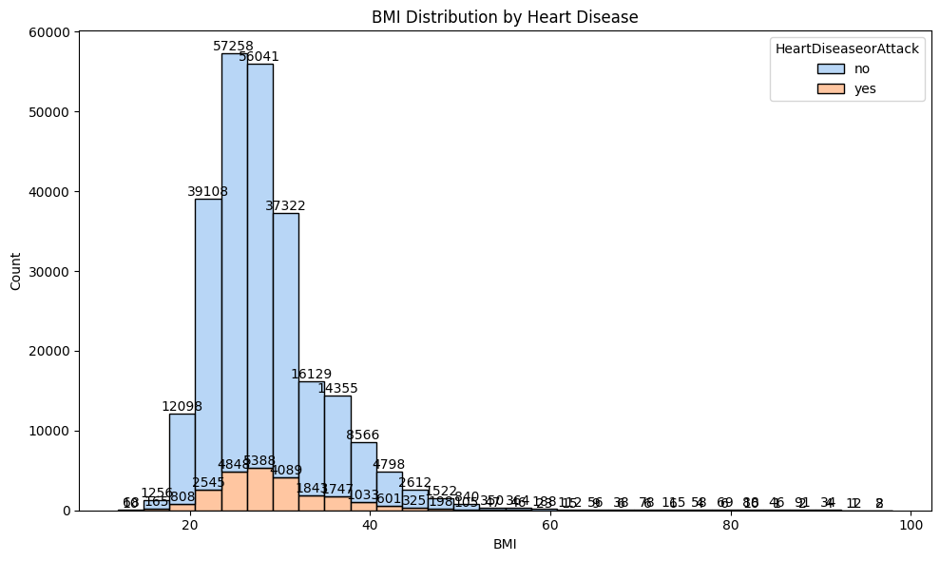
BMI vs Heart Disease
Key Insight: Higher BMI ranges are associated with an increased incidence of heart disease, with the 21-30 and 31-40 BMI ranges showing the highest numbers of affected individuals. The trend indicates that as BMI increases, so does the likelihood of heart disease, emphasizing the importance of managing and monitoring BMI for cardiovascular health.
General Trend: The majority of individuals with heart disease fall within the BMI ranges of 21-30 and 31-40. Higher BMI ranges, though less populated, show a higher proportion of heart disease cases, suggesting an increased risk associated with higher BMI.
Risk Correlation: Individuals with a BMI in the 21-30 range have the highest number of heart disease cases, highlighting a critical area for health interventions. As BMI increases, the number of heart disease cases increases proportionally, reinforcing the link between higher BMI and the likelihood of heart disease.

Slide 15
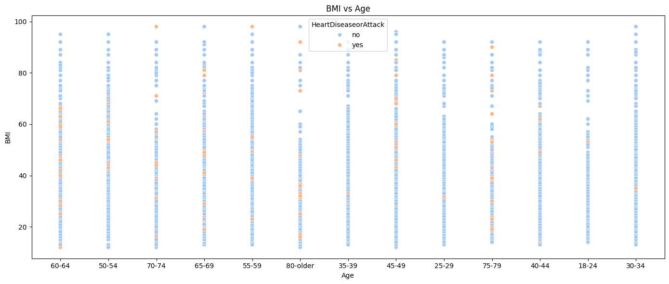
BMI vs AGE
Increasing BMI Variability:
As age increases, the average BMI for individuals with heart disease remains higher compared to those without heart disease.
Trend:
Higher average BMI is consistently observed in individuals with heart disease across all age groups, suggesting a potential link between higher BMI and increased risk of heart disease.
Across all age groups, individuals with heart disease tend to have a higher average BMI compared to those without. The variability of BMI also increases with heart disease, indicating that higher BMI might be associated with a greater risk of heart disease as individuals age.
Implication:
Managing BMI from a young age could be important for reducing the risk of developing heart disease later in life.
The data suggests that monitoring and managing BMI from a young age could be crucial in reducing the risk of heart disease.

Slide 16
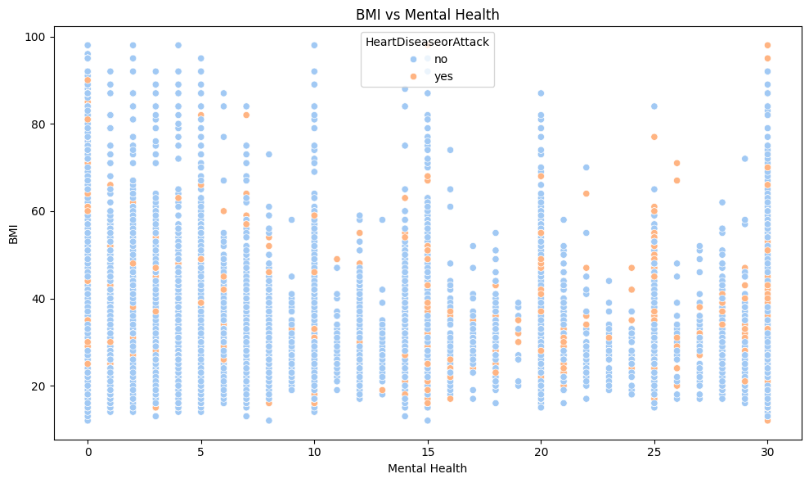
BMI vs Mental Health
Observations:
Increased Mean BMI: Individuals with more days of mental health issues generally have a higher mean BMI, especially those with heart disease.
BMI Variation: The standard deviation of BMI is relatively high across all mental health categories, indicating variability in BMI within each group.
Implications:
Potential Association: The data suggests a potential association between mental health issues and higher BMI, particularly among individuals with heart disease.
Healthcare Focus: Addressing both mental health and BMI may be important for managing and preventing heart disease.

Slide 17
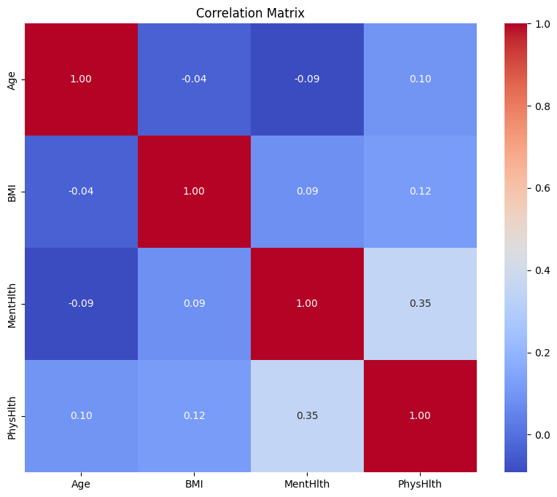
Correlational Matrix
Correlation Coefficients:
Age vs. BMI: -0.04
Interpretation: There is a very weak negative correlation between Age and BMI, suggesting that age has a minimal impact on BMI in this dataset.
Age vs. Mental Health Days: -0.09
Interpretation: A weak negative correlation indicates a slight tendency for older individuals to report fewer mental health days.
Age vs. Physical Health Days: 0.10
Interpretation: A weak positive correlation suggests a slight increase in physical health days with age.
BMI vs. Mental Health Days: 0.09
Interpretation: There is a very weak positive correlation between BMI and mental health days, indicating a minor association where higher BMI is slightly associated with more mental health days.
BMI vs. Physical Health Days: 0.12
Interpretation: A weak positive correlation suggests that higher BMI is slightly associated with more physical health days.
Mental Health Days vs. Physical Health Days: 0.35
Interpretation: A moderate positive correlation indicates that individuals who report more mental health days also tend to report more physical health days.

Slide 18
Correlational Matrix
Key Findings:
Weak Relationships: Most of the correlations are weak, indicating that these variables have limited direct relationships with each other.
Moderate Correlation: The moderate positive correlation between Mental Health Days and Physical Health Days suggests a more noticeable relationship, where increased mental health issues may be associated with more physical health challenges.
Implications:
Complex Interactions: While individual correlations are weak, the moderate correlation between mental and physical health days highlights an important interaction that may warrant further investigation.
Focus Areas: Consider exploring how mental health and physical health days are interrelated in more detail, as they exhibit a more significant correlation compared to other variables.

Slide 19
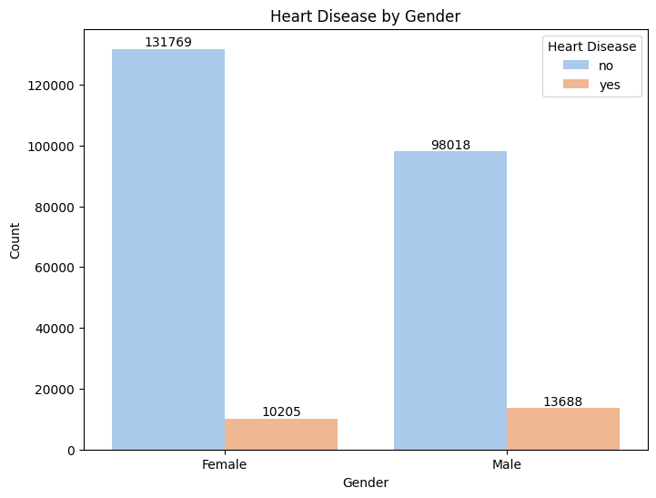
Heart Disease by Gender
The prevalence of heart disease is higher among males (12.3%) compared to females (7.2%).
A larger proportion of females (92.8%) do not have heart disease compared to males (87.7%).
Conclusion:
The data suggests that males have a higher prevalence of heart disease compared to females. This difference highlights the need for targeted heart disease prevention strategies that consider gender-specific risk factors and health interventions.

Slide 20
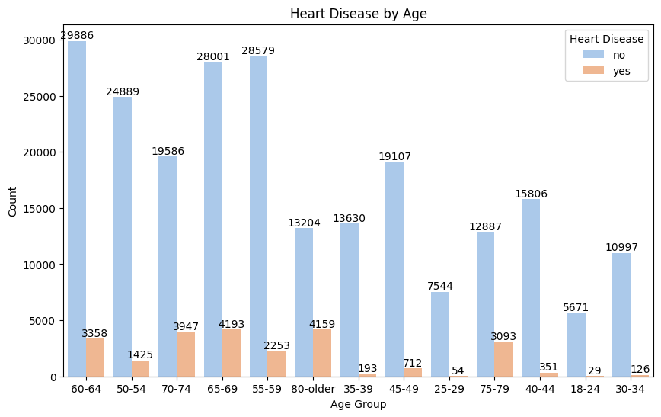
Heart Disease by Age Group
Older Age Groups (60-69): The age groups 60-64 and 65-69 show the highest total population counts, with over 28,000 individuals. However, heart disease prevalence is also significant, especially in the 65-69 group, where over 4,000 individuals have heart disease.
55-59 and 70-74: These age groups show a moderate number of cases, with around 2,000 to 4,000 individuals affected by heart disease. The 55-59 group has a slightly higher number of healthy individuals compared to the 70-74 group.
Younger Age Groups: As expected, younger age groups (below 50) have a much lower prevalence of heart disease. Notably, there are very few heart disease cases in people aged 40-44 (around 350 cases) and 35-39 (less than 200 cases). The 25-29 group has the lowest heart disease count (around 54 cases).
High-Risk Groups: The 65-69 age group appears to have the highest heart disease prevalence, making it a high-risk group for cardiovascular conditions.
Decline in Heart Disease Prevalence: There’s a sharp decline in heart disease cases as the age decreases, particularly in individuals aged below 50.

Slide 21
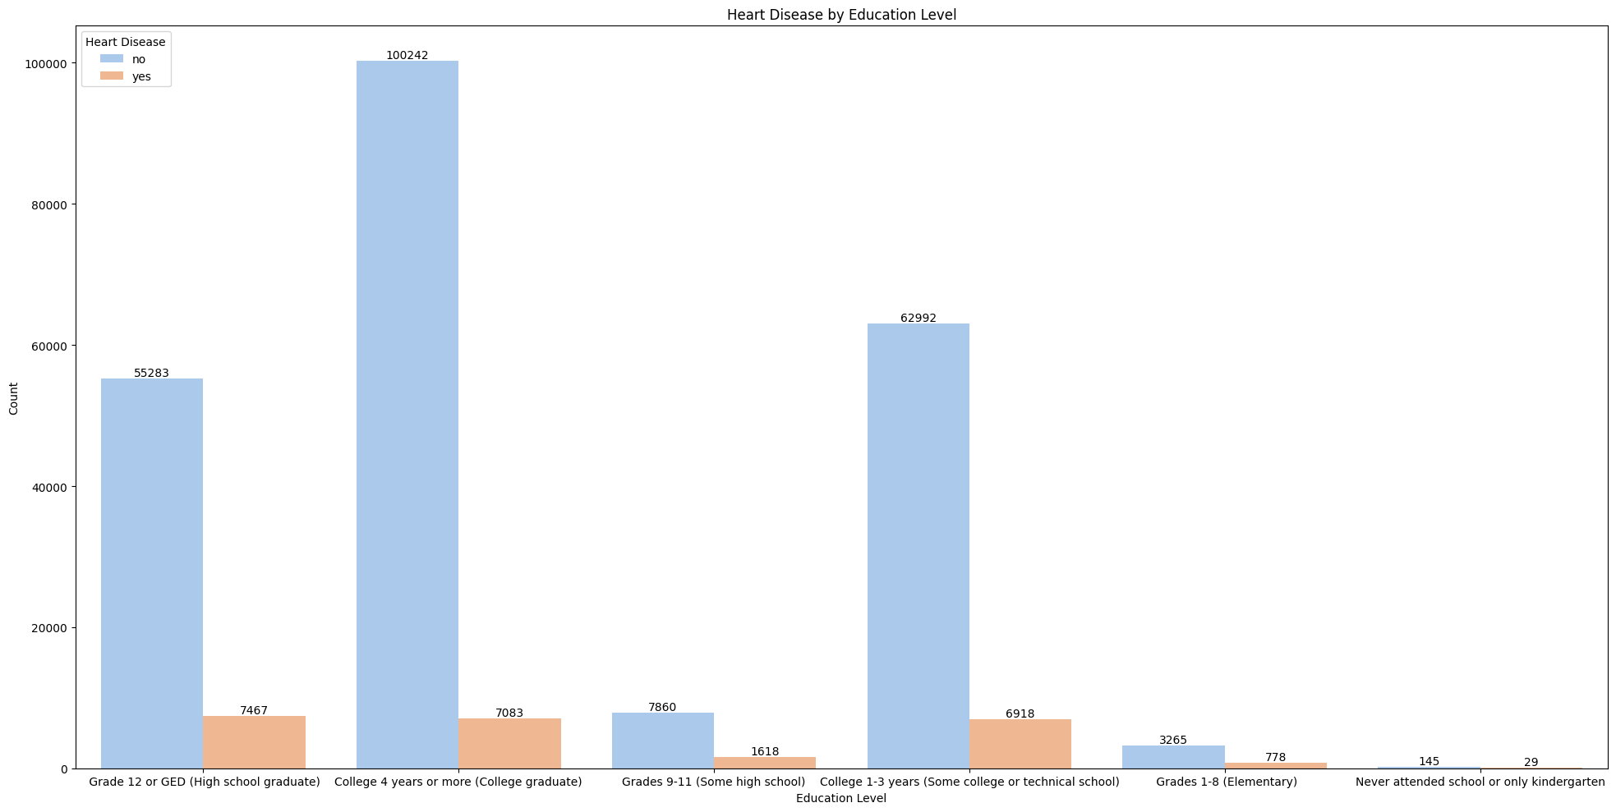
Heart Disease by Educational Level
Prevalence:
The number of heart disease cases increases with education level, with higher education levels showing more cases of heart disease.
College pass out or graduate has the highest number of both heart disease cases (7,083) and non-cases (100,242).
Trends:
There is a clear trend showing that as the level of education increases, the number of heart disease cases also increases.
This trend might reflect underlying socio-economic factors or health-related behaviors associated with different education levels.
Conclusion:
The data indicates that heart disease cases increase with age within the early childhood years. This may reflect increasing risk factors or evolving health conditions as children grow older. Further analysis could provide insights into specific age-related risk factors contributing to this trend.

