Slide 1
Text Mining With Rapid Miner
Using:
Rapid-Miner “Python Scripting Extension”
Rapid-Miner Python Library

Slide 2
Rapid-Miner Python package
allows you to interact with RapidMiner Studio and AI Hub.
You can collaborate with others using the RapidMiner repository
run processes from Python scripts
leverage the scalable infrastructure of RapidMiner AI Hub
Call Rapid-Miner from Python (use-cases):
you work locally on the same data in RapidMiner and in Python.
you need to reuse business logic that exists in a RapidMiner.
you develop Python code snippets that may later beused in a RapidMiner process.
you use Python primarily, but want to collaborate with colleagues
Installation: is a one-liner using the Python package manager pip
Note: It is best practice to use package manager which supports multiple environments.
For example Anaconda, to isolate package dependencies to ensure reproducible execution.
pip install rapidminer

Slide 3
Python Scripting Extension
To execute Python code as part of a RapidMiner process, rapid miner provides
Python Scripting Extension
Prerequisites:
To be able to run Python code within the RapidMiner
you will need a working Python environment
The Python environment in use needs to contain the library pandas version 1.0 or later.
Installation:
To install the extension, go to the Extensions menu, Open Marketplace and search Python Scripting.
Link: python script installation

Slide 4
Python scripts for working with RapidMiner Studio
Connection to local Studio instance:
# connection.py
import rapidminer
import os
rm_home="C:\Program Files\RapidMiner\RapidMiner Studio"
# If you don't want to see the log messages of the operations, use rm_stdout=open(os.devnull,"w")
connector = rapidminer.Studio(rm_home, rm_stdout=None)
Reading ExampleSets:
# main.py
import os
from utils.connection import connector
def rm_main():
iris, deals, golf = connector.read_resource(["//Samples/data/Iris", "//Samples/data/Deals", "//Samples/data/Golf"])
print("The result are pandas DataFrames")
print(iris.head(1))
print(deals.head(1))
print(golf.head(1))
return iris.head(1) , deals.head(1), golf.head(1)
if __name__ == '__main__':
rm_main()

Slide 5
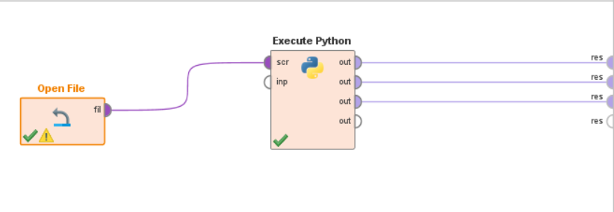
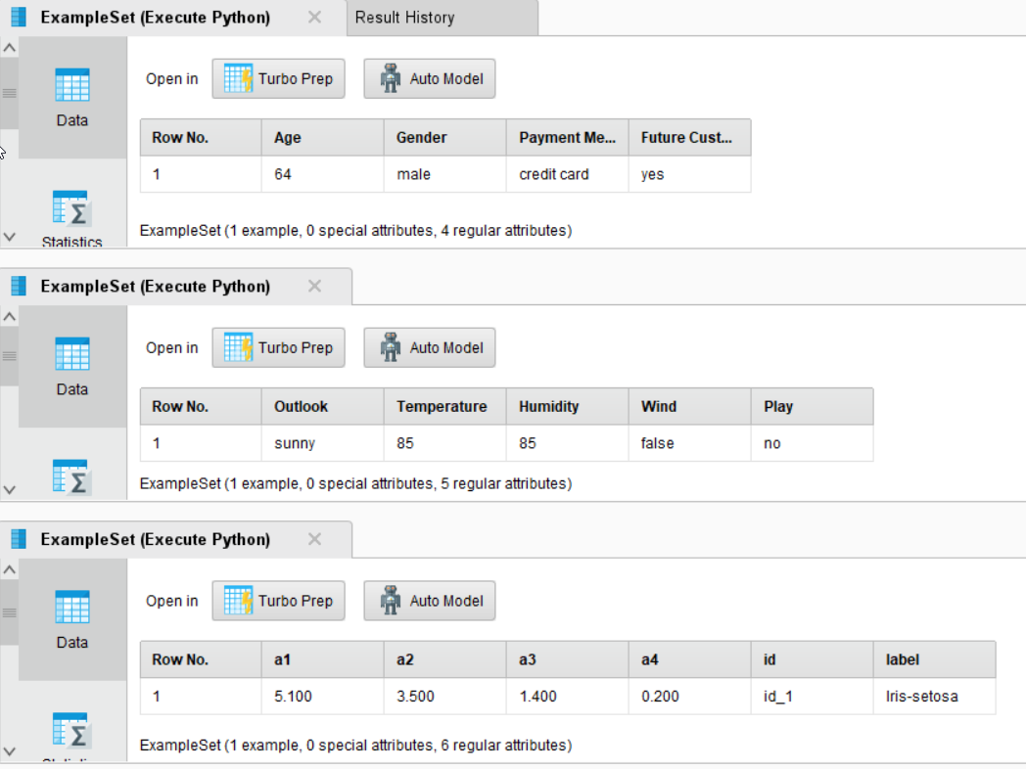
Reading ExampleSets: Result in cmd
Connection to local Studio instance:

Slide 6
Call Python from RapidMiner:
you find it easier or more convenient to write a data prep step or a modeling step as Python code
you want to reuse a piece of Python code that someone on your team has created
You want to extend RapidMiner with a cutting edge Python library

