Slide 1
Text Mining With Rapid Miner
Using:
Rapid-Miner Python Library
Rapid-Miner “Python Scripting Extension”

Slide 2
Rapid-Miner Python package
allows you to interact with RapidMiner Studio and AI Hub.
You can collaborate with others using the RapidMiner repository
run processes from Python scripts
leverage the scalable infrastructure of RapidMiner AI Hub
Call Rapid-Miner from Python (use-cases):
you work locally on the same data in RapidMiner and in Python.
you need to reuse business logic that exists in a RapidMiner.
you develop Python code snippets that may later beused in a RapidMiner process.
you use Python primarily, but want to collaborate with colleagues
Installation: is a one-liner using the Python package manager pip
Note: It is best practice to use package manager which supports multiple environments.
For example Anaconda, to isolate package dependencies to ensure reproducible execution.
pip install rapidminer

Slide 3
Python Scripting Extension
To execute Python code as part of a RapidMiner process, rapid miner provides
Python Scripting Extension
Prerequisites:
To be able to run Python code within the RapidMiner
you will need a working Python environment
The Python environment in use needs to contain the pandas library version 1.0 or later.
Installation:
To install the extension, go to the Extensions menu, Open Marketplace and search Python Scripting.
Link: Install the Python Scripting Extension

Slide 4
Python scripts & working with RapidMiner Studio
Connection to local Studio instance:
# connection.py
import rapidminer
import os
rm_home="C:\Program Files\RapidMiner\RapidMiner Studio"
# If you don't want to see the log messages of the operations, use rm_stdout=open(os.devnull,"w")
connector = rapidminer.Studio(rm_home, rm_stdout=None)
Reading ExampleSets:
# main.py
import os
from utils.connection import connector
# rm_main is a mandatory function
# the number of arguments has to be the number of input ports (can be none) def rm_main():
iris, deals, golf = connector.read_resource(["//Samples/data/Iris", "//Samples/data/Deals", "//Samples/data/Golf"])
print("The result are pandas DataFrames")
print(iris.head(1))
print(deals.head(1))
print(golf.head(1))
return iris.head(1) , deals.head(1), golf.head(1)
if __name__ == '__main__':
rm_main()

Slide 5
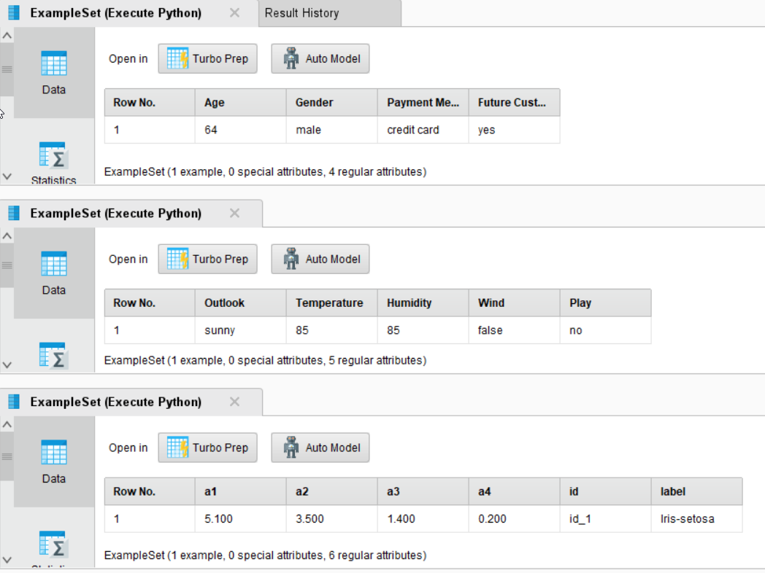
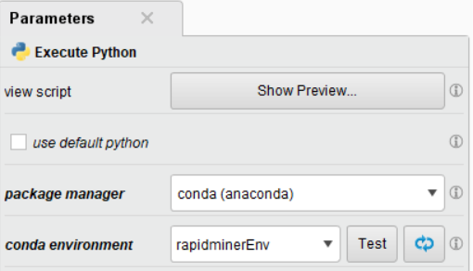
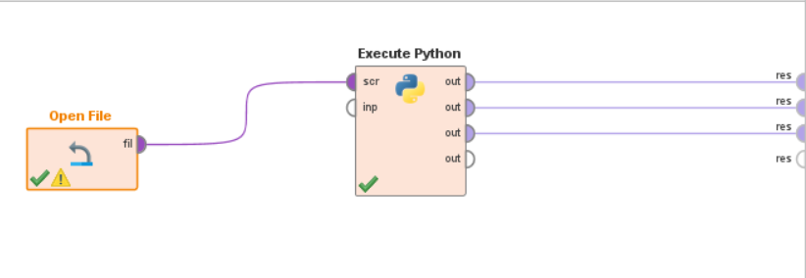
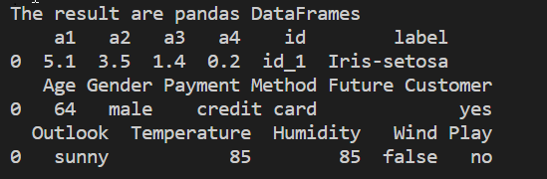
Reading ExampleSets: Result in RapidMiner Studio
Execute Python: Executes a Python script.
Takes Input as File
Provides outputs as pandas.DataFrame
Reading ExampleSets: Result in cmd

Slide 6
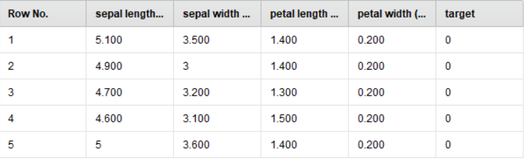
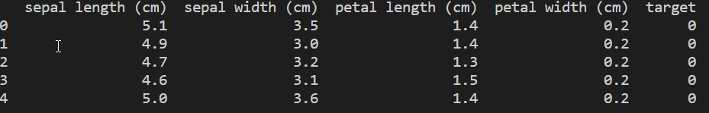
Writing ExampleSets:
# writingExample.py
import pandas
from utils.connection import connector
from sklearn.datasets import load_iris
def rm_main():
sklearn_iris = load_iris()
iris = pandas.DataFrame(sklearn_iris["data"], columns=sklearn_iris["feature_names"])
iris["target"] = sklearn_iris["target"]
# set the parameter to the desired repository location
connector.write_resource(iris, "//Local Repository/RapidMiner_Python/scripts/data/Iris")
return iris.head(5)
if __name__ == '__main__':
print(rm_main())
Result in RapidMiner Studio
In cmd:

Slide 7
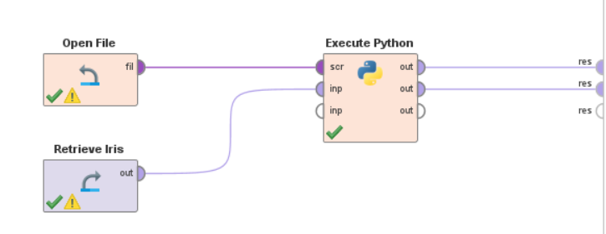
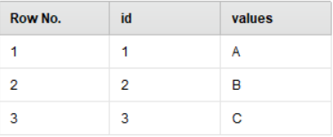
TestInput:
#testInput.py
from pandas import DataFrame
def rm_main(file):
data = DataFrame(dict(
id = (1,2,3),
values = ("A","B","C")
))
d = DataFrame([str(file.rm_metadata)])
return data,d
TestInput:

Slide 8
Resourses:
Project Github Repo: https://github.com/Huzefa-Mustafa/rapidminer-python
RapidMiner Python package: https://github.com/rapidminer/python-rapidminer
Python Scripting Extension: https://docs.rapidminer.com/latest/python/extension/install.html
RapidMiner docs for python: https://docs.rapidminer.com/latest/python/
Thank You! The END…

