Slide 1
Text Mining With Rapid Miner
Using:
Rapid-Miner Python Library
Rapid-Miner “Python Scripting Extension”

Slide 2
Rapid-Miner Python package
allows you to interact with RapidMiner Studio and AI Hub.
You can collaborate with others using the RapidMiner repository
run processes from Python scripts
Call Rapid-Miner from Python (use-cases):
you have work locally on the same data in RapidMiner and in Python.
you need to reuse business logic that exists in a RapidMiner.
you have develop Python code snippets that may later beused in a RapidMiner process.
you are using Python primarily, but want to collaborate with colleagues
Installation: is a one-liner using the Python package manager pip
Note: It is best practice to use package manager which supports multiple environments.
For example Anaconda, to isolate package dependencies to ensure reproducible execution.
pip install rapidminer

Slide 3
Python Scripting Extension
To execute Python code as part of a RapidMiner process, rapid miner provides
Python Scripting Extension
Prerequisites:
To be able to run Python code within the RapidMiner
you will need a working Python environment
The Python environment in use needs to contain the pandas library version 1.0 or later.
Installation:
To install the extension, go to the Extensions menu, Open Marketplace and search Python Scripting.
Link: Install the Python Scripting Extension

Slide 4
Python scripts & working with RapidMiner Studio
Connection to local Studio instance:
# connection.py
import rapidminer
import os
rm_home="C:\Program Files\RapidMiner\RapidMiner Studio"
# If you don't want to see the log messages of the operations, use rm_stdout=open(os.devnull,"w")
connector = rapidminer.Studio(rm_home, rm_stdout=None)
Reading ExampleSets:
# main.py
import os
from utils.connection import connector
# rm_main is a mandatory function, its our main entrypoint
# the number of arguments has to be the number of input ports (can be none) def rm_main():
iris, deals, golf = connector.read_resource(["//Samples/data/Iris", "//Samples/data/Deals", "//Samples/data/Golf"])
print("The result are pandas DataFrames")
print(iris.head(1))
print(deals.head(1))
print(golf.head(1))
return iris.head(1) , deals.head(1), golf.head(1)
if __name__ == '__main__':
rm_main()

Slide 5
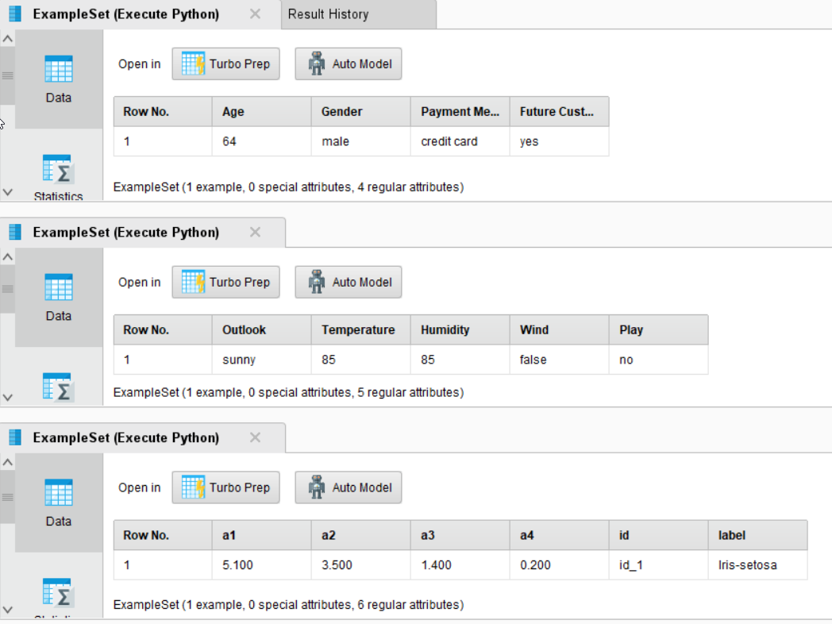
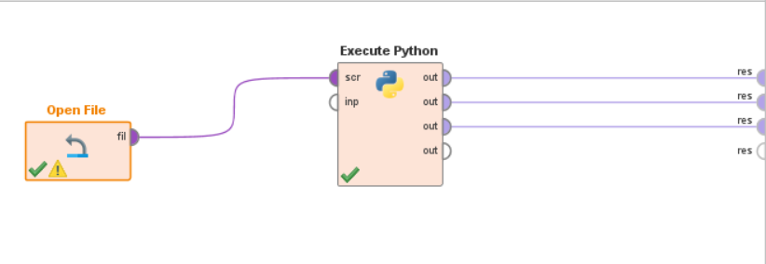
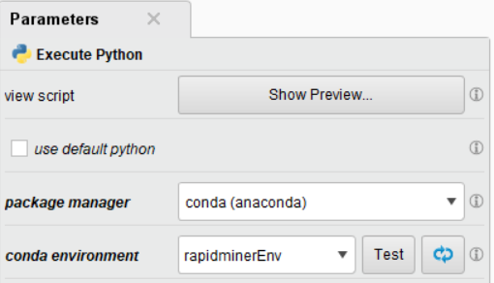
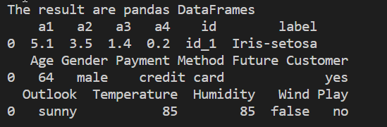
Reading ExampleSets: Result in RapidMiner Studio
Execute Python: Executes a Python script.
Takes Input as File
Provides outputs as pandas.DataFrame
Reading ExampleSets: Result in cmd

Slide 6
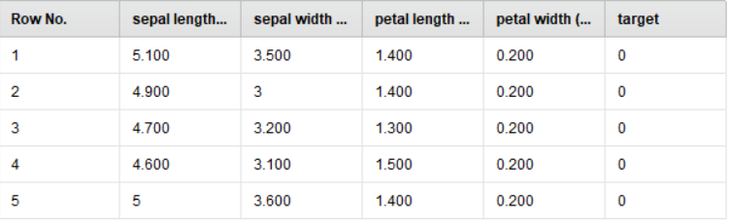
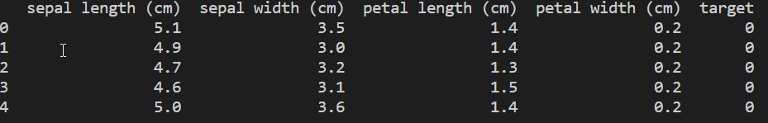
Writing ExampleSets:
# writingExample.py
import pandas
from utils.connection import connector
from sklearn.datasets import load_iris
def rm_main():
sklearn_iris = load_iris()
iris = pandas.DataFrame(sklearn_iris["data"], columns=sklearn_iris["feature_names"])
iris["target"] = sklearn_iris["target"]
# set the parameter to the desired repository location
connector.write_resource(iris, "//Local Repository/RapidMiner_Python/scripts/data/Iris")
return iris.head(5)
if __name__ == '__main__':
print(rm_main())
Result in RapidMiner Studio
In cmd:

Slide 7
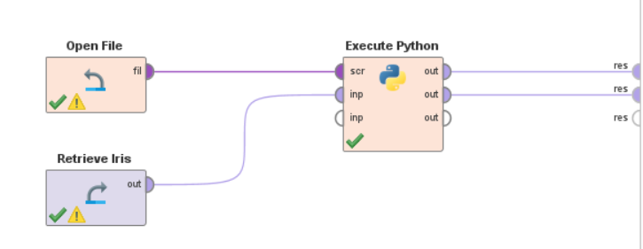
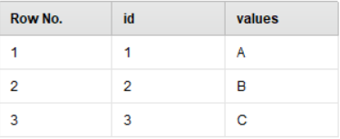
TestInput:
#testInput.py
from pandas import DataFrame
def rm_main(file):
data = DataFrame(dict(
id = (1,2,3),
values = ("A","B","C")
))
# rm_metadata to get metadata (types and roles) related to given input
d = DataFrame([str(file.rm_metadata)])
return data,d
TestInput:

Slide 8
Resourses:
Project Github Repo: https://github.com/Huzefa-Mustafa/rapidminer-python
RapidMiner Python package: https://github.com/rapidminer/python-rapidminer
Python Scripting Extension: https://docs.rapidminer.com/latest/python/extension/install.html
RapidMiner docs for python: https://docs.rapidminer.com/latest/python/
Thank You! The END…

