Slide 1
Shortfall
01
Shortfall
NORTHSTAR INVOICE
$4,800
Resolve invoice exceptions
as receiving records change
120 units at $40
REVISED PROPOSAL
$400
Review the evidence.
Approve the current amount.
LATE RECEIPT
10 more units
110 units received
Huzyefah Wasim
Previous proposal: $800
Vultr Future of Work challenge
Notes:
I'm about to approve an eight hundred dollar hold on an invoice. A late receipt arrives, and the right amount drops to four hundred. I built Shortfall so a finance reviewer can see what changed before approving the correction. The illustration uses the synthetic Northstar case.
Sources
https://github.com/Huzyefahwasim/vultr-hackathon/blob/main/docs/pitch.md
https://github.com/Huzyefahwasim/vultr-hackathon/blob/main/public/samples/receipt-late.txt

Slide 2
Shortfall
02
The work behind an invoice exception
A late receipt means another round of checking and explaining.
Manual review | With Shortfall
Find the invoice, order, and receipts | Inspect source fields and their quotes
Recalculate when receiving changes | Review the recalculated discrepancy
Explain the decision to the next reviewer | Read the assigned task and case history
Expected time benefit
Less searching, repeated arithmetic, and handover work.
Existing accounting products offer matching controls. Review time savings still need operator measurement.
Notes:
Reviewing this manually means checking the invoice against the purchase order and receipts, recalculating when goods arrive, and recording why the amount changed. The next reviewer may have to reconstruct that decision. Existing accounting systems offer matching controls. Shortfall focuses on the exception itself: the changed evidence, the next action, and the approval needed to finish it. The target benefit is less staff time spent on each case. This is a workflow hypothesis to validate with operators, not measured customer behavior.
Sources
https://learn.microsoft.com/en-us/dynamics365/finance/accounts-payable/accounts-payable-invoice-matching
https://support.ramp.com/hc/en-us/articles/30227975187731-3-Way-Match-with-Ramp-Procurement
https://github.com/Huzyefahwasim/vultr-hackathon/blob/main/docs/product.md

Slide 3
Shortfall
03
A late receipt changes the decision
120 units invoiced at $40 each. Invoice total: $4,800.
Before the receipt
After the receipt
100 units received
10 more units
110 units received
$800
$400
proposed hold
current discrepancy
Old $800 approval rejected
The ledger stays unchanged.
Notes:
Northstar invoices one hundred and twenty units at forty dollars each. With one hundred received, the discrepancy is eight hundred dollars. I prepare that proposal, then upload a receipt for ten more units. Claude Opus extracts the fields and supporting quotes. Code validates the evidence and recalculates the discrepancy. When I try the earlier approval, the server rejects it because the evidence changed. The internal held amount remains zero. I review and approve the revised four hundred dollar hold.
Sources
https://github.com/Huzyefahwasim/vultr-hackathon/blob/main/docs/evaluation.md
https://github.com/Huzyefahwasim/vultr-hackathon/blob/main/public/samples/receipt-late.txt

Slide 4
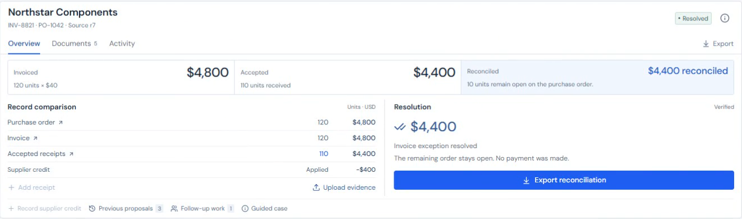
Shortfall
04
The correction stays traceable
Approve the $400 hold. Verify a $400 supplier credit. Approve credit and release.
$4,400
$0
10
Net invoice
Held amount
Order units still open
Notes:
I approve the revised four hundred dollar hold. The worker records it and creates a supplier follow up task. Next, I upload a four hundred dollar supplier credit. Importing the credit does not apply it. I inspect the verified credit and proposed hold release, then approve the correction. The result is four thousand four hundred dollars net, zero held, and ten units still open on the purchase order. I can inspect the execution history and export the reconciliation. This is a synthetic internal ledger correction. No payment was made and the four hundred dollars is not measured cash saved. Screenshot: the recorded public application on 6 November 2026.
Sources
https://github.com/Huzyefahwasim/vultr-hackathon/blob/main/docs/evaluation.md
https://shortfall.95.179.254.189.sslip.io/submission/

Slide 5
Shortfall
05
Vultr runs the workflow
Vultr Cloud Compute
Reviewer
Web + API
PostgreSQL
Node worker
Web browser
Next.js / HTTPS
Cases, jobs, receipts
Extraction + execution
Code checks evidence and amounts.
Approvals use current records.
Approved work survived a restart
with one execution and one task.
External model API
Claude Opus 5.5
Fields and source quotes
Notes:
Vultr hosts the Next.js web application and API, PostgreSQL, and a separate Node worker, behind Caddy HTTPS. Claude Opus five point five runs through the external Anthropic API and extracts fields and source quotes. The worker alone receives its model API key. Code handles monetary arithmetic, evidence linkage, current approval checks, and duplicate prevention. PostgreSQL stores durable jobs and execution receipts. A queued hold survived container replacement and produced one execution and one task after replay. This deployment uses a single VM and is not a high availability cluster.
Sources
https://github.com/Huzyefahwasim/vultr-hackathon/blob/main/docs/architecture.md
https://github.com/Huzyefahwasim/vultr-hackathon/blob/main/compose.yaml
https://github.com/Huzyefahwasim/vultr-hackathon/blob/main/docs/evaluation.md

Slide 6
Shortfall
06
Evidence from three separate test sets
Original baseline
CSV correction
Fresh CSV cases
24 documents
3 targeted reruns
4 new documents
9/12 supported accepted
3/3 accepted
2 accepted
3 sent to review
24/24 fields correct
18/18 fields correct
12/12 risk cases met
expected outcomes
Same inputs rerun
after a validator fix
2 sent to review
as expected
28 unique documents 31 model calls $0.47 model cost
Synthetic records and project labels. No independent reviewer.
Notes:
The original evaluation contained twenty four synthetic documents. Nine of twelve supported inputs were accepted and three valid CSV inputs were sent to review. Twelve additional cases tested unsupported inputs, incorrect references, and embedded instructions, and all met their expected outcomes. After correcting a validator, three targeted reruns passed with twenty four out of twenty four required fields correct. Four fresh CSV cases then produced two accepted results with eighteen out of eighteen required fields correct and two expected review outcomes. Across these sets there were twenty eight unique documents, thirty one settled model calls, and a model cost of $0.474656. The original baseline had seventy four correct critical fields, twenty four withheld, and zero incorrectly accepted critical fields out of ninety eight required. These sets do not establish production accuracy or customer ROI. Separately, all fifty three configured automated tests and twelve public API and browser workflows passed.
Sources
https://github.com/Huzyefahwasim/vultr-hackathon/blob/main/docs/evaluation-results.md
https://github.com/Huzyefahwasim/vultr-hackathon/blob/main/docs/evaluation.md

Slide 7
Shortfall
07
The business case for a finance team
Expected value
Proposed buyer
Finance manager
at a small distributor
Less staff time
Find cited values and review calculated amounts.
Fewer overpayments
$99
Check received quantities before approving.
Fewer missed credits
per workspace / month
Price to test with operators
Keep the credit, approval, and result in one case.
Next: measure review minutes and correction errors on comparable cases.
Notes:
The proposed buyer is a finance manager at a small distributor. The user is an accounts payable reviewer working with receiving staff. I expect less time spent finding values, repeating arithmetic, and reconstructing previous decisions. The financial goals are less staff time per case, fewer overpayments, and fewer missed supplier credits. These benefits still need operator measurement. I plan to compare active review time and correction errors on comparable cases. The ninety nine dollar monthly workspace price is a hypothesis to test. Existing ERP products and companies such as Ramp already provide invoice matching controls. Shortfall focuses on reviewing changing evidence through an approved correction, and I am not claiming that this feature is exclusive.
Sources
https://github.com/Huzyefahwasim/vultr-hackathon/blob/main/docs/product.md
https://github.com/Huzyefahwasim/vultr-hackathon/blob/main/docs/pitch.md
https://support.ramp.com/hc/en-us/articles/30227975187731-3-Way-Match-with-Ramp-Procurement

Slide 8
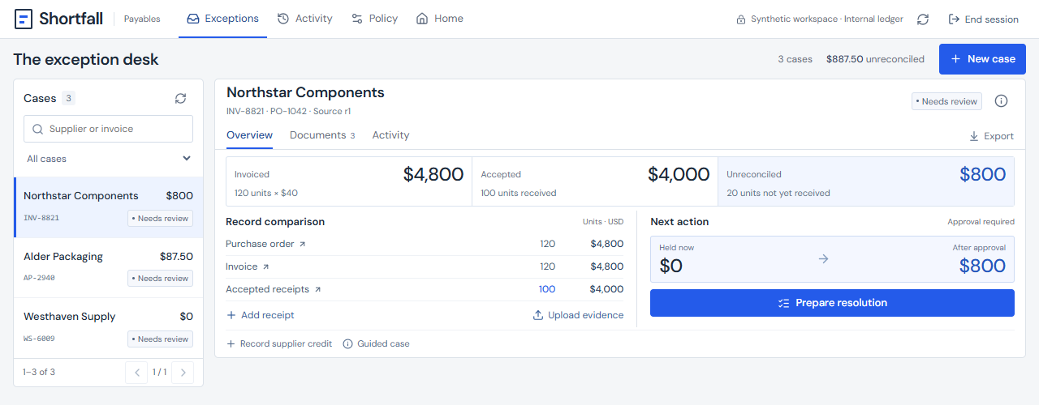
Shortfall
08
Try a case, then inspect the result
Open the live application
Choose a sample or create a case.
Inspect evidence and approve.
Export the reconciliation.
Public repository
Huzyefah Wasim
Solo developer
Next: operator interviews, authenticated roles, accounting connector.
Synthetic records. Internal ledger. No bank or ERP connection. Savings remain unmeasured.
Notes:
Judges can explore the sample or enter a case with their own supported values. They can inspect evidence, review an approval, follow the execution history, and export the reconciliation. The next steps are operator interviews, authenticated roles, and an accounting connector. This prototype uses synthetic records and an internal ledger. No payment, ERP update, or supplier message occurs. Time and cost savings remain unmeasured. The live application and public repository links on this slide are clickable. Screenshot: current public application captured on 6 November 2026.
Sources
https://shortfall.95.179.254.189.sslip.io/
https://github.com/Huzyefahwasim/vultr-hackathon
https://github.com/Huzyefahwasim/vultr-hackathon/blob/main/docs/submission/judge-quickstart.md

