Slide 1
Wine Quality Classification
Hwan Cho

Slide 2
Contents
01
Research Question
03
Model Results
02
Dataset overview
04
Conclusions

Slide 3
Research question
How we will use machine learning models:
We can analyze if there is any systematic way sommeliers rate wine or if it is purely a subjective measure.
If yes then we can find important features that wineries should focus on.
Fun Fact: The size of the global wine industry is OVER $500 BILLION!

Slide 4
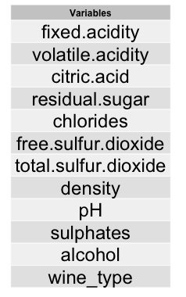
Dataset Overview
Our data is from UCI machine learning repository with wine quality as response variable and 11 features.
Initially had two datasets, one on white wine, and the other on red wine.
Combined the two datasets and created Wine_type (dummy variable where 0 is white wine, 1 is red wine. (so now 12 features)
We have 12 variables, where 11 are continuous variables, and only 1 is binary, with a total sample size of 6497 observations
Taster Qualifications: The sample population are professional wine tasters from a wine research institute with extensive experience in tasting and evaluating wine.

Slide 5
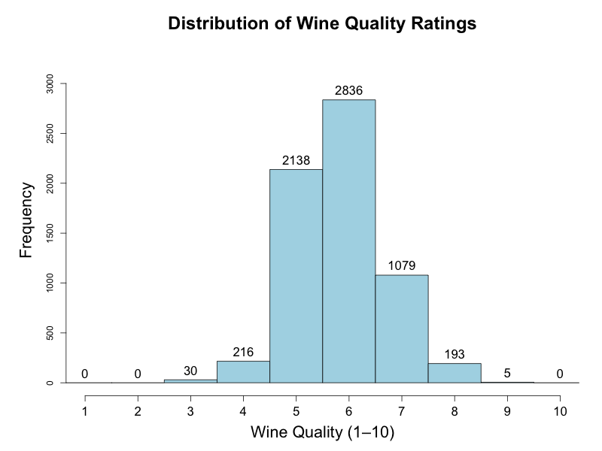
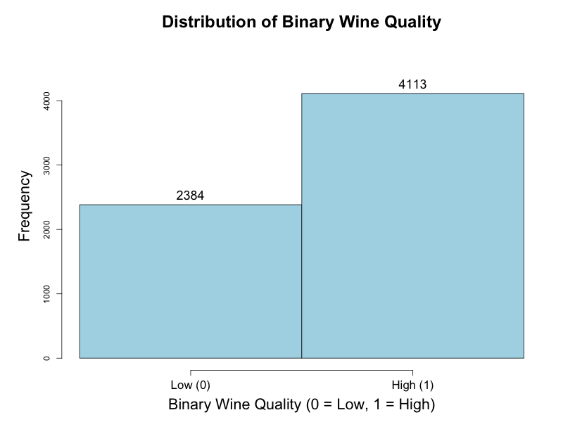
Response variable
Since our response variable, wine quality ranged from 1-10, we created a binary variable for classification of low quality wine(0-5) and high quality wine (6-10).
This gives us a no information rate of roughly 64%, so our response variable is relatively balanced - but we still consider accuracy, F-1 score, and AUC as metrics.

Slide 6
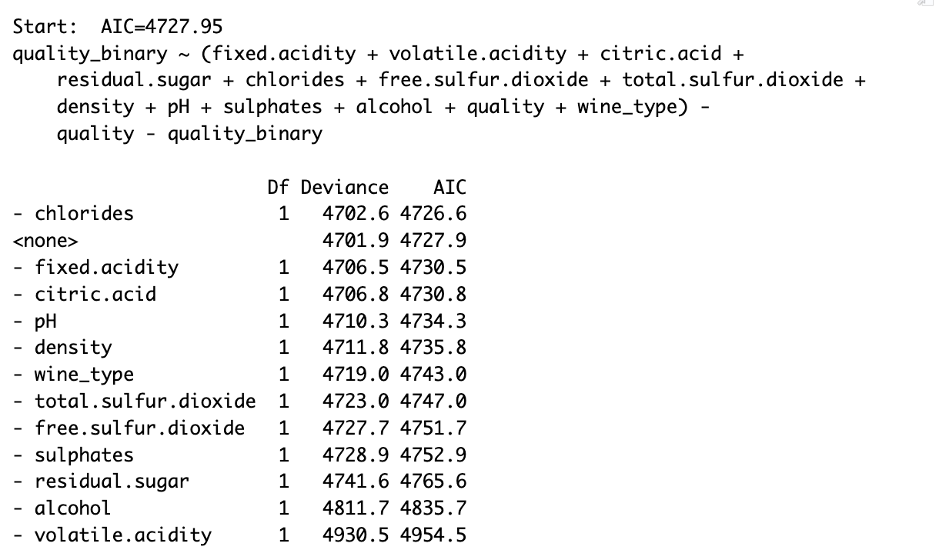
Feature Selection
We conducted feature selection using stepwise AIC, and concluded that removing only the predictor chlorides decreases AIC. As a result, we removed chrlodies. We will fit our models using the remaining 11 predictors.
Further Notes:
-We scaled features when the model required it (KNN, SVM, Neural Networks, and Logistic Regression)
-We conducted a 70/30 train test split and will be comparing models using three metrics (accuracy, F1 Score, and AUC)
Tried lasso and PCA for dimension reduction

Slide 7
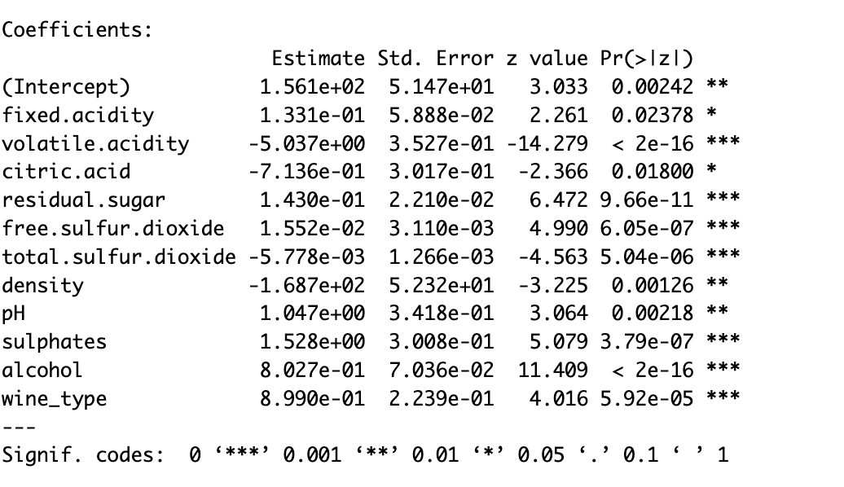
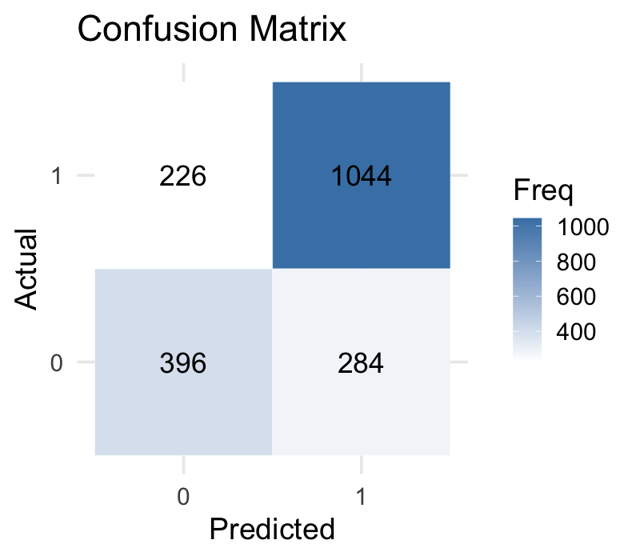
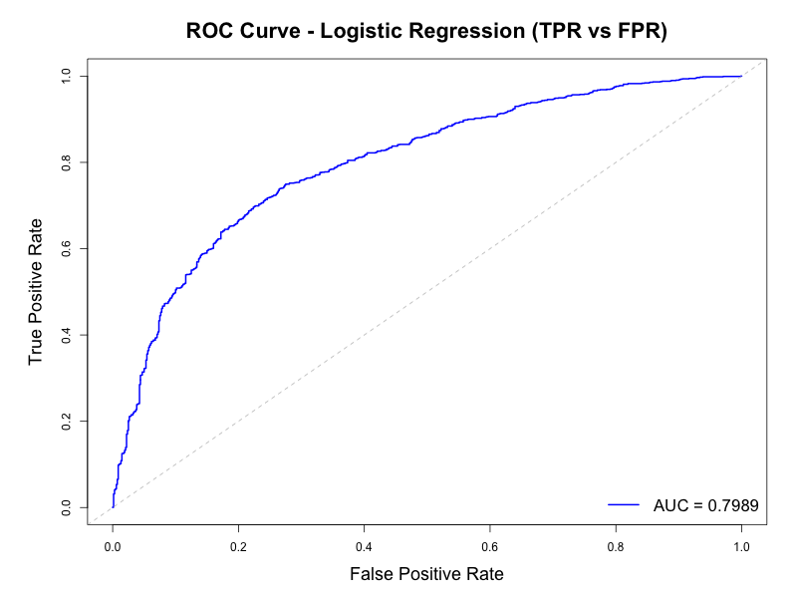
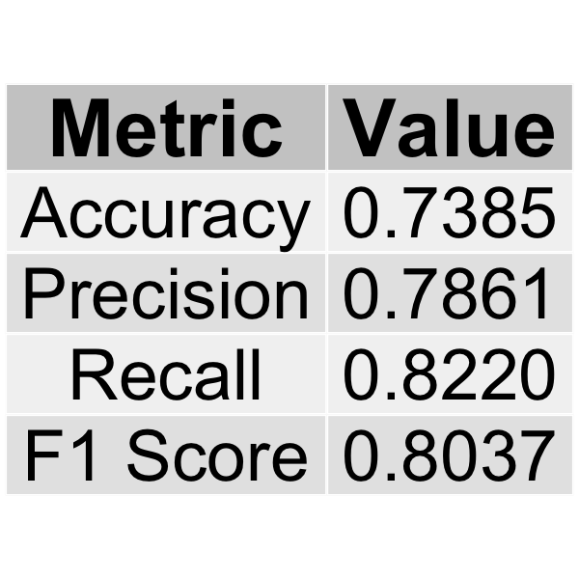
Logistic Regression
All predictors (without chlorine predictor) are significant under 5% significance level.
Next Steps: Using logistic regression as our baseline are there any advanced machine learning methods that outperforms logistic regression?

Slide 8
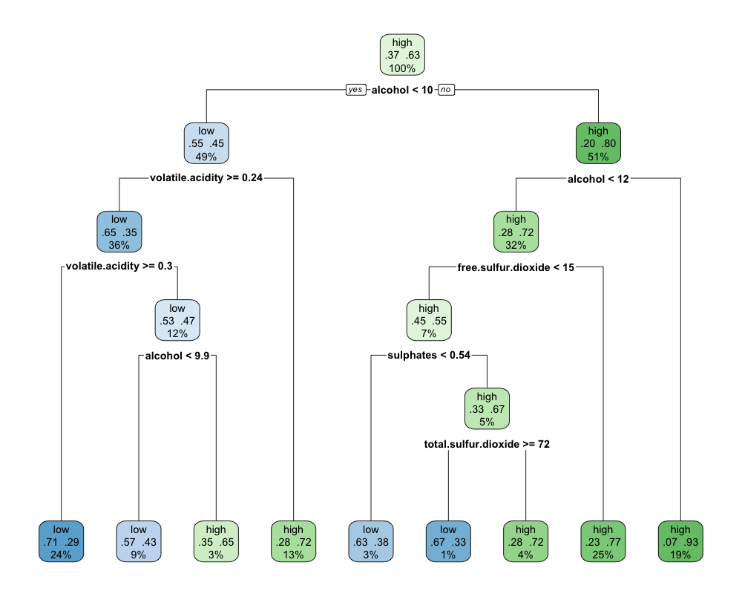
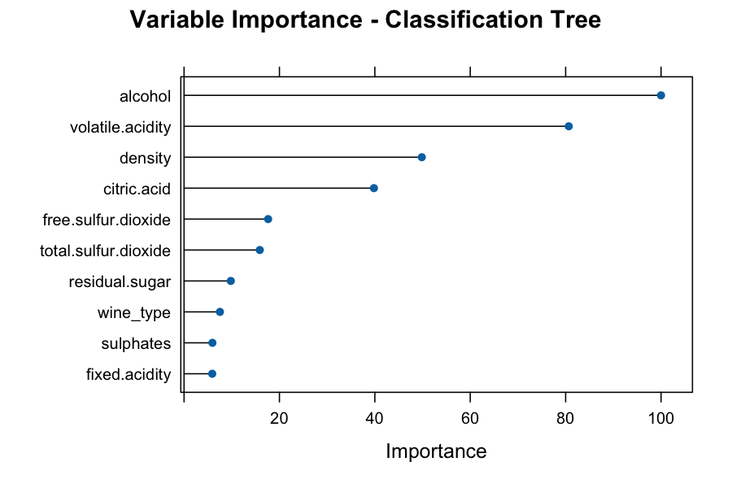
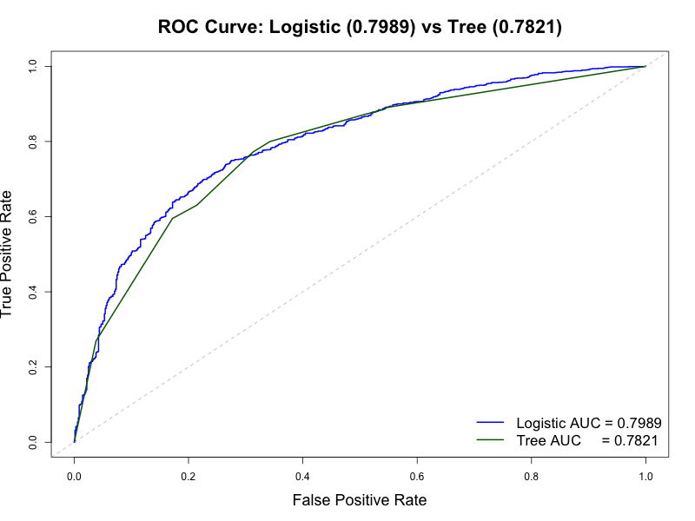
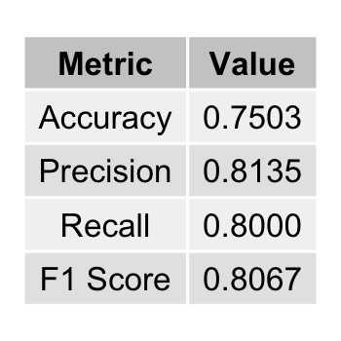
Classification Tree
cp = 0.03
Notes:
So this is our pruned classification tree, we see that root split is alcohol so it is one of the significant predictors which confirms with out Variance importance plot. If we go through the tree usually having alcohol content greater than 10%, and especially 12% is associated with higher quality wine.
t’s a relative scale — the variable with the highest importance is assigned a value of 100, and all other variables are scaled relative to it. Alcohol = 100 means it’s the most important variable — all others are expressed as a % of alcohol’s importance.
Important to note that in the Variable importance plot, density is marked to be third most important predictor but is not included in the prune classification tree. This is probably because I set tune length to 5 and found a cp with around 0.03, so it may have been possible that it was pruned. So if I did this again maybe create three classification trees for different complexity parameters.
Accuracy was 0.75 and F-1 score was 0.8067 which were improvements compared to logistic, but AUC was lower at 0.78. So since f-1 score and accuracy are threshold based metrics, our classification tree is better at binary decision making rather than ranking the wine qualities.

Slide 9
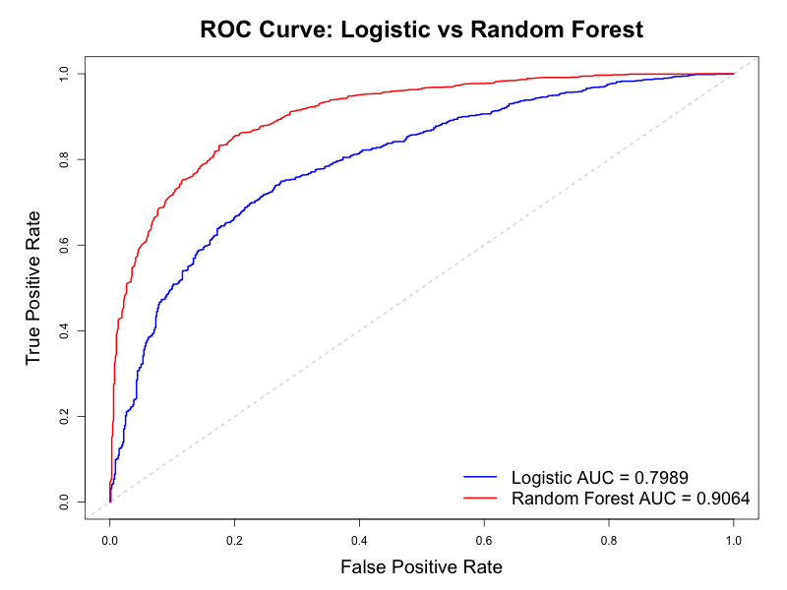
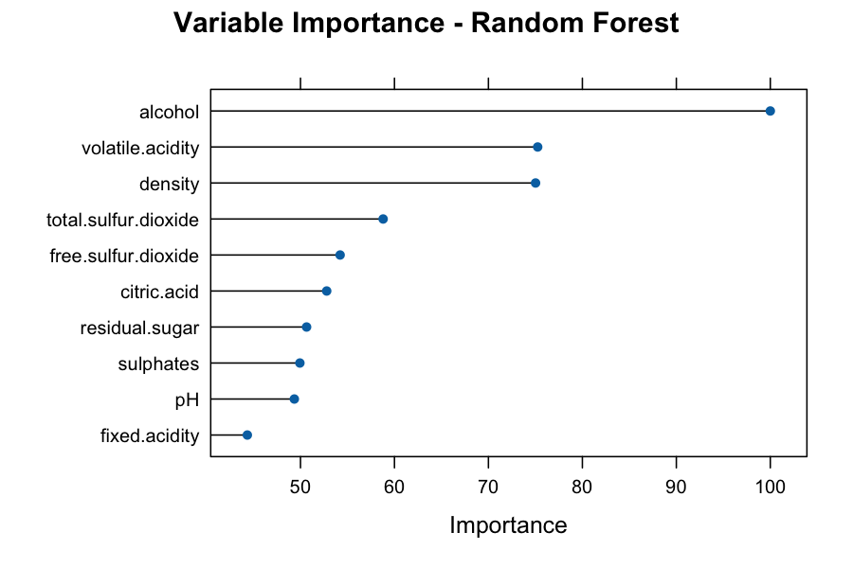
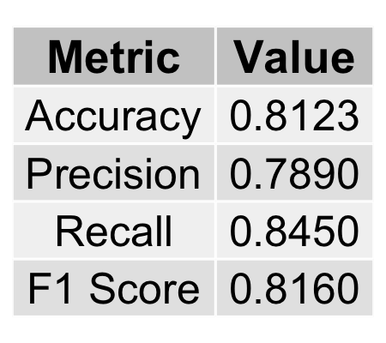
Random Forest (Bagging)
The hyperparameter here is mtry where it's the number of predictor variables randomly selected at each split in a tree during the construction of a Random Forest. We tested 2,3,4,6,8 using 10 fold CV and found that mtry= 6 is optimal.
Notes:
So know default for mtry is sqrt(11) our total number of predictors which is between 3 and 4, but we wanted to use cross validation to check if it was actually optimal. Found that using 6 variables at each split is optimal. The variable importance plot is similar to the results found in classification tree where alcohol is the most important, then volatile acidity, and density.
When looking at the metrics we see that Random Forest performs really well with accuracy 0.81, F-1 score 0.82, and AUC at 0.91! Performs significantly better than logistic.
Since it took a somewhat long time to run, maybe cutting down mtry and seeing if it still performs well should be considered the next time we do this.

Slide 10
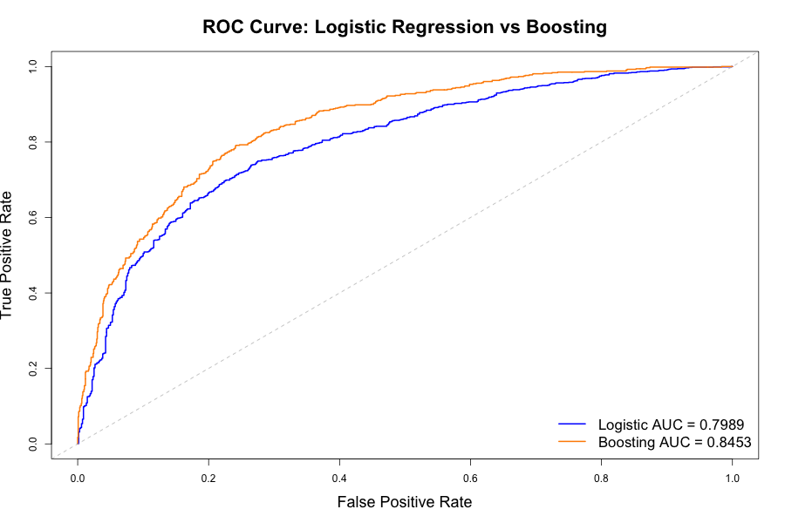
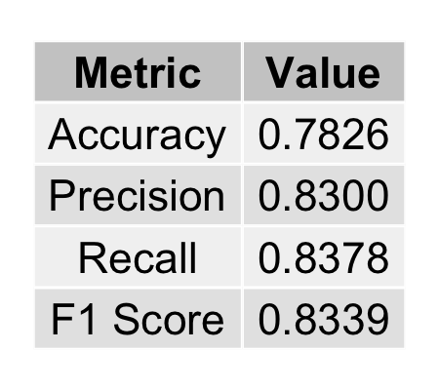

Gradient Boosting
Chosen parameters through 10-fold cross validation:
interaction.depth= 5
-> depth of each tree
n.trees = 150
-> number of trees
shrinkage = 0.1
-> learning rate, risking either over-generalization or over-fitting
n.minobsinnode = 10
-> sets minimum number of observations per terminal node
Notes:
So for gradient boosting we considered 4 hyperparameters which were interaction depth, n.trees, shrinkage, and n.minobisinnode.
We tested values of 1, 3, and 5 for interaction depth to explore models ranging from simple (shallow trees) to more complex (deeper trees) and found 5 was best. We tested 50, 100, 150 trees and fund 150 was best. We saw that Boosting did perform better than logistic in all 3 metrics as well, AUC, Accuracy, and F-1
So maybe for future work, since we see that all our hyperparameters were set to maximum level (5, 150), maybe expanding our search and seeing at which value(s) does it peak should be considered, but need to be careful because computationally expensive. So I actually did run it here and as you can see it took the max again, the accuracy was way better, but just compuatinally expensive, so this is not ideal

Slide 11
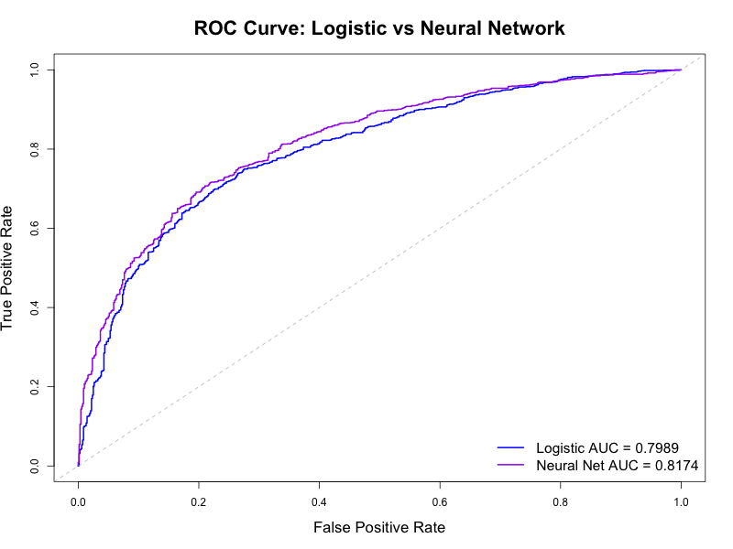
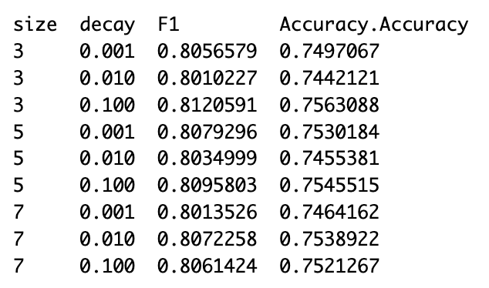
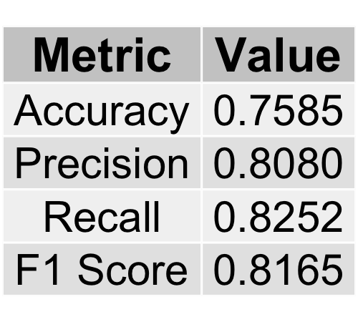
Neural Networks
Chosen parameters through cross validation:
size = 7
-> 7 nodes in the hidden layer
decay = 0.1
-> prevent overfitting by
penalizing weights
Notes:
So for neural network we used cross validation to choose 3 hyperparameters which were the hidden size and the decay to be 7 and 0.1.
We find that neural network does outperform logistic in all 3 categories as well 0.76 accuracy, f-1 score 0.82, and AUC as 0.8174

Slide 12
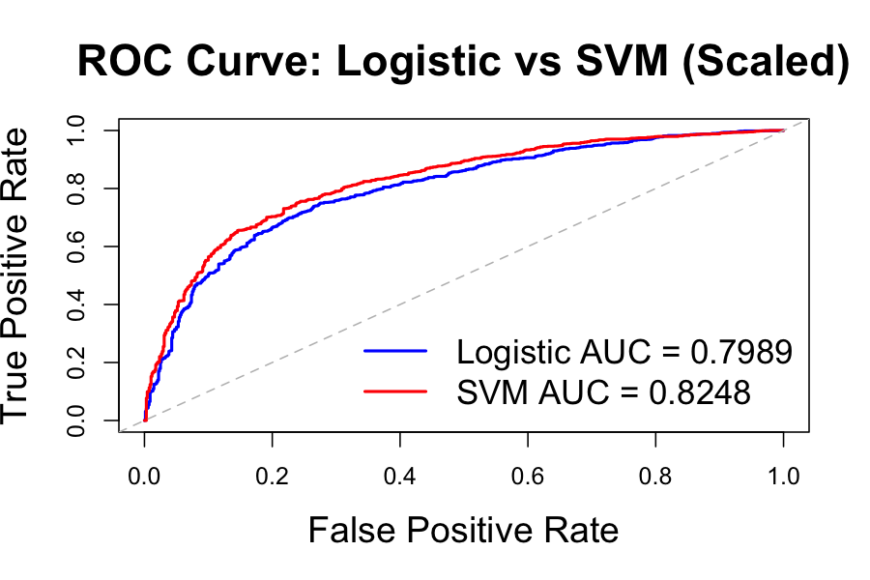
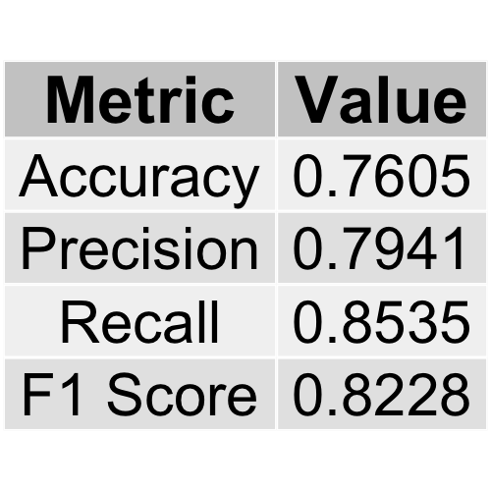
SVM
Used 10-fold cross validation to tune gamma and cost
gamma=.01 and cost=10
parameters. Both of these parameters are used to control
overfitting .
Also checked radial kernel and linear kenral and radial outperformed
on all metrics.
One problem when optimizing parameters was when doing grid search
It was very computationally expensive.
Notes:
So since neural networks

Slide 13
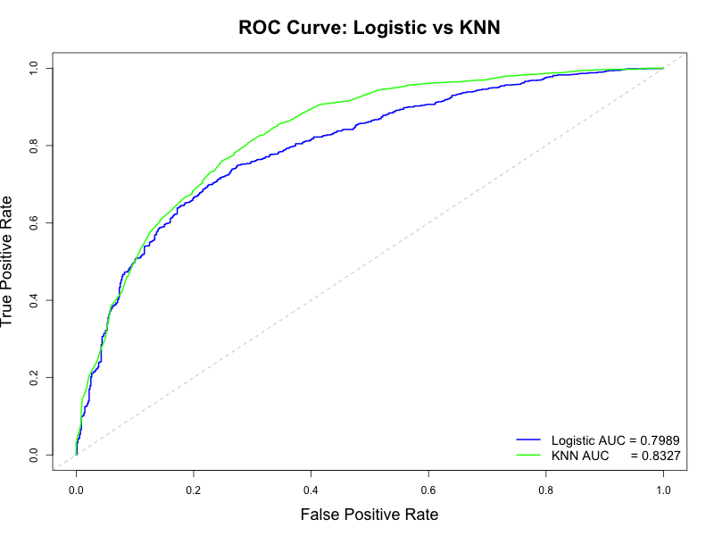
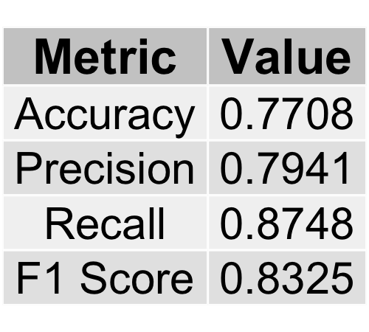
KNN
-> General rule of thumb for k = sqrt(training set sample size) which was around 67.5
k = 63 through cross validation check odd from 1-69
-> The complexity and dimensionality that follows with 11 predictors made the nearest neighbors less accurate as a model.
Notes:
K = Number of Nearest Neighbors

Slide 14
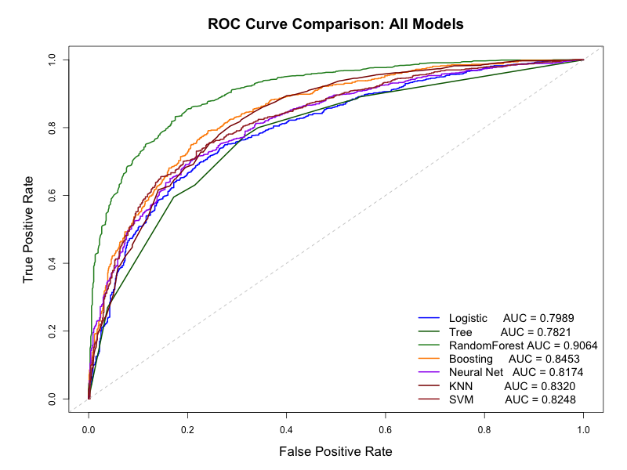
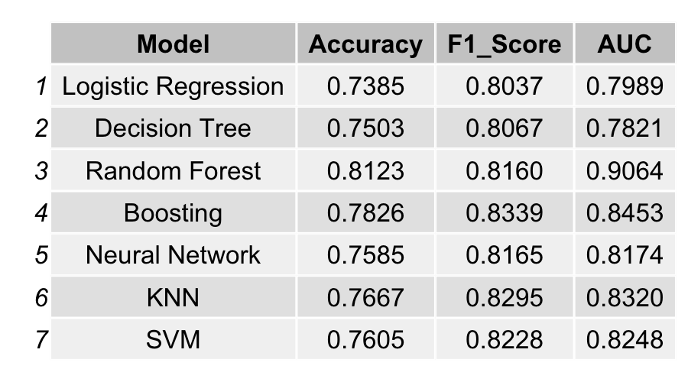
All Together
Random Forest was selected as our best model using the following metrics:
Highest Accuracy
Steepest AUC
Computational Efficiency

Slide 15
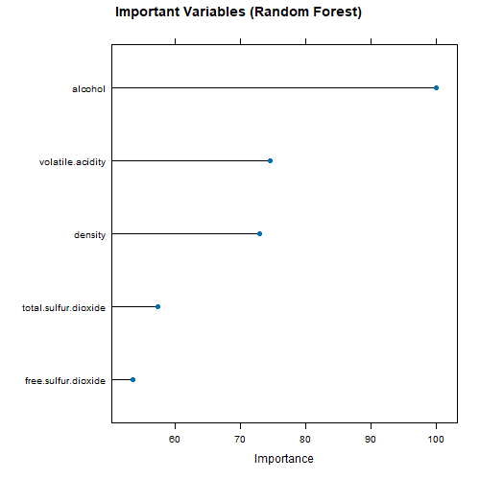
Economic Conclusions
1. Quality Can Be Predicted from Measurable Inputs
Economic Implication: Producers may optimize production costs by adjusting specific measurable chemical inputs to achieve higher quality without relying solely on trial-and-error or expensive sensory testing.
Top 3 Important Variables:
Alcohol
Volatile Acidity
Density

Slide 16
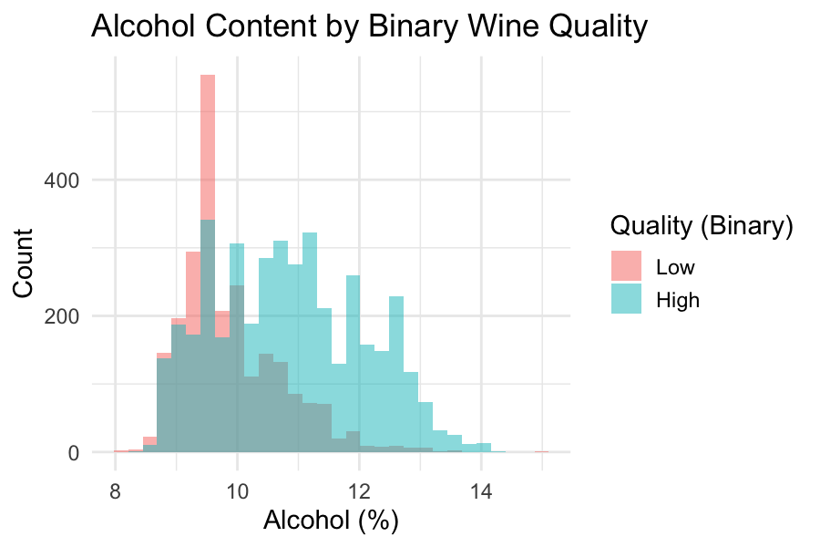
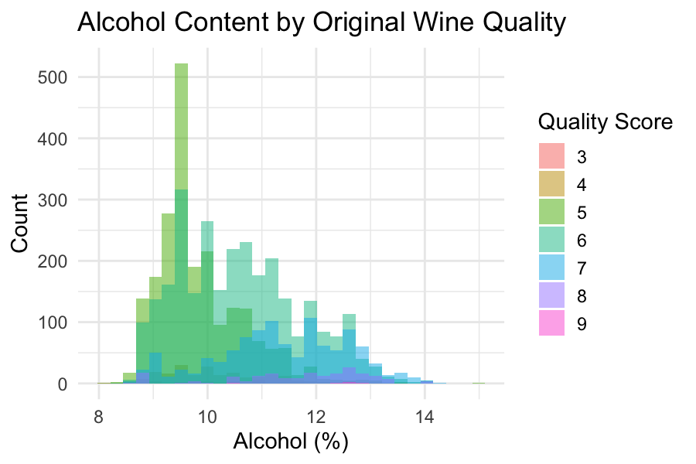
Extra Graphs

