Slide 1
AI for Trading: Pair Trading and Mean Reversion
DSA: Skip I delete j, Swap Nodes
2022-10-01

Slide 2
Ⅰ. | Pair Trading
Ⅱ. | Mean Reversion
Ⅲ. | Skip I delete j, Swap Nodes

Slide 3
AI for Trading - Pair Trading

Slide 4
AI for Trading – Mean Reversion
* Mean Reversion Strategy:
Mean Reversion Strategies work on assumption that there is an underlying stable trend in the price of an asset and prices fluctuate randomly around this trend
price of the asset are far below the trend -> buy the stock
price of the asset are far above the trend -> sell the stock
This is because mean reversion strategy assumes that prices will eventually go back to underlying trend.

Slide 5
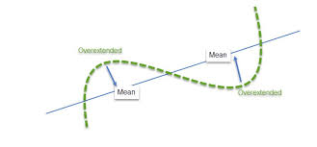
AI for Trading – Mean Reversion

Slide 6
AI for Trading – Mean Reversion
How to identify underlying trend
Moving Average – We can use Moving Average to estimate underlying trend
How to generate signal in Mean Reversion Strategy
To generate signal, we can use rolling standard deviation. For example, we can buy the asset, if price of asset is above 2σ from moving average and sell the asset, if price of asset is below 2σ from moving average.
We can Refer to Bollinger Bands to generate signal

Slide 7
AI for Trading – Mean Reversion
Bollinger Band
Bollinger band is chart that characterizes prices and volatility over time. Bollinger band consist of three parts:
Moving Average
Upper band – MA + Kσ(N-period standard deviation)
Lower band – MA – kσ

Slide 8
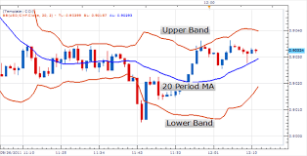
AI for Trading – Mean Reversion

