Slide 1
Python in Systems
2022-08-20

Slide 2
Ⅰ. | Exercise1
Ⅱ. | Exercise2
Ⅲ. | Exercise3
Ⅳ. | Exercise4

Slide 3
Ⅰ. Exercise1
* CLI(Command Line Interface)
CLI allows users to use written commands that associate directly with console window. This makes user be able to interact directly with OS.
* GUI(Graphical User Interface)
GUI allows users to use graphics to interact with OS. In GUI, users have variety of options that are intuitive and make things easy such as buttons, icons.

Slide 4
Ⅰ. Exercise1
Parameters | CLI | GUI
Ease of Use | Hard | Easy
Memory Consumption | Less | More
Level of Precision | High | Low
Speed | High | Low
Graphics | X | O
Menus | X | O
Display of Information | Text | text, images, etc.

Slide 5
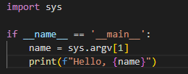
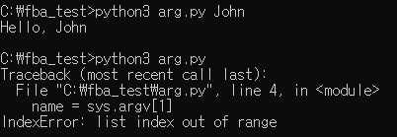
Ⅰ. Exercise1

Slide 6
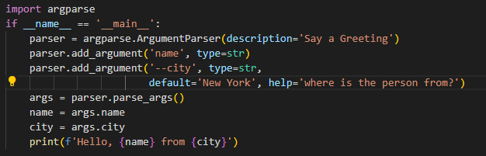
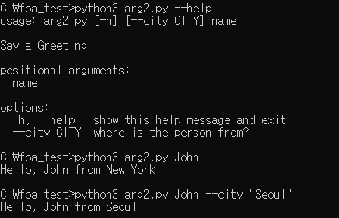
Ⅰ. Exercise1

