Slide 1
Python in Systems
2022-08-20
Team 2

Slide 2
Ⅰ. | Exercise1
Ⅱ. | Exercise2
Ⅲ. | Exercise3
Ⅳ. | Exercise4

Slide 3
Ⅰ. Argparser -Exercise1
* CLI(Command Line Interface)
CLI allows users to use written commands that associate directly with console window. This makes user be able to interact directly with OS.
* GUI(Graphical User Interface)
GUI allows users to use graphics to interact with OS. In GUI, users have variety of options that are intuitive and make things easy such as buttons, icons.

Slide 4
Ⅰ. Arg parser-Exercise 1
Parameters | CLI | GUI
Ease of Use | Hard | Easy
Memory Consumption | Less | More
Level of Precision | High | Low
Speed | High | Low
Graphics | X | O
Menus | X | O
Display of Information | Text | text, images, etc.

Slide 5
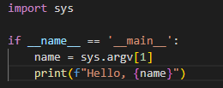
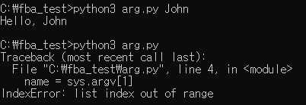
Ⅰ. Arg parser-Exercise 1

Slide 6
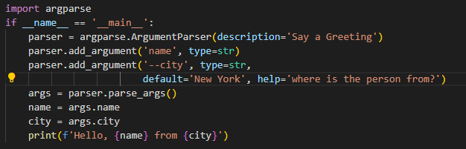
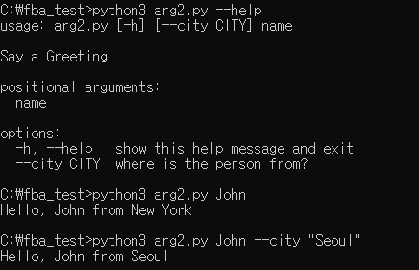
Ⅰ. Arg parser-Exercise 1

Slide 7
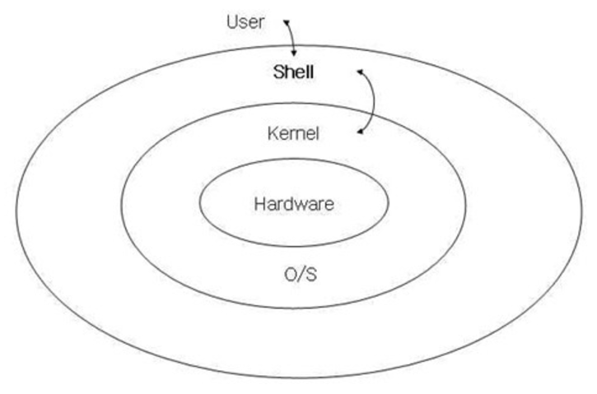
BASIC CLI
CLI(Command Line Interface)
Terminal :
software (or hardware) to be able to input/output
Shell:
software program to interpret the input from user
Ex) Window file explorer, Mac OS finder, Bourne Shell(sh) / bash
Notes:
Terminal 은 사용자 언어를 input/output할 수 있는 소프트웨어나 하드웨어를 가리키는 말이며, shell이란 user단 과 kernel단 중간에서 사용자의 input을 해석해주는 역할을 하는 소프트웨어입니다.

Slide 8
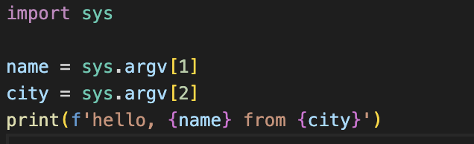
Ⅱ. Basic CLI
Using sys module to attribute CLI argument
cli.py file

Slide 9
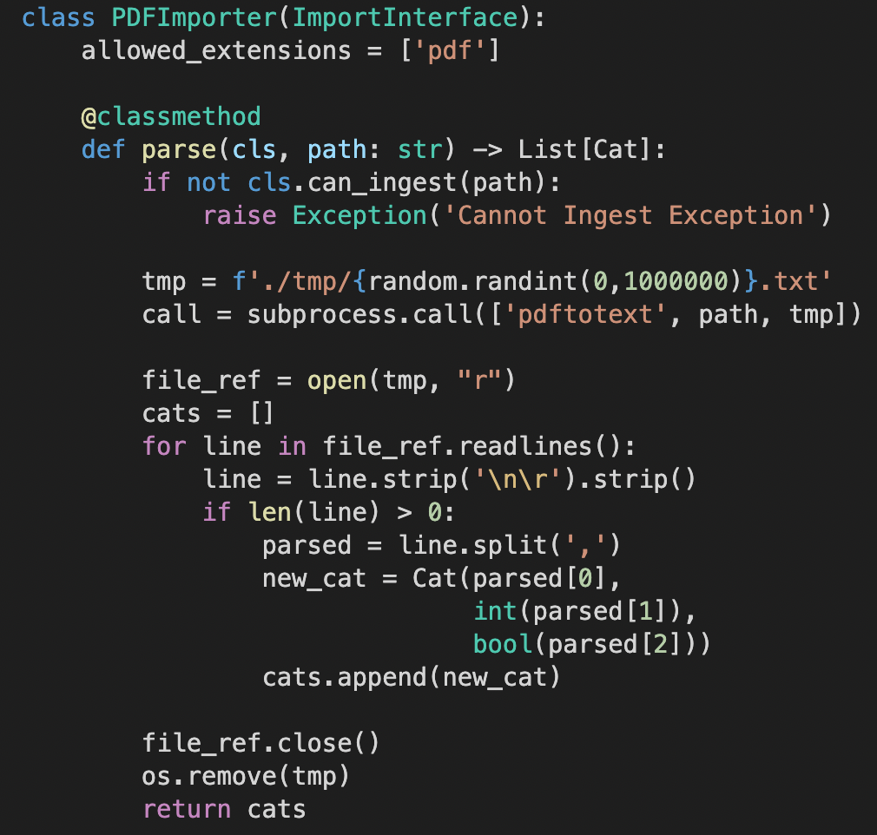
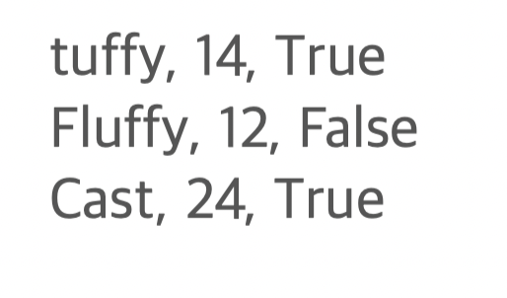
Ⅲ. Complex Strategies - Exercise 3
Using pdftotext module,
Change pdf file to txt file
Pdf file example

Slide 10
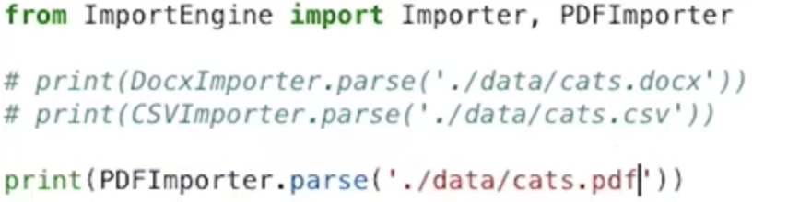
Ⅲ. Complex Strategies - Exercise 3
run.py

Slide 11
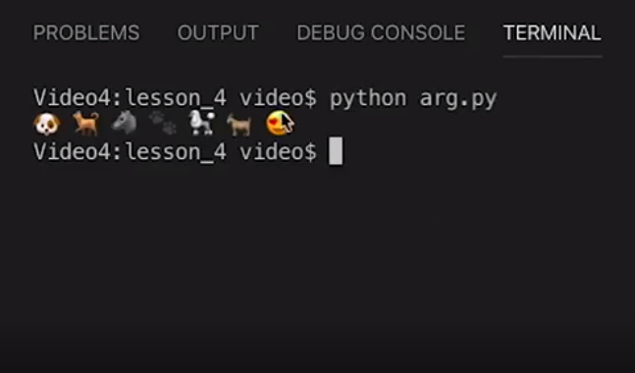
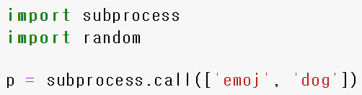
IV. Using Subprocess
To use command line within python scripts, we can use subprocess package.
We can simply use call method to implement processes we did with CLA,
typing in the tools that we want to call and emoji type we need.

Slide 12
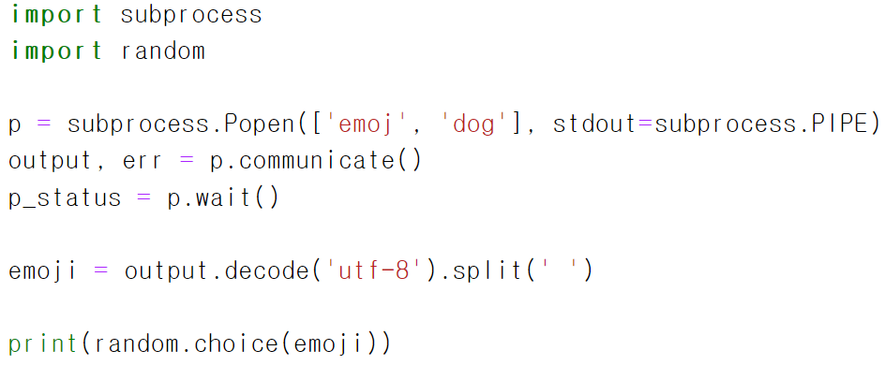
IV. Using Subprocess
But if we want additional process with these emojis (i.e. writing new file),
instead of using call, we can use Popen for further work in python scripts.
In this case, dog symbols are stored in emoji variable.
Since emoj characters are defined in ‘utf-8’, we must decode with utf-8.

Slide 13
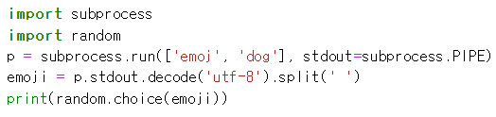
IV. Using Subprocess
Subprocess packages supports both Popen and run method
Due to its simplicity, run is preferred over Popen these days.

