Slide 1
AIT 6. Data Processing DS&A 3. How to solve the problem
2022.09.03
FAI TEAM2

Slide 2
Ⅰ. | AIT Lesson6. Data Processing
Ⅱ. | DS&A Lesson3. How to solve the problem

Slide 3
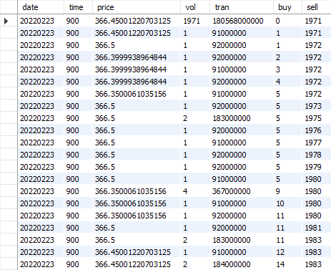
6.1. Tick data
Components of tick data
Time : date & time
Ticker
Trade data : volume & price
Quote data
: price & size of bid/ask

Slide 4
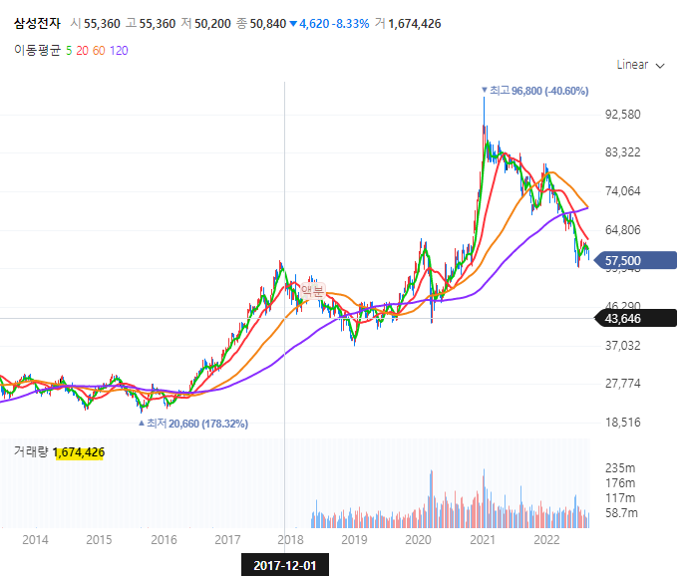
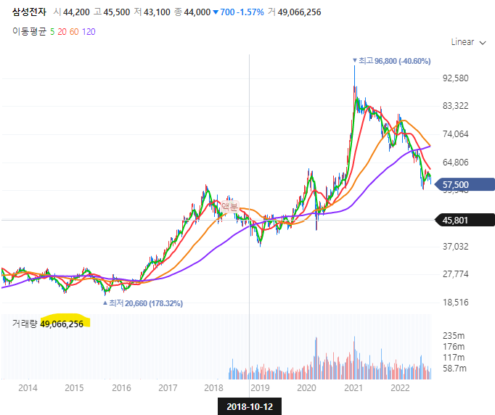
6.2. Corporate Actions
1. Stock Splits
: maintain the total market cap(=price * amt of stock), splitting the stock in purpose of to activate the transactions. We have to adjust the close data & volume after split.

Slide 5
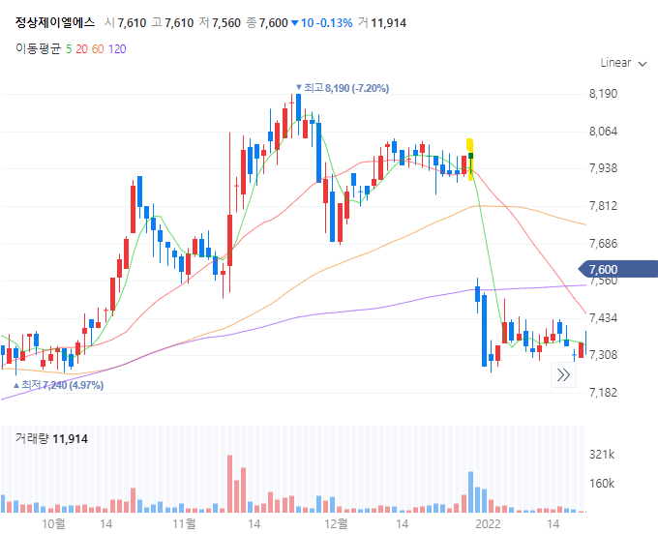
6.2. Corporate Actions
2. Dividends
: To normalize stock prices prior to ex-dividend date,
We need to divide historical price data with price factor(1+D/S)

Slide 6
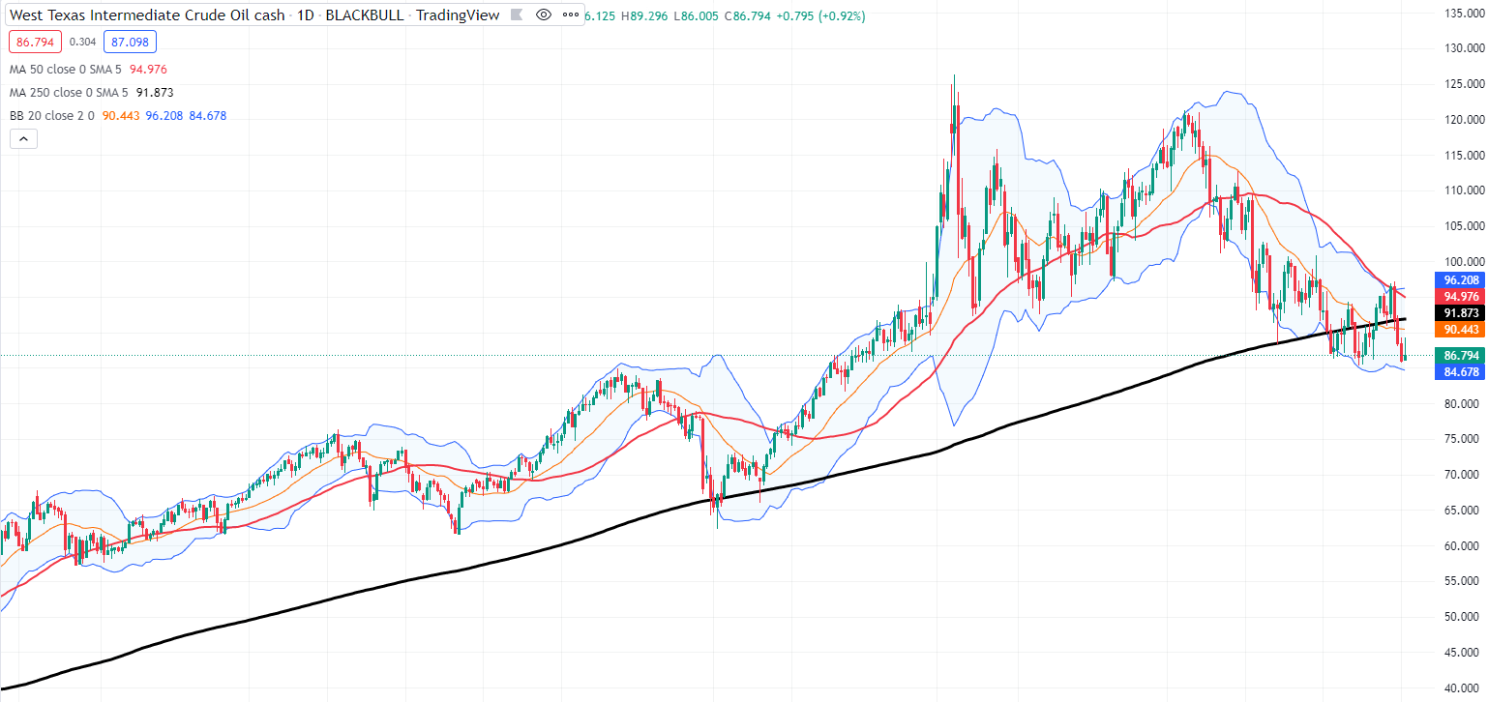
6.3. Technical Indicators

Slide 7
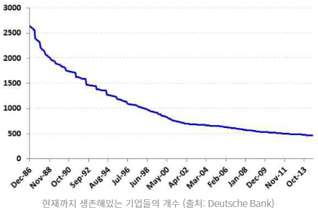
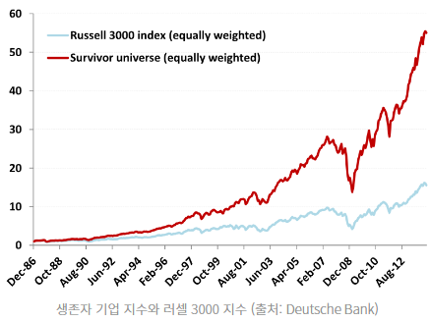
6.4. Survivor Bias

Slide 8
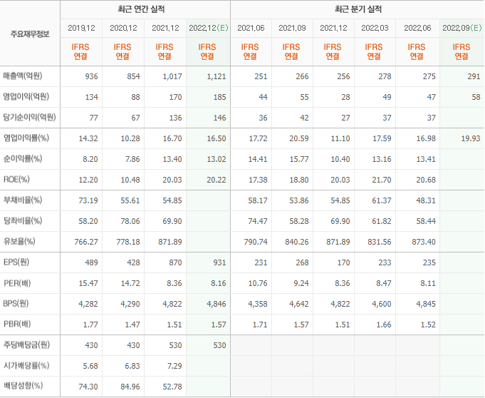
6.5. Fundamental Information
BS, CFS
: health snapshot of the company
Sales per share
Earnings per share
Dividends per share

Slide 9
6.6. Exchange Traded Funds
Three types of ETFs
Tracking Market Index(e.g. S&P500) – SPY
Tracking Specific Sector(e.g. Infrastructure, Semicon) – SOXX
Actively managed Funds - ARKK

Slide 10
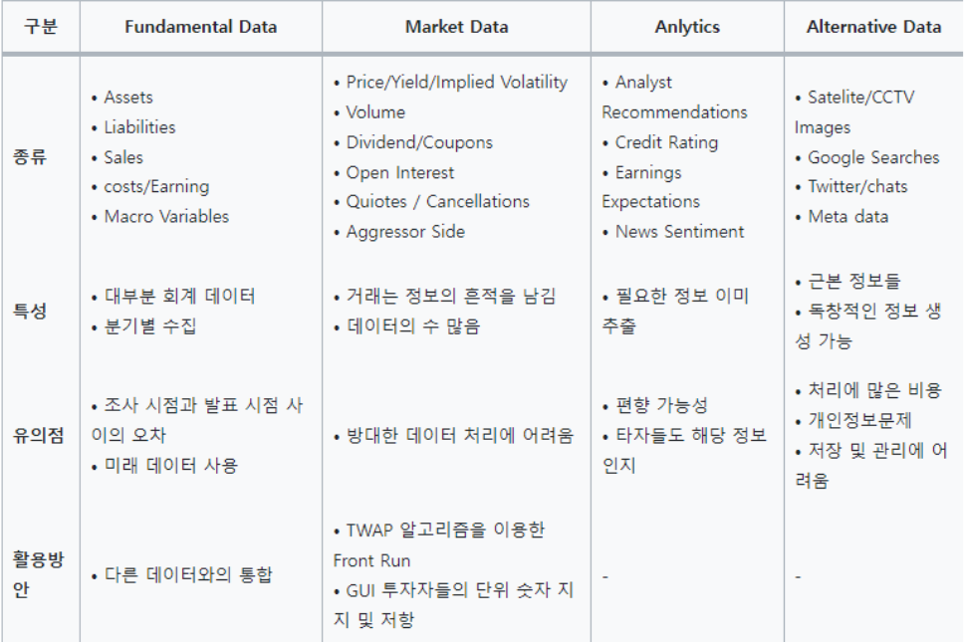
6.7. Alternative Data

Slide 11
Attmepting the Problem & Completing the Problem
0. Don’t Panic
Make sure to understand the Problem
What are the input(s)?
How are inputs represented?
What are the output(s)?
How should outputs be represented?
Find relationship between input and output
- Work out exmaples

Slide 12
Attmepting the Problem & Completing the Problem
Make sure to understand the Problem
- Given your birthday and the current date, calculate age in days.
What are the input(s)?
Birthday and current date
How are inputs represented?
(year, month, day) -> (2022, 09, 03)

Slide 13
Attmepting the Problem & Completing the Problem
What are the output(s)?
Return(not print) days between first date and second date
Find relationship between input and output
Work out exmaples
daysBetweenDates(2012, 12, 7, 2012, 12, 7) -> 0
daysBetweenDates(2012, 12, 7, 2012, 12, 8) -> 1
daysBetweenDates(2012, 12, 8, 2012, 12, 7) -> Not valid
daysBetweenDates(2012, 6, 29, 2013, 6, 29) -> 365
daysBetweenDates(2012, 6, 29, 2013, 6, 31) -> Not valid

Slide 14
Attmepting the Problem & Completing the Problem
Find relationship between input and output
daysBetweenDates(2013,1,24, 2015, 6,29)
2013 ~ 2015(No leap year) = 365 *2 = 730
Jan: 31-24 = 7
Feb: 28, March: 31, April: 30, May:31
June: 1-29
Total: 886

Slide 15
Attmepting the Problem & Completing the Problem
Algorithm “Pseudo Code”
days = # of days in month1 –day1
Month1 += 1
While month1 < month2:
days += # of days in month1
month1 += 1
days += day2
While year1 < year2:
days += days in year1

Slide 16
Attmepting the Problem & Completing the Problem
Should we implement this algorithm?
No, we should try finding a simpler way

Slide 17
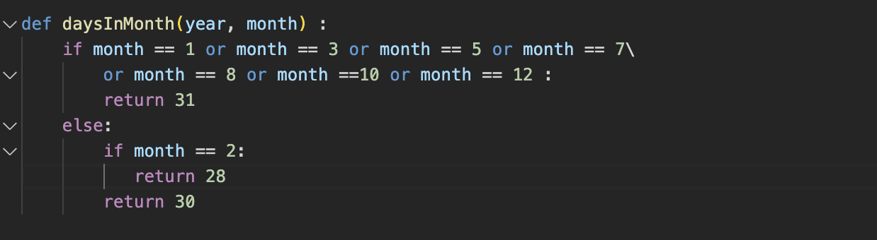
Lesson3. How to solve problems
The number of days in month is different , so we add a function named daysInMonth(),
To calculate the number of days in the given month.
However, we also need to consider a leap year

Slide 18
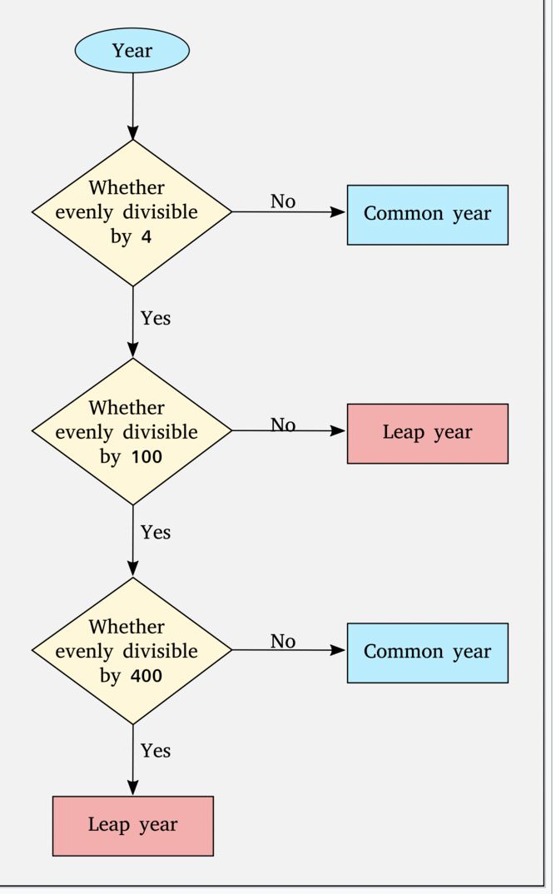
Lesson3. How to solve problems - Leap year
Leap year algorithm
https://en.wikipedia.org/wiki/Leap_year

Slide 19
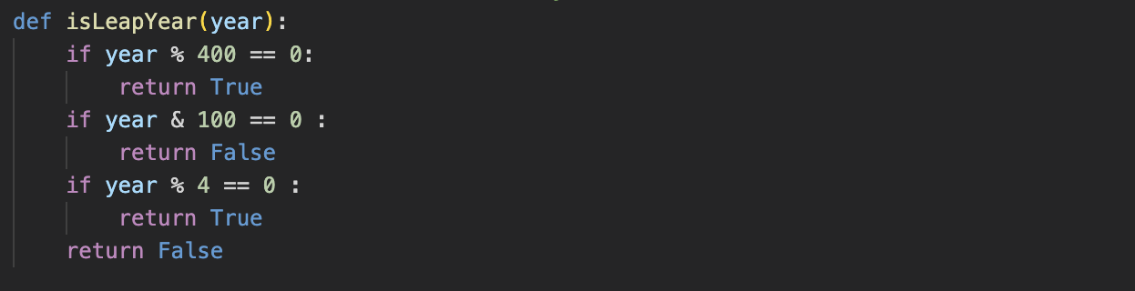
Lesson3. How to solve problems
Create isLeapYear() function to check if the year is leap year and add it to the daysinMonth() function

Slide 20
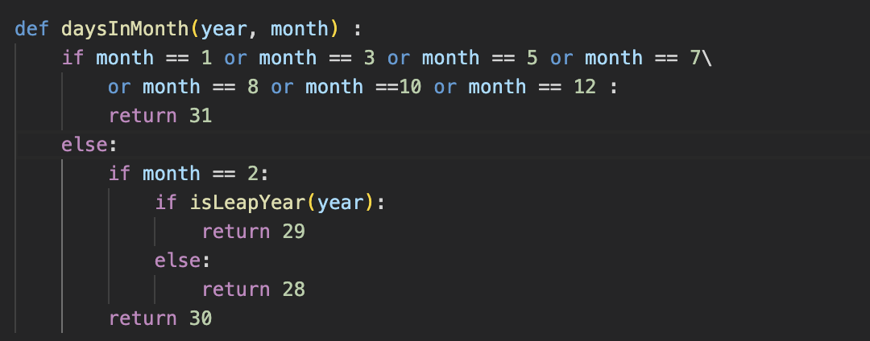
Lesson3. How to solve problems
If the month is February, and the year is a leap year, return 29 days
If it is not a leap year, return 28 days

Slide 21
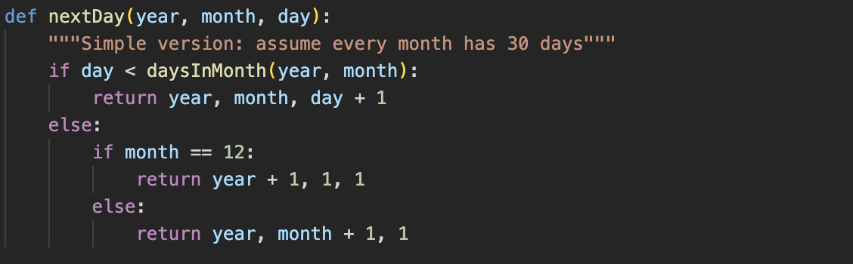
Lesson3. How to solve problems
Update the nextDay() function with the daysInMonth() function.

Slide 22
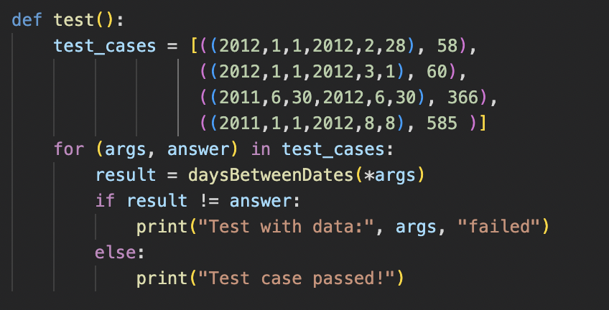
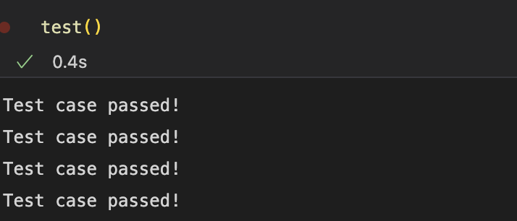
Lesson3. How to solve problems –test

Slide 23
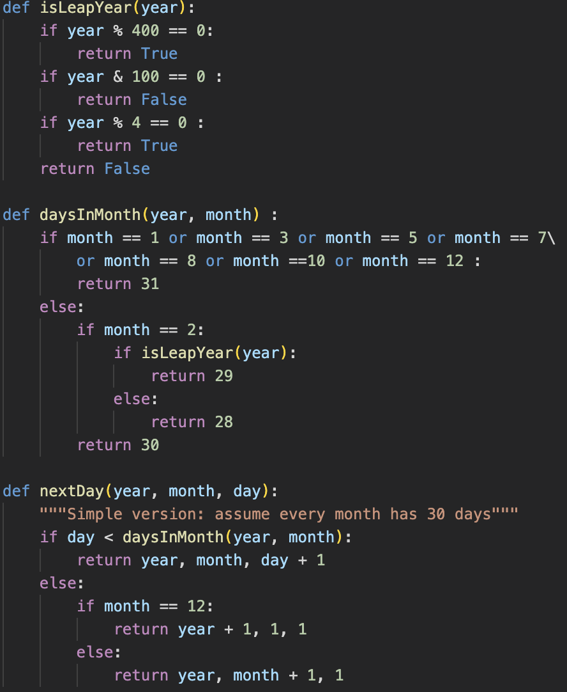
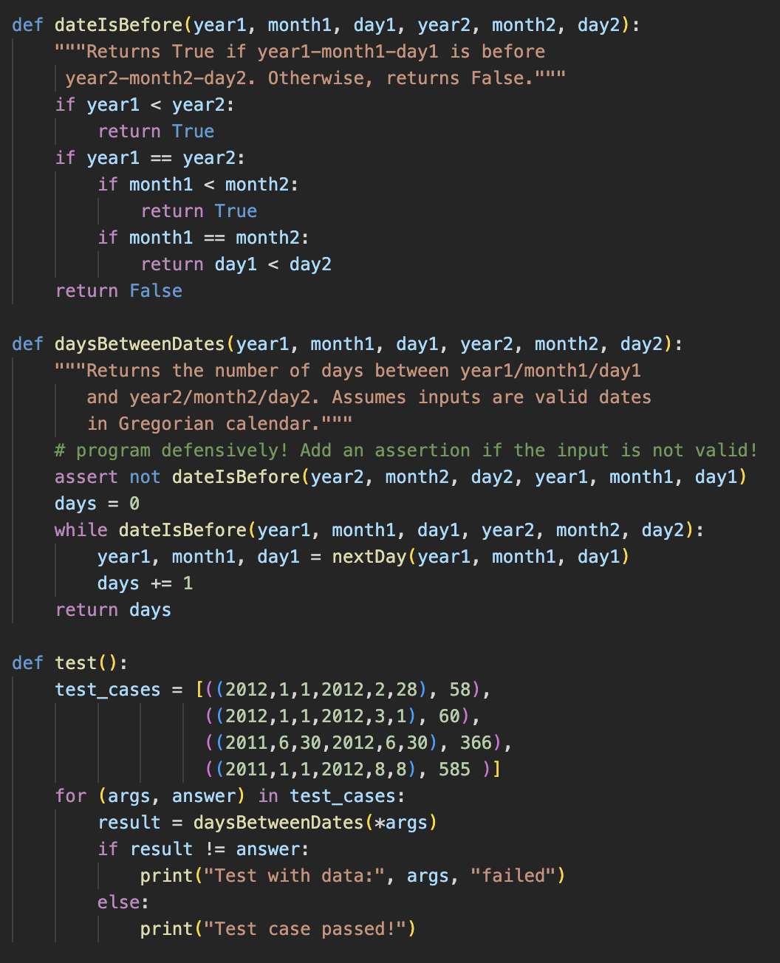
Final code

