Slide 1
FAI Week4 Team2

Slide 2
Outliers
Outliers : extreme value which may not represent real event
1. Fat Finger errors
- Data produced by human errors or computer bugs
- Na values, duplicates, or too high values;
due to lax quality control by data vendors or exchanges.
- Stop trading by regulatory issues(high volatility due to M&A or big events)
or high order imbalances(massive pending orders)
-> this could be checked with the trading volume

Slide 3
Outliers
Outliers : extreme value which may not represent real event
2. Unadjusted or Nominal Data
- Stock splits, M&A, special dividends

Slide 4
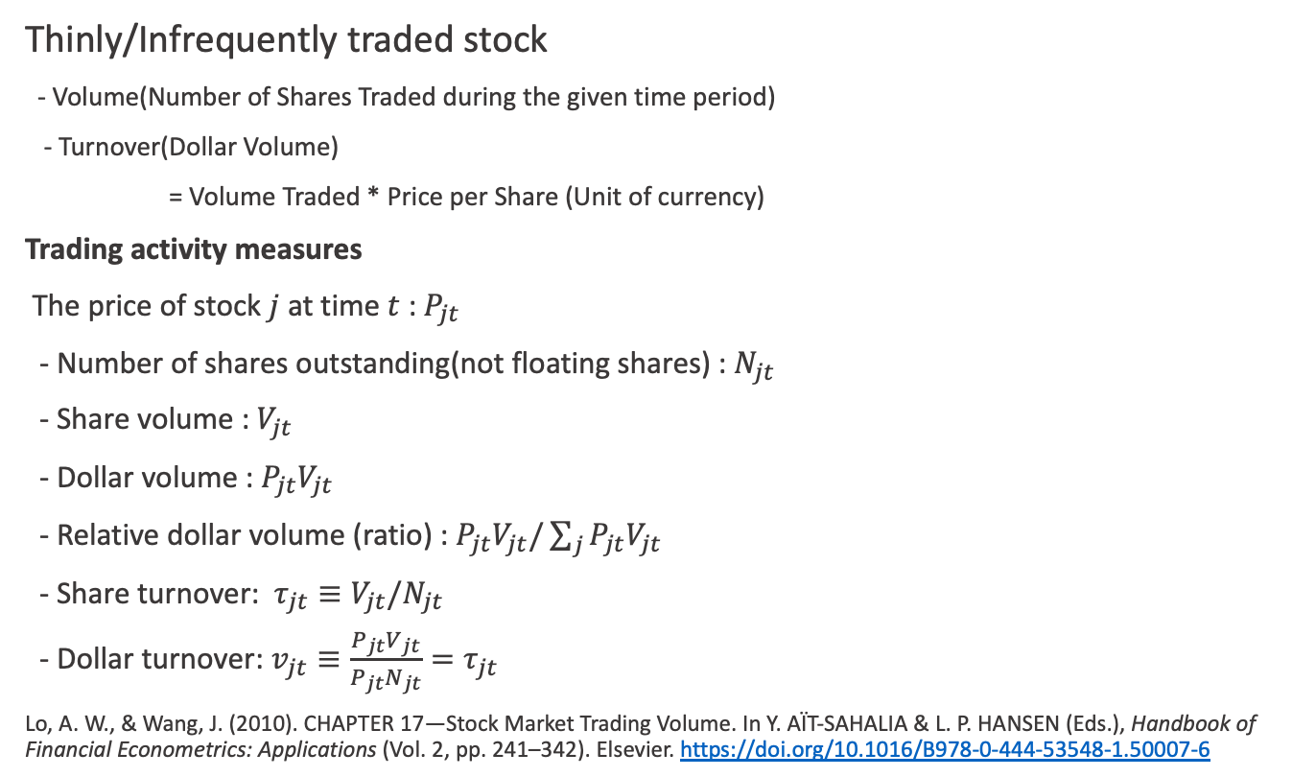
Outliers
Thinly/Infrequently traded stock
- Volume(Number of Shares Traded during the given time period)
- Turnover(Dollar Volume)
= Volume Traded * Price per Share (Unit of currency)
Trading activity measures
The price of stock $j$ at time $t$ : $P_{jt}$
- Number of shares outstanding(not floating shares) : $N_{jt}$
- Share volume : $V_{jt}$
- Dollar volume : $P_{jt}V_{jt}$
- Relative dollar volume (ratio) : $P_{jt}V_{jt}/\sum_{j}{P_{jt}V_{jt}}$
- Share turnover: $τ_{jt}≡V_{jt}/N_{jt}$
- Dollar turnover: $v_{jt}≡\frac{P_{jt}V_{jt}}{P_{jt}N_{jt}}=τ_{jt}$
Lo, A. W., & Wang, J. (2010). CHAPTER 17—Stock Market Trading Volume. In Y. AÏT-SAHALIA & L. P. HANSEN (Eds.), Handbook of Financial Econometrics: Applications (Vol. 2, pp. 241–342). Elsevier. https://doi.org/10.1016/B978-0-444-53548-1.50007-6

Slide 5
Spotting Outliers in Raw Data
Large changes in stock price, missing dates, missing volumes
How to find them
1. Look all rows and columns
2. Rule-based searching and filtering

Slide 6
Spotting Outliers in Raw Data
Our recommended approach to multivariate outliers is comprised of five steps:
test for the presence of multivariate outliers since they are suggestive of bad data (e.g., data entry errors, sampling errors, and omitted variables),
2) identify outliers robustly in a multivariate context,
3) carefully consider and examine the nature and origin of the outliers,
4) correct data and omitted variables errors, and
5) consider the nature of the research question and economic theory to determine whether to mitigate further by dropping the influential observations in the OLS regressions or by employing outlier robust estimators.

Slide 7
Handling Outliers in Raw Data
1. Cross check with the other data source
2. Fill in with average value -> Look ahead bias
Look ahead biase: bias caused by using unknowable data from the future
3. Replacing with previous data
4. Just keep the missing data

Slide 8
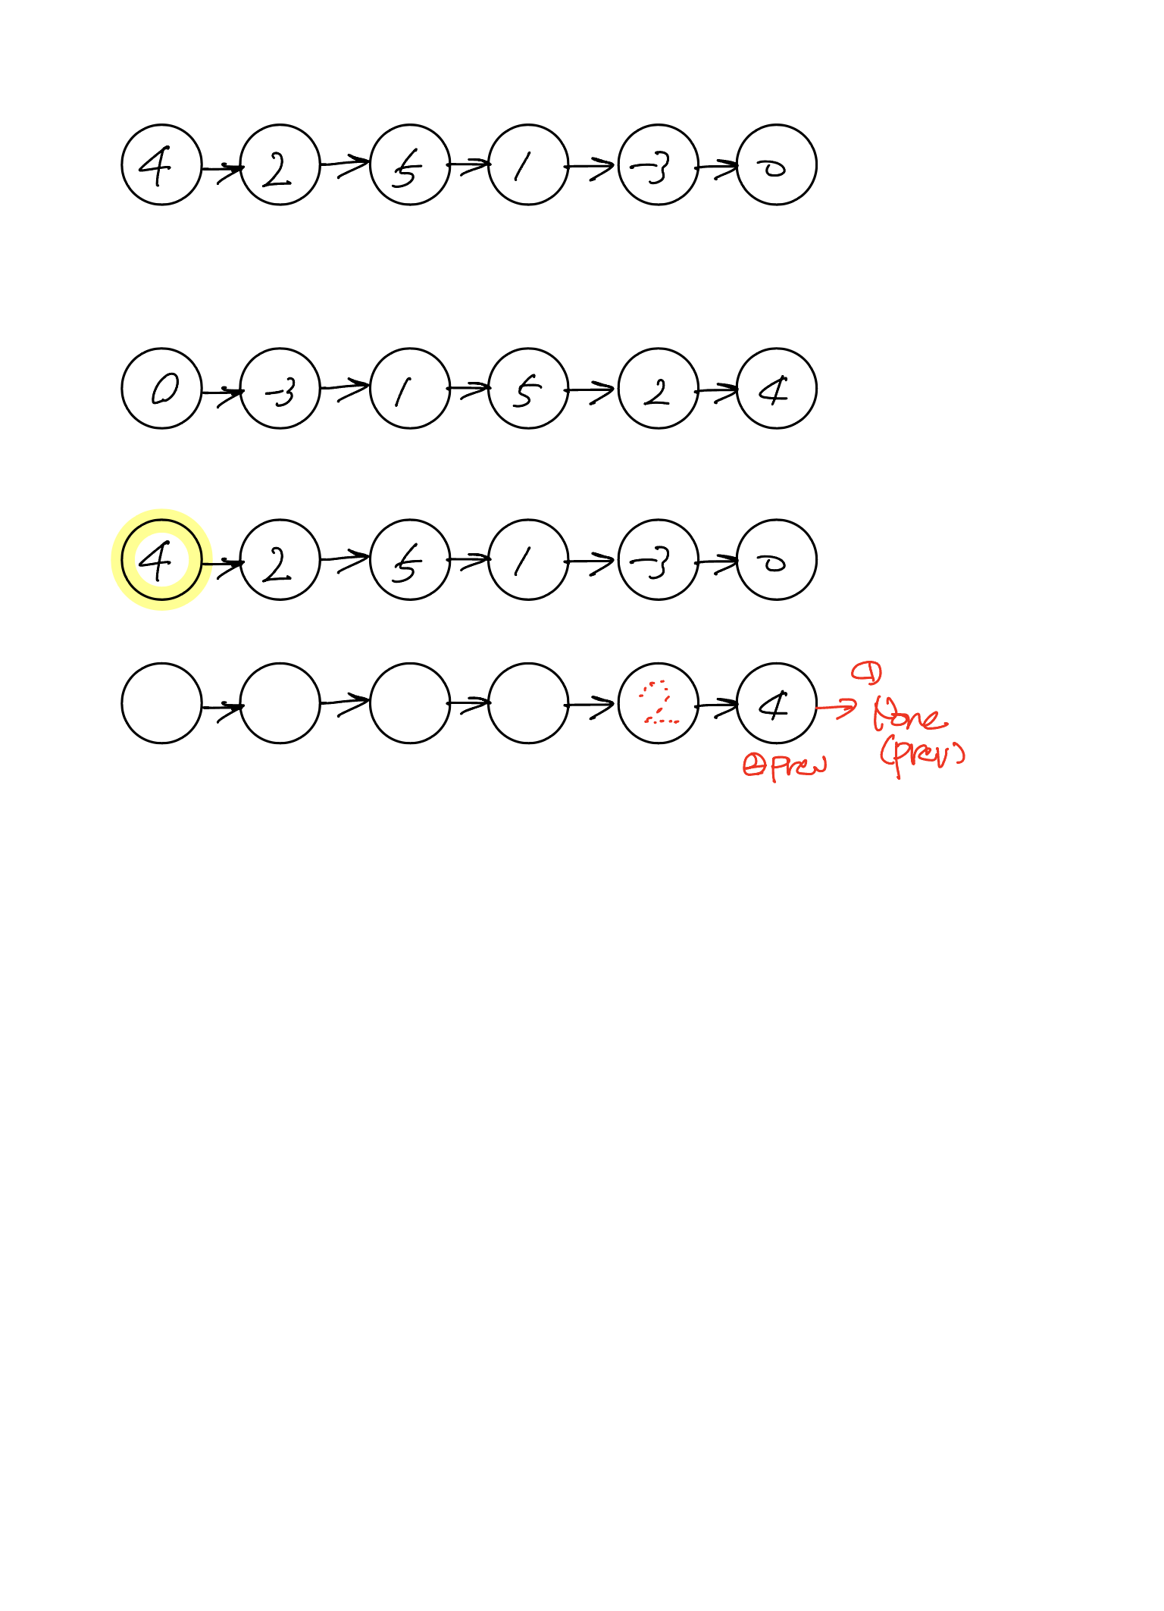
[Exercise] Reversing a linked list

Slide 9
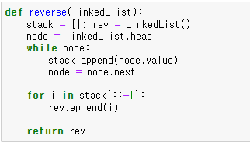
[Exercise] Reversing a linked list

Slide 10
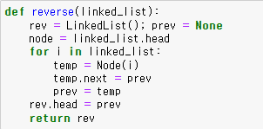
[Exercise] Reversing a linked list

Slide 11
[Exercise] Reversing a linked list

Slide 12
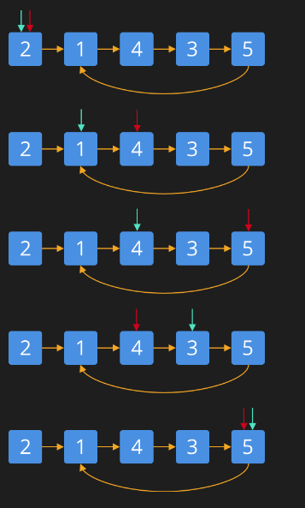
Loop Detection

Slide 13
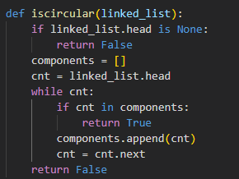
Loop Detection

Slide 14
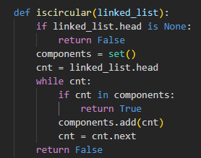
Loop Detection

Slide 15
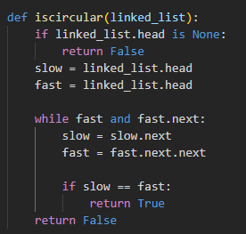
Loop Detection

Slide 16
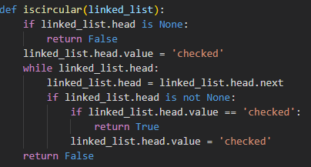
Loop Detection

