Slide 1
AI for Trading: Term 2 Introduction
DSA: The Call Stack and Recursion Recurrence Relations
2022-11-17

Slide 2
Ⅰ. | Term 2 Introduction
Ⅱ. | The Call Stack and Recursion, Recurrence Relations

Slide 3

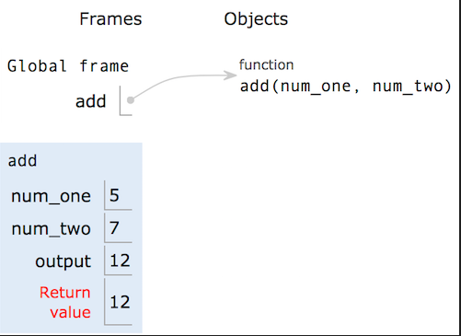
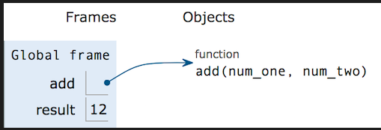
Call Stack and Recursion
Call Stack:
Stack of frames that are used for the functions that we are calling

Slide 4
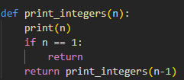
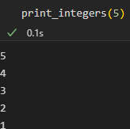
Call Stack and Recursion
Print_integers (Using Recursion instead of loop)

Slide 5
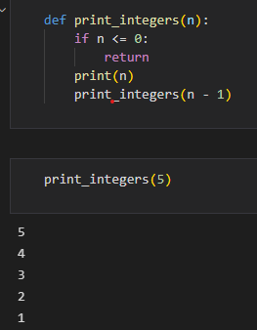
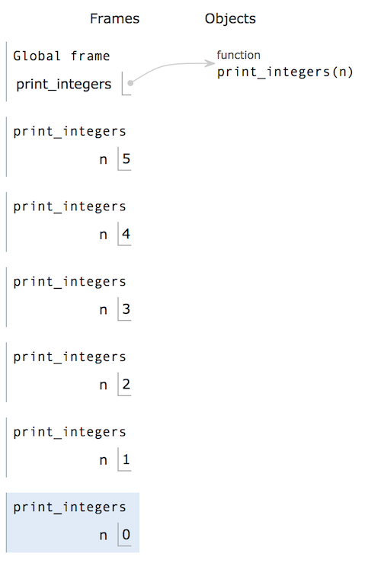
Recurrence Relations

Slide 6
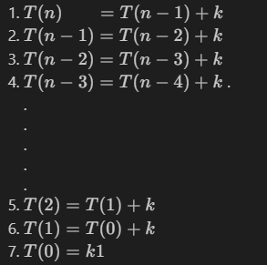

Recurrence Relations
Time Complexity
T(n): time taken to execute function
k: time taken to execute the function’s own simple operation(constant)
Time Complexity:
O(N)

Slide 7
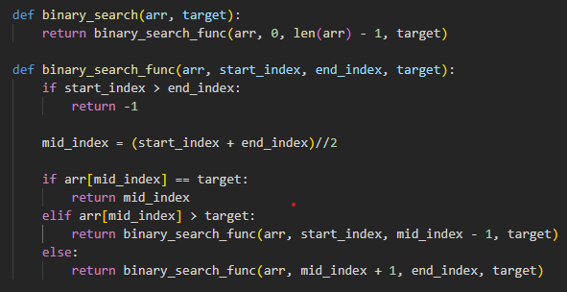
Recurrence Relations
* Binary Search(이진탐색)
정렬된 배열에서 배열의 중간에 있는 값을 선택하여 찾는 값과 비교한 후, 찾는 값이 그 값보다 작으면 좌측의 데이터들을 대상으로 크면 배열의 우측을 대상으로 탐색하는 과정을 반복 함으로써 탐색을 진행
*재귀함수로 구현!

Slide 8
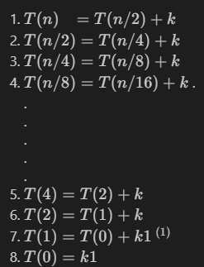

Recurrence Relations
Time Complexity
T(n): time taken to execute function
k: time taken to execute the function’s own simple operation(constant)
Time Complexity:
O(logN)

