Slide 1
XÂY DỰNG ỨNG DỤNG QUẢN LÝ GIẢI BÓNG ĐÁ Nhóm 11

Slide 2
Danh sách thành viên
Họ Tên
1. Nguyễn Đăng Khoa
2. Nguyễn Lê Minh Quang
3. Lê Tuấn Anh
4. Hoàng Lê Huy
5. Lương Chí Thiện
Mã Số Sinh Viên
1.
2. 2024802010074
3.
4.
5.
GVHD: Ths. Bùi Thanh Khiết

Slide 3
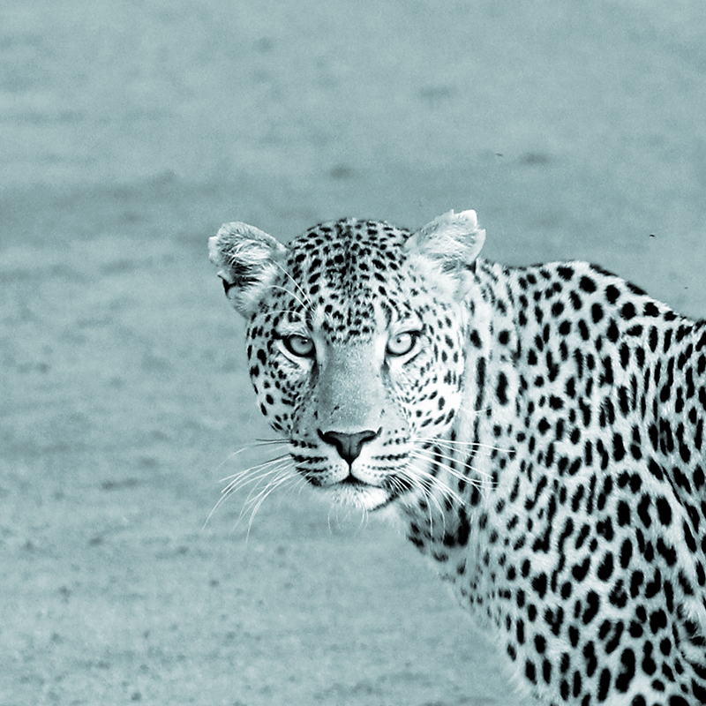
Chapter 1!
Lý Do Chọn Đề Tài

Slide 4
Quotations are commonly printed as a means of inspiration and to invoke philosophical thoughts from the reader.

Slide 5
This is a slide title
Here you have a list of items
And some text
But remember not to overload your slides with content
Your audience will listen to you or read the content, but won’t do both.

Slide 6
1.
Transition headline
Let’s start with the first set of slides

Slide 7
BIG CONCEPT
Bring the attention of your audience over a key concept using icons or illustrations

Slide 8
You can also split your content
White
Is the color of milk and fresh snow, the color produced by the combination of all the colors of the visible spectrum.
Black
Is the color of ebony and of outer space. It has been the symbolic color of elegance, solemnity and authority.

Slide 9
In two or three columns
Yellow
Is the color of gold, butter and ripe lemons. In the spectrum of visible light, yellow is found between green and orange.
Blue
Is the colour of the clear sky and the deep sea. It is located between violet and green on the optical spectrum.
Red
Is the color of blood, and because of this it has historically been associated with sacrifice, danger and courage.

Slide 10
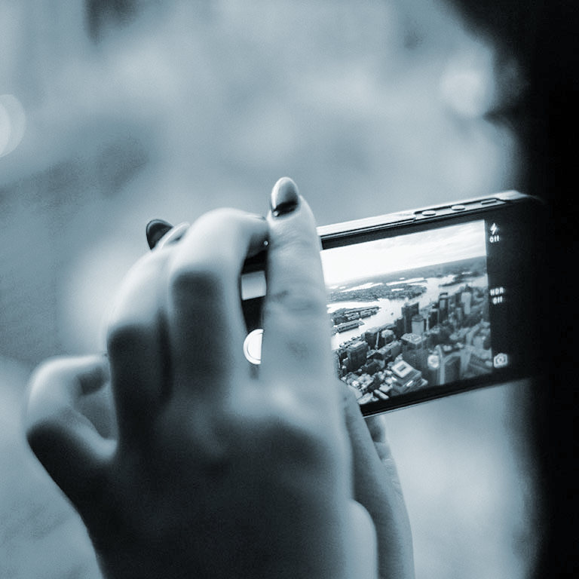
A picture is worth a thousand words
A complex idea can be conveyed with just a single still image, namely making it possible to absorb large amounts of data quickly.

Slide 11
Let’s review some concepts
Yellow
Is the color of gold, butter and ripe lemons. In the spectrum of visible light, yellow is found between green and orange.
Blue
Is the colour of the clear sky and the deep sea. It is located between violet and green on the optical spectrum.
Red
Is the color of blood, and because of this it has historically been associated with sacrifice, danger and courage.
Yellow
Is the color of gold, butter and ripe lemons. In the spectrum of visible light, yellow is found between green and orange.
Blue
Is the colour of the clear sky and the deep sea. It is located between violet and green on the optical spectrum.
Red
Is the color of blood, and because of this it has historically been associated with sacrifice, danger and courage.

Slide 12
Thanks!
Any questions?
You can find me at:
@username
user@mail.me

