Slide 1
INTERNSHIP PRESENTATION
DATA ENGINEERING
CONCEPTS IN AI WORKFLOWS
Based on internship at Coding Blocks School of Technology
Presented by ANSH PANDEY
AI Engineer | Gen AI Certified
1 June 2026 – 14 July 2026
2026–2027

Slide 2
Internship Overview
Details transcribed from the supplied certificate
Organization
Internship Role
Certification
Coding Blocks School of Technology
AI Engineer
Gen AI Certified
Internship Duration
Certificate Statement
1 June 2026 to 14 July 2026
Performance described as commendable
This presentation connects the AI Engineer internship context with the Data Engineering foundations used in AI workflows.
INTERNSHIP REPORT • ANSH PANDEY
2

Slide 3
What Is Data Engineering?
The data foundation behind analytics and AI
Data Engineering designs systems that collect, process, transform, store and deliver data for reliable use.
Collect
Prepare
Deliver
Gather data from files, databases, applications, sensors and APIs.
Clean, validate and transform raw data into consistent formats.
Store and provide trusted data to analytics and AI/ML systems.
INTERNSHIP REPORT • ANSH PANDEY
3

Slide 4
Typical Data Engineering Pipeline
A simplified end-to-end workflow
1. Sources
2. Ingestion
3. Processing
4. Storage
5. AI / Analytics
Files • Databases • APIs
Batch • Streaming
Clean • Validate • Transform
Warehouse • Data lake
Features • Models • Insights
Each stage should be repeatable, monitored and designed to protect data quality.
INTERNSHIP REPORT • ANSH PANDEY
4

Slide 5
Data Cleaning & Validation
Improving trustworthiness before data reaches AI systems
Common data issues
Cleaning activities
Missing values • Duplicate records • Inconsistent formats • Incorrect entries
Handle missing data • Remove duplicates • Standardize formats • Correct data types
Validation checks
Why it matters
Expected schema • Allowed ranges • Required fields • Consistency rules
Better data quality supports more dependable analysis and AI model inputs.
INTERNSHIP REPORT • ANSH PANDEY
5

Slide 6
Data Transformation & Preparation
Turning raw information into useful model inputs
• Filtering and joining records from different sources
• Aggregation and type conversion for consistent datasets
• Normalization and encoding when required
• Feature engineering: creating useful variables from existing data
• Feature selection: keeping relevant inputs for a task
INTERNSHIP REPORT • ANSH PANDEY
6

Slide 7
Role of Data Engineering in AI
How reliable data pipelines support AI applications
Reliable Inputs
Data Quality
Feature Preparation
Provide consistent data to AI and ML systems.
Reduce errors from incomplete or inconsistent records.
Convert raw data into useful model inputs.
Scalability
Reproducibility
Maintenance
Support larger datasets and distributed processing.
Make data preparation repeatable and auditable.
Support dataset updates and evolving model needs.
INTERNSHIP REPORT • ANSH PANDEY
7

Slide 8
Common Technologies & Concepts
Examples used across Data Engineering and AI environments
Python
SQL
Pandas
Scripting and data manipulation
Querying structured data
Tabular data cleaning
Apache Spark
Apache Kafka
ETL / ELT
Distributed data processing
Event streaming
Moving and transforming data
These are reference examples, not a verified list of tools used during this internship.
INTERNSHIP REPORT • ANSH PANDEY
8

Slide 9
Learning Outcomes & Practical Work
Add only activities and projects that were actually completed
• Understand the role of data quality in AI workflows
• Recognize the stages of ingestion, cleaning, transformation and storage
• Explain how prepared data supports AI/ML pipelines
• Record verified training tasks, tools and project outcomes in the final report
Project details to complete
Project title • Dataset • Tools • Methodology • Output • Challenges
INTERNSHIP REPORT • ANSH PANDEY
9

Slide 10
CONCLUSION
Reliable data is the foundation of reliable AI.
• Data Engineering supports the complete data journey—from source to AI application.
• Cleaning, validation, transformation and storage improve data reliability.
• Well-managed pipelines help AI workflows become scalable and repeatable.
Thank You
INTERNSHIP REPORT • ANSH PANDEY
10

Slide 11
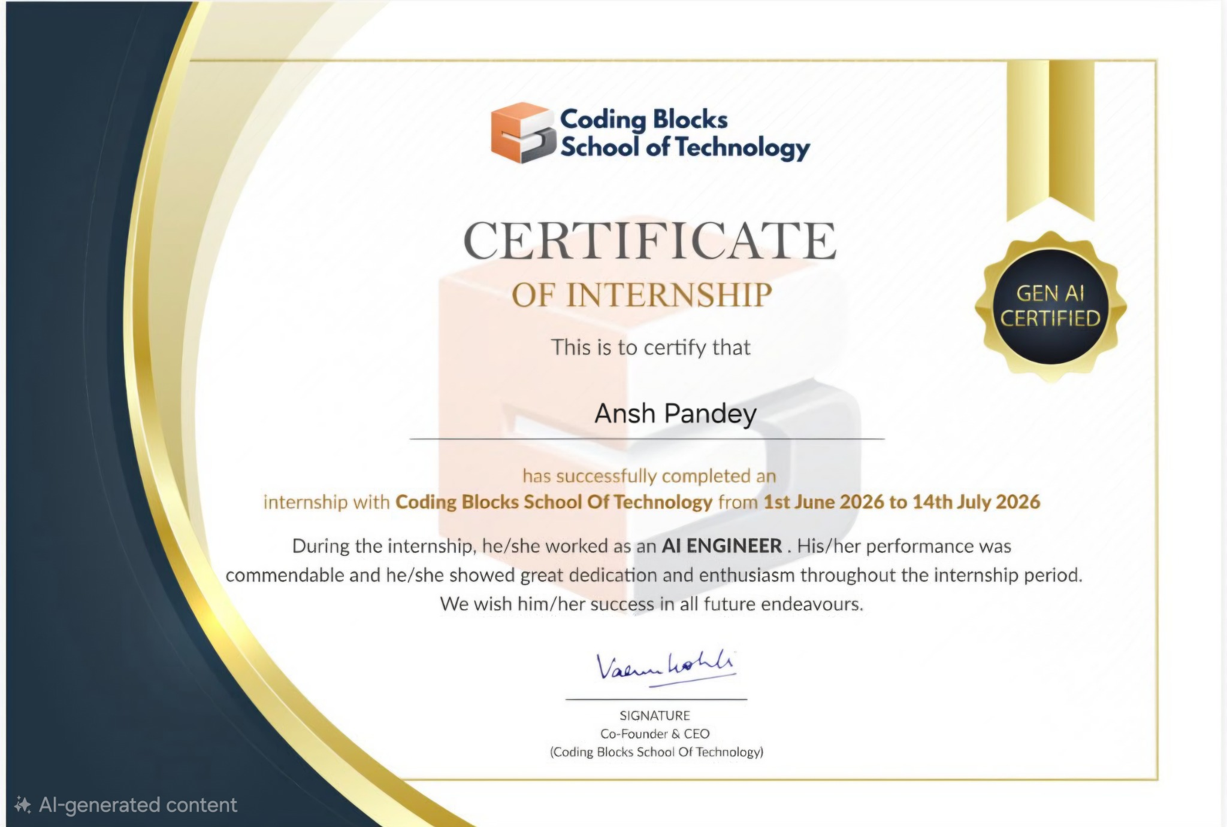
Internship Certificate
Certificate image supplied for this presentation
INTERNSHIP REPORT • ANSH PANDEY
11

