Slide 1
Linear Motor
책상 높이 제어
Arduino UNO R4 WIFI
Ubuntu OS Server(AWS)
Android OS Mobile(S10+)
책상 높이 측정
Ultrasonic Sensor
사용자 출력
Raspberry PI 4
작동 확인
LED
Display
E-Paper
출근 확인
RFID

Slide 2
Button
Li-Po
GND
5V
UP
Arduino
GND
D13
DOWN
CT7809
5V
D11
Vin
D9
Ultrasonic Sensor
GND
D8
Display E-Paper
D6
Vcc
A2
A3
D5
GND
Busy
A4
D3
ECHO
Vcc
RST
A5
D2
TRIG
GND
DC
CS
Linear Motor
DIN
CLK
Motor Driver
UP
Converter
DOWN

Slide 3
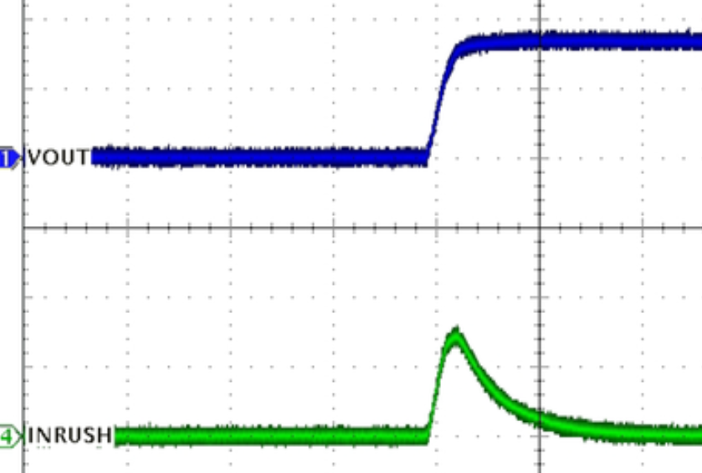
Hardware 구성 – Power
Converter
12V, 5A max
DC Motor Driver
12V, 2A max
Battery
12V, 10A max
PWM Control
Linear Motor
Regulator
9V, 1A
Arduino

Slide 4
Hardware 구성 – GATE
Raspberry PI
Tag LED
GPIO 4
Power LED
GPIO 14
RFID
3.3Vcc
3.3V
Sub Battery
GND
GND
GPIO 8
RST
GPIO 9
IRQ
GPIO 10
MISO
GPIO 11
MOSI
GPIO 24
SCK
GPIO 25
SDA

Slide 5
Software 기능
Raspberry PI 4
HTTP
Card ID
flag, name, distance, team_name, state
Login, Reservation, Schedule
Arduino UNO R4 WIFI
Web Socket
Ubuntu OS Server(AWS)
HTTP
APP
(Android)
Table ID, Desk height
User Information, Schedule, Seat Availability

