Slide 1
ECE 18-649
Final Project
Presentation
Dec 3, 2014
Group # 04
Howard Lee
Zhu Zhang
Hua Liu
1
Howard Lee

Slide 2
Overview
Project Statistics
DriveControl Design Process
  Use case
  Scenarios
  Sequence Diagrams
  Requirements
  Statecharts
  Code
  Testing
Lessons Learned
Open Issues
Suggestions
Howard Lee

Slide 3
Project Statistics
# of scenarios/ sequence diagrams | 23
# of SD arcs | 146
# of lines of requirements | 117
# of statecharts | 8
# of SC states | 36
# of SC arcs | 53
# of non-comment LOC | 2792
# of test files written | 59
# of reversions | 27
# of peer review | 33
# of defects found via reviews | 59
# of defects fixed | 59
# of defects found via test & other | 24
# of defects fixed | 24
3
Howard Lee
Notes:
*
For counting non-comment lines of code, I used loc at http://freshmeat.net/projects/loc/
Note: it is okay to have unresolved defects

Slide 4
DriveControl: Use Case and Scenario
U8. Move Car to Next Floor
  Primary use case for elevator moving to another floor
    Scenario 8A : Elevator moves from {f, b} to {g, c}
4
Howard Lee
Notes:
The bold text is the part that is related to the sequence diagram on the next slide.

Slide 5
DriveControl: Use Case and Scenario
Scenario 8A:
  Precondition:
    Elevator is at floor f, with at least one door[b, r] open.
    Drive is stopped.
    DesiredFloor is set to {g, c}
  Scenario
    Doors start closing
    Doors finish closing
    Drive starts to move elevator in d direction.
    Drive move in fast mode part of the time and slow down.
    Elevator arrives at floor g.
    Drive starts to level and eventually stop.
  Postcondition
    Elevator stopped at floor {g,c} with doors closed.
5
Howard Lee
Notes:
The bold text is the part that is related to the sequence diagram on the next slide.

Slide 6
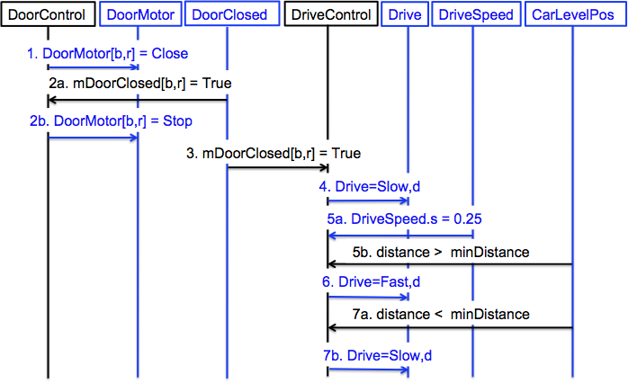
Sequence Diagram 8A
6
Howard Lee
Notes:
This diagram was produced by exporting WMF from DIA, inserting it. The inserted graphic did not meet minimum font size so we ungrouped it, set the font size on the text, then manipulated the diagram so it is still legible. The 16pt box serves as a font size reference.

Slide 7
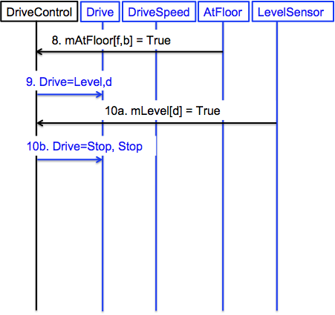
Sequence Diagram 8A
7
Howard Lee
Notes:
This diagram was produced by exporting WMF from DIA, inserting it. The inserted graphic did not meet minimum font size so we ungrouped it, set the font size on the text, then manipulated the diagram so it is still legible. The 16pt box serves as a font size reference.

Slide 8
Requirements
12 Requirements total
R6.15 When DriveSpeed.s reaches Slow speed and the distance to mDesiredFoor.f is greater than minDistance, Drive should be set to [Fast, d].
8
Howard Lee
Notes:
Explain the requirement. R2.4 is chosen because it is traceable to the scenario/sequence diagram shown in previous slides.

Slide 9
Statechart
States: 7 in total
  state 1 - Stop
  state 2 - Slow Down
  state 3 - Slow Up
  state 4 - Level Up
  state 5 - Level Down
  state 6 - Fast Down
  state 7 - Fast Up
Transitions: 14 in total
DrC2: Stop -> Slow Up | mDoorClosed[b, r] == True && DesiredDirection == UP && mEmergencyBrake == False && DriveSpeed.d != Down && mDoorMotor == STOP
DrC5: Level Up -> Stop | DriveSpeed.s <= LevelSpeed && mLevel[up] == True OR mEmergencyBrake == True
9
Zhu Zhang
Notes:
The statechart from Dia did not import well. The best solution for an easy to read diagram was to remake the statechart in powerpoint.
Explain T2.1 – it is chosen because it is traceable to the R2.4 in the previous slide.

Slide 10
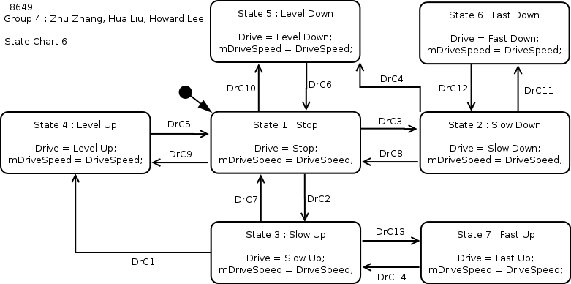
10
Zhu Zhang

Slide 11
Code
//#transition 'DrC2'
if (doorClosedArrayBack.getBothClosed() && doorClosedArrayFront.getBothClosed() && desiredDirection == Direction.UP && localDriveSpeed.direction() != Direction.DOWN && doorMotorArray.getAllStopped() && !mEmergencyBrake.getValue()) {
newState = State.STATE_SLOW_UP;
}
……
//#transition 'DrC5'
if((localDriveSpeed.speed() <= DriveObject.LevelingSpeed && mLevelUp.getValue()) || mEmergencyBrake.getValue()) {
newState = State.STATE_STOP;
}
11
Zhu Zhang

Slide 12
Testing
Unit test
  Inject the conditions of transitions
  Assert the state and outputs
Integration test
  Follow the arcs, inject & assert
Acceptance test
  -gui
  -seed
The same as sabbath mode version
12
Zhu Zhang

Slide 13
Commit Point Computing
Function used:
public static int computeNeededDistance(double speed) {
return (int) (Math.pow(speed, 2) * 1000 / 2 + 100 * speed + 200);
}
Speed - current moving speed rate (m/s)
Minimal necessary distance to stop:
speed^2 / 2 (meters)
Add some padding for message delay:
speed / 10 + 0.2 (meters)
13
Zhu Zhang

Slide 14
Lessons Learned
Dispatcher!
  Original design has A LOT of race conditions.
  Re-design the statechart and rewrite all code.
Code reuse
  Use good abstractions for utility class/methods
  Passing the tests doesn’t mean bug-free
  The elevator may not behave as expected
  … and the test may pass because of luck.
  make MORE assertions
14
Hua Liu

Slide 15
Suggestions
How to test race conditions
  The “right” way:
    Write integration tests for all races.
    Run them after every build.
  Our approach:
    Use scripts to run batch acceptance tests.
    Note all problematic random seeds.
    Test them after every build.
Don’t be afraid of rewriting
  Rewriting takes less time as it happens more.
  A great chance to rethink about the design.
  Occam’s razor: the simpler, the better.
15
Hua Liu

