Slide 1
ECE 18-649
Mid-Term Project
Presentation
Oct 27, 2014
Group # 04
Howard Lee
Zhu Zhang
Hua Liu
1
Howard Lee

Slide 2
Overview
Project Statistics
DoorControl Design Process
  Use case
  Scenarios
  Sequence Diagrams
  Requirements
  Statecharts
  Code
  Testing
Lessons Learned
Open Issues
Suggestions
2
Howard Lee

Slide 3
Project Statistics
# of scenarios/ sequence diagrams | 23
# of SD arcs | 144
# of lines of requirements | 117
# of statecharts | 8
# of SC states | 33
# of SC arcs | 49
# of non-comment LOC | 15187 (1965)
# of test files written | 50
# of reversions | 19
# of peer review | 23
# of defects found via reviews | 48
# of defects fixed | 48
# of defeats found via test & other | 17
# of defeats fixed | 17
3
Howard Lee
Notes:
*
For counting non-comment lines of code, I used loc at http://freshmeat.net/projects/loc/
Note: it is okay to have unresolved defects

Slide 4
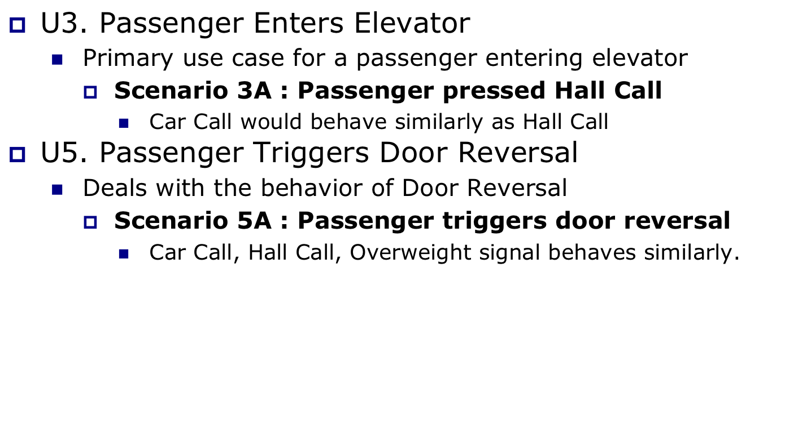
DoorControl: Use Case and Scenario
4
Howard Lee
Notes:
The bold text is the part that is related to the sequence diagram on the next slide.

Slide 5
DoorControl: Use Case and Scenario
Scenario 3A: Hall call button is pressed, and a passenger enters the elevator.
  Precondition:
    Car is about to arrive at hallway [f,b]
    Hall call button desired direction d has already been pushed
    Elevator is going in direction d
  Scenario
    Doors start opening
    HallLight[f,b,d] turns off
    Doors open completely
  Postcondition
    HallLight[f,b,d] is off
    Elevator is at floor f
    All doors are open
5
Howard Lee
Notes:
The bold text is the part that is related to the sequence diagram on the next slide.

Slide 6
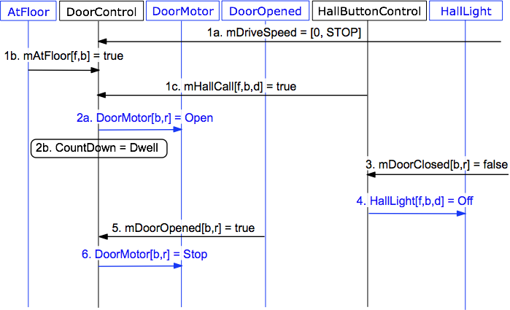
Sequence Diagram 3A
6
Howard Lee
Notes:
This diagram was produced by exporting WMF from DIA, inserting it. The inserted graphic did not meet minimum font size so we ungrouped it, set the font size on the text, then manipulated the diagram so it is still legible. The 16pt box serves as a font size reference.

Slide 7
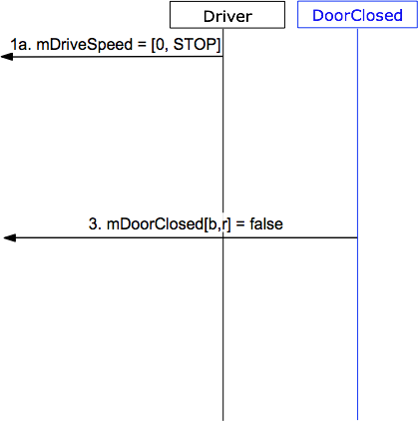
Sequence Diagram 3A
7
Howard Lee
Notes:
This diagram was produced by exporting WMF from DIA, inserting it. The inserted graphic did not meet minimum font size so we ungrouped it, set the font size on the text, then manipulated the diagram so it is still legible. The 16pt box serves as a font size reference.

Slide 8
Requirements
19 Requirements total
R5.6 is where door motor is set to open
  If
    mAtFloor[f, b] True AND
    mDriveSpeed = [0, STOP] AND
    mHallCall[f, b, d] True OR mCarCall[f, b] True
  then
    DoorMotor[f, b] shall be commanded to Open
    CountDown shall be set to Dwell
8
Howard Lee
Notes:
Explain the requirement. R2.4 is chosen because it is traceable to the scenario/sequence diagram shown in previous slides.

Slide 9
Statechart
States: 6 in total
  state 1 - DoorClosed
  state 2 - DoorOpening
  state 3 - DoorOpened
  state 4 - DoorClosing
  state 5 - DoorNudging
  state 6 - DoorReversal
Transitions: 10 in total
DC1: DoorClosed -> DoorOpening | mDriveSpeed == (0,d) && mAtFloor[f,b] == True && (mHallCall[f,b,d] == True || mCarCall[f,b] == True)
DC2: DoorOpening -> DoorOpened | mDoorOpened[b,r] == true
9
Zhu Zhang
Notes:
The statechart from Dia did not import well. The best solution for an easy to read diagram was to remake the statechart in powerpoint.
Explain T2.1 – it is chosen because it is traceable to the R2.4 in the previous slide.

Slide 10
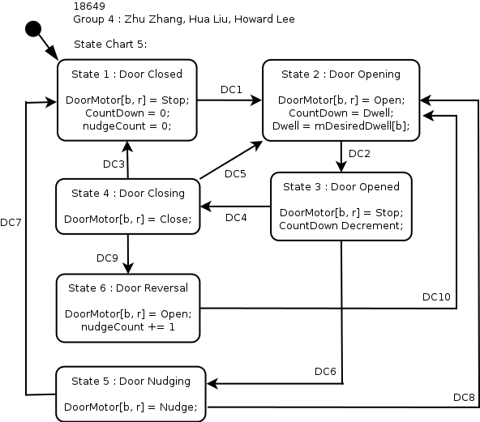
10
Zhu Zhang

Slide 11
Code
//#transition 'DC1'
if(currentFloor > 0 && mDriveSpeed.getSpeed() == 0 && mAtFloor.isAtFloor(currentFloor, this.hallway) ){
if( (mHallCall.isHallCall(currentFloor, hallway, mDesiredFloor.getDirection())) || (mCarCall.isCarCall(currentFloor, hallway)) )
newState = State.STATE_DOOR_OPENING;
}
……
//#transition 'DC2'
if(mDoorOpened.getValue() == true)
newState = State.STATE_DOOR_OPENED;
11
Zhu Zhang

Slide 12
Testing
Unit test
  Inject the conditions of transitions
  Assert the state and outputs
Integration test
  Follow the arcs, inject & assert
Acceptance test
  -gui
  -seed (try different seeds)
12
Zhu Zhang

Slide 13
Lessons Learned
Different interpretation on important concept.
  mDesiredFloor.f can have multiple interpretations.
  The problem is not spotted until Project 7.
  We discussed and picked the one which works and simplifies the design.
Scheduling problem
  Team of 3, therefore more work to do and more difficult to divide.
  Used to start the project on Wednesday night.
  Divide weekly project into multiple parts and start to work on Sunday.
Communication matters
  Better to book a group study room and physically work together.
Version control works well
  Especially when we want to revoke everything after messed up.
  But can be extremely annoying when working on binary files.
  (such as sd_req_traceability.xls)
13
Hua Liu

Slide 14
Open Issues
Challenge: Smart dispatcher.
  Being smart means many pending improvements in the future.
  Every modification on design propagate to everything else.
  Testing improvements are more difficult than testing functions.
Challenge: DriveControl for fast elevator
  How drive should accelerate based on next DesiredFloor.
  How Dispatcher negotiate with DC when car is moving.
Problem: Inconsistent Document
  Documents are not updated with actual code
  Will be fixed with new sequence diagrams since project 8.
14
Hua Liu

Slide 15
Suggestions
Project Instructions
  should be more clear about what we shall and shall not do
Logistics
  better tools to compose and sync documents.
15
Hua Liu

