Slide 1
Altmetrics(1)
坂田・森研究室
M2 キム フィミョン
Paper review(1)

Slide 2
Altmetrics: an overview and evalution
Ann E. Williams(2017)
Online Information Review. 41.

Slide 3
目次
1.What are altmetrics?
2.How do altmetrics work?
3.Typologies/classifications
4.Technological capabilities
5.Pros and Cons
6.Directions for future research

Slide 4
１ What are altmetrics?

Slide 5
1.1 definition
１ What are altmetrics?
Measurement of web-driven scholarly interactions (Howard, 2012; Robinson-Garcia et al, 2014)
―Sources: Tweeter, Blog, Bookmark, …
―Promoted by: Altmetrics.org, Altmetrics.com, …
Promoted by: Altmetrics.org(NPO), Altmetrics.com(Commercial), …

Slide 6
1.2 the rise of altmetrics(1/2)
１ What are altmetrics?
Technological changes 90s~2000s had driven the necessity of new measures
―Sources: Tweeter, Blog, Bookmark, …
―Promoted by: Altmetrics.org, Altmetrics.com, …
Limitations of existing measures of social, public, and/or "real world" impact of research
―Traditional citation-based measures ignores other work outputs such as blogs and datasets.
Altmetrics measures impact of journal articles through SMS

Slide 7
1.2 the rise of altmetrics(2/2)
１ What are altmetrics?
New: New information that was previously difficult to obtain
Fast: Discern the impact of work faster than traditional metrics ―Crowdsourcing could assess article's impact almost immediately (Galligan and Dyas-Correia, 2013)

Slide 8
2 how do altmetrics work?

Slide 9
2 How do altmetrics work?
Aggregate info from different sources(Bold: Main source of Altmetrics.com(Melero, 2015))
―Peer reviews
―References on Wikipedia
―Public policy documents
―Research blogs
―Media coverage
―Bookmarks on reference managers(e.g. Mendeley)
―Social media
Online data of Altmetrics.com: Blogs, News, Reddit, FB, Google+, Pinterest, Twitter, Stack Exchange, CiteULike, Connotea, Mendeley, F1000, YouTube, LinkedIn Groups, Research Highlights, …(Robinson-Garcia et al., 2014)

Slide 10
3 Typologies/classifications

Slide 11
3 TYPOLOGIES/CLASSIFICATIONS(1/2)
By primary functions(Robinson-Garcia et al., 2014)
Function | Sources
Discussions | blogs, news, Reddit, Stack Exchanges, ...
Mentions | FB, Twitter, Google+, Pinterest, LinkedIn Groups, ...
Readers
Reviews | CiteUlike, Connotea, F1000, ...
Videos | YouTube
Citations | Research Highlights

Slide 12
3 TYPOLOGIES/CLASSIFICATIONS(2/2)
By terms of use(Wouters and Costa, 2014)
By engagement(Lin and Fenner, 2013): Viewed, Saved, Discussed, Recommended, Cited
Use | Descriptions
Diversity of channel anlyzed | Altmetrics enable the user to analyze different types of materials such as books, blogs, FB, or tweets
Speed of acquiring/retrieving data | Instantly available for analysis
Openness of method | Altmetric data is open to download and free to use
The ability to measure impact beyond the scholarly realm | Accessibility to a variety of readers helps research escape the judgment of the scientific readers

Slide 13
4 technological capabilities

Slide 14
4 TECHNOLOGICAL CAPABILITIES
Altmetrics by Altmetrics.com
―Frequency of mentions: how often it is mentioned on different media platforms
―A record of attention: how many people discussed
―A measure of dissemination: where and why it has been discussed
―An indicator of influence and impact: how it can influence society

Slide 15
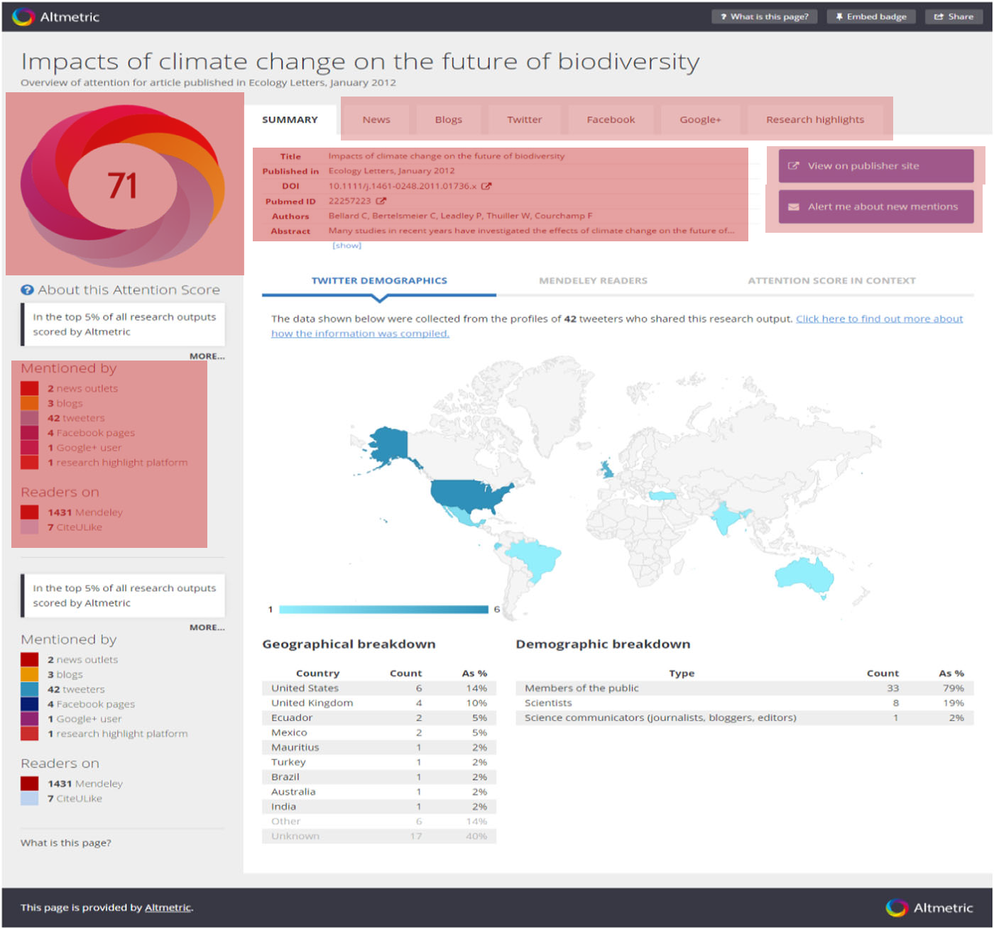
4.1 Key functionalities
4 Technological capabilities
3 components of altmetrics by Altmetrics.com
―Output: journal article, dataset, ...
―Identifier: DOI, RePEc, …(attached to the output)
―Mentions: mentions in a source
Display page shows:
―The donut and attention scores
―Summary counts
―Bibliographic details
―Browse the original mentions
―Signup for alerts
―Access the published research
―demographics, rankings, geographic of attentions

Slide 16
5 pros and cons

Slide 17
5.1 pros
5 pros and cons
Altmetrics complement traditional meatures
Pros | Descriptions
Quick view | Users can have a quick view of the impact of the work (Melero, 2015)
Quick dissemination | Spread the work via social media (Melero, 2015)
Track researcher | Helps track scholarly outputs including data sharing, SW, presentations
Hidden opportunities | Researcher can access real-time discussion of works or unpublished articles

Slide 18
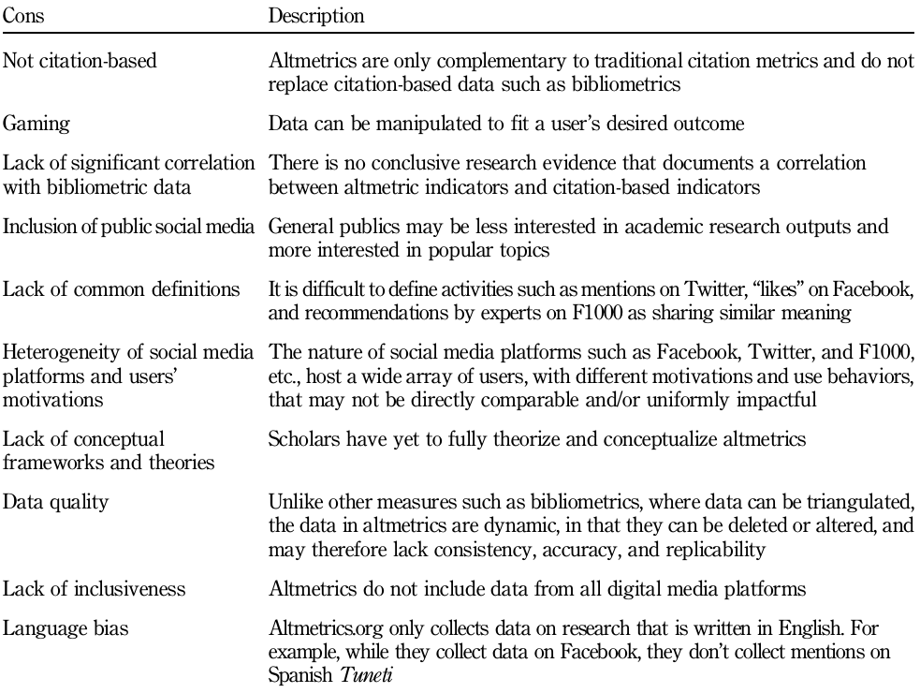
5.2 cons
5 pros and cons
Limitations of altmetrics

Slide 19
6 directions for future research

Slide 20
6 DIRECTIONS FOR FUTURE RESEARCH
Prompt issues
―Monolingual data: Altmetrics.com, Altmetrics.org currently cannot collect data in languages other than English.
―Lack of theory: No definitive theory-based explanation on the mechanisms of altmetrics.
―A measure of dissemination: where and why it has been discussed
―An indicator of influence and impact: how it can influence society
Expected:
―(Users)leverage the dissemination of research particularly in domains that provide research to the general public
―(Designers)develop new, improved tools and consider limitations of altmetrics
Essential: exploring academics' adoption and use of altmetrics over-time to uncover the long-term impact and value

