Slide 1

Remote connections to Oracle database
KNUT
Korea National University of Transportation

Slide 2
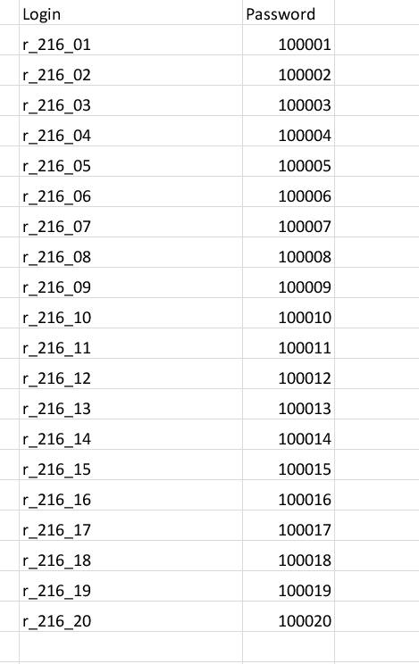
Communication Java and Oracle database
User Interfaces (Default login and passwords)

Slide 3
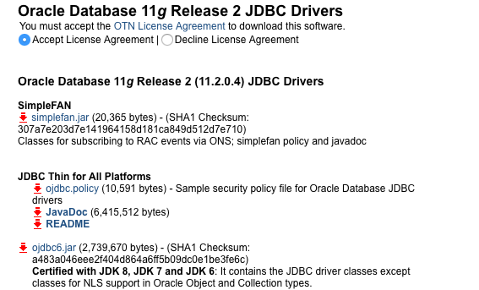
Communication Java and Oracle database
OJDBC in Java
Download “ojdbc6.jar” JDBC driver from http://www.oracle.com/technetwork/apps-tech/jdbc-112010-090769.html

Slide 4
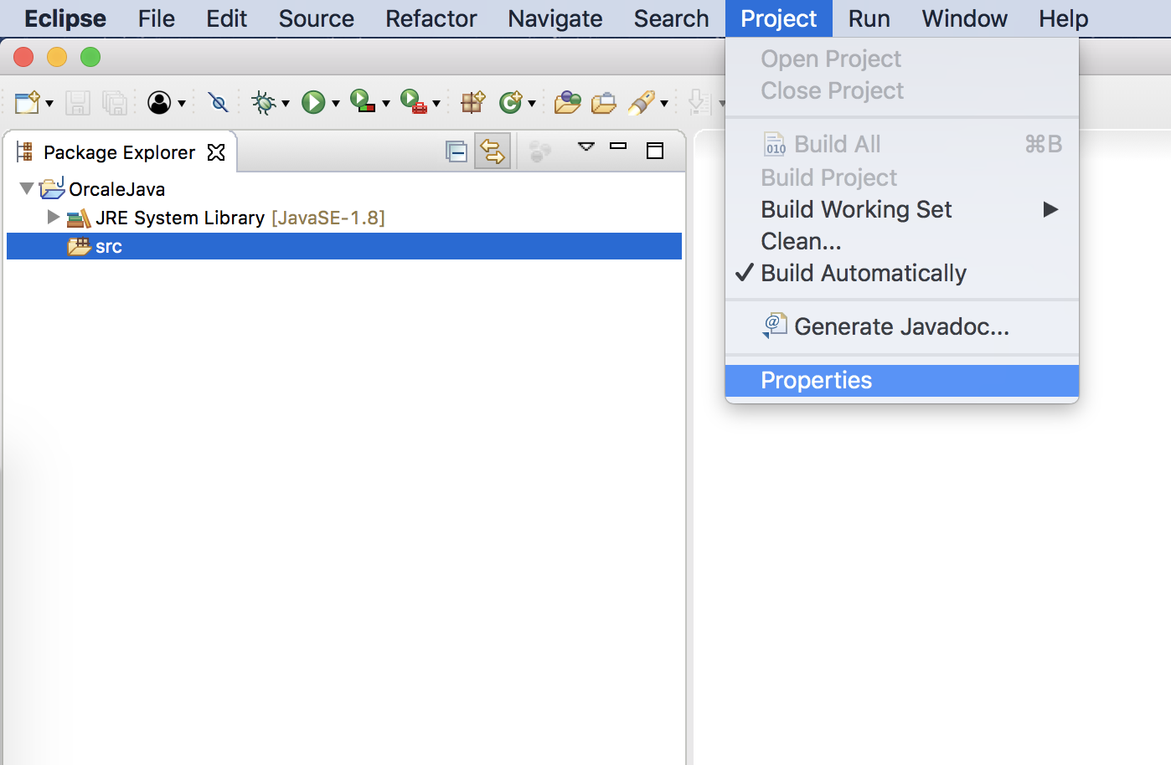
Communication Java and Oracle database
OJDBC in Java
Import ojdbc6.jar to Java project in Eclipse.
Project->Properties

Slide 5
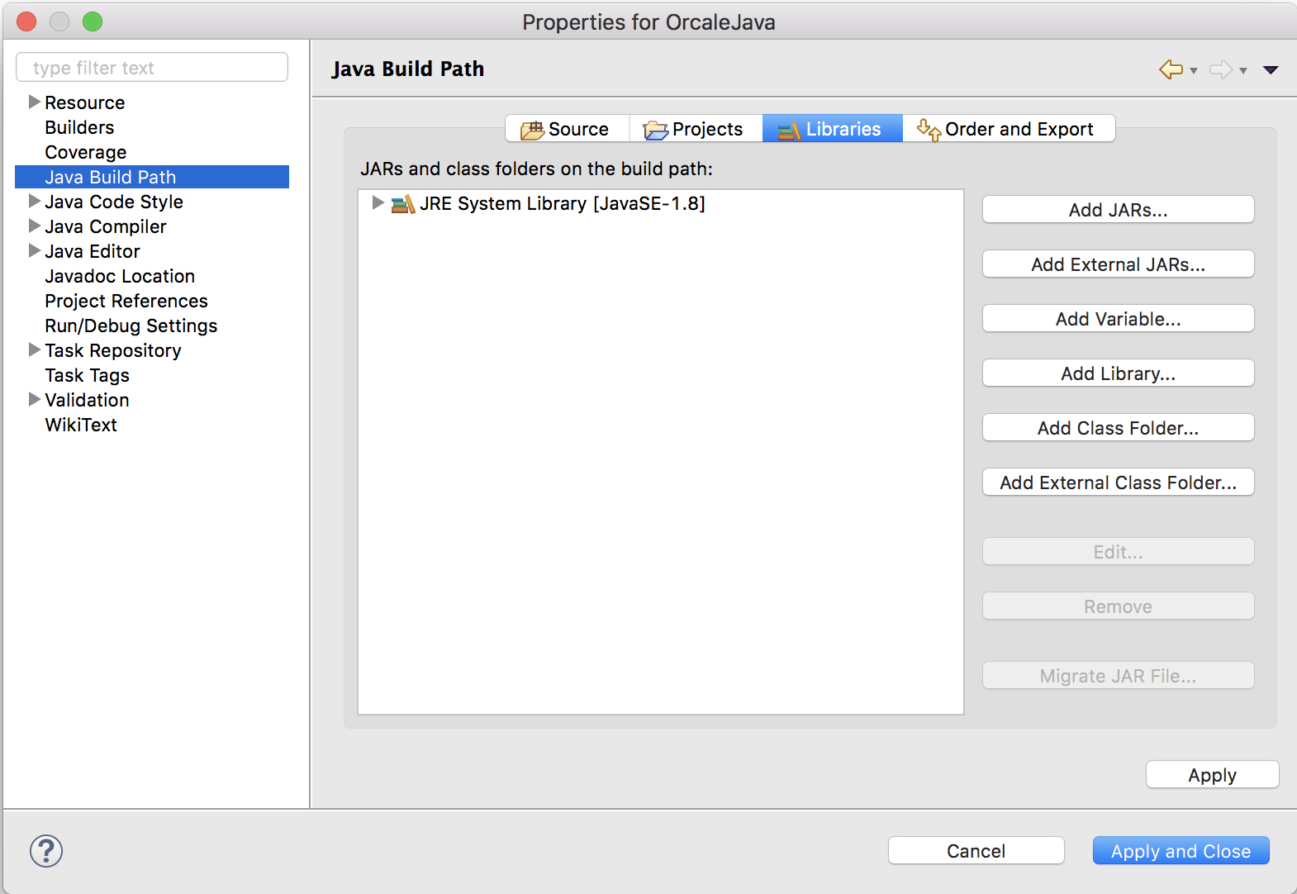
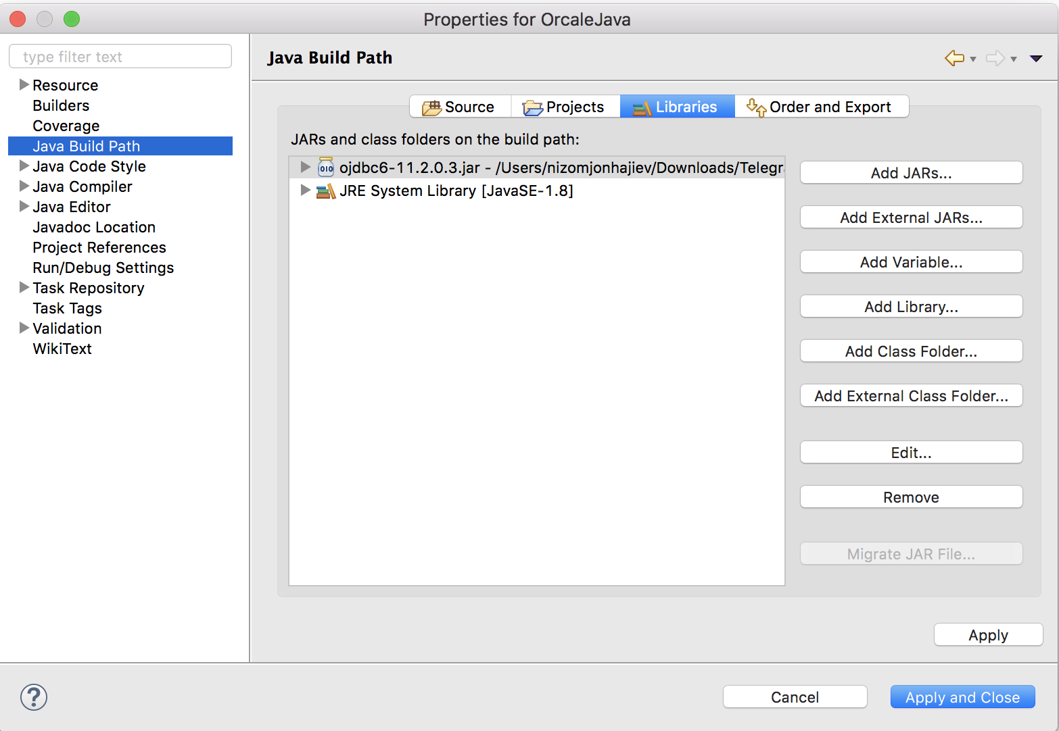
Communication Java and Oracle database

Slide 6
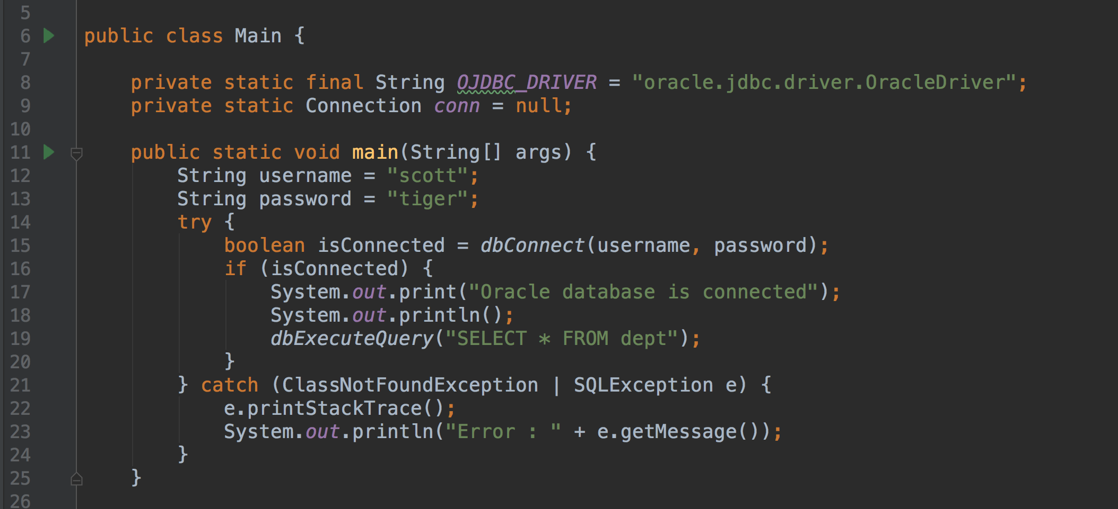
Communication Java and Oracle database (Source Code)

Slide 7
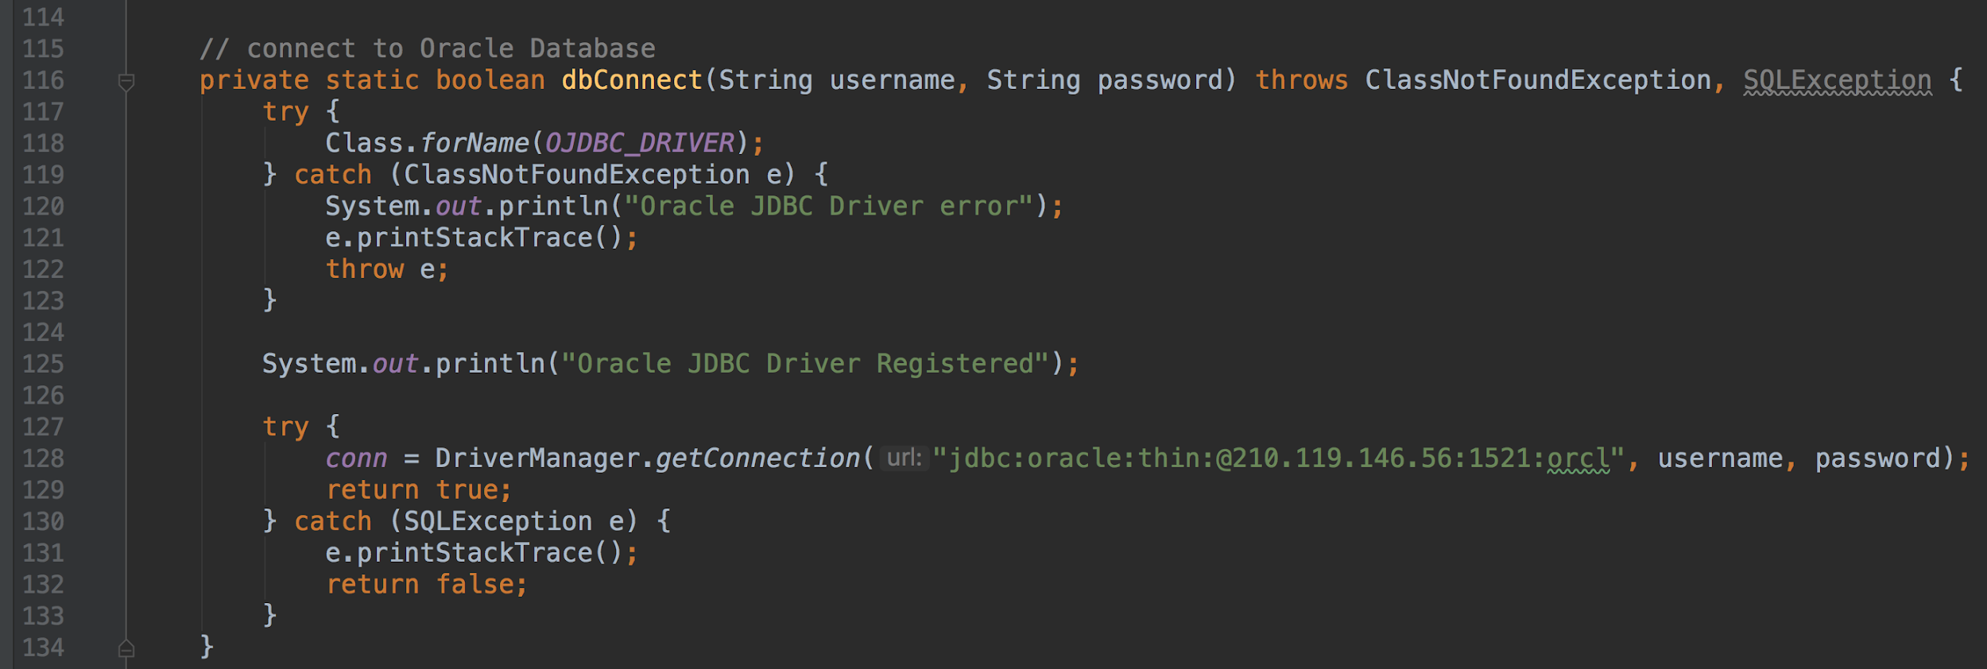
Communication Java and Oracle database (Source Code)

Slide 8
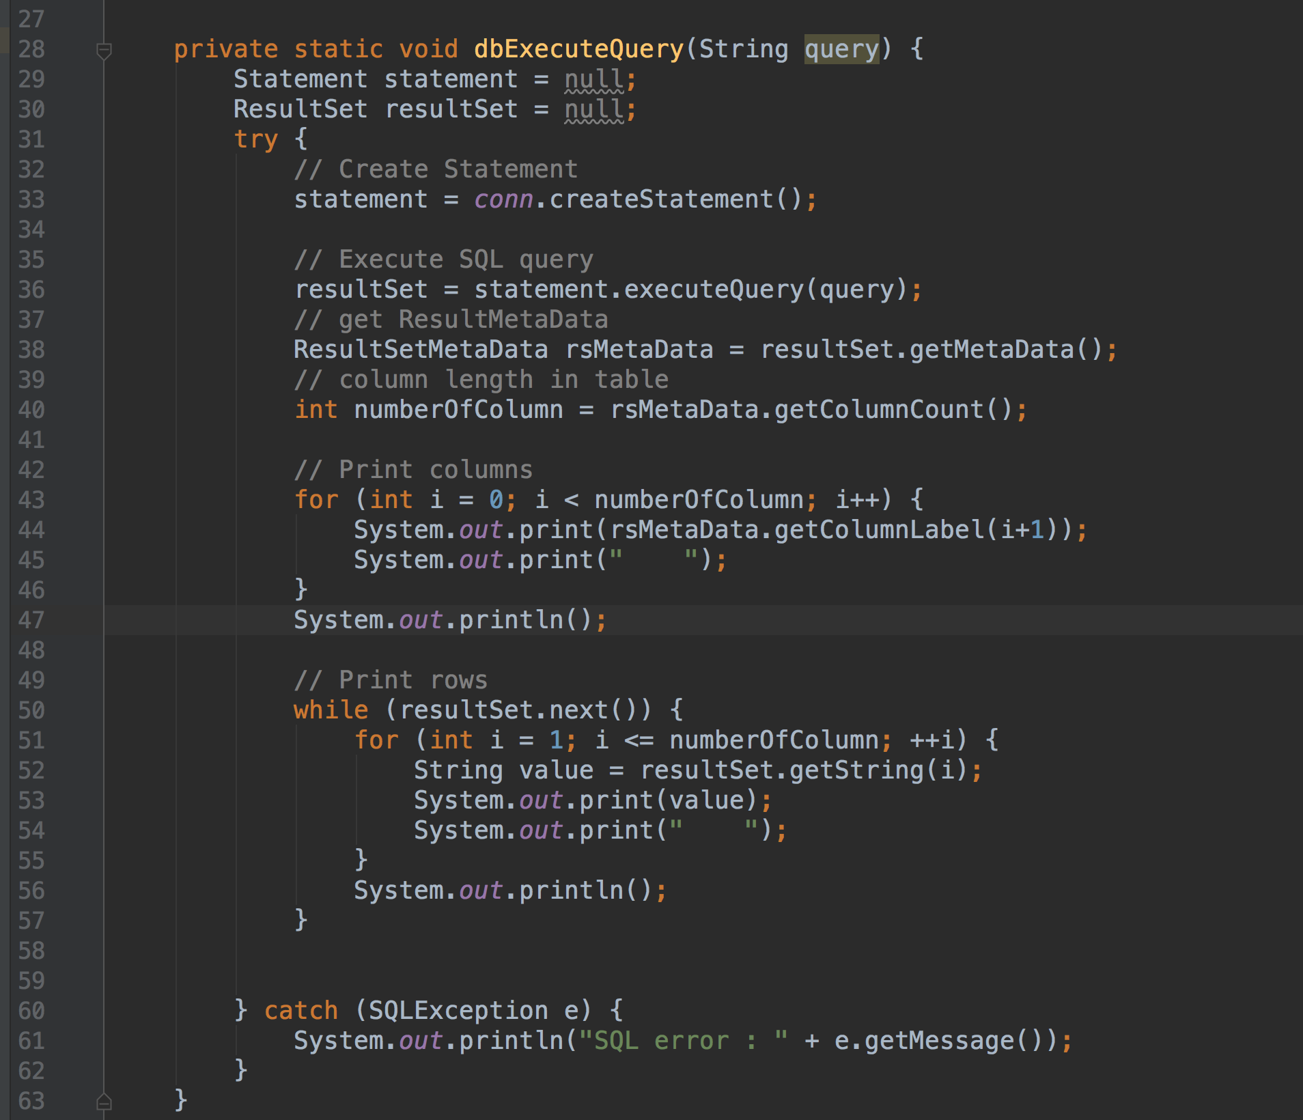
Communication Java and Oracle database (Source Code)

