Slide 1

Remote connections to Oracle database
KNUT
Korea National University of Transportation

Slide 2
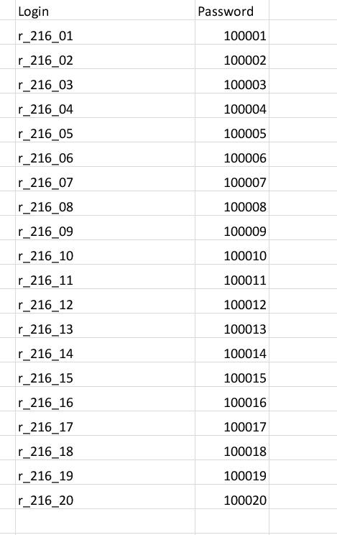
Communication Java and Oracle database
User Interfaces (Default login and passwords)

Slide 3
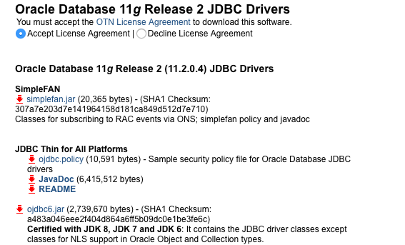
Communication Java and Oracle database
OJDBC in Java
Download “ojdbc6.jar” JDBC driver from http://www.oracle.com/technetwork/apps-tech/jdbc-112010-090769.html

Slide 4
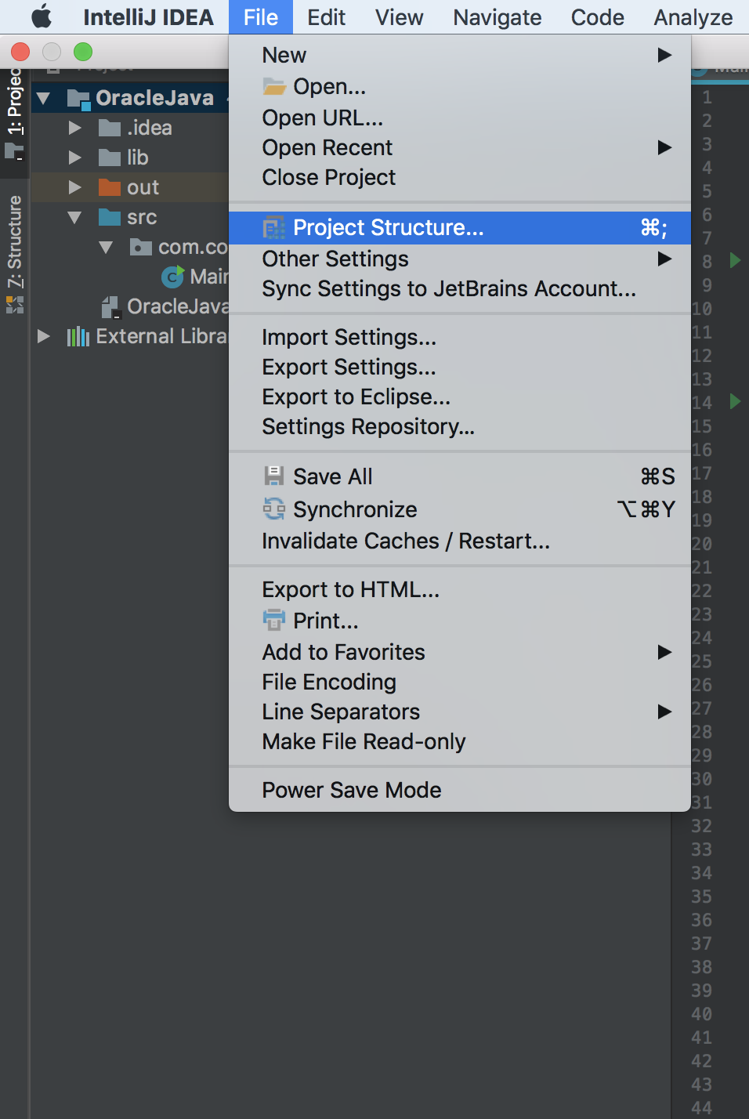
Communication Java and Oracle database
OJDBC in Java
Import ojdbc6.jar to Java project in IntelliJ Idea.
File-> Project Structure

Slide 5
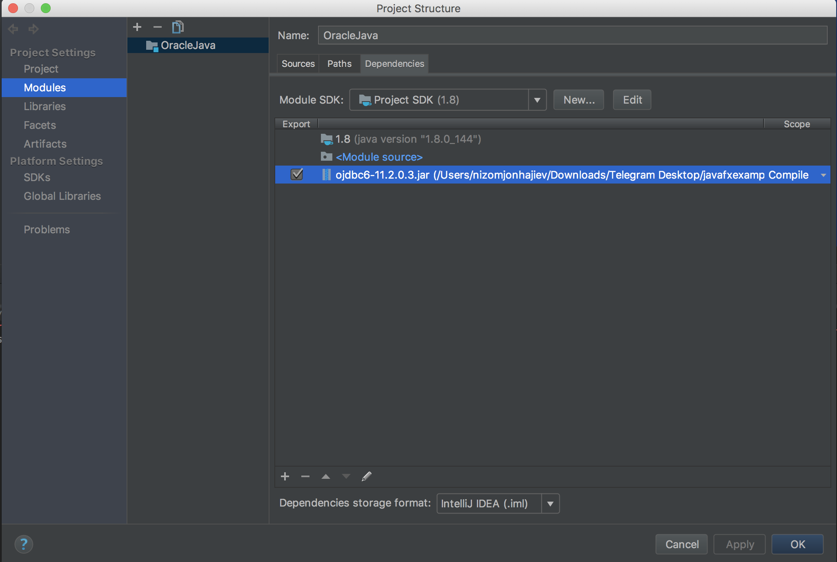
Communication Java and Oracle database
OJDBC in Java

Slide 6
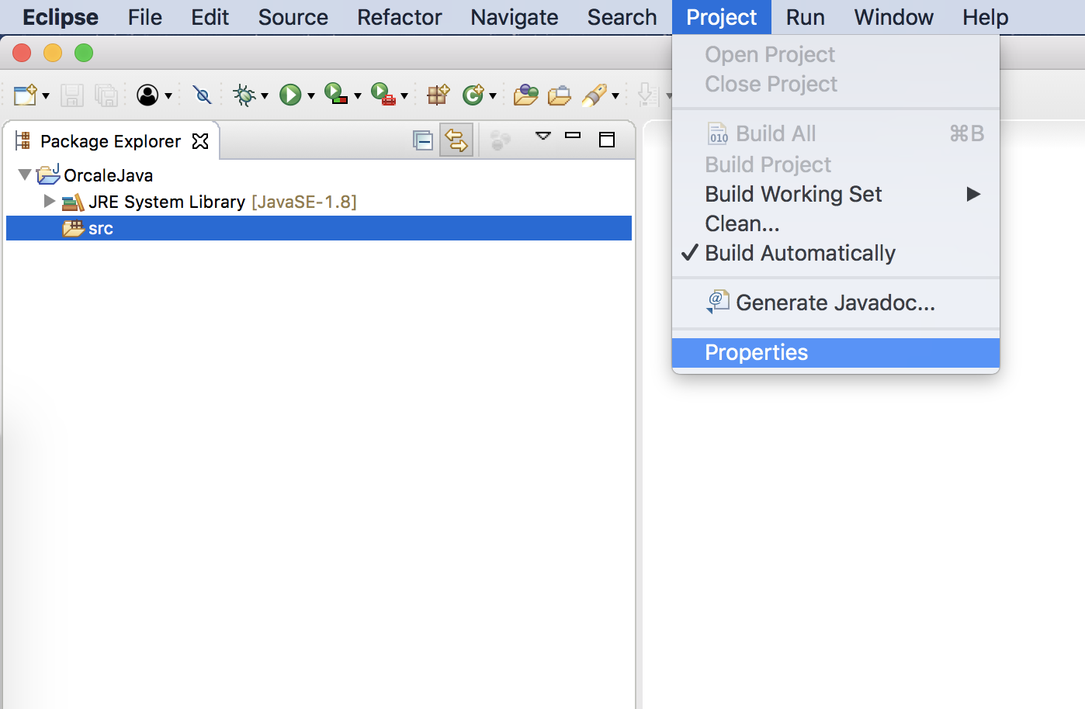
Communication Java and Oracle database
OJDBC in Java
Import ojdbc6.jar to Java project in Eclipse.
Project->Properties

Slide 7
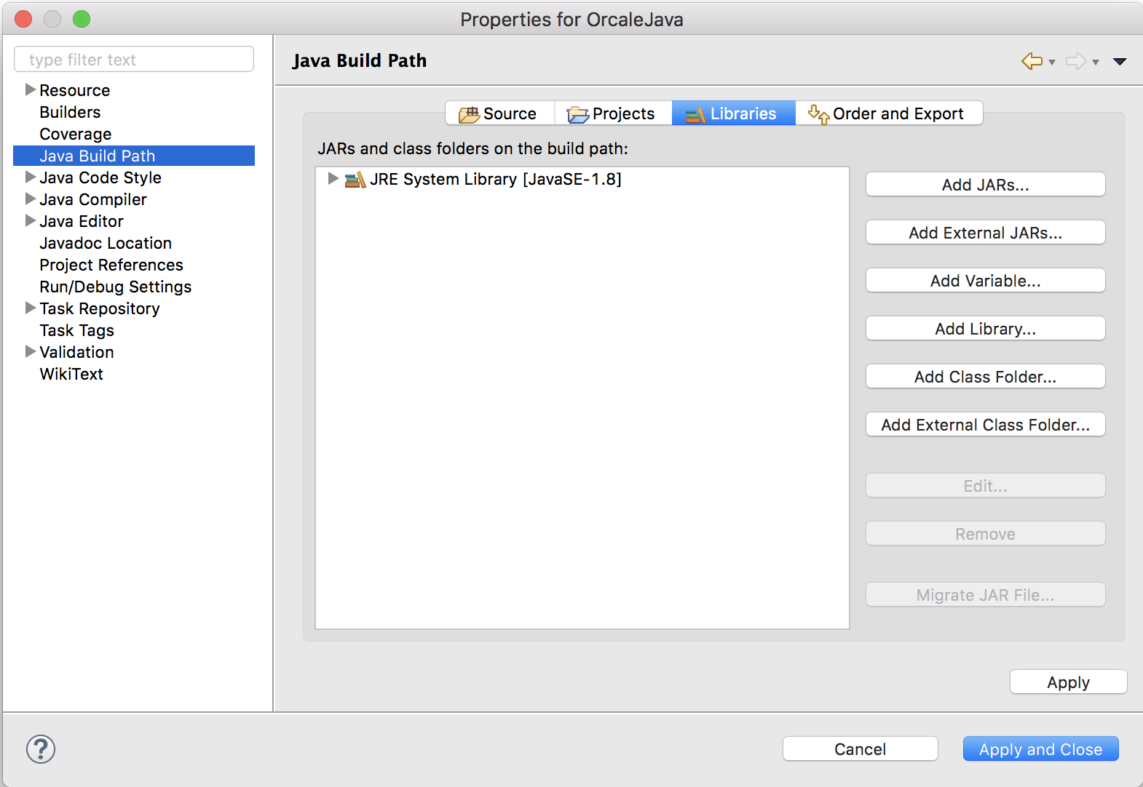
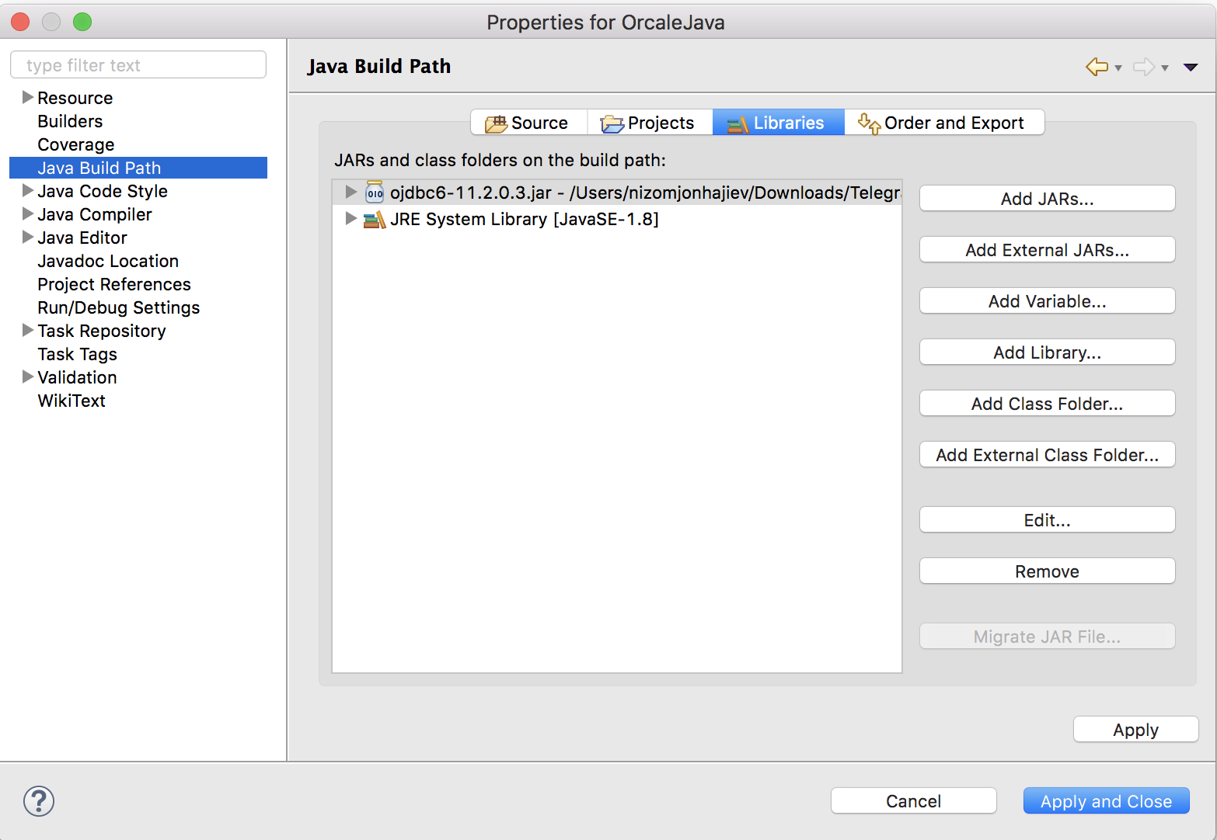
Communication Java and Oracle database

Slide 8
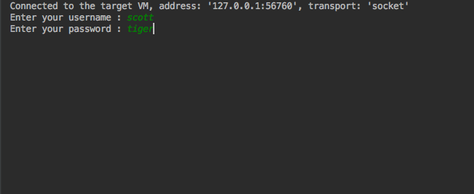
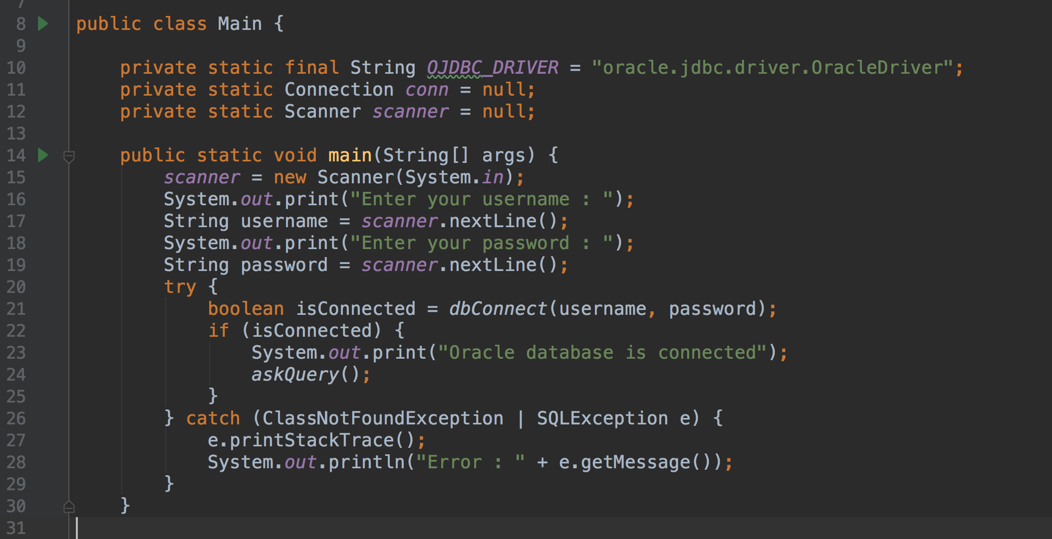
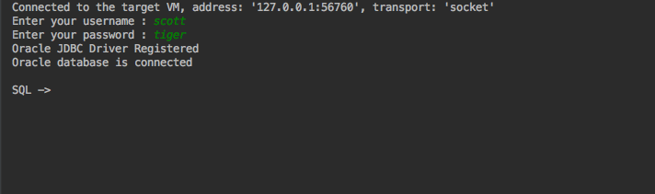
Communication Java and Oracle database (Source Code)

Slide 9
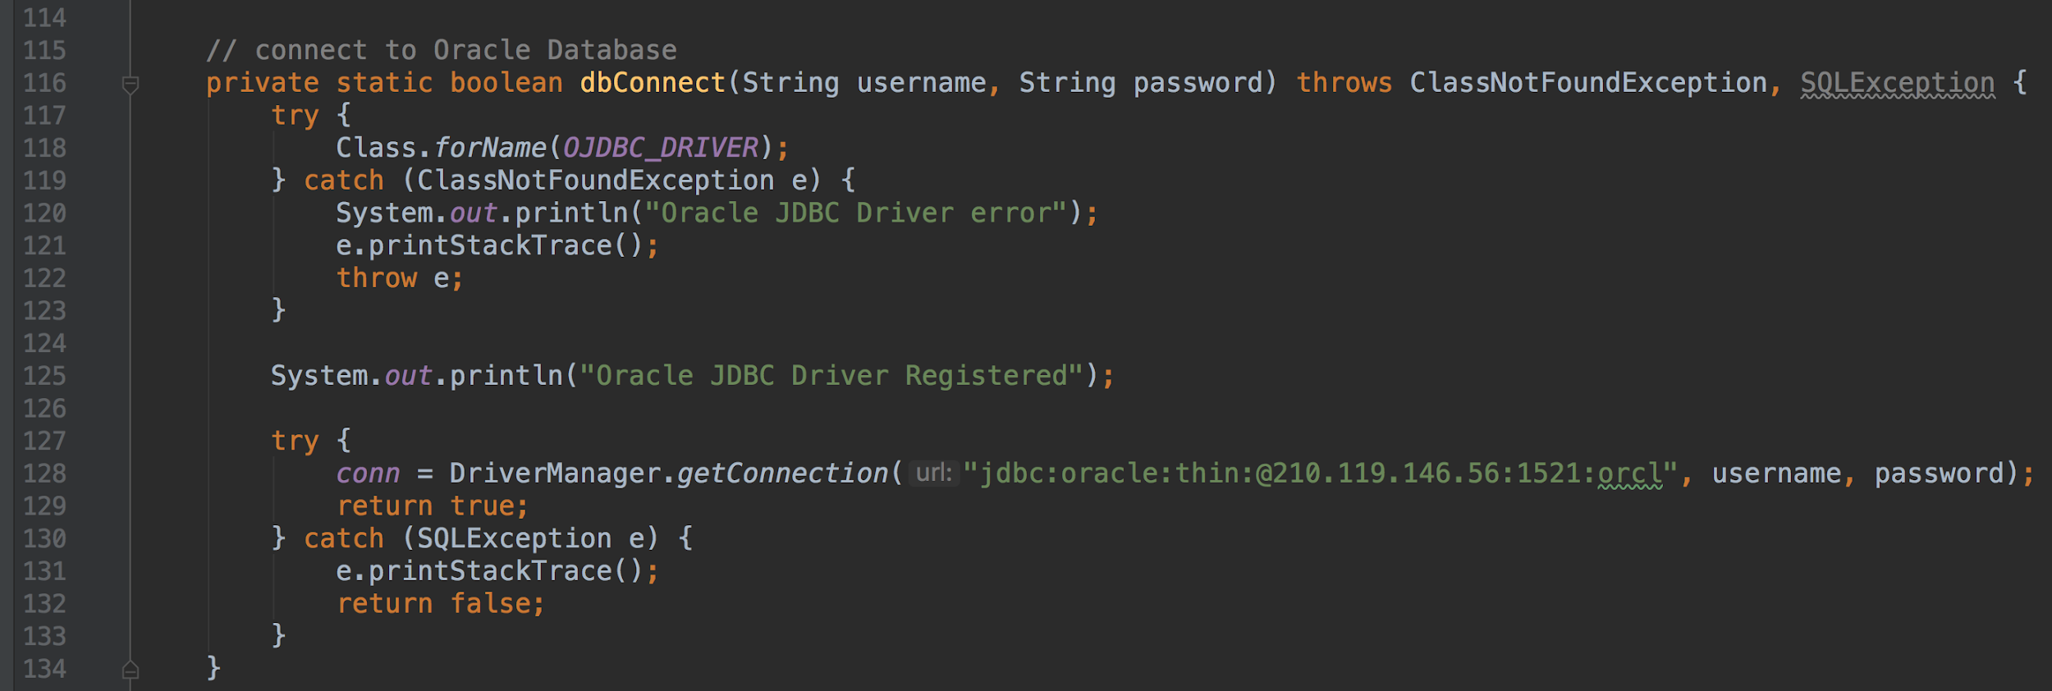
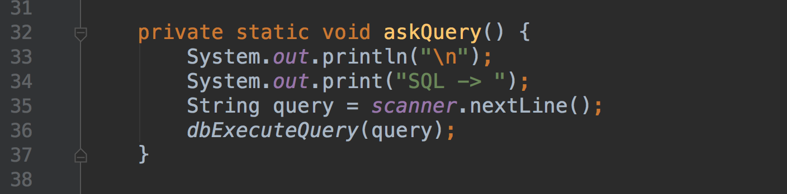
Communication Java and Oracle database (Source Code)

Slide 10
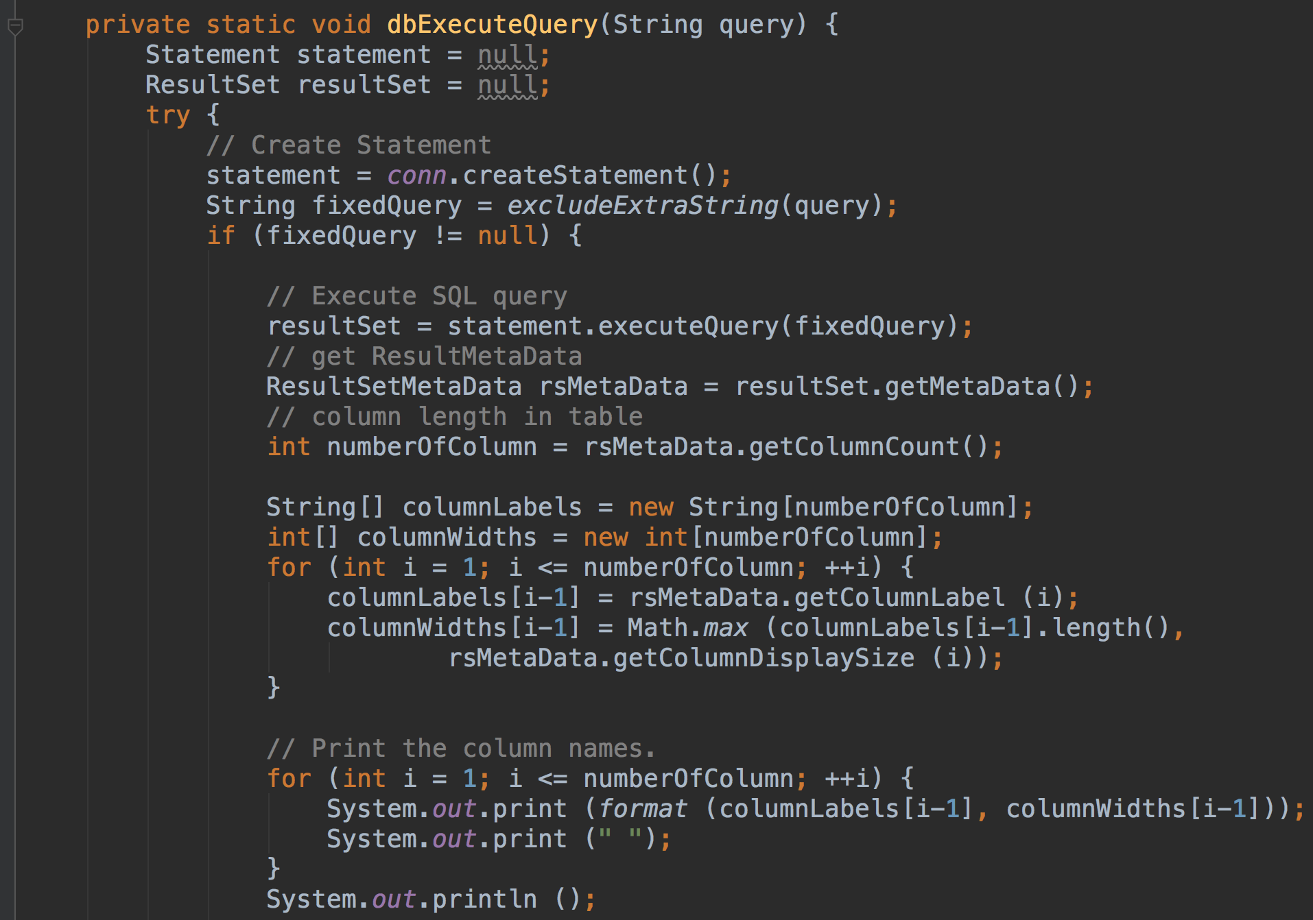
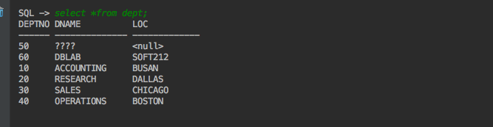
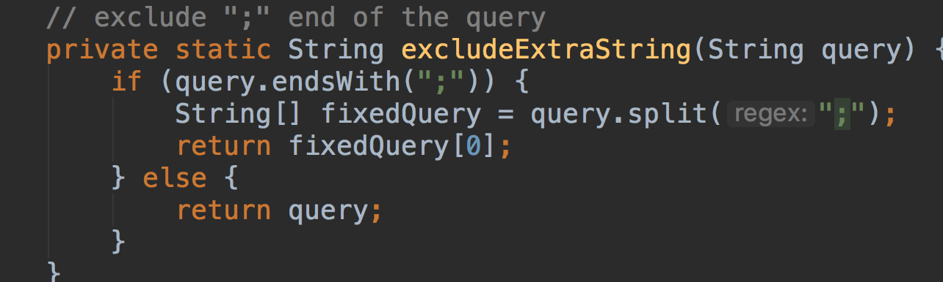
Communication Java and Oracle database (Source Code)

Slide 11
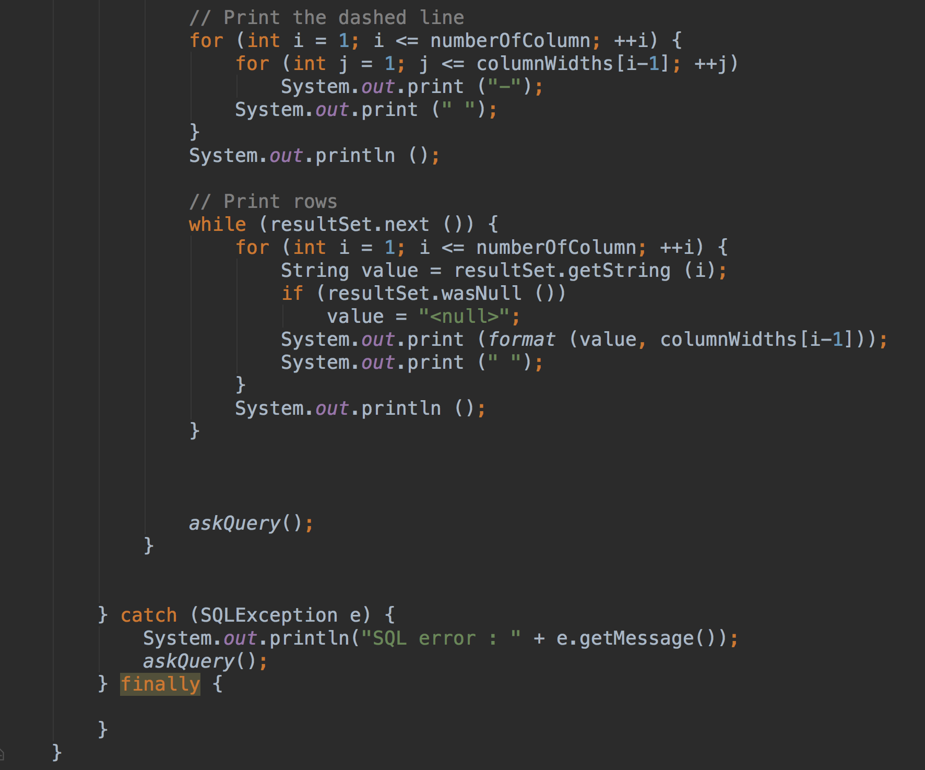
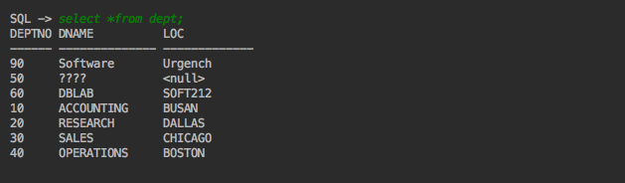
Communication Java and Oracle database (Source Code)

Slide 12
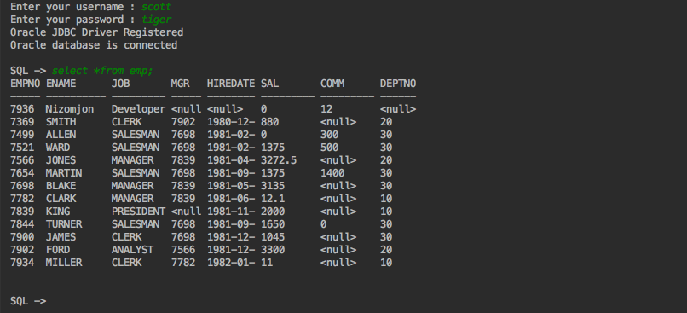
Communication Java and Oracle database(SELECT)
SQL -> select *from emp;

Slide 13
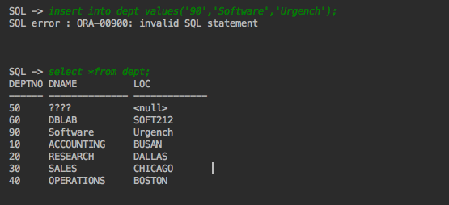
Communication Java and Oracle database (INSERT)
SQL -> select *from dept;
SQL -> insert into dept values(‘90’,’Software’,’Urgench’)

Slide 14
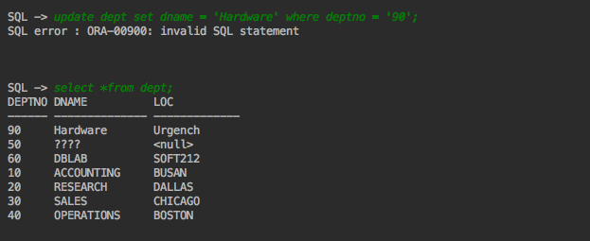
Communication Java and Oracle database (UPDATE)
SQL -> select *from dept;
SQL -> update dept set dname = ‘Hardware’ where deptno = ‘90’;

Slide 15
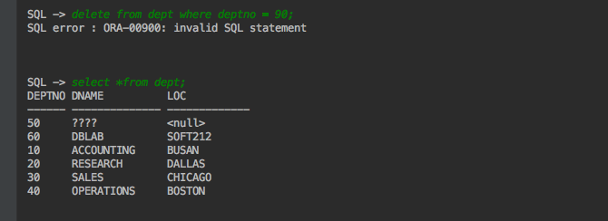
Communication Java and Oracle database (DELETE)
SQL -> select *from dept;
SQL -> delete from dept where deptno = 90;

Slide 16
Source code in https://gist.github.com/Nizomjon1994/cb2d65fa4dce8b0ca174026e3e429672

Slide 17
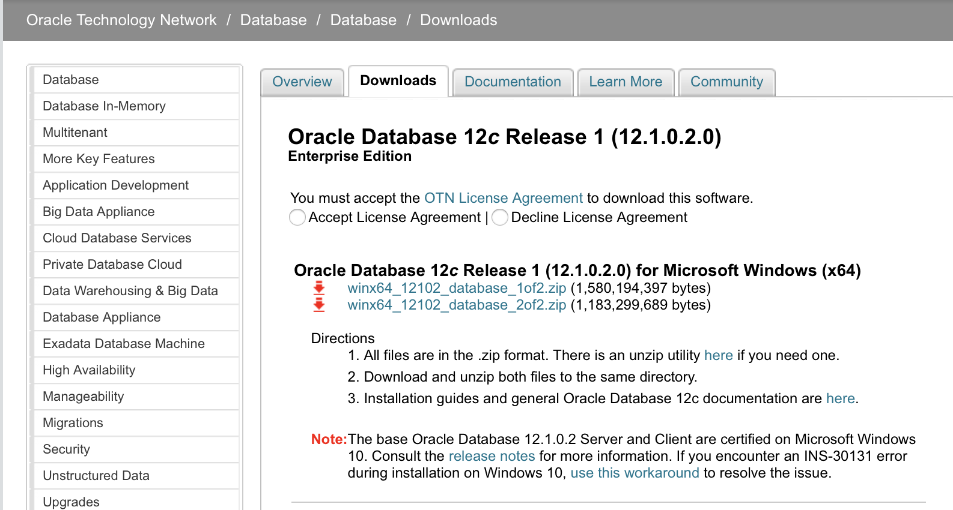

Instant client in Oracle
Download Oracle Database 12c
http://www.oracle.com/technetwork/database/enterprise-edition/downloads/database12c-win64-download-2297732.html
Oracle 12c installation guidelines.
http://www.oracle.com/webfolder/technetwork/tutorials/obe/db/12c/r1/Windows_DB_Install_OBE/Installing_Oracle_Db12c_Windows.html

Slide 18
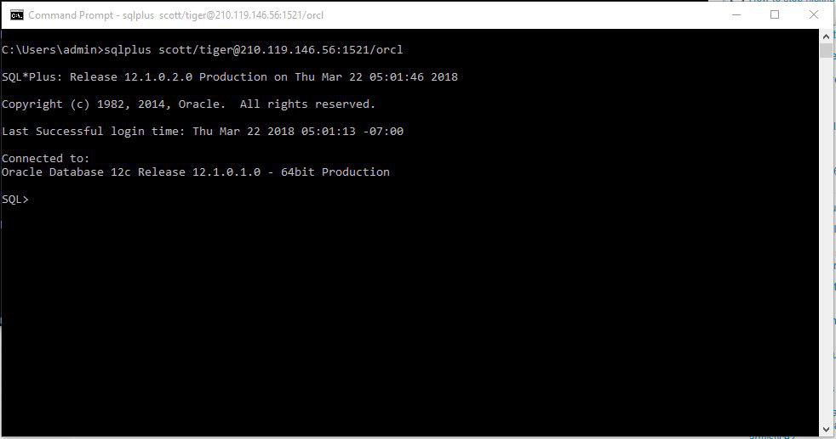
Instant client in Oracle
Remote connection with SQL*Plus
Open command line and write sqlplus username/password@hostname:port/service_name
host is the host name or IP address of the computer that is running Oracle Database XE
port (optional) is the TCP port number on which the Oracle Net listener is listening. If not specified, the default port number 1521 is assumed.
service_name is the name of the database service to which to connect.

Slide 19
Wait!!!
Writing always sqlplus scott/tiger@210.119.146.56:1521/orcl is boring.

Slide 20
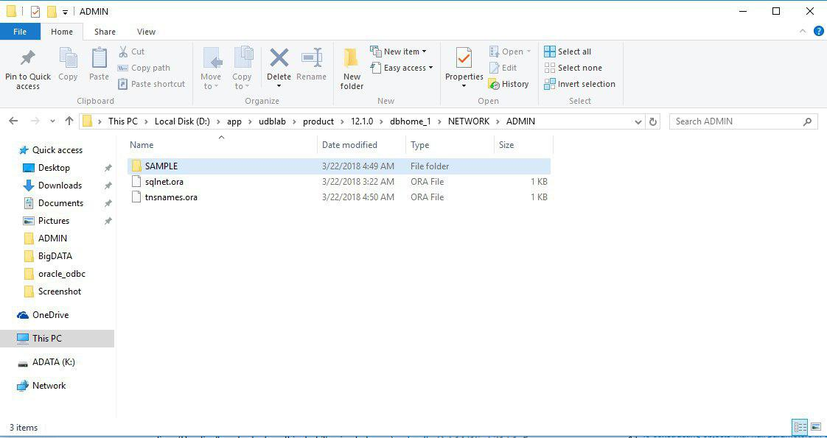
Instant client in Oracle
Setup TNSNAMES
The tnsnames.ora file is a configuration file that contains network service names mapped to connect descriptors for the local naming method, or net service names mapped to listener protocol addresses.
Need to create tnsnames.ora file /product/12.1.0/db_home1/network/admin/
Source : https://docs.oracle.com/database/121/NETRF/tnsnames.htm#NETRF259

Slide 21
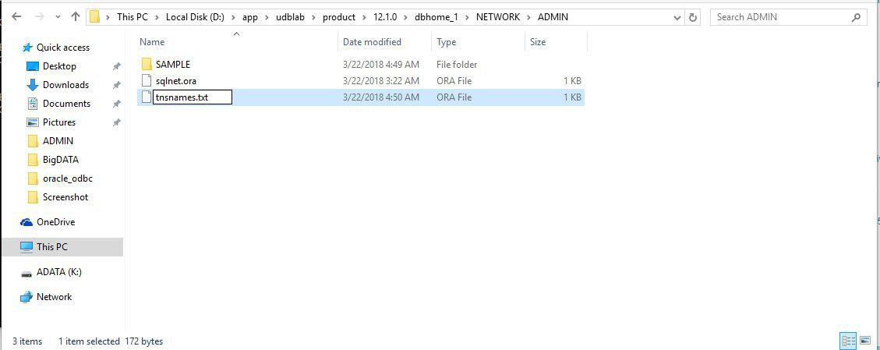
Instant client in Oracle
Setup TNSNAMES
Change tnsnames.ora file type to *.txt

Slide 22
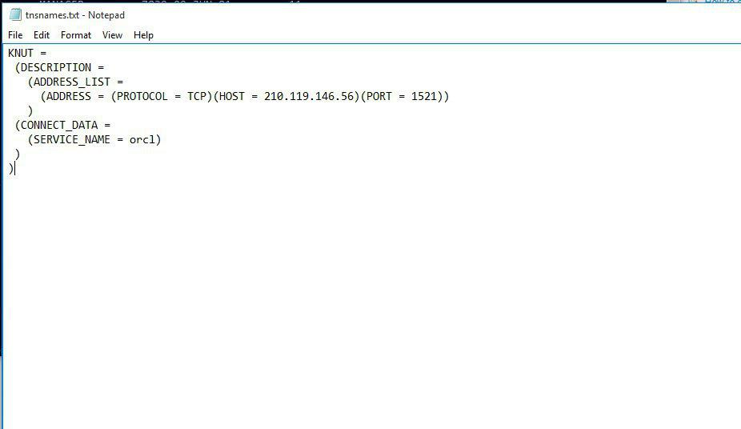
Instant client in Oracle
Setup TNSNAMES
Write write tnsnames configurations.
HOST - IP address
PORT - Port number
Save it and change tnsnames.txt to tnsnames.ora.
tnsnames.ora sample :
KNUT =
(DESCRIPTION =
(ADDRESS_LIST =
(ADDRESS = (PROTOCOL = TCP)(HOST = 210.119.146.56)(PORT =1521)) )
(CONNECT_DATA =
(SERVICE_NAME = orcl))
)

Slide 23
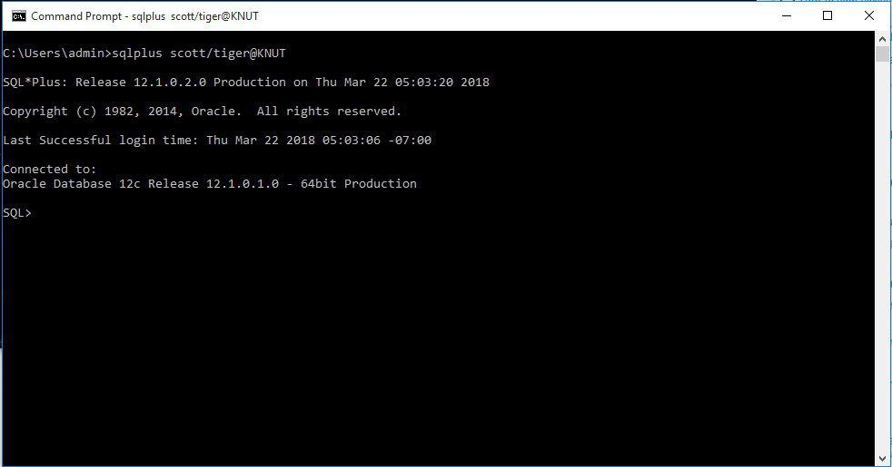
Instant client in Oracle
Open command line and write sqlplus username/password@tnsName

