Slide 1

Team 3 - Progress
20102128 Yu Jeong Hwang
22170111 Halim Youssef
18102089 Jeong Woog Lee

Slide 2
TABLE OF CONTENTS
01
02
03
Reminder
Dataset
Preprocessing
04
05
06
07
EDA
Multicollinearity
Linear Model
Github
Notes:
I feel like we should maybe change the name of part 3 and 4 but idk how :/

Slide 3

01
Reminder

Slide 4
Purpose of the Analysis
OVERALL GOAL
MAIN GOAL
Analyze the relationship between weather and renewable energy
Find an optimal policy to find the optimal real-time electricity pricing models based on weather-related energy generation and consumption data. (change)

Slide 5


Purpose of the Analysis
Constraint
Our energy distribution policy considers only electric power transmissions from REE national power plants to substations of each company.
Loss of power due to distance is not considered.

Slide 6
Purpose of the Analysis
Hypothesis
The price we predict could greatly enhance the profit of the entire region, rather than the price of electric energy under the TSO's current system.
Our end goal
Our end goal in this project is to promote the development of renewable energy in the local market, to increase the acceptability of local renewable energy by predicting the energy price in TSOs, and to respond to power peak times.

Slide 7
02
Dataset

Slide 8
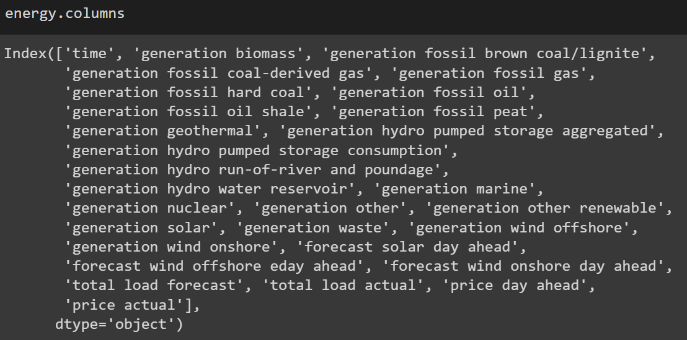
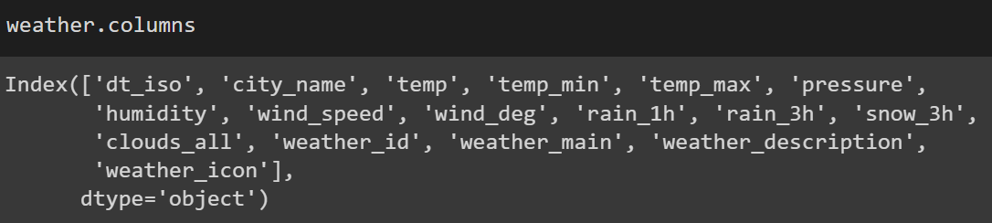
Dataset
Energy data
By the hour, not specific to one city
Generation energy features such as fossil, gas, solar, etc.
Some weather forecast features such as wind forecast a day ahead, solar forecast a day ahead, etc.
Weather data
By the hour
5 cities (Madrid, Bilbao, Seville, Barcelona, Valencia)
Weather features such as temperature, humidity, description etc.

Slide 9


Check ‘NAN’
Energy data
There are null values -> We need to address later
Weather data
There are no null values

Slide 10
03
Preprocessing

Slide 11
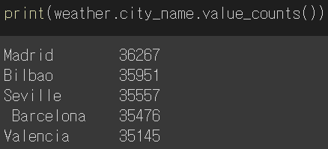
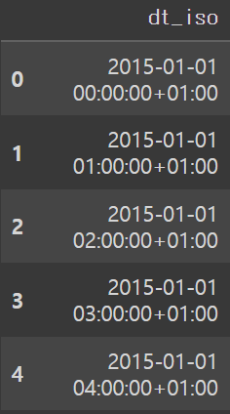
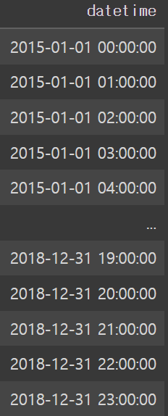
Preprocessing - Weather data
There are five cities of Spain in dataset -> My team chose Madrid (⸪ capital city in Spain)
Create ‘datetime’ column by deleting unnecessary part of the ‘dt_iso’ column

Slide 12
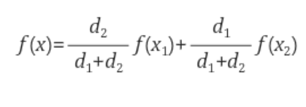
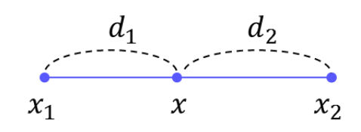
Preprocessing - Energy data
Change null values of energy data by using linear interpolation method
Q. What is the interpolation method?
Interpolation is a method of constructing new data points based on the range of a discrete set of known data points.
Q. What is the linear interpolation method?
If two points have values{f(x1), f(x2)}, data result has f(x).

Slide 13
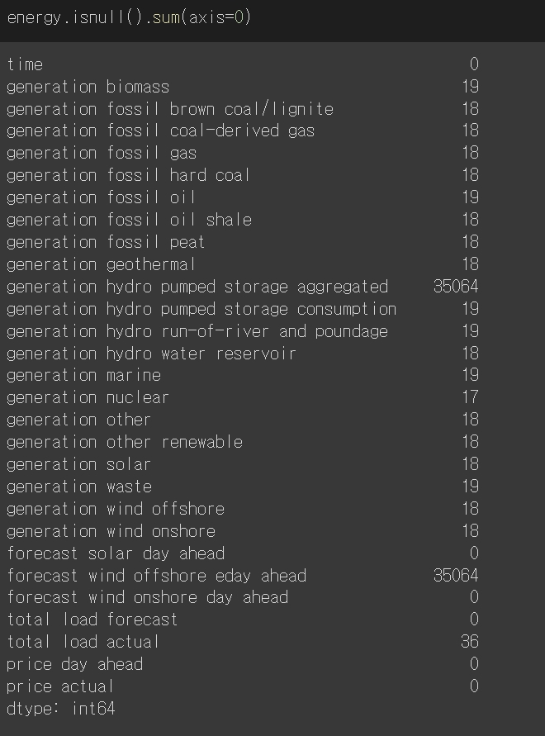
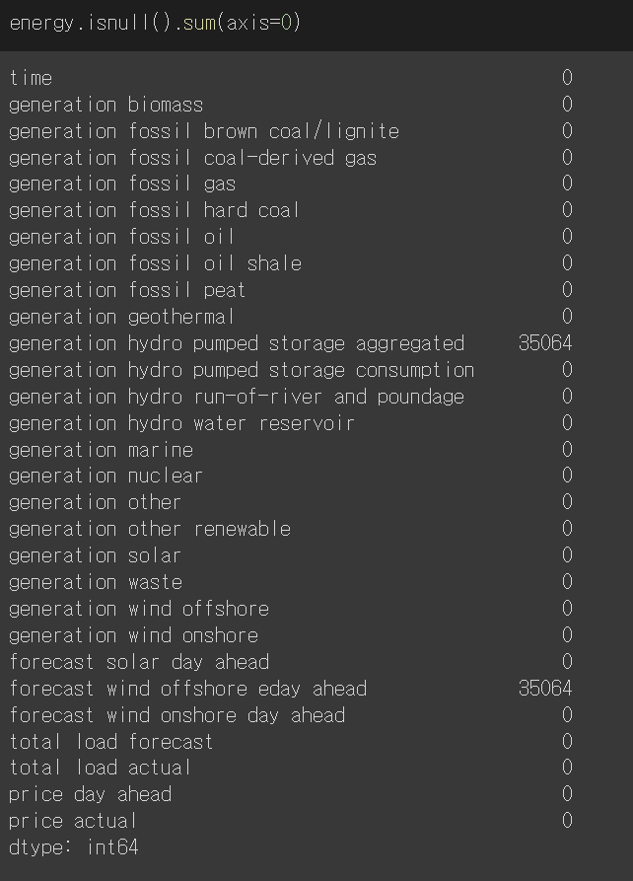
Preprocessing - Energy data
Change null values of energy data by using linear interpolation method - continue

Slide 14

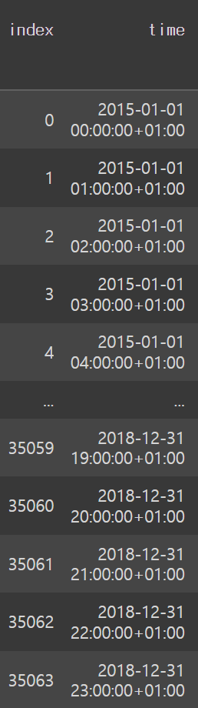
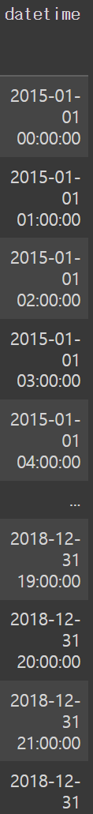
Preprocessing - Energy data
Create ‘datetime’ column by deleting unnecessary part of the ‘time’ column (similar with weather data)

Slide 15
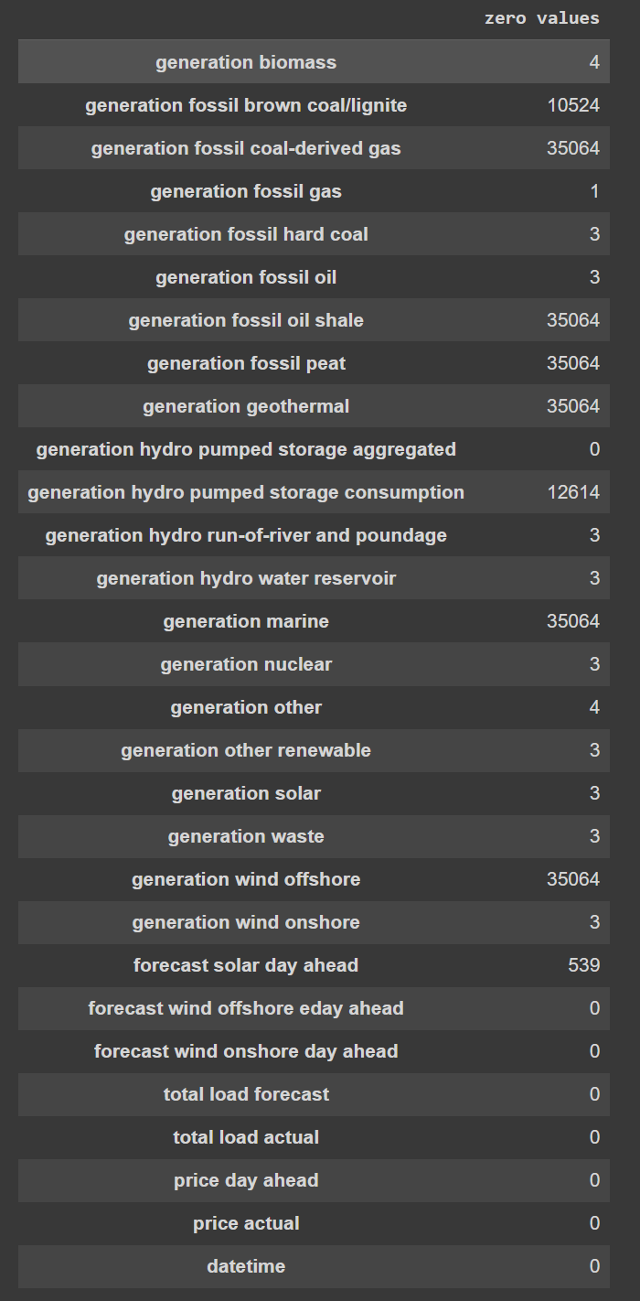
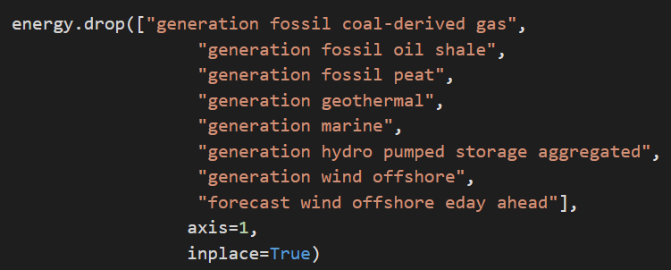
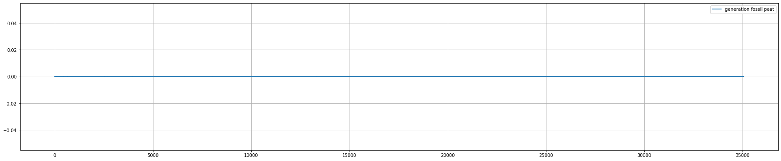
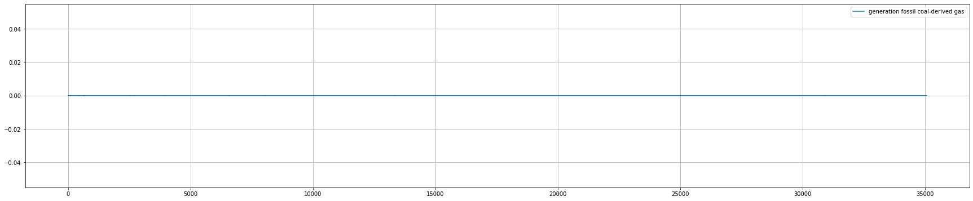
Preprocessing - Adress‘NAN’
Addressing NaN values in energy set
Columns such as generation fossil peat or generation fossil coal-derived gas that only has NaN values are dropped

Slide 16
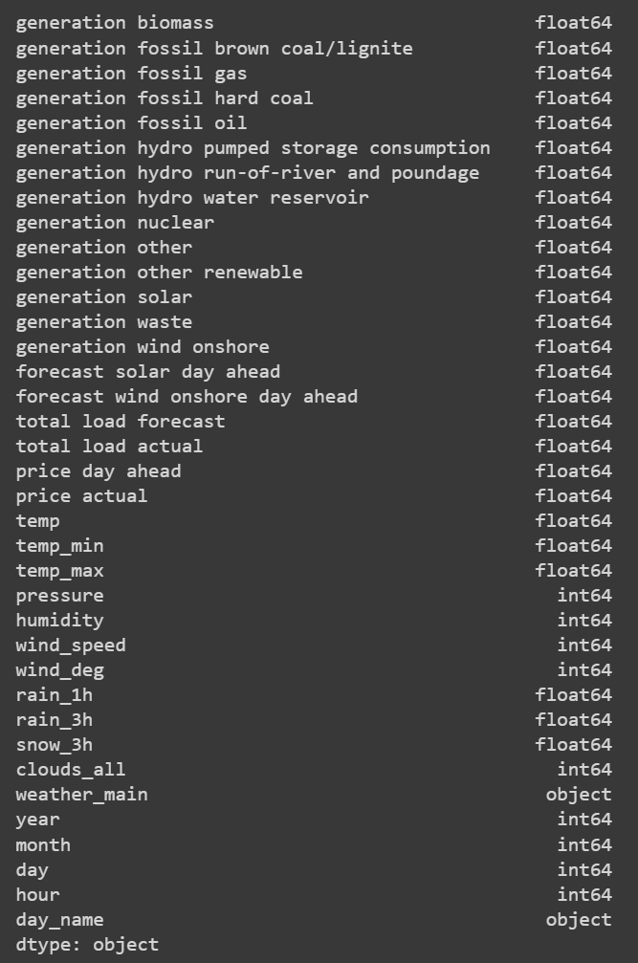
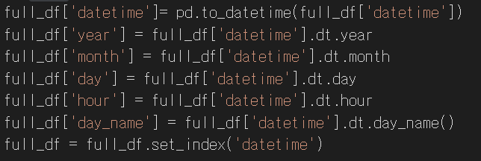
Preprocessing - Merge the datasets
Merge dataset and create year, month, day, hour and day_time column

Slide 17
04
Exploratory Data Analysis (EDA)

Slide 18
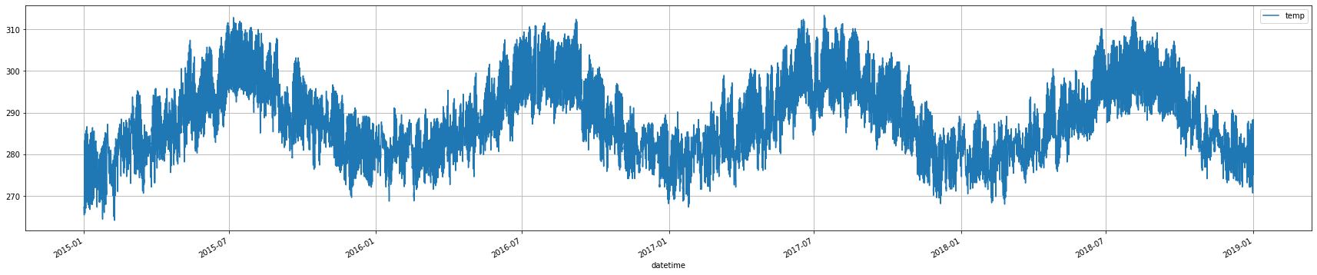
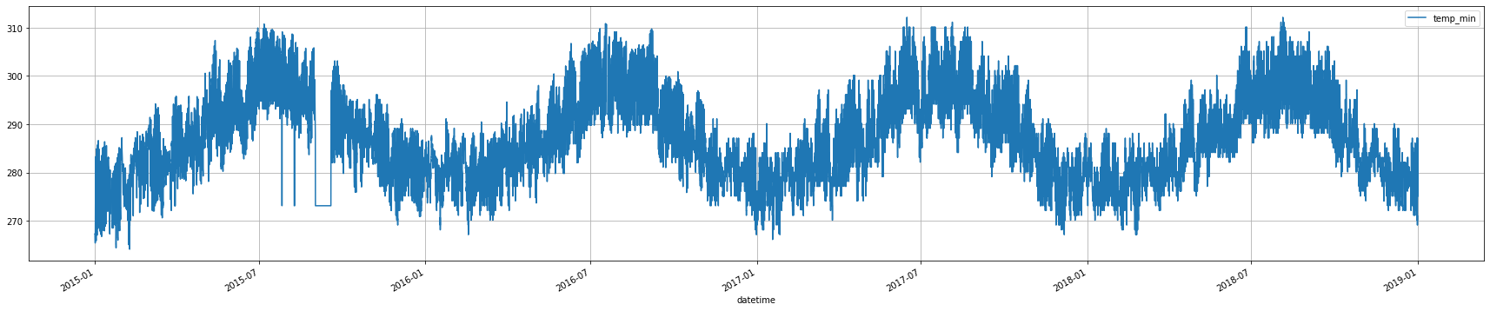
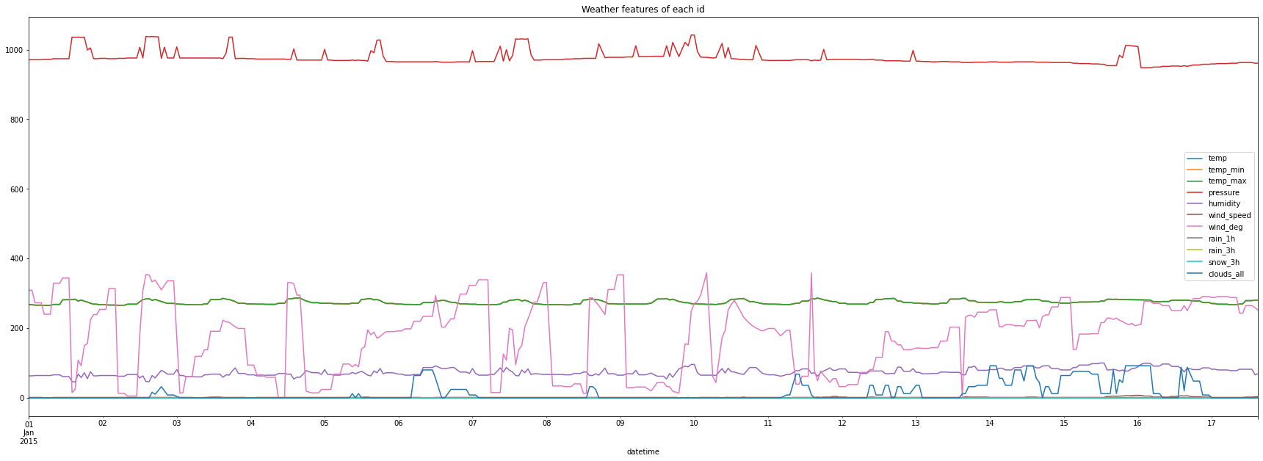
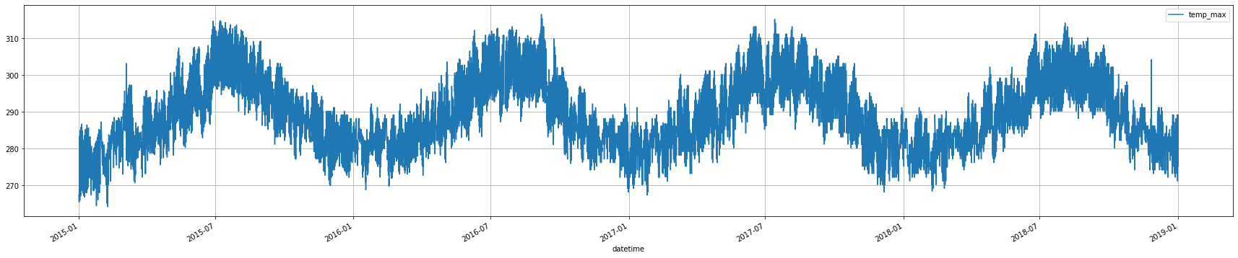
Observation - Weather data
Weather data
We have fewer columns than energy data
Some columns such as snow_3h are close to 0 as it rarely snows in Madrid.
Temp, temp_min, temp_max are very similar

Slide 19
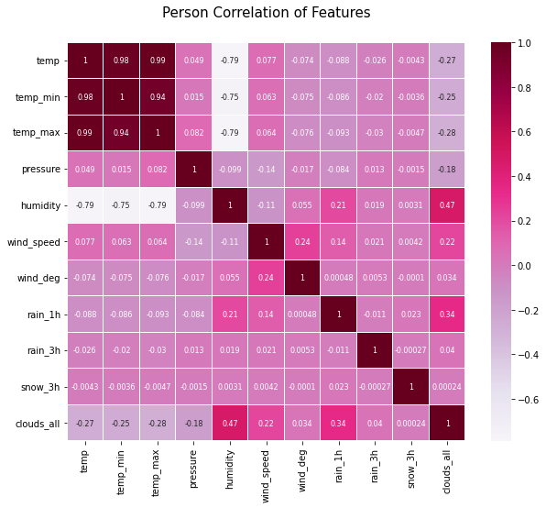
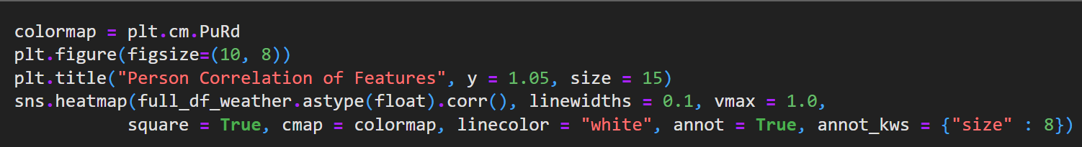
Correlation - Weather data
Temp, temp_min and temp_max have high correlation values so we should either merge them together or drop the min and max
Only humidity has a big negative value

Slide 20
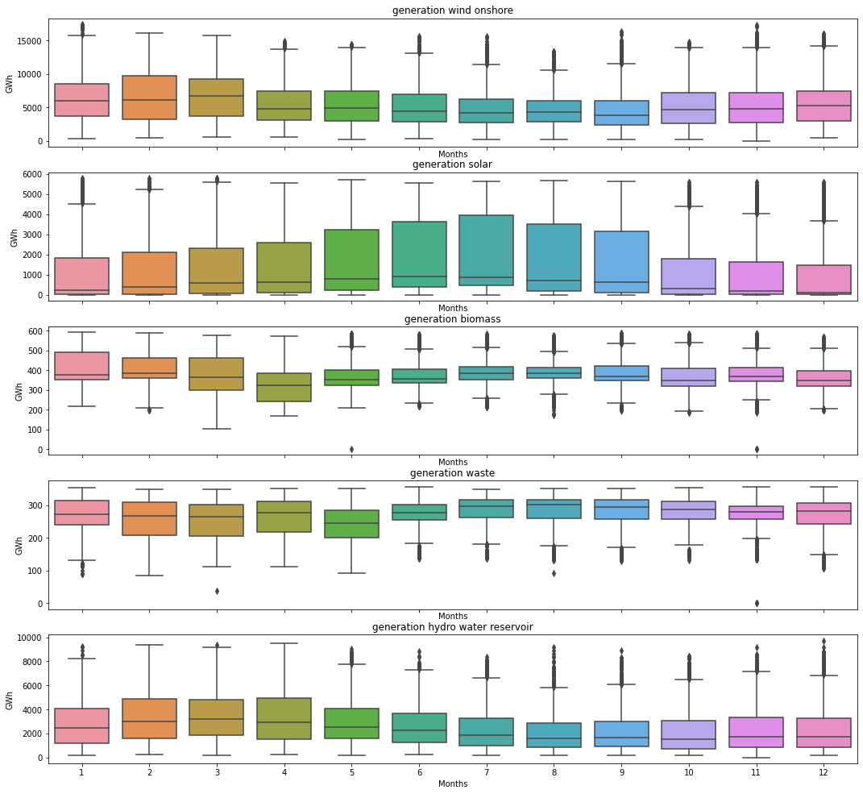
Observation - Energy data
Energy data
Generation solar is high during summer and low during winter
Generation wind shows less seasonal variation, with high generation around March to April
Generation biomass is pretty much constant over the year
Generation waste and generation hydro water reservoir have opposite tendencies

Slide 21
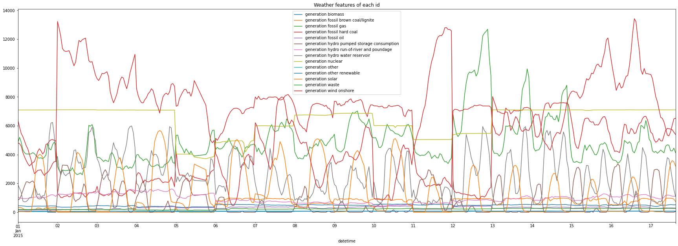
Observation - Energy data
We have A LOT of different features.
Some however seems to always be very very small, even close 0.
These two issues needs to be deal with !

Slide 22
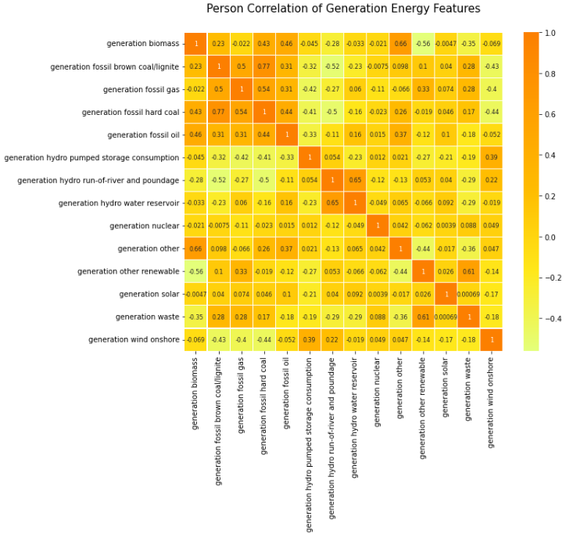
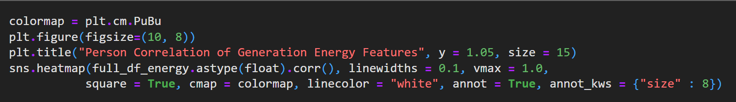
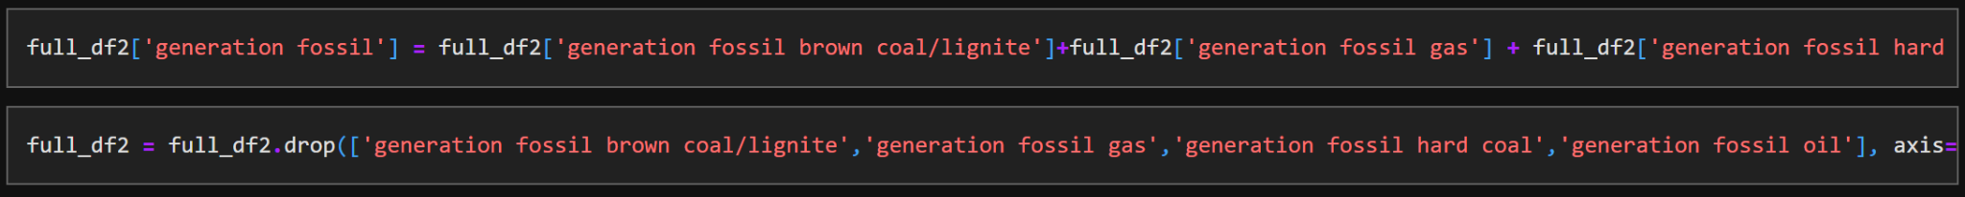
Correlation - Energy data
As Generation fossil hard coal, fossil oil and fossil brown coal/lignite have high correlation values we can calculate their mean and create a single feature.
We will drop them for our model training

Slide 23
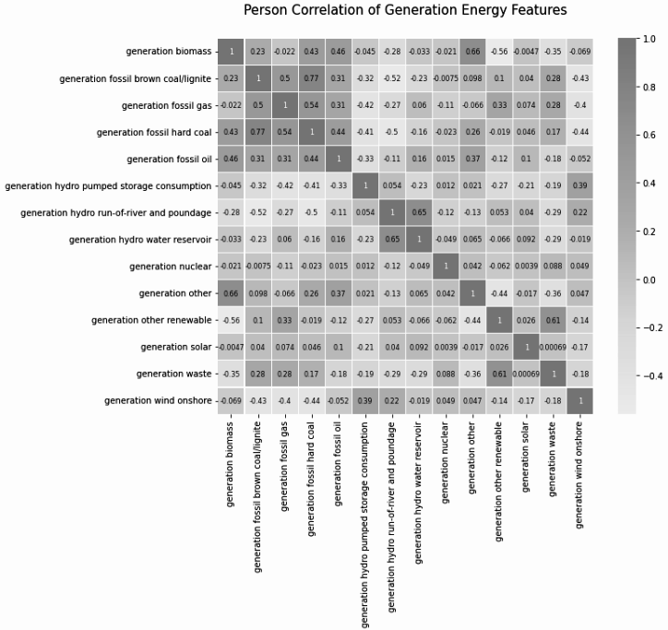
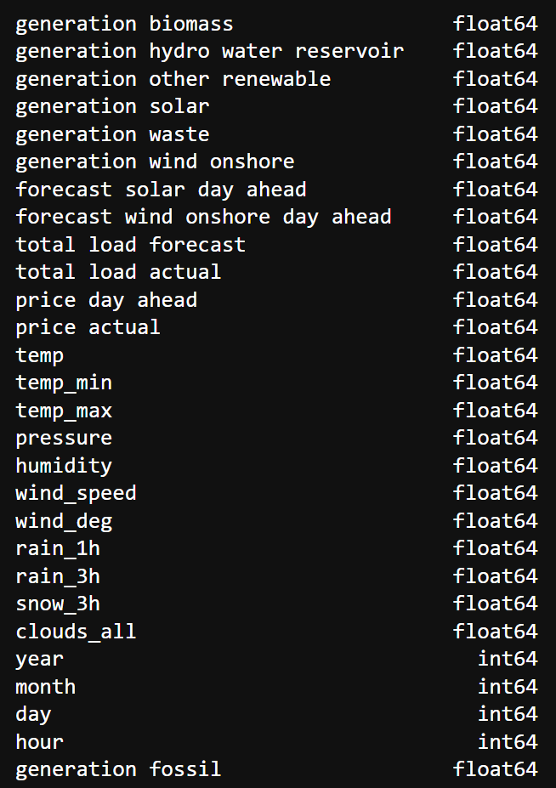
Correlation - Energy data
Features with negative correlation such as generation hydro hydro pumped storage consumption are removed as not useful for our model
Non renewable energy such as generation nuclear are also removed
We now have only renewable energy and one fossil energy that we keep as it is still the main energy used nowadays

Slide 24
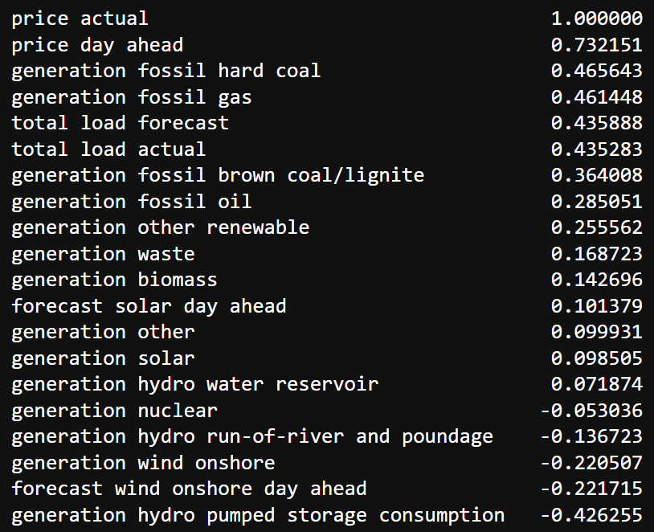
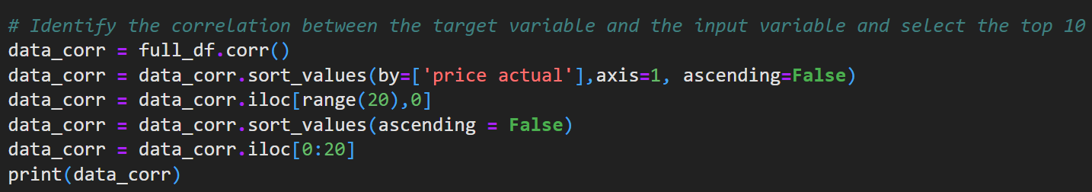
Correlation - Energy type and price
In the top 10 of of features correlated to the actual price, there is a lot of fossil energy. This means actual price is mainly decided by non renewable energy for now.
We also have features that are negative !

Slide 25
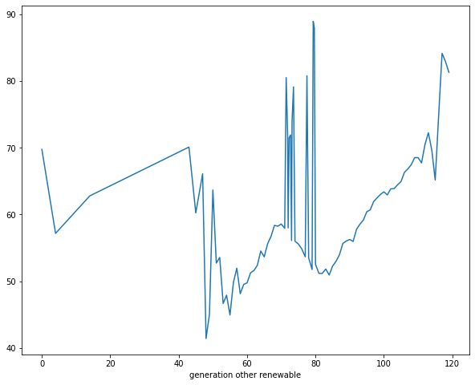
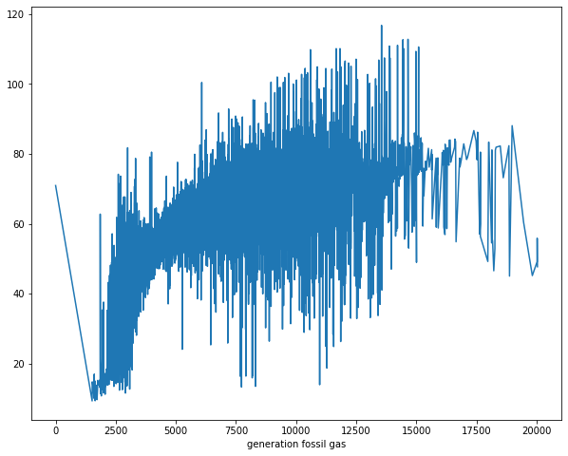
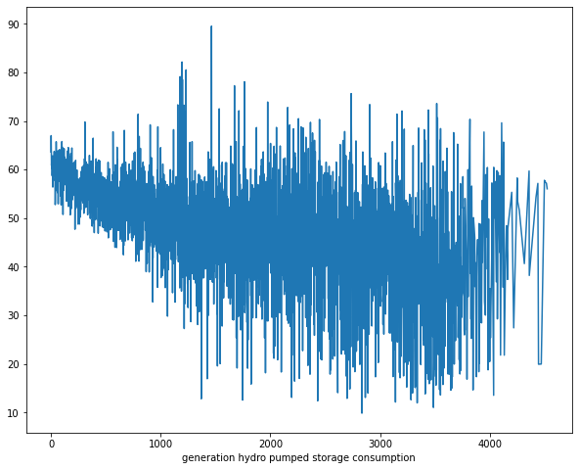
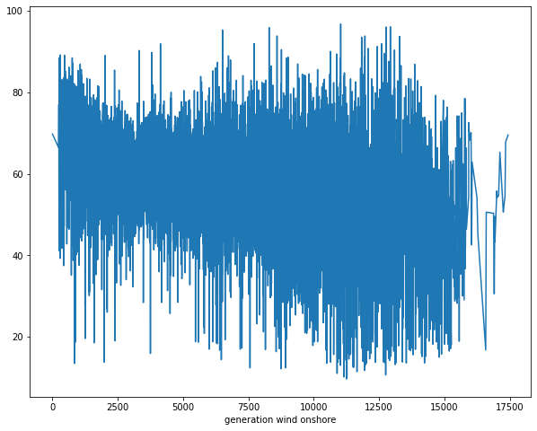
Correlation - Energy type and price
Positive correlation energy types
(generation other renewable & fossil gas)
Negative correlation energy types
(generation hydro pumped storage consumption & wind onshore)

Slide 26
05
Multicollinearity

Slide 27
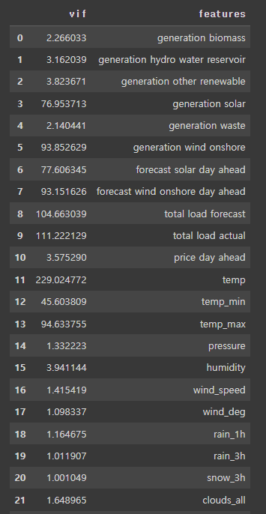
VIF (Variance Inflation Factors)
For selecting final input variables, we consider the multicollinearity..
‘'total load forecast', 'total load actual', 'temp' -> draw scatter plot to determine if it is helpful information by looking correlation between price and each feature..
‘Forecast solar day ahead’, ‘forecast wind onshore day ahead’. -> not useful information to predict the price., we will NOT exclude them.
‘generation solar’, ‘generation wind onshore’ -> important factor, so we will exclude them.

Slide 28
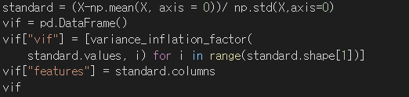
VIF (Variance Inflation Factors)
For selecting final input variables, we consider the multicollinearity..
‘'total load forcast', 'total load actual', 'temp' -> draw scatter plot to determine if it is helpful information by looking correlation between price and each feature..
‘Forecast solar day ahead’, ‘forecast wind onshore day ahead’. -> not useful information to predict the price., we will exclude them.
‘generation solar’, ‘generation wind onshore’ -> important factor, so we will not exclude them.

Slide 29

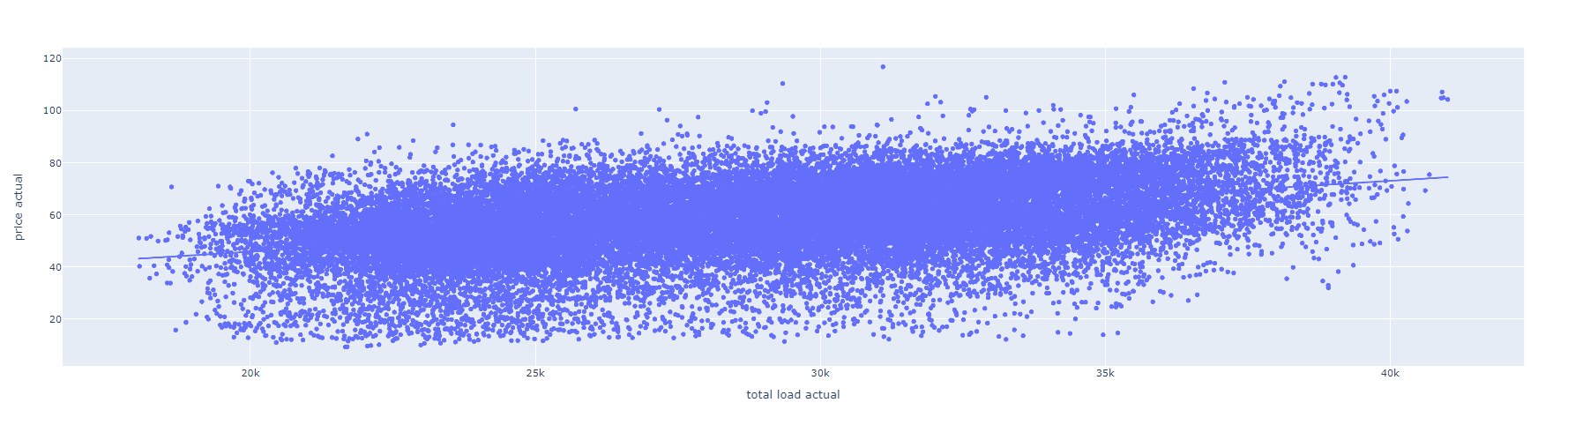
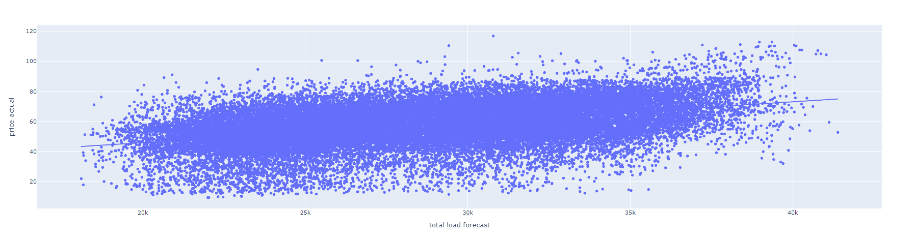
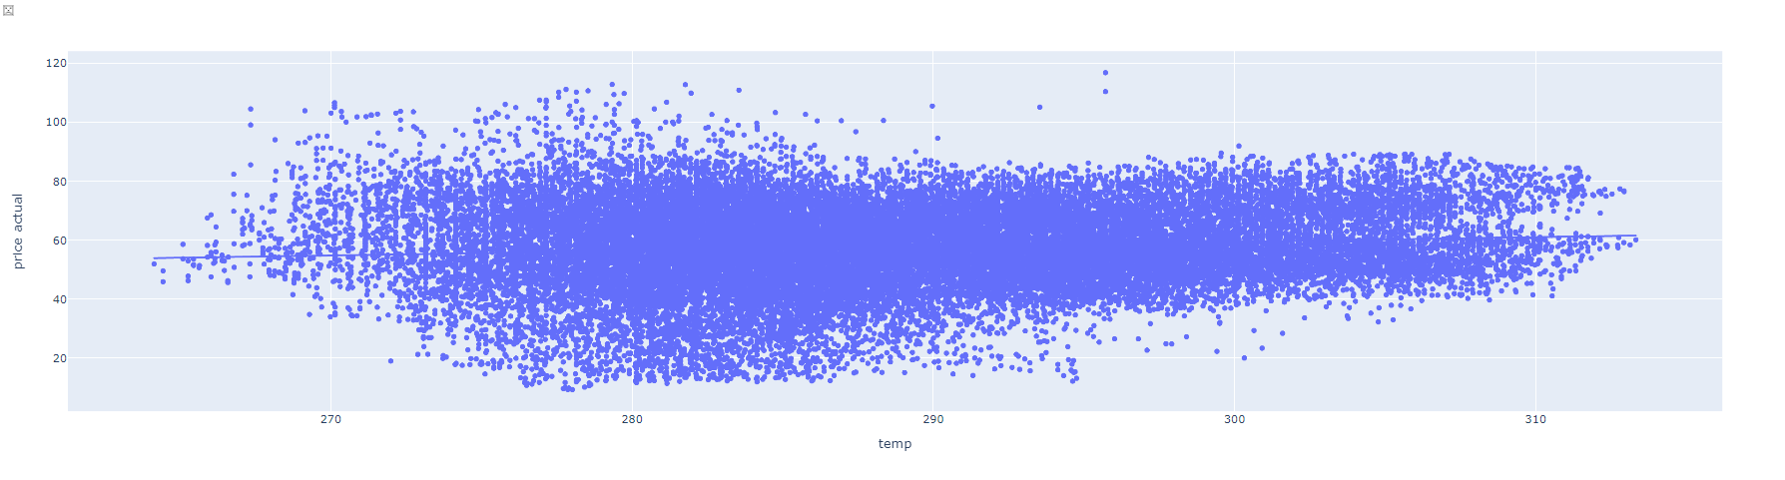
Scatter plot
<- We add Ordinary Least Squares regression trendline to scatterplots.
x= ‘total load actual’, y = ‘price actual’
x= ‘total load forecast’, y = ‘price actual’
x= ‘temp’, y = ‘price actual’

Slide 30
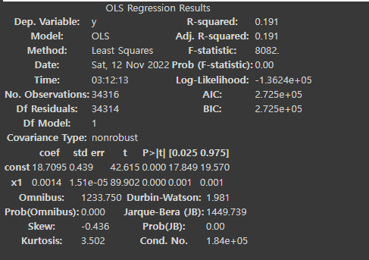

Scatter plot
Therefore, we will remove the 'total load actual', 'total load forecast' and for ‘temp’, we decided to drop 'temp min' and ‘temp max since it has similar value with ‘temp’.

Slide 31
06
Linear Model
To configure relationship of each renewable energy generation and weather features.

Slide 32
Linear Model
Train linear model to know relationship of weather state and energy production
Input: weather state
Output: production by energy types
generation biomass
generation hydro water reservoir
generation other renewable
generation solar
generation waste
generation wind onshore
Training models: Linear regression, Ridge, Lasso

Slide 33
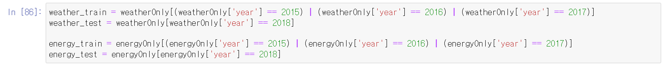
Linear Model
Before training
Data split by year
Use K Fold for cross-validation

Slide 34
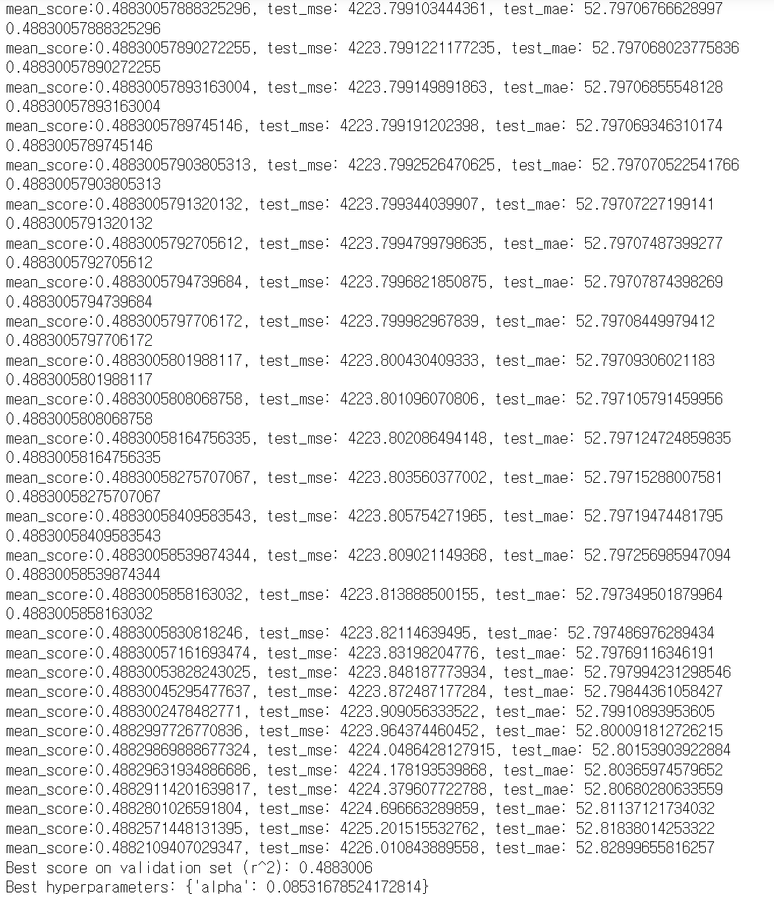
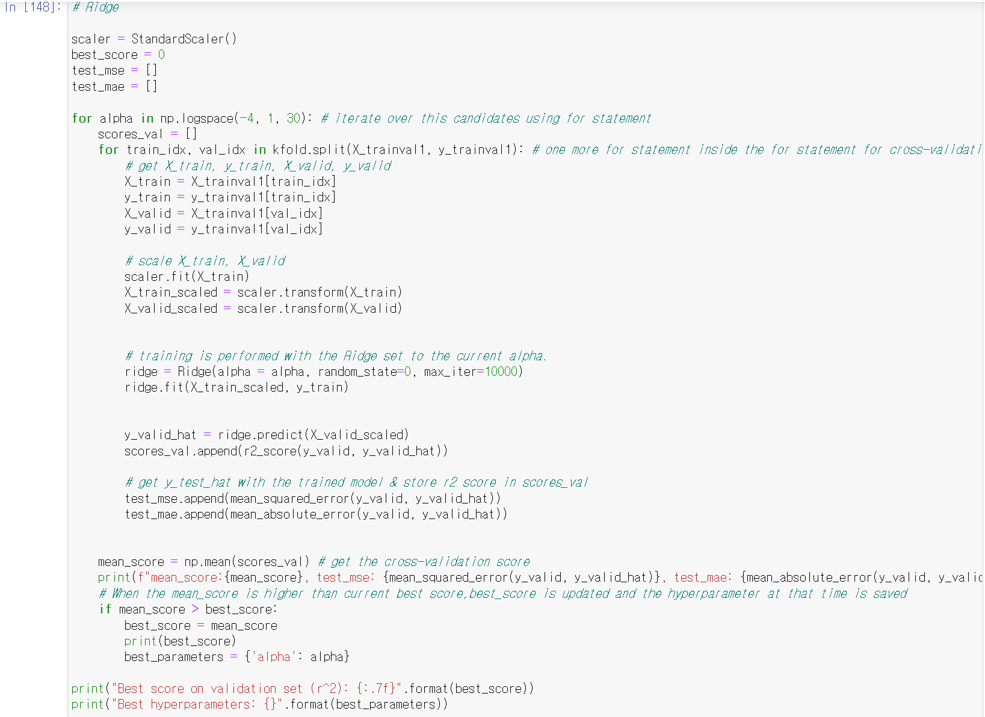
Linear Model
Train model (ex. Generation biomass - Ridge)

Slide 35
Linear Model
Train model (summary - best score)
 | Linear | Ridge | Lasso
biomass | 0.4883006 | 0.4883006 | 0.4883006
hydro water reservoir | 0.0835230 | 0.0835231 | 0.0835231
other renewable | 0.6131350 | 0.6131372 | 0.6131352
solar | 0.1899786 | 0.1899790 | 0.1899786
waste | 0.3806739 | 0.3806741 | 0.3806739
wind onshore | 0.3806739 | 0.1061007 | 0.1060960
=> Best scores are low except other renewable therefore my team needs to more perform feature engineering of weather

Slide 36
Limitation
It would be better to perform feature engineering in weather features.
We will create column in dataframe that inputs the season based on the conditions created above.

Slide 37
07
Github

Slide 38

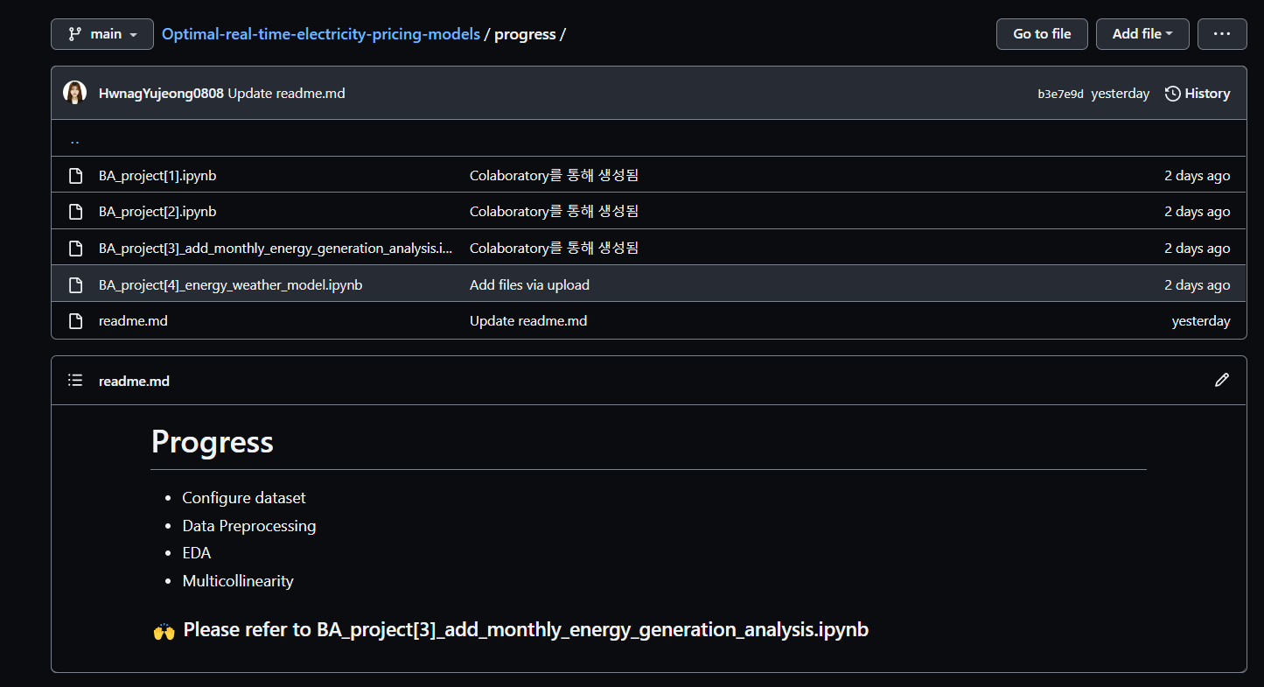
Github
Link: https://github.com/HwnagYujeong0808/Optimal-real-time-electricity-pricing-models
Our code: progress > BA_project[3]_add_monthly_energy_generation_analysis.ipynb

Slide 39
Thank You!

