Slide 1

POSTS AND TELECOMMUNICATIONS INSTITUTE OF TECHNOLOGY
Chapter 2
IoT System Architecture and Components
TS. Lê Văn Vịnh
vinhlv@ptit.edu.vn
1

Slide 2
Chapter 2 Learning Outcomes
What students should be able to do after this chapter
• Explain why IoT systems require layered and distributed architectures.
• Compare three-layer, four-layer, five-layer, and seven-layer IoT models.
• Trace information flows from devices to analytical applications and back to actuators.
• Distinguish device, gateway, edge, fog, data-center, and cloud responsibilities.
• Describe a typical IoT node architecture and its energy constraints.
• Explain the IoT data lifecycle from acquisition to analytics, retention, and deletion.
2

Slide 3
Teaching Roadmap for 3 Hours
Structure of the session
• Part 1: Common IoT architecture models.
• Part 2: Information flow from devices to applications.
• Part 3: Fog, edge, and cloud processing models.
• Part 4: Typical IoT node architecture.
• Part 5: Gateway, backhaul, data center, and cloud server roles.
• Part 6: Energy sources and power-saving modes.
• Part 7: IoT data lifecycle and design activity.
3

Slide 4
Opening Scenario: Smart Campus Air Quality
Use this scenario throughout the chapter
• Sensors measure air quality in classrooms, corridors, and outdoor spaces.
• Measurements are transmitted periodically and when thresholds are exceeded.
• Dangerous pollution levels require immediate alerts and local response.
• Historical data must support reporting and long-term campus planning.
• Battery-powered devices should operate for months with limited maintenance.
• Architecture question: what should happen on the device, at the gateway, at the edge, and in the cloud?
4

Slide 5
Why Architecture Matters in IoT
Architecture is the allocation of responsibilities across system components
• IoT architecture determines where sensing, communication, processing, storage, analytics, and control occur.
• A poor architecture can increase latency, waste bandwidth, drain batteries, and create security weaknesses.
• A good architecture balances local autonomy with centralized management and large-scale analytics.
• The same application can have different architectures depending on latency, energy, cost, privacy, and reliability constraints.
• For Information Technology students, architecture is the bridge between devices and information systems.
5

Slide 6
2.1
Common IoT Architecture Models
• Understand layered IoT thinking.
• Compare simple and detailed reference architectures.
• Select a model based on analysis purpose.
6

Slide 7
2.1.1 Architecture as Layered Abstraction
Why do we use architecture models?
• A layered model decomposes a complex IoT problem into understandable parts.
• Each layer has a defined responsibility and interacts with adjacent layers through interfaces.
• Layering supports interoperability because different vendors can provide different components.
• Layering also supports security design by identifying trust boundaries between components.
• Layer names vary across sources, but the design questions are similar: where are data generated, transmitted, processed, stored, and used?
7

Slide 8
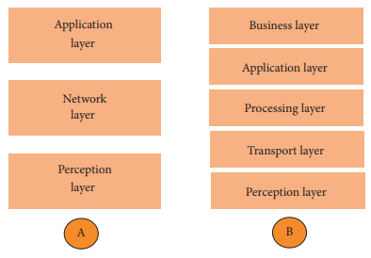
2.1.2 The Simplest View: Three-Layer Architecture
Perception, network, and application layers
• Perception layer: sensors, actuators, RFID tags, and physical devices that observe or influence the environment.
• Network layer: communication and routing between devices, gateways, networks, and processing systems.
• Application layer: domain-specific services such as smart home, healthcare, transportation, and industrial monitoring.
• Strength: simple and easy to introduce.
• Limitation: hides data management, edge processing, security management, and business-process integration.
8

Slide 9
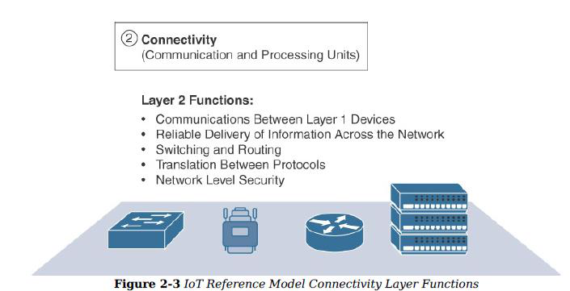
2.1.4 Interpreting the Network Layer
Transporting data and commands
• The network layer moves data from devices toward processing services and moves commands in the reverse direction.
• It covers device-to-gateway, gateway-to-network, and backhaul connectivity.
• Typical technologies include Wi-Fi, Bluetooth, Zigbee, LoRaWAN, NB-IoT, LTE-M, 4G/5G, Ethernet, RFID, and NFC.
• The layer must address reliability, routing, protocol translation, latency, congestion, and secure transmission.
• In IoT, networking is often constrained by limited power, unreliable wireless channels, and mobile or remote deployment environments.
Figure source: IoT & Applications Digital Notes, p. 16. Connectivity layer functions.
9

Slide 10
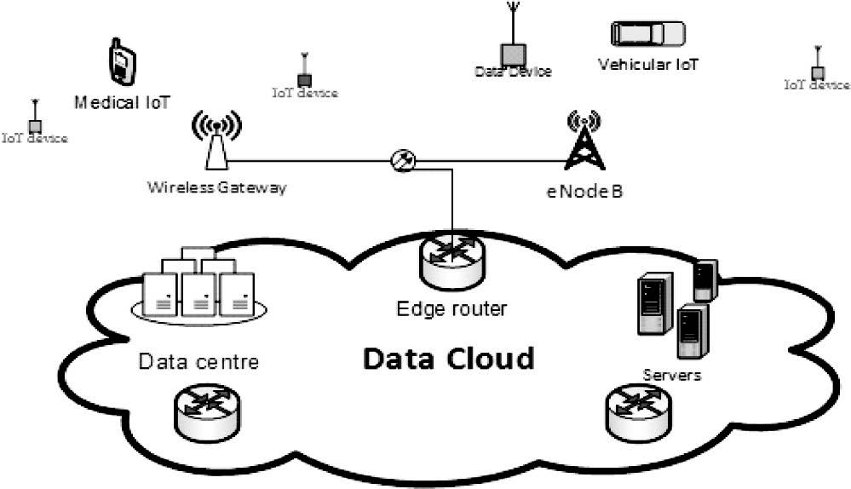
2.1.6 Four-Layer Architecture
Adding gateway and management/service responsibilities
• A four-layer model often separates device sensing, gateway networking, service management, and application services.
• Sensor and connectivity layer: gathers physical-world data and transfers events securely.
• Gateway and network layer: connects device networks with higher-level platforms.
• Management/service layer: abstracts hardware differences and supports data analysis, device management, and service logic.
• Application layer: presents domain-specific services to users and organizations.
Figure source: Khan and Yuce, Internet of Things: Systems and Applications, Fig. 1.5.
10

Slide 11
2.1.7 Five-Layer Architecture
Adding processing and business layers
• Perception layer: devices, sensors, actuators, and physical objects.
• Transport layer: transfers data from perception to processing and commands in the reverse direction.
• Processing layer: stores, filters, aggregates, analyzes, and prepares data for applications.
• Application layer: provides services for specific domains.
• Business layer: connects the IoT system to governance, privacy, strategy, cost, and organizational value.
Figure source: IoT & Applications Digital Notes, p. 22. Layered architecture models.
11

Slide 12
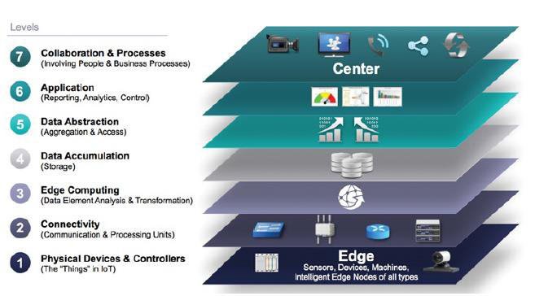
2.1.8 IoTWF Seven-Layer Reference Model
A detailed model from edge to business processes
• Physical devices and controllers generate data and perform actions.
• Connectivity transfers events and commands through networks.
• Edge computing performs early filtering, transformation, and local analysis.
• Data accumulation converts data in motion into data at rest.
• Data abstraction integrates and exposes data to applications.
• Applications, collaboration, and business processes transform data into organizational value.
Figure source: IoT & Applications Digital Notes, p. 15. IoTWF Reference Model.
12

Slide 13
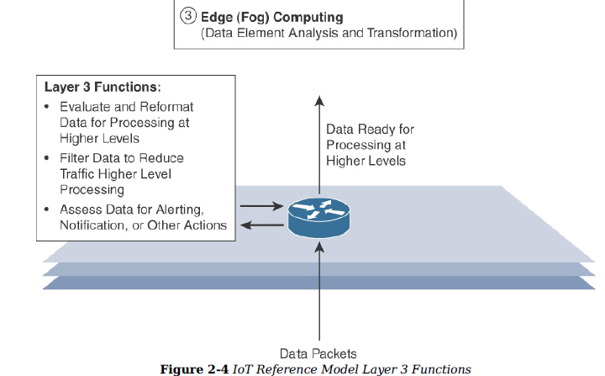
2.1.9 Why Use a Seven-Layer View?
Detailed analysis for real deployments
• The seven-layer view makes it easier to locate design responsibilities.
• It separates real-time processing from storage-oriented processing.
• It clarifies where data is filtered, accumulated, abstracted, analyzed, and used.
• It supports interface definition, vendor separation, and layered security control.
• It is especially useful for enterprise IoT systems that involve multiple sites, users, applications, and business processes.
Figure source: IoT & Applications Digital Notes, p. 17. Edge computing layer functions.
13

Slide 14
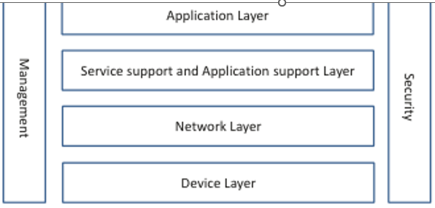
2.1.10 ITU Reference Model
Another architecture perspective
• Some IoT reference models emphasize communication and service-support functions.
• The ITU view uses device, network, service-support, and application layers, with management and security across all layers.
• This model highlights that management and security are not separate afterthoughts.
• They are cross-cutting concerns that must be embedded into device, network, service, and application design.
• Students should learn to compare reference models rather than memorize only one model.
Figure source: Serpanos and Wolf, Internet-of-Things Systems, Fig. 5.3, p. 44.
14

Slide 15
2.1.12 Choosing the Right Architecture Model
Architecture model depends on the teaching or design purpose
• Use three layers when introducing IoT fundamentals.
• Use four layers when emphasizing gateways and service management.
• Use five layers when connecting technical functions to business and governance concerns.
• Use seven layers when analyzing data pipelines, edge computing, data accumulation, abstraction, and enterprise processes.
• The best model is the one that helps stakeholders understand responsibilities, interfaces, constraints, and risks.
15

Slide 16
2.2
Information Flow from Devices to Analytical Applications
• Trace upstream data flows.
• Trace downstream control flows.
• Understand metadata, events, and data quality.
16

Slide 17
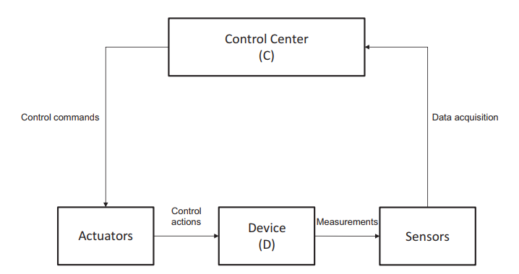
2.2.1 End-to-End Information Flow
From physical phenomenon to digital action
• An IoT system begins with a physical state, such as temperature, vibration, position, light, pressure, or movement.
• A sensor observes that state and produces a signal or measurement.
• The measurement is converted, processed, transmitted, stored, analyzed, and finally used by an application.
• The application may only inform a user, or it may trigger an actuator that changes the physical environment.
• This is why IoT systems are cyber-physical information systems, not only data collection tools.
Figure source: Serpanos and Wolf, Internet-of-Things Systems, Fig. 6.1, p. 56.
17

Slide 18
2.2.2 Upstream Flow: From Environment to Application
Typical data path
• Physical phenomenon: the real-world condition to be observed.
• Sensing: physical input is converted into a measurable signal.
• Signal conditioning: noise removal, amplification, calibration, and range adjustment.
• Analog-to-digital conversion: analog signals become digital values.
• Local processing: validation, filtering, threshold detection, compression, and timestamping.
• Transmission: data moves to gateway, edge, fog, cloud, or data center.
• Analytics and application: data becomes insight, alert, report, or decision support.
18

Slide 19
2.2.3 Signal Path Inside an IoT Node
Before data reaches the network
• Sensors gather signals from the physical environment.
• Signal-conditioning circuits prepare sensor output for digital processing.
• Analog-to-digital conversion is necessary when sensor output is analog.
• The processor executes application logic and communication routines.
• Data may be stored locally or transmitted through the wireless interface.
• The same node may also receive commands and control an actuator.
19

Slide 20
2.2.4 Gateway and Edge Processing in the Flow
The first aggregation and decision point
• A gateway can aggregate data from many constrained devices.
• It can remove invalid data, compact measurements, and reduce redundant transmissions.
• It can translate between local device protocols and Internet protocols.
• It may locally decide on urgent actions when cloud communication is unavailable.
• It can also enforce security policies before data leaves the local network.
20

Slide 21
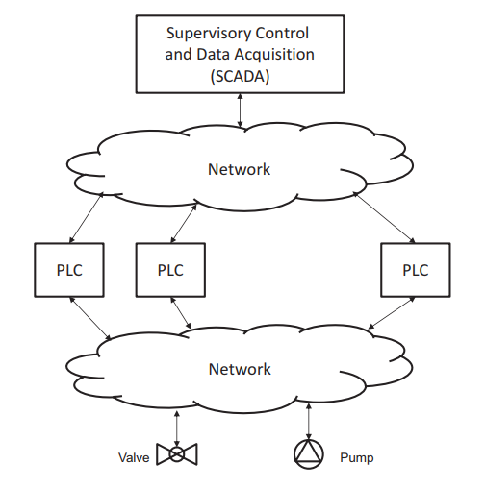
2.2.6 Downstream Flow: From Decision to Actuation
Commands travel back toward the physical world
• A user, dashboard, rule engine, or analytics model generates a command.
• The platform checks identity, authorization, and command validity.
• The command is transmitted through cloud, backhaul network, gateway, and local network.
• The IoT node receives the command, validates it, and executes local logic.
• The actuator changes the physical state, and sensors verify the outcome.
• Safety-critical commands should include safeguards, logging, and fallback behavior.
Figure source: Serpanos and Wolf, Internet-of-Things Systems, Fig. 6.2, p. 57.
21

Slide 22
2.2.7 Metadata and Context
A sensor value is not enough
• A useful IoT message should include more than the measurement value.
• Common metadata: device identifier, timestamp, sensor type, measurement unit, location, sequence number, and quality indicator.
• Context can include room, asset, patient, vehicle, production line, weather condition, or device configuration.
• Without metadata, the system may not know where the value came from, whether it is trustworthy, or what action it should trigger.
• Information Systems design must preserve context across the entire data pipeline.
22

Slide 23
2.2.8 Events and Time-Sensitive Flow
Not all IoT data is periodic
• IoT devices can generate events when thresholds are crossed or abnormal patterns are detected.
• Examples: smoke detected, battery low, heart rate abnormal, machine vibration high, door opened, pressure above limit.
• Each event should carry at least an event ID, device ID, timestamp, state, and severity.
• The event path must be faster and more reliable than ordinary background reporting when safety is involved.
• Architects must decide which events are handled locally and which events are sent to cloud services.
23

Slide 24
2.2.9 Data in Motion and Data at Rest
Two different processing needs
• Data in motion is moving through the system and is often processed by stream-processing or rule-engine components.
• Data at rest is stored in databases, data lakes, object storage, or warehouses for later analysis.
• Real-time monitoring depends on data in motion.
• Reporting, forecasting, auditing, and machine-learning training often depend on data at rest.
• A complete IoT architecture normally needs both fast event handling and long-term storage.
24

Slide 25
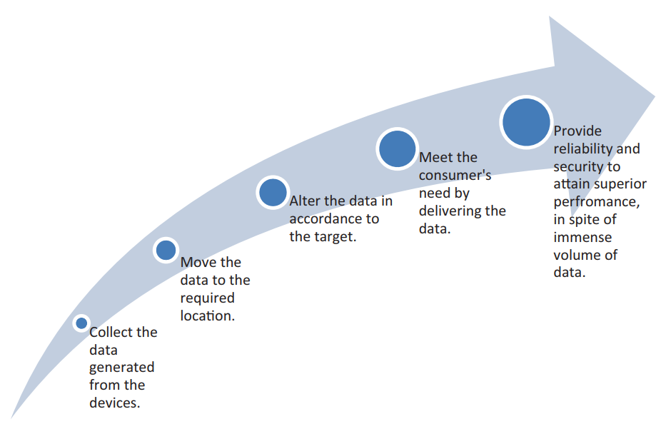
2.2.10 From Data to Decision and Action
IoT information flow must create value
• Raw data has limited value until it changes a decision or action.
• A complete flow may include collection, transmission, storage, analytics, visualization, recommendation, and control.
• For example, a vibration signal becomes an anomaly score, then a maintenance alert, then a work order.
• The value of architecture is measured by decision quality, response time, reliability, cost, and user trust.
• Students should always ask: who uses the information and what decision does it support?
Figure source: Alam, Shakil, and Khan, Internet of Things: Concepts and Applications, Fig. 1.6.
25

Slide 26
2.3
Fog, Edge, and Cloud in IoT Processing
• Distribute processing close to data sources when needed.
• Use cloud for scale, integration, and long-term analytics.
• Make placement decisions based on requirements.
26

Slide 27
2.3.1 Why Not Send Everything to the Cloud?
The cloud is powerful but not always sufficient
• Sending all raw data to the cloud may increase latency, cost, and bandwidth consumption.
• Cloud dependency can reduce system resilience when Internet connectivity is unavailable.
• Some privacy-sensitive data should not leave the local environment in raw form.
• Safety-critical actions may require response times that are faster than remote cloud processing can guarantee.
• Therefore, IoT systems often distribute computation across device, gateway, edge, fog, and cloud layers.
27

Slide 28
2.3.2 Edge Computing
Processing at or very close to the data source
• Edge computing performs computation near the device or directly on the device.
• Examples include microcontrollers, smart cameras, industrial controllers, vehicle computers, and local gateways.
• Typical edge tasks: filtering, threshold detection, compression, local safety response, simple inference, and actuator control.
• Advantages: low latency, reduced traffic, operation during cloud disconnection, and better privacy control.
• Limitations: limited computation, memory, energy, and manageability.
Figure source: IoT & Applications Digital Notes, p. 17. Edge computing layer functions.
28

Slide 29
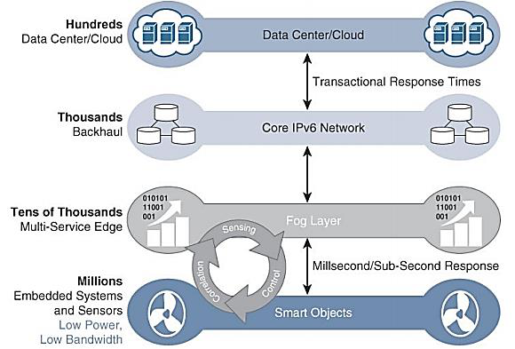
2.3.3 Fog Computing
Distributed processing between edge devices and cloud
• Fog computing places storage, computation, and control closer to end-user applications than centralized cloud servers.
• Fog nodes may include gateways, routers, switches, industrial controllers, embedded servers, and local micro-data centers.
• Fog computing is useful when applications require low latency, local context awareness, bandwidth reduction, and resilience.
• It can coordinate multiple local devices and perform regional analytics.
• It is not a replacement for cloud computing; it complements the cloud.
Figure source: IoT & Applications Digital Notes, p. 29. Fog computing architecture.
29

Slide 30
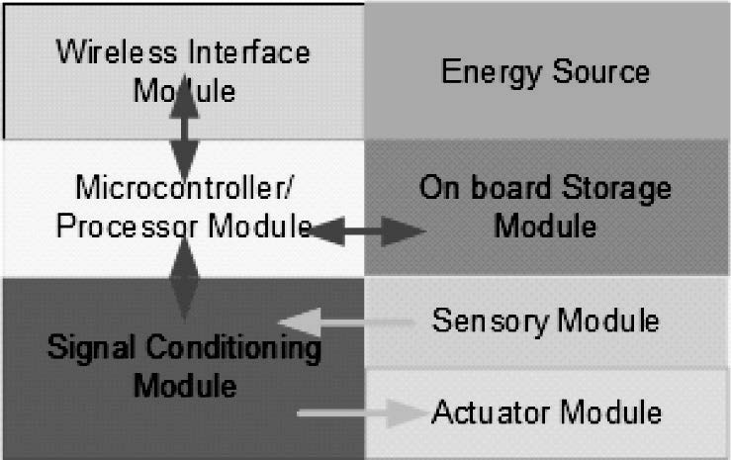
2.3.5 Cloud Computing
Centralized scale, storage, analytics, and integration
• Cloud platforms provide scalable storage and computation for large numbers of devices.
• They support cross-site analytics, machine-learning model training, dashboards, APIs, backup, and global device management.
• Cloud platforms simplify integration with enterprise systems and external applications.
• They are suitable for long-term storage, fleet-wide analytics, reporting, and lifecycle management.
• They are less suitable for ultra-low-latency safety-critical control loops.
Figure source: Khan and Yuce, Internet of Things: Systems and Applications, Fig. 1.4, p. 16.
30

Slide 31
2.3.6 Device-Centric, Gateway-Centric, Fog-Centric, Cloud-Centric
Where should computation be offloaded?
• Device-centric processing: immediate but limited by microcontroller resources.
• Gateway-centric processing: bridges devices and cloud, supports protocol translation and stronger local computation.
• Fog-centric processing: provides more computing power closer to users and applications, often with lower delay than cloud.
• Cloud-centric processing: provides large-scale computation and storage but depends on connectivity.
• The main design decision is to determine where each computation should be executed.
31

Slide 32
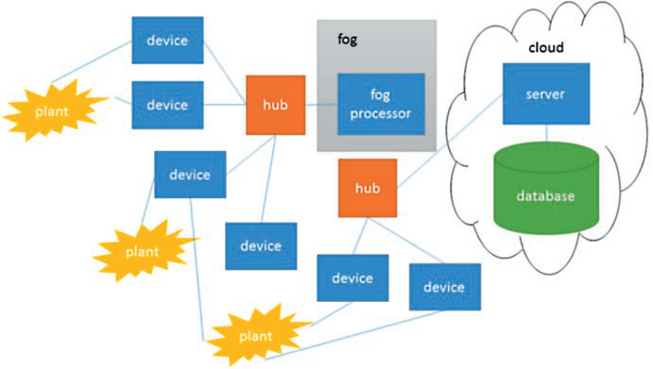
2.3.7 Placement Criteria for Processing
Architecture decisions are requirement-driven
• Latency: immediate responses should remain local.
• Bandwidth: high-volume data such as video may need local filtering.
• Energy: transmitting data may consume more energy than local lightweight processing.
• Privacy: sensitive data may be processed locally before transmission.
• Reliability: essential functions should continue when connectivity fails.
• Management: central cloud services simplify updates, dashboards, and reporting.
Figure source: Serpanos and Wolf, Internet-of-Things Systems, Fig. 2.1, p. 8.
32

Slide 33
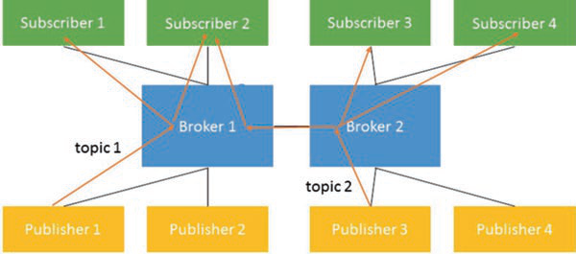
2.3.8 Publish-Subscribe as a Common IoT Pattern
Decoupling data producers and consumers
• Many IoT systems use a publish-subscribe pattern.
• Devices or gateways publish events to topics.
• Applications, analytics services, or dashboards subscribe to topics of interest.
• The broker decouples producers from consumers and supports flexible routing.
• This pattern is common in MQTT-based IoT systems and stream-processing pipelines.
Figure source: Serpanos and Wolf, Internet-of-Things Systems, Fig. 2.2, p. 8.
33

Slide 34
2.3.9 Case: Smart Traffic Intersection
Processing placement example
• On-device: vehicle or pedestrian detection from sensors and cameras.
• Edge/fog: local signal optimization and emergency priority handling.
• Cloud: city-wide traffic trend analysis, model training, reporting, and planning.
• Local action: safety-critical signal changes should not wait for distant cloud decisions.
• Cloud insight: long-term patterns can guide infrastructure planning and policy decisions.
34

Slide 35
2.3.10 Case: Remote Patient Monitoring
Processing placement example
• On-device: basic signal acquisition, simple filtering, and battery management.
• Gateway: smartphone or home hub uploads data and may issue local alerts.
• Fog or hospital edge server: patient-specific monitoring and near-real-time screening.
• Cloud: longitudinal analysis, population-level analytics, model training, and secure records integration.
• Architecture must prioritize privacy, reliability, clinical responsibility, and alert timeliness.
35

Slide 36
2.4
Typical IoT Node Architecture
• Understand internal node components.
• Connect sensing, processing, communication, actuation, and power.
• Recognize resource constraints.
36

Slide 37
2.4.1 What Is an IoT Node?
The endpoint that connects the physical world to the digital system
• An IoT node is a physical device that senses, processes, communicates, and sometimes acts on the environment.
• It may be a simple battery-powered sensor or a complex embedded computing unit.
• A node configuration depends on application requirements such as accuracy, sampling rate, communication range, actuation, and lifetime.
• The node is often the most constrained component of the IoT system.
• Its design affects data quality, energy consumption, reliability, and security.
37

Slide 38
2.4.2 Functional Blocks of a Typical IoT Node
Seven basic modules
• Sensor module gathers physical signals.
• Signal-conditioning module amplifies, filters, and prepares the signal.
• Analog-to-digital converter turns analog signals into digital values.
• Microcontroller or processor executes firmware and local logic.
• Storage module holds firmware, configuration, and buffered data.
• Wireless interface communicates with other nodes or gateways.
• Actuator module performs physical actions when required.
• Energy source powers every component of the node.
38

Slide 39
2.4.3 Sensor Module
Data quality begins at the sensor
• The sensor determines what physical state can be observed.
• Examples include temperature, humidity, pressure, gas, vibration, light, position, image, sound, and biomedical signals.
• Sensor placement, calibration, sampling frequency, and environmental conditions strongly affect data quality.
• Poor sensor data cannot be fully corrected by cloud analytics.
• Architectural design must include sensor maintenance, calibration, and failure detection.
39

Slide 40
2.4.4 Signal Conditioning and Conversion
Preparing physical signals for digital processing
• Many sensors produce weak, noisy, or analog electrical signals.
• Signal conditioning may include amplification, filtering, isolation, linearization, and noise removal.
• Analog-to-digital conversion changes analog signals into digital samples.
• A/D converter resolution and sampling rate affect accuracy, data volume, and energy consumption.
• In actuator paths, D/A conversion or driver circuitry may be required to control real-world devices.
40

Slide 41
2.4.5 Microcontroller and Local Firmware
The local brain of the IoT node
• The microcontroller manages sensing schedules, local processing, communication routines, and power states.
• It may run threshold rules, filtering algorithms, simple inference, and device-health monitoring.
• Firmware must be reliable because node failures can compromise the whole system.
• Secure boot, signed firmware, and safe update mechanisms are important for deployed IoT nodes.
• The microcontroller is often constrained by limited CPU, memory, storage, and energy.
41

Slide 42
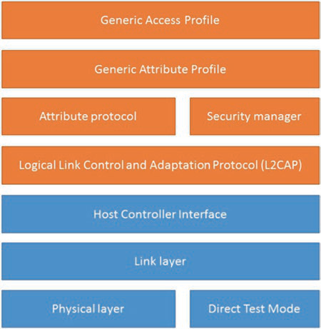
2.4.6 Communication Interface
Connecting the node to the system
• The communication interface may use Wi-Fi, Bluetooth, Zigbee, LoRa, cellular, Ethernet, serial communication, or other technologies.
• Selection depends on range, data rate, power, mobility, environment, reliability, and cost.
• Wireless communication often consumes significant energy in battery-powered nodes.
• The interface must support security mechanisms such as authentication and encrypted communication.
• Network design must consider packet loss, interference, retransmissions, and message timing.
Figure source: Serpanos and Wolf, Internet-of-Things Systems, Bluetooth network topology, p. 11.
42

Slide 43
2.4.7 Actuator Interface
From digital decision to physical action
• Actuators allow an IoT node or system to change the physical environment.
• Examples include motors, relays, pumps, valves, locks, heaters, alarms, displays, and robot arms.
• Actuator commands require stronger validation because errors may have physical consequences.
• Safety-critical actuation should include limits, interlocks, confirmation, and fallback behavior.
• Every actuator action should ideally be followed by sensing feedback to verify the result.
43

Slide 44
2.4.8 Storage and Buffering in IoT Nodes
Small memory with important responsibilities
• Program memory stores firmware and communication stacks.
• Working memory supports local computation and temporary variables.
• Non-volatile memory stores configuration, calibration parameters, security credentials, and buffered readings.
• Buffering is useful when network connectivity is intermittent.
• However, storage is limited; the node must decide what to keep, overwrite, compress, or transmit.
44

Slide 45
2.4.9 Smart Irrigation Node Example
Applying the node architecture
• Sensor module: soil-moisture sensor and optional temperature or light sensor.
• Signal path: conditioning and A/D conversion for analog sensor output.
• Processor: compares measurement with irrigation thresholds.
• Communication: LoRa or Wi-Fi sends readings to gateway or cloud.
• Actuator: relay opens or closes a water valve.
• Energy: battery with possible solar charging and duty-cycled operation.
45

Slide 46
2.5
Gateway, Backhaul, Data Center, and Cloud Server
• Clarify infrastructure roles.
• Distinguish local, network, and central processing.
• Understand operational architecture.
46

Slide 47
2.5.1 Gateway Role
Bridge between constrained devices and platforms
• A gateway connects local IoT devices to cloud or enterprise systems.
• It may translate protocols, aggregate data, filter noise, and perform local preprocessing.
• It can provide local control when cloud connectivity is unavailable.
• It improves security by mediating access to constrained devices.
• Examples include smart-home hubs, industrial Modbus-to-MQTT gateways, LoRaWAN gateways, and smartphone gateways.
Figure source: IoT & Applications Digital Notes, p. 16. Connectivity layer functions.
47

Slide 48
2.5.2 Access Network
The last-mile network of IoT
• The access network connects endpoint devices to a gateway, base station, or local network.
• Examples include Zigbee mesh, Bluetooth, Wi-Fi, LoRaWAN, cellular radio access, and industrial Ethernet.
• Access networks often face limited power, interference, mobility, and unreliable wireless channels.
• The access layer must ensure timely and reliable data transmission from constrained devices.
• It also influences sampling strategy, data rate, battery life, and gateway placement.
48

Slide 49
2.5.3 Backhaul Network
From local gateways to central infrastructure
• Backhaul transports aggregated traffic from gateways or base stations to data centers or cloud platforms.
• It must support capacity, availability, routing reliability, and security for aggregated IoT traffic.
• Backhaul may use fiber, broadband, cellular, private WAN, or satellite links depending on deployment context.
• Failures in the backhaul can isolate local IoT domains from centralized services.
• Architectures should define what the local system can still do when backhaul is unavailable.
49

Slide 50
2.5.4 Typical Cloud IoT Operational System
Operational view of devices, gateways, data centers, servers, and applications
• Distributed devices connect through wireless gateways or base stations.
• Data is forwarded toward servers and data centers in the cloud.
• Applications consume data and may issue commands, alerts, or reports.
• Routers and communication infrastructure connect the operational network.
• Security must be applied across devices, gateways, communication links, servers, and applications.
Figure source: Khan and Yuce, Internet of Things: Systems and Applications, Fig. 1.4, p. 16.
50

Slide 51
2.5.5 Data Center
Physical facility for computation and storage
• A data center contains servers, storage systems, high-speed networks, and security infrastructure.
• It provides backup, data protection, recovery systems, redundant communication links, and power protection.
• Critical organizations rely on data centers because data availability and integrity are essential.
• For IoT, data centers may host ingestion services, databases, analytics platforms, dashboards, and API services.
• Data-center design must address reliability, cooling, physical security, network capacity, and disaster recovery.
51

Slide 52
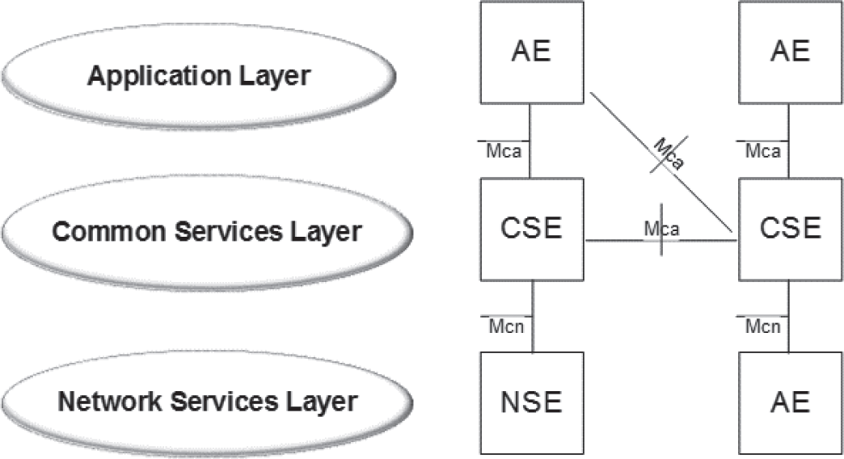
2.5.6 Cloud Server and IoT Platform
Logical services running on scalable infrastructure
• Cloud servers provide elastic computation and storage for IoT workloads.
• An IoT platform typically includes device registry, data ingestion, message broker, rule engine, storage, analytics, dashboards, and APIs.
• It also supports authentication, authorization, monitoring, firmware updates, and remote configuration.
• Cloud platforms simplify integration with web, mobile, enterprise, and analytics applications.
• Architects should distinguish the physical data center from the cloud service layer.
Figure source: Khan and Yuce, Internet of Things: Systems and Applications, service architecture diagram.
52

Slide 53
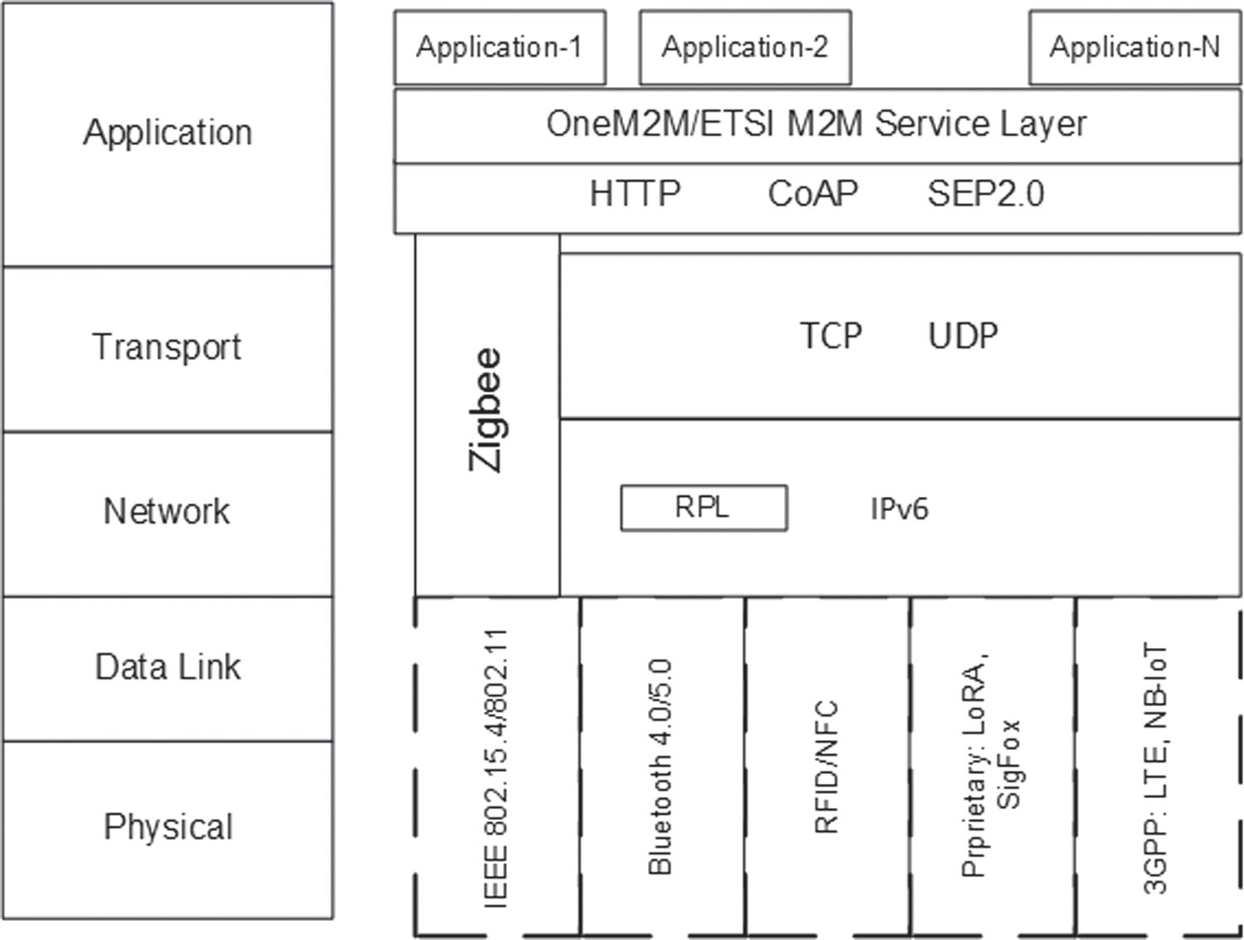
2.5.7 IoT Platform Technology Stack
Things, connectivity, core IoT features, applications and analytics
• Devices may connect directly to a platform or indirectly through an IoT gateway.
• A gateway is useful when endpoints cannot communicate directly with the cloud.
• Gateways also provide edge computing power and protocol conversion.
• Platform functions include data ingestion, device management, storage, analytics, rule processing, and application integration.
• A strong platform hides device heterogeneity while exposing reliable services to applications.
Figure source: Khan and Yuce, Internet of Things: Systems and Applications, IoT protocol/application stack figure.
53

Slide 54
2.5.8 Clarifying Infrastructure Terms
Avoid common confusion
Close to devices
Central infrastructure
• IoT node: senses, processes locally, communicates, and may actuate.
• Gateway: connects local devices to external networks or platforms.
• Edge or fog node: performs local or regional computation close to data sources.
• Backhaul: transports aggregated traffic from local sites to central systems.
• Data center: physical facility containing servers, storage, networking, and protection systems.
• Cloud platform: elastic service environment for device management, analytics, storage, APIs, and applications.
54

Slide 55
2.6
Energy Sources and Power-Saving Modes
• Understand energy as an architectural constraint.
• Analyze duty cycling and communication cost.
• Design for long operating lifetime.
55

Slide 56
2.6.1 Why Energy Matters in IoT
Many IoT devices are constrained by power
• IoT devices may be deployed in remote, mobile, outdoor, or inaccessible locations.
• Replacing or recharging batteries can dominate operational cost.
• Energy limits affect sensing frequency, communication interval, local computation, security mechanisms, and device lifetime.
• An energy-aware architecture may process data locally, batch transmissions, or reduce sampling frequency.
• Energy should be treated as a system-level design concern, not only a hardware detail.
56

Slide 57
2.6.2 Energy Sources for IoT Devices
Power options depend on deployment context
Common energy sources
Specialized and hybrid options
• Mains electricity for fixed infrastructure.
• Primary battery for simple long-life devices.
• Rechargeable battery when maintenance or charging is possible.
• Solar energy harvesting for outdoor sensors.
• Vibration harvesting in machines and vehicles.
• Thermal harvesting where temperature gradients exist.
• RF energy harvesting for very low-power devices.
• Hybrid designs combine storage and harvesting for longer lifetime.
57

Slide 58
2.6.3 Major Energy Consumers
Where does energy go?
• Sensing: sensor activation and measurement.
• Analog-to-digital conversion: sampling and conversion cost.
• Processing: local computation and memory access.
• Communication: radio transmission, reception, association, and retransmission.
• Security: encryption, authentication, and secure update operations.
• Actuation: motors, relays, pumps, valves, locks, and alarms may consume significant power.
58

Slide 59
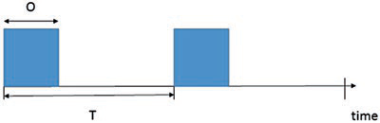
2.6.4 Duty Cycle Model
Most IoT devices do not operate continuously
• Duty cycle is the fraction of time a device spends in active mode.
• A device may wake up, sense, process, transmit, and then return to sleep.
• Lower duty cycle generally reduces average power consumption.
• However, very low duty cycles may reduce data freshness or increase event detection delay.
• Architects must balance lifetime, latency, accuracy, and communication reliability.
Figure source: Serpanos and Wolf, Internet-of-Things Systems, Fig. 3.2, p. 21.
59

Slide 60
2.6.5 Operating Modes
Active, idle, sleep, and deep sleep
• Active mode: sensing, processing, communicating, or actuating.
• Idle mode: powered but waiting, often wasting energy if not managed carefully.
• Sleep mode: most components disabled while selected state is preserved.
• Deep-sleep mode: minimal energy use, but wake-up may take longer.
• Wake-up mode: transition period where energy is consumed before useful work begins.
• The system should spend most of its time in low-power states when events are infrequent.
60

Slide 61
2.6.6 Power-Saving Techniques
Architectural and firmware-level strategies
• Duty cycling and scheduled wake-up.
• Event-triggered sampling and adaptive sampling frequency.
• Local filtering, aggregation, and compression.
• Batch transmission instead of frequent small messages.
• Reducing radio-on time and avoiding unnecessary retransmissions.
• Turning off unused peripherals and selecting low-power communication protocols.
• Using energy harvesting when the environment supports it.
61

Slide 62
2.6.8 Energy-Aware Architecture Example
Battery-powered environmental sensor
• Sense temperature and humidity every five minutes.
• Transmit summary data every thirty minutes under normal conditions.
• Wake immediately if pollution level exceeds threshold.
• Gateway aggregates data from many sensors before sending to cloud.
• Cloud stores history and generates monthly reports.
• This design balances battery lifetime, timely alerts, and long-term analytics.
62

Slide 63
2.7
IoT Data Lifecycle
• Treat IoT data as a managed asset.
• Understand each lifecycle stage.
• Connect data governance to architecture.
63

Slide 64
2.7.1 Why Study the IoT Data Lifecycle?
Architecture is also data management
• IoT data begins as raw physical observations, but it may become events, alerts, decisions, reports, or business records.
• Data can be processed in real time, stored for later analysis, or discarded after aggregation.
• Lifecycle decisions affect storage cost, privacy, auditability, analytics quality, and system performance.
• IoT architectures must define how data is generated, validated, enriched, transmitted, stored, processed, visualized, retained, and deleted.
• Data governance is a core part of IoT system design.
64

Slide 65
2.7.2 Data Generation and Acquisition
The beginning of the lifecycle
• Sensors generate measurements from the physical world.
• Devices and applications also generate events, logs, commands, and status messages.
• Acquisition attaches device identity, timestamp, sensor type, unit, and possibly location.
• Sampling strategy affects accuracy, bandwidth, storage, energy, and latency.
• Acquisition should be designed according to the decisions the system must support.
65

Slide 66
2.7.3 Validation, Cleaning, and Preprocessing
Improving reliability before analysis
• Invalid values should be filtered before they create false alerts or incorrect reports.
• Preprocessing may include noise filtering, duplicate removal, missing-value handling, normalization, calibration, and unit conversion.
• Some validation can be done on the device, at the gateway, or at the edge.
• Filtering irrelevant data reduces communication and storage overhead.
• However, excessive filtering may remove details needed for later investigation.
66

Slide 67
2.7.4 Enrichment and Contextualization
Turning data into meaningful information
• Enrichment adds context such as location, asset ID, room, patient, vehicle, production line, or operational state.
• Context helps applications interpret raw measurements correctly.
• Semantic models and metadata can improve interoperability across heterogeneous devices and systems.
• A temperature value in a hospital refrigerator has different meaning from the same value in an outdoor weather station.
• Good data architecture preserves context throughout the pipeline.
67

Slide 68
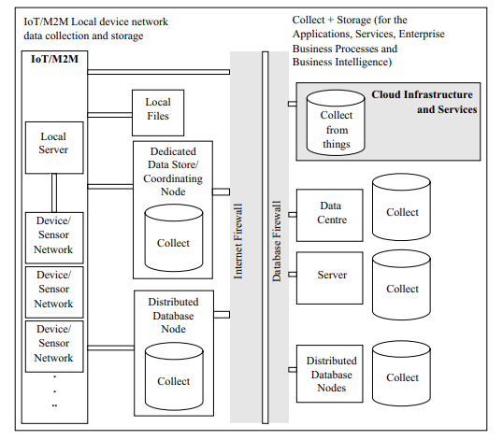
2.7.5 Aggregation and Reduction
Managing volume and bandwidth
• Aggregation combines multiple observations into summaries such as averages, minimums, maximums, counts, or trends.
• Reduction removes redundant or irrelevant data.
• Compression lowers communication and storage cost.
• Sensor fusion combines data from multiple sensors for a more reliable interpretation.
• Architects must decide whether to store raw data, processed data, analytical results, or a combination.
Figure source: IoT & Applications Digital Notes, data collection and storage architecture.
68

Slide 69
2.7.6 Storage Categories
What should be stored?
• Store raw data when it must be repeatedly processed, audited, or referenced in the future.
• Store both raw data and analytical results when quick visualization and auditability are required.
• Store only results when raw data has limited future value or is too costly to retain.
• Real-time or streaming data may be processed immediately, with selected results stored afterward.
• Large-scale IoT data may require distributed databases, data lakes, warehouses, or cloud object storage.
69

Slide 70
2.7.7 Processing and Analytics
From stored or streaming data to insight
• Real-time analytics focuses on fast-running sensor streams and timely response.
• Batch analytics processes historical data for trends, forecasting, and model training.
• Event processing identifies meaningful changes that require action.
• Machine learning may support anomaly detection, classification, prediction, and optimization.
• Visualization converts analysis results into dashboards, maps, reports, or alerts.
70

Slide 71
2.7.8 Visualization, Action, and Integration
How data creates operational value
• Dashboards show current status and historical trends.
• Alerts notify users when thresholds or anomalies occur.
• APIs provide IoT data to enterprise systems such as ERP, CRM, MES, asset management, or business intelligence.
• Automatic actions can trigger actuators or update business workflows.
• The final test of the data lifecycle is whether it improves decisions, operations, safety, or service quality.
71

Slide 72
2.7.9 Retention, Archival, and Deletion
The lifecycle continues after analytics
• Retention policies define how long different data types should be kept.
• Archival moves older data to lower-cost storage while preserving long-term value.
• Deletion removes data that no longer has a legitimate purpose.
• Privacy-sensitive data should not be retained longer than necessary.
• Audit, compliance, and security requirements must be considered during retention planning.
72

Slide 73
2.7.10 Cross-Cutting Data Governance
Governance applies throughout the lifecycle
• Data ownership: who controls the data?
• Data quality: how accurate, complete, and timely is the data?
• Security: who can access, modify, or delete the data?
• Privacy: does the data reveal personal or sensitive information?
• Lineage: where did the data come from and how was it transformed?
• Auditability: can the organization explain decisions based on IoT data?
73

Slide 74
In-Class Activity
Architecture Design Exercise
• Apply Chapter 2 concepts to a realistic IoT scenario.
• Work in groups and justify architectural choices.
• Focus on processing placement, data flow, energy, and governance.
74

Slide 75
Activity: Design an IoT Architecture
Choose one scenario and design the architecture
• Scenario options: smart hospital patient monitoring, smart traffic intersection, precision agriculture, industrial predictive maintenance, cold-chain logistics, or campus energy management.
• Identify physical devices, sensors, actuators, access network, gateway, fog or edge nodes, cloud services, applications, and users.
• Decide what is processed on the device, at the gateway, in the fog or edge layer, and in the cloud.
• Define one urgent event and explain where it should be handled.
• Identify the energy source and at least two power-saving techniques.
• Describe the data lifecycle and two governance risks.
75

Slide 76
Discussion Prompts
Use these questions for group presentations
• Which part of your architecture must continue working when cloud connectivity fails?
• Which data should never be transmitted in raw form?
• Which event requires the lowest latency?
• Which component is the best place for protocol translation?
• Which data should be stored for long-term analysis?
• How would you reduce battery consumption without losing important information?
76

Slide 77
Chapter Summary
Key takeaways
• IoT architecture organizes responsibilities across devices, networks, gateways, edge, fog, data centers, cloud platforms, applications, and business processes.
• Different architecture models are useful for different levels of analysis.
• Data flows upward from physical observations to applications and downward from decisions to actuators.
• Edge and fog computing reduce latency, traffic, and dependency on centralized cloud services.
• Gateway, backhaul, data center, and cloud server roles must be distinguished clearly.
• Energy constraints shape device behavior and system architecture.
• The IoT data lifecycle includes generation, validation, enrichment, storage, analytics, visualization, retention, and deletion.
77

Slide 78
References Used in This Chapter
• Serpanos and Wolf, Internet-of-Things Systems: Architectures, Algorithms, Methodologies, Springer, 2018.
• Alam, Shakil, and Khan, Internet of Things: Concepts and Applications, Springer, 2020.
• MRCET, IoT & Applications Digital Notes, Unit 1: Fundamentals of IoT.
• Khan and Yuce, Internet of Things: Systems and Applications, Jenny Stanford Publishing, 2019.
• Chapter 1 IoT Overview teaching slides, used as the visual style template and continuity reference.
• Figures are excerpted or adapted from the provided teaching documents for classroom use.
80

