Slide 1

Why Study IoT?
↔
Physical–digital bridge
⚡
Real-time data
⚙
Automation
Turns physical operations into measurable digital events.
Enables monitoring and reaction while events are happening.
Links sensing, decision logic, and actuation.
☁
Cloud + edge
📊
Data-driven decisions
🔐
New risks
Distributes processing across devices, gateways, edge, and cloud.
Supports operational, managerial, and strategic decisions.
Creates security, privacy, safety, and governance challenges.
2
Notes:
Teaching notes: Position IoT as a systems and business topic, not just a hardware topic. Emphasize why Information Systems students need to understand both data flows and business processes.

Slide 2
Learning Objectives
• Define Internet of Things and explain core characteristics of IoT systems.
• Trace the evolution from Internet, RFID, M2M, and WSN toward modern IoT.
• Explain smart devices, sensors, actuators, and the sense–process–act loop.
• Identify ecosystem components: devices, connectivity, gateway, platform, applications, users.
• Relate IoT to digital transformation, automation, and real-time decision making.
• Compare major application domains: home, city, health, agriculture, transport, infrastructure, industry.
3
Notes:
Teaching notes: Use this slide to set expectations. Tell students that the chapter provides the vocabulary for the remaining course.

Slide 3
Opening Question
When does a normal object become an IoT object?
💡
Light bulb
⌚
Watch
🚗
Car
Remote control, automation, energy data
Sensors, health data, cloud sync
Telemetry, OTA update, app control
📷
Camera
🏭
Machine
🌱
Farm sensor
Video stream, motion detection, alerts
Condition monitoring, predictive maintenance
Soil data, irrigation control, decision support
[R3]
4
Notes:
Teaching notes: Ask students to name examples they personally use. Guide them toward four properties: sensing, connectivity, processing, and service value.

Slide 4
IoT Connects Physical and Digital Worlds
Physical object
→
Sensing
→
Data
→
Processing
→
Decision
→
Action
Core idea: physical state becomes data; data drives digital services; digital decisions can change physical state.
• IoT is not only “Internet-connected devices”.
• IoT combines devices, networks, software, data, users, and processes.
• The business value appears when data changes decisions and actions.
5
Notes:
Teaching notes: Emphasize the closed loop between the physical and digital world.

Slide 5
1.1 IoT Concepts
Notes:
Teaching notes: Introduce the chapter and explain that this lesson provides the conceptual foundation for all later IoT architecture, protocol, platform, and application topics.

Slide 6
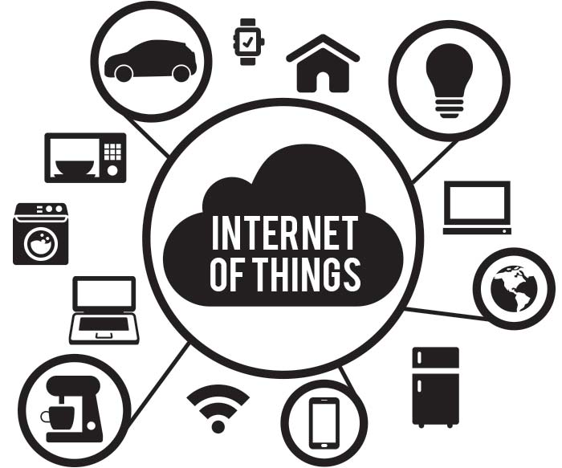
What Is the Internet of Things?
• A distributed ICT system that integrates sensors, computing devices, algorithms, and uniquely identifiable physical objects.
• Objects collect and exchange data over connected systems, often with minimal human intervention.
• IoT systems may include sensors, actuators, gateways, cloud services, applications, and users.
• For Information Systems: the important question is how device data becomes useful information for processes and decisions.
6
Notes:
Teaching notes: Introduce a system-oriented definition rather than a device-only definition.

Slide 7
IoT as a System, Not a Gadget
Device-only view
System view
• A sensor or connected object
• Focus on hardware and connectivity
• Often misses data, platform, and user value
• Designed for one or more applications
• Considers physical dynamics and time-series data
• Includes security, reliability, lifecycle, and business process
7
Notes:
Teaching notes: Use the contrast to move students away from thinking of IoT as merely embedded hardware.

Slide 8
Example: Smart Irrigation System
Soil sensor
→
Controller
→
Network
→
Cloud/app
→
Decision rule
→
Water valve
• Sensors measure soil moisture, temperature, humidity, and sunlight.
• Data is sent to a controller, gateway, or cloud platform.
• Rules or analytics decide when to irrigate.
• An actuator opens or closes a water valve.
• The user monitors and configures thresholds through an app.
8
Notes:
Teaching notes: Use this example throughout the lecture because it contains all essential parts: sensor, connectivity, processing, actuator, app, and user.

Slide 9
The Basic IoT Loop
Sense
→
Communicate
→
Process
→
Decide
→
Act
→
Monitor
• Sense: collect data about physical state.
• Communicate: transfer data through a network.
• Process: clean, aggregate, analyze, or infer.
• Act: notify users or control actuators.
• Monitor: measure outcome and update future decisions.
9
Notes:
Teaching notes: Draw attention to the fact that IoT is often a feedback-control loop, not just a data collection system.

Slide 10
Core Characteristics of IoT Systems
What makes an IoT system different from a conventional information system?
Connectivity and communication
IoT devices exchange data with other devices, gateways, cloud platforms, and applications.
Communication may be continuous, periodic, event-triggered, or command-based.
Common technologies include Wi-Fi, Bluetooth, Zigbee, Lora WAN, NB-IoT, 4G/5G, Ethernet, MQTT, CoAP, and HTTP.
Identification and addressability
Each IoT device needs a unique identity so that it can be registered, monitored, managed, and secured.
Device identity supports ownership, authentication, access control, and lifecycle management.
Examples include device ID, MAC address, SIM identity, certificate, serial number, or cloud registry ID.
10
Notes:
Teaching notes: Provide the master list. The following slides unpack each characteristic.

Slide 11
Core Characteristics of IoT Systems
What makes an IoT system different from a conventional information system?
Sensing and Actuation
Sensors collect data from the physical world, such as temperature, humidity, location, vibration, motion, health signals, or energy use.
Actuators allow the system to take physical actions, such as opening a valve, turning on a motor, locking a door, or triggering an alarm.
This creates a closed loop: sense → process → decide → act.
Distributed Processing
IoT data can be processed at different locations: device, gateway, edge server, cloud platform, or enterprise system.
Processing location depends on latency, bandwidth, power, cost, privacy, and reliability requirements.
A well-designed IoT system balances local intelligence and cloud-scale analytics.
10
Notes:
Teaching notes: Provide the master list. The following slides unpack each characteristic.

Slide 12
Core Characteristics of IoT Systems
What makes an IoT system different from a conventional information system?
Event-driven and time sensitive behavior
Many IoT systems react to events instead of waiting for manual data entry.
Examples include fire detection, patient alerts, traffic congestion, abnormal machine vibration, and low battery warnings.
Timeliness is important because late data may reduce system value or create safety risks.
Heterogeneity, scalability, and lifecycle management
IoT systems often include many device types, vendors, protocols, data formats, and deployment environments.
Systems must scale from a few devices to thousands or millions of connected objects.
Devices must be provisioned, configured, monitored, updated, repaired, replaced, and securely decommissioned.
10
Notes:
Teaching notes: Provide the master list. The following slides unpack each characteristic.

Slide 13
Core Characteristics of IoT Systems
What makes an IoT system different from a conventional information system?
Security, privacy and safety
IoT devices observe and sometimes control the real world, so security risks can have physical consequences.
Privacy risks may involve location, health, video, home activity, industrial operations, or behavioral data.
Security must protect device identity, data transmission, cloud services, applications, and control commands.
10
Notes:
Teaching notes: Provide the master list. The following slides unpack each characteristic.

Slide 14
Core Characteristics of IoT Systems
Processing and Intelligence – Where should data be processed ?
On-device processing
Data is processed directly inside the sensor, controller, embedded board, or smart device.
Suitable for simple filtering, threshold detection, immediate control, and low-power operation.
Advantages:
Very low latency.
Less network traffic.
Can continue basic operation when the network is unavailable.
Limitations:
Limited CPU, memory, storage, and energy.
Difficult to run complex analytics or large AI models.
10
Notes:
Teaching notes: Provide the master list. The following slides unpack each characteristic.

Slide 15
Core Characteristics of IoT Systems
Processing and Intelligence – Where should data be processed ?
Gateway/Edge Processing
Data is processed close to the devices, usually at a gateway, local server, or edge node.
Suitable for local aggregation, protocol conversion, anomaly detection, and near real-time decision.
Advantages:
Reduces the amount of raw data sent to the cloud
Improves response time.
Support local decision-making when cloud connectivity is unavailable.
Example: A factory gateway detects abnormal vibration and triggers a local machine shutdown before sending a report to the cloud.
10
Notes:
Teaching notes: Provide the master list. The following slides unpack each characteristic.

Slide 16
Core Characteristics of IoT Systems
Processing and Intelligence – Where should data be processed ?
Cloud Processing
Data is sent to a cloud platform for scalable storage, analytics, machine learning, dashboards, and integration.
Advantages:
High scalability
Limitation:
Suitable for long-term data analysis, cross-device comparison, training AI models, and enterprise reporting.
Easier integration with applications and business systems.
Supports centralized monitoring and management.
Depends on network connectivity.
May introduce latency
May raise data privacy, cost, and bandwidth concerns.
10
Notes:
Teaching notes: Provide the master list. The following slides unpack each characteristic.

Slide 17
Core Characteristics of IoT Systems
Processing and Intelligence – Where should data be processed ?
Enterprise-system
Processing
IoT data may be integrated with ERP, CRM, MES, asset management, logistics, or business intelligence systems.
Example:
Maintenance planning based on machine sensor data.
This connects real-time device data with organizational decision-making.
Inventory decisions based on smart shelf data.
Fleet operation decisions based on vehicle telemetry.
10
Notes:
Teaching notes: Provide the master list. The following slides unpack each characteristic.

Slide 18
Core Characteristics of IoT Systems
Processing and Intelligence – Where should data be processed ?
Design question for IoT architects
Which data must be processed immediately?
Which data can be sent to the cloud?
Which data should be stored for historical analysis?
Which decisions should be automatic, and which require human approval?
10
Notes:
Teaching notes: Provide the master list. The following slides unpack each characteristic.

Slide 19
1.2 History
Notes:
Teaching notes: Introduce the chapter and explain that this lesson provides the conceptual foundation for all later IoT architecture, protocol, platform, and application topics.

Slide 20
Historical Evolution of IoT
Internet
→
RFID
→
M2M
→
WSN
→
Cloud + Mobile
→
AI + Edge IoT
• The Internet first connected people, computers, and services.
• RFID and identification technologies connected objects to digital records.
• M2M enabled machine-to-machine data exchange and remote monitoring.
• Wireless sensor networks enabled distributed sensing.
• Cloud, mobile, AI, and edge computing turned connected devices into service ecosystems.
14
Notes:
Teaching notes: Explain IoT as an evolution of several technology streams rather than a single invention.

Slide 21
IoT and the Internet
From digital services to physical systems
• Traditional Internet: connects computers, servers, people, and digital services.
• IoT: extends Internet concepts to physical objects, devices, machines, vehicles, and environments.
• Traditional systems often depend on human-entered data.
• IoT systems generate data automatically from the physical world.
• Result: information systems become more real-time and context-aware.
15
Notes:
Teaching notes: Use examples: web form order data versus sensor-generated cold-chain data.

Slide 22
IoT and M2M
Machine-to-machine communication
• M2M focuses on direct communication between machines or between a machine and a monitoring system.
• Typical examples: smart meters, vending machines, ATM monitoring, industrial telemetry.
• M2M is often narrow, task-specific, and less user-facing.
• IoT is broader: cloud platforms, mobile apps, analytics, APIs, users, and business processes.
• M2M can be viewed as a predecessor or component of IoT.
16
Notes:
Teaching notes: Draw a simple Venn diagram on the board if helpful: M2M is inside the broader IoT ecosystem.

Slide 23
IoT and Wireless Sensor Networks
Distributed sensing foundation
• WSN consists of distributed sensor nodes that collect and transmit environmental data.
• Traditional WSN research emphasized sensing, energy efficiency, and wireless communication.
• IoT extends WSN with actuation, cloud platforms, applications, device management, users, and business value.
• WSN is a key enabling technology, but IoT is an end-to-end ecosystem.
17
Notes:
Teaching notes: Use agriculture or environmental monitoring as examples where WSN becomes part of a larger IoT solution.

Slide 24
1.3 Smart Devices
Notes:
Teaching notes: Introduce the chapter and explain that this lesson provides the conceptual foundation for all later IoT architecture, protocol, platform, and application topics.

Slide 25
Smart Devices
• A smart device is a physical object with sensing, processing, communication, and software capabilities.
• It may be configurable, updateable, and remotely manageable.
• It may also include actuators to influence the environment.
• Examples: smartwatch, smart lock, camera, thermostat, industrial controller, smart meter, connected vehicle.
18
Notes:
Teaching notes: Ask students to identify the smart-device features of their phones or watches.

Slide 26
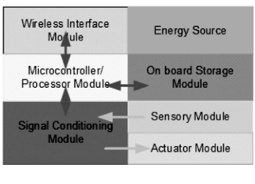
Components of a Smart Device
Inside a thing
• Sensor module: gathers physical signals.
• Signal conditioning and A/D conversion: prepares sensor signal as digital input.
• Microcontroller/processor: executes logic and communication routines.
• Wireless interface: exchanges data with other nodes or gateways.
• Storage and energy source: support operation and local data handling.
• Actuator module: executes physical actions when required.
Source: [R4], Fig. 1.3 typical IoT node
19
Notes:
Teaching notes: Use the figure to explain why IoT device design is constrained by power, computation, memory, and communication.

Slide 27
Sensors in IoT
Role of sensors
• Sensors allow an IoT system to “see” the physical world.
• They convert physical conditions into signals and then data.
• They provide the input for monitoring, prediction, automation, and control.
• Sensor data quality is affected by placement, calibration, sampling frequency, noise, and environment.
20
Notes:
Teaching notes: Stress that poor sensor data cannot be fixed entirely by software analytics.

Slide 28
Common Sensor Data Types
What can IoT measure?
🌡
Environmental
↝
Motion
⌖
Location
Temperature, humidity, air quality, light
Acceleration, vibration, rotation, presence
GPS, indoor location, proximity
♡
Biometric
⚡
Electrical
◉
Visual / acoustic
Heart rate, SpO₂, glucose, activity
Voltage, current, energy, power quality
Image, video, sound, voice, anomaly cues
21
Notes:
Teaching notes: Group sensors by what they measure and ask students which domains use each type.

Slide 29
Actuators in IoT
Role of actuators
• Actuators allow an IoT system to act on the physical world.
• Examples: motor, relay, pump, valve, smart lock, alarm, display, robot arm.
• They enable automation: irrigation, HVAC control, door access, machine shutdown, traffic light adjustment.
• Actuation requires careful validation because digital decisions have physical consequences.
22
Notes:
Teaching notes: Link actuation to safety: a wrong command can waste resources, damage equipment, or create danger.

Slide 30
Sense–Process–Actuate Feedback Loop
Cyber-physical thinking
Sensors
→
Data
→
Rules / analytics
→
Decision
→
Actuators
→
Feedback
Example: smart HVAC
Example: industrial machine
• Temperature sensor
• Occupancy sensor
• Comfort rule
• Actuator controls AC/fan
• Vibration sensor
• Edge anomaly detection
• Maintenance alert
• Automatic safe shutdown
23
Notes:
Teaching notes: Students should understand that IoT systems are feedback systems.

Slide 31
1.4 Ecosystem
Notes:
Teaching notes: Introduce the chapter and explain that this lesson provides the conceptual foundation for all later IoT architecture, protocol, platform, and application topics.

Slide 32
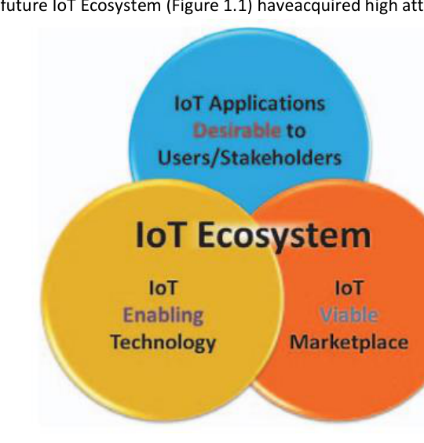
IoT Ecosystem: Enabling Technology + Market + Users
• IoT ecosystems do not exist as isolated sensors.
• They combine enabling technologies, viable markets, and user/stakeholder needs.
• Value depends on applications that solve real problems.
• For IS students: map stakeholders, data flows, decisions, and processes.
Source: [R3], IoT ecosystem diagram
24
Notes:
Teaching notes: Use the Venn diagram to highlight that technical feasibility alone does not guarantee value.

Slide 33
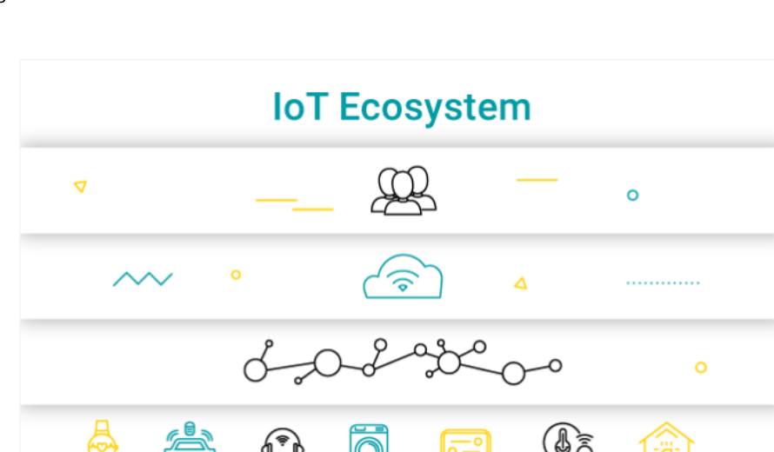
Functional Blocks of an IoT Ecosystem
Devices, networks, platforms, agents
Source: [R3], functional blocks of an IoT ecosystem
• Devices collect data from the environment.
• Networks move data across the ecosystem.
• Platforms aggregate, store, process, and expose data.
• Agents/users act on insights and manage the ecosystem.
25
Notes:
Teaching notes: Explain the basic ecosystem schema from device to network to platform to user.

Slide 34
Ecosystem Component 1: Devices
The source of data and action
• Devices include sensors, actuators, smart objects, embedded controllers, wearables, machines, meters, and vehicles.
• They operate under constraints: energy, memory, computation, connectivity, and environment.
• They must be identified, configured, monitored, updated, secured, and eventually decommissioned.
• Device management becomes difficult at scale.
26
Notes:
Teaching notes: Link this slide to lifecycle management and platform requirements.

Slide 35
Ecosystem Component 2: Connectivity
Moving data across the system
• Short range: Bluetooth LE, Zigbee, Z-Wave, RFID, NFC.
• Local/high bandwidth: Wi‑Fi, Ethernet.
• Wide area/low power: LoRaWAN, NB‑IoT, LTE‑M.
• Mobile/high bandwidth: 4G/5G.
• Selection criteria: range, power, cost, data rate, reliability, mobility, deployment environment.
27
Notes:
Teaching notes: Ask students to match technologies to smart home, smart agriculture, fleet tracking, and industrial settings.

Slide 36
Ecosystem Component 3: Gateway
Bridge between constrained devices and platforms
• A gateway connects local IoT devices to cloud or enterprise systems.
• It can translate protocols, aggregate data, filter noise, and perform local preprocessing.
• It may provide local control when cloud connectivity is unavailable.
• It improves security by mediating access to constrained devices.
28
Notes:
Teaching notes: Use examples: Zigbee smart-home hub, industrial Modbus-to-MQTT gateway, LoRaWAN gateway.

Slide 37
Ecosystem Component 4: Edge and Fog Computing
Processing closer to the device
• Edge/fog nodes analyze IoT data close to where it is collected.
• Benefits: lower latency, reduced network traffic, local resilience, privacy-sensitive processing.
• Examples: industrial controller, smart camera, gateway, router, embedded server.
• Design trade-off: edge is faster and local; cloud is more scalable and easier to integrate.
29
Notes:
Teaching notes: Explain that fog and edge are especially useful when latency or bandwidth matter.

Slide 38
Ecosystem Component 5: Cloud / IoT Platform
The middleware of IoT
• IoT platforms connect heterogeneous devices to applications and services.
• Typical functions: device registry, data ingestion, storage, analytics, rule engine, alerts, APIs.
• Platforms support scalability, cross-device compatibility, security, and remote configuration.
• Commercial examples include AWS IoT, Azure IoT, Google Cloud IoT, and IBM Watson IoT.
30
Notes:
Teaching notes: Emphasize platform as middleware between hardware and business applications.

Slide 39
Ecosystem Component 6: Applications and Users
Where value is realized
• Applications convert IoT data into monitoring, control, reporting, and decision support.
• Users include residents, patients, doctors, operators, managers, engineers, farmers, and public agencies.
• Business processes determine what data is useful and what action should follow.
• A technically working IoT system fails if users cannot make better decisions from it.
31
Notes:
Teaching notes: Tie this to Information Systems: users, workflows, value creation, organizational adoption.

Slide 40
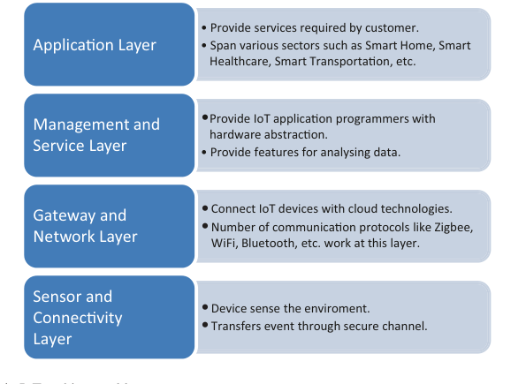
IoT Architectural Layers
Four-layer reference architecture
• Sensor and connectivity layer: sense the environment and transfer events securely.
• Gateway and network layer: connect devices with cloud technologies.
• Management/service layer: hardware abstraction and data analysis features.
• Application layer: services across domains such as smart home, healthcare, transportation.
Source: [R2], Fig. 3.1 IoT architectural layers
32
Notes:
Teaching notes: Use this to map the ecosystem components into a layered architecture.

Slide 41
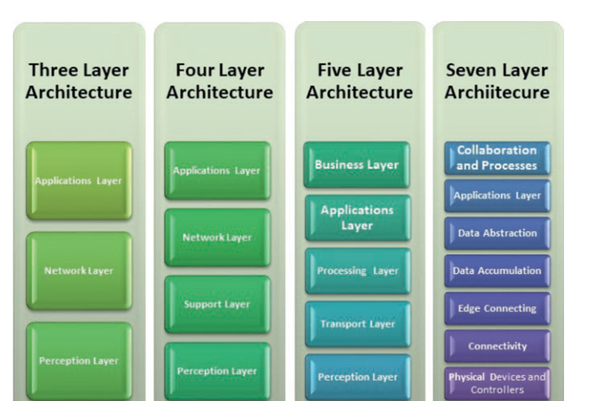
Multiple Views of IoT Architecture
Three-, four-, five-, and seven-layer models
• There is no single universal IoT architecture.
• Three-layer view: perception, network, application.
• Four-layer view adds a support/service layer.
• Five-layer view adds processing and business layers.
• Seven-layer view separates edge, data accumulation, abstraction, applications, and processes.
Source: [R2], Fig. 4.2 multi-tier IoT architecture
33
Notes:
Teaching notes: Clarify that models are simplifications; choose the model that best supports analysis and design.

Slide 42
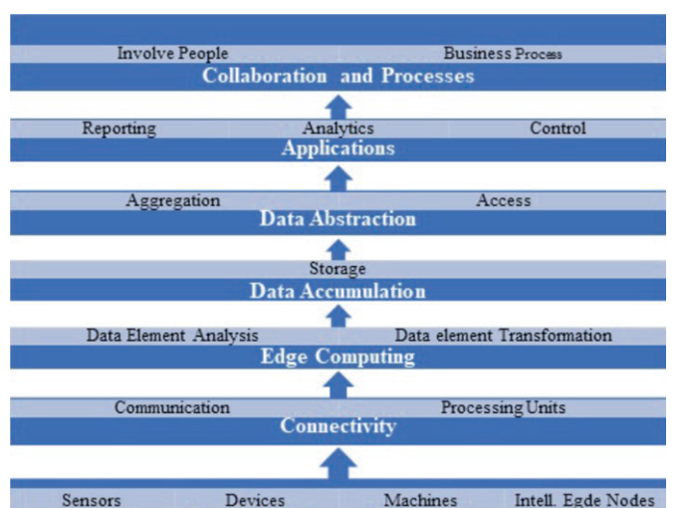
Seven-Layer Architecture: A More Detailed View
From physical devices to business process
Source: [R2], Fig. 4.3 basic architecture of IoT
• Physical devices and controllers produce or consume real-world signals.
• Connectivity moves data and commands.
• Edge computing transforms and analyzes data near the source.
• Applications, collaboration, and business processes create organizational value.
34
Notes:
Teaching notes: Connect the seven-layer view to distributed-system design: layered architecture, middleware, and edge-cloud architecture.

Slide 43
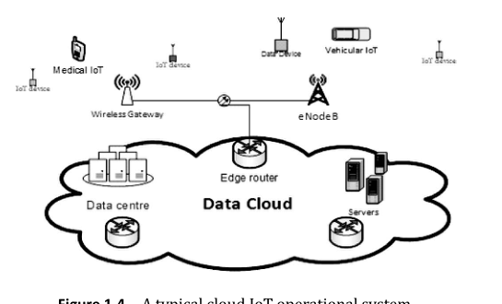
A Typical Cloud IoT Operational System
Operational architecture
• Distributed IoT devices connect through wireless gateways or base stations.
• Data is sent to cloud data centers, servers, and routers.
• Applications consume data and issue commands or alerts.
• Security mechanisms must be distributed throughout the architecture.
Source: [R4], Fig. 1.4 typical cloud IoT operational system
35
Notes:
Teaching notes: Use the figure to transition from conceptual layers to operational deployment.

Slide 44
Data Flow in an IoT System
From device data to action
Device event
→
Gateway/ edge
→
Data ingestion
→
Storage/ stream
→
Analytics/ rules
→
Dashboard/API
→
Action
• IoT data can be data in motion, data at rest, or both.
• Stream processing supports real-time alerts and control.
• Historical storage supports reporting, forecasting, and model training.
• APIs connect IoT platforms to enterprise applications and business processes.
36
Notes:
Teaching notes: Explain how data pipelines support both real-time operational use and long-term analytics.

Slide 45
1.5 IoT and Digital Transformation
Notes:
Teaching notes: Introduce the chapter and explain that this lesson provides the conceptual foundation for all later IoT architecture, protocol, platform, and application topics.

Slide 46
IoT in Digital Transformation
• Digital transformation means changing operations and services using data and digital technology.
• IoT brings real-world operational data into digital systems automatically.
• Organizations can monitor assets, automate responses, optimize processes, and create new services.
• IoT transforms physical assets into data-producing, service-connected assets.
37
Notes:
Teaching notes: Connect IoT to enterprise transformation rather than technology adoption alone.

Slide 47
Automation Maturity in IoT
From monitoring to optimization
1. Monitor
→
2. Alert
→
3. Recommend
→
4. Control
→
5. Predict
→
6. Optimize
• Monitoring: observe asset/environment state.
• Alerting: notify when thresholds or anomalies occur.
• Recommendation: suggest actions to humans.
• Control: execute rule-based actions automatically.
• Prediction and optimization: use analytics/AI to improve future performance.
38
Notes:
Teaching notes: Ask which levels are appropriate for a healthcare application versus an irrigation application.

Slide 48
Real-Time Data for Decision Making
Operational, managerial, strategic
• Operational decisions: immediate actions, alerts, dispatching, control, maintenance response.
• Managerial decisions: resource allocation, performance monitoring, cost reduction, SLA tracking.
• Strategic decisions: service innovation, new business models, product improvement, data monetization.
• IoT value increases when real-time data is connected to decision rights and workflows.
39
Notes:
Teaching notes: Clarify that real-time data alone does not create value; it must be connected to decisions and processes.

Slide 49
1.5 Domains
Notes:
Teaching notes: Introduce the chapter and explain that this lesson provides the conceptual foundation for all later IoT architecture, protocol, platform, and application topics.

Slide 50
Major IoT Application Domains
⌂
Smart home
▦
Smart city
✚
Healthcare
Comfort, security, energy, automation
Traffic, parking, lighting, waste, air quality
Wearables, remote monitoring, alerts
♧
Agriculture
◆
Transportation
▤
Infrastructure
Soil, irrigation, greenhouse, livestock
Fleet, vehicles, parking, logistics
Grid, bridges, water, buildings
⚙
Industry
☁
Environment
📱
Consumer IoT
IIoT, predictive maintenance, smart factory
Air, water, flood, climate monitoring
Wearables, appliances, personal services
40
Notes:
Teaching notes: Briefly survey domains. The next slides group them into concrete examples.

Slide 51
Domain 1: Smart Home
Consumer and residential IoT
• Devices: smart lights, locks, thermostats, cameras, sensors, appliances, speakers.
• Use cases: remote control, scene automation, energy savings, security, comfort.
• Key IS questions: user identity, access sharing, data privacy, interoperability, vendor lock-in.
• Example scenario: “arrive home” triggers lighting, HVAC, door access, and notification rules.
41
Notes:
Teaching notes: Have students identify which smart-home devices are sensors, actuators, or both.

Slide 52
Domain 2: Smart City
Urban services and civic infrastructure
• Use cases: traffic management, parking, street lighting, waste collection, public safety, air quality.
• Requires sharing data across agencies, infrastructure providers, and citizens.
• Challenges: interoperability, scale, privacy, governance, data quality, and availability.
• Goal: improve quality of life, resource efficiency, safety, and sustainability.
42
Notes:
Teaching notes: Connect smart city to multi-stakeholder information systems, not just sensors on streets.

Slide 53
Domain 3: Healthcare IoT
Monitoring and care support
• Devices: wearables, connected blood pressure monitors, SpO₂ sensors, glucose monitors, fall detectors.
• Use cases: remote patient monitoring, elderly care, emergency alerts, medication support.
• Benefits: earlier detection, home-based care, continuous monitoring, personalized treatment.
• Risks: sensitive health data, reliability, device accuracy, clinical responsibility, usability.
43
Notes:
Teaching notes: Emphasize that healthcare IoT requires high attention to privacy, accuracy, and responsibility.

Slide 54
Domain 4: Smart Agriculture
Data-driven farming
• Sensors measure soil moisture, temperature, humidity, sunlight, plant health, water quality.
• Use cases: irrigation control, greenhouse automation, livestock tracking, pest detection.
• Benefits: water savings, yield improvement, reduced labor, better resource allocation.
• Design issues: sensor placement, power supply, wireless range, maintenance cost, data analytics.
44
Notes:
Teaching notes: Use this to revisit the smart irrigation example.

Slide 55
Domain 5: Transportation and Vehicular IoT
Connected mobility
• Use cases: fleet tracking, connected vehicles, smart parking, logistics monitoring, public transport updates.
• Data: location, speed, fuel/energy use, route, vehicle status, cargo temperature, driver behavior.
• Benefits: safety, efficiency, reduced waiting time, optimized routing, better asset utilization.
• Challenges: latency, mobility, coverage, security, and privacy of movement data.
45
Notes:
Teaching notes: Mention that vehicular IoT often has stricter latency and reliability requirements.

Slide 56
Domain 6: Smart Infrastructure
Monitoring critical assets
• Assets: bridges, roads, water pipes, power grids, buildings, dams, telecom sites.
• Sensors monitor vibration, pressure, corrosion, water level, energy consumption, structural health.
• Benefits: proactive maintenance, lower risk, extended asset life, better public safety.
• Challenges: harsh environments, long device lifetime, energy supply, connectivity, data governance.
46
Notes:
Teaching notes: Connect infrastructure IoT to public service reliability and safety.

Slide 57
Domain 7: Industrial IoT
Smart factory and IT/OT integration
• Use cases: machine monitoring, predictive maintenance, production tracking, quality control, energy management.
• IIoT integrates sensors, PLC/SCADA, MES, ERP, and analytics.
• Goals: increase flexibility and productivity while reducing downtime and production cost.
• Challenges: real-time requirements, safety, legacy systems, interoperability, cybersecurity.
47
Notes:
Teaching notes: Explain IT/OT integration: enterprise information systems meet operational technology.

Slide 58
In-Class Activity: Design a Campus Air-Quality IoT System
Group work: 12–15 minutes
System design questions
IS and governance questions
• What sensors are needed?
• Where should they be installed?
• Which connectivity technology is suitable?
• Do we need a gateway or edge processing?
• What data should the dashboard show?
• Who are the users and stakeholders?
• What decisions will the system support?
• What alerts should be generated?
• What privacy/security risks exist?
• How will success be measured?
48
Notes:
Teaching notes: Divide students into groups of four or five. Ask each group to present a 60-second system concept.

Slide 59
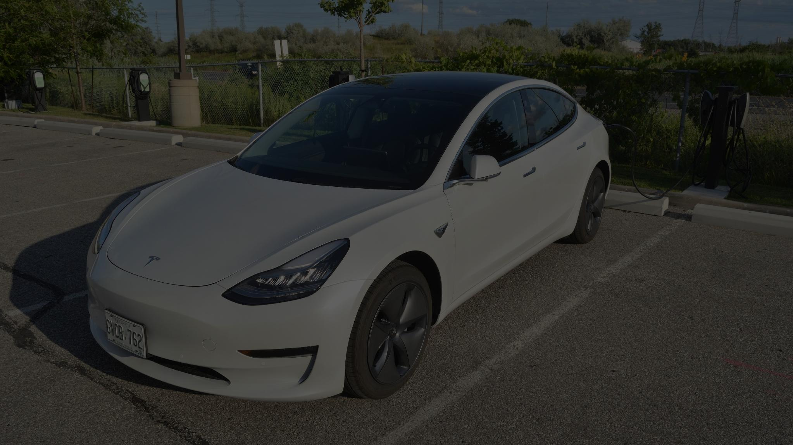
CASE STUDY
Tesla’s IoT System
for Electric Vehicle
Management
01
Notes:
Teaching notes:
- Open with the question: Is Tesla only a vehicle, or should we analyze it as an IoT platform?
- Frame the lecture as a systems analysis case rather than a discussion of Tesla as a company.
References:
- Tesla Support, “Tesla App”, https://www.tesla.com/support/tesla-app
- Tesla Support, “Software Updates”, https://www.tesla.com/support/software-updates
- Tesla, “Supercharger”, https://www.tesla.com/supercharger

Slide 60
Opening Question
Is a Tesla a car, a computer, or an IoT device?
Collects data
Connects to the Internet
Receives remote commands
Updates software
Interacts with cloud + mobile app
02
Notes:
Teaching notes:
- Expected answers: a Tesla is all three. It is a physical vehicle, a computer system, and an IoT node.
- Use the prompt to transition to the concept of a software-defined vehicle.
References:
- Tesla Support, “Tesla App”, https://www.tesla.com/support/tesla-app
- Tesla Support, “Software Updates”, https://www.tesla.com/support/software-updates

Slide 61
The Smart EV Management Problem
A connected EV must be managed as a mobile, software-defined, safety-critical asset.
Vehicle state
Energy & charging
Software & service
Access control
location
online/offline
doors/trunk/charge port
battery level
charging session
charging cost/history
OTA version
diagnostic alerts
maintenance workflow
owner account
authorized drivers
third-party APIs
Discussion: Which of these is most critical for safety? Which is most critical for business value?
Sources: Tesla App; Fleet API; Supercharger; Software Updates
05
Notes:
Teaching notes:
- This slide introduces the management perspective: not merely controlling the vehicle, but managing the full lifecycle.
- Ask students to rank the four categories by criticality.
References:
- Tesla Support, “Tesla App”, https://www.tesla.com/support/tesla-app
- Tesla Developer Docs, “Fleet API”, https://developer.tesla.com/docs/fleet-api/getting-started/what-is-fleet-api
- Tesla, “Supercharger”, https://www.tesla.com/supercharger
- Tesla Support, “Software Updates”, https://www.tesla.com/support/software-updates

Slide 62
Tesla from an Information Systems Perspective
A vehicle becomes a managed digital object with identity, permissions, data, and workflows.
Digital identity
User account
+ permissions
Vehicle as
IoT endpoint
Operational
data
Service and
analytics workflows
Every action may generate data for operations, maintenance, analytics, product improvement, and customer service.
Sources: Fleet API; Customer Privacy Notice
06
Notes:
Teaching notes:
- Connect to Information Systems concepts: identity management, authorization, transactions/events, analytics, service workflows.
- Emphasize that data from the vehicle supports multiple organizational functions, but also raises privacy and governance issues.
References:
- Tesla Developer Docs, “Fleet API”, https://developer.tesla.com/docs/fleet-api/getting-started/what-is-fleet-api
- Tesla, “Customer Privacy Notice”, https://www.tesla.com/legal/privacy

Slide 63
Overall System Architecture
High-level view of major components and interactions.
User
Tesla App
Tesla Cloud
Identity + APIs
Tesla Vehicle
Edge + Sensors
Supercharger
Network
Fleet / Third-party
API Client
Service
System
Two typical flows: User → App → Cloud → Vehicle, and Vehicle → Cloud → App / Service / Charging.
Sources: Tesla App; Fleet API; Supercharger; Software Updates
07
Notes:
Teaching notes:
- Point out that the vehicle is not a passive client. It is a connected edge node that can both send data and receive commands.
- Use this slide as the map for the rest of the lecture.
References:
- Tesla Support, “Tesla App”, https://www.tesla.com/support/tesla-app
- Tesla Developer Docs, “Fleet API”, https://developer.tesla.com/docs/fleet-api/getting-started/what-is-fleet-api
- Tesla, “Supercharger”, https://www.tesla.com/supercharger
- Tesla Support, “Software Updates”, https://www.tesla.com/support/software-updates

Slide 64
Five-Layer IoT Model in the Tesla Case
A teaching model to map Tesla features to general IoT architecture.
5. Application & service
Tesla App, dashboard, notifications, service portal
4. Cloud platform
identity, vehicle registry, telemetry, OTA, billing
3. Connectivity
cellular, Wi‑Fi, Bluetooth, charging network, APIs
2. In‑vehicle edge
BMS, motor control, local processing, alerts
1. Devices & sensors
cameras, GPS, temperature, doors, charge port
Sources: IoT architecture literature; Tesla App; Fleet Telemetry
08
Notes:
Teaching notes:
- Explain that this is a pedagogical mapping. Names differ across sources, but the layered thinking is useful for analysis.
- Ask students to place a feature such as OTA or remote climate control into the appropriate layers.
References:
- IoT five-layer architecture: perception, network/transport, processing, application, business layer; see e.g., IoT architecture literature.
- Tesla Support, “Tesla App”, https://www.tesla.com/support/tesla-app
- Tesla Developer Docs, “Fleet Telemetry”, https://developer.tesla.com/docs/fleet-api/fleet-telemetry

Slide 65
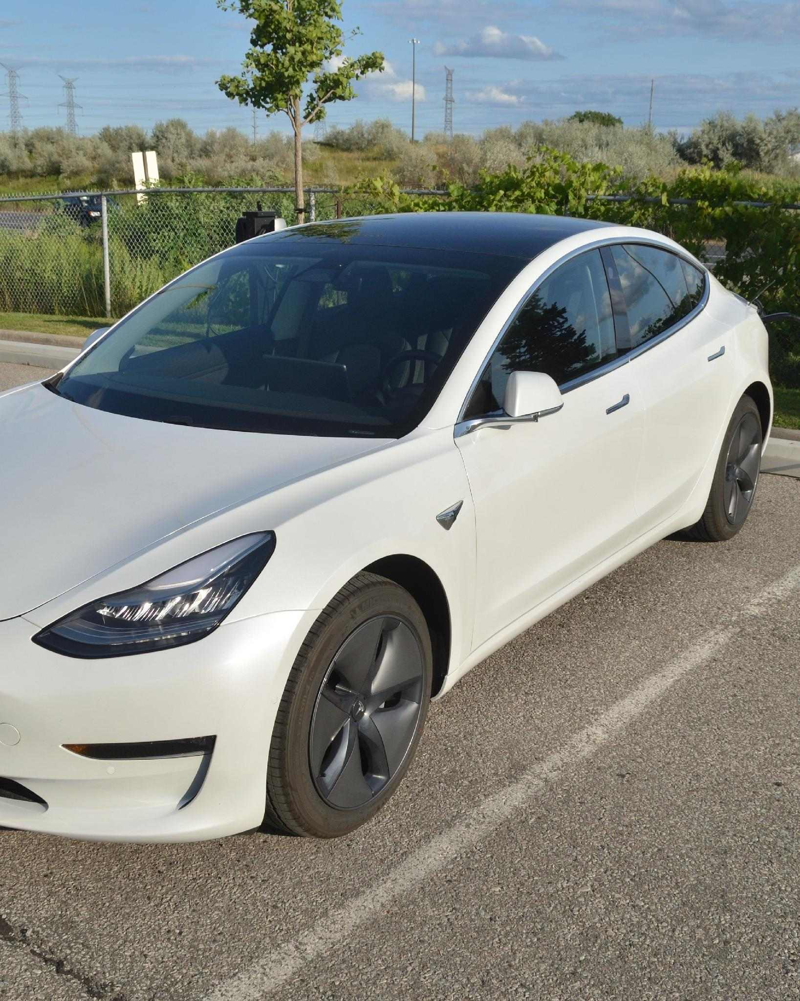
Device and Sensor Layer in the Vehicle
Physical states are captured by sensors and controllers.
Position & motion
GPS, speed, acceleration
Energy system
Battery Management System, current, voltage, temperature
Vehicle body
doors, trunk, charge port, locks
Environment
cameras, external perception, driver assistance inputs
Human interface
central touchscreen, alerts, controls
Teaching focus: sensors convert vehicle and environment states into data; controllers can act on physical components.
Sources: Tesla Model 3 Owner’s Manual; Fleet Telemetry Available Data
09
Notes:
Teaching notes:
- Use this slide to connect IoT perception layer to real vehicle components.
- Avoid going too deep into automotive engineering; focus on data sources and control points.
References:
- Tesla Model 3 Owner’s Manual, https://www.tesla.com/ownersmanual/model3/en_us/Owners_Manual.pdf
- Tesla Developer Docs, “Fleet Telemetry: Available Data”, https://developer.tesla.com/docs/fleet-api/fleet-telemetry/available-data

Slide 66
Edge Computing in the Vehicle
Low-latency and safety-critical tasks should be processed locally.
Process locally on the vehicle
Use cloud for coordination
Battery management and thermal control
Motor and brake-related control loops
Safety alerts and local status visualization
Camera data processing for driver assistance
Operation when cloud connectivity is unavailable
Account and access management
Fleet analytics and reporting
OTA distribution and status tracking
Charging history and billing
Service workflows and notifications
Rule of thumb: safety-critical control loops belong at the edge; enterprise and lifecycle workflows belong in the cloud.
Sources: IoT architecture literature; Tesla Owner’s Manual; FSD supervised documentation
10
Notes:
Teaching notes:
- Ask: what would happen if lane visualization or battery control depended on a distant cloud server?
- This distinction between edge and cloud is central to IoT systems.
References:
- IoT five-layer architecture: perception, network/transport, processing, application, business layer; see e.g., IoT architecture literature.
- Tesla Model 3 Owner’s Manual, https://www.tesla.com/ownersmanual/model3/en_us/Owners_Manual.pdf
- Tesla Support, “Full Self-Driving (Supervised)”, https://www.tesla.com/support/fsd

Slide 67
Tesla Cloud Platform
Cloud services coordinate accounts, vehicles, telemetry, updates, charging, and service.
Identity & access
accounts, ownership, permissions
Vehicle registry
vehicle ID, specs, software version
Telemetry ingestion
realtime signals and alerts
OTA update service
download, install status, release tracking
Charging & billing
sessions, cost, payment method
Diagnostics & notification
service alerts and user messages
System design question: Which cloud service should be highly available even if the app or analytics module is degraded?
Sources: Fleet API; Fleet Telemetry; Software Updates
11
Notes:
Teaching notes:
- Cloud platform is where Information Systems concepts become visible: identity, data, workflows, integration, monitoring.
- Encourage students to distinguish operational services from analytics services.
References:
- Tesla Developer Docs, “Fleet API”, https://developer.tesla.com/docs/fleet-api/getting-started/what-is-fleet-api
- Tesla Developer Docs, “Fleet Telemetry”, https://developer.tesla.com/docs/fleet-api/fleet-telemetry
- Tesla Support, “Software Updates”, https://www.tesla.com/support/software-updates

Slide 68
Tesla Mobile App
The app is the user-facing control and monitoring interface.
Main functions
View battery level
Check charging status and history
View vehicle location / connectivity status
Lock or unlock the vehicle
Turn on climate control remotely
Receive notifications
Monitor software updates
User
App
Cloud
API
Vehicle
Read operations: status, charge, location
Command operations: lock/unlock, climate, charge port
Sources: Tesla App support
12
Notes:
Teaching notes:
- Differentiate read operations from command operations. Commands have stricter security implications.
- Point out that app features are a concrete example of application layer services.
References:
- Tesla Support, “Tesla App”, https://www.tesla.com/support/tesla-app
- Tesla Developer Docs, “Fleet API Authentication Overview”, https://developer.tesla.com/docs/fleet-api/authentication/overview

Slide 69
Remote Vehicle Control: Data Flow
Example: user sends a command from the app to the vehicle.
1
User sends request
in Tesla App
2
Cloud authenticates
account + scope
3
Cloud forwards
command
4
Vehicle executes
command
5
Status feedback
returns to app
Example commands
Security concerns
Unlock vehicle
Turn on climate control
Open charge port
Wake vehicle
Schedule software update
Account compromise
Overbroad API permissions
Unlogged commands
Replay or spoofing risk
Sources: Tesla App; Fleet API authentication/scopes
13
Notes:
Teaching notes:
- This is a simple sequence diagram; remind students that real systems include retries, timeouts, logs, and secure channels.
- Focus the discussion on access control and auditability.
References:
- Tesla Support, “Tesla App”, https://www.tesla.com/support/tesla-app
- Tesla Developer Docs, “Fleet API Authentication Overview”, https://developer.tesla.com/docs/fleet-api/authentication/overview
- Tesla Developer Docs, “Fleet API”, https://developer.tesla.com/docs/fleet-api/getting-started/what-is-fleet-api

Slide 70
OTA Software Updates
Over-the-air updates allow the vehicle to improve after purchase.
1
Develop
2
Test
3
Release
4
Download
5
Install
6
Report
Purposes
Significance
Control needs
Add features
Fix software bugs
Improve performance
Adjust vehicle functions
Continuous product improvement
Fewer service-center visits for software fixes
Lifecycle-based software product model
Signed packages
Version control
Rollback plan
Post-install monitoring
Sources: Tesla Software Updates
14
Notes:
Teaching notes:
- Tesla states that OTA updates can introduce new features and updates, making the vehicle safer and more capable over time.
- During installation, the vehicle cannot be driven as a safety measure. Use this to discuss release governance.
References:
- Tesla Support, “Software Updates”, https://www.tesla.com/support/software-updates

Slide 71
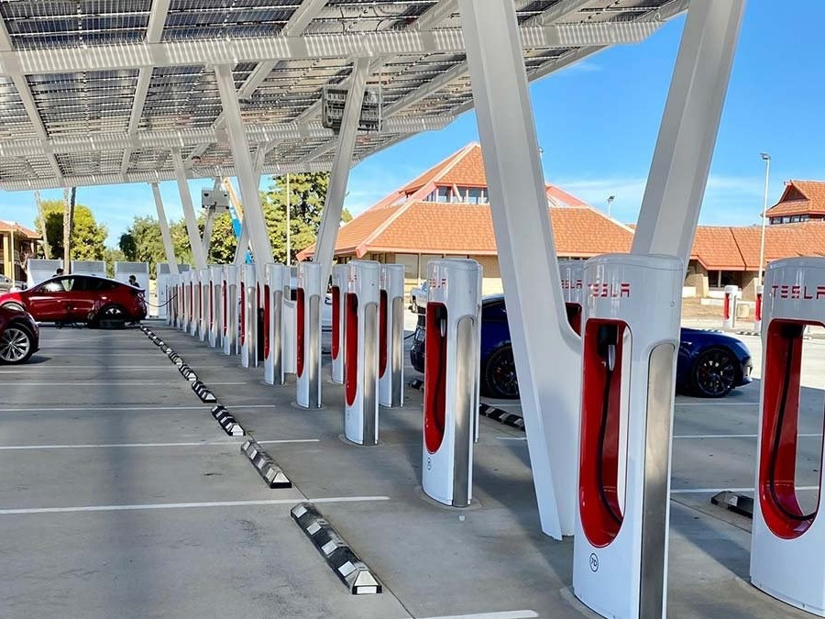
Charging Management and Supercharger Network
Charging is an IoT service linking vehicle, station, app, cloud, and payment.
Navigate
Trip Planner selects charging route
Plug in
Vehicle starts charging automatically
Monitor
App shows real-time charging status
Bill / history
Session cost and history are recorded
Tesla states that the app can show Supercharger stall availability, charge status, and notifications when ready to go.
Sources: Tesla Supercharger
15
Notes:
Teaching notes:
- Explain that charging management is not only an electrical problem. It includes availability, session state, payment, notifications, and historical data.
- Ask students: what happens if station connectivity fails during a charging session?
References:
- Tesla, “Supercharger”, https://www.tesla.com/supercharger
- Tesla Support, “Tesla App”, https://www.tesla.com/support/tesla-app

Slide 72
Fleet Telemetry and Fleet Management
For organizations, streaming telemetry supports dashboards and operational decisions.
Polling approach
Streaming telemetry approach
Fleet
App
API
Vehicle
Vehicle
Telemetry
Server
Dashboard
Repeated vehicle_data calls
Can wake the vehicle
May increase battery drain
Vehicle streams selected data
More efficient for fleets
Supports real-time operations
Tesla describes Fleet Telemetry as a way to stream vehicle data directly to a server and avoid unnecessary polling.
Sources: Tesla Developer: Fleet Telemetry; Available Data
16
Notes:
Teaching notes:
- This slide is important for IoT design: do not blindly poll devices at high frequency.
- Discuss sampling, minimum delta, signal selection, and battery impact.
References:
- Tesla Developer Docs, “Fleet Telemetry”, https://developer.tesla.com/docs/fleet-api/fleet-telemetry
- Tesla Developer Docs, “Fleet Telemetry: Available Data”, https://developer.tesla.com/docs/fleet-api/fleet-telemetry/available-data

Slide 73
Digital Twin and Event-Driven Architecture
A digital representation of a vehicle supports monitoring, history, and decision support.
Vehicle ID
VIN / model / configuration
Operational state
battery, charge, online/offline
Digital Twin
Vehicle Profile
Owner & permissions
account, roles, third-party access
History
charging, faults, maintenance
Software state
current version, update status
Events
BatteryLow, ChargingStarted, OTAInstalled
NIST describes a digital twin as a computer model of a physical system that can support monitoring, optimization, and decision support.
Sources: NIST Digital Twins; Tesla Fleet Telemetry Available Data
17
Notes:
Teaching notes:
- Emphasize that the digital twin is not the vehicle; it is a data model that helps other systems reason about the vehicle.
- Connect digital twin to event-driven architecture: changes in the physical object trigger digital updates and actions.
References:
- NIST, “Digital Twins”, https://www.nist.gov/digital-twins
- Tesla Developer Docs, “Fleet Telemetry: Available Data”, https://developer.tesla.com/docs/fleet-api/fleet-telemetry/available-data

Slide 74
Value of Tesla’s IoT System
Connected vehicle data creates value for users, Tesla, and fleet operators.
Users
Tesla
Fleet operators
smart vehicle experience
remote control
continuous updates
convenient charging
operational data
faster fault detection
lower service cost
software service model
central dashboard
battery and charging KPIs
maintenance alerts
cost optimization
Business insight: connected vehicles shift value from one-time product sales toward lifecycle services, analytics, and software-enabled experiences.
Sources: Tesla App; Software Updates; Supercharger; Fleet Telemetry
18
Notes:
Teaching notes:
- Use this slide to connect technical architecture to business value.
- Ask students to identify the stakeholders and what each stakeholder gains from the IoT system.
References:
- Tesla Support, “Tesla App”, https://www.tesla.com/support/tesla-app
- Tesla Support, “Software Updates”, https://www.tesla.com/support/software-updates
- Tesla, “Supercharger”, https://www.tesla.com/supercharger
- Tesla Developer Docs, “Fleet Telemetry”, https://developer.tesla.com/docs/fleet-api/fleet-telemetry

Slide 75
Risks and Control Measures
Security, privacy, and safety must be designed into the IoT system.
Risks
Control measures
Account compromise
Exposure of location data
API abuse or excessive polling
OTA pipeline attack
Software fault affecting safety
Misunderstanding driver assistance as full autonomy
Strong authentication and scoped authorization
Encryption and secure command protocol
Access control and audit logs
Digitally signed updates
API rate limiting and telemetry filtering
Rollback and incident response plan
Tesla states FSD (Supervised) does not make the vehicle fully autonomous and does not replace the driver.
Sources: NIST IoT Cybersecurity; Tesla Privacy; Fleet API Authentication; FSD Supervised
19
Notes:
Teaching notes:
- Tie risk categories to course concepts: confidentiality, integrity, availability, safety, and privacy.
- Use the FSD note to clarify that driver assistance is not the same as fully autonomous driving.
References:
- NIST SP 800-213, “IoT Device Cybersecurity Guidance”, https://csrc.nist.gov/pubs/sp/800/213/final
- Tesla, “Customer Privacy Notice”, https://www.tesla.com/legal/privacy
- Tesla Developer Docs, “Fleet API Authentication Overview”, https://developer.tesla.com/docs/fleet-api/authentication/overview
- Tesla Support, “Full Self-Driving (Supervised)”, https://www.tesla.com/support/fsd

Slide 76
Discussion and Summary
End the session with synthesis questions and transferable lessons.
Discussion questions
Key takeaways
If you design a dashboard to manage 500 Tesla vehicles, what KPIs should it include?
Which data should be processed inside the vehicle, and which data should be sent to the cloud?
Which component should receive the highest security priority, and why?
Tesla is a cyber-physical IoT system.
Core value lies in data, software, and services.
Modern IoT combines devices, edge computing, cloud platforms, cybersecurity, and business models.
Sources: Tesla ecosystem sources; NIST IoT cybersecurity; NIST Digital Twins
20
Notes:
Teaching notes:
- Reserve 8–10 minutes for discussion.
- If time is short, ask students to answer only the dashboard KPI question.
References:
- Tesla Support, “Tesla App”, https://www.tesla.com/support/tesla-app
- Tesla Support, “Software Updates”, https://www.tesla.com/support/software-updates
- Tesla, “Supercharger”, https://www.tesla.com/supercharger
- Tesla Developer Docs, “Fleet Telemetry”, https://developer.tesla.com/docs/fleet-api/fleet-telemetry
- NIST SP 800-213, “IoT Device Cybersecurity Guidance”, https://csrc.nist.gov/pubs/sp/800/213/final
- NIST, “Digital Twins”, https://www.nist.gov/digital-twins

Slide 77
Chapter Summary
Key takeaways
• IoT connects physical objects, digital systems, users, and business processes.
• A complete IoT system includes devices, connectivity, gateways, edge/cloud platforms, applications, and users.
• IoT evolved from Internet, RFID, M2M, WSN, cloud/mobile, and embedded systems.
• Sensors produce data; actuators create physical action; platforms turn data into services.
• IoT creates value through real-time monitoring, automation, and data-driven decision making.
• Major domains include smart home, smart city, healthcare, agriculture, transportation, infrastructure, and industry.
49
Notes:
Teaching notes: Close the lecture by connecting the chapter to later topics: architecture, protocols, platforms, analytics, and security.

Slide 78
References Used in This Lecture
• [R1] Serpanos & Wolf, Internet-of-Things (IoT) Systems, Springer, 2018.
• [R2] Alam, Shakil & Khan (eds.), Internet of Things (IoT): Concepts and Applications, Springer, 2020.
• [R3] IoT & Applications Digital Notes, MRCET, Unit 1: Fundamentals of IoT.
• [R4] Khan & Yuce (eds.), Internet of Things (IoT): Systems and Applications, Jenny Stanford Publishing, 2019.
• [R5] Van Steen & Tanenbaum, Distributed Systems, 4th ed., 2025.
Figures adapted or excerpted from the provided teaching documents for classroom use.
50
Notes:
Teaching notes: End with references.

Slide 79
Tesla Support – Tesla App: https://www.tesla.com/support/tesla-app
Tesla Support – Software Updates: https://www.tesla.com/support/software-updates
Tesla – Supercharger: https://www.tesla.com/supercharger
Tesla Developer Docs – Fleet API: https://developer.tesla.com/docs/fleet-api/getting-started/what-is-fleet-api
Tesla Developer Docs – Fleet Telemetry: https://developer.tesla.com/docs/fleet-api/fleet-telemetry
Tesla Developer Docs – Fleet Telemetry Available Data: https://developer.tesla.com/docs/fleet-api/fleet-telemetry/available-data
Tesla – Customer Privacy Notice: https://www.tesla.com/legal/privacy
Tesla Support – Full Self-Driving (Supervised): https://www.tesla.com/support/fsd
NIST SP 800-213 – IoT Device Cybersecurity Guidance: https://csrc.nist.gov/pubs/sp/800/213/final
NIST – Digital Twins: https://www.nist.gov/digital-twins
Tesla Model 3 Owner’s Manual: https://www.tesla.com/ownersmanual/model3/en_us/Owners_Manual.pdf
Images: Wikimedia Commons and public web image search results used for classroom illustration.
21
Notes:
Teaching notes:
- This slide may be hidden during teaching or kept as the final appendix slide.
- Encourage students to use official documentation when analyzing commercial IoT systems.
References:
- Tesla Support, “Tesla App”, https://www.tesla.com/support/tesla-app
- Tesla Support, “Software Updates”, https://www.tesla.com/support/software-updates
- Tesla Developer Docs, “Fleet API”, https://developer.tesla.com/docs/fleet-api/getting-started/what-is-fleet-api
- Tesla Developer Docs, “Fleet Telemetry”, https://developer.tesla.com/docs/fleet-api/fleet-telemetry
- Tesla Developer Docs, “Fleet Telemetry: Available Data”, https://developer.tesla.com/docs/fleet-api/fleet-telemetry/available-data
- Tesla, “Supercharger”, https://www.tesla.com/supercharger
- Tesla, “Customer Privacy Notice”, https://www.tesla.com/legal/privacy
- Tesla Developer Docs, “Fleet API Authentication Overview”, https://developer.tesla.com/docs/fleet-api/authentication/overview

