Slide 1
Chapter 3. Protocols, Networks, and Communication Standards in IoT
1

Slide 2

Chapter Learning Outcomes
What students should be able to explain and design
Explain the constraints and traffic characteristics of IoT networks.
Compare short-range access technologies, LPWAN, and cellular IoT options.
Explain IPv4, IPv6, 6LoWPAN, and compatibility mechanisms.
Explain RPL routing in low-power and lossy networks.
Compare CoAP, MQTT, AMQP, request-response, and publish-subscribe.
Describe the roles of IETF, IEEE, ETSI, and oneM2M.
Select and justify an end-to-end protocol stack for a given application.
2

Slide 3
Agenda
3.1 Network characteristics
3.2 Access + LPWAN
3.3 IP + 6LoWPAN
3.4 RPL
3.5 App protocols
3.6 Standards
3.7 Selection + activity
3

Slide 4
Opening Scenario: Smart Campus Environmental Monitoring
One application, several networking requirements
Battery-powered air-quality sensors are installed indoors and outdoors.
Indoor radio signals must penetrate walls and coexist with Wi-Fi networks.
Outdoor sensors may be several kilometers from the nearest gateway.
Dangerous pollution events require timely and reliable delivery.
Historical measurements must be stored in a cloud platform.
Question: should every device use the same access and application protocol?
Sensors
Gateway
Backhaul
Cloud
Dashboard
Design tension
Range, energy, latency, payload size, reliability, and cost cannot all be optimized simultaneously.
4

Slide 5
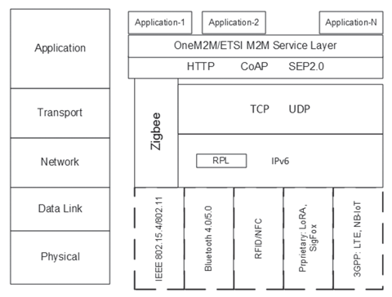
Where Do IoT Protocols Operate?
A protocol stack connects physical transmission to application services
Physical and data-link protocols determine radio access and framing.
Network and routing protocols provide addressing and path selection.
Transport protocols provide connection-oriented or datagram delivery.
Application protocols define resource access and message exchange.
Service layers support interoperability, management, and reusable functions.
Source figure: [R2] Khan & Yuce, Fig. 1.6, p. 20
Chapter 3
5

Slide 6
3.1 Characteristics of Networks in IoT
Why conventional Internet assumptions often fail at the edge
6

Slide 7
3.1.1 Why IoT Networks Are Different
Constrained endpoints interact with dynamic physical environments
Constrained endpoints
Machine-generated traffic
Physical consequences
Limited processing, memory, energy, and buffer capacity.
Periodic telemetry, event alerts, commands, and bursty updates.
Communication failures can affect safety and actuation.
Long lifetimes
Heterogeneity
Scale
Devices may remain deployed for years in unattended locations.
Multiple vendors, radios, protocol stacks, and data models.
A deployment may include thousands or millions of endpoints.
3.1
7

Slide 8
3.1.2 Constrained IoT Nodes
Node limitations shape the complete communication stack
Resource Constraints
Architectural Consequences
Limited CPU and memory
Small packet buffers
Battery or harvested energy
Low-cost radio hardware
Limited security acceleration
Compact packet formats
Short control exchanges
Sleep-aware protocols
Local filtering and aggregation
Gateway-assisted services
3.1
8

Slide 9
3.1.3 Low-Power and Lossy Networks
Wireless links may be unstable, asymmetric, and intermittent
Low data rates may range from a few kilobits to a few hundred kilobits per second.
Packet-delivery ratio can change with interference, distance, weather, and obstacles.
Links may be asymmetric: A can hear B, while B cannot reliably hear A.
Temporary disconnection is normal rather than exceptional.
Routing control traffic must remain small to avoid consuming scarce capacity.
General principle: underreact to transient failure and avoid network-wide instability.
Example: fluctuating link quality
Time →
Sources: [R1], constrained-network discussion; [R3], wireless networks
9

Slide 10
3.1.4 IoT Traffic Patterns
A network must support more than periodic sensor reporting
Periodic telemetry
Event alert
Command / response
Temperature every 5 minutes
Smoke detected immediately
Open valve and confirm state
Bursty upload
Many-to-one
One-to-many
Batch of buffered measurements
Sensors report to a gateway
Firmware or configuration update
10

Slide 11
3.1.5 Communication Range
The physical deployment determines the required network reach
PAN
LAN
MAN
WAN
1–10 m
10–100 m
City scale
Kilometers
Wearable to phone
Building or factory
Parking and lighting
Agriculture and logistics
Select a protocol whose practical range matches the environment, antenna placement, regulatory limits, and required reliability.
11

Slide 12
3.1.6 Bandwidth, Payload, and Overhead
Small device messages can still create large aggregate traffic
Bandwidth limits how quickly measurements can be transferred upstream.
Packet headers are expensive when the application payload is only a few bytes.
Large payloads may require fragmentation over constrained links.
Images and video usually require Wi-Fi, Ethernet, or cellular broadband.
Local filtering and aggregation reduce traffic but may remove analytical detail.
Bidirectional applications must consider both uplink and downlink capacity.
Illustrative packet composition
10-byte sensor value
Header
Payload
100-byte telemetry
Header
Payload
1,000-byte record
Header
Payload
Source: [R1], bandwidth discussion
12

Slide 13
3.1.7 Energy Cost of Communication
Radio activity strongly affects battery lifetime
Longer range and poor link quality generally increase transmission energy.
Retransmissions, acknowledgements, and repeated network association add overhead.
Batching several readings may be more efficient than many short sessions.
Sleep scheduling reduces the time that the radio remains active.
Local processing can reduce traffic, but computation also consumes energy.
Design objective: balance lifetime, latency, reliability, and data freshness.
Device duty cycle
Sleep
Wake
Sense
TX
Sleep
Most of the operating time should be spent in a low-power state when the application permits.
13

Slide 14
3.1.8 Intermittent Connectivity and Reliability
Disconnection must be treated as a normal operating state
Devices may sleep, move out of coverage, or experience temporary interference.
Gateways can buffer messages until backhaul connectivity returns.
Acknowledgements and retries improve delivery but increase delay and energy.
Applications must define acceptable loss, duplication, and delivery delay.
Local safe operation should continue when cloud services are unavailable.
Connected
Degraded
Recovering
Offline
14

Slide 15
3.1.9 Heterogeneity, Interoperability, and Security
A complete solution crosses many administrative and protocol boundaries
Interoperability Challenges
Security Challenges
Different radio technologies
Different addressing schemes
Proprietary device profiles
Incompatible data semantics
Legacy industrial protocols
Device authentication
Key provisioning and rotation
Encryption overhead
Gateway and broker trust
Long-term update support
15

Slide 16
3.1.10 Network Performance Metrics
Metrics must be defined from the application perspective
Latency
Throughput
Loss rate
Time from physical event to useful response
Events or messages handled per second
Events or packets not delivered
Availability
Energy/message
Service lifetime
Probability that service is usable
Energy required for useful delivery
Expected duration of operation
3.1
16

Slide 17
3.2 IoT Access Technologies and LPWAN
Selecting the radio and link technology for the deployment environment
17

Slide 18
3.2.1 IoT Access Technology Landscape
Access technologies occupy different positions in the range–rate–energy space
Higher data rate ↑
4G/5G
Wi-Fi
LTE-M
Wi-Fi HaLow
NB-IoT
BLE
802.15.4
LoRaWAN
NFC/RFID
Longer range →
Sources: [R1], access technology overview
18

Slide 19
3.2.2 Comparison Dimensions
Protocol selection begins with measurable application constraints
Range
Data rate
Energy
Topology
meters to kilometers
bytes/day to video
mains to multi-year battery
star, mesh, cellular
Mobility
Spectrum
Security
Cost
fixed, nomadic, moving
licensed or unlicensed
link and end-to-end
device, infrastructure, service
19

Slide 20
3.2.3 IEEE 802.15.4 Overview
A low-rate PHY and MAC foundation for constrained wireless networks
Designed for low-cost, low-data-rate, battery-powered devices.
Defines physical and MAC layers rather than a complete application stack.
Provides small frames, device association, acknowledgements, and link security.
Supports star, peer-to-peer, tree, and mesh-oriented deployments.
Forms the lower-layer foundation for ZigBee, Thread, 6LoWPAN, ISA100.11a, and other profiles.
Typical uses: building automation, smart energy, industrial sensing, and remote controls.
Design profile
Low rate + low power + low complexity
Key limitation
Small frame size and variable wireless reliability
20

Slide 21
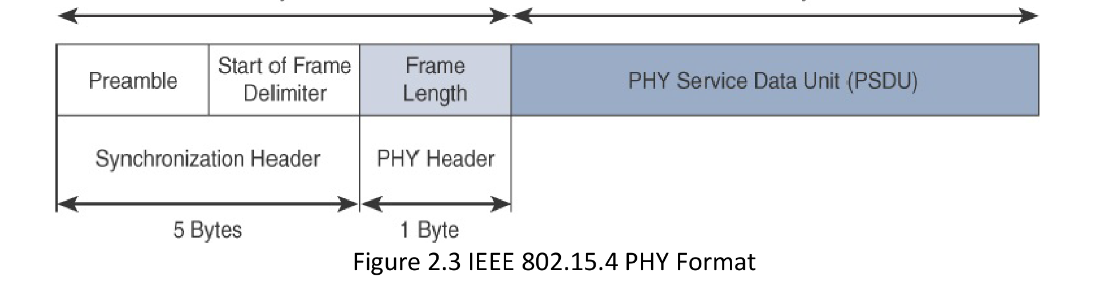
3.2.4 IEEE 802.15.4 Physical Layer
The PHY defines modulation, channels, synchronization, and the transmitted frame
Frequency options include 2.4 GHz and regional sub-GHz bands.
Data rate depends on band and modulation.
The synchronization header identifies the start of a frame.
The PHY header identifies the expected frame length.
The PHY service data unit carries the MAC frame.
Source figure: [R1], Fig. 2.3, p. 42
21

Slide 22
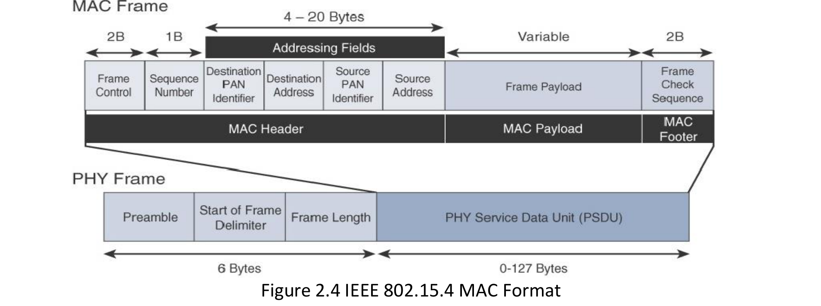
3.2.5 IEEE 802.15.4 MAC Layer
The MAC coordinates channel access, framing, association, and integrity
Four frame categories: data, beacon, acknowledgement, and command.
MAC header contains control, sequence, and addressing fields.
MAC payload depends on the selected frame type.
Frame check sequence detects transmission errors.
64-bit extended addresses and shorter local addresses are supported.
Source figure: [R1], Fig. 2.4, p. 43
22

Slide 23
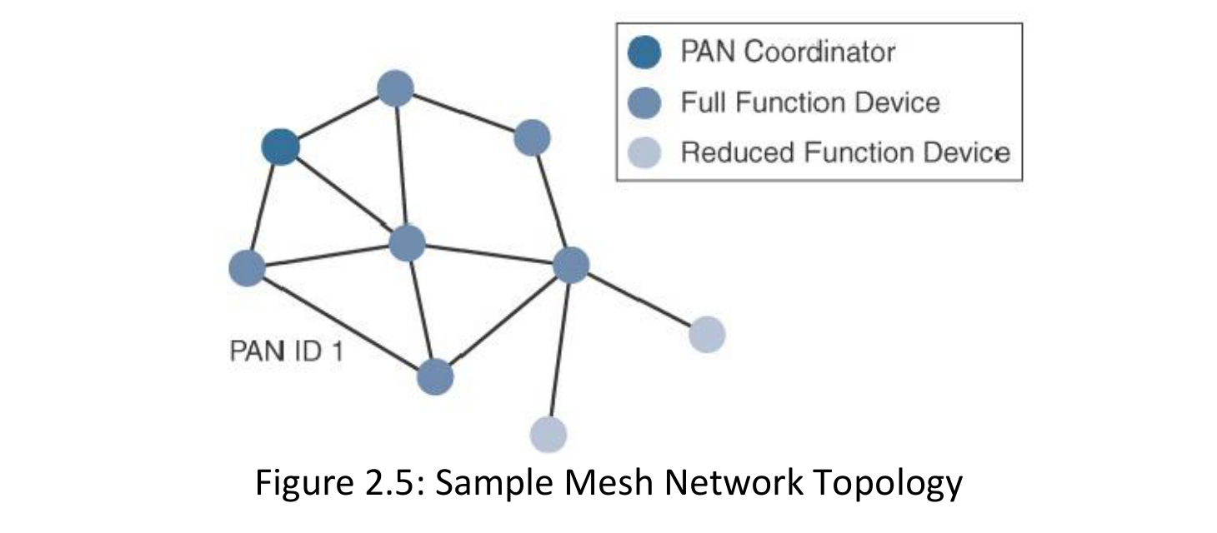
3.2.6 IEEE 802.15.4 Topologies
Mesh communication extends coverage through intermediate nodes
Star topology centralizes communication through a coordinator.
Peer-to-peer links permit direct communication among capable devices.
Mesh paths extend range and provide alternative routes.
Mesh-under forwards below the IP layer.
Route-over uses a network-layer routing protocol such as RPL.
Topology affects control overhead, reliability, energy, and manageability.
Source figure: [R1], Fig. 2.5, p. 44
23

Slide 24
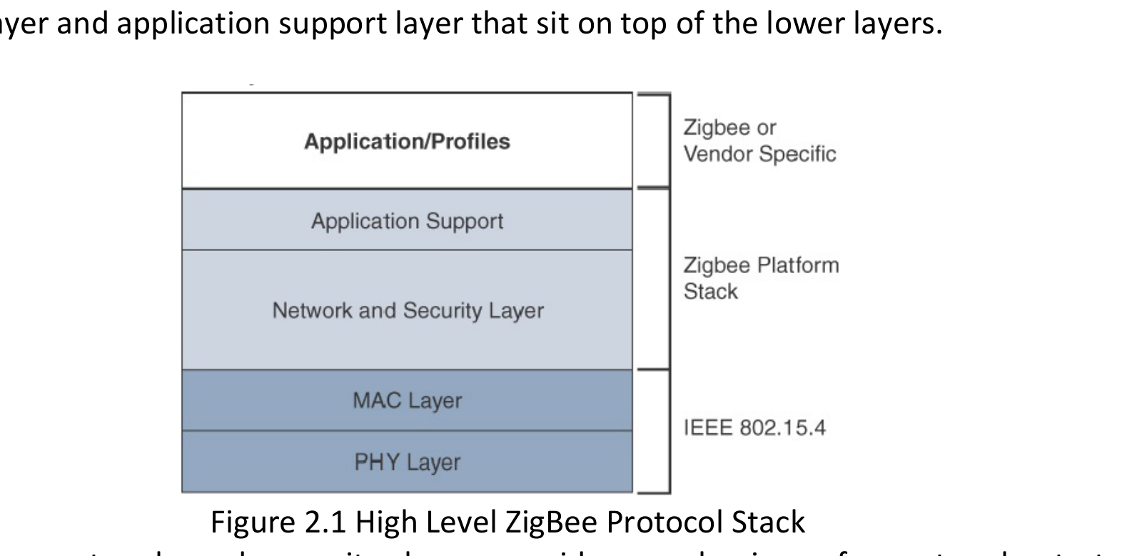
3.2.7 ZigBee Protocol Stack
ZigBee adds network, security, and application services above IEEE 802.15.4
IEEE 802.15.4 supplies the PHY and MAC layers.
ZigBee network layer manages topology, routing, discovery, and security.
Application support connects the network stack to device applications.
Profiles standardize common functions such as lighting and smart energy.
Interoperability depends on common profiles and certification.
Source figure: [R1], Fig. 2.1, p. 40
24

Slide 25
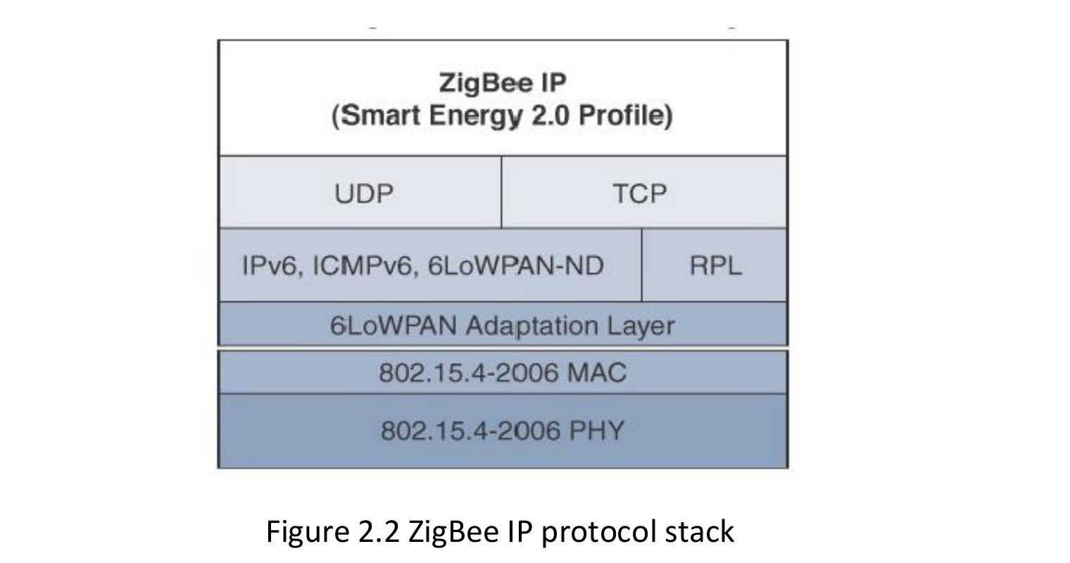
3.2.8 ZigBee IP and Open Standards
An IP-oriented stack improves integration beyond a single alliance ecosystem
6LoWPAN adapts IPv6 to IEEE 802.15.4.
IPv6 and ICMPv6 provide addressing and network control.
RPL provides routing across the low-power mesh.
UDP and TCP offer datagram and connection-oriented transport.
Open Internet protocols enable broader interoperability.
Source figure: [R1], Fig. 2.2, p. 41
25

Slide 26
3.2.9 IEEE 802.11ah and Wi-Fi HaLow
Sub-GHz Wi-Fi extends range and improves support for low-power stations
Key Enhancements
Suitable Uses
Sub-GHz operation
Shorter MAC headers
Restricted Access Window
Target Wake Time
Support for many stations
Smart meters and utilities
Industrial sensor aggregation
Extended-range Wi-Fi
Building and agriculture sensing
Low-rate devices requiring IP/Wi-Fi integration
26

Slide 27
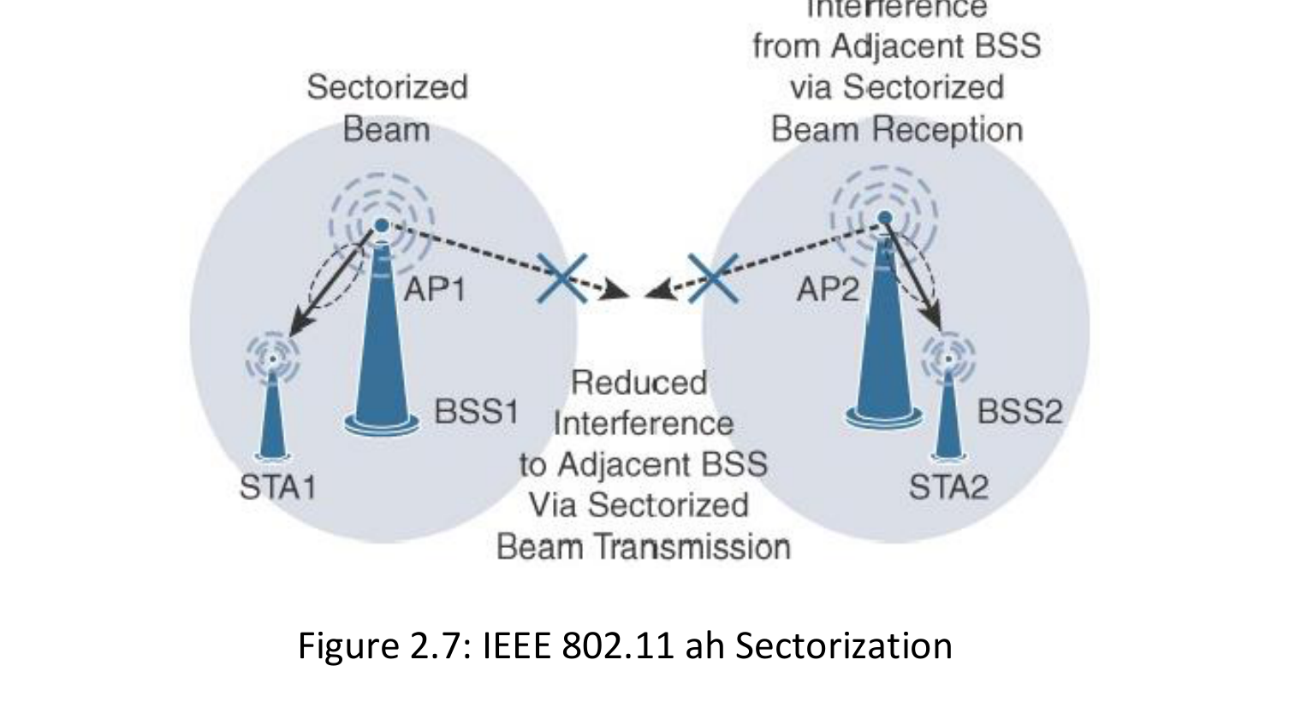
3.2.10 IEEE 802.11ah Sectorization
Spatial scheduling reduces contention in large cells
Coverage is divided into directional sectors.
Only selected groups contend during assigned windows.
Interference between neighboring access points is reduced.
Battery-powered endpoints spend less time contending for access.
Sectorization improves capacity but increases infrastructure complexity.
Source figure: [R1], Fig. 2.7, p. 48
27

Slide 28
3.2.11 What Is LPWAN?
Low-Power Wide-Area Networking targets small messages over long distances
Long range
Low energy
Low data rate
Kilometers rather than meters
Multi-year battery targets
Small and infrequent payloads
Large scale
High link budget
Trade-offs
Many endpoints per network
Coverage in difficult locations
Delay and limited downlink capacity
28

Slide 29
3.2.12 Licensed and Unlicensed LPWAN
Spectrum choice affects interference, ownership, and recurring cost
Unlicensed Spectrum
Licensed Cellular Spectrum
LoRaWAN and alliance-based solutions
Enterprise may deploy private infrastructure
No cellular spectrum subscription
Potential interference and duty-cycle limits
Coverage depends on gateway placement
NB-IoT and LTE-M
Operator-managed infrastructure
Controlled spectrum and wide coverage
SIM/eSIM and recurring service cost
Mobility and roaming depend on service
29

Slide 30
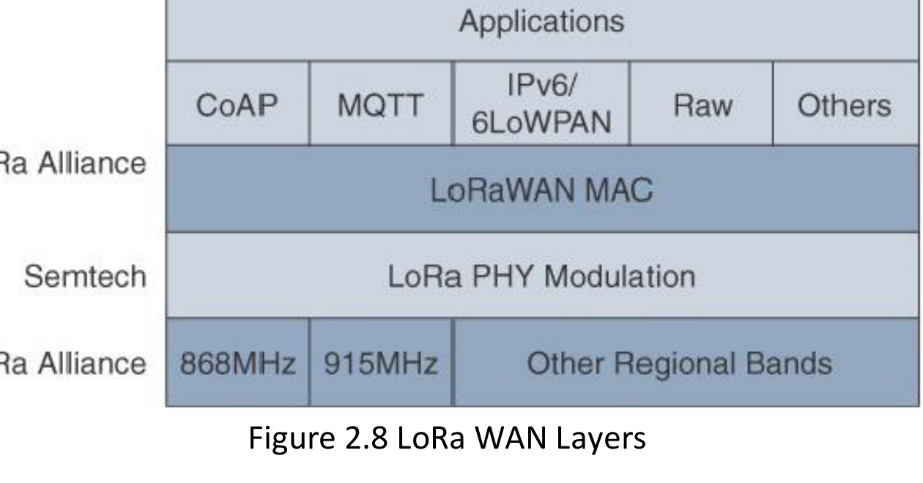
3.2.13 LoRa and LoRaWAN Layers
LoRa defines radio modulation; LoRaWAN defines MAC and system behavior
LoRa uses chirp spread spectrum at the physical layer.
LoRaWAN defines MAC behavior and regional frequency profiles.
Application payload may carry raw data or higher-layer protocols.
Spreading factor trades data rate for communication distance.
Operation uses unlicensed regional sub-GHz bands.
Source figure: [R1], Fig. 2.8, p. 49
30

Slide 31
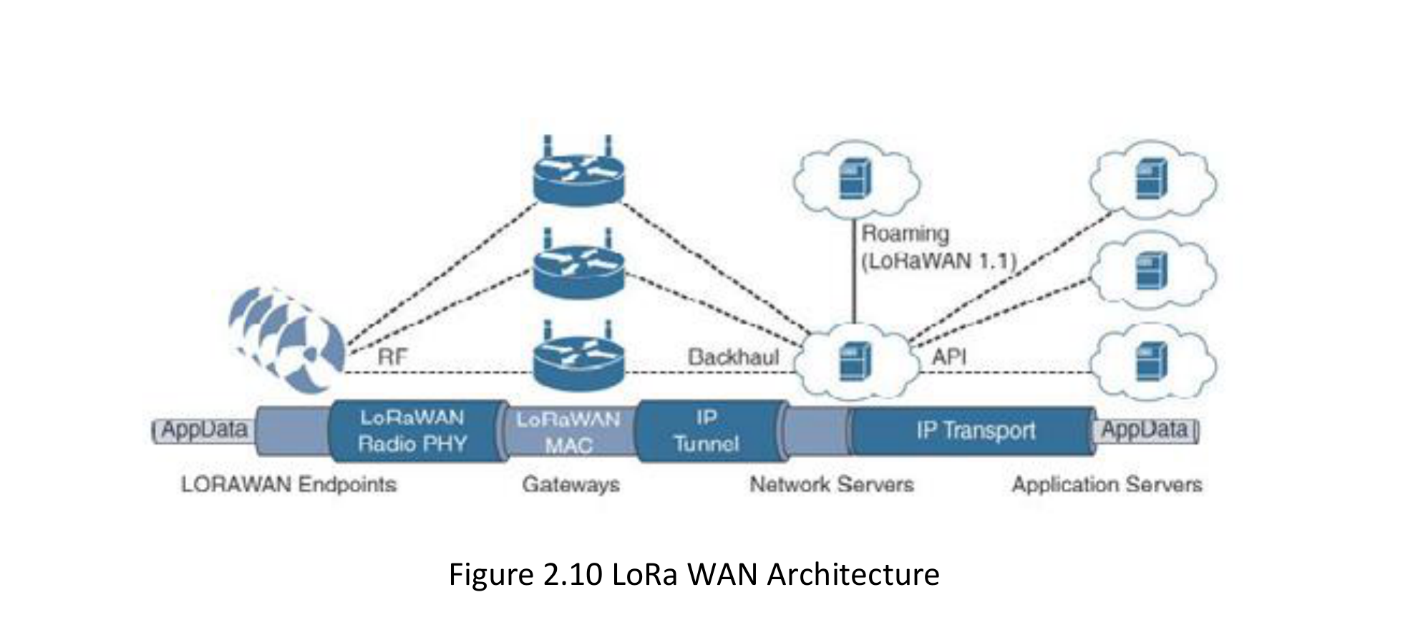
3.2.14 LoRaWAN Architecture
A star-of-stars network connects endpoints to centralized network services
Endpoints communicate with one or more gateways.
Gateways bridge radio traffic to an IP backhaul.
Network server removes duplicates and manages radio parameters.
Application server processes the business payload.
Multiple gateways improve coverage and diversity.
Source figure: [R1], Fig. 2.10, p. 53
31

Slide 32
3.2.15 LoRaWAN Data Rate, ADR, and Device Classes
Battery lifetime and downlink responsiveness are explicit design choices
Class A
Class B
Class C
Lowest energy
Receive windows after uplink
Scheduled receive
Additional synchronized windows
Lowest downlink delay
Receiver open when not transmitting
Adaptive Data Rate
ADR increases data rate and reduces transmit power when link conditions permit; distant devices use slower rates and higher power.
32

Slide 33
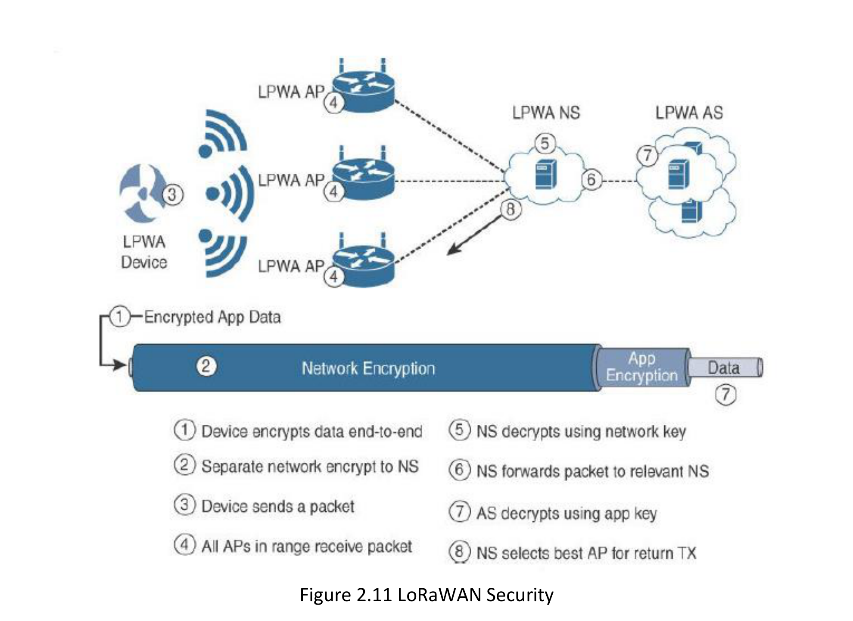
3.2.16 LoRaWAN Security and Activation
Network and application protection use separate security contexts
Network session key protects MAC-level integrity and network operations.
Application session key protects application payload confidentiality.
ABP preconfigures address and session keys.
OTAA performs a join procedure and derives session keys.
Gateway backhaul also requires protection and operational security.
Source figure: [R1], Fig. 2.11, p. 54
33

Slide 34
3.2.17 NB-IoT
Cellular LPWAN for low-rate and largely stationary devices
Technical Profile
Best Fit
Trade-offs
Licensed cellular spectrum
Narrow bandwidth
Strong indoor coverage
Low device complexity
Operator-managed access
Smart meters
Utility infrastructure
Environmental monitoring
Fixed asset status
Infrequent telemetry
Subscription dependency
Limited mobility support
Higher latency than broadband cellular
Operator coverage constraints
Module and certification cost
34

Slide 35
3.2.18 LTE-M
Cellular IoT for mobility, more frequent communication, and higher data rates
Technical Profile
Best Fit
Trade-offs
Licensed LTE infrastructure
Higher rate than NB-IoT
Mobility and handover
Lower latency
Voice support in some profiles
Moving asset tracking
Wearables
Vehicle telemetry
Logistics
Frequent bidirectional updates
More energy than very low-rate LPWAN
Subscription dependency
Coverage varies by operator
More capable module required
Service and certification cost
35

Slide 36
3.2.19 Access-Technology Selection Exercise
Choose a technology and defend the dominant requirement
Smart electricity meter
Wearable health monitor
Remote farm sensor
Fixed, tiny daily payload, indoor coverage
Short range, mobility, frequent sync
Kilometer range, multi-year battery
Industrial video camera
Delivery vehicle
High rate, low latency, mains power
Mobility, wide coverage, bidirectional data
Justify range, rate, energy, mobility, cost, security, and infrastructure.
36

Slide 37
3.3 IPv4, IPv6, and Compatibility in IoT
Addressing constrained subnetworks while preserving legacy interoperability
37

Slide 38
3.3.1 IPv4 and IPv6 Addressing
Address size matters, but deployment architecture matters more
IPv4
IPv6
32-bit address space
Extensive legacy deployment
Private addressing and NAT
Common in industrial protocols
Limited standardized adaptation for new constrained links
128-bit address space
Large-scale unique addressing
Auto-configuration support
Foundation for 6LoWPAN and RPL
Increasing support in modern IoT stacks
38

Slide 39
3.3.2 Why IPv6 Is Important for IoT
IPv6 enables scalable addressing and open Internet integration
Address scale
Auto-configuration
Hierarchical routing
128-bit addresses support very large deployments
Nodes can form addresses with less manual configuration
Prefix structure supports aggregation and routing design
Open protocols
End-to-end model
Interoperability
6LoWPAN, RPL, CoAP, and related IETF work
Reduces dependence on proprietary device addressing
Common network layer across heterogeneous links
39

Slide 40
3.3.3 IPv4 and IPv6 Coexistence
Most real deployments require transition rather than immediate replacement
IPv4 legacy devices
Dual-stack / gateway
IPv6 IoT subnet
Cloud services
Dual Stack
Tunneling
Translation / Proxy
A device or gateway operates IPv4 and IPv6 concurrently.
One protocol is carried through infrastructure using another.
A gateway maps addresses, messages, or application semantics.
Compatibility is an architectural responsibility, not only an addressing decision.
40

Slide 41
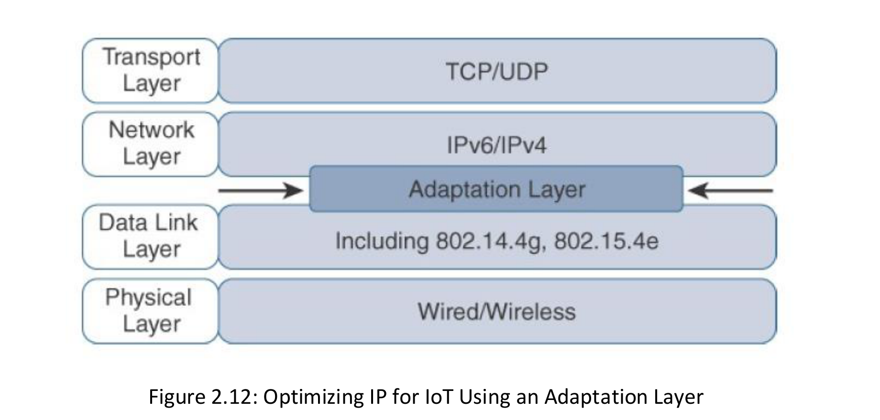
3.3.4 Why an Adaptation Layer Is Needed
Constrained links cannot carry native IP packets efficiently without optimization
Lower-layer frame size and timing differ across access technologies.
IPv6 headers are large relative to an IEEE 802.15.4 frame.
Adaptation defines encapsulation over the selected PHY and MAC.
IoT adaptation may add header compression and fragmentation.
The layer preserves IP integration while respecting link constraints.
Source figure: [R1], Fig. 2.12, p. 60
41

Slide 42
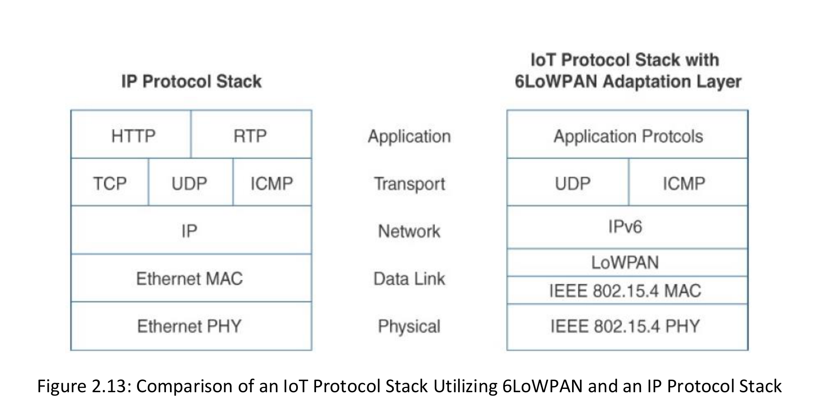
3.3.5 6LoWPAN in the Protocol Stack
6LoWPAN carries IPv6 efficiently over IEEE 802.15.4
6LoWPAN sits between IPv6 and IEEE 802.15.4.
It supports IPv6 header compression.
It provides fragmentation for packets larger than a link frame.
Optional mesh addressing may be included.
UDP and CoAP are common upper-layer choices.
6LoWPAN does not define an IPv4 adaptation.
Source figure: [R1], Fig. 2.13, p. 61
42

Slide 43
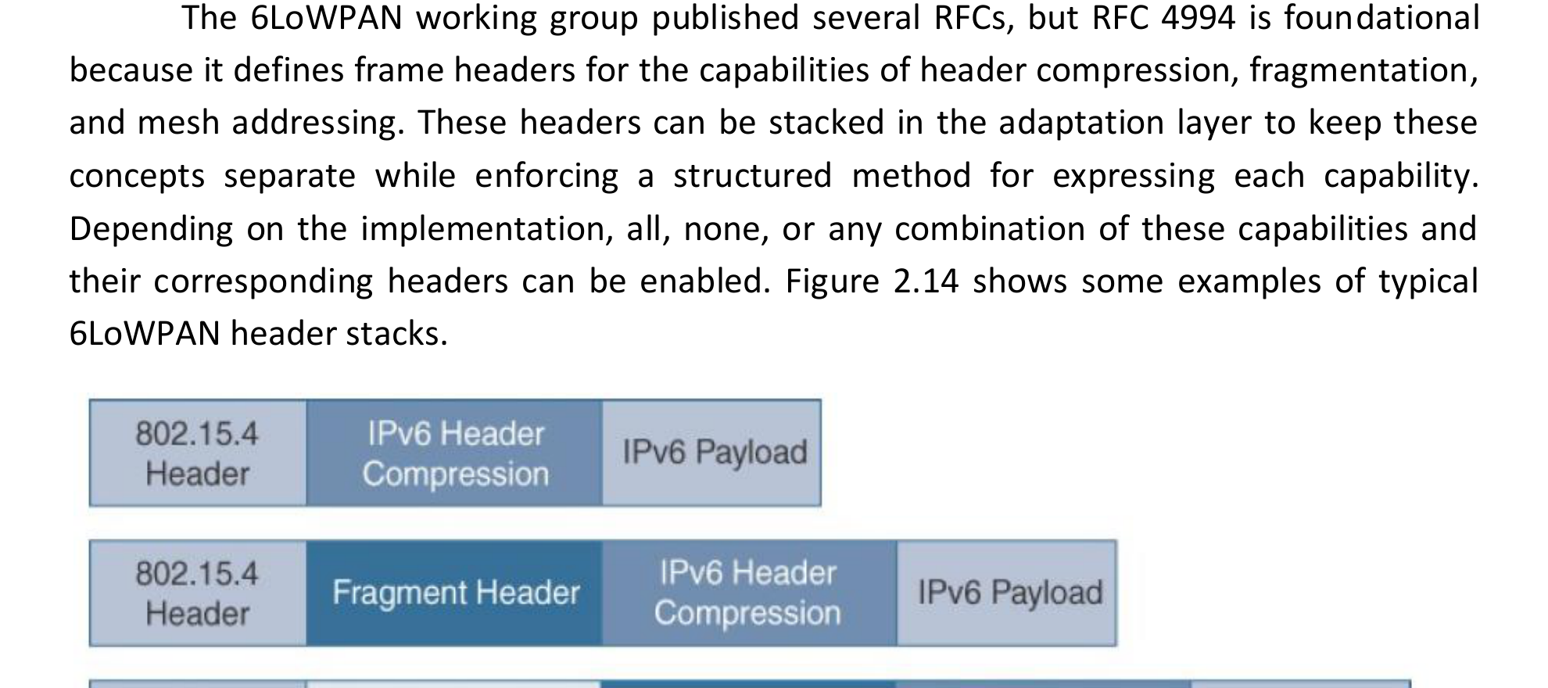
3.3.6 6LoWPAN Header Stack
Optional headers express compression, fragmentation, and mesh functions
Basic frame may carry a compressed IPv6 header and payload.
Fragment header is added when a packet spans several frames.
Mesh-addressing header supports forwarding below the IP layer.
Only the functions required by the deployment are included.
More headers reduce the remaining application payload.
Source figure: [R1], Fig. 2.14, p. 61
43

Slide 44
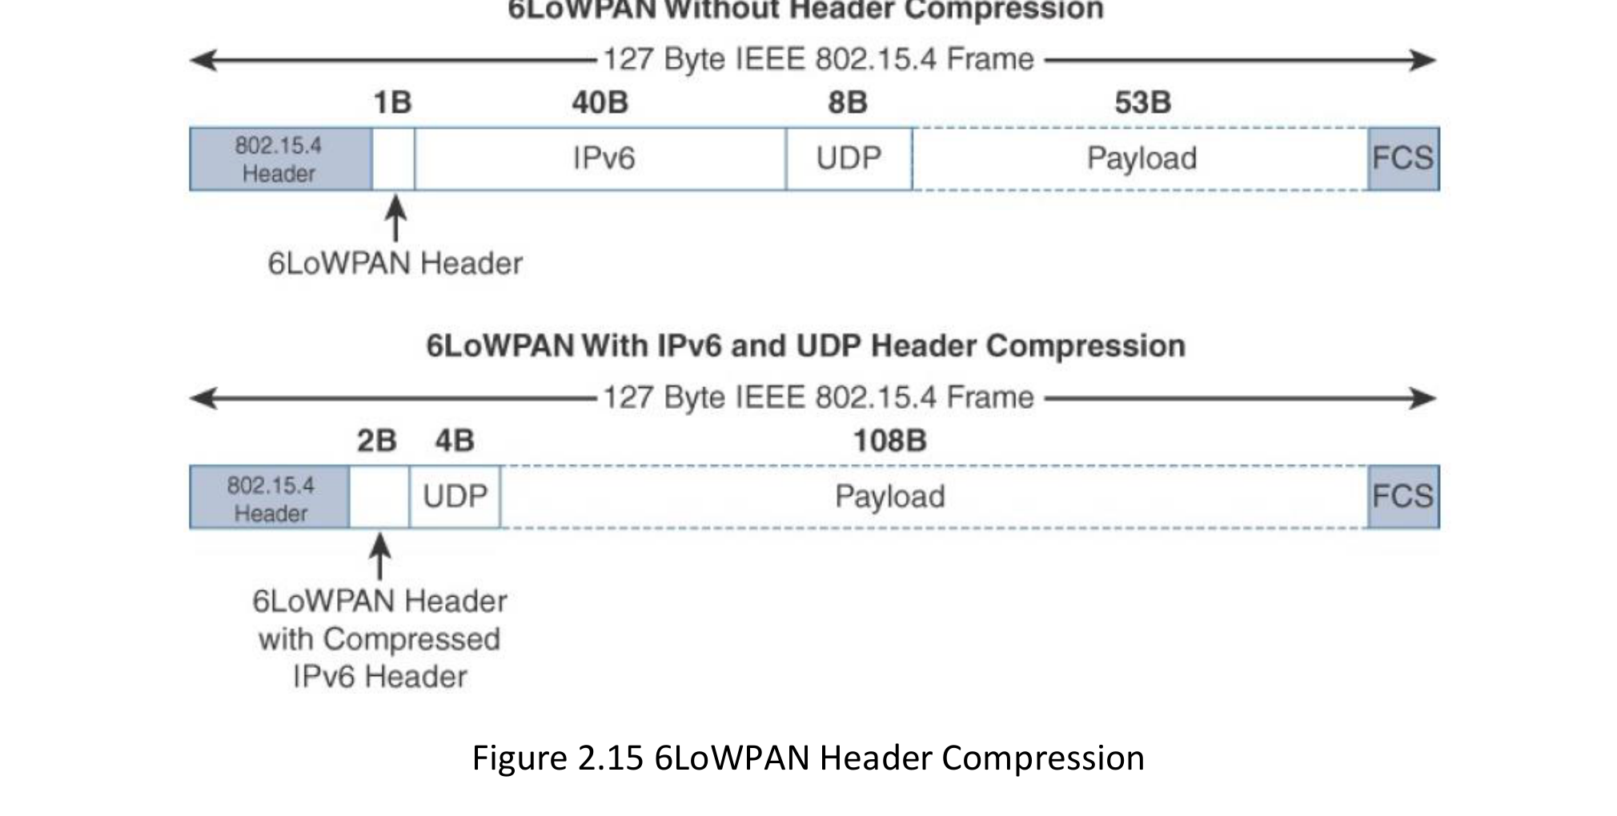
3.3.7 6LoWPAN Header Compression
Shared context and predictable values remove redundant information
Native IPv6 header: 40 bytes.
UDP header: 8 bytes.
Compression omits fields inferred from local context.
Best-case compression leaves substantially more application payload.
Less radio airtime reduces energy and fragmentation risk.
Source figure: [R1], Fig. 2.15, p. 62
44

Slide 45
3.3.8 Fragmentation and MTU Challenges
A single IPv6 packet may require several constrained-link frames
IPv6 packet
Large network-layer packet
Fragment 1
Fragment 2
Fragment 3
Fragment 4
Loss of one fragment may prevent reassembly of the complete packet.
Fragmentation consumes buffer memory, airtime, and energy.
Application payloads should remain compact when operating over constrained links.
45

Slide 46
3.3.9 Compatibility Case: Legacy Industrial Network
Where should protocol adaptation occur?
IPv4 Modbus controller
Industrial gateway
IPv6 / 6LoWPAN sensors
Cloud analytics
Gateway Responsibilities
Design Questions
Risk
Serial or IPv4 integration
Data normalization
Security boundary
Translate at network layer?
Proxy at application layer?
Preserve end-to-end identity?
A simple translator may preserve packets but lose application semantics and security context.
46

Slide 47
3.4 RPL Routing in Low-Power and Lossy Networks
Routing IPv6 traffic while minimizing control overhead and energy use
47

Slide 48
3.4.1 Why Conventional Routing Is Difficult in LLNs
The best path may change with energy, reliability, and interference
Unstable links
Energy limits
Small memory
Link quality changes over time
Parent selection affects battery drain
Nodes cannot store large routing tables
Control overhead
Asymmetry
Many-to-one traffic
Frequent updates consume scarce bandwidth
Upward and downward quality may differ
Most sensors report toward one root
48

Slide 49
3.4.2 RPL Overview
An IPv6 routing protocol designed for low-power and lossy networks
RPL is developed through IETF work on routing over low-power and lossy networks.
It organizes nodes into a destination-oriented directed acyclic graph.
The root is normally a border router or data-collection point.
Nodes select parents using an Objective Function.
Metrics may include link quality, hop count, latency, or remaining energy.
RPL supports both upward data collection and downward control.
Core Design Goal
Maintain useful routes while keeping control traffic and node state sufficiently small for constrained devices.
49

Slide 50
3.4.3 DODAG Structure
Nodes select parents that progress toward a common root
Root
A
R1
B
R1
C
R1
D
R2
E
R2
F
R2
G
R2
H
R3
Rank increases away from the root; directed edges must not create routing loops.
50

Slide 51
3.4.4 Rank and Objective Function
RPL separates graph structure from the policy used to choose a parent
Rank
Objective Function
Relative position toward the root
Must increase away from the root
Prevents directed routing loops
Not necessarily equal to hop count
Changes when topology or metric changes
Computes rank and preferred parent
Uses one or more metrics
Examples: ETX, energy, latency, hop count
Encodes application priorities
No universal objective is best
51

Slide 52
3.4.5 RPL Control Messages
A small set of messages builds and maintains the routing graph
DIO
DIS
DODAG Information Object
Advertises root, instance, rank, and configuration
DODAG Information Solicitation
Requests nearby nodes to send DIO information
DAO
DAO-ACK
Destination Advertisement Object
Advertises downward reachability toward descendants
DAO Acknowledgement
Confirms processing of downward-route information
52

Slide 53
3.4.6 Upward and Downward Routing
RPL supports sensor collection and command delivery
DODAG Root
Border router / collector
Node 1
Node 2
Node 3
Node 4
Sensor / actuator
Sensor / actuator
Sensor / actuator
Sensor / actuator
Solid blue: upward multipoint-to-point telemetry
Dashed orange: downward point-to-multipoint control
Storing mode distributes downward state; non-storing mode relies more heavily on the root.
53

Slide 54
3.4.7 Trickle Timer and Network Repair
Stable networks should remain quiet; inconsistency should trigger controlled updates
Trickle increases the interval between control messages when information is consistent.
Inconsistency resets the interval so that updates propagate more quickly.
Local repair attempts to change parent or route near the failure.
Global repair creates a new graph version from the root.
Excessive repair traffic can reduce capacity and battery lifetime.
Control-message interval
Stable → longer intervals | inconsistency → reset
54

Slide 55
3.4.8 Worked RPL Routing Example
The best parent is selected by policy, not by hop count alone
Candidate route from Node X
Objective 1: Minimum ETX
Via Parent A
Choose Parent B, but risk draining a low-energy parent.
2 hops | ETX 3.1 | Energy 80%
Via Parent B
Objective 2: Energy-Aware
3 hops | ETX 1.8 | Energy 25%
Choose Parent C to balance reliability and parent lifetime.
Via Parent C
3 hops | ETX 2.0 | Energy 70%
Teaching Point
A routing metric encodes application priorities and can create unintended side effects.
55

Slide 56
3.4.9 RPL Limitations and Security Risks
Routing attacks can redirect traffic or exhaust constrained nodes
Rank attack
Sinkhole
Control flooding
Advertise false progress toward the root
Attract traffic through a malicious node
Force excessive DIO/DIS/DAO processing
Selective forwarding
Version attack
Parent exhaustion
Drop selected packets after joining routes
Trigger unnecessary global repair
Concentrate traffic on a low-energy node
56

Slide 57
3.5 Application-Layer Protocols and Publish/Subscribe
Selecting the interaction model for resources, telemetry, and enterprise messaging
57

Slide 58
3.5.1 Application Messaging in the IoT Stack
Application protocols build on network and transport services
Applications
CoAP | MQTT | AMQP
UDP | TCP
IPv6 / IPv4
6LoWPAN / Link Adaptation
IEEE 802.15.4 | Wi-Fi | LPWAN | Cellular
Typical mapping: CoAP over UDP; MQTT over TCP; AMQP in broker and enterprise middleware.
58

Slide 59
3.5.2 Interaction Models
The communication model determines coupling and message flow
Request–Response
Publish–Subscribe
Queue-Based Messaging
Client asks for a resource or operation.
Best for direct resource interaction and explicit commands.
Publisher sends to a topic; broker forwards to subscribers.
Decouples producers and consumers.
Messages wait in a durable queue until a consumer processes them.
Useful for reliable workflows.
Client
Server
Pub
Broker
Sub
Producer
Queue
Consumer
59

Slide 60
3.5.3 CoAP Overview
A REST-oriented protocol for constrained resources
Constrained Application Protocol is developed through IETF CoRE work.
Uses resource-oriented URIs and methods similar to HTTP.
Normally operates over UDP for low overhead.
Supports confirmable and non-confirmable messages.
Provides discovery, caching, proxying, and observation extensions.
Appropriate for direct access to sensors, actuators, and device-management resources.
Typical Example
GET /sensors/temperature
PUT /actuators/valve
Observe /status
60

Slide 61
3.5.4 CoAP Message Types and Reliability
CoAP provides optional reliability above UDP
CON
NON
Confirmable
Retransmit until ACK or timeout
Non-confirmable
No application-level acknowledgement
ACK
RST
Acknowledgement
Confirms a CON message
Reset
Message received but not understood
61

Slide 62
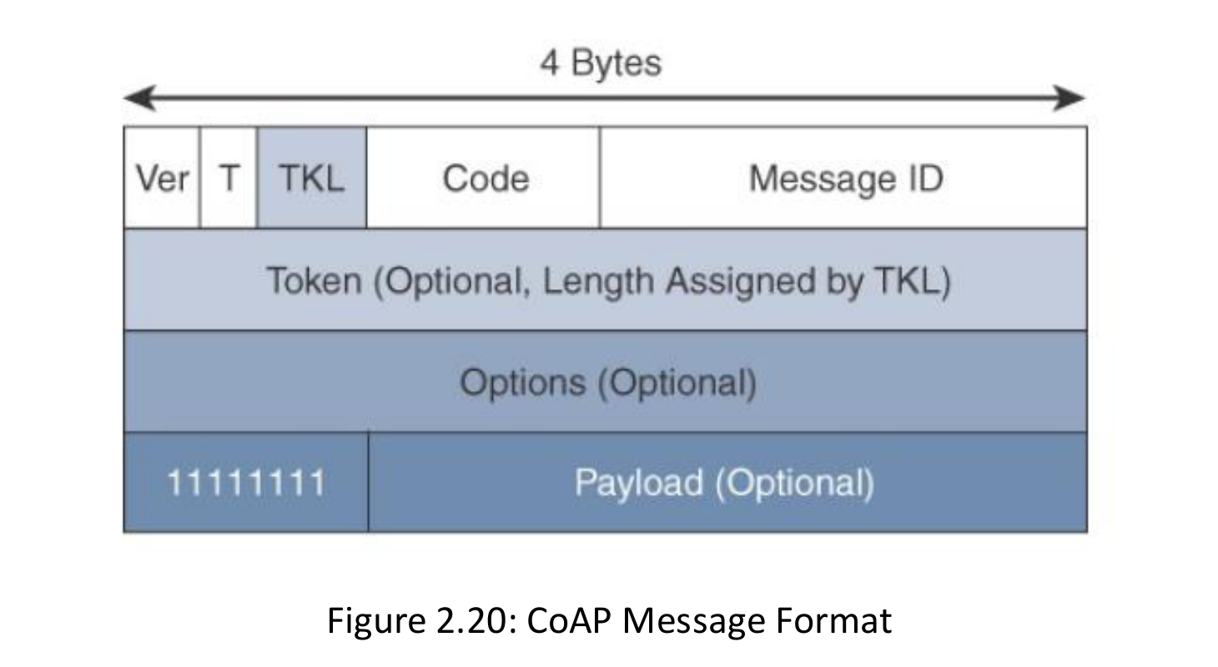
3.5.5 CoAP Message Format
A compact structure reduces parsing and transmission overhead
Fixed header is four bytes.
Token associates requests and responses.
Options encode URI, content format, and other metadata.
Payload is optional.
Small and predictable structure supports constrained parsing.
Messages should avoid unnecessary IP fragmentation.
62

Slide 63
3.5.6 CoAP Resources and Methods
REST semantics expose device state as addressable resources
GET
POST
Read a representation
Example: /sensors/temp
Create or trigger processing
Example: /measurements
PUT
DELETE
Update a known resource
Example: /actuators/valve
Remove a resource
Example: /subscriptions/7
63

Slide 64
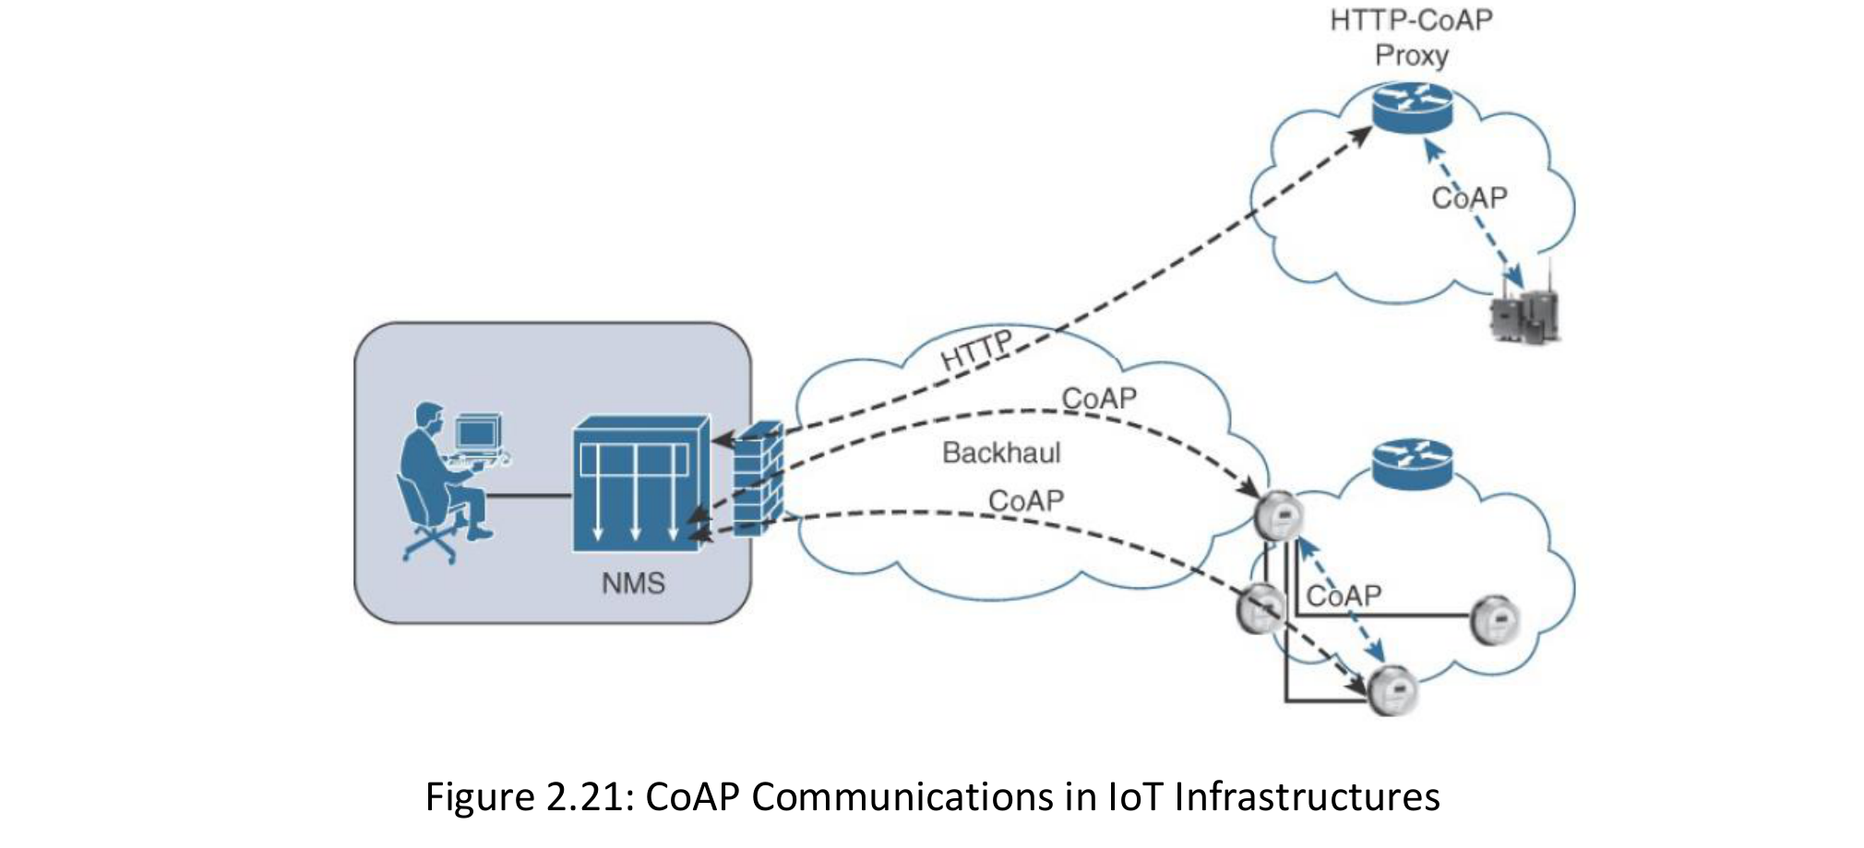
3.5.7 CoAP Proxies and IoT Infrastructure
Proxies bridge constrained resources with conventional web services
CoAP nodes can communicate within one constrained network or across IP networks.
HTTP–CoAP proxy maps web requests to constrained resources.
Caching reduces repeated access to sleeping or expensive nodes.
Proxy location depends on architecture, security, and management needs.
Gateways may translate both protocol syntax and application semantics.
Source figure: [R1], Fig. 2.21, p. 69
64

Slide 65
3.5.8 MQTT Overview
A lightweight broker-based publish/subscribe protocol for telemetry
Publishers send messages to named topics through a broker.
Subscribers receive messages for matching topic filters.
Publishers and subscribers do not need direct knowledge of each other.
MQTT normally operates over TCP.
The broker handles connection state, subscriptions, buffering, and authorization.
Common uses include sensor telemetry, device state, and cloud event distribution.
Example Topic Tree
campus/buildingA/room201/temp
campus/+/+/airquality
alerts/#
65

Slide 66
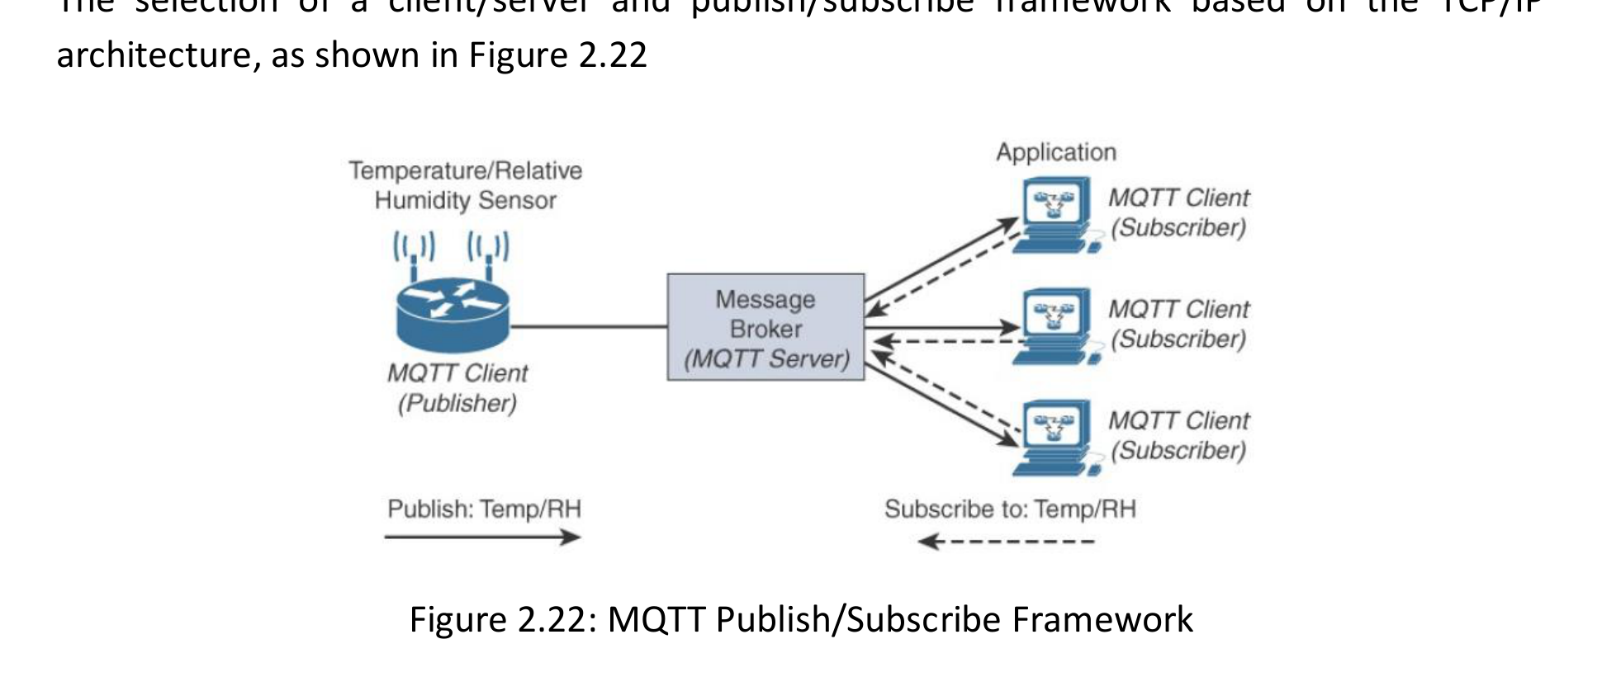
3.5.9 MQTT Publish/Subscribe Framework
The broker decouples data producers from consumers
Publisher sends data without identifying each consumer.
Broker matches published topics with subscription filters.
One publication can reach many subscribers.
Publishers and subscribers may be online at different times when broker state is retained.
Broker becomes a critical availability and security component.
Source figure: [R1], Fig. 2.22, p. 70
66

Slide 67
3.5.10 MQTT Topics and Message Features
Topic design affects scalability, authorization, and data governance
campus
Hierarchical topic names improve organization.
Wildcards support flexible subscriptions.
Retained messages provide the latest known state.
Last Will message signals unexpected disconnection.
Authorization should restrict publish and subscribe permissions.
Poor topic design creates governance and scaling problems.
buildingA
buildingB
room201
room202
temp
airquality
temp
airquality
67

Slide 68
3.5.11 MQTT Quality of Service
Delivery assurance increases protocol exchanges and state
QoS 0
QoS 1
QoS 2
At most once
PUBLISH
Lowest overhead; loss is possible
At least once
PUBLISH + PUBACK
Duplicates are possible
Exactly once protocol flow
Four-step exchange
Highest overhead and state
Select QoS according to loss tolerance, energy, bandwidth, latency, and application idempotency.
68

Slide 69
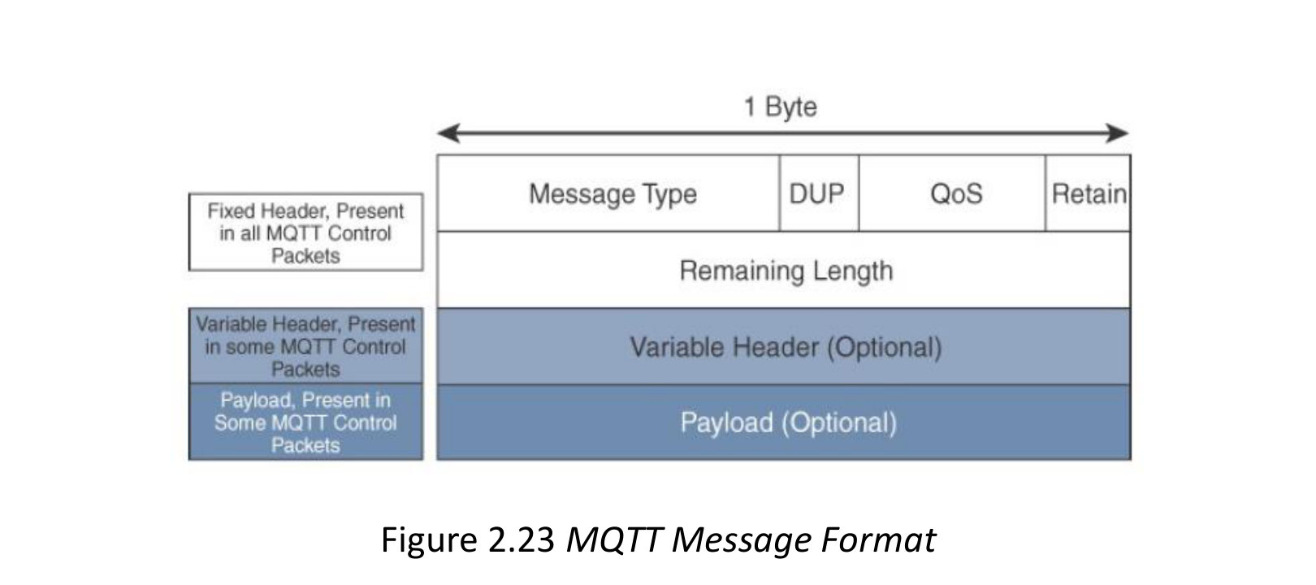
3.5.12 MQTT Packet Format and Security
A compact header is combined with TCP connection and broker security
Fixed header starts at two bytes.
Packet type identifies CONNECT, PUBLISH, SUBSCRIBE, and other control messages.
Variable header and payload depend on packet type.
TCP provides ordered byte delivery.
TLS protects transport; broker authentication and topic authorization remain necessary.
Persistent broker state must be protected and monitored.
Source figure: [R1], Fig. 2.23, p. 71
69

Slide 70
3.5.13 AMQP and Message-Oriented Middleware
AMQP supports durable routing and enterprise integration
Producer
Exchange
Queue
Consumer
Exchange
Queue
Best Fit
Routes messages according to type, key, and binding rules.
Stores messages until a consumer receives and acknowledges them.
Gateways, backend services, workflows, and enterprise middleware rather than tiny endpoints.
70

Slide 71
3.5.14 Comparing CoAP, MQTT, and AMQP
The protocol should match the interaction and deployment model
CoAP
MQTT
AMQP
REST request–response
Usually UDP
Direct resource access
Very constrained devices
Optional confirmable delivery
Publish–subscribe
Usually TCP
Broker required
Telemetry and events
QoS 0, 1, 2
Queue and routing
TCP-based middleware
Broker/exchange/queue
Enterprise workflows
Durable messaging
71

Slide 72
3.6 Standards Organizations and IoT Communication
Different organizations standardize complementary parts of the stack
72

Slide 73
3.6.1 The IoT Standards Ecosystem
No single organization defines the entire end-to-end system
IEEE
IETF
ETSI
PHY and MAC standards
Internet, routing, and application RFCs
Telecom and M2M architecture
oneM2M
3GPP
Industry alliances
Common service layer and interoperability
Cellular radio and core-network standards
Profiles, certification, and ecosystems
73

Slide 74
3.6.2 IETF and IEEE Roles
Internet protocols and access technologies are standardized in different communities
IETF
IEEE
IPv6 and Internet architecture
6LoWPAN and 6Lo adaptation
RPL through ROLL work
CoAP through CoRE work
Publishes standards as RFCs
IEEE 802.15.4 low-rate WPAN
IEEE 802.11ah Wi-Fi HaLow
IEEE 802.3 Ethernet
PHY and MAC frame specifications
Link-level security and access mechanisms
74

Slide 75
3.6.3 ETSI and M2M Standardization
Telecommunications architecture adds service capabilities and operational management
ETSI develops telecommunications standards and M2M service architecture concepts.
Service capabilities provide reusable functions above the access network.
Functions include registration, security, device management, and service exposure.
Architecture considers network operators, service providers, and application providers.
ETSI activities contributed to broader harmonization through oneM2M.
Application Domain
Smart metering, transport, healthcare, industry
Service Capabilities
Registration, security, management, data functions
Underlying Networks
Cellular, fixed, wireless, and constrained access
75

Slide 76
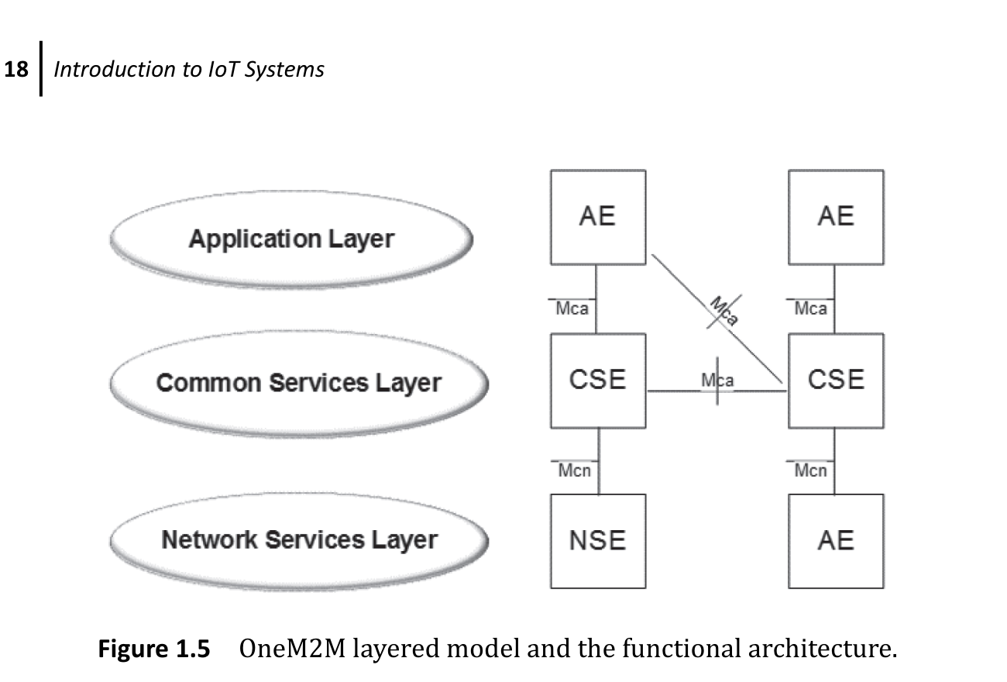
3.6.4 oneM2M Layered Model
Common services separate application logic from underlying network functions
Application Entity implements domain-specific application logic.
Common Services Entity provides reusable service functions.
Network Services Entity exposes capabilities from the underlying network.
Reference points standardize interactions among entities.
Common services include registration, security, data, communication, and device management.
Goal: cross-vendor and cross-domain interoperability.
Source figure: [R2], Fig. 1.5, p. 18
76

Slide 77
3.7 Selecting Protocols for an IoT Application
An end-to-end decision framework based on requirements and trade-offs
77

Slide 78
3.7.1 Protocol-Selection Framework
Choose the stack from application requirements downward
1. Application event
What is sensed or controlled? What response time is required?
2. Endpoint constraints
Energy, memory, processing, payload, and mobility
3. Access technology
Range, data rate, topology, spectrum, and cost
4. Network and routing
IP or non-IP, IPv4/IPv6, adaptation, and routing
5. Application messaging
Resource access, telemetry, queueing, and QoS
6. Security and operations
Identity, keys, updates, monitoring, and lifecycle
78

Slide 79
3.7.2 In-Class Group Design Activity
Select and justify a complete communication stack
Choose one scenario: smart irrigation, patient monitoring, smart building, industrial maintenance, smart parking, or cold-chain vehicles.
Define range, payload, event frequency, latency, mobility, energy, and loss tolerance.
Select an access technology and topology.
Define IPv4, IPv6, gateway, and routing strategy.
Select CoAP, MQTT, AMQP, or another application model.
Identify the relevant standards organizations and security controls.
Deliverable 1
One end-to-end protocol stack diagram
Deliverable 2
Three trade-offs and one rejected alternative
60-second presentation
State the dominant requirement that drove the design
79

Slide 80
Chapter Summary
IoT networks are constrained, heterogeneous, lossy, and energy-sensitive.
Access technology must match range, payload, mobility, and power requirements.
IPv6, 6LoWPAN, and RPL support open networking over constrained links.
CoAP, MQTT, and AMQP serve different interaction and deployment models.
IETF, IEEE, ETSI, and oneM2M standardize complementary system functions.
Protocol selection must consider the complete application and operational lifecycle.
Selected references
[R1] IoT & Applications Digital Notes, MRCET.
[R2] Khan & Yuce, Internet of Things: Systems and Applications, 2019.
[R3] Serpanos & Wolf, Internet-of-Things Systems, 2018.
80

