Slide 1

POSTS AND TELECOMMUNICATIONS INSTITUTE OF TECHNOLOGY
Chapter 4
Design and Development of IoT Solutions
1

Slide 2
Chapter 4 Learning Outcomes
What students should be able to design and justify
• Explain a systematic methodology for designing IoT solutions.
• Translate application requirements into device, network, platform, and application requirements.
• Model domain entities, information structures, services, functional views, and operational views.
• Explain embedded computing requirements for smart IoT devices.
• Select hardware according to computation, memory, I/O, communication, energy, cost, and deployment constraints.
• Build and evaluate an end-to-end IoT prototype.
2

Slide 3
Teaching Roadmap for 3 Hours
Structure of the teaching session
• 4.1 Overview of IoT system design methodology.
• 4.2 Basic design steps.
• 4.3 Embedded computing in IoT.
• 4.4 Microcontrollers, embedded processors, and hardware selection.
• 4.5 Common IoT development platforms.
• 4.6 Prototype model for IoT applications.
• 4.7 Device and system-component integration.
• 4.8 Experimental deployment of a basic IoT application.
3

Slide 4
Opening Question: How Do We Build an IoT Solution?
Start from the problem, not from a board or a cloud service
• Do we begin by buying sensors?
• Do we begin by selecting Arduino or Raspberry Pi?
• Do we begin by creating a cloud account?
• Or should we first define the problem, users, data, constraints, and expected actions?
• Main message: hardware selection should follow system requirements, not precede them.
4

Slide 5
Running Case: Smart Classroom
A continuous example for the whole chapter
Environment
Sensors
Device
Network
Platform
Dashboard
Actuator
• Measure temperature, humidity, and optional air quality.
• Display current and historical conditions on a dashboard.
• Generate alerts and optionally control a fan, LED, or relay.
• Use the case to discuss requirements, embedded design, hardware selection, prototyping, integration, and testing.
5

Slide 6
4.1
Overview of IoT System Design
• Transform a real-world problem into an end-to-end cyber-physical information system.
• Allocate responsibilities across device, gateway, platform, application, and user workflow.
6

Slide 7
4.1.1 Why IoT Design Is Different
IoT combines software, hardware, networks, data, and physical effects
• Physical measurements may be noisy, delayed, or inaccurate.
• Devices have constrained power, memory, processing, and connectivity.
• Communication failures can affect sensing, automation, and safety.
• Some decisions must be made locally, while others benefit from cloud-scale analytics.
• Security and lifecycle management must include both software and physical devices.
7

Slide 8
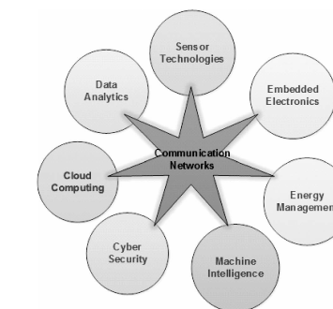
4.1.2 IoT as a Multi-Technology Engineering Problem
An IoT solution is not a hardware-only or software-only project
• Communication networks sit at the center of a multi-technology system.
• A complete solution combines sensing, embedded electronics, energy management, cybersecurity, cloud computing, analytics, and intelligence.
• Design decisions in one domain affect all the others.
Source: Khan & Yuce, Fig. 1.2, p. 14
8

Slide 9
4.1.3 Basic IoT System Building Blocks
Four major blocks shape a practical IoT solution
• Sensors and actuators connect to the physical world.
• Processors interpret data and execute local logic.
• Gateways connect local devices to broader networks and services.
• Applications turn data into monitoring, control, and decision support.
9

Slide 10
4.1.4 Requirement-Driven Design
The design problem is a trade-off
Functional requirements
Non-functional requirements
• What must be measured?
• What actions must be controlled?
• What events must be detected?
• Which users interact with the system?
• What services must the application provide?
• Latency and timeliness.
• Reliability and availability.
• Energy and lifetime.
• Security and privacy.
• Cost, maintainability, and scalability.
10

Slide 11
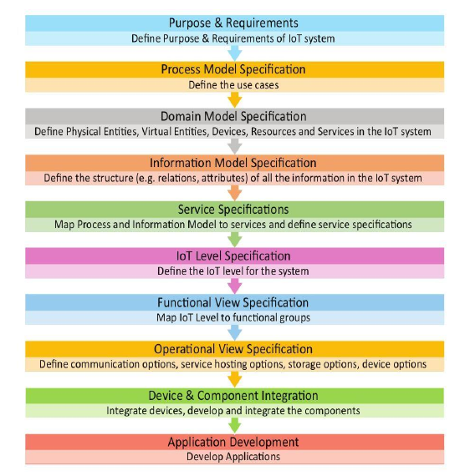
4.1.5 The Ten-Step IoT Design Methodology
Formal flow from requirements to implementation
• The method begins with purpose and requirements specification.
• It then defines process, domain, information, service, functional, and operational views.
• Implementation follows through device integration and application development.
• Use the methodology as a design guide, not as a rigid waterfall process.
Source: IoT & Applications Digital Notes, p. 74
11

Slide 12
4.1.6 Design Is Iterative
Practical IoT design requires feedback loops
Define
Build
Measure
Diagnose
Refine
Retest
• Hardware tests may force requirement revision.
• Network tests may change the sampling period or payload size.
• Security constraints may change platform or protocol choices.
• A prototype often reveals missing user-interface and operational requirements.
12

Slide 13
4.2
Basic IoT Design Steps
• Use the ten-step methodology to organize requirements, models, services, deployment, integration, and application development.
13

Slide 14
4.2.1 Step 1: Purpose and Requirements Specification
Define what the IoT system must achieve
• Why is the system being built?
• Who will use the system and who owns the data?
• What must the system observe or control?
• What data must be collected and at what frequency?
• What decisions or actions must be supported?
• What security, privacy, reliability, and usability constraints apply?
14

Slide 15
4.2.2 Functional and Non-Functional Requirements
Both types are needed for a complete design
Functional examples
Non-functional examples
• Measure temperature and humidity.
• Transmit telemetry to the platform.
• Display current and historical values.
• Generate alerts when thresholds are exceeded.
• Control fan, LED, or relay.
• Alert within a defined delay.
• Operate continuously for the required period.
• Recover from communication loss.
• Protect credentials and device identity.
• Remain affordable and maintainable.
15

Slide 16
4.2.3 Step 2: Process Specification
Convert requirements into use cases and scenarios
• Sensor reads a physical variable.
• Device validates and timestamps the reading.
• Device transmits data through the selected network.
• Platform stores and analyzes measurement.
• Dashboard displays status.
• Rule detects abnormal condition.
• System alerts user or triggers actuator.
16

Slide 17
4.2.4 Use Case: High Temperature Response
Example process for the running case
• Actor: sensor node or classroom monitoring service.
• Trigger: temperature exceeds the configured threshold.
• Input: current measurement, timestamp, device ID, and location.
• Processing: validate reading, compare threshold, and check previous state.
• Output: alert and optional actuator command.
• Feedback: later measurements confirm whether the response worked.
17

Slide 18
4.2.5 Step 3: Domain Model Specification
Identify the important entities and relationships
• Physical entities: classroom, sensor, fan, environment.
• Digital entities: device record, measurement, alert, threshold, user.
• Relationships: classroom contains device; device produces measurement; rule produces alert; user monitors classroom.
• A domain model is independent of the specific hardware or software platform.
18

Slide 19
4.2.6 Domain Model for Smart Classroom
Instructor-created model for the running case
Classroom
SensorNode
Measurement
Rule
Alert
Fan
• Classroom contains one or more sensor nodes.
• Sensor node produces measurements and device-health status.
• Rules evaluate measurements and generate alerts.
• Commands may change actuator state, followed by sensing feedback.
19

Slide 20
4.2.7 Step 4: Information Model Specification
Define the structure of information used by the system
• Measurement: device ID, timestamp, temperature, humidity, unit, and quality indicator.
• Alert: alert ID, device ID, severity, event time, current value, and threshold.
• Device state: firmware version, battery level, connectivity state, and last-seen time.
• Information model defines meaning and structure; serialization format can be chosen later.
20

Slide 21
4.2.8 From Domain Model to Information Model
Convert real-world objects into useful data structures
Real object
Virtual entity
Attributes
Message
Storage
• A classroom sensor becomes a SensorNode entity.
• The entity has attributes such as ID, location, status, and measurement capability.
• Messages carry attribute values with timestamp and context.
• Databases and dashboards use the information model to interpret data correctly.
21

Slide 22
4.2.9 Step 5: Service Specification
Define the operations provided by the system
• Read latest measurement.
• Publish telemetry.
• Query historical measurements.
• Change threshold.
• Send alert.
• Set actuator state.
• Read device health.
• For each service define input, output, preconditions, trigger, schedule, and side effect.
22

Slide 23
4.2.10 Step 6: IoT-Level Specification
Decide the architecture level and deployment pattern
Design questions
Running case choice
• Single device or multiple devices?
• Is a gateway required?
• Which processing is local?
• Which processing is remote?
• Is cloud storage required?
• Local threshold check on device or gateway.
• Telemetry to platform for history.
• Dashboard in application layer.
• Remote configuration through platform.
• Safe local fallback during disconnection.
23

Slide 24
4.2.11 Step 7: Functional View Specification
Group functions and assign responsibilities
• Sensing and calibration.
• Local validation and filtering.
• Communication and retry.
• Device management and configuration.
• Data ingestion and storage.
• Analytics and rules.
• User interaction and visualization.
• Security and access control.
24

Slide 25
4.2.12 Step 8: Operational View Specification
Define deployment and operation choices
Deployment choices
Operational choices
• Device type and enclosure.
• Network and gateway.
• Service hosting.
• Storage and retention.
• Application hosting.
• Authentication method.
• Physical installation.
• Maintenance schedule.
• Failure behavior.
• Monitoring and logging.
25

Slide 26
4.2.13 Step 9: Device and Component Integration
Plan interface contracts before assembling the system
• Sensor electrical interface and sampling schedule.
• Processor board and firmware modules.
• Communication interface and network credentials.
• Gateway or broker endpoint.
• Telemetry message format and command format.
• Dashboard data schema.
• Actuator interface and safe operating limits.
26

Slide 27
4.2.14 Step 10: Application Development and Traceability
Develop the user-facing and service-facing application
• Visualization of current status and history.
• Configuration of thresholds and device settings.
• Alert management and acknowledgement.
• Device health and connectivity monitoring.
• Historical analysis and reporting.
• Traceability: requirement → function → component → interface → test.
27

Slide 28
4.3
Embedded Computing in IoT
• Understand what computation must happen inside a smart device and why device constraints shape system design.
28

Slide 29
4.3.1 Embedded System vs General-Purpose Computer
IoT devices are usually task-specific systems
Embedded system
General-purpose computer
• Designed for specific functions.
• Closely interacts with hardware.
• Often resource constrained.
• May have timing requirements.
• Often runs unattended.
• Supports many applications.
• Larger memory and storage.
• Higher energy budget.
• Rich operating system.
• Frequent human supervision.
29

Slide 30
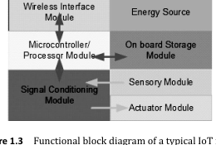
4.3.2 Functional Architecture of a Typical IoT Node
A typical node contains sensing, processing, communication, actuation, and energy modules
• Sensor module observes the physical environment.
• Signal conditioning prepares the signal for conversion.
• Processor executes local logic and communication protocol.
• Storage preserves firmware, state, and buffered data.
• Wireless interface connects to other nodes or gateways.
• Actuator module can influence the environment.
Source: Khan & Yuce, Fig. 1.3, p. 15
30

Slide 31
4.3.3 Sensor-to-Processor Data Path
From physical variable to digital value
Physical quantity
Sensor
Conditioning
ADC
Processor
• Signal conditioning may amplify, filter, and protect the input.
• Analog sensors require analog-to-digital conversion.
• Firmware validates ranges, applies calibration, and attaches time and device context.
• Bad data at this stage affects all later analysis.
31

Slide 32
4.3.4 Processor-to-Actuator Data Path
From digital command to physical effect
Command
Validate
Driver / PWM
Actuator
Feedback
• Actuator commands must be validated against safety limits.
• Drivers translate processor output into current, voltage, PWM, or relay control.
• Feedback sensing is needed to verify that the physical effect occurred.
• Fail-safe state is essential for cyber-physical systems.
32

Slide 33
4.3.5 Embedded Software Responsibilities
Firmware is the local intelligence of an IoT device
• Sensor drivers and sampling schedule.
• Data conversion, calibration, and threshold logic.
• Local state management and error handling.
• Communication client and retry behavior.
• Power management and sleep scheduling.
• Basic security checks and credential handling.
• Support for configuration and firmware update when required.
33

Slide 34
4.3.6 Resource Constraints
Every firmware decision has a device-level cost
• CPU capability limits local algorithms.
• RAM limits buffers, protocol state, and runtime data structures.
• Flash limits firmware size and update strategy.
• I/O pins limit sensors and actuators.
• Radio resources constrain transmission frequency and payload.
• Energy budget limits sensing, processing, and communication.
• Device cost constrains the selected hardware platform.
34

Slide 35
4.3.7 Duty Cycle and Power Consumption
Most IoT devices should not operate continuously
• Duty cycle is the fraction of time the device is active.
• Lower duty cycle usually reduces average power consumption.
• Increasing sleep time may reduce data freshness or increase latency.
• Communication setup overhead can dominate when messages are small.
• A good design balances lifetime, responsiveness, and reliability.
35

Slide 36
4.3.8 Embedded Design Trade-Off
Overdesign wastes cost and energy; underdesign fails requirements
Design pressure
Common consequences
• More CPU for local analytics.
• More memory for buffers and OTA.
• Better radio for range and reliability.
• More security features.
• Longer device lifetime.
• Higher cost.
• Higher power use.
• Larger device size.
• More complex firmware.
• More demanding maintenance.
36

Slide 37
4.4
Microcontrollers, Embedded Processors, and Hardware Selection
• Select hardware based on requirements, not popularity.
37

Slide 38
4.4.1 Microcontroller, Microprocessor, and SoC
Different device classes serve different design needs
Microcontroller / MCU
Processor / SoC
• CPU, memory, and peripherals integrated for control tasks.
• Good for sensing, actuation, and low-power operation.
• Often programmed close to the hardware.
• Higher computing capability and richer software stack.
• May support operating systems and networking services.
• SoC integrates processor, communication, memory interfaces, accelerators, and peripherals.
38

Slide 39
4.4.2 Core Microcontroller Selection Criteria
Use requirement-derived criteria
• Bit depth: affects numeric capability and performance.
• RAM and Flash: determine firmware size, buffers, and protocol complexity.
• GPIO: connects sensors, actuators, and peripheral modules.
• Power consumption: critical for battery-operated devices.
• Peripheral availability: ADC, PWM, timers, UART, SPI, I2C, USB, watchdog.
• Development ecosystem: tools, libraries, examples, and debugging support.
39

Slide 40
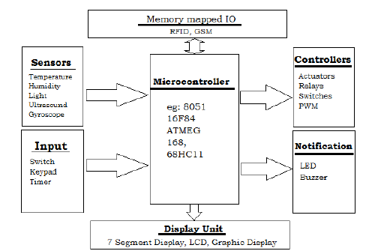
4.4.3 Embedded System Hardware Example
Microcontroller-centered view of sensing and actuation
• Inputs may include sensors, switches, keypad, or timer events.
• Outputs may drive controllers, relays, LEDs, buzzers, or displays.
• Memory-mapped I/O connects the processor to hardware resources.
• Use the figure to reason about peripheral and I/O requirements.
Source: IoT & Applications Digital Notes, p. 77
40

Slide 41
4.4.4 Processing Performance
Ask what must run locally
• Is local filtering enough, or is local inference required?
• Does the firmware use floating-point computation?
• Is encryption performed locally?
• What is the maximum sampling or event rate?
• What latency is acceptable between sensing and actuation?
• How much processing headroom is needed for future updates?
41

Slide 42
4.4.5 Memory and Storage Sizing
Small memory decisions can shape the whole architecture
• Firmware image and libraries.
• Communication stack and security state.
• Runtime buffers and queues.
• Sensor history for local filtering.
• Offline storage during connectivity loss.
• OTA update image and rollback space.
• Logs for debugging and operation.
42

Slide 43
4.4.6 Connectivity as a Hardware Requirement
Protocol selection has hardware consequences
• Wi-Fi: convenient IP connectivity but higher energy use.
• BLE: short-range low-power interaction.
• Zigbee or 802.15.4: low-power mesh or local device network.
• LoRa: long-range low data rate.
• Ethernet: reliable wired connection when power and cabling are available.
• Cellular: mobility and wide-area access with higher cost and power.
43

Slide 44
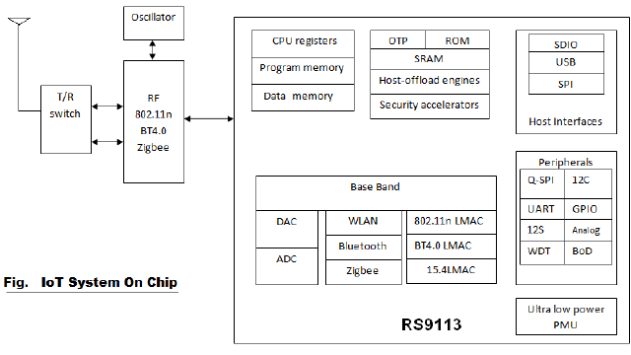
4.4.7 System-on-Chip Architecture
Conceptual example of integrated IoT communication hardware
• Typical IoT SoCs integrate RF, baseband, processor, memory, host interfaces, and peripherals.
• Integration reduces board complexity but constrains design flexibility.
• Selection requires balancing power consumption, throughput, size, latency, and ecosystem support.
• Use this as an architectural example, not a current product recommendation.
Source: IoT & Applications Digital Notes, p. 78
44

Slide 45
4.4.8 Hardware Selection Framework
A practical decision sequence
• List mandatory interfaces and peripherals.
• Estimate local processing load.
• Estimate RAM, Flash, and storage requirements.
• Determine communication technology and range.
• Define power source and lifetime target.
• Define security requirements and update strategy.
• Check physical size, enclosure, cost, and development ecosystem.
• Validate through prototype measurements.
45

Slide 46
4.4.9 Hardware Selection Exercise
Choose a platform and justify the trade-off
• Scenario A: battery-powered soil sensor.
• Scenario B: smart-camera edge gateway.
• Scenario C: connected laboratory equipment.
• For each scenario, choose MCU or SBC, memory class, I/O interfaces, connectivity, and power source.
• Justify the choice using requirements rather than brand preference.
46

Slide 47
Break
10-Minute Break
• Reflection question: which IoT design decision is hardest to change after deployment?
47

Slide 48
4.5
Common IoT Development Platforms
• Distinguish hardware development platforms from IoT software and cloud platforms.
48

Slide 49
4.5.1 What Is an IoT Development Platform?
The word “platform” has two meanings
Hardware platform
Software / cloud platform
• Development board or single-board computer.
• Exposes pins, sensors, peripherals, and network modules.
• Used to build and test device-side behavior.
• Examples: Arduino and Raspberry Pi.
• Manages devices, data, messaging, rules, and applications.
• Provides APIs, identity, storage, analytics, and visualization.
• Supports deployment, scaling, and operations.
• Examples include cloud or self-hosted IoT platforms.
49

Slide 50
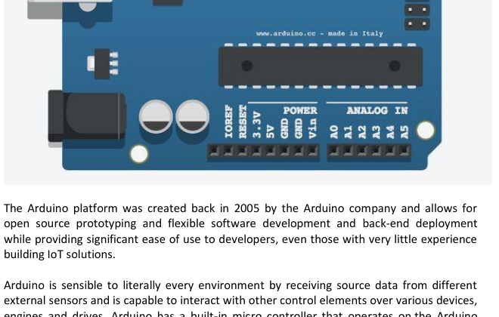
4.5.2 Arduino as a Prototyping Platform
Microcontroller-based platform for sensing and actuation experiments
• Open-source hardware and software ecosystem.
• Simple IDE and straightforward upload workflow.
• Analog and digital I/O for sensors and actuators.
• Appropriate for experiments, device-side control, and classroom prototypes.
• Limited compared with full single-board computers.
Source: IoT & Applications Digital Notes, p. 103
50

Slide 51
4.5.3 Arduino Development Workflow
Typical workflow for a simple board-based prototype
• Create or open a sketch.
• Select the correct board.
• Select the serial port.
• Verify or compile the program.
• Upload firmware to the board.
• Observe serial monitor output.
• Test input and output behavior with real sensors and actuators.
51

Slide 52
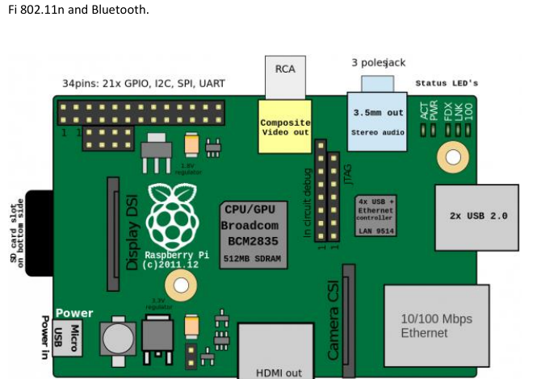
4.5.4 Raspberry Pi as an IoT Development Platform
Single-board computer for gateways, edge services, and richer processing
• Runs a general-purpose operating system.
• Provides processor, memory, storage, USB, network interfaces, and GPIO.
• Suitable for gateway, dashboard, local database, or edge analytics roles.
• Less deterministic and usually more power-hungry than a simple microcontroller.
• Use the figure as an SBC architecture example; the shown model is historical.
Source: IoT & Applications Digital Notes, p. 105
52

Slide 53
4.5.5 Arduino vs Raspberry Pi
Choose based on role in the architecture
Arduino-like MCU platform
Raspberry Pi-like SBC
• Direct sensor and actuator interfacing.
• Simple control loops.
• Lower resource demand.
• Good for low-power prototypes.
• Limited OS and networking capabilities.
• Linux and rich software stack.
• Better for gateway or edge roles.
• Can run brokers, dashboards, scripts, and databases.
• Higher processing capability.
• Higher energy and management needs.
53

Slide 54
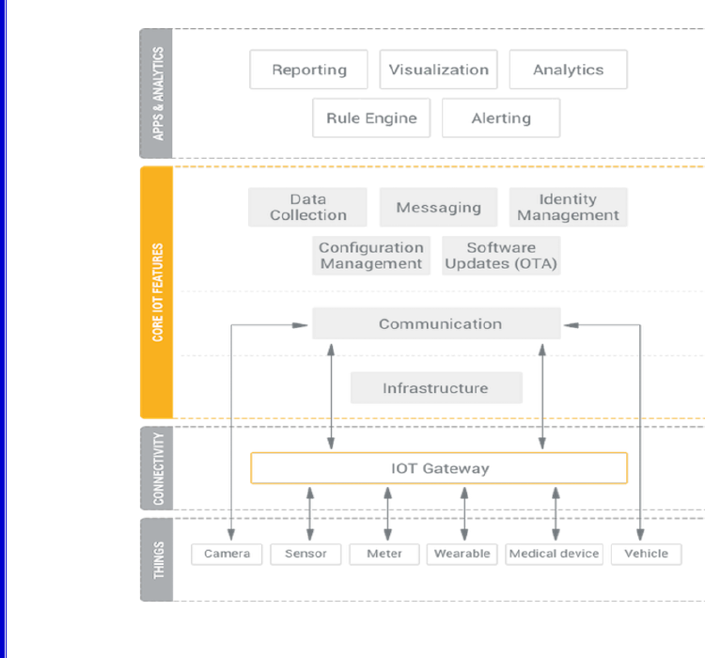
4.5.6 IoT Platform Technology Stack
Platform functions connect devices to applications and analytics
• Things connect directly or through gateways.
• Connectivity enables device-to-platform communication.
• Core IoT features include data collection, messaging, device management, configuration, identity, and OTA updates.
• Applications and analytics include reporting, visualization, rules, alerts, and analytics.
Source: IoT & Applications Digital Notes, p. 87
54

Slide 55
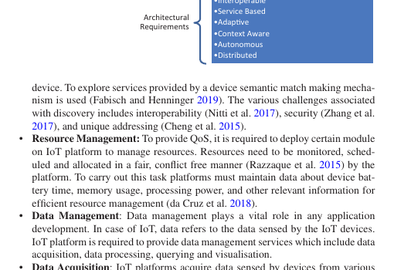
4.5.7 IoT Platform Requirements
A platform must satisfy functional, non-functional, and architectural requirements
• Functional requirements include resource discovery, data management, visualization, event processing, and code management.
• Non-functional requirements include scalability, timeliness, availability, security, privacy, and ease of deployment.
• Architectural requirements include abstraction, interoperability, service-based design, adaptability, context awareness, autonomy, and distribution.
Source: Alam et al., Fig. 3.2, p. 47
55

Slide 56
4.5.8 Selecting a Development Platform
Use a requirement-based decision checklist
• Does the device need real-time control or a full OS?
• How many sensors and actuators must be connected?
• Which communication technology is required?
• How much local processing is needed?
• What is the power source and lifetime target?
• What programming tools and libraries are available?
• How will credentials, updates, and logs be managed?
56

Slide 57
4.6
Prototype Development Model
• Use prototypes to reduce technical uncertainty before full deployment.
57

Slide 58
4.6.1 Why Prototype?
Prototype to answer engineering questions early
• Validate sensor feasibility and measurement quality.
• Test hardware interfaces and voltage compatibility.
• Measure communication reliability and latency.
• Validate message format and data model.
• Test platform integration and dashboard behavior.
• Discover missing requirements and operational constraints.
• Reduce technical risk before pilot deployment.
58

Slide 59
4.6.2 Three Useful Prototype Stages
Increase fidelity gradually
Proof of Concept
Functional Prototype and Pilot
• Can the essential technical idea work?
• One sensor, one board, one output.
• Low concern for enclosure and operations.
• Can main components work together?
• Can the system operate in a realistic environment?
• Test reliability, latency, power, usability, and maintenance.
59

Slide 60
4.6.3 Prototype Architecture for the Running Case
End-to-end prototype for classroom monitoring
Environment
Sensors
Device
Network
Platform
Dashboard
Actuator
End-to-end loop: sense → process → decide → act → verify
• Prototype should validate both data flow and control flow.
• Each interface requires a defined format, identity, timing assumption, and failure behavior.
• A working IoT application is a complete cyber-physical loop, not only a sensor connected to the Internet.
Source: Instructor-created diagram based on the design methodology and system-building concepts in the provided references.
60

Slide 61
4.6.4 Iterative Prototype Loop
Every prototype cycle should answer a specific question
Define
Build
Measure
Diagnose
Refine
Retest
• Define one testable question per iteration.
• Build the smallest experiment that answers it.
• Measure with real data rather than assumptions.
• Refine requirements, hardware, firmware, protocol, or application as needed.
61

Slide 62
4.6.5 Define Interfaces Before Integration
Integration fails when interfaces are implicit
• Sensor pins, voltage levels, sampling interval, and units.
• Data type, range, calibration, and error representation.
• Telemetry message format, topic or endpoint, and timestamp policy.
• Command format and allowed actuator states.
• Authentication method and credential location.
• Expected retry, timeout, and offline behavior.
62

Slide 63
4.6.6 Prototype Test Checklist
Minimum tests before classroom demonstration
• Correct sensor reading and calibration sanity check.
• Device restart behavior.
• Network connection and reconnection.
• Message delivery and timestamp correctness.
• Dashboard update.
• Alert generation.
• Actuator operation.
• Offline behavior and safe fallback.
• Authentication and access control.
63

Slide 64
4.7
Device and System Component Integration
• Bring sensors, firmware, network, platform, application, security, and actuation into one working loop.
64

Slide 65
4.7.1 What Must Be Integrated?
A working IoT solution crosses several technology boundaries
• Sensors and MCU or SBC.
• Actuator drivers and protection circuits.
• Embedded software and device configuration.
• Local network and gateway.
• Messaging protocol and broker or platform endpoint.
• Database and dashboard.
• Authentication and authorization.
• Monitoring, logs, and maintenance workflow.
65

Slide 66
4.7.2 Four Levels of Integration
Failures at each level look different
Physical and device level
Network and application level
• Electrical: voltage, current, pinout, grounding.
• Device communication: GPIO, I2C, SPI, UART, ADC, PWM.
• Firmware: driver, timing, error handling.
• Network: Wi-Fi, IP, MQTT, CoAP, broker, retries.
• Application: data schema, APIs, events, commands.
• Security: identity, credentials, authorization.
66

Slide 67
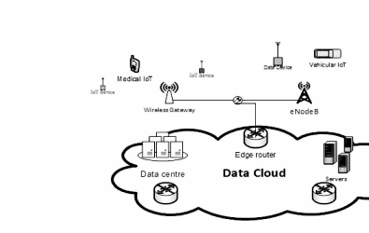
4.7.3 From IoT Device to Cloud
Operational deployment includes devices, gateway, network, data center, and cloud services
• IoT devices collect data or act on the physical world.
• Wireless gateway or base station connects devices to infrastructure.
• Routers and fixed networks connect to data centers and servers.
• Cloud services provide storage, applications, analytics, and management.
Source: Khan & Yuce, Fig. 1.4, p. 16
67

Slide 68
4.7.4 Common Integration Problems
Many failures are interface failures
• Wrong voltage or wiring.
• Wrong I/O mode or timing.
• Sensor unit mismatch.
• Incorrect message schema.
• Authentication failure.
• Network interruption or unstable Wi-Fi.
• Duplicate, delayed, or missing messages.
• Clock and timestamp mismatch.
• Unsafe actuator behavior.
68

Slide 69
4.7.5 End-to-End Integration Test
Test the complete cyber-physical path
Event
Sense
Process
Transmit
Decide
Command
Actuate
Verify
• Verify correctness and latency from physical event to displayed result.
• Verify command path from application to actuator.
• Measure recovery after disconnection or device restart.
• Check observability: can operators diagnose what happened?
69

Slide 70
4.8
Experimental Deployment of a Basic IoT Application
• Deploy and test a smart classroom environmental monitor and controller.
70

Slide 71
4.8.1 Demo Application Overview
Smart classroom environmental monitor and controller
• Measure temperature and humidity.
• Publish telemetry to a local or cloud service.
• Display values on a dashboard.
• Generate alert when threshold is exceeded.
• Control LED, fan, or relay as an actuator.
• Record historical values for later analysis.
• Demonstrate both monitoring and control paths.
71

Slide 72
4.8.2 Prototype Components
One possible classroom implementation
Device-side components
Platform-side components
• Temperature/humidity sensor.
• Arduino, ESP32, Raspberry Pi, or equivalent board.
• Wi-Fi or wired network.
• LED, relay, or fan as actuator.
• Power supply.
• MQTT broker or equivalent messaging service.
• Simple database or log storage.
• Dashboard.
• Rule engine or simple threshold script.
• Device credentials and configuration.
72

Slide 73
4.8.3 Physical and Logical Architecture
Separate physical wiring from logical services
Physical view
Logical view
• Sensor connected to board.
• Actuator connected through safe driver or relay.
• Board connected to router or gateway.
• Power supply and enclosure considered.
• Sensor driver and sampling service.
• MQTT or API client.
• Broker or platform.
• Data consumer and dashboard.
• Rule and command path.
73

Slide 74
4.8.4 Application Data Flow
Normal telemetry operation and event operation
Sample
Validate
Publish
Store
Display
Rule
Command
Feedback
• Normal operation publishes validated telemetry with device ID and timestamp.
• Event operation adds threshold detection, alert generation, actuator command, and feedback sensing.
• Both paths must be tested separately and end-to-end.
74

Slide 75
4.8.5 Deployment Procedure
Recommended classroom sequence
• Prepare hardware and verify wiring.
• Configure firmware or operating system.
• Validate local sensor reading.
• Configure network and broker endpoint.
• Publish a test message.
• Connect dashboard and storage.
• Add threshold rule.
• Connect actuator and test command path.
• Run end-to-end test and record results.
75

Slide 76
4.8.6 Acceptance Test
Define measurable success criteria
• Sensor value updates successfully.
• Dashboard displays device identity and timestamp.
• Alert occurs within required latency.
• Actuator responds to command.
• Invalid measurements are rejected.
• System detects device disconnection.
• Credentials are not stored in public source code.
• System returns to safe state after restart.
76

Slide 77
4.8.7 Failure Testing and Prototype Hardening
A prototype should be tested under controlled failure
Failure scenarios
Expected behavior
• Sensor disconnected.
• Network unavailable.
• Broker unavailable.
• Duplicate telemetry.
• Delayed command.
• Device reboot.
• Invalid credentials.
• Detect and report failure.
• Avoid unsafe actuation.
• Buffer or retry where appropriate.
• Recover automatically if possible.
• Log enough information for diagnosis.
• Fail closed or safe when necessary.
77

Slide 78
4.8.8 In-Class Design Activity
Design a small IoT solution using the Chapter 4 methodology
• Choose one application: smart classroom, smart greenhouse, cold-chain monitor, or equipment monitoring.
• Define purpose, functional requirements, and non-functional requirements.
• Create domain and information models.
• Select device, connectivity, platform, and application functions.
• Define one prototype test and one failure test.
• Prepare a five-minute group explanation.
78

Slide 79
Chapter Summary
Key messages from Chapter 4
• IoT design begins with purpose and requirements, not hardware selection.
• A useful methodology links requirements to models, services, functions, deployment, integration, and application development.
• Embedded computing connects physical signals to digital services.
• Hardware must be selected based on computation, memory, I/O, connectivity, energy, reliability, and cost.
• Prototypes reduce uncertainty before deployment.
• Integration must be tested across electrical, device, network, platform, application, and safety boundaries.
79

Slide 80
Exit Ticket
Answer individually before leaving
• Why should hardware selection occur after requirements analysis?
• What is the main difference between a microcontroller platform and a single-board computer?
• Which functions belong on the device, and which should be handled by the platform?
• Name three tests you would run before moving an IoT prototype into a pilot deployment.
• What is one failure scenario that could make an IoT prototype unsafe?
80

