Slide 1

POSTS AND TELECOMMUNICATIONS INSTITUTE OF TECHNOLOGY
Chapter 5
Data, Analytics, and Supporting Services in IoT
IoT and Applications
1
Notes:
Introduce the chapter as the transition from device and network design to the data layer of IoT. Emphasize that useful IoT systems turn physical measurements into decisions, services, and actions.

Slide 2
Chapter 5 Learning Outcomes
What students should be able to explain and design
• Explain how IoT data is generated, acquired, validated, stored, processed, queried, visualized, and used.
• Distinguish structured, semi-structured, unstructured, in-motion, and at-rest data.
• Identify major IoT data challenges: scale, speed, heterogeneity, data quality, privacy, and schema evolution.
• Explain cloud services, XaaS, and IoT platform functions for supporting IoT applications.
• Design a basic telemetry dashboard and alert pipeline.
• Use descriptive, diagnostic, predictive, and prescriptive analytics to support decisions.
2
Notes:
Frame the learning outcomes as design abilities rather than vocabulary memorization. Students should be able to analyze why a particular data architecture is suitable for an IoT application.

Slide 3
Teaching Roadmap for 90 Minutes
Structure of the teaching session
• 5.1 Data collection and management in IoT systems.
• 5.2 Structured and unstructured data in the IoT context.
• 5.3 Challenges of IoT data.
• 5.4 Cloud services, XaaS, and IoT platforms.
• 5.5 Real-time dashboard, telemetry monitoring, and alerts.
• 5.6 Sensor data analytics for decision support.
3
Notes:
Walk through the session structure. The flow starts from raw data generation, moves to data classification and challenges, then introduces cloud and platform support before closing with dashboards, alerts, and decision support.

Slide 4
Opening Scenario: Smart Classroom Data
Use this scenario throughout the chapter
• Temperature, humidity, CO₂, and optional air-quality sensors are installed in classrooms.
• Devices send periodic readings and immediate abnormal-event messages.
• A dashboard shows current room conditions and historical trends.
• Alerts notify staff when thresholds are exceeded or devices go offline.
• Historical data supports maintenance planning, energy optimization, and reporting.
• Design question: what should be processed locally, at a gateway, and in the cloud?
Sensors
Device
Main tension
Latency • Cost • Privacy • Reliability • Energy
Network
Platform
Dashboard
Decision
4
Notes:
Use the smart classroom as the running case. Ask students where threshold detection should occur: on the device, at the gateway, or in the cloud. Use the answers to introduce data placement and processing trade-offs.

Slide 5
Why Data Is the Core Value of IoT
Connecting a device is only the beginning
• A connected sensor has limited value until its readings support a decision or action.
• IoT value appears when data is acquired, trusted, stored, analyzed, visualized, and acted upon.
• Data is used at several time scales: immediate alert, daily operation, long-term planning.
• The same measurement may be telemetry now, historical evidence later, and training data in the future.
• For IT students, Chapter 5 connects physical devices to information systems and business processes.
Physical state
becomes data
Data becomes
information
Information supports
decisions
Decisions trigger
actions
5
Notes:
Emphasize the information systems perspective. The main question is not only whether the sensor can measure, but how the measurement changes monitoring, automation, and organizational decisions.

Slide 6
5.1
Data Collection and Management
• Follow data from device generation to storage, querying, and analytics.
• Understand what must happen before raw readings become reliable information.
6
Notes:
Start Section 5.1 by explaining that IoT data management is a pipeline. Each stage can introduce design decisions and possible failures.

Slide 7
5.1.1 End-to-End IoT Data Pipeline
A reference flow from physical events to decisions
Generate
Sensor or device produces data
Acquire
Application or gateway receives data
Validate
Check range, timestamp, identity
Clean
Remove noise and duplicates
Store
Persist raw or processed data
Analyze
Extract patterns and insight
Visualize
Dashboard, map, or report
Act
Alert, decision, or control
• The pipeline is logical; stages may run on device, gateway, edge, cloud, or application server.
• Not every system stores every raw reading.
• Data-management choices affect latency, bandwidth, battery life, privacy, and cost.
• A failure in early stages can make later analytics misleading.
7
Notes:
Present this as a high-level mental model. It is not a strict implementation sequence; in practice, validation, filtering, storage, and analytics may be split across multiple layers.

Slide 8
5.1.2 Data Generation Modes
Different devices generate data in different ways
Periodic telemetry
Event-driven data
On-demand data
Continuous stream
• temperature every 60 seconds
• battery every 5 minutes
• door opened
• CO₂ exceeds threshold
• read device status
• request latest image
• video
• audio
• high-frequency vibration
• Generation mode affects sampling frequency, message size, power consumption, and storage design.
• A smart system may switch modes: periodic in normal conditions, event-driven during anomalies.
• Every message should carry context: device identity, timestamp, location, unit, and quality information.
8
Notes:
Connect the generation mode to the smart-classroom scenario. Normal air-quality readings may be periodic, while a dangerous threshold crossing should produce an event immediately.

Slide 9
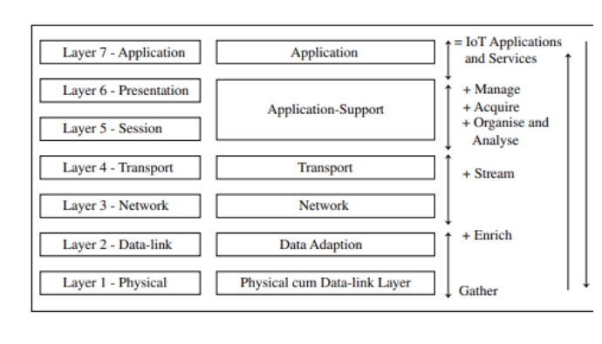
5.1.3 Data Acquisition in the IoT Stack
Acquisition is where device data enters the application-support layer
• Data acquisition means acquiring data from IoT or M2M devices.
• Devices may send data on demand or at configured intervals.
• Gateways can adapt, filter, enrich, and forward data.
• Acquisition design must consider addressing, scalability, configuration, security, and interoperability.
Source figure: [R1] IoT & Applications Digital Notes, Fig. on data acquisition, p. 115
9
Notes:
Use the figure to show that acquisition is not just reading a sensor value. It links the lower communication layers with application support functions such as acquiring, organizing, analyzing, streaming, and enriching.

Slide 10
5.1.4 Validation, Cleaning, and Preprocessing
Raw readings are not automatically reliable information
Typical problems
Typical treatments
• Missing values
• Out-of-range values
• Duplicate messages
• Incorrect timestamp
• Noisy signal
• Unit inconsistency
• Sensor drift
• Corrupted payload
• Range check
• Type and unit validation
• Duplicate removal
• Timestamp correction
• Smoothing/filtering
• Normalization
• Calibration
• Anomaly detection
Preprocessing
10
Notes:
Explain that analytics quality depends on earlier data quality. A prediction model cannot compensate for bad timestamps, wrong units, or a faulty sensor.

Slide 11
5.1.5 Storage Choices for IoT Data
Choose storage according to data type and access pattern
Relational DB
Fixed schema, SQL query, transactional data
NoSQL store
Flexible schema, large scale, evolving device data
Time-series DB
Timestamped readings and trend queries
Object storage
Images, audio, video, logs, long-term archives
Data warehouse/lake
Analytics, reporting, machine-learning datasets
Design question: Do we store raw data, processed data, or both?
11
Notes:
Discuss the trade-off between storing raw data and storing only processed results. Raw data enables reanalysis and audit, but increases cost and privacy exposure.

Slide 12
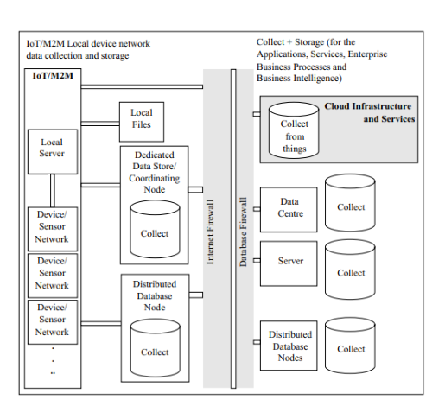
5.1.6 Data Collection, Storage, and Computing Alternatives
IoT data may be stored locally, in distributed stores, or in cloud infrastructure
• Local files or local servers can support simple deployments and offline operation.
• A distributed DBMS or data center supports enterprise-scale systems.
• Cloud infrastructure offers scalable storage, computing, analytics, and services.
• Architecture depends on latency, connectivity, ownership, security, and cost requirements.
Source figure: [R1] IoT & Applications Digital Notes, Fig. 6.1, p. 120
12
Notes:
Use the figure to show that cloud is not the only possible storage destination. It is part of a broader set of data placement choices.

Slide 13
5.2
Data Types in the IoT Context
• Classify data by structure and by movement.
• Select storage and processing tools according to data characteristics.
13
Notes:
Transition from data management steps to data classification. Students need classification because different data types require different tools.

Slide 14
5.2.1 Structured Data
Well-defined schema and values
• Follows a predefined model or schema.
• Can be represented in rows, columns, and typed fields.
• Easy to query, aggregate, and visualize.
• Common examples: temperature, humidity, battery level, GPS location, device state.
device_id
timestamp
temp
humidity
room01
10:00
28.5
65
room02
10:00
27.2
60
room03
10:00
29.1
70
Example: smart-classroom telemetry table
14
Notes:
Structured data is often the easiest starting point for IoT analytics. Many sensor values are numeric and can be stored as time-stamped records.

Slide 15
5.2.2 Semi-Structured Data
Some structure exists, but fields may evolve
• Common in IoT messages and APIs.
• Examples: JSON telemetry, XML, logs, MQTT payloads.
• Allows flexible fields across device types and firmware versions.
• Requires careful versioning and validation to avoid inconsistent interpretation.
{
"device_id": "room01",
"ts": "2026-10-06T09:00:00",
"measurements": {
"temp": 28.5,
"humidity": 65,
"co2": 850
},
"status": "normal"
}
Example: JSON telemetry payload
15
Notes:
Semi-structured data is very common in IoT. It is flexible, but this flexibility must be governed through validation, schemas, or versioning.

Slide 16
5.2.3 Unstructured Data
Images, video, audio, and text require different tools
Image / video
Audio / speech
Text / logs
Smart camera, traffic camera, surveillance
Voice command, acoustic monitoring, machine sound
Maintenance notes, device logs, event descriptions
• Unstructured data does not fit naturally into a fixed relational table.
• Machine learning, computer vision, NLP, or signal processing are often required.
• Storage and privacy risks are usually higher than simple numeric telemetry.
16
Notes:
Use familiar examples such as cameras or audio sensors. Emphasize that unstructured data changes both storage design and analytics design.

Slide 17
5.2.4 Data in Motion vs Data at Rest
The same reading may pass through both states
Data in motion
Data at rest
• Currently being transmitted or streamed.
• Requires low-latency filtering and event detection.
• Often processed by gateway, edge, broker, or stream engine.
• Examples: telemetry stream, alarm event, live video.
• Stored in database, object storage, or data warehouse.
• Used for reporting, historical trend analysis, and model training.
• May require retention policy, indexing, access control, and backup.
• Examples: time-series history, archived video, monthly report data.
17
Notes:
Explain that motion/rest is not only a theoretical distinction. It determines whether the system needs stream processing or historical query and storage tools.

Slide 18
5.3
Challenges of IoT Data
• IoT data is challenging because it is large, fast, diverse, noisy, distributed, and operationally sensitive.
• Good analytics requires good data engineering.
18
Notes:
Transition to challenges. Stress that IoT data is not difficult only because it is big; it is also heterogeneous, time-sensitive, and tied to physical processes.

Slide 19
5.3.1 Volume, Velocity, and Variety
The classic 3V view is a useful starting point
Volume
Velocity
Variety
Many devices generate large datasets over time.
Data arrives continuously or in bursts.
Numeric readings, events, logs, images, video, audio, and text.
• These dimensions affect storage capacity, network load, processing latency, and analytics design.
• In practice, IoT systems also face veracity, security, ownership, and governance challenges.
19
Notes:
Use the 3V model as a simple classification. Then remind students that IoT data challenges extend beyond the standard big-data slogan.

Slide 20
5.3.2 Scalability and Schema Volatility
IoT deployments change after installation
• The number of devices can grow from tens to thousands or millions.
• Sensor models, firmware versions, and message fields may change over time.
• A schema designed once at deployment time may become too rigid.
• Database and platform designs must support growth, partitioning, indexing, and versioned data formats.
Initial deployment
10 classrooms
2 sensors each
Expanded system
200 rooms
multiple vendors
Schema evolution
new CO₂ field
new device status
new firmware version
20
Notes:
Explain that volatility is a practical problem. New fields and device versions often appear after deployment, so data models need careful planning.

Slide 21
5.3.3 Streaming, Timeliness, and Edge Processing
Some data loses value if processed too late
• Streaming data may require immediate filtering, aggregation, or anomaly detection.
• Edge or gateway processing reduces latency and bandwidth consumption.
• Cloud analytics is powerful but may be unsuitable for safety-critical immediate responses.
• Design must distinguish urgent events from data that can be processed later.
Device
Gateway / Edge
Cloud
Urgent: local alert
seconds or less
Historical: trend analysis
minutes, hours, days
21
Notes:
Ask students to classify examples: fire alarm, monthly energy report, offline device notification, and predictive maintenance trend.

Slide 22
5.3.4 Data Quality and Heterogeneity
More data does not automatically mean better information
Sensor quality
Time quality
Different accuracy, calibration, drift, and failure modes.
Clock drift, missing timestamps, unsynchronized samples.
Context quality
Vendor diversity
Wrong room ID, changed location, missing metadata.
Different payload formats, units, device models, and protocols.
Good IoT analytics begins with reliable, contextualized data.
22
Notes:
Emphasize context. Without device ID, location, units, and timestamp quality, measurements may not support reliable decisions.

Slide 23
5.3.5 Security, Privacy, and Governance
IoT data may describe people, places, and critical operations
• Security: protect data in transit, at rest, and during processing.
• Privacy: limit collection and exposure of location, video, health, and behavioral data.
• Governance: define ownership, retention, deletion, access control, and audit policies.
• Trust: make sure data is authentic, complete, and not maliciously modified.
• Compliance: organizational and legal requirements may restrict where data can be stored.
Key question
Who is allowed to see, modify, export, retain, or delete IoT data?
Security is not added after analytics; it must be designed into the data pipeline.
23
Notes:
Keep this slide concise because security can be a separate chapter. The goal is to show that data management decisions have security and privacy implications.

Slide 24
5.4
Cloud, XaaS, and IoT Platforms
• Understand why cloud computing supports large-scale IoT.
• Relate service models and IoT platform functions to application development.
24
Notes:
Move from data challenges to supporting infrastructure. Cloud and platforms exist because IoT data and device management are hard to build from scratch.

Slide 25
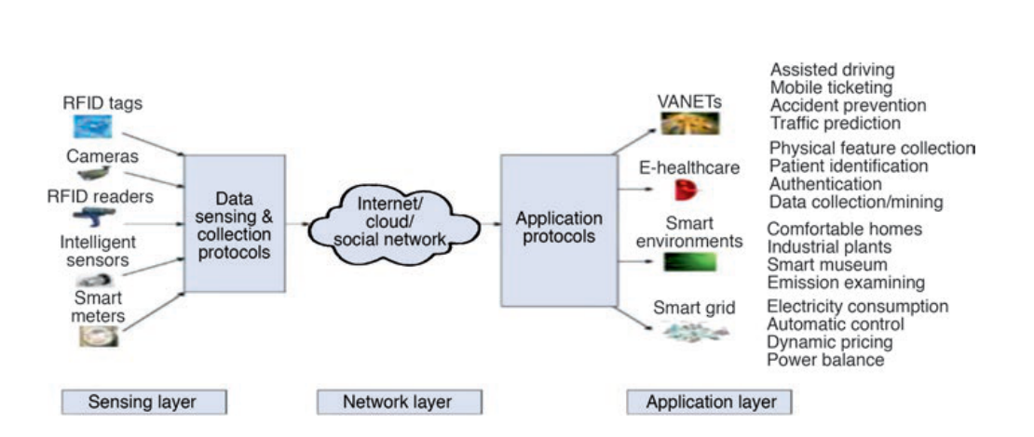
5.4.1 Why Cloud Supports IoT
Cloud provides scalable storage, computation, and integration
• IoT devices often have limited local storage and computation.
• Cloud services provide scalable compute, databases, analytics, APIs, and remote access.
• Cloud can aggregate data from many sites and devices.
• Cloud enables dashboards, reports, machine learning, and integration with enterprise applications.
Source figure: [R2] Tyagi & Kumar, Cloud-IoT Architecture, Fig. 2.4, p. 30
25
Notes:
Use the figure to show a simple layered cloud-IoT architecture. Emphasize that cloud sits between device data and application services, not as a replacement for all local processing.

Slide 26
5.4.2 XaaS and Cloud Service Models
Everything-as-a-Service exposes capabilities on demand
IaaS
PaaS
SaaS
DaaS
Infrastructure as a Service
Platform as a Service
Software as a Service
Data as a Service
Virtual machines, networking, storage
Runtimes, databases, messaging, app hosting
Ready-to-use applications and services
Data store, data warehouse, datasets, APIs
• For IoT, service models reduce the need to build every storage, messaging, analytics, and visualization component from scratch.
• The trade-off is dependence on provider APIs, cost model, security model, and service-level guarantees.
26
Notes:
Explain models with IoT examples. IaaS might host custom services; PaaS might provide brokers and databases; SaaS might provide a dashboard; DaaS can expose device data through APIs.

Slide 27
5.4.3 Cloud Deployment Models
Choose the deployment model according to control, sharing, and compliance
Public cloud
Shared provider infrastructure; high elasticity and low entry cost.
Private cloud
Dedicated to one organization; more control and governance.
Community cloud
Shared by organizations with common requirements.
Hybrid cloud
Combination of two or more models; common in enterprise IoT.
IoT systems often combine edge/local processing with cloud-scale data services.
27
Notes:
Use examples. A smart campus may use public cloud for dashboards and private local edge servers for immediate safety alerts or sensitive data.

Slide 28
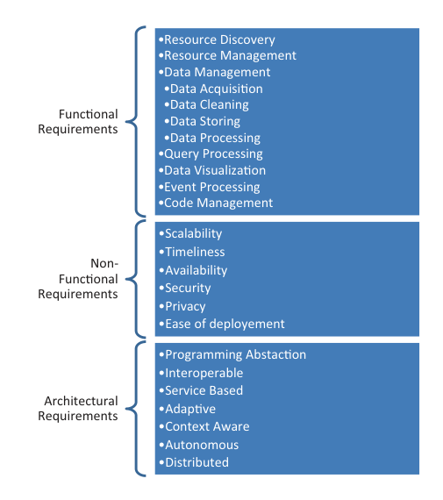
5.4.4 What an IoT Platform Provides
A platform bundles reusable services for IoT application development
• Device/resource discovery and management.
• Data acquisition, cleaning, storage, processing, and querying.
• Visualization through dashboards, maps, and reports.
• Real-time event processing and notification services.
• APIs and code/application management for developers.
Source figure: [R2] Agarwal & Alam, IoT Platform Requirements, Fig. 3.2, p. 47
28
Notes:
Explain that the platform is not only a database. It supports the whole application lifecycle: device onboarding, data flow, analytics, visualization, and event handling.

Slide 29
5.4.5 Platform Trade-Offs
Functional power must be balanced with non-functional requirements
Functional requirements
Non-functional requirements
Architectural requirements
• Data acquisition
• Data cleaning
• Storage
• Processing
• Querying
• Visualization
• Event processing
• Scalability
• Timeliness
• Availability
• Security
• Privacy
• Ease of deployment
• Interoperable
• Service-based
• Adaptive
• Context-aware
• Autonomous
• Distributed
Design question: Which requirement is most important for your application?
29
Notes:
Ask students to choose a requirement for different applications. A healthcare alert system values timeliness and availability; a long-term building report values storage and query capability.

Slide 30
5.5
Dashboard, Telemetry, and Alerts
• Convert continuous telemetry into operational visibility.
• Convert important events into timely attention and action.
30
Notes:
Transition from platforms to the user-facing operational layer: dashboards and alerts.

Slide 31
5.5.1 Real-Time Telemetry Monitoring Pipeline
Telemetry becomes useful when it updates state and triggers events
Device
Broker / Ingestion
Stream Processing
Time-Series Store
Dashboard
Rule Engine
• Dashboards usually read current state plus recent history.
• Alerts usually come from event or rule evaluation in the streaming path.
• The same telemetry may feed both visualization and alerting.
Alert / Notification
31
Notes:
Explain the separation between visualization and alerting. A dashboard is passive until someone watches it; an alert pushes attention to users or systems.

Slide 32
5.5.2 Dashboard Design Principles
A dashboard should support a decision, not display every metric
• Show current value, trend, status, and last update time.
• Group related devices by room, location, or function.
• Use clear severity levels: normal, warning, critical, offline.
• Make stale data and device failure visible.
• Avoid overloading users with too many charts or raw fields.
Room A
28.5°C
Normal
Room B
950 ppm
Warning
Room C
Offline
15 min
Trend chart placeholder
Temperature / CO₂ over time
Example dashboard layout
32
Notes:
Use this slide to discuss dashboard purpose. A dashboard is not a database browser; it should surface what users need to decide or respond.

Slide 33
5.5.3 Alert Processing
Convert important events into timely attention
1. Receive telemetry
2. Validate value
3. Evaluate condition
4. Confirm severity
5. Notify user/system
6. Track acknowledgement
7. Clear alert
• Threshold alert: value exceeds a defined limit.
• Rate-of-change alert: value changes too quickly.
• Missing-data alert: device has not reported within the expected time window.
• Composite alert: multiple sensor streams jointly indicate a situation.
33
Notes:
Explain that a good alert lifecycle includes acknowledgement and clearing. Otherwise users may receive repeated messages without knowing whether the issue is resolved.

Slide 34
5.5.4 Avoiding Bad Alerts
Bad alert design makes users ignore the system
• Alert storm: too many alerts in a short period.
• Flapping alert: state repeatedly switches between normal and alarm.
• False positive: sensor noise looks like a real event.
• Duplicate alert: the same condition is reported multiple times.
• Unclear ownership: nobody knows who should respond.
Design techniques
• Hysteresis
• Minimum-duration condition
• Debouncing
• Severity levels
• Cooldown period
• Acknowledgement workflow
• Escalation policy
34
Notes:
Use real examples. If the CO2 value fluctuates around a threshold, hysteresis prevents repeated alert and clear cycles.

Slide 35
5.6
Sensor Analytics for Decision Support
• Use analytics to move from raw measurements to operational, managerial, and strategic decisions.
• Different levels of analytics answer different questions.
35
Notes:
Introduce the analytics section. Emphasize the progression from data to information, insight, decision, and action.

Slide 36
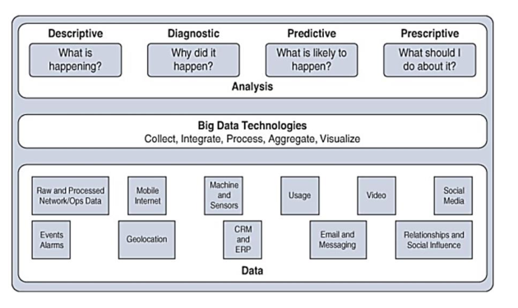
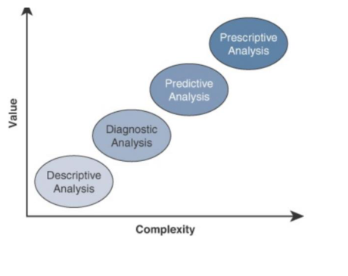
5.6.1 Four Levels of Analytics
Descriptive, diagnostic, predictive, and prescriptive analytics
• Descriptive: What is happening now or what happened before?
• Diagnostic: Why did it happen?
• Predictive: What is likely to happen next?
• Prescriptive: What should we do about it?
Source figure: [R1] IoT & Applications Digital Notes, analytics figures, p. 110
36
Notes:
Use the figures to show increasing analytical value and complexity. The same sensor dataset can support several levels of analytics.

Slide 37
5.6.2 Sensor Analytics for Smart-Classroom Decisions
One sensor stream can support several decision levels
Descriptive
Current CO₂ is 950 ppm in Room B.
Show warning on dashboard.
Diagnostic
CO₂ rose after class started and ventilation stayed low.
Check ventilation setting or window state.
Predictive
CO₂ will exceed 1200 ppm in 15 minutes if trend continues.
Warn lecturer before the room becomes uncomfortable.
Prescriptive
Increase ventilation now or move class if level remains high.
Recommend best action under cost and comfort constraints.
Decision support becomes stronger as analytics moves from observation to recommendation.
37
Notes:
Use this slide to make the analytics levels concrete. The same CO2 stream can show current status, explain causes, predict future risk, and recommend action.

Slide 38
Chapter Summary and Exit Questions
Check understanding before the next chapter
• IoT data must be acquired, validated, stored, processed, visualized, and used in decisions.
• Structured, semi-structured, and unstructured data require different storage and analytics approaches.
• Data in motion supports stream processing and alerts; data at rest supports historical analysis.
• Cloud and IoT platforms provide reusable services for storage, processing, visualization, and event handling.
• Dashboards create visibility; alerts create attention; analytics supports decisions.
Exit questions
• Why should we not store every raw reading forever?
• Give one structured and one unstructured IoT data example.
• When is streaming analytics better than batch analytics?
• What does an IoT platform provide beyond a database?
• How is predictive analytics different from prescriptive analytics?
38
Notes:
Use the exit questions for quick classroom discussion or as a short written check. These questions also prepare students for assignment and exam-style reasoning.

