Slide 1

POSTS AND TELECOMMUNICATIONS INSTITUTE OF TECHNOLOGY
Chapter 6
Security, Privacy, and Representative IoT Applications
IoT and Applications
1
Notes:
Introduce Chapter 6 as the trustworthiness chapter. Explain that IoT security is not only a technical protection topic, because a compromised IoT system may affect physical operations, personal privacy, and human safety.

Slide 2
Chapter 6 Learning Outcomes
What students should be able to analyze and design
• Explain major security, privacy, safety, and dependability requirements in IoT systems.
• Distinguish confidentiality, integrity, authentication, access control, availability, non-repudiation, privacy, and safety.
• Identify threats at device, network, gateway, cloud, application, and user levels.
• Explain how false or compromised sensor data can create unsafe physical behavior.
• Apply security-by-design principles across the IoT device and service lifecycle.
• Analyze representative IoT applications: smart home, healthcare, connected vehicle, and Industrial IoT.
2
Notes:
Frame the outcomes as design and analysis abilities. Students should be able to identify assets, threats, consequences, and controls rather than only memorize attack names.

Slide 3
Teaching Roadmap for 90 Minutes
Structure of the teaching session
• 6.1 Security, safety, and protection requirements in IoT.
• 6.2 Privacy in IoT systems and sensor-data risks.
• 6.3 Attacks and threats across the IoT architecture.
• 6.4 Security by design across the lifecycle.
• 6.5 Reliability and operational safety.
• 6.6 Representative IoT applications and security priorities.
3
Notes:
Walk through the flow. The chapter starts from requirements, then examines privacy, threats, and design principles, and closes with operational safety and representative application domains.

Slide 4
Opening Scenario: Smart Building Control
Use this scenario throughout the chapter
• Sensors measure temperature, humidity, smoke, occupancy, and air quality.
• A gateway or controller processes data and forwards telemetry to a dashboard.
• Actuators may control ventilation, alarms, doors, or other building systems.
• Operators need visibility, alerts, and safe response policies.
• Design question: what could go wrong if data, commands, accounts, or devices are compromised?
Sensors
Controller
Trust boundary questions
• Who sends data?
• Who sends commands?
• Is the value true?
• Is the action safe?
Network
Dashboard
Actuator
4
Notes:
Use this smart building example to anchor the lecture. Ask students what happens when a false temperature value is injected, when a cloud account is compromised, or when the network becomes unavailable.

Slide 5
Why IoT Security Is Different
IoT connects digital attacks with physical consequences
• IoT combines IT systems with operational technology and physical processes.
• Endpoints are often resource constrained: limited CPU, memory, energy, and storage.
• Devices may operate unattended in public, remote, or hostile environments.
• Patching and replacement can be difficult after deployment.
• A compromised device can leak data, disrupt service, or trigger unsafe actuation.
• A failure and an attack may produce the same unsafe outcome.
Conventional IT risk
Data loss
Service disruption
Account compromise
IoT / CPS risk
Data loss
Service disruption
Unsafe physical behavior
Security must be linked to safety and dependability.
5
Notes:
Emphasize that IoT risk is amplified by physical deployment, constrained hardware, and actuation. Security must be discussed together with safety and reliability.

Slide 6
6.1
Security, Safety, and Protection Requirements
• Identify the properties a trustworthy IoT system must preserve.
• Relate security requirements to data, devices, users, services, and physical actions.
6
Notes:
Start the requirement section. Explain that this section gives vocabulary and principles that will be reused in the rest of the chapter.

Slide 7
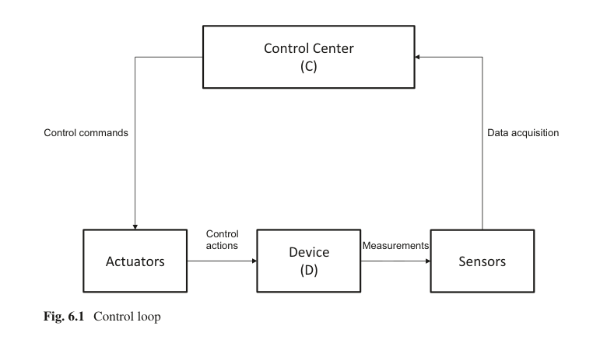
6.1.1 From Control Loop to Security Requirements
Security protects the data and commands that drive physical behavior
• Sensors produce measurements used by the control center.
• The control center makes decisions and sends commands.
• Actuators change the physical system.
• A corrupted measurement can lead to a wrong decision.
• An unauthorized command can create unsafe physical action.
Source figure: [R1] Serpanos & Wolf, Fig. 6.1 Control loop, source PDF p. 64
7
Notes:
Use the control loop to introduce why data integrity and command authenticity are essential in IoT. If the input or command is untrusted, the physical action becomes untrusted.

Slide 8
6.1.2 Core Security and Trustworthiness Requirements
Eight properties that appear repeatedly in IoT systems
Confidentiality
protect data disclosure
Integrity
protect data correctness
Authentication
identify devices and users
Access control
authorize actions
Non-repudiation
prevent denial of actions
Dependability
continue correct service
Safety
avoid hazards
Privacy
protect personal information
Security is not one mechanism. It is a set of properties that must be achieved together.
8
Notes:
Explain each term briefly and relate it to IoT: data, devices, services, and actuation. Point out that safety and privacy are not identical to confidentiality or encryption.

Slide 9
6.1.3 Confidentiality, Integrity, and Availability
The classic security triad becomes cyber-physical in IoT
Confidentiality
Integrity
Availability
• Prevent unauthorized disclosure
• IoT examples: health data, video, location, industrial data
• Typical controls: Encryption and access control
• Prevent or detect unauthorized modification
• IoT examples: sensor value, firmware, command, configuration
• Typical controls: Authentication and integrity check
• Keep required service operational
• IoT examples: alarm, dashboard, local control, emergency message
• Typical controls: Redundancy and resilience
In IoT, integrity often has direct safety implications.
9
Notes:
Focus on integrity as the bridge to safety. A wrong measurement or command can be worse than a leaked measurement in a cyber-physical system.

Slide 10
6.1.4 Authentication and Access Control
First identify the entity, then decide what it may do
Authentication
Who or what are you?
Access control
What are you allowed to do?
• Device identity
• Gateway identity
• User account
• Cloud service
• Application/API client
• Publish telemetry
• Read dashboard data
• Change alert threshold
• Send actuator command
• Install firmware update
A valid identity does not imply unlimited privileges.
10
Notes:
Explain the distinction between authentication and authorization. Use the example of a sensor that is allowed to publish data but not allowed to send commands to actuators.

Slide 11
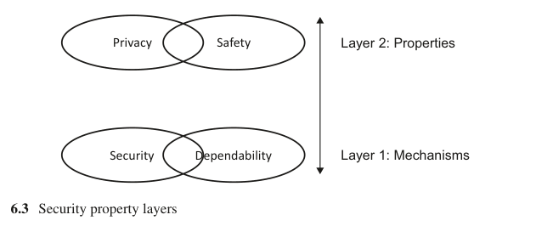
6.1.5 Security and Dependability Support Privacy and Safety
Trustworthy systems require mechanisms and application-level properties
• Security mechanisms address malicious behavior and unauthorized access.
• Dependability mechanisms address failures and continued service operation.
• Privacy and safety are application/process properties built on those mechanisms.
• If mechanisms are weak, privacy can be violated and unsafe conditions can occur.
Example: a health IoT system needs confidentiality for patient data, integrity for measurements, availability for alerts, and safe behavior for clinical response.
Source figure: [R1] Serpanos & Wolf, Fig. 6.3 Security property layers, source PDF p. 67
11
Notes:
Use the figure to explain why privacy and safety cannot be treated as isolated add-ons. They depend on security and dependability mechanisms across the system.

Slide 12
6.1.6 Security Must Span the Entire System
An IoT chain is only as strong as its weakest trust boundary
Device
identity, boot, keys
Gateway
protocol bridge
Network
routing, encryption
Cloud
storage, APIs
Application
web/mobile logic
User
roles, passwords
• Device protection alone is insufficient if cloud accounts are weak.
• Encrypted traffic alone is insufficient if APIs allow excessive privileges.
• Strong cloud security is insufficient if deployed devices can be physically replaced or tampered with.
• Security controls must cover identity, communication, storage, application logic, monitoring, and operations.
12
Notes:
Make students think end-to-end. Every boundary introduces possible attack surfaces, so security must be designed as an architecture rather than a single tool.

Slide 13
6.2
Privacy in IoT Systems
• Identify sensitive information created by sensing, storage, sharing, and analytics.
• Protect users and organizations across the complete sensor-data lifecycle.
13
Notes:
Transition from security properties to privacy. Emphasize that privacy is not just encryption; it is about appropriate collection, use, sharing, and retention of data.

Slide 14
6.2.1 What Makes IoT Privacy Difficult?
Sensors can reveal behavior even when users do not type anything
• IoT data may be collected continuously and automatically.
• Location, health, video, audio, energy use, and occupancy data may be sensitive.
• Small signals can become sensitive when combined over time.
• A device may collect data about bystanders, visitors, or employees who did not configure the device.
• Analytics can infer habits, routines, relationships, and risk profiles.
Raw sensor value
Pattern over time
Personal inference
Privacy risk
14
Notes:
Give examples such as smart meters revealing daily routines or vehicle location data revealing travel patterns. The privacy risk often arises from aggregation and inference.

Slide 15
6.2.2 Privacy Across the Sensor-Data Lifecycle
Every stage creates a different privacy question
Collect
Is this data necessary?
Transmit
Is it protected in transit?
Store
Who can access it?
Analyze
What can be inferred?
Share
Who receives it?
Retain/Delete
How long is it kept?
• Privacy-by-design starts before data collection, not after storage.
• Data minimization reduces risk and cost at the same time.
• Retention policy matters because old sensor data may remain sensitive.
• Auditing helps answer who accessed which data and for what purpose.
15
Notes:
Use this slide as a checklist. Ask students what privacy control is appropriate at each stage of the lifecycle.

Slide 16
6.2.3 Privacy Controls for IoT
Technical controls must be paired with policy and governance
Collection controls
Access controls
Processing controls
Governance controls
• collect only needed data
• define purpose
• avoid hidden sensing
• role-based access
• least privilege
• strong authentication
• anonymize or pseudonymize
• aggregate where possible
• separate identifiers
• retention limits
• audit logs
• policy updates
Good privacy design reduces both legal risk and user trust risk.
16
Notes:
Clarify that anonymization and minimization are not magic solutions. They must match the use case and threat model.

Slide 17
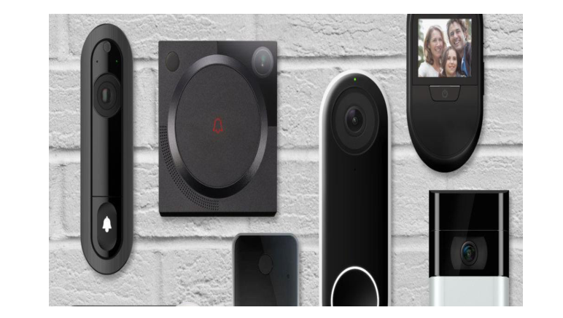
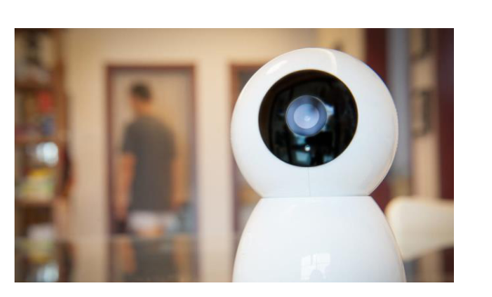
6.2.4 Privacy Case: Smart Home and Surveillance Devices
Convenience and safety may create new visibility into daily life
• Smart cameras and doorbells can reveal visitors, routines, and occupancy.
• Appliance data can reveal habits and activity patterns.
• Cloud access and mobile apps expand the privacy boundary beyond the home.
• Controls should include strong authentication, access review, encryption, retention limits, and clear user consent.
Source figure: [R2] IoT & Applications Digital Notes, smart doorbell and camera examples, source PDF p. 141
17
Notes:
Use the smart home examples to ask students what information can be inferred beyond the intended use. For example, camera and doorbell data reveal visitors and activity patterns.

Slide 18
6.3
Attacks and Threats in IoT
• Classify threats according to what they attack: device, data, network, platform, application, or user.
• Understand how cyber attacks can become operational and safety incidents.
18
Notes:
Transition from privacy to threat analysis. The goal is not to list every possible attack but to build a classification that students can apply to new systems.

Slide 19
6.3.1 End-to-End IoT Attack Surface
Threats can appear at every layer and interface
Physical
device
Firmware
Local
network
Gateway
Internet
Cloud/API
Mobile/Web
app
User
tampering
malicious update
eavesdropping
weak translation
DoS
API abuse
injection
phishing
• A secure sensor value can become unsafe if a later API command is unauthorized.
• A secure cloud service can still fail if device credentials are default or exposed.
• Threat analysis should follow data and command paths from physical device to user workflow.
Design rule: protect every trust boundary, not only the most visible component.
19
Notes:
Walk left to right across the chain and ask students to name one risk at each point. Emphasize that the attacker chooses the weakest boundary, not the one the designer prefers to discuss.

Slide 20
6.3.2 Computational Attacks vs Data Attacks
Some attacks alter execution; others alter the data that drives decisions
Computational attacks
Data attacks
• Exploit code, firmware, memory, APIs, or configuration.
• Affect correct execution of a program or service.
• May cause information leakage, unauthorized behavior, or system crash.
• Examples: malicious firmware, code injection, unsafe update, account compromise.
• Alter input or communicated data without necessarily changing the control algorithm.
• Create wrong decisions from apparently normal computation.
• Especially dangerous when algorithms control physical processes.
• Examples: false sensor values, spoofed state, replayed telemetry, modified commands.
20
Notes:
Explain that data attacks are particularly important in IoT because the system may faithfully compute the wrong action based on false input data.

Slide 21
6.3.3 False Data Injection
Compromised input can produce unsafe output
Real physical state
Room temperature = 22°C
Valid measurement
22°C
Controller
normal cooling
Safe behavior
Real physical state
Room temperature = 22°C
Injected value
37°C
Controller
maximum cooling
Unsafe or wasteful
behavior
• The attacker may not need to compromise the control algorithm if they can corrupt the measurement or command path.
• Integrity checks, sensor plausibility checks, redundancy, and monitoring can reduce this risk.
21
Notes:
Use the HVAC example. Students should see why integrity and sensor validation are safety requirements.

Slide 22
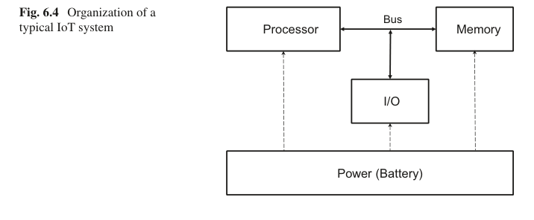
6.3.4 Device-Level Threats
Deployed devices may be constrained, unattended, and physically exposed
• Physical tampering or device replacement.
• Default or weak credentials.
• Insecure boot process or firmware image.
• Malware or unauthorized local code.
• Exposed debug ports and unnecessary services.
• Key extraction, memory attacks, or side-channel leakage.
Design question: what secrets and functions must survive physical exposure?
Source figure: [R1] Serpanos & Wolf, Fig. 6.4 Organization of a typical IoT system, source PDF p. 68
22
Notes:
Emphasize that many IoT devices are not protected like servers. Security mechanisms must consider low cost, limited resources, and potential physical access.

Slide 23
6.3.5 Network Threats
IoT communication must protect constrained and heterogeneous links
Common threats
Core controls
• Eavesdropping
• Man-in-the-middle attack
• Spoofing and replay
• Routing attack
• Denial of service
• Distributed denial of service
• Endpoint authentication
• Encryption and integrity protection
• Secure routing where applicable
• Key management
• Firewalling and port protection
• Traffic monitoring and anomaly detection
23
Notes:
Relate threats to protocols from Chapter 3. Explain that constrained devices make key management and encryption choices more difficult but not optional.

Slide 24
6.3.6 IoT Botnets and DDoS
An insecure device can attack systems beyond its own application
Vulnerable IoT devices
weak credentials or unpatched firmware
Malware infection
devices become bots
Command and control
attacker coordinates traffic
Target overload
service becomes unavailable
• DDoS attacks overload processor, memory, network, or service capacity.
• IoT devices are attractive because they are numerous and often poorly managed.
• Availability is a security property and an operational requirement.
• Controls include patching, credential management, device monitoring, network filtering, and service-level protection.
24
Notes:
Explain that IoT security is ecosystem security. A cheap camera or router can become part of a global attack if it is poorly managed.

Slide 25
6.3.7 Application and Cloud Threats
Remote management increases value and expands risk
• Weak or reused user credentials.
• Insecure web or mobile interface.
• Overly broad API permissions.
• Injection vulnerabilities and unsanitized input.
• Misconfigured cloud storage or database access.
• Unauthorized remote control commands.
• Insecure third-party integrations.
Encrypted traffic does not protect the system if the account, API, or application logic is compromised.
Design controls
• MFA and strong identity
• Least privilege APIs
• Input validation
• Secure logging
• Change review
• Incident response
25
Notes:
Connect to standard web and cloud security, but explain that application errors in IoT can have physical consequences when APIs control devices.

Slide 26
6.4
Security by Design
• Build security into requirements, architecture, implementation, deployment, updates, and decommissioning.
• Design controls before attackers and failures reveal design weaknesses.
26
Notes:
Transition to design principles. Security by design is not a single technology; it is a lifecycle discipline.

Slide 27
6.4.1 Threat Modeling Before Implementation
Reason about assets, threats, impact, controls, and tests
Asset
what must be protected?
Threat
what can go wrong?
Vulnerability
where is the weakness?
Impact
what is the consequence?
Control
how do we reduce risk?
Test
how do we verify?
Example: HVAC command
Unauthorized manipulation
Unsafe temperature
Authenticate + authorize + log
• Threat modeling should happen before prototype deployment.
• The output is a prioritized list of controls and tests, not only a list of possible attacks.
27
Notes:
Introduce threat modeling as a practical engineering technique that students can use in projects.

Slide 28
6.4.2 Device Security by Design
Protect identity, firmware, secrets, and local interfaces
Unique device identity
avoid shared credentials
Secure provisioning
install secrets safely
Secure boot
verify firmware before execution
Protected key storage
reduce extraction risk
Minimized interfaces
close debug and unused ports
Tamper strategy
evidence, response, or resistance
Device security is most effective when it is designed before large-scale deployment.
28
Notes:
Explain that device identity and firmware integrity are foundational. If the device itself cannot be trusted, later cloud or dashboard decisions become questionable.

Slide 29
6.4.3 Secure Communication and Access
Protect communication channels and restrict unnecessary exposure
• Authenticate devices, gateways, users, services, and applications.
• Encrypt sensitive data in transit and protect message integrity.
• Use appropriate transport security for the protocol and network conditions.
• Open only the ports and services required for the application.
• Disable insecure discovery or remote-management features if not needed.
• Monitor traffic patterns for abnormal behavior.
Device
Gateway
Mutual authentication
Encrypted and integrity-protected traffic
Minimal exposed ports and services
Monitoring for abnormal behavior
Source figure: Instructor-created synthesis based on [R2] IoT & Applications Digital Notes, security factors, source PDF pp. 14-15
29
Notes:
Use the architecture figure to remind students that security must cut across all layers. The bullet list connects to authentication, encryption, and port protection.

Slide 30
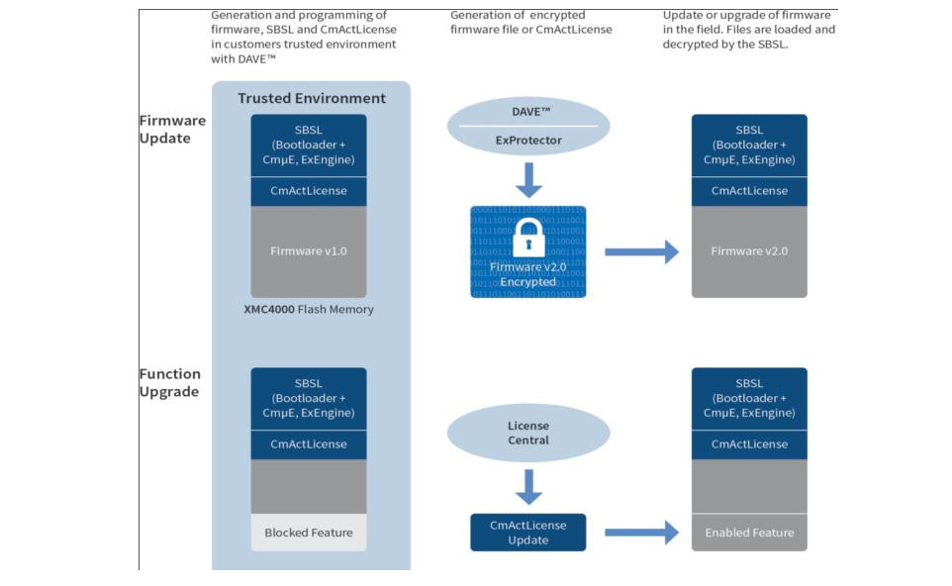
6.4.4 Secure Firmware and OTA Updates
Updates are necessary, but the update channel is a powerful attack surface
• Updates are needed for vulnerability fixes, bug repair, configuration changes, and new features.
• Risks include malicious firmware, unauthorized operator action, failed update, or rollback to a vulnerable version.
• Design goals: verify origin, verify integrity, authorize updater, protect delivery, and preserve safe recovery.
• For safety-critical functions, update policy may require extra approval and staged rollout.
Source figure: [R2] IoT & Applications Digital Notes, firmware update/security illustration, source PDF p. 138
30
Notes:
Explain the paradox: the ability to update deployed devices is necessary for security, but also creates a route for malicious code if not protected.

Slide 31
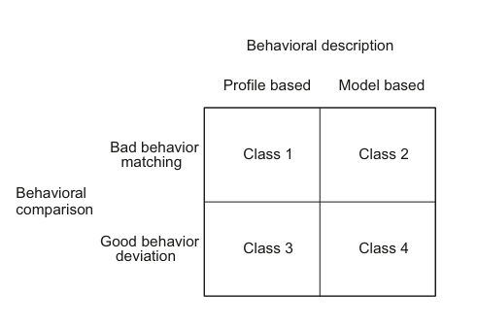
6.4.5 Run-Time Security Monitoring
Detect abnormal behavior after deployment
• Profile-based monitoring learns statistical patterns of operation.
• Model-based monitoring compares behavior against explicit system models.
• Bad-behavior matching detects known attacks or fault signatures.
• Good-behavior deviation can detect unknown events but may raise false alarms.
• Monitoring is essential because design-time protection is never perfect.
Source figure: [R1] Serpanos & Wolf, Fig. 6.5 Classification of run-time security monitoring systems, source PDF p. 75
31
Notes:
Use the matrix to discuss trade-offs between known-attack signatures and anomaly detection. Relate false alarms to operational cost.

Slide 32
6.5
Reliability and Operational Safety
• Analyze how faults, failures, attacks, and unsafe conditions are related.
• Design safe behavior when components, networks, or services fail.
32
Notes:
Transition to reliability and safety. Explain that not every harmful outcome begins with an attacker; ordinary faults can also cause unsafe behavior.

Slide 33
6.5.1 Fault, Failure, Attack, and Hazard
Different causes can lead to the same unsafe state
Fault or attack
sensor fault, code bug, malicious data
Incorrect state/data
wrong measurement or command
Failure
system cannot provide required function
Unsafe action
actuator or service behaves incorrectly
Hazard
possible harm or damage
• A fault is an abnormal condition or defect.
• A failure is inability to provide the required function.
• An attack intentionally introduces faults or manipulates conditions.
• A hazard is a condition that can cause harm to people, equipment, or service continuity.
• Safety engineering asks how to break the chain before hazard occurs.
33
Notes:
Use this slide to connect dependability and security. In practice, systems must respond safely regardless of whether the abnormal condition is accidental or malicious.

Slide 34
6.5.2 Dependability and Availability
A system must remain useful under faults and degraded conditions
• Dependability includes reliable and available service provision even under errors or failures.
• Availability matters when alarms, monitoring, or control functions are time sensitive.
• Some safety functions should remain local when cloud connectivity fails.
• Redundancy, health monitoring, watchdogs, and fallback modes support dependable operation.
• An attacker may intentionally create faults that dependability mechanisms must handle.
If cloud is unavailable...
Dashboard may stop updating
Local smoke alarm must still work
Local controller may keep bounded control
Operator is notified after reconnection
34
Notes:
Highlight that cloud dependency must be designed carefully. Not all functions have the same availability and latency requirements.

Slide 35
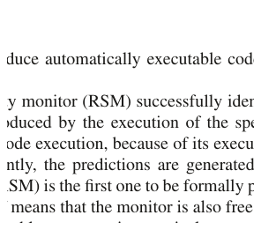
6.5.3 Fail-Safe and Graceful Degradation
When the system cannot operate normally, it should still avoid unsafe behavior
• Stop safely instead of continuing unsafe action.
• Maintain a known safe state when possible.
• Switch to local controller if cloud or network is unavailable.
• Limit capability under degraded conditions.
• Alert a human operator when automatic recovery is uncertain.
• Use domain-specific safety limits that cannot be bypassed by ordinary commands.
Example: a tank controller should never overflow the tank, even when a sensor reading or command is abnormal.
Source figure: [R1] Serpanos & Wolf, Fig. 6.7 Water tank, source PDF p. 78
35
Notes:
Use the water tank example to make fail-safe behavior concrete. Safety policies should define what is never allowed, not only what should happen under normal conditions.

Slide 36
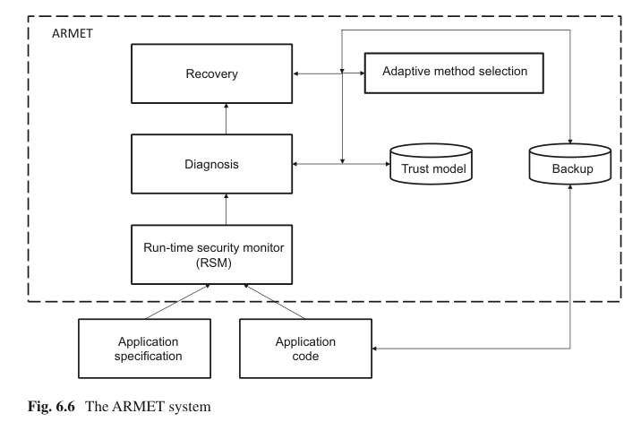
6.5.4 Monitor, Diagnose, Recover
Runtime safety and security require more than detection
• Monitor system behavior against expected behavior.
• Detect deviation caused by a failure or attack.
• Diagnose the likely cause or affected component.
• Select a recovery action based on trust and available information.
• Recover from a previous safe state if uncertainty is high.
Source figure: [R1] Serpanos & Wolf, Fig. 6.6 The ARMET system, source PDF p. 77
36
Notes:
Present ARMET at a conceptual level. Students only need the idea of monitor, diagnose, and recover, not the formal verification details.

Slide 37
6.6
Representative IoT Applications
• Different domains prioritize security, privacy, availability, and safety differently.
• Analyze trustworthy design in smart home, healthcare, vehicle, and Industrial IoT examples.
37
Notes:
Transition to applications. Explain that the same security principles appear in different forms depending on domain requirements.

Slide 38
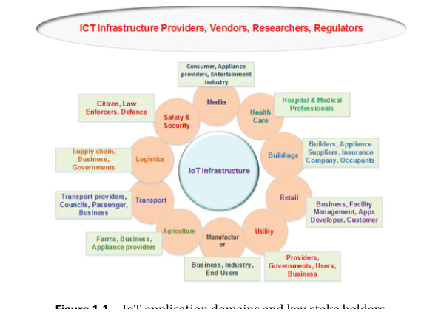
6.6.1 IoT Application Domains and Stakeholders
Trust requirements vary by domain and stakeholder
• Healthcare: privacy, safety, and timely alerts.
• Safety and security: surveillance, emergency response, and access control.
• Transport: location privacy, message integrity, and low-latency safety data.
• Utility and smart grid: availability, integrity, and continuous operation.
• Manufacturing: safe control, reliability, and protection of production data.
Source figure: [R3] Khan & Yuce, Fig. 1.1 IoT application domains and key stakeholders, source PDF p. 21
38
Notes:
Use the figure to show the diversity of IoT domains. Ask students which security property is most important in each domain.

Slide 39
6.6.2 Security Priorities in Representative Applications
The same principles lead to different design priorities
Healthcare IoT
health data, wearable or implantable sensors
confidentiality, integrity, availability, safe response
Smart home
camera, doorbell, lock, appliance data
privacy, account security, local safety, consent
Connected vehicle
telemetry, location, OTA update, remote commands
authentication, integrity, update security, safety
Industrial IoT
sensors, PLC, SCADA, actuator, production data
availability, integrity, fail-safe control, segmentation
Good security design starts from domain-specific consequences, not from a generic checklist.
39
Notes:
Compare domain priorities. Healthcare emphasizes patient privacy and safe clinical response; Industrial IoT emphasizes availability and safe control; vehicles emphasize integrity and update safety.

Slide 40
Chapter Summary and Exit Questions
Check understanding before course wrap-up
• IoT security must protect data, devices, communication, cloud services, applications, users, and physical actions.
• Integrity is essential because corrupted data can produce unsafe behavior.
• Privacy must be managed across collection, transmission, storage, analytics, sharing, retention, and deletion.
• Threats include computational attacks, false data injection, network attacks, insecure updates, weak APIs, and account compromise.
• Security by design combines threat modeling, secure devices, secure communication, secure updates, monitoring, and recovery.
• Reliability and safety require safe behavior under faults, failures, attacks, and degraded conditions.
Exit questions
• Why is integrity critical in cyber-physical IoT?
• Give one example where a security failure becomes a safety failure.
• How is privacy different from confidentiality?
• Why can OTA update become an attack vector?
• What should an IoT system do when a critical component fails?
40
Notes:
Use the exit questions for a quick classroom discussion. These questions test conceptual understanding rather than memorization.

