Slide 1
Text-Aware Predictive Monitoring of Business Processes with LSTM Neural Networks
David Benedikt Georgi
18.08.2020
Interim Presentation

Slide 2
Business Process Monitoring – A Modern Environment for Commercial Process Mining
Traditional Process Mining
Applied project-based
Manual data extraction
Historical event data only (offline)
Standalone process mining software
Process Mining in
Business Process Monitoring
Applied continuously
Permanent data connection
Historical and real-time event data (online)
Integrated process mining platform
vs.

Slide 3
Business Process Monitoring – A Modern Environment for Commercial Process Mining

Slide 4
Motivation: Adding the Forward Perspective to Business Process Monitoring
Knowing the future of a process gives organizations a competitive advantage.

Slide 5
Contribution: A Text-Aware Process Prediction Framework

Slide 6
Contribution: A Text-Aware Process Prediction Framework

Slide 7
Contribution: A Text-Aware Process Prediction Framework

Slide 8
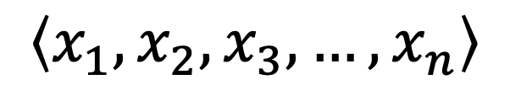
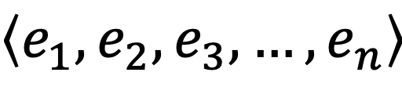
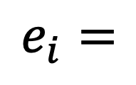
Trace Encoding
Transforming a sequence of events to a sequence of vectors
$$\left\langle e_{1}, e_{2}, e_{3},…, e_{n}\right\rangle$$
$$\left\langle x_{1},x_{2},x_{3},…,x_{n}\right\rangle$$
Case ID | Activity | Timestamp | Resource | Cost | Comment
254 | Consultation | 02.02.2020:18.14 | J. Brown, MD | 67.24 | "The patient has been diagnosed with high blood pressure."
$$e_{i}=$$
$x_{i}=(a_{i},t_{i}, d_{i}^{1},d_{i}^{2}, d_{i}^{3})$

Slide 9


Encoding of Categorical and Numerical Attributes
Activities & Categorical Attributes
Numerical Attributes
1-Hot-Encoding
Normalization
1-Hot$\left(„Consultation“\right)=(0,1,0,0,0)$
$$\hat{d}= \frac{d −min⁡(d)}{\max\left(d\right)−min⁡(d)}$$
Index | Activity
1 | Register patient
2 | Consultation
3 | Blood test
4 | MRI
5 | Release Patient

Slide 10

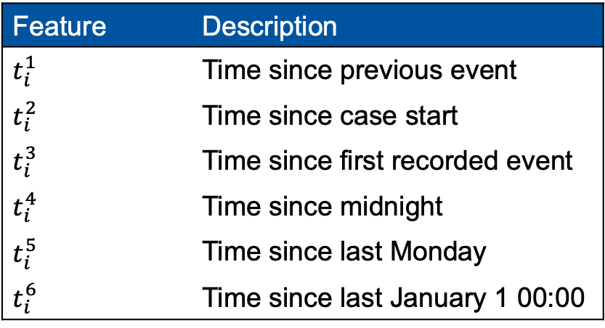
Capturing Temporal Dependencies
Encoding of timestamp data
6-dimensional vector with time-based features is part of every encoded event
Capture daily, weekly, seasonal dependencies and concept drifts
Idea: Process behavior might be influenced by office hours, weekends, seasons, etc.
All time features are normalized to [0,1]
Feature | Description
$$t_{i}^{1}$$ | Time since previous event
$$t_{i}^{2}$$ | Time since case start
$$t_{i}^{3}$$ | Time since first recorded event
$$t_{i}^{4}$$ | Time since midnight
$$t_{i}^{5}$$ | Time since last Monday
$$t_{i}^{6}$$ | Time since last January 1 00:00
$${t_{i}=(t}_{i}^{1},t_{i}^{2},t_{i}^{3},t_{i}^{4},t_{i}^{5},t_{i}^{6})$$

Slide 11
Text Vectorization
1. Step: Text Normalization
Transformation | Example
Original | "The patient has been diagnosed with high blood pressure."
Lowercase | "the patient has been diagnosed with high blood pressure."
Tokenization | [“the", "patient", "has", "been", "diagnosed", "with", "high", "blood", "pressure", ".”]
Lemmatization | ["the", "patient", "have", "be", "diagnose", "with", "high", "blood", "pressure", "."]
Stop word filtering | ["patient", "diagnose", "high", "blood", "pressure”]

Slide 12
Text Vectorization – 4 Approaches
2. Step: Apply Text Model
Bag of Words
Bag of N-Gram
Paragraph Vector
Latent Dirichlet Allocation

Slide 13
Bag of Words
Represent documents by the term frequencies (tf) of its words
Construct vocabulary using the historical event log
Create vector with size of the vocabulary with the term frequencies of the words
Normalize each component with the inversed document frequency (idf)
Example:
Vocabulary
Index | Word
1 | patient
2 | urgent
3 | blood
4 | pressure
5 | notice
6 | leg
7 | high
8 | low
Document
["patient", "diagnose", "high", "blood", "pressure”]
(1, 0, 1, 1, 0, 0, 1, 0)
(0.5, 0, 0.4, 1.2, 0, 0, 1.4, 0)

Slide 14
Bag of N-Gram
Represent documents by the term frequencies (tf) of its n-grams
Construct n-gram-vocabulary using the historical event log
Create vector with size of the vocabulary with the term frequencies of the words
Normalize each component with the inversed document frequency (idf)
Example: 2-Gram
Document
["patient", "diagnose", "high", "blood", "pressure”]
[("patient", "diagnose"), ("diagnose", "high"), ("high", "blood") and ("blood", "pressure”)]
(1, 0, 1, 0, 0, 0, 1, 1)
(0.5, 0, 0.4, 0, 0, 0, 1.4, 0.6)
Vocabulary
Index | 2-Gram
1 | (patient, diagnose)
2 | (urgent, quick)
3 | (blood, pressure)
4 | (value, significant)
5 | (notice, recently)
6 | (leg, break)
7 | (diagnose, high)
8 | (high, blood)

Slide 15
Paragraph Vector

Slide 16

Latent Dirichlet Allocation
Describe documents as a probability distribution over topics
Document is represented by a vector of dimension k, such that component i describe the “affiliation” to topic i
Topics are probability distributions over words
Find the topic distribution for each document that most likely would generate the corresponding document
Example: 3 Topics, 3 Words
Affiliation to topic 2
$$(0.1, 0.2, 0.7)$$
Topic distribution of a document

Slide 17
Text Vectorization – Comparison
Text Model | Pro | Contra
Bag of Words | Simple and fast | Ignores word order High dimensionality
Bag of N-Gram | Simple and fast Considers word order | Very high dimensionality
Paragraph Vector | Expressive representation Low dimensionality | High computation costs Requires big training corpus
Latent Dirichlet Allocation | Low dimensionality | Ignores word order Choice of number of topics is difficult

Slide 18
LSTM Module

Slide 19
LSTM Network Architecture

Slide 20
The Next Steps…
Evaluation on real-life event logs
Research Focus:
Impact of the utilization of textual data
Impact of the text model choice and other parameters
Comparison with existing techniques regarding prediction quality

Slide 21
Schedule

Slide 22
Any questions?

