Slide 1
HTML Basics
Hy-Tech Club: Web 101

Slide 2
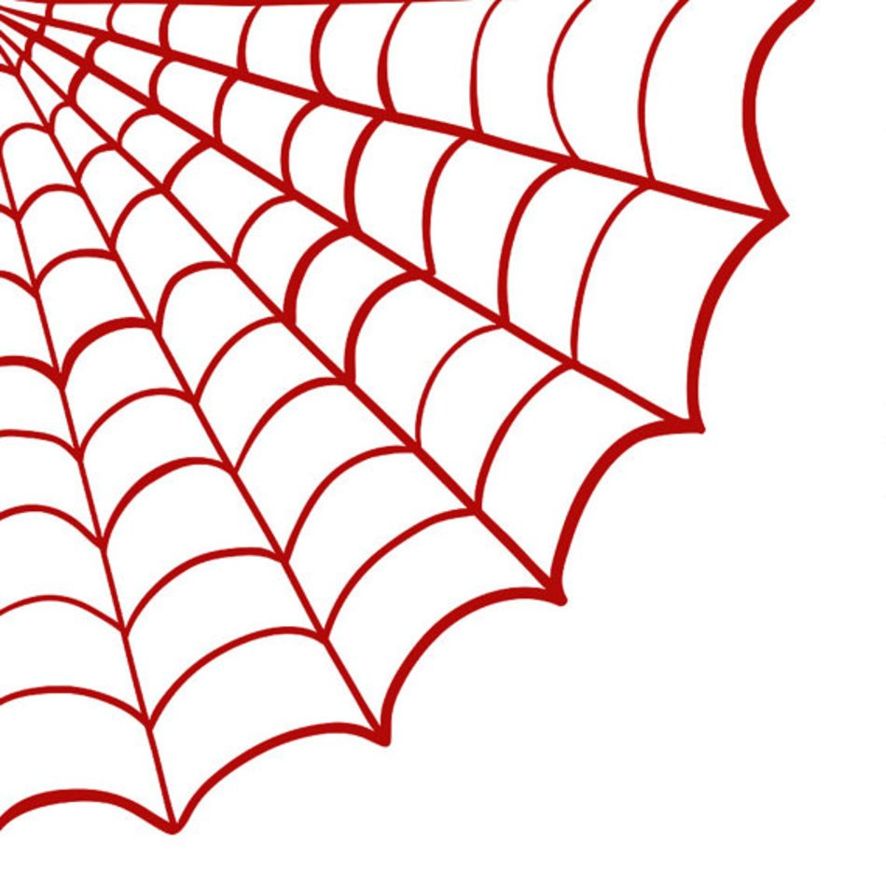
Web Overview

Slide 3
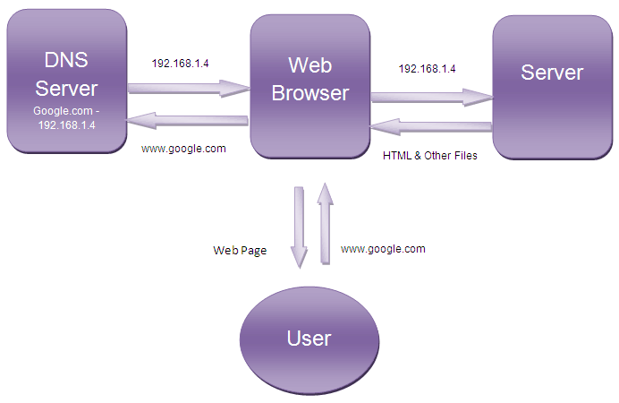
How does the web work?
User
Type a URL into a web browser
See the content of a website
Behind the Scenes
The browser finds the server
The server sends content
The browser renders content
Notes:
Students should be familiar with websites – they enter a URL, and see some content.
Behind the scenes, a lot of stuff happens to get that content to the user!
Most of this doesn’t really apply to this course, but it is helpful to have this background knowledge.

Slide 4
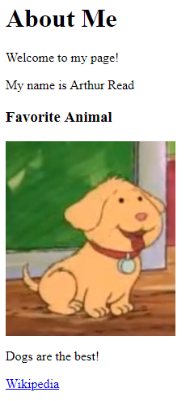
How does a browser use HTML?
The browser gets HTML from the server and renders it as a webpage
<html>
<body>
<h1>About Me</h1>
<p>Welcome to my page!</p>
<p>My name is Arthur Read</p> <h3>Favorite Animal</h3>
<img src="https://i.imgur.com/GfT5Z9R.png" />
<p>Dogs are the best!</p>
<a href="https://en.wikipedia.org/wiki/Dog">Wikipedia</a>
</body>
</html>
Server
Notes:
Browser reads the text, interprets it, and shows it to the user. HTML is behind every user interface on the web.
It can be helpful to view a popular Wikipedia page in the web, and then view the source to see how the web browser renders it into a viewable page.

Slide 5
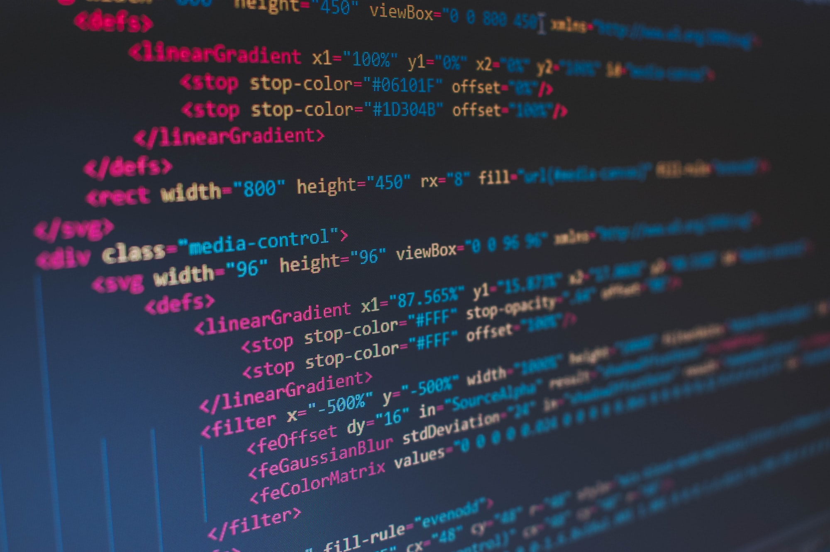
HTML Introduction

Slide 6
HTML Introduction
An HTML Document is a text file with a specific format
The file extension should be .html (e.g., index.html)
HTML is made up of elements, each with a different purpose
E.g., images, text, tables, links, and so on!
The HTML file must be formatted in a particular way – using tags
Notes:
This may seem abstract, but it should make more sense after some examples

Slide 7
HTML Tags
HTML Tags typically consist of an opening and a closing tag:
<tag>content</tag>
The formatting is very important – make sure each tag has the proper less-than and greater-than symbols (called angle brackets)
Whitespace does not matter, but indenting tags properly makes the code much easier to read
Notes:
This may seem abstract, but it should make more sense after some examples. Seeing the code in action and working with it makes it clearer!

Slide 8
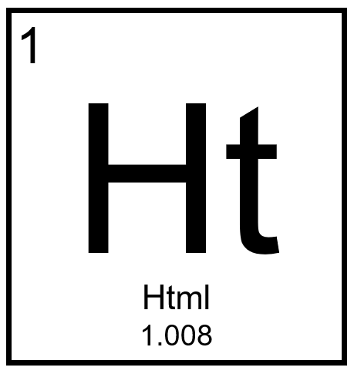
Basic HTML Elements

Slide 9
The html Element
The foundation for every HTML document
Starts and ends the entire file
All the other HTML is the content in between these tags
<html>
<!-- content -->
</html>

Slide 10
The body Element
Goes within the <html></html> element
Everything within these tags determines the structure of the page
All of the visible HTML elements go within the <body>
<html>
<body>
<!-- content -->
</body>
</html>

Slide 11
The p (Paragraph) Element
Displays common text on the page
The content does not have to be multiple sentences
Each <p></p> creates a new line under it
<p><!-- content --></p>

Slide 12
Practice: Hello World
Create a new HTML file, and add a paragraph that says “Hello World”
<html>
<body>
<p>Hello World</p>
</body>
</html>

