Slide 1
HTML Basics
Web 101

Slide 2
How does the Web work?
HTML Introduction
Our first HTML tags!

Slide 3
How does the Web work?

Slide 4
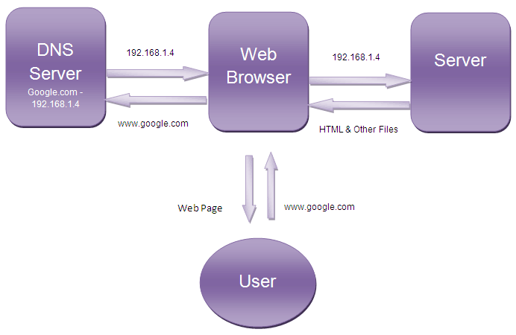
How does the Web work?
http://4.bp.blogspot.com/-k02Z7I84nxc/Twcmm44Mn6I/AAAAAAAAAjk/isnJ942gCS4/s1600/How-Browsers-work.gif
Notes:
Don’t need to go too in-depth with this stuff, it’s only kind of related to the class content

Slide 5
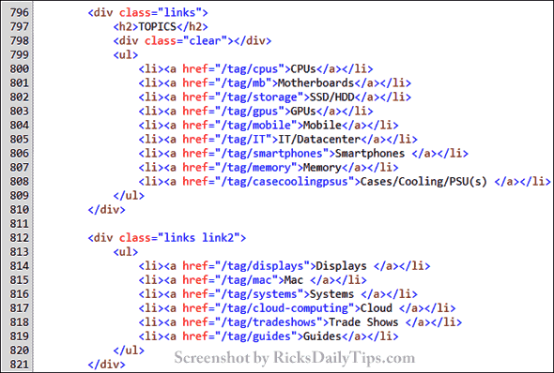
How does a browser use HTML?
http://www.ricksdailytips.com/wp-content/uploads/2014/12/html-source-code-screenshot.gif
Notes:
Browser reads the text, interprets it, and shows it to the user. HTML is behind every user interface on the web.

Slide 6
HTML Introduction

Slide 7
HTML Introduction
An HTML Document is a text file composed of tags
Different tags are interpreted by the browser in different ways, and will appear accordingly on the webpage
Each tag represents its own HTML Element
Tags (typically) have an opening tag and a closing tag:
<tag>content</tag>
Notes:
This stuff may seem abstract, but will hopefully make more sense after some examples.

Slide 8
HTML Tips
Always remember your opening and closing tags!
Use proper indentation to keep your files neat
Whitespace does not matter to the browser when rendering the HTML
Notes:
This stuff may seem abstract, but will hopefully make more sense after some examples.

Slide 9
Our first HTML tags!

Slide 10
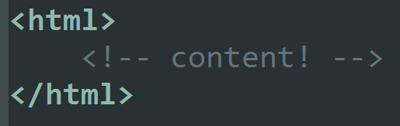
HTML Tag: <html></html>
The foundation of every HTML document
Starts and ends the entire document
All other HTML is the “stuff” that goes in between the <html> tags

Slide 11
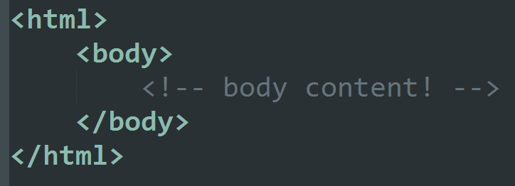
Body Tag: <body></body>
Goes inside the <html> tags
Another foundational tag, everything inside these tags is what we see when we go to a website
All of the structural tags go within the <body>

Slide 12
Paragraph Tag: <p></p>
Used to display common text in your page
Each <p> should be used to display a paragraph-sized chunk of text
Each new <p> tag will create a new paragraph beneath the previous one
Notes:
Show examples in the TryIt Editor

Slide 13
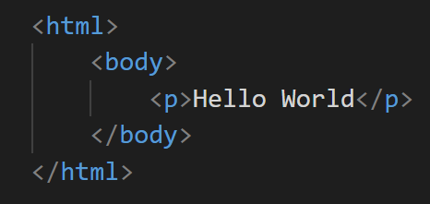
Practice: Hello World!
Create a new HTML file, and add a paragraph that says Hello World!
Notes:
Show examples in the TryIt Editor

