Slide 1
HTML Tags
Web Design 101

Slide 2
Header Tags: <h1></h1> - <h6></h6>
Used to display important text in your page.
<h1> is the biggest and boldest text, while <h6> is the smallest and lightest. <h2>, <h3>, <h4>, <h5> fall in between.
Only display short lines of text, not entire sentences or paragraphs
Notes:
Show examples in the TryIt Editor

Slide 3
Paragraph Tag: <p></p>
Used to display common text in your page
Each <p> should be used to display a paragraph-sized chunk of text
Each new <p> tag will create a new paragraph beneath the previous one
Notes:
Show examples in the TryIt Editor

Slide 4
Anchor Tag: <a></a> (Better known as hyperlink, link, etc)
Used to create a link to another website
Use an href value to actually link to the site:
<a href="http://www.google.com">Google</a>
The href has to match the URL of the site exactly. The content in between the tags can be whatever you want!
Notes:
Show examples in the TryIt Editor

Slide 5
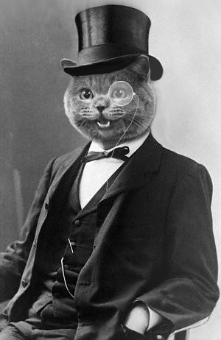
Image Tag: <img />
Used to display an image with its src value
One of a few self-closing tags
<img src="https://i.imgur.com/cahBnPD.png" />
Notes:
Show examples in the TryIt Editor

Slide 6
CodePen!

