Slide 1
Comments, Data Types, & Math
Hy-Tech Club: Web 102

Slide 2
Agenda
Comments
Data Types
Math

Slide 3
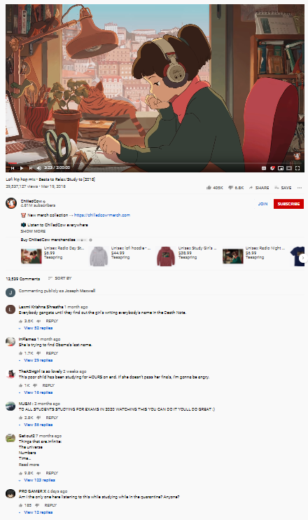
comments
Notes:
Comments in code are not exactly like YouTube comments, but they kind of are.

Slide 4
Comments in code
In a programming language, comments are any pieces of code that the computer ignores
In JavaScript, any line that starts with // is a comment, and will be ignored
Developers can also make multi-line comments using /* and */
Everything between is ignored
In Visual Studio Code, comments will be green

Slide 5
Comments Example
// alert("comment");
alert("not a comment");
/*
anything can go here
alert("comment again");
*/
Notes:
Ask the students what the user will see if this code is run..
In this program, the user will see “not a comment” and no other messages.

Slide 6
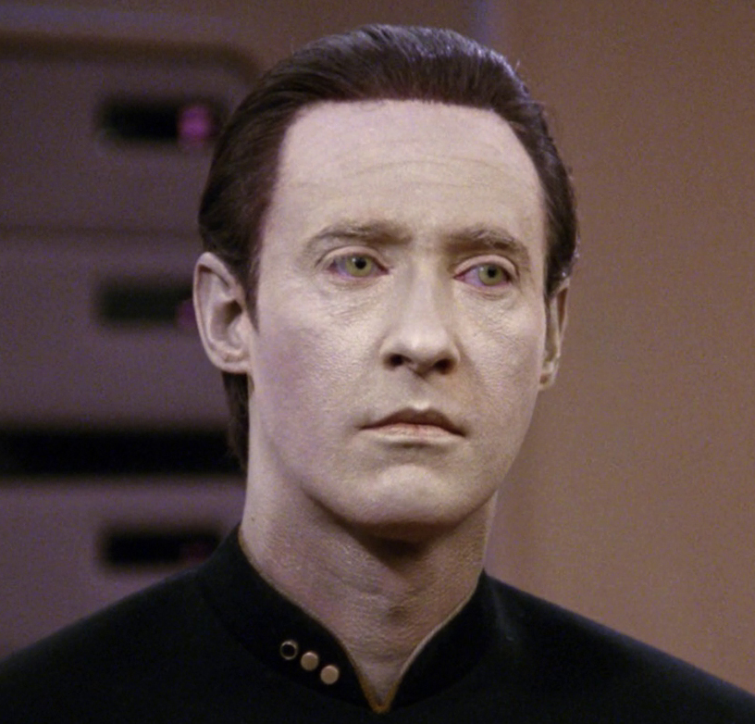
Data types
Notes:
Students probably will not understand the reference to Data from Star Trek – he was an android and chief operations officer of the Enterprise.

Slide 7
Data types
What types of data does a computer store?
Two basic data types:
String – A block of text, like "Hello, friend"
Number – A number, like 8
Notes:
Ask the students to think of types of data the computer stores.
For now, we will be considering only two data types: strings and numbers.
Students should know what numbers are, but what about strings?

Slide 8
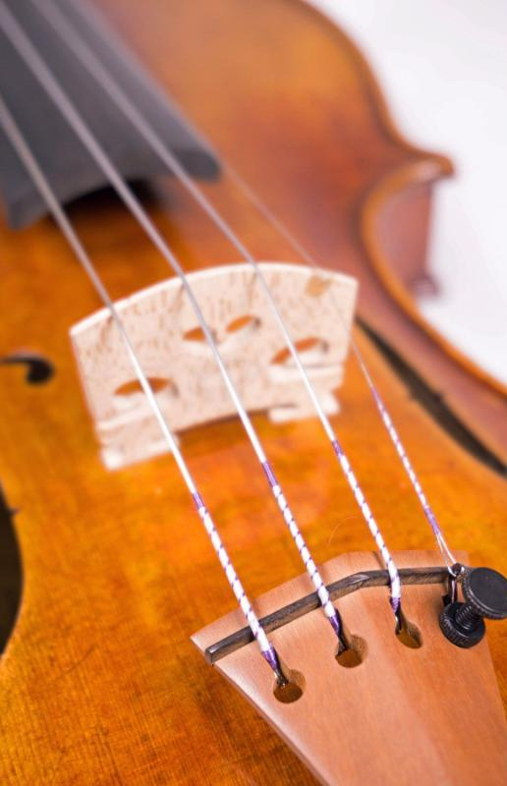
Strings
Strings are a sequence of characters
To create a string, place quotes around some text
Strings are used to send/receive messages
alert("I am a string!");
var name = prompt("What is your name?");
Notes:
Note that the things within the double quotes are strings. The variable is also a string.

Slide 9
Mini-quiz: Name that data type!
12
Notes:
For this section, go around the room and ask the students to name the data type
number

Slide 10
Mini-quiz: Name that data type!
“Message”
Notes:
For this section, go around the room and ask the students to name the data type
string

Slide 11
Mini-quiz: Name that data type!
“14.5”
Notes:
For this section, go around the room and ask the students to name the data type
string

Slide 12
Mini-quiz: Name that data type!
14.500
Notes:
For this section, go around the room and ask the students to name the data type
number

Slide 13
Mini-quiz: Name that data type!
var name = 8;
Notes:
Looking for the data type of the variable name
number

Slide 14
Mini-quiz: Name that data type!
var name = "Bob";
Notes:
Looking for the data type of the variable name
string

Slide 15
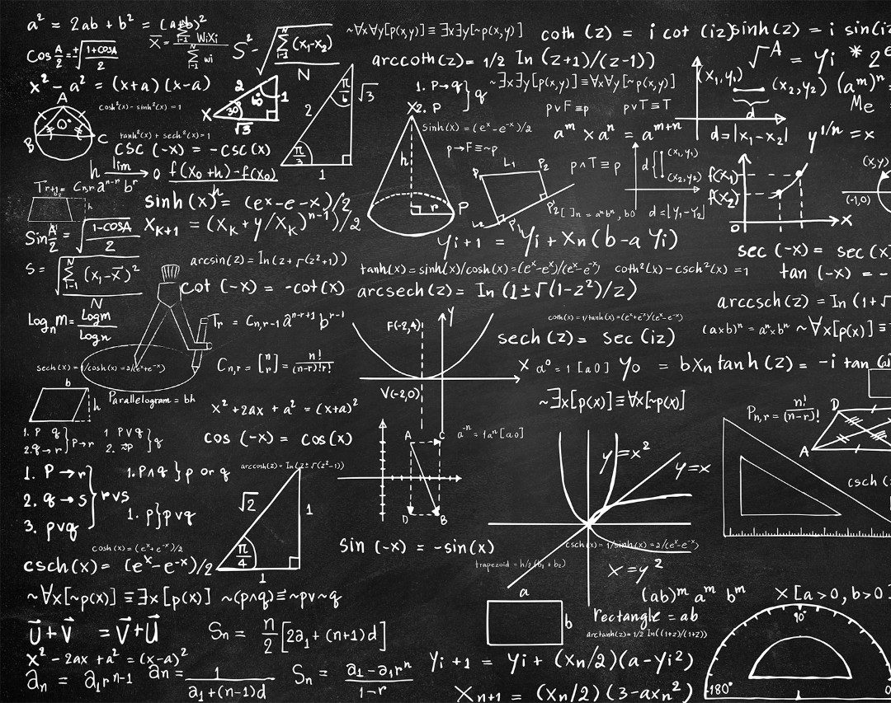
Math

Slide 16
Arithmetic operators
Addition: 4 + 5
Subtraction: 14 - 5
Multiplication: 3 * 3
Division: 18 / 2
Notes:
Ask the students what the values of each of these is

Slide 17
Arithmetic operators - variables
var x = 14 / 2;
var y = x + 2;
var z = 22 + 6 / 2;
Notes:
Ask the students what the values of each of these is

Slide 18
Converting a string to a number
Input from the user using prompt will be in the form of a string
To do any math, we need to make it a number
We use Number to convert the string
var age = prompt("How old are you?");
var ageNumber = Number(age);
Notes:
It is necessary to convert a string to number to be able to do math with it

Slide 19
String to number example
https://repl.it/repls/SpectacularCompetitivePoint
Notes:
For this Repl – see what happens if you do NOT convert the string to a number. Change “var ageNumber = Number(age)” to “var ageNumber = age” and see what happens…
Instead of doing the addition, it should append “1” to the end of the number. So, age 14 -> you are almost 141

