Slide 1
Hy-Tech Club: JavaScript
More Concepts

Slide 2
Separate JS files
Buttons

Slide 3
.js files

Slide 4
Why have separate files?
Keeps the structure of a webpage separate from the functionality
Keeps files shorter/easier to read
Makes your code easier to maintain

Slide 5
How to link an external JS file
<script src="FollowAlong.js"></script>
<script> tag
src attribute
FollowAlong.js filename

Slide 6
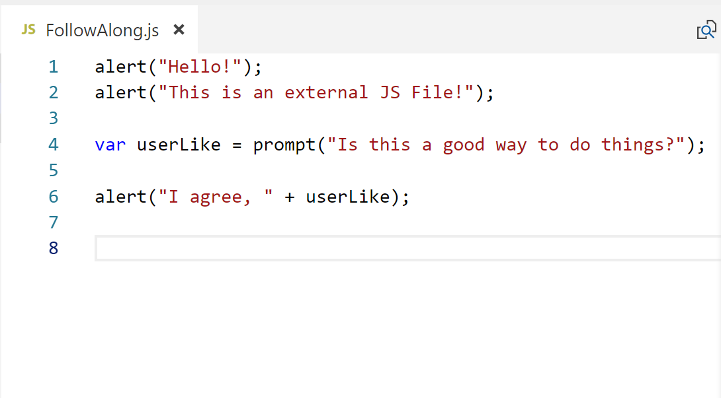
Notes:
JS files contain the same JavaScript code that would go within the script tag

Slide 7
Buttons

Slide 8
What can you do with buttons?
Execute JS code whenever the user wants to
Make your application more interactive

Slide 9
How to add a button
<button onclick="buttonClick()">Send</button>
<button> tag
onclick attribute
buttonClick() “function” or “action”
More on this later

Slide 10
JavaScript program with button and separate file
<html>
<head>
<script src="script.js"></script>
</head>
<body>
<button onclick="buttonClick()">Click me!</button>
</body>
</html>
Notes:
Ask the students to guess what this does

Slide 11

How to connect your button to your page
Make sure "onclick" value matches in .js file
Script.js:
button.html:
Need to match!

Slide 12
How does this work?
Buttons are calling functions
The function in this instance is buttonClicked
Functions run a specific block of code
A sequence of statements

Slide 13
Functions
Function keyword.
Function name.
Parentheses.
Curly brackets.
JavaScript code (statements).
function sayNumbers() {
var x = 1;
alert(x);
x = x + 1;
alert(x);
x = x + 10;
alert(x);
}

Slide 14
Revisiting
<html>
<head>
<script src="script.js"></script>
</head>
<body>
<button onclick="buttonClick()">Click me!</button>
</body>
</html>
buttonClick is assumed to be a function defined in script.js
buttonClick will run its statements when the button is clicked
Notes:
Ask the students to guess what this does

Slide 15
Still Confused?
We will visit functions more as the semester goes on
Important: Make sure your onclick value matches the function/action defined in your JavaScript code

