Slide 1
DAYANANDA SAGAR UNIVERSITY
SCHOOL OF ENGINEERING
Department of CSE (AI & ML)
Special Topic-I Review 1
PERSONAL ROBOT WITH AI ENABLED VOICE ASSISTANT
Under the Supervision
Prof. Mary Jasmine
Assistant Professor
Dept. of CSE(AI&ML)
1
Presented By:
CSS Krishna Kaushik (ENG21AM0020)
Amar Jyoti Panda(ENG21AM0006)
Prathit Panda (ENG21AM0088)
DIksha Sinha (ENG21AM0033)
Chinmay Agrawal (ENG21AM0024)

Slide 2
Overview
2
Abstract
Problem Statement
Introduction
State of the Art work (Literature survey)
Design
Methodology
References

Slide 3
Abstract
3
A voice assistant is a digital assistant that uses voice recognition, language processing algorithms, and voice synthesis to listen to specific voice commands and return relevant information or perform specific functions as requested by the user.
Over here we are planning to add few things in our voice assistant like it can greet hi , means it defines a list of possible greeting responses and chooses a random response from the list each time.
It can also play music , stop music , tell the current time ,Open What’s app , open YouTube, Open Netflix and search something on Google as per the user requirements.
We used various types of libraries of python for the desired output.

Slide 4
Contd.
4
Voice assistants will give required information by hearing the specific keywords from the input command and filter out the noise by detecting the Wake word and using some noise reduction algorithms.
Some Libraries which we used in our Program are datetime, speech-recognition ,pyttsx3, web browser, vlc , etc.
At the end you can expect result as a Apple's Siri, Amazon's Alexa, Microsoft's Crotona, and Google's Assistant which are the most popular voice assistants and are embedded in smart phones or dedicated home speakers.

Slide 5
Problem Statement
5
A voice assistant is a digital assistant that uses voice recognition, language processing algorithms, and voice synthesis to listen to specific voice commands and return relevant information or perform specific functions as requested by the user.
While voice assistants can be completely software based and able to integrate into most devices, some assistants are designed specifically for single device applications, such as the Amazon Alexa Wall Clock.
The voice assistants are mainly used to automate the things happening around us .It is mainly used to reduce the human effort and reduce time to do certain specific tasks.

Slide 6
Introduction
6
Voice assistants (VA) are type of voice-enabled artificial intelligence (AI).
It is an application program that understands natural language and voice commands to complete tasks for the users.
It is software that carries out everyday tasks via voice command. It's brings AI and machine learning together to recognize our voice and do what we ask it.
We built a voice assistant called Andrew that can do basic tasks like performing a web search, tell current time, date and weather, play youtube videos just through a simple voice command.
We want to further develop the voice assistant by adding more features and integrating Natural Language Processing (NLP) and Deep learning models.

Slide 7
Assumptions
7
We hope to integrate NLP and DL models to the voice assistant to increase it performance and add more features.
After the voice assistant is ready we plan on integrating it with a personal desk robot that interacts and communicates with the user in a friendly and supportive way.
We want to add more features like objection detection to enable the personal robot to percept it’s surrounding environment to provide a better user interaction.

Slide 8
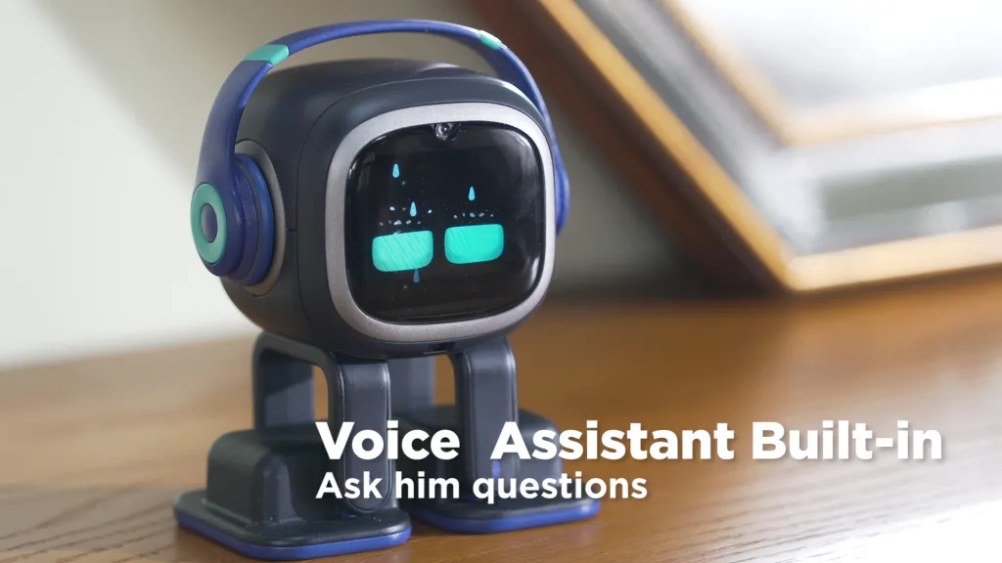
Pre Existing Personal Robots
8
Emo Robot:

Slide 9
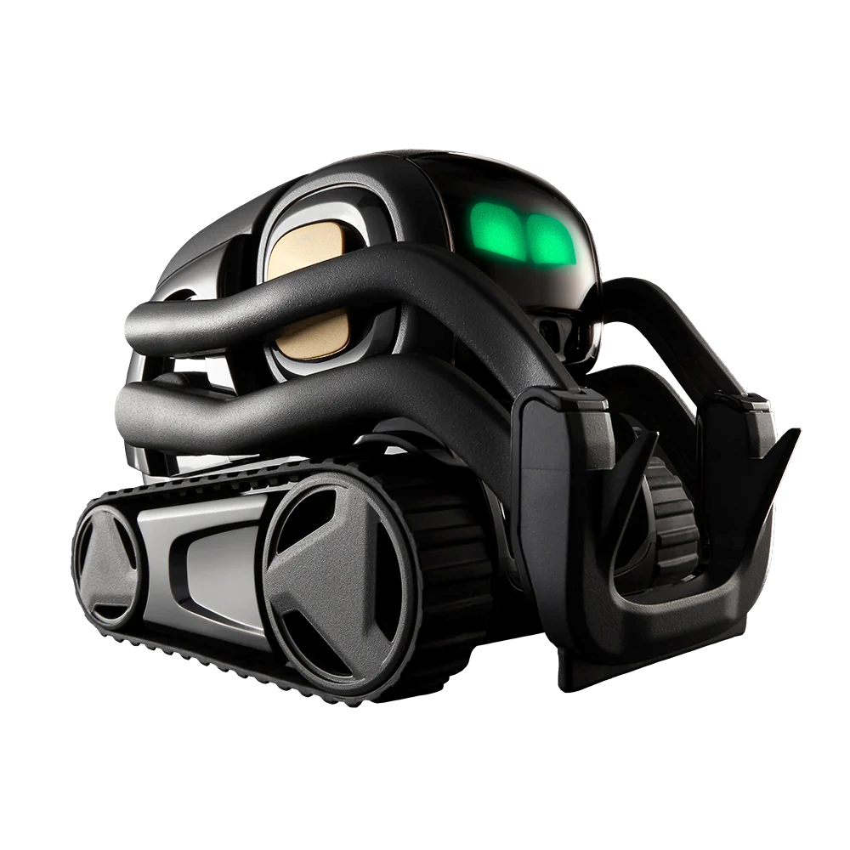
Vector Robot:
9

Slide 10
Literature Survey
Paper Title/Journal name | Author’s Name and published year | Results shared by author | What you infer
Study of Voice Controlled Personal Assistant Device. Journal: International Journal of Computer Trends and Technology (IJCTT) | Abhay Dekate, Chaitanya Kulkarni, Rohan Killedar. Published on: December 2016 | Voice Controlled Personal Assistant System will use the Natural language processing and can be integrated with artificial intelligence techniques to achieve a smart assistant that can control IoT applications and even solve user queries using web searches | AI powered voice assistant that is capable of automating or doing any told task can help our day to day tasks much easier and save us a lot of time and effort
AI-Based Voice Assistant Systems: Evaluating from the Interaction and Trust Perspectives Conference: AMCIS 2017 | Mohsen Ahmadian University of Massachusetts Boston Published on: 23rd January 2018 | From the research results, we found that interaction quality is the most important factor of the system which builds trust in users . | Focuses on two key perspectives: the quality of the interaction between the user and the AI-based voice assistant system, and the level of trust that users have in the system.

Slide 11
Literature Survey
Paper Title/Journal name | Author’s Name and published year | Results shared by author | What you infer
Humanizing voice assistant. Journal: Journal of Retailing and Consumer Services | Atieh Poushneh Published on: 2 September 2020 | Investigates how the personality of voice assistants may influence people's attitudes and behaviors towards them | Analyzed factors such as the tone of voice, the language used, and the overall persona of the voice assistant to determine how it affects consumer behavior
Research Paper on Desktop Voice Assistant. Journal: International Journal of Research in Engineering and Science | Vishal Kumar Dhanraj, Lokeshkriplani ,Semal Mahajan Published on: February 2022 | A virtual assistant is a software that understands user commands and completes tasks, saving time. It's always available and can adapt quickly to changing needs. It's a convenient option for running machines and helping others. | Virtual Personal assistants are also reliable than Human Personal Assistant because, virtual personal Assistants are more portable, loyal and available to use anytime. We can expect this device to be permanent.
Voice Assistant using Artificial Intelligence. Journal: International Journal of Engineering Research & Technology | Abishek K and Ms. Preethi G Published on: 05 may 2022 | These voice assistants provide users with a personalized and conversational experience | AI-powered voice assistants are constantly learning and improving their capabilities through data analysis and machine learning algorithms.

Slide 12
Technology and Design
12
Python is used for developing the voice assistant and few libraries like
●Speech Recognition,
●Datetime
●Wikipedia
●Webbrowser
●Pyttsx3
●Pyjokes
● Pywhatkit
●JSON
●Requests

Slide 13
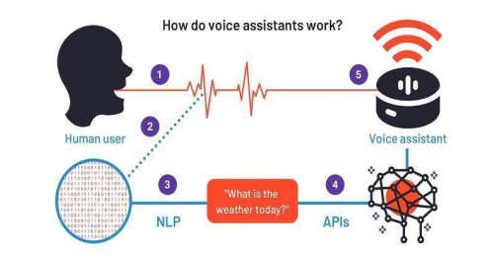
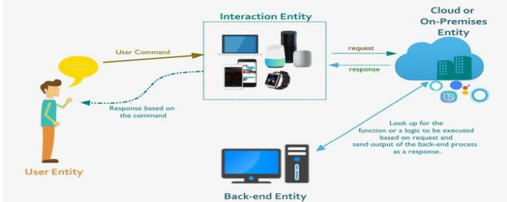
DESIGN
13

Slide 14
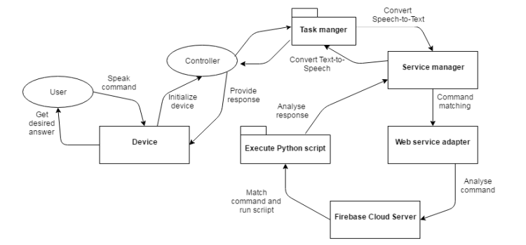
Design-Examples
14

Slide 15
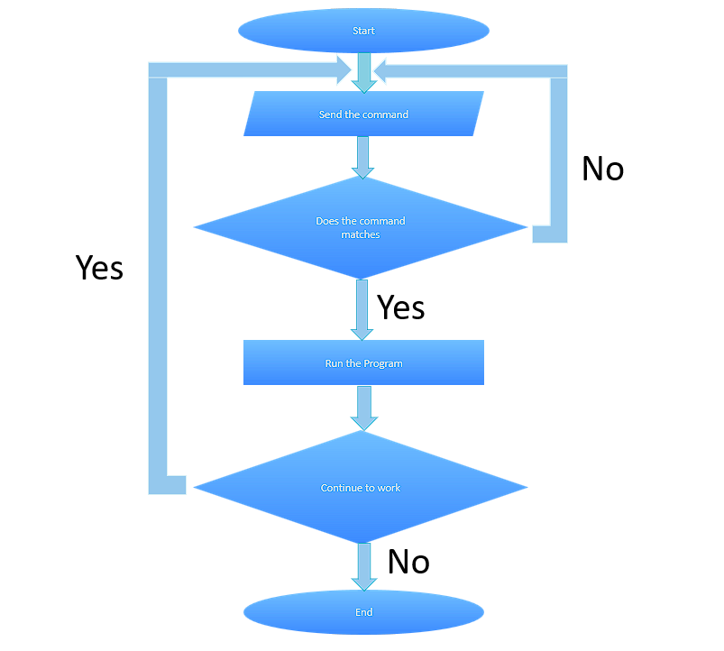
Design-Examples

Slide 16
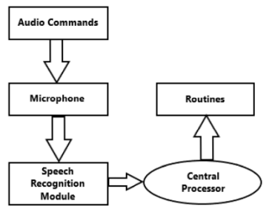
SYSTEM ARCHITECTURE
16

Slide 17
METHODOLOGY
17
We built a voice assistant called Andrew using python that is capable of speech recognition and speech to text conversion and perform the task given by the user through a voice command.
It is also capable of converting text to voice.
We worked as a team and added multiple features or tasks that the voice assistant can perform.
The voice assistant can do tasks like tell the current date, time weather. It can do a web search and open anything the user says through the voice command. It can play any songs or youtube videos.
Finally we made a simple website to demonstrate the voice assistant using HTML, CSS and Flask

Slide 18
METHODOLOGY
18
During this time we learned about many libraries which we implemented in our project.
Some of the Libraries that we used are :-
Pyttsx3:- pyttsx3 is a Python library that allows us to convert text to speech. So we will be providing it our text and it will convert that text into audio.
Speech Recognition:-Speech recognition is a machine's ability to listen to spoken words and identify them. You can then use speech recognition in Python to convert the spoken words into text, make a query or give a reply.
Datetime:-Python Datetime module supplies classes to work with date and time. These classes provide a number of functions to deal with date and time etc.

Slide 19
METHODOLOGY
Web Browser:-It is a python library. The web browser module provides a high-level interface to allow displaying web-based documents to users. Under most circumstances, simply calling the open() function from this module will do the right thing.
VLC:-The VLC media player is an open-source and free media player software that is portable and can be used on multiple platforms. The VLC media player is also a stream media server designed and developed by the Video LAN project.
Pywhatkit:-It is a Python library with various helpful features. It's easy-to-use and does not require you to do any additional setup. Currently, it is one of the most popular library for WhatsApp and YouTube automation.
Pyjokes:- Pyjokes is a python library that is used to create one-line jokes for programmers. Informally, it can also be referred as a fun python library which is pretty simple to use.

Slide 20
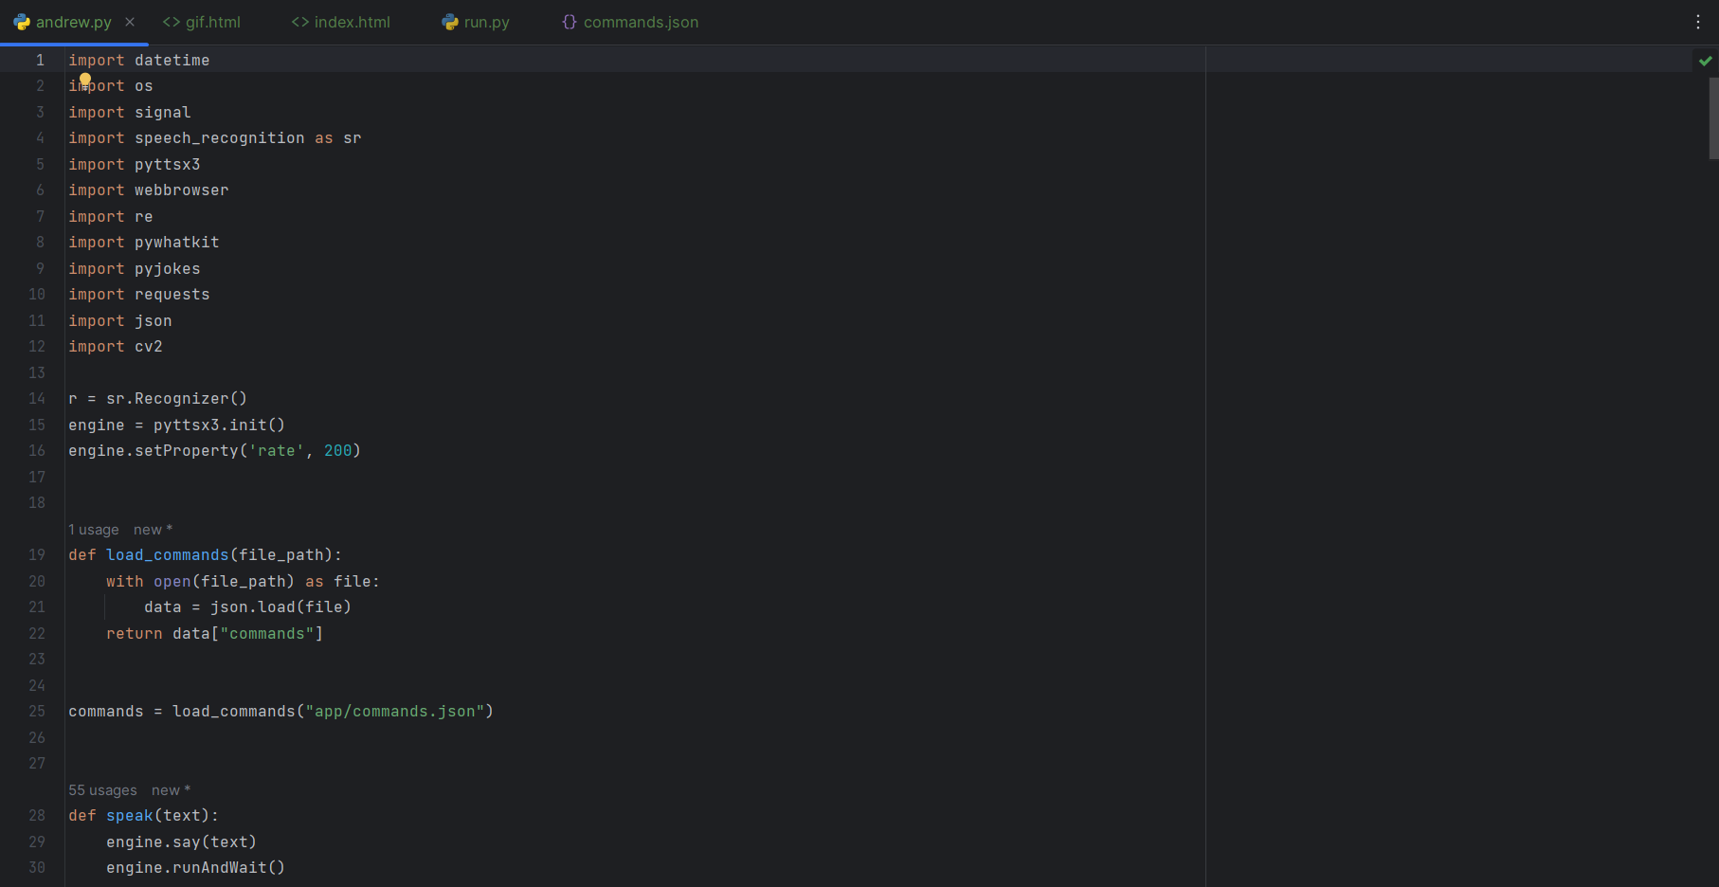
Code in andrew.py:

Slide 21
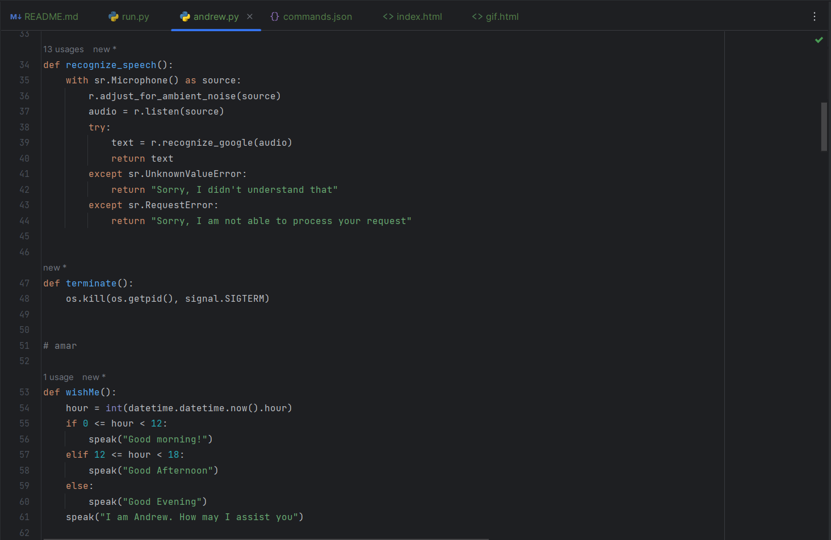
Code in andrew.py:

Slide 22
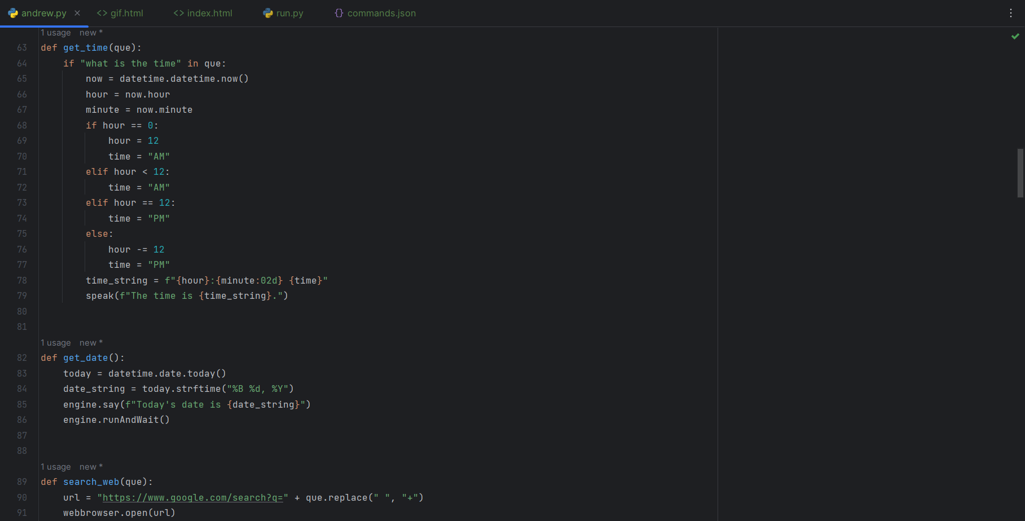
Code in andrew.py:

Slide 23
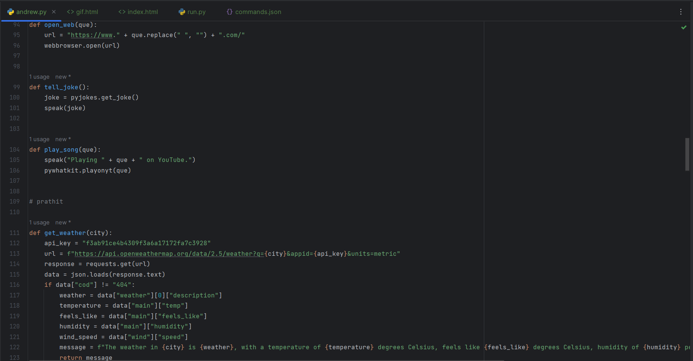
Code in andrew.py:

Slide 24
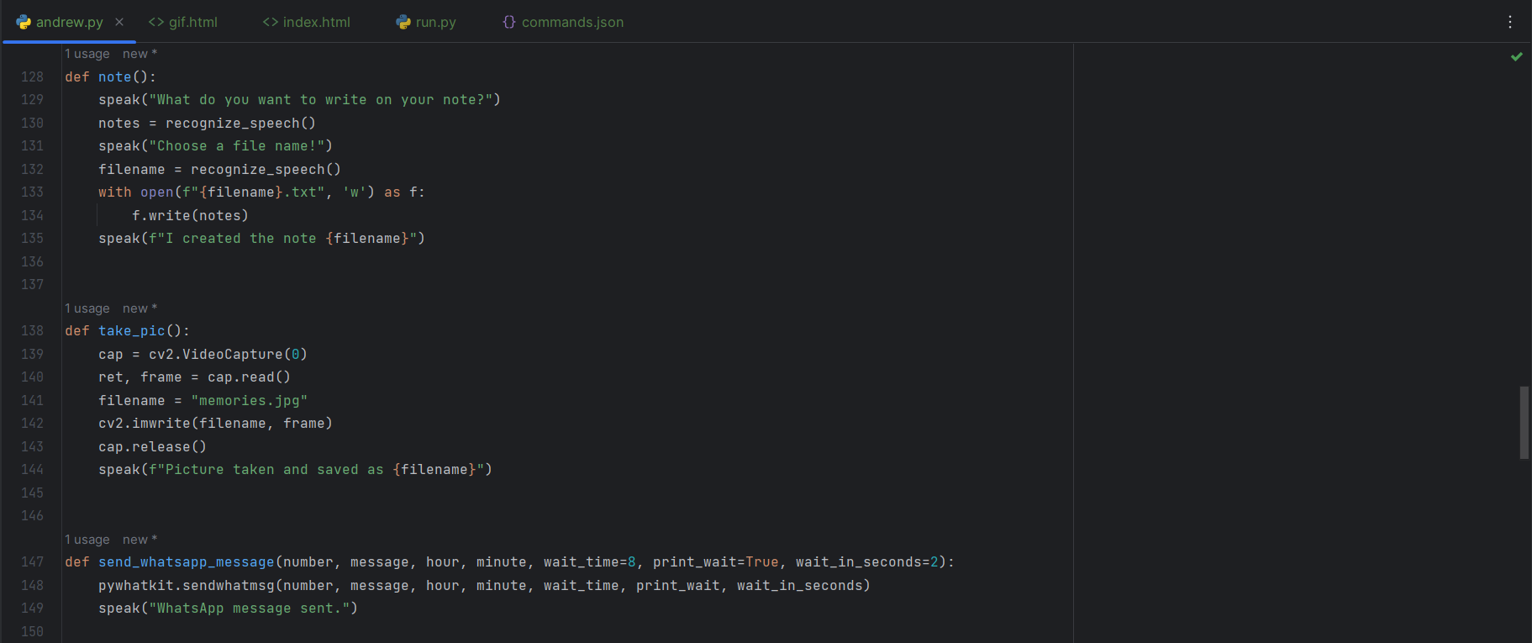
Code in andrew.py:

Slide 25
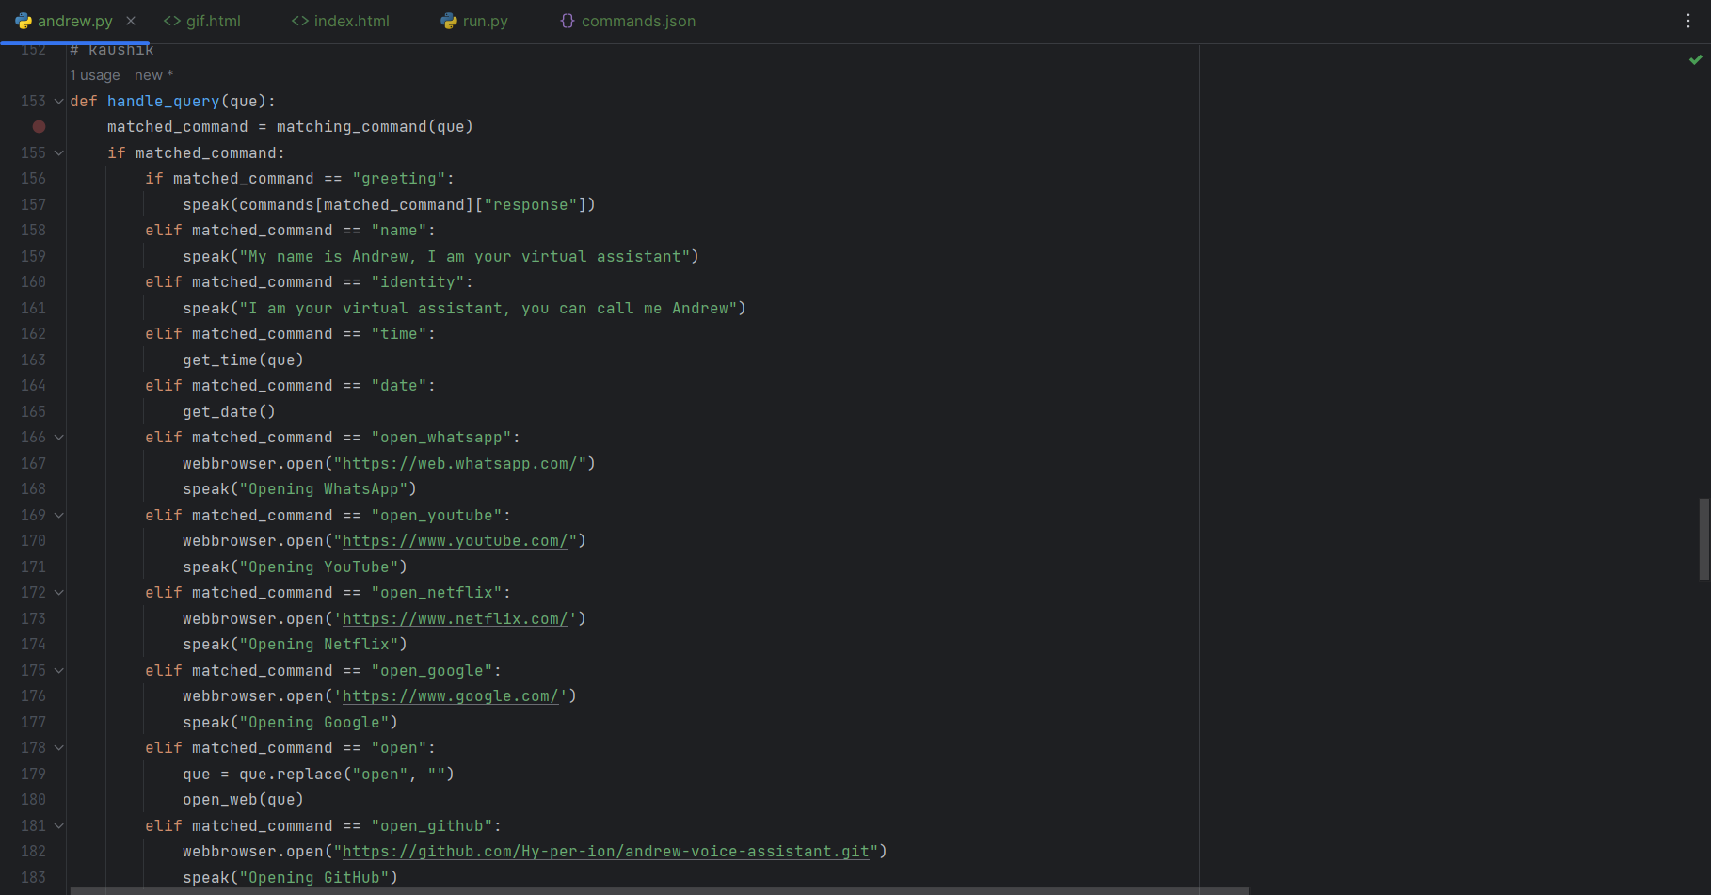
Code in andrew.py:

Slide 26
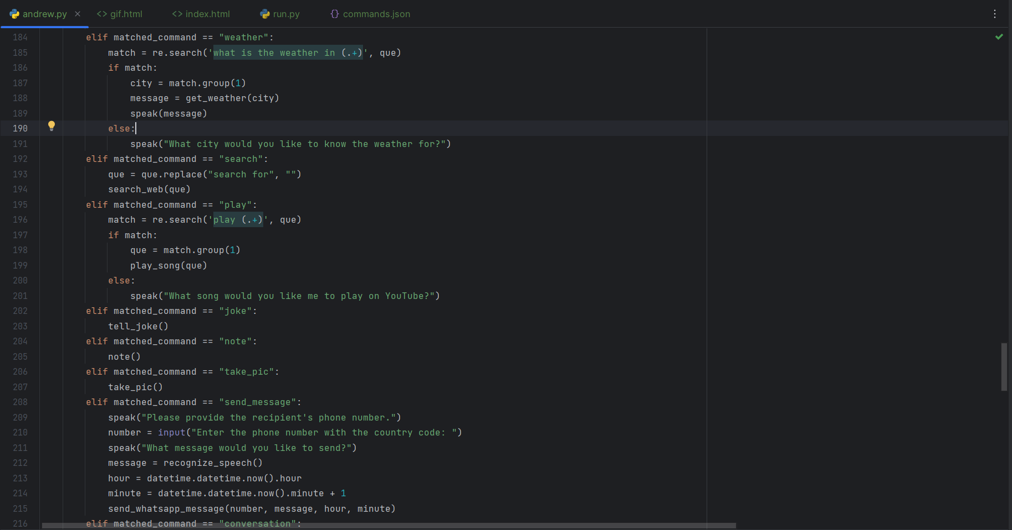
Code in andrew.py:

Slide 27
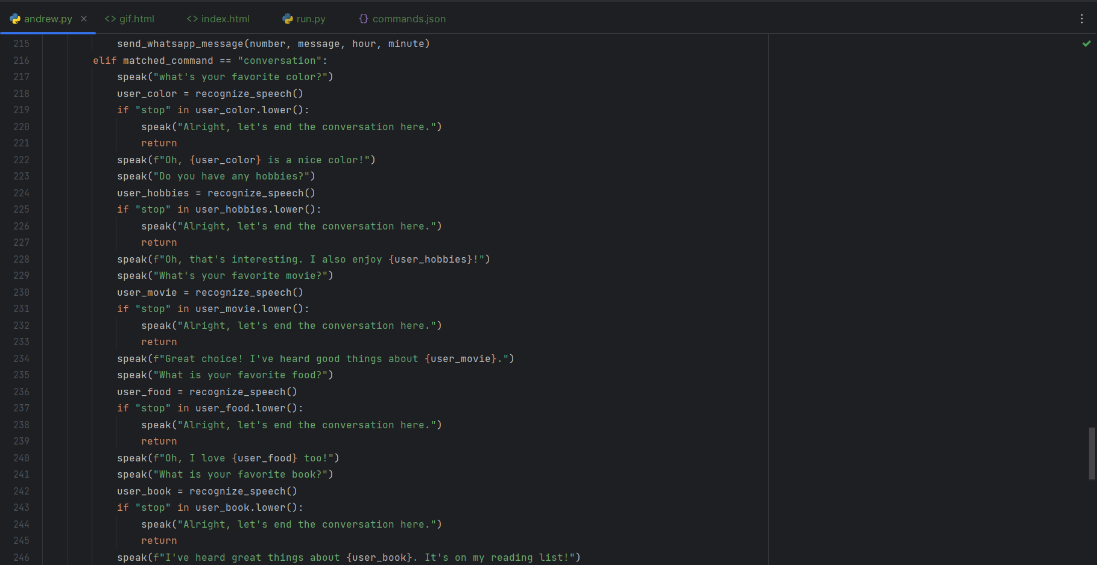
Code in andrew.py:

Slide 28
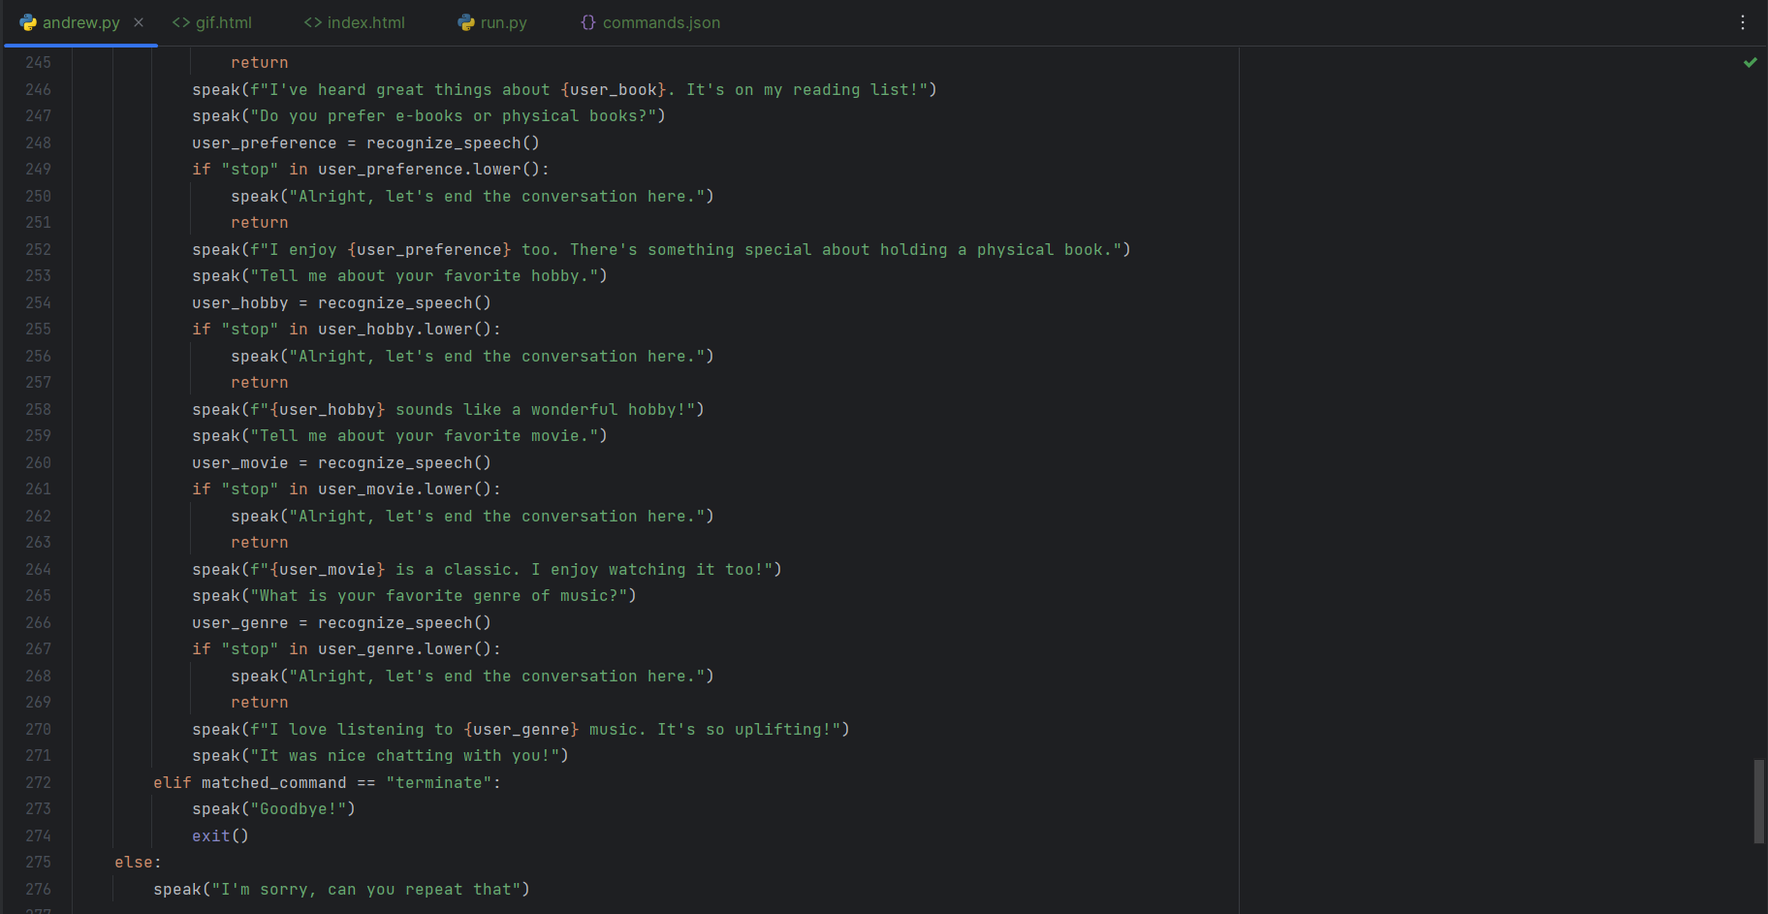
Code in andrew.py:

Slide 29
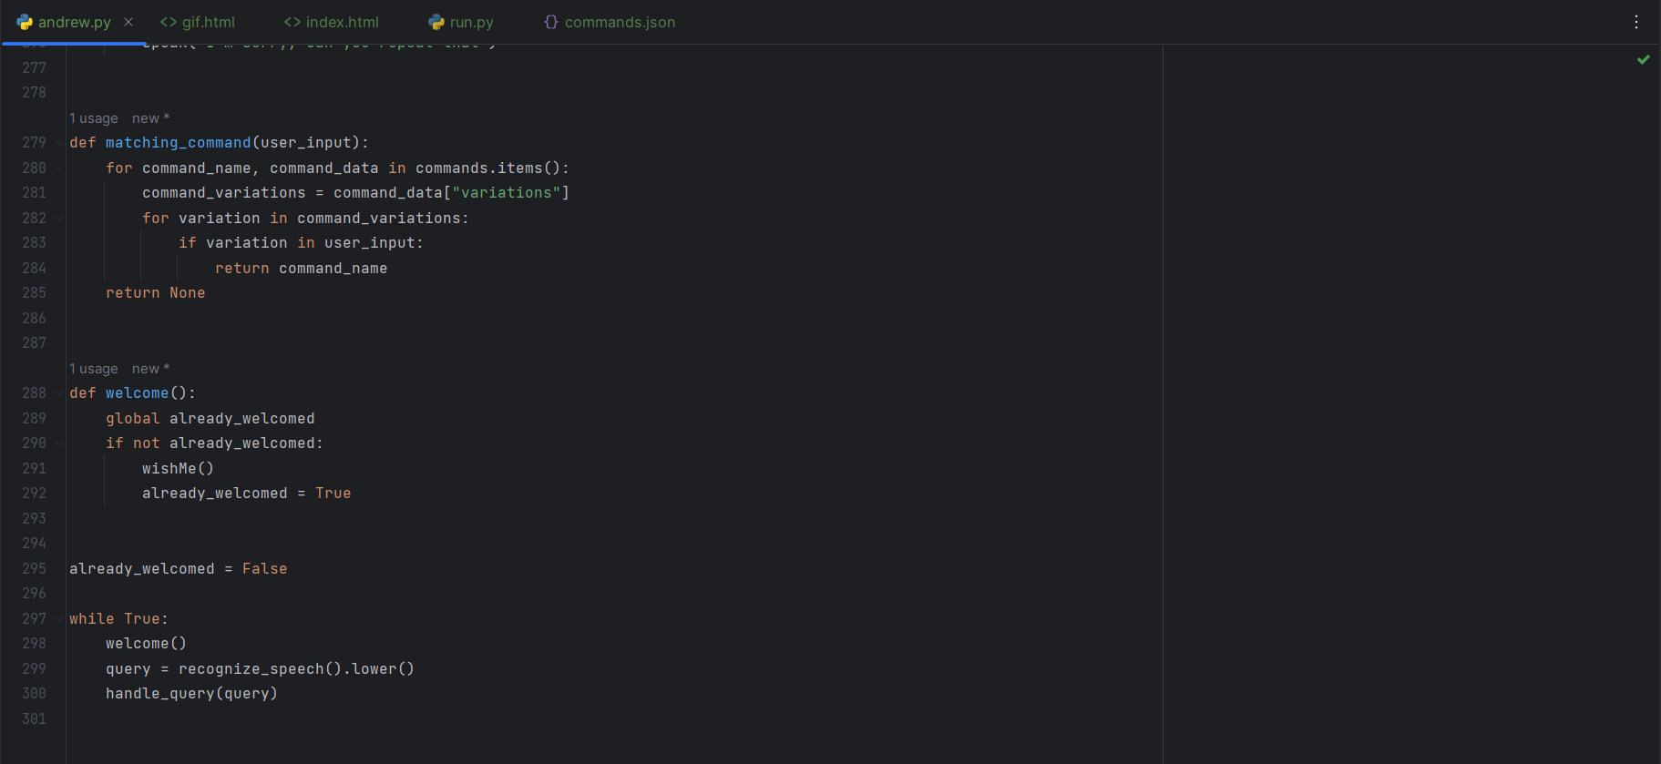
Code in andrew.py:

Slide 30
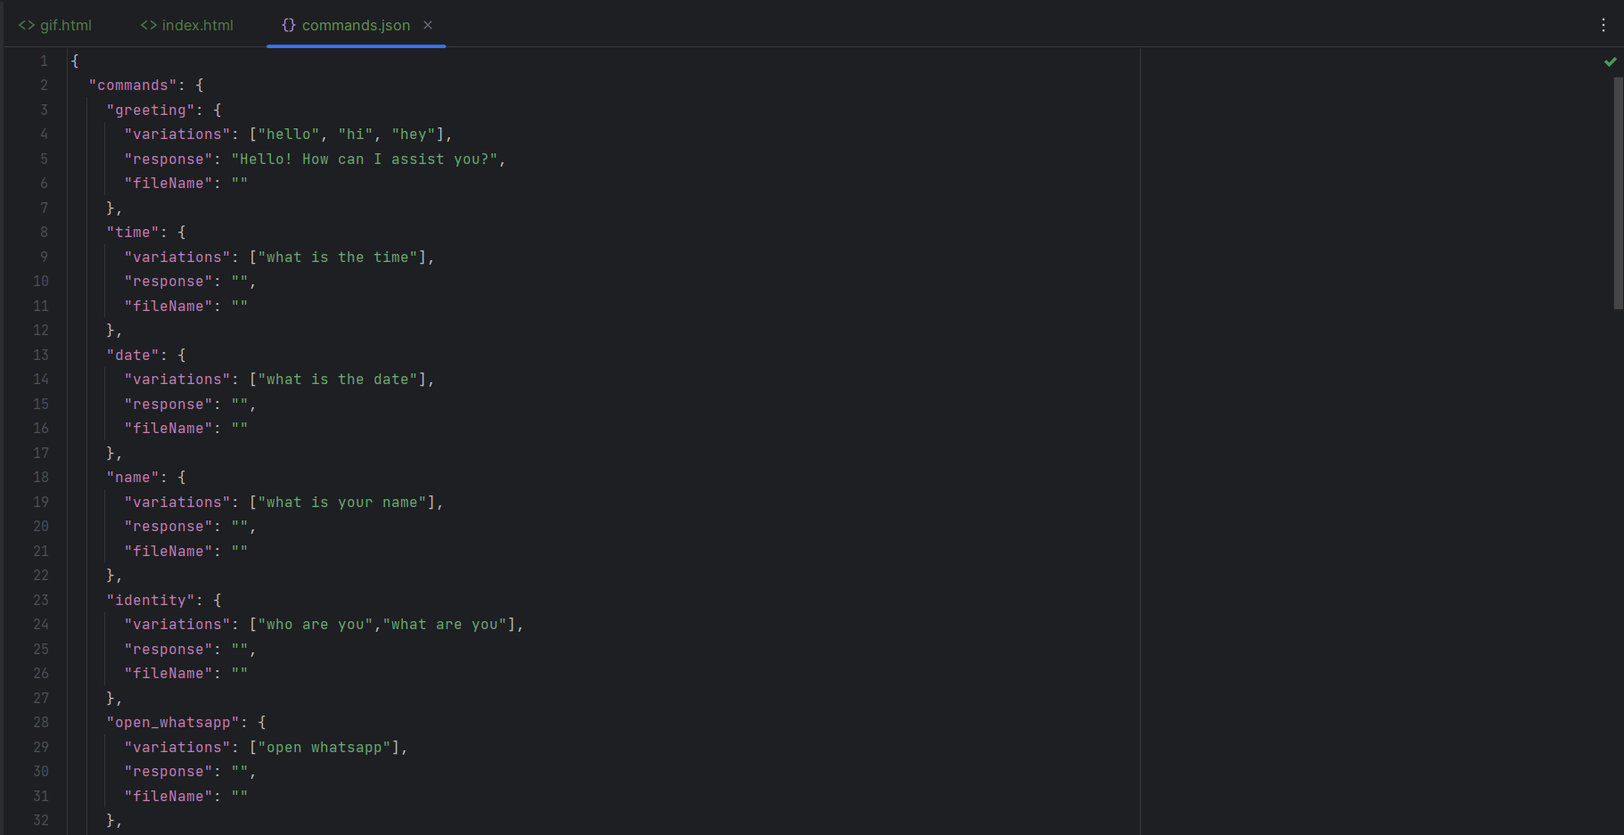
Code in commands.json:

Slide 31
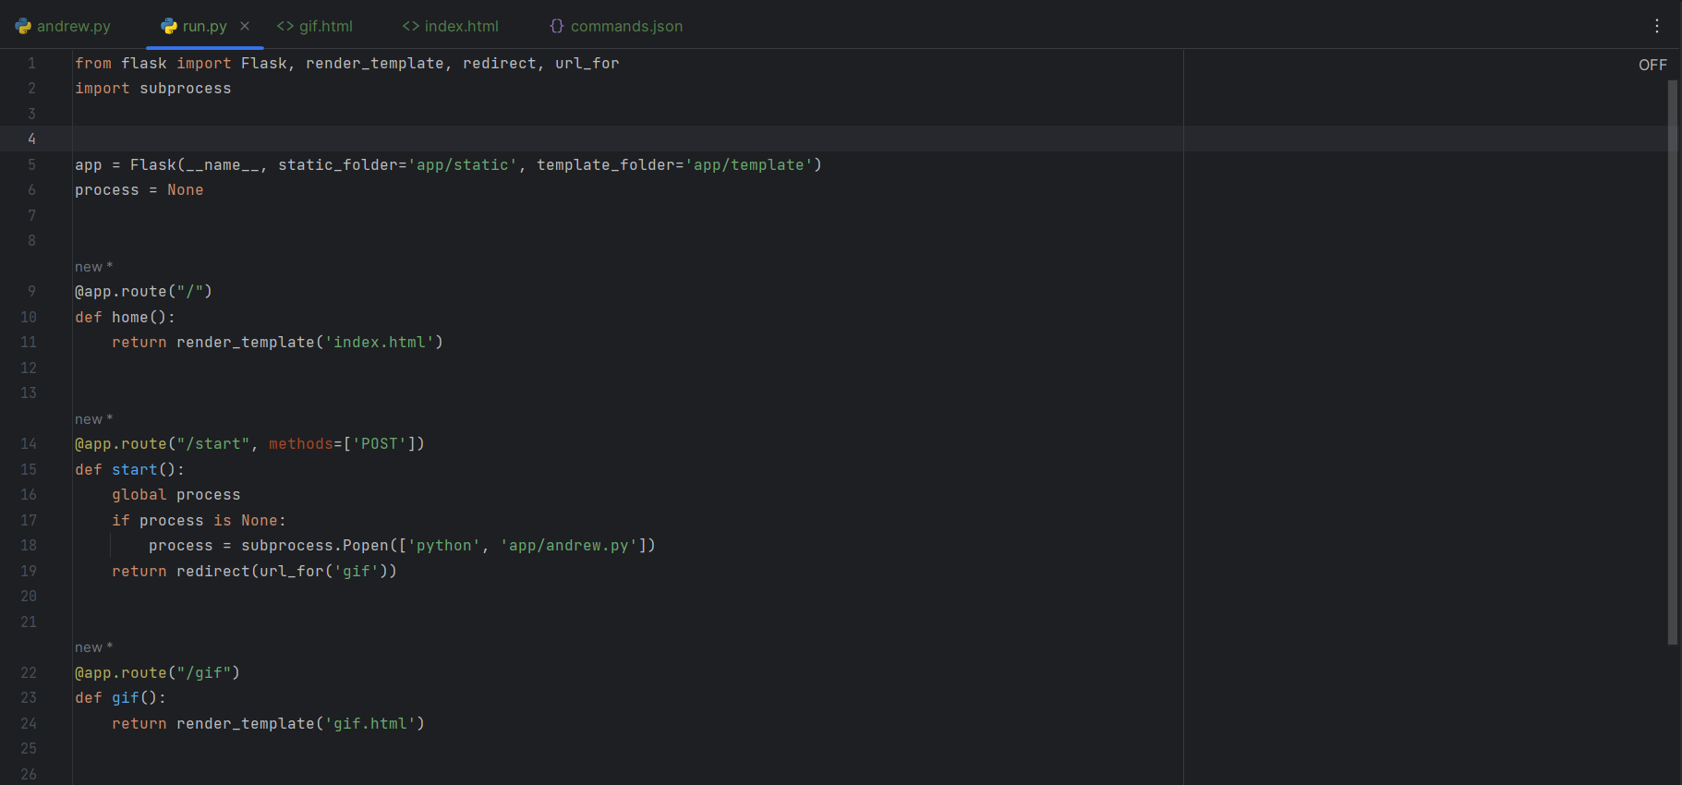

Code in run.py:

Slide 32
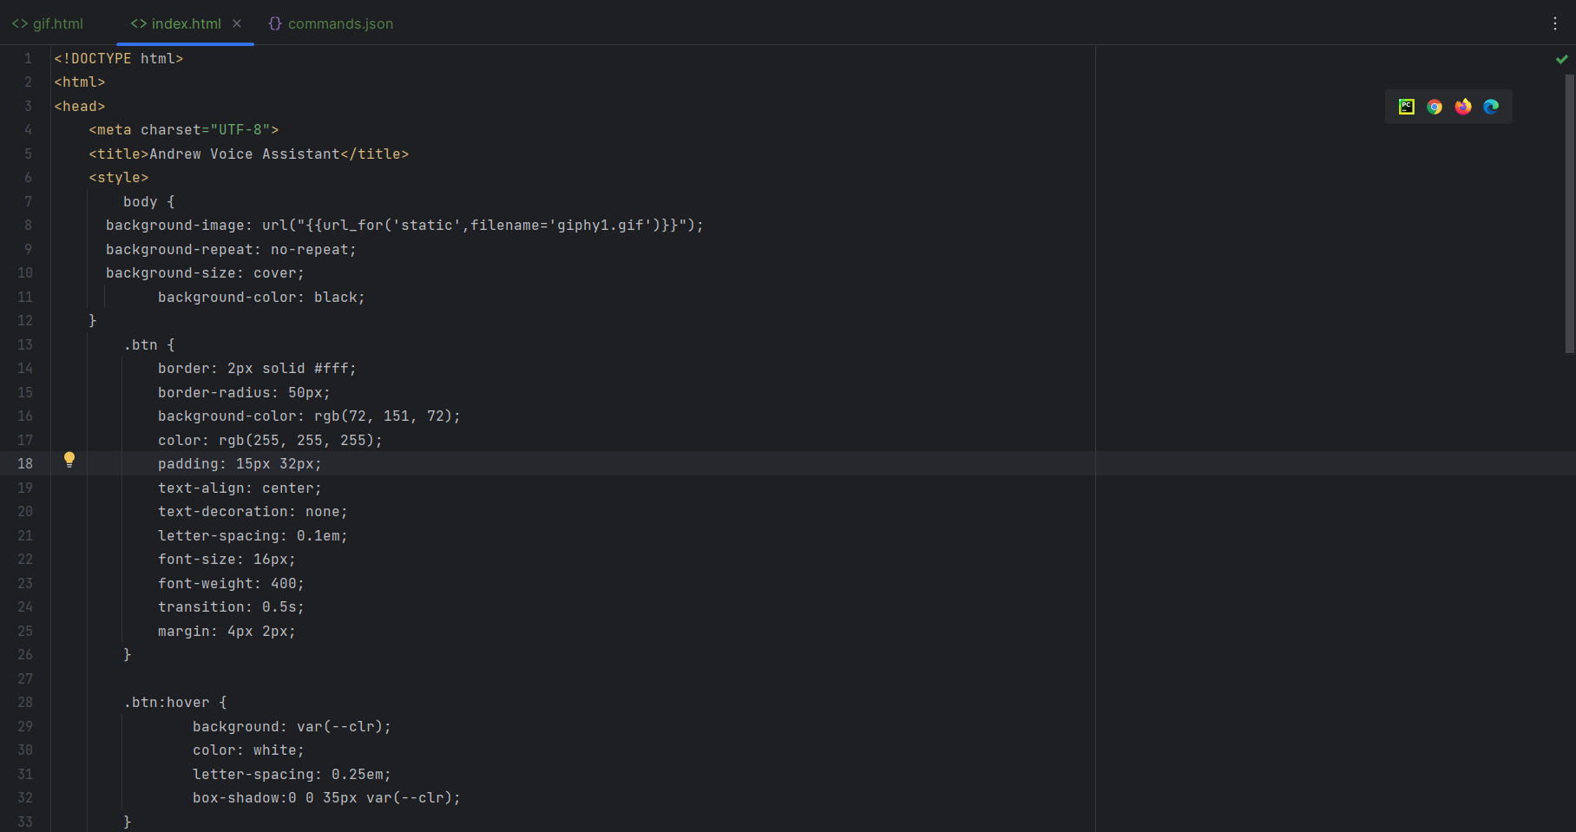
Code in index.html:

Slide 33
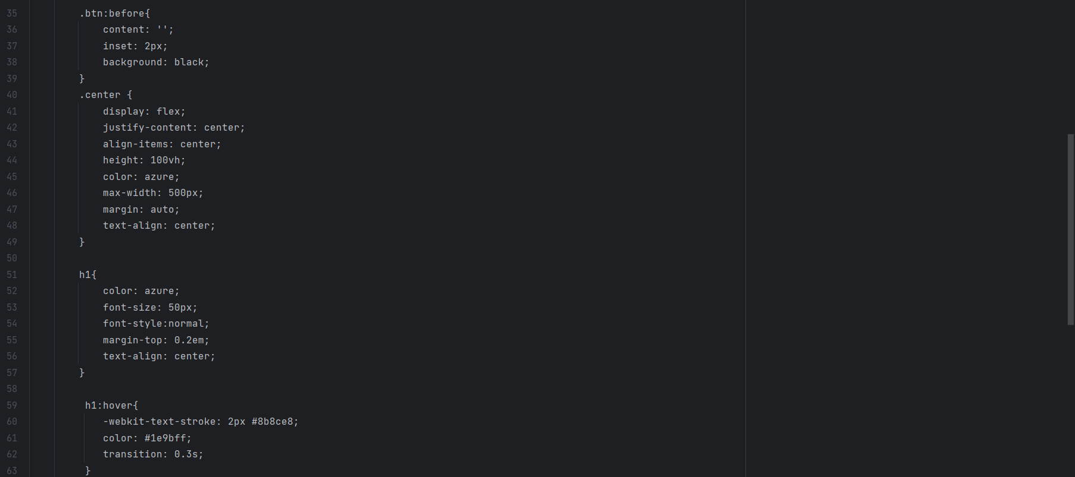
Code in index.html:

Slide 34
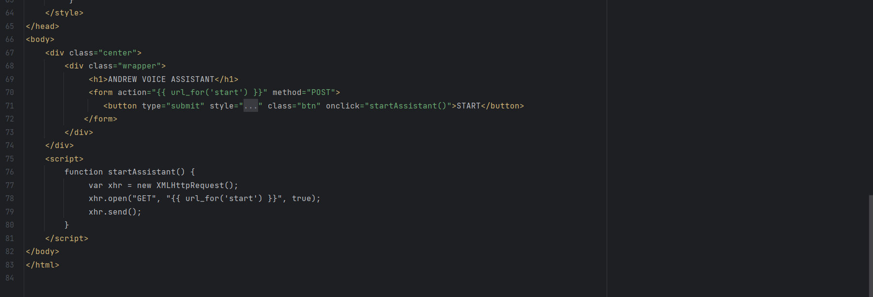
Code in index.html:

Slide 35
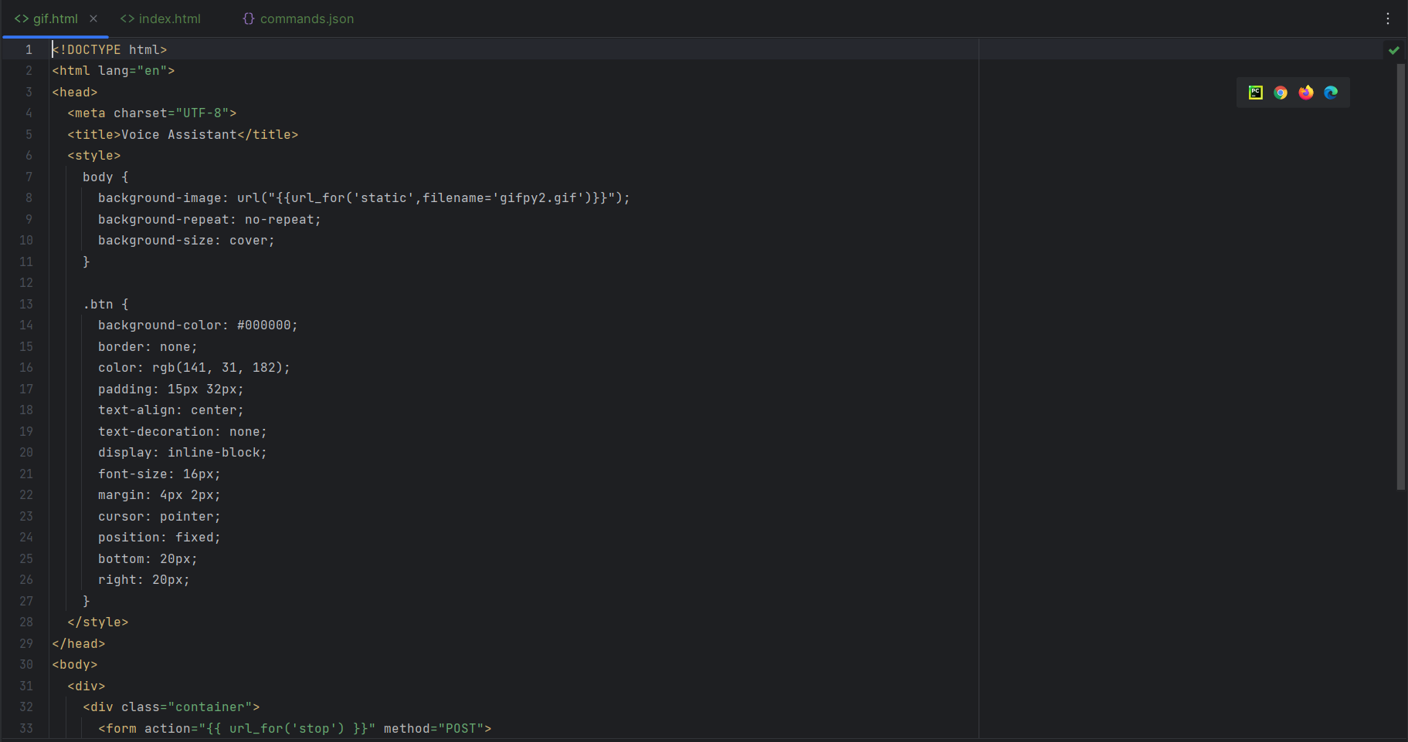
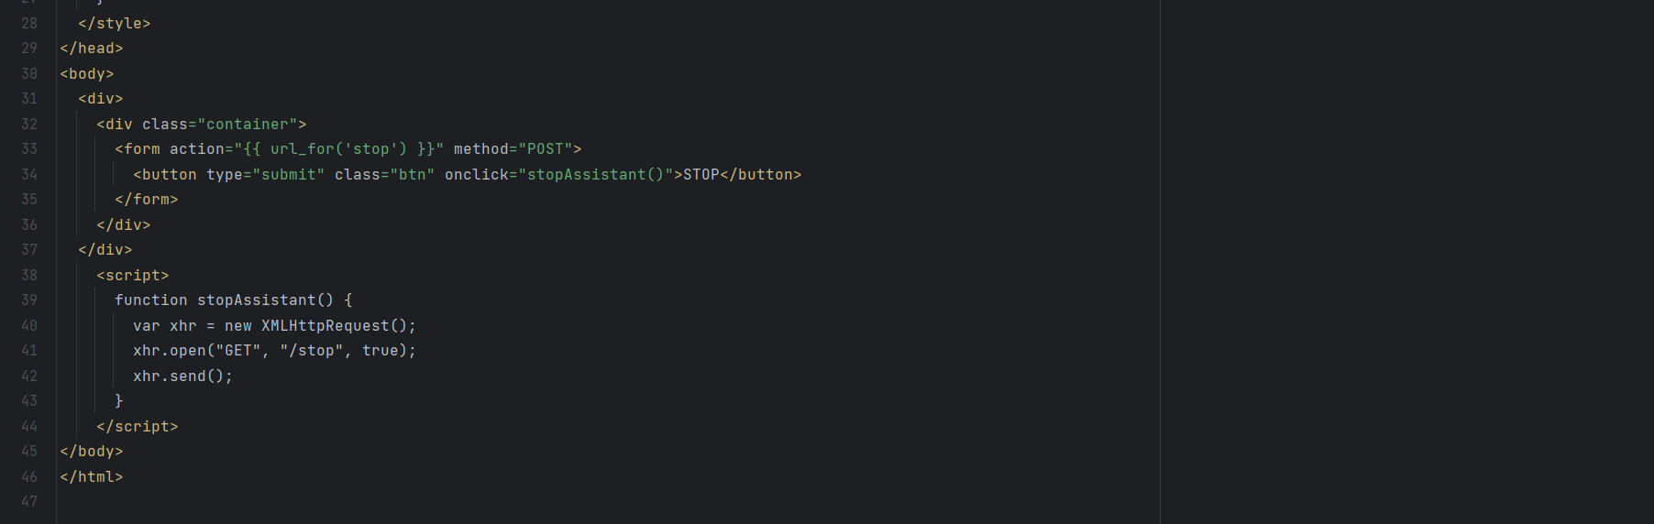
Code in gif.html:

Slide 36
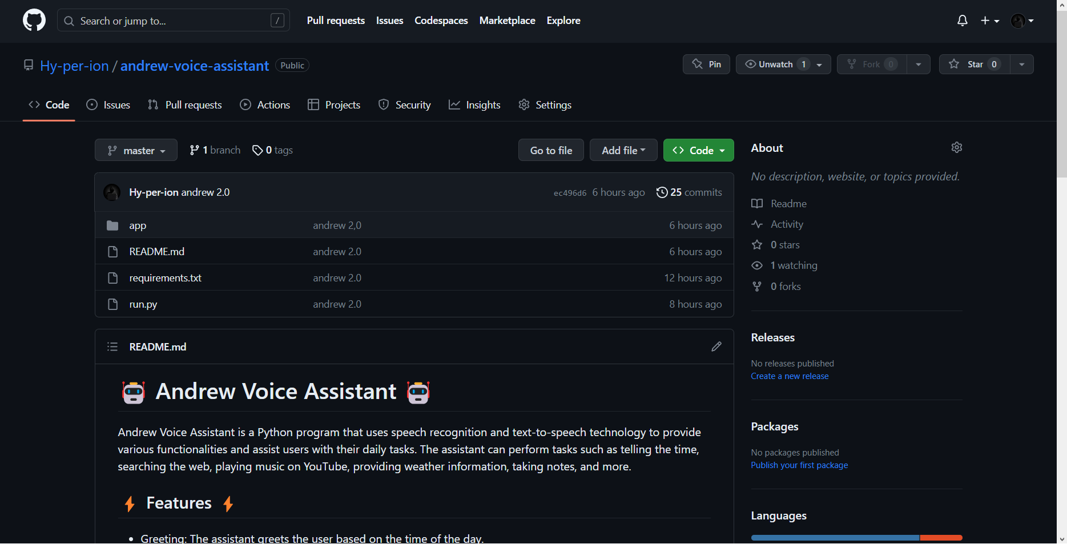
Code On GitHub:-
VOICE ASSISTANT

Slide 37
CONCLUSION
Voice assistants have become increasingly popular and widely used in various applications, including smartphones, smart speakers, cars, and home automation systems.
Here, we designed a voice assistant in such a way that which can offer a range of features and functionalities, such as answering questions, setting reminders, playing music, providing weather updates, managing calendars, controlling smart home devices, and much more.
With continuous advancements in natural language processing and machine learning, voice assistants are expected to become even more sophisticated and capable in the future, further enhancing our digital experiences.

Slide 38
FUTURE ENHANCEMENT
We are focusing on further improving the accuracy, scalability, and practicality of the system. Here are some potential areas for future development: -
Enhanced Natural Language Understanding
Emotional Intelligence
Enhanced Personalization
Increased Domain Expertise
Smoother integration with Robotics
Increased Offline Functionality

Slide 39
References
39
Dekate, Abhay & Kulkarni, Chaitanya & Killedar, Rohan. (2016). Study of Voice Controlled Personal Assistant Device. International Journal of Computer Trends and Technology. 42. 42-46.
Nasirian, Farzaneh & Ahmadian, Mohsen & Lee, One-Ki. (2017). AI-Based Voice Assistant Systems: Evaluating from the Interaction and Trust Perspectives.
Poushneh, Atieh. (2021). Humanizing voice assistant: The impact of voice assistant personality on consumers’ attitudes and behaviors. Journal of Retailing and Consumer Services. 58.
Vishal Kumar Dhanraj, Lokesh Kriplani Semal Mahajan. Research Paper on Desktop Voice Assistant, International Journal of Research in Engineering and Science (IJRES) Volume 10 ,Issue 2,PP. 15-20 (February 2022)
G. Preethi , Abishek. K , Thiruppugal S , Vishwaa D A, 2022, Voice Assistant using Artificial Intelligence, INTERNATIONAL JOURNAL OF ENGINEERING RESEARCH & TECHNOLOGY (IJERT) Volume 11, Issue 05 (May 2022)

Slide 40
40
THANK YOU

