Slide 1



Predicting Stock Volatility using Daily news articles Supriyo Ghosh, Feride Kose, Hy Lam, Mehdi Rezaie and Trung Vo
THE ERDŐS INSTITUTE
DATA SCIENCE BOOTCAMP FALL 2023
GitHub Repository

Slide 2
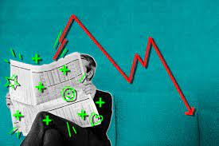
Introduction
Good news makes stock prices go up,
and bad news makes stock prices go down, right?
Then, how can we use news to improve our prediction of stock prices?

Slide 3
Project pipeline
A schematic figure will be added.

Slide 4
Data collection
Used YahooFinance for news articles and stock price information
Focused on 20 publicly traded companies (including Apple, Meta, Google etc.)
Focused on articles and stock prices of October 2023
Gathered sentiment scores based on article content
Needs update: 600 sentiment scores in total; how many for train and how many for train?

Slide 5
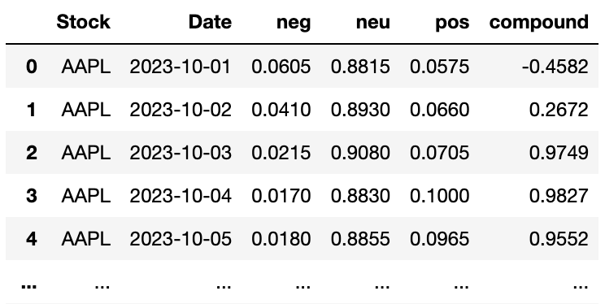
SENTIMENT ANALYSIS
Model: VADER (Valence Aware Dictionary for Sentiment Reasoning)
VADER is a lexicon and rule-based sentiment analysis tool that is specifically attuned to sentiments expressed in social media
Given a text, VADER returns the probability of the input to be positive, negative, and neutral.
Also, a compound score:
positive sentiment; compound > 0.05
negative sentiment; compound < -0.05
neutral sentiment; compound in [-0.05,0.05]

Slide 6
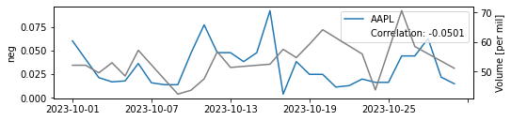
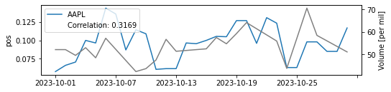
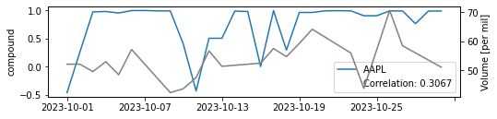
Correlation

