Slide 1



Predicting Stock dynamics using sentiment analysis Supriyo Ghosh, Feride Kose, Hy Lam, Mehdi Rezaie and Trung Vo
THE ERDŐS INSTITUTE
DATA SCIENCE BOOTCAMP FALL 2023
GitHub Repository

Slide 2
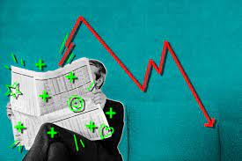
Introduction
Good news makes stock prices go up,
and bad news makes stock prices go down, right?
Then, how can we use news to improve our prediction of stock prices?

Slide 3
Project pipeline
A schematic figure will be added.

Slide 4
Data collection
Used YahooFinance for news articles and stock price information
Focused on 20 publicly traded companies (including Apple, Meta, Google etc.)
Focused on articles and stock prices of October 2023
Gathered sentiment scores based on article content
Needs update: 600 sentiment scores in total; how many for train and how many for train?

Slide 5
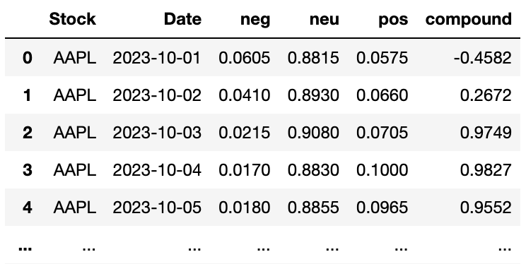
SENTIMENT ANALYSIS
Model: VADER (Valence Aware Dictionary for Sentiment Reasoning)
VADER is a lexicon and rule-based sentiment analysis tool that is specifically attuned to sentiments expressed in social media
Given a text, VADER returns the probability of the input to be positive, negative, and neutral.
Also, a compound score:
positive sentiment; compound > 0.05
negative sentiment; compound < -0.05
neutral sentiment; compound in [-0.05,0.05]

Slide 6
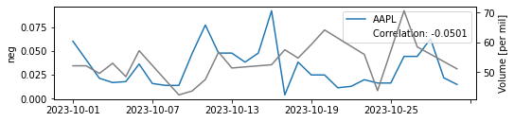
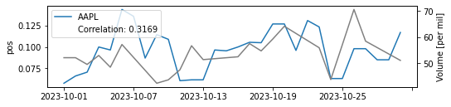
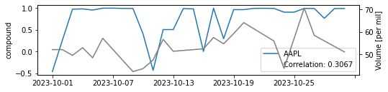
Correlation

Slide 7
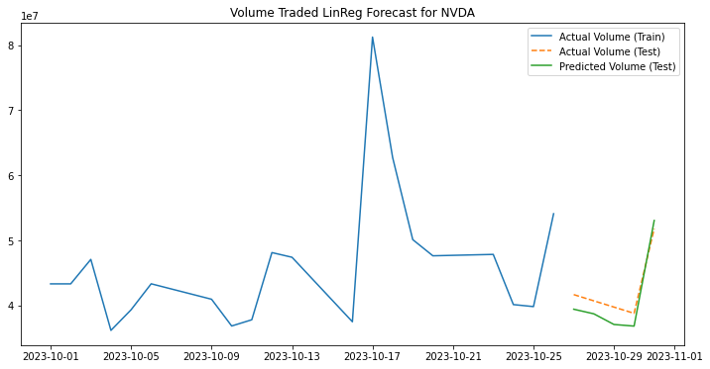
Prediction model
Linear Regression model with
features neg, pos and compound
RMSE = 1.155545e+07

Slide 8
future work
We can improve our approach by
estimating the uncertainty associated with the prediction
scraping data from other news outlets beside Yahoo, such as Bloomberg
increasing the number of news we collect for each day, thus making the sentiment scores more stable
performing k-fold cross-validation to better measure success and tune hyper-parameters
(such as the lag considered in the sentiment scores from news in the past)
including other metrics to assess the performance of the models, such as MAE, Pearson/Spearman Correlation
extending our pipeline to include ensemble-based models such as Random Forest Regressors, Gaussian Processes, etc.
consider longer terms, e.g., a few months
(with a larger data, we can incorporate more advanced models such as Transformers)

