Slide 1

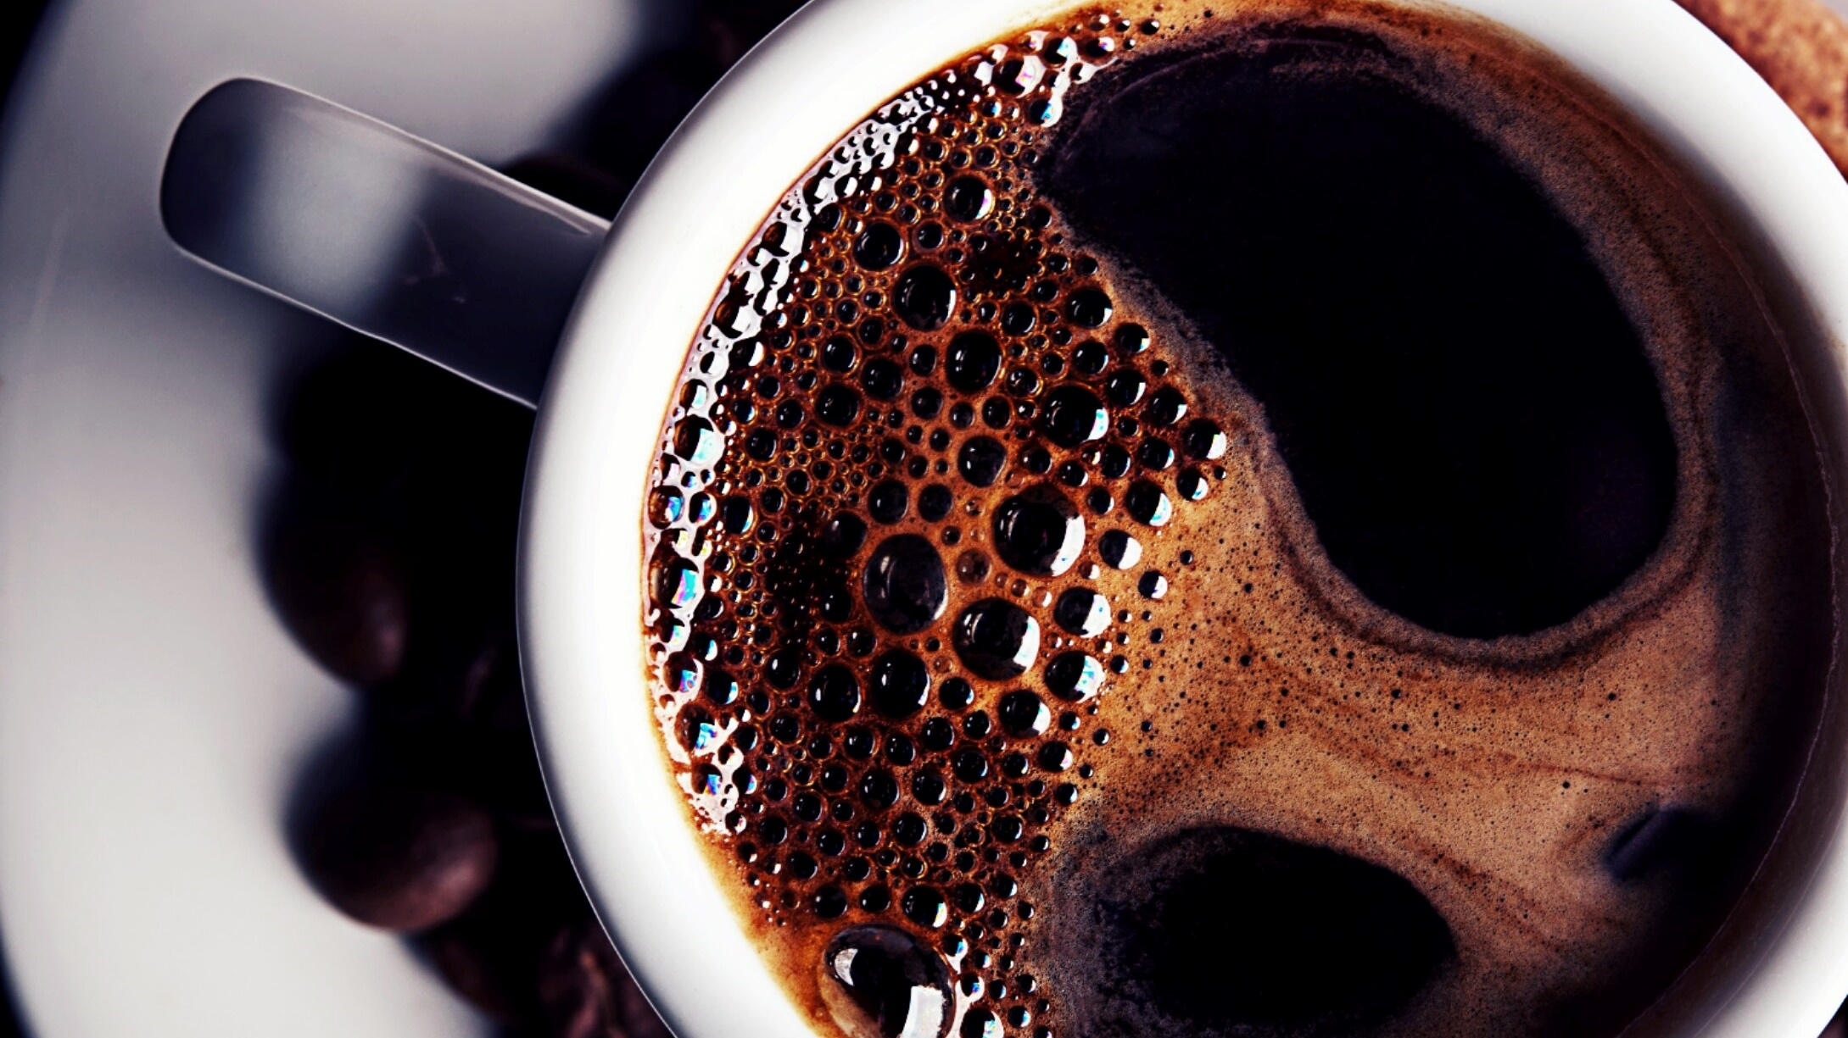
The Battle of Neighborhoods in Toronto

Slide 2
Predicting the optimal place to open a coffee shop
In this project, we will try to find the best location for the coffee shop.
Specifically, this report will target stakeholders who are interested in opening a coffee shop in Toronto, Ontario.
we will also try to choose locations with a low density of coffee shops closer to the city center.

Slide 3
Explore Dataset
List of postal codes of Canada: M From Wikipedia from https://en.wikipedia.org/wiki/List_of_postal_codes_of_Canada:_M
a csv file named "GeoSpatial Dataset" which has the geographical coordinates of each postal code from https://cf-courses-data.s3.us.cloud-object-storage.appdomain.cloud/IBMDeveloperSkillsNetwork-DS0701EN-SkillsNetwork/labs_v1/Geospatial_Coordinates.csv

Slide 4
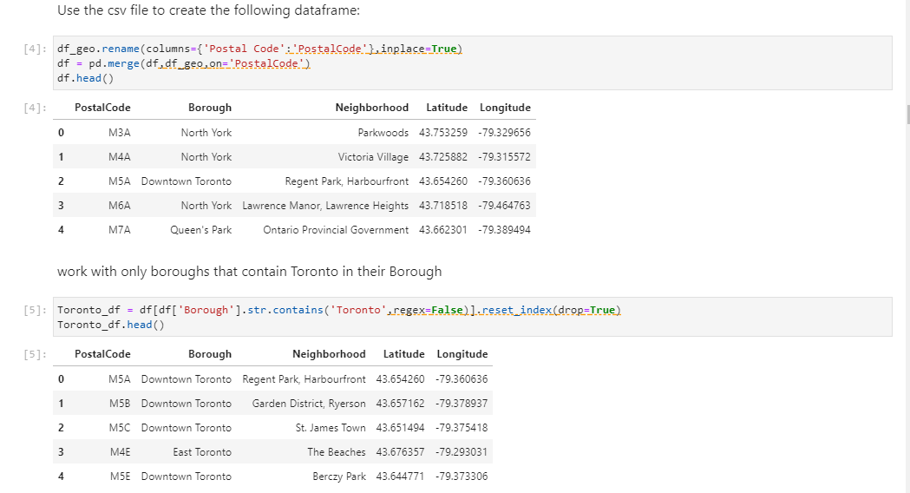
work with only boroughs that contain Toronto in their Borough

Slide 5
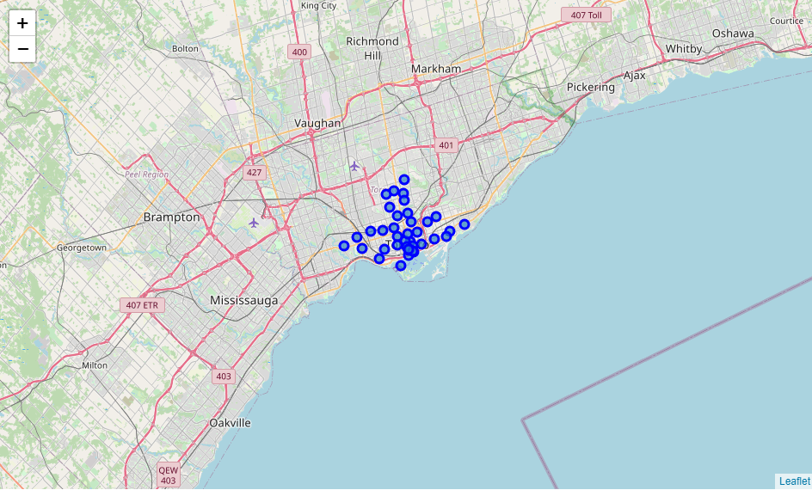
map of Toronto with neighborhoods

Slide 6
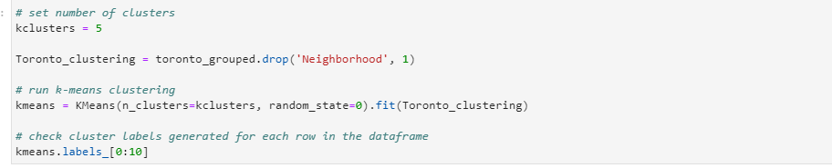
cluster the neighborhood into 5 clusters

Slide 7
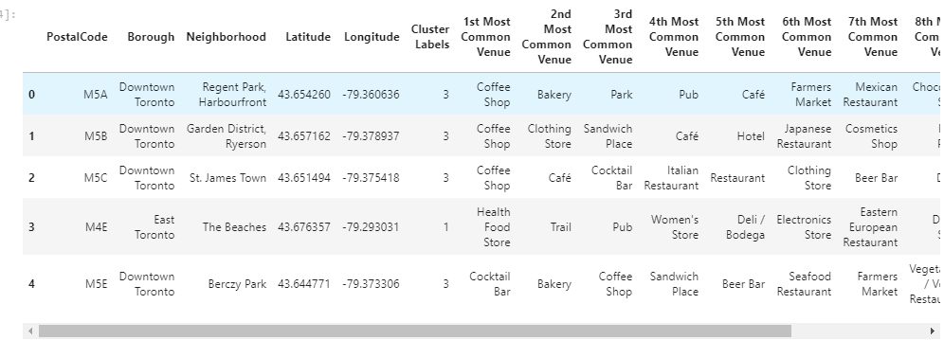
top 10 venues for each neighborhood

Slide 8
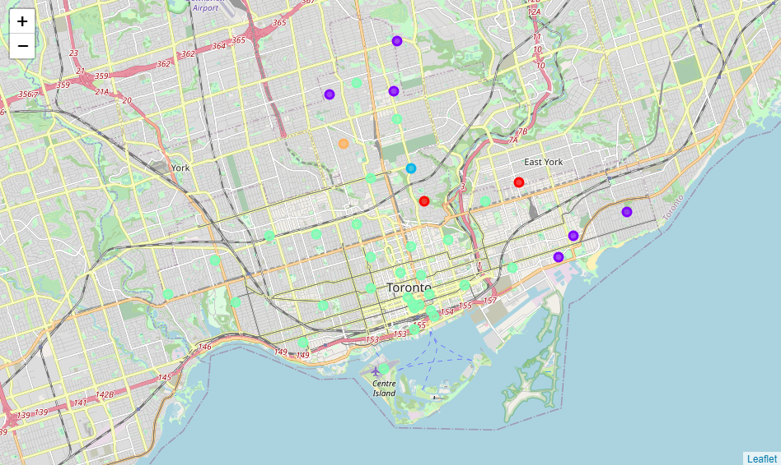
map of Toronto with neighborhoods in 5 clusters
Green cluster: Coffee shop and restaurant
Red cluster: Park and playground
Purple cluster: gym, restaurant and store
Blue cluster; restaurant, lawyer and store
Orange cluster: Trail, store and restaurant

Slide 9
Results and Discussion
Our analysis shows that while Toronto has many coffee shops, there are also a few areas with a low density of coffee shops closer to the city center. The greatest concentration of coffee shops is found in the Central Bay Street, Christie and so on, so we focused our attention on Church and Wellesley, Little Portugal, Trinity and Regent Park, Harbourfront.

Slide 10
Conclusion
The optimal coffee shop location will be determined by the stakeholders based on the characteristics and location of the particular neighborhood in each recommended area, taking into account more factors such as the attractiveness of each location (proximity to the park or water), the distance of the office location, the social and economic dynamics of each neighborhood, etc.

