Slide 1

StreetsmartIndia
Andrdoid app

Slide 2
Team details team name - Delta
Member | Role | Key Contributions | Technologies/Tools Used
M.Tharun | Android UI & Navigation Lead | - Designed UI screens with ScrollView, LinearLayout, RecyclerView- Set up Fragment–Activity navigation- Applied Material 3 themes & toolbar- Integrated LiveData for dynamic UI | XML, Java, Android Studio, LiveData, Material 3
Y.Sumasree | Firebase & Backend Integration | - Set up FirebaseAuth and Firestore- Handled Firestore queries for reports/votes- Integrated Cloudinary for image upload- Used OkHttp to send image data | Firebase, Firestore, OkHttp, Cloudinary, Java
P.SriRamanan | Location & Permissions Handling | - Integrated GPS via FusedLocationProviderClient- Used Geocoder for address conversion- Managed runtime permissions- Handled image intents & FileProvider | FusedLocationProviderClient, Geocoder, FileProvider, Java

Slide 3
Problem: Street issues like potholes, broken lights, and water leaks often go unnoticed or unreported.
Solution: Create an app that lets users report street issues instantly by snapping a photo, automatically tagging location, and sending it to the concerned civic body.
Vision: Empower citizens to become active participants in improving urban infrastructure.

Slide 4


Solution
StreetSmartIndia App Features:
📸 Take/Upload Photo of issue
📍 Auto-detect GPS Location
📝 Short Description Input
☁️ Save to Firebase backend
📬 Send Report to Civic Body (via Email/API) (optional)
📊 Display Public Reports and Voting to prioritize issues

Slide 5
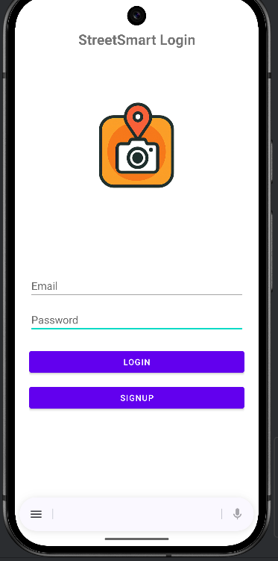
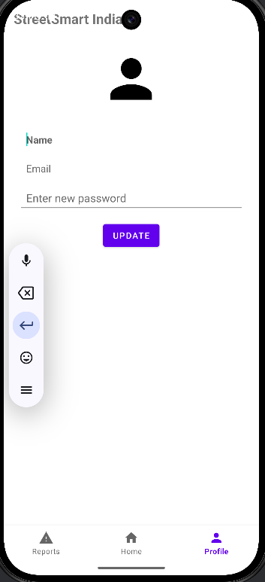
Concepts used
Frontend – UI & Media
UI & Layouts:
ScrollView, LinearLayout, RecyclerView
Custom Toolbar, EditText, and Material 3 Design
Fragment & Activity-based Navigation
Dynamic UI updates using LiveData
Media Handling:
Camera/Gallery access using Intents
Secure image sharing via FileProvider
Handled image input with onActivityResult()

Slide 6
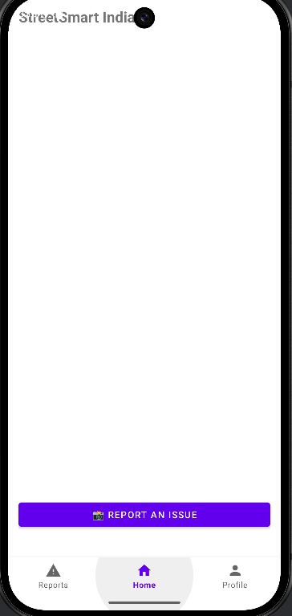
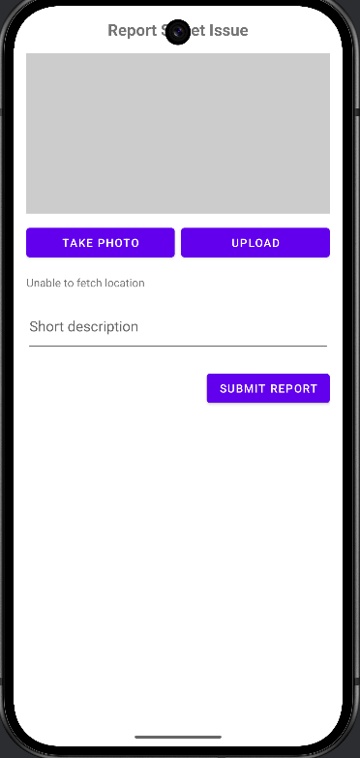
Concepts used
Location & Permissions
Location Services:
FusedLocationProviderClient for accurate GPS
Lat/Lng + Geocoder for address mapping
Real-time updates using LiveData
Permissions:
Runtime permissions for Location, Camera, Storage
Manual checks and requests with system prompts

Slide 7
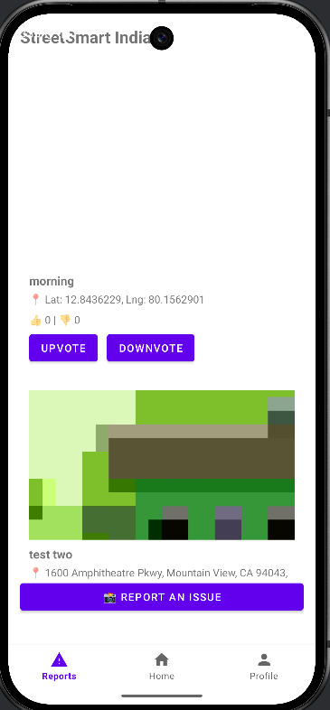
Concepts used
Backend – Firebase & Upload
Firebase Integration:
FirebaseAuth for user login/signup
Firestore to store reports and user votes
Subcollections to track user-specific voting
Image Upload:
Used Cloudinary with OkHttp (Multipart POST)
Stored secure image URLs in Firestore

