Slide 1
Characterizing and Mitigating the Impact of Process Variations on
Phase Change based Memory Systems

Slide 2

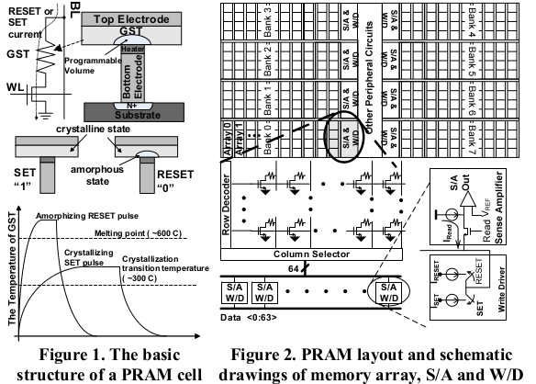
Background
PRAM
Architecture

Slide 3
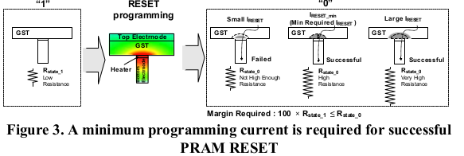
Background
PRAM RESET

Slide 4
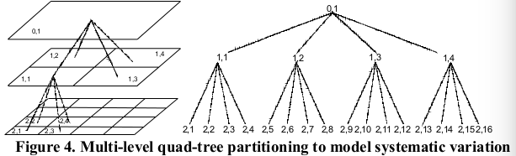
Background
use the multiple-level quad tree approach to model
the correlated within-die variation effect

Slide 5
PRAM Design Parameters subject to
Process Variation
Variations in Physical Dimensions of PRAM Devices
Variation in Transistor Parameters within PRAM cells

Slide 6
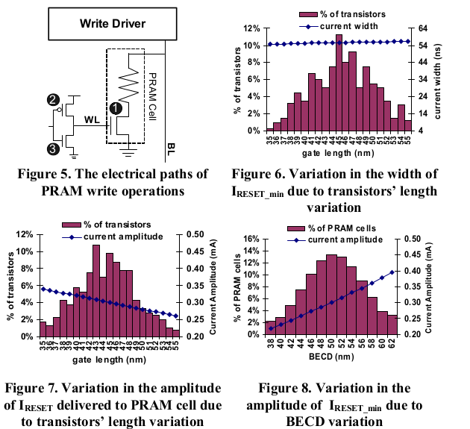
Characterizing the Effect of Process
Variations on PRAM Programming Current

Slide 7
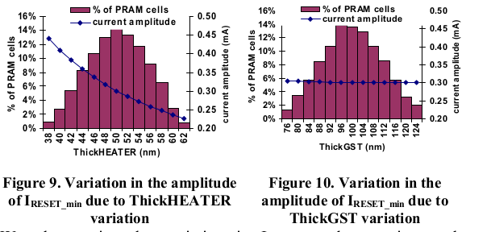
Characterizing the Effect of Process
Variations on PRAM Programming Current

Slide 8
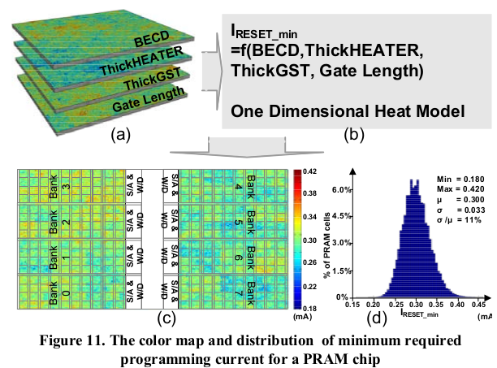
Characterizing the Effect of Process
Variations on PRAM Programming Current

Slide 9
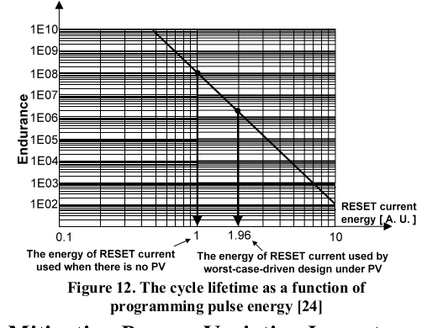
PV Induced PRAM Programming Power
Overhead and Reliability Degradation

Slide 10
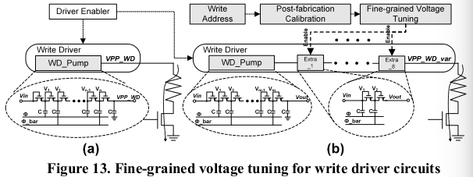
Variation-aware Programming Current
Provision

Slide 11
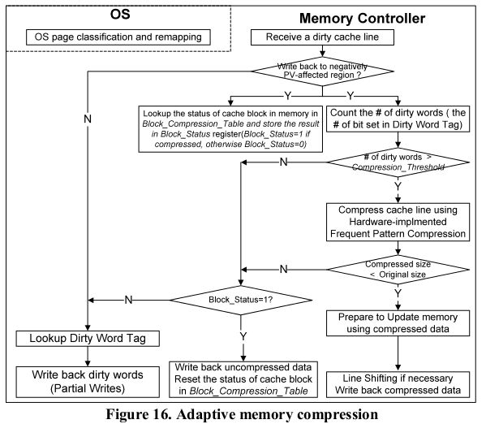
Adaptive Data Comparison Write using
Page Classification

Slide 12
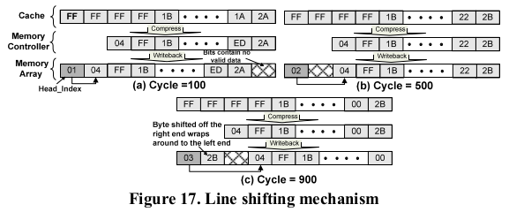
Adaptive Memory Compression with
PRAM Cell Refreshing

Slide 13
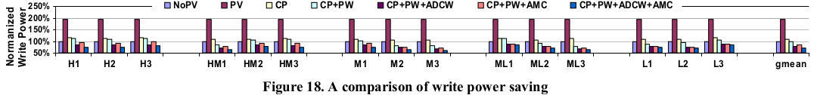
Power Savings

Slide 14
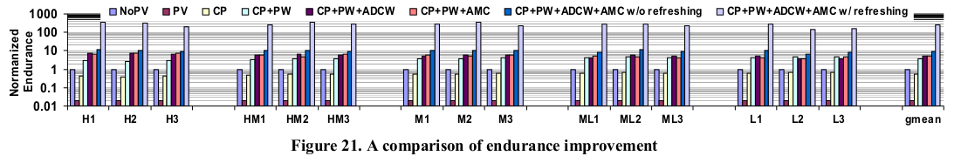
Endurance Enhancement

