Slide 1

Module Federation
Results of our experiments
October 4th, 2022

Slide 2
Introduction
Winamp has done a series of investigations in 2021 and 2022 on how to split RBO
Micro app and Module Federation
This presentation focuses on Module Federation
Technical talk about our process
Many illustrations/diagrams to illustrate concepts and problems
A lot to talk about, but not everything is included – focus on problems we encountered
Quick pace
Reach out if there is something you are interested in but haven’t seen

Slide 3
Table of contents
What is Module Federation? (5 sheets)
Shared dependencies (12 sheets)
Split strategy (8 sheets)
Applying Module Federation (32 sheets)
Why we won’t continue with Module Federation (for now) (1 sheet)

Slide 4
What is Module Federation?

Slide 5
A simple application
Application
{1}
{2}
1.1
1.2
1.3
2.1
2.2
2.3
A
Shared dependency

Slide 6

Separating a domain
Application
{1}
{2}
1.1
1.2
1.3
2.1
2.2
2.3
A
Shared dependency

Slide 7
Isolated / federated module
Application
Federated Module
{1}
{2}
1.1
1.2
1.3
2.1
2.2
2.3
A
Shared dependency

Slide 8

Shell and remote
Application (shell)
Federated Module (remote)
App routing
import remote entry module
build
exposes
Remote entry module
remoteEntry.mjs
webpack config
{1}
{2}
exports
1.1
1.2
1.3
A
2.1
2.2
2.3
Shared dependency

Slide 9



Shell with imported remote module
Application (shell)
App routing
Remote entry module
{1}
{2}
1.1
1.2
1.3
A
2.1
2.2
2.3
Shared dependency

Slide 10
Shared dependencies

Slide 11
Shared dependencies
Application (shell)
Federated Module (remote)
App routing
Remote entry module
webpack config
webpack config
{1}
{2}
1.1
1.2
1.3
A
2.1
2.2
2.3
Shared dependency

Slide 12

Shared dependencies - Properties
webpack config
shared : { “< importPathToModule >”: {…} }
version
requiredVersion
strictVersion
singleton
eager + pinned
The version of the shared module
The required version of the shared module
Throws an error if the shared module version is not valid
Only allow a single version of the shared module
Preload a shared module in the main bundle

Slide 13
version & requiredVersion
shared : {
“@angular/core”: { “version”: “12.1.3”, “requiredVersion”: ”^12.0.0”}
}
version
requiredVersion
The version of the shared module
The required version of the shared module

Slide 14
version & requiredVersion
shared : {
“@angular/core”: { “version”: “12.1.3”, “requiredVersion”: ”^12.0.0”}
}
Inferred from package.json
version
requiredVersion
The version of the shared module
The required version of the shared module

Slide 15
version & requiredVersion
shared : {
“@angular/core”: { “requiredVersion”: ”^12.0.0”}
}
Shell
Remote
@angular/core: ^12.1.0
@angular/core: 12.1.0
@angular/core: 12.1.0
@angular/core: ^12.1.0
@angular/core: ^12.1.0
@angular/core: 12.1.0
@angular/core: 12.1.0
@angular/core: ^12.0.0
@angular/core: ^12.0.0
@angular/core: 12.0.0
@angular/core: 12.1.0
fallback
@angular/core: ^12.1.0
@angular/core: ^12.0.0
@angular/core: 12.0.0
@angular/core: 11.0.0
triggers warning
@angular/core: ^11.0.0

Slide 16
strictVersion & singleton
shared : {
“@angular/core”: { “requiredVersion”: ”^12.0.0”, “strictVersion”: true, “singleton”: true}
}
requiredVersion
strictVersion
singleton
The required version of the shared module
Throws an error if the shared module version is not valid
Only allow a single version of the shared module

Slide 17
strictVersion & singleton
shared : {
“@angular/core”: { “requiredVersion”: ”^12.0.0”, “strictVersion”: true, “singleton”: true}
}
Shell
Remote
@angular/core: ^12.1.0
@angular/core: 12.1.0
@angular/core: ^12.1.0
@angular/core: ^12.1.0
@angular/core: 12.1.0
@angular/core: ^12.0.0
@angular/core: ^12.0.0
@angular/core: 12.1.0
@angular/core: ^12.1.0
@angular/core: ^12.0.0
Webpack throws error
@angular/core: ^11.0.0

Slide 18
Singleton shared dependency
Application (shell)
Federated Module (remote)
App routing
Remote entry module
“@senses/A” : { singleton : true }
webpack config
webpack config
{1}
{2}
1.1
1.2
1.3
A
2.1
2.2
2.3
Shared dependency

Slide 19
Singleton shared dependency
Application (shell)
App routing
Remote entry module
{1}
{2}
1) Hey Webpack , I need a shared dependency “A” from source “@senses/A”
1.1
1.2
1.3
A
2.1
2.2
2.3
“@senses/A” : { singleton : true }

Slide 20
Singleton shared dependency
Application (shell)
App routing
2) No shared dependency “A” from source “@senses/A” has been registered yet
Remote entry module
{1}
3) Registering
{2}
4) Here is the shared dependency instance
1.1
1.2
1.3
A
2.1
2.2
2.3
“@senses/A” : { singleton : true }

Slide 21
Singleton shared dependency
Application (shell)
App routing
Remote entry module
6) Here is the shared dependency instance
{1}
{2}
5) Hey Webpack , I need a shared dependency “A” from source “@senses/A”
1.1
1.2
1.3
A
2.1
2.2
2.3
“@senses/A” : { singleton : true }

Slide 22
eager & pinned
shared : {
“@angular/core”: { “requiredVersion”: ”^12.0.0”, “eager”: true, “pinned”: true}
}
Improves startup time by eliminating asynchronous import requests
Improves load time of a remote module by preloading its dependencies
eager
pinned
Preload a shared module in the main bundle
Preload an unused shared module in the main bundle
Increases build time and bundle size
Increases build time and bundle size

Slide 23
Split strategy

Slide 24


Split strategy
RBO
500+ features
900+ pages
11 domains
Fine-grained split strategy
Coarse-grained split strategy
Section / domain split strategy

Slide 25
Selecting a domain to split for MVP
insights, insurances, investments, loans, mortgages, payments, pension, profile, savings, service, store

Slide 26

Selecting a domain to split for MVP
insights, insurances, investments, loans, mortgages, payments, pension, profile, savings, service, store

Slide 27
Selecting a domain to split for MVP
Split complexity: ∑(usage of cross-domain pages, interdependencies, senses1)

Slide 28
Selecting a domain to split for MVP
loans, mortgages
insights, investments, pension
profile
payments
savings
service
store
insurances
Split complexity: ∑(usage of cross-domain pages, interdependencies, senses1)

Slide 29
Selecting a domain to split for MVP
loans, mortgages
insights, investments, pension
profile
payments
savings
service
store
insurances
Split complexity: ∑(usage of cross-domain pages, interdependencies, senses1)

Slide 30
Selecting a domain to split for MVP
 | Pages from other domains imported within this domain | Pages from this domain imported within other domains
Loans | 2 | 0
Mortgages | 0 | 25
Insights | 121 | 46
Investments | 54 | 152
Pension | 0 | 263
Profile | 26 | 383
Payments | 10 | 644
Savings | 67 | 1641
Service | 1986 | 233
Store | 3049 | 2
Insurances | 0 | 3979

Slide 31

Rabo Problem-o-Meter 5000TM
Large number of cross-domain page imports

Slide 32
Applying Module Federation
A.K.A. the fun part ☺

Slide 33
Steps to apply module federation
Mortgages:
Add a new stand-alone Mortgages remote app
Add webpack config with the ModuleFederationPlugin
Support Module Federation’s eager consumption of dependencies
Add and expose functionality from the Mortgages domain step by step
RBO: (I won’t cover this in this presentation)
Extend webpack config with the ModuleFederationPlugin to transform RBO into a shell
Support Module Federation’s eager consumption of dependencies
Replace mortgages page imports with imports of the federated remote module
Senses tools: (I won’t cover this in this presentation)
Support building apps with Module Federation in the custom Webpack build scripts

Slide 34
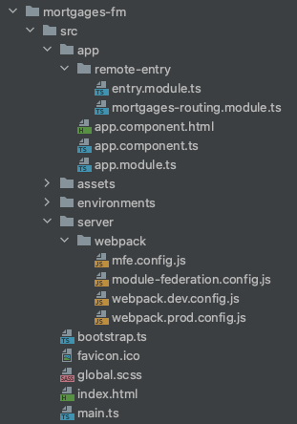
New Mortgages app

Slide 35
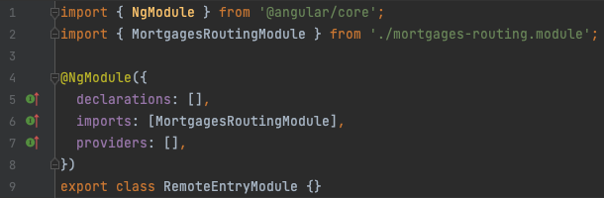
New Mortgages app

Slide 36
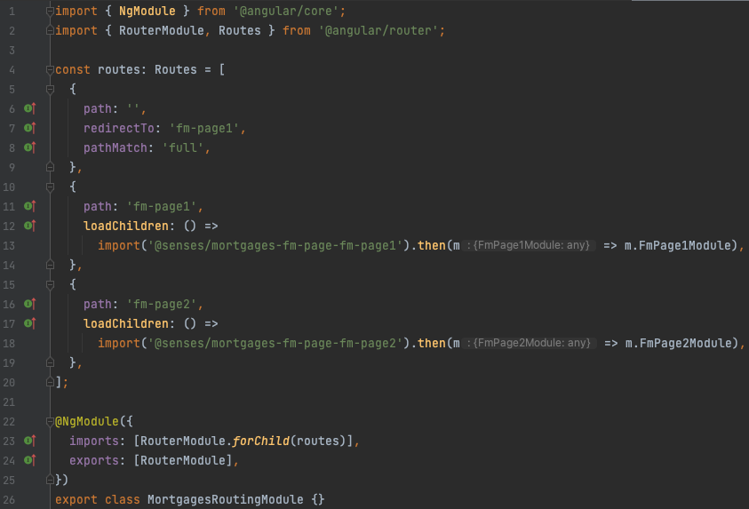
New Mortgages app

Slide 37
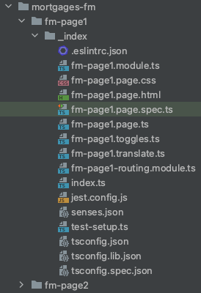
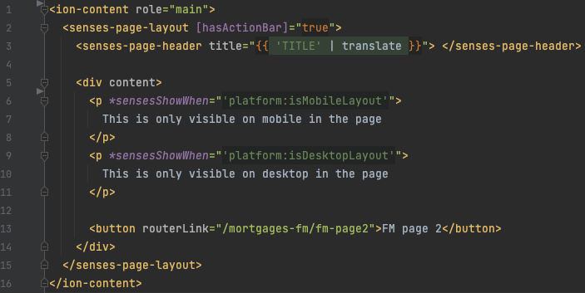
New Mortgages app

Slide 38
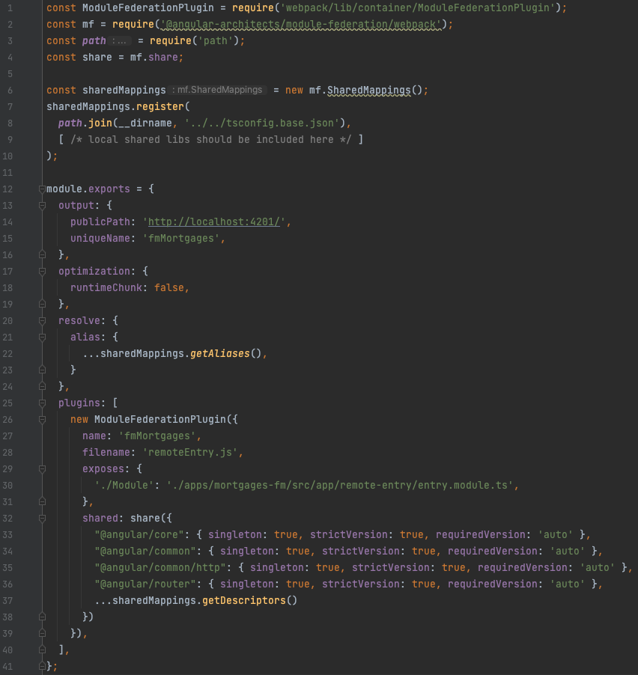

Slide 39
New Mortgages app
Not rendered

Slide 40
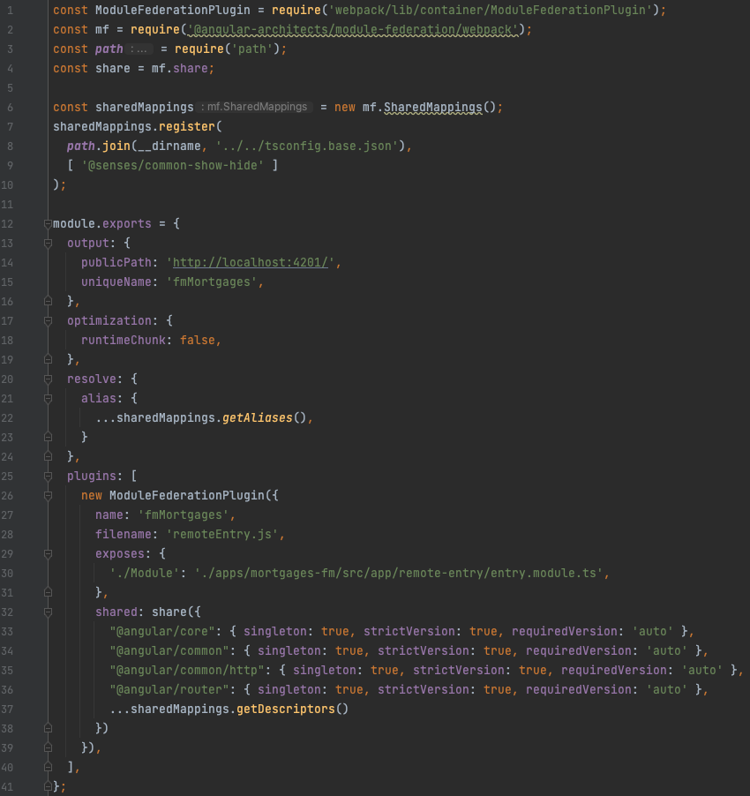

Slide 41
Error: Cannot find module 'rxjs'
at webpackMissingModule (consumes:134:162)
at consumes:134:270
at __webpack_require__.m.<computed> (consumes:164:1)
at __webpack_require__ (bootstrap:19:1)
at 5256 (app.module.ts:24:28)
at Function.__webpack_require__ (bootstrap:19:1)
at _ZoneDelegate.invoke (zone.js:372:26)
at Zone.run (zone.js:134:43)
at zone.js:1275:36
at _ZoneDelegate.invokeTask (zone.js:406:31)

Slide 42
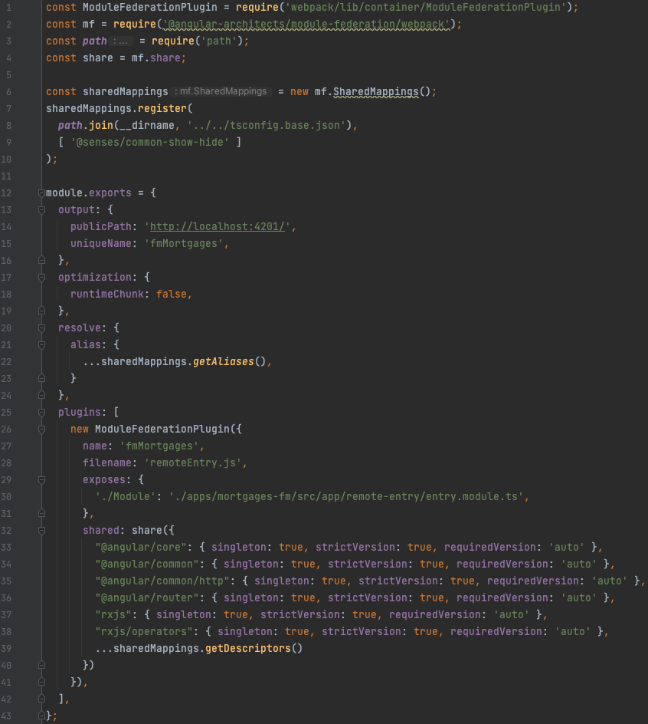

Slide 43
Error: Cannot find module 'ramda'
at webpackMissingModule (consumes:134:162)
at consumes:134:270
at __webpack_require__.m.<computed> (consumes:164:1)
at __webpack_require__ (bootstrap:19:1)
at 5256 (app.module.ts:24:28)
at Function.__webpack_require__ (bootstrap:19:1)
at _ZoneDelegate.invoke (zone.js:372:26)
at Zone.run (zone.js:134:43)
at zone.js:1275:36
at _ZoneDelegate.invokeTask (zone.js:406:31)

Slide 44
What is going on?
RBO (shell)
Mortgages (remote)
RBO
import bundle 412.js
fm-page-1
webpack config
common-show-hide
webpack config
register as shared bundle 412.js
register as shared bundle 412.js
import bundle 562.js
ramda
register as bundle 562.js
register as bundle 783.js

Slide 45
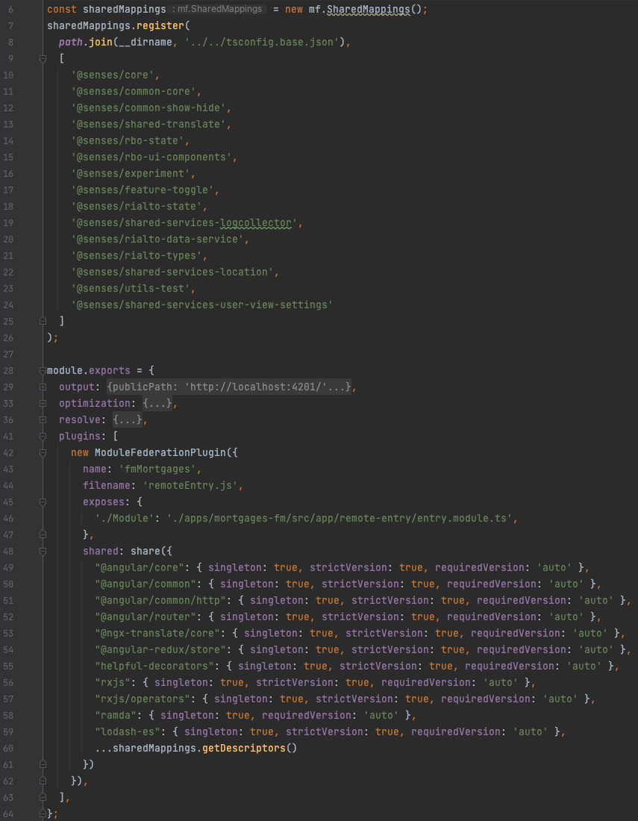

Slide 46
New Mortgages app
Still not rendered *sigh*

Slide 47
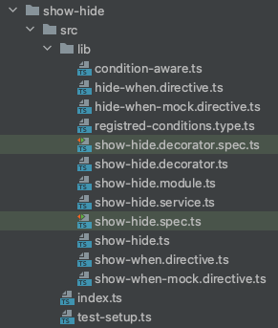
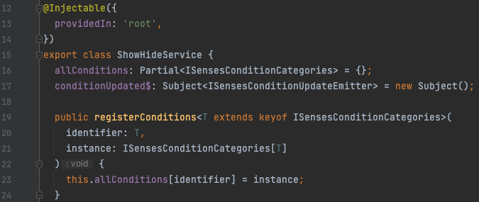
New Mortgages app
Different between RBO and Mortgages, so this is still not a singleton??

Slide 48
ShowHideService not a singleton
RBO (shell)
Mortgages (remote)
common-show-hide
show-hide.ts
import “. /show-hide-service”
RBO
import “@senses/common-show-hide”
show-hide-service.ts
Register conditions
import “@senses/common-show-hide”
fm-page-1
show-hide-service.ts (2)
Registered for import “. /show-hide-service”,
This source is not registered as singleton

Slide 49
ShowHideService not a singleton
RBO (shell)
Mortgages (remote)
common-show-hide
RBO
import “@senses/common-show-hide”
import “@senses/common-show-hide”
show-hide.ts
fm-page-1
import “@senses/common-show-hide-service”
common-show-hide-service
import “@senses/common-show-hide-service”
show-hide-service.ts
import “@senses/common-show-hide-service”
Register conditions

Slide 50
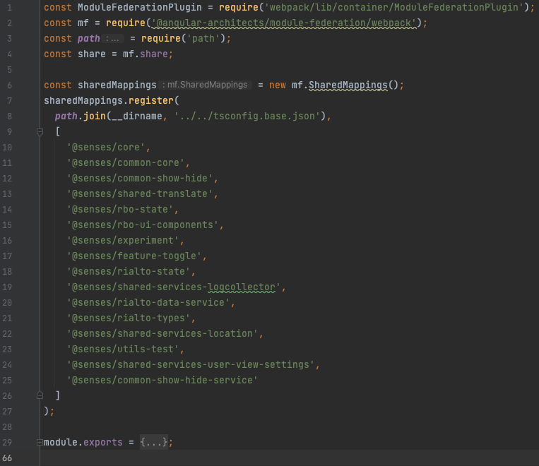

Slide 51

Rabo Problem-o-Meter 5000TM
Large number of cross-domain page imports
Every stateful service may only be imported from exactly 1 source
Webpack config is getting complex and difficult to manage

Slide 52
Transition to nrwl
It is already used as our toolset
It simplifies and automates the webpack configuration
It automatically scans your local NX workspaces and finds shared npm packages and local libraries
It is easy to configure what npm packages and local libraries you want to share or exclude between the host and remotes
It includes schematics that provide a well-thought-out project structure for your remotes and host apps
The NX CLI has the capability to boost up serving your remote and host apps locally by leveraging cache. When using NX14 together with Angular 14 you will have an opportunity to use improved CLI commands to speed up builds exponentially

Slide 53
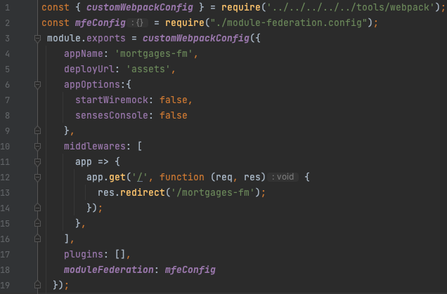
Transition to nrwl

Slide 54

Transition to nrwl

Slide 55
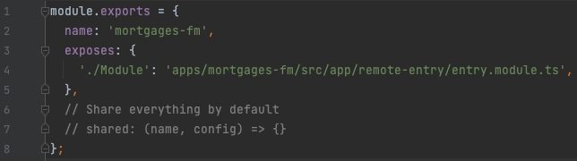
Transition to nrwl

Slide 56
Uncaught Error: Shared module is not available for eager consumption: ‘ramda’
at Object.__webpack_modules__.<computed> (consumes:133)
at __webpack_require__ (bootstrap:21)
at fn (hot module replacement:61)
at Module../src/index.js (main.bundle.a8d89941f5dd9a37d429.js:239)
at __webpack_require__ (bootstrap:21)
at startup:4
at startup:6

Slide 57
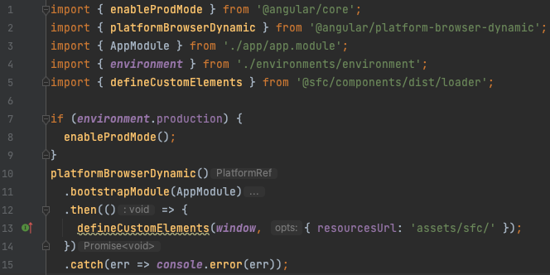
Eager consumption support

Slide 58
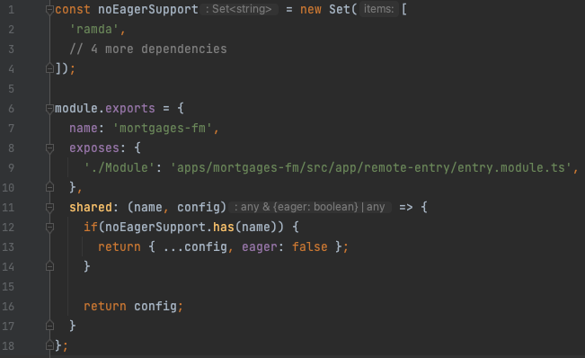
Remove eager setting

Slide 59
NRWL improvements
Webpack configuration less complex than before, but still not ideal…
Angular 13+ modular javascript bundles (*.mjs) automatically supported
NX cache improved performance
Everything was fine…

Slide 60

NRWL improvements
Webpack configuration less complex than before, but still not ideal…
Angular 13+ modular javascript bundles (*.mjs) automatically supported
NX cache improved performance
Until…
AOT

Slide 61
The big AOT dilemma
The error that haunted us for weeks:
ERROR Error: Uncaught (in promise): TypeError: Cannot read properties of undefined (reading 'ɵcmp')
TypeError: Cannot read properties of undefined (reading 'ɵcmp')

Slide 62
The big AOT dilemma
Component / directive definition not found

Slide 63
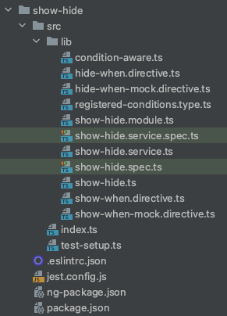
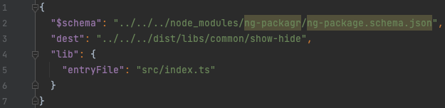
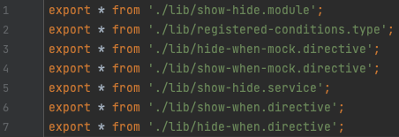
The big AOT dilemma
The only way to resolve this issue is to build and export definition files (*.d.ts) on the root level of the shared libs. @angular/core can use this to fetch the component definitions

Slide 64
The big AOT dilemma
Every peer dependency of a shared lib also needs to become a buildable lib like this!
None of the libs may have any boundary violations, otherwise the lib is not self-contained and the build fails
Disabling AOT is a no-go! So this issue needs to be tackled one way or another

Slide 65
Why we won’t continue with Module Federation (for now)

Slide 66

Rabo Problem-o-Meter 5000TM
Large number of cross-domain page imports
Every stateful service may only be imported from exactly 1 source
Webpack config can get complex and difficult to manage
To get AOT working:
Every shared local lib and its peer dependencies need to be buildable
This may negatively affect performance of cold boots because of the sheer number of shared libs
A lot of work because there are hundreds of shared libs
Every shared local lib cannot have any boundary issues, otherwise the lib is not self-contained and the build fails
Huge workload because there are roughly ~3000 violations across ~58 teams, all greatly varying in complexity
There still are lots of unknowns…

