Slide 1

UNIVERSITY DEPARTMENT,
RAJASTHAN TECHNICAL UNIVERITY, KOTA
DEPARTMENT OF COMPUTER SCIENCE AND ENGINEERING
Hybrid AI-Assisted Page Replacement
Submitted by:-
Hemant Singh Chouhan (22/420)
Naman Sehra (22/518)
Naresh Parmar(22/519)
Shubham Garg (23/776)
Submitted to:-
Mr. Dinesh Soni Sir
Ms. Nirmala Sharma Ma’am

Slide 2
Overview
This presentation provides a comprehensive walkthrough of our Hybrid AI-Assisted Page Replacement System, showcasing how machine learning can enhance traditional operating system memory management without altering core kernel algorithms. The work integrates OS internals, Linux kernel instrumentation, deep learning, real-time data analytics, and GUI-based visualization into a unified research prototype.
KEY COVERAGE :
Background: OS memory challenges & motivation
Project objectives and scope
Hybrid AI + OS concept
System architecture and workflow
Kernel data acquisition via kprobes
Data preprocessing & PFN slicing
GRU-based prediction model (Model V3)
Kernel middleware integration using netlink
Prediction validation & trust controller
GUI visualization and monitoring
Performance evaluation & insights
Future enhancement (Model V4 & RESAT-X)
Conclusion and acknowledgements

Slide 3
Problem Statement
“How can we provide the operating system with future memory access insight so page replacement becomes smarter, faster, and more efficient?”
Background :
Modern operating systems often suffer from latency spikes when memory pressure is high. The root cause is page faults — when the OS cannot find a required memory page in RAM and must fetch or replace it. This process is slow and directly contributes to system lag.
Problem statement:
Traditional page replacement algorithms (FIFO, LRU, NRU, CLOCK, etc.) are limited because they:
Depend only on historical access patterns
Use heuristics without foresight
Cannot predict future memory usage
In today’s workloads (cloud computing, machine learning, gaming, multitasking):
Access patterns are dynamic and unpredictable
Kernel decisions often become sub‑optimal
This leads to poor victim page selection, extra page faults, and ultimately lagging performance.
Cause of Lagging :-
The lagging issue arises because:
High memory pressure → triggers page faults
Wrong victim page selection → forces extra disk fetches
Disk I/O is far slower than RAM access
Delays accumulate → noticeable system lag

Slide 4
Vision & Motivation
“Enable the OS to look a few steps into the future, allowing smarter page‑fault handling and more stable performance.”
vision :-
To design a next‑generation, intelligent Page Replacement Support System that strengthens traditional OS memory‑management techniques using AI‑based future prediction — without modifying or replacing the OS kernel’s native algorithms
Motivation:-
Modern operating systems experience performance drops due to page faults, particularly major faults, which cause disk access. Traditional page replacement algorithms (LRU, FIFO, CLOCK, NRU, etc.) rely heavily on past access patterns and do not have visibility into future page demand, leading to avoidable lag, inaccurate victim selection, and inefficient memory utilization.
AI excels in pattern recognition, sequential modeling, and predictive inference. Where OS algorithms lack future insight, machine learning can predict upcoming PFN sequences and act as an intelligent advisory layer.

Slide 5
Objective & Scope
Objective of the Project :
To design and implement a Hybrid AI‑Assisted Page Replacement System that enhances the Linux kernel’s ability to predict future page faults, minimize lag caused by inefficient victim selection, and support traditional page‑replacement algorithms with data‑driven intelligence — without replacing the OS kernel’s existing mechanisms.
📌 Key Goals
Develop an AI model capable of predicting upcoming major page-fault PFN sequences with high accuracy.
Integrate prediction intelligence into the Linux kernel workflow using kprobes.
Reduce false victim selection during memory pressure situations (shrink_folio_list).
Improve system responsiveness and provide a more efficient memory‑management pipeline.
Maintain compatibility with existing OS algorithms (LRU, CLOCK, FIFO, etc.).
In Scope :-
Designing end‑to‑end workflow combining:
Linux kernel instrumentation via kprobes
PFN major fault sequence extraction
ML-based PFN prediction using GRU, embeddings, and custom slice modelling
Integration with traditional page replacement logic
Data visualization, smoothing, and performance analysis
Developing a complete desktop UI + full web interface for monitoring and demo
Building multiple model versions (V1 → V3) with incremental accuracy improvements.
Real‑time prediction of fixed‑length future PFNs inside kernel event triggers.

Slide 6
Project Layout
AI Prediction Pipeline
Data Encoded: PID, mapping, folio index, latency cluster, PFN slices.
Sequence Window: Fixed‑length sequence (30 steps).
Model Engine: GRU‑based hybrid multi‑head classifier (Model‑v3).
Output: Predicted next set of PFN slices (6 values).
System Layers Overview
Kernel Layer Captures real-time PFN major‑fault data using Kprobes.
ML Processing Layer Preprocesses sequences, slices PFN into components, predicts future faults.
Decision Engine Combines OS logic + ML prediction to validate or override victim selection.
User Interface Layer Python‑based dashboard for data visualization & model monitoring.
Kernel Instrumentation (Kprobes)
do_swap_page → pre_handler Captures incoming major‑fault context.
finish_fault → post_handler Extracts PFN, latency, folio index & mapping.
shrink_folio_list Observes victim‑selection pipeline.
Intelligent Page Replacement Workflow
Step 1 — Fault Detected: Kernel notices a major fault → triggers ML module.
Step 2 — Future Sequence Predicted: ML predicts upcoming PFN slice sequence.
Step 3 — Victim Validation: Prediction checked against shrink_folio_list victim.
Step 4 — Final Decision:
If victim is future-use, hold it.
Else, OS performs normal replacement.
Integrated Hybrid System
AI + OS Collaboration AI predicts future access patterns; OS executes validated actions.
Non‑intrusive Design Does not replace algorithms—only augments decision quality.a
Modular Architecture Independent kernel module, ML engine, UI
6. Benefits (Infographic-Friendly)
⬆ Performance Boost → Reduced unnecessary evictions
⬇ Latency Drops → Better future fault avoidance
🔁 Efficient Memory Cycles → Smarter victim choices
🎯 Higher Prediction Accuracy → Model‑v3 stability

Slide 7
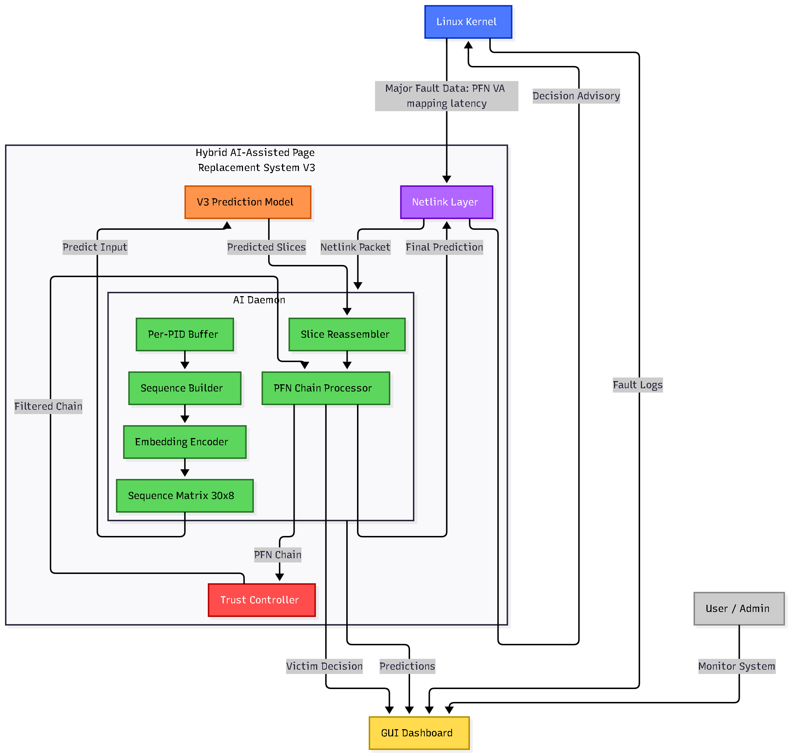
Project Architecture

Slide 8
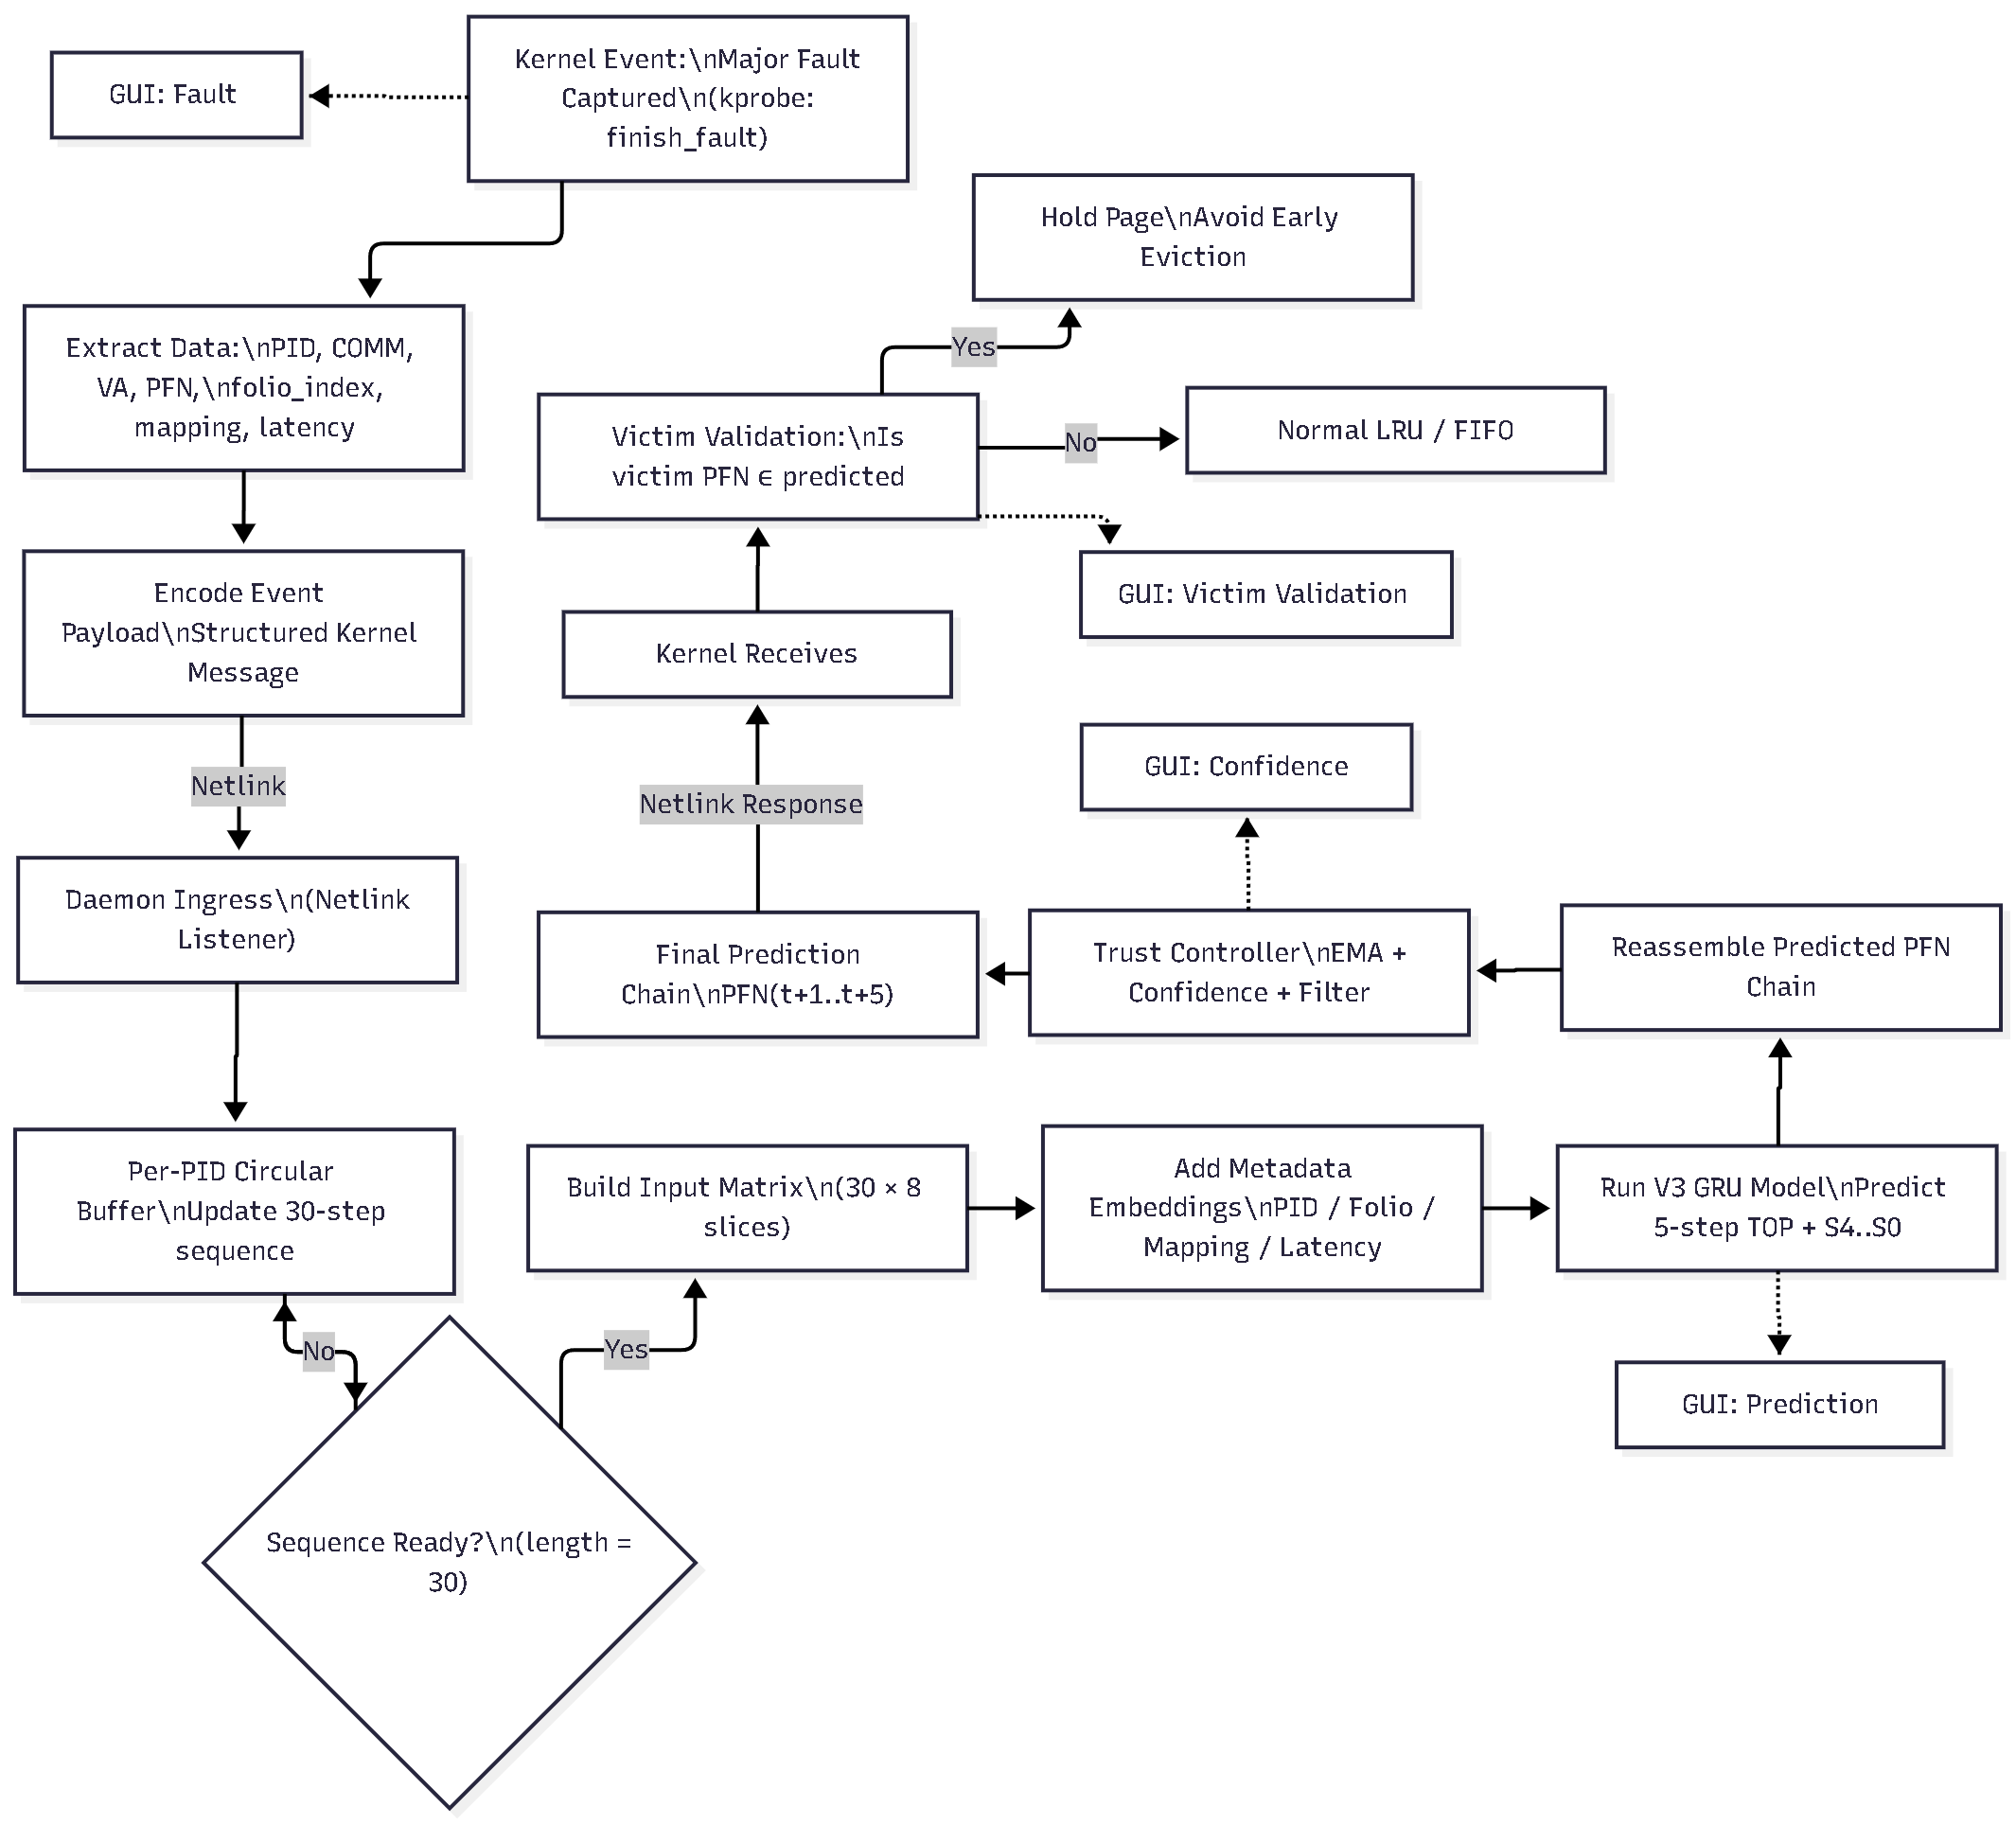
Proposed Hybrid AI–LRU System

Slide 9
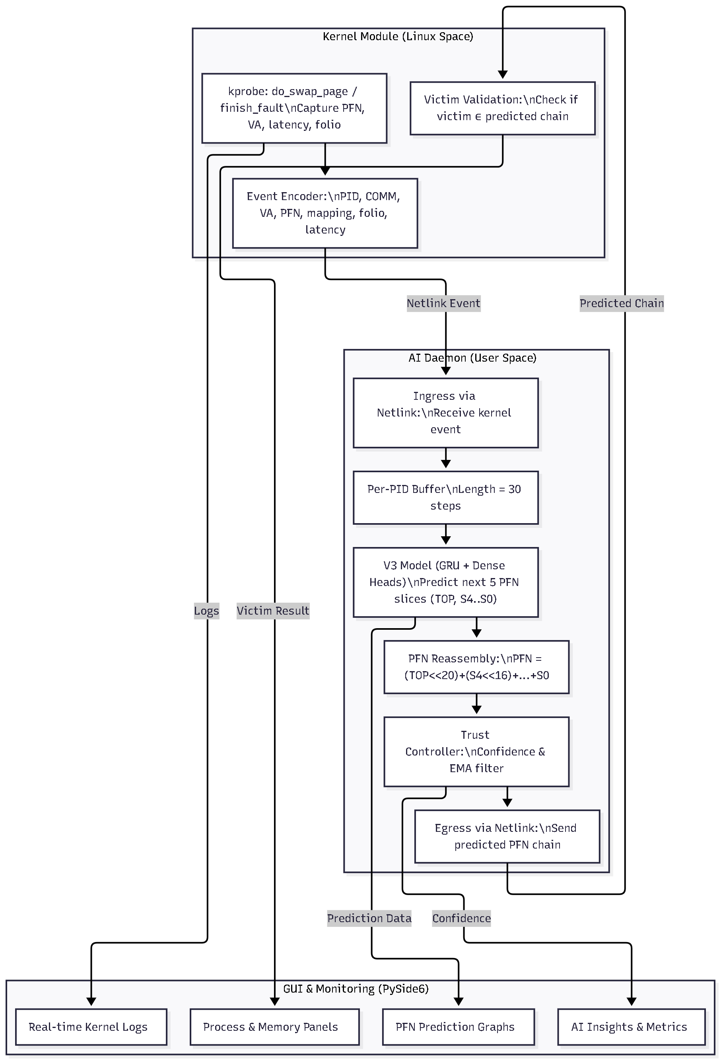
Architecture Overview & Core Components (Polished Version)
Main Components
🔹 Memory Manager (LRU — Kernel Space) Handles page replacement using standard LRU. AI does not replace LRU—only advises through validation.
🔹 Event Encoder (Kernel Module) Captures PFN major faults via kprobes and sends compact event packets (PID, VA, PFN, mapping, folio) to user space through Netlink.
🔹 AI Daemon (User Space) Receives kernel events → maintains per-PID buffer (30 steps) → runs V3 GRU model → predicts 5 future PFNs → applies trust filter → returns predicted chain + confidence to kernel.
🔹 Trust Controller Computes trust score (T = 0.3S + 0.4μ + 0.3W) and allows AI suggestions only when confidence is reliable.
🔹 Kernel Victim Validation When LRU selects a victim, kernel checks AI-predicted chain → protects page if needed → ensures safe, advisory-only enhancement.
🔹 Reality Daemon Continuously compares predictions vs actual outcomes → updates long-term trust (W) for adaptive learning.
🔹 Hold Queue Temporarily keeps pages predicted to be needed soon; avoids premature eviction.
🔹 GUI Dashboard Shows real-time kernel logs, prediction chains, trust scores, and memory activity.

Slide 10
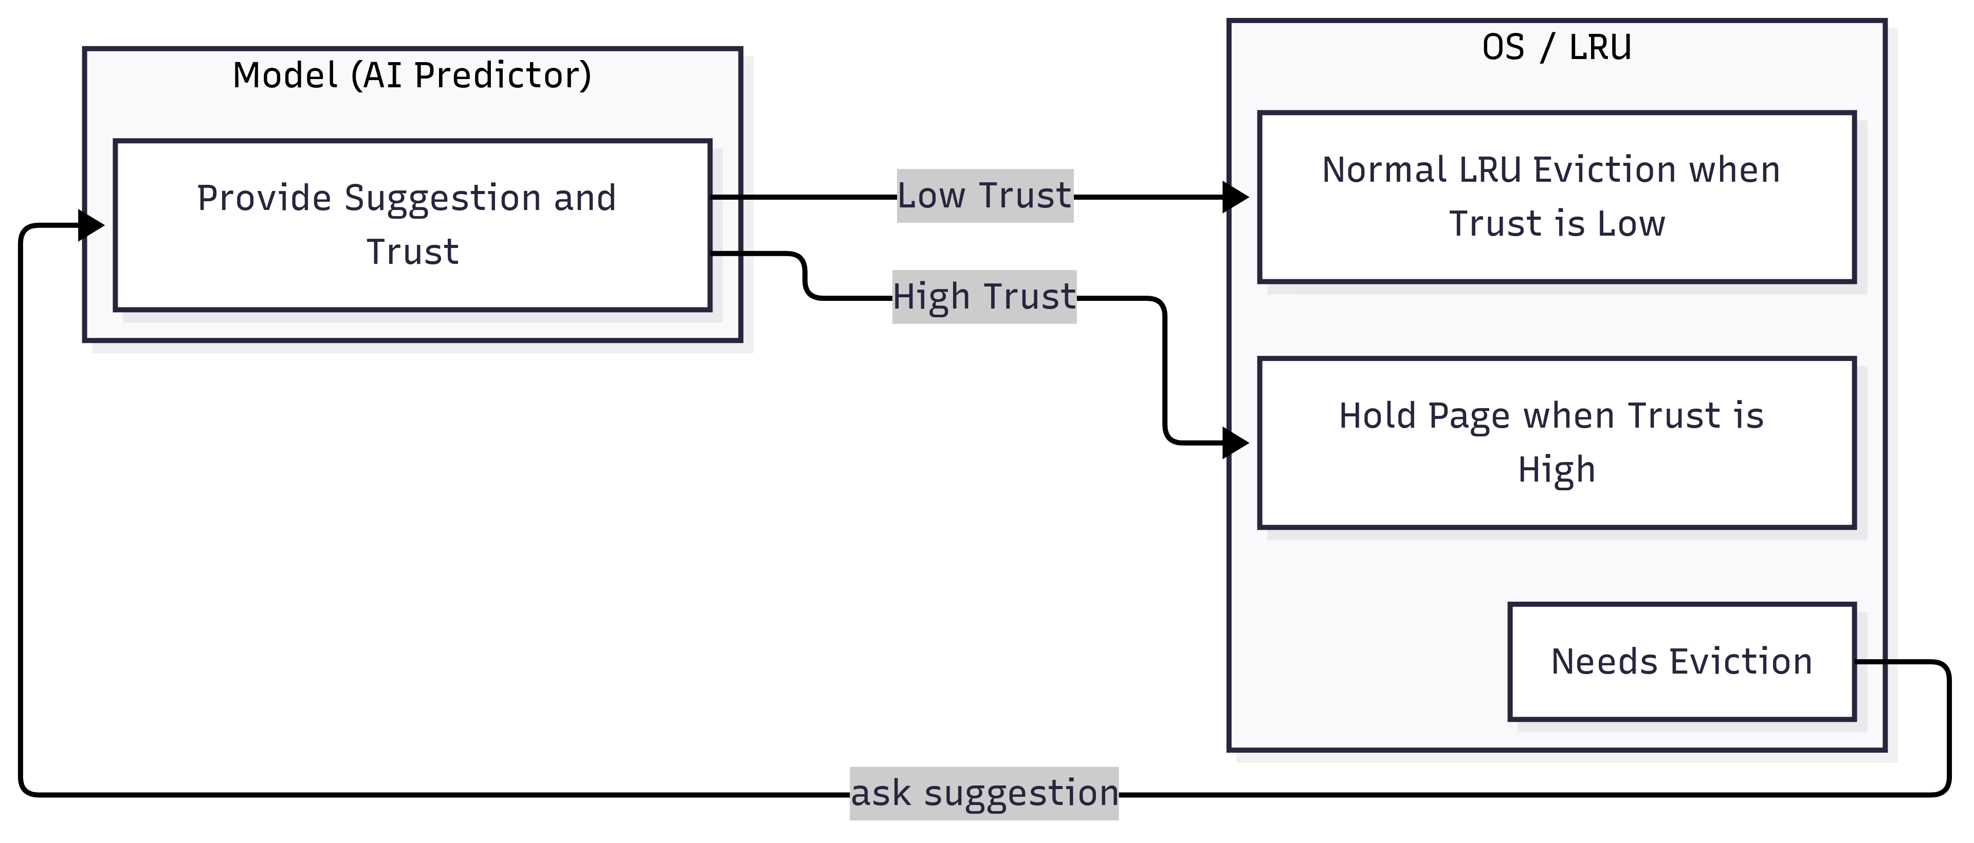
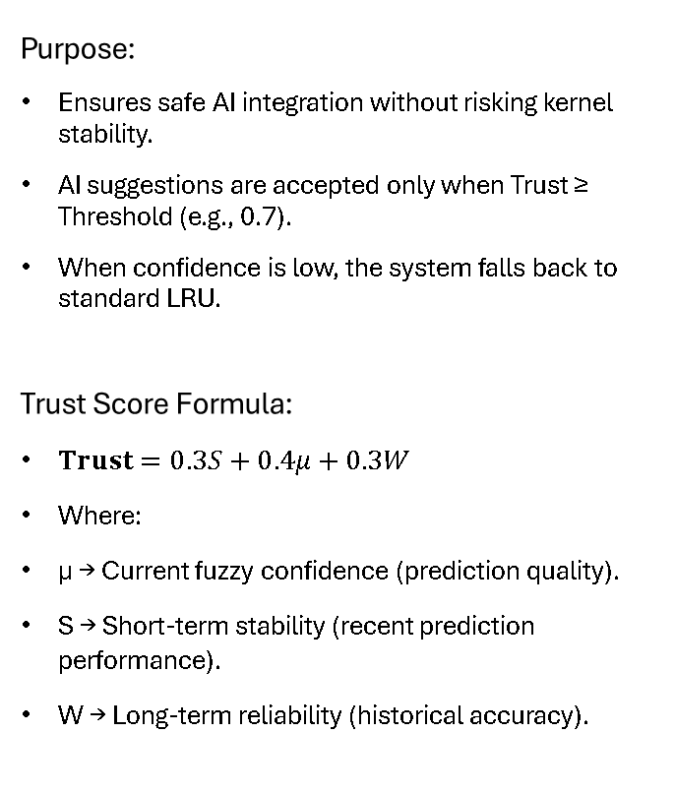
Trust-Based Decision Logic
Purpose:
Ensures safe AI integration without risking kernel stability.
AI suggestions are accepted only when Trust ≥ Threshold (e.g., 0.7).
When confidence is low, the system falls back to standard LRU.
Trust Score Formula:
$\text{Trust}=0.3S+0.4μ+0.3W$
Where:
μ → Current fuzzy confidence (prediction quality).
S → Short-term stability (recent prediction performance).
W → Long-term reliability (historical accuracy).
Decision Flow :
Trust ≥ Threshold → Kernel honors AI prediction and protects the predicted page.
Trust < Threshold → Kernel uses normal LRU eviction.
Ensures AI influence grows only when it proves consistent accuracy.
Outcome:
High Trust → Page is held (AI suggestion applied).
Low Trust → Page is evicted normally (LRU path).
Overall behavior remains stable, safe, and adaptive.

Slide 11
Performance Baseline Before Hybrid Integration — Detailed Explanation
Before introducing the hybrid AI-assisted model, it was essential to measure the current system behavior under normal conditions. This baseline helped identify performance gaps, validate assumptions, and understand how memory behaves during various workloads.
Setup Environment:
Testing was performed on Ubuntu (VirtualBox or any Linux environment works).
Two key tools were used:
vmstat → Tracks system-level memory statistics such as page faults, swap usage, and CPU wait time.
stress-ng → Generates controlled synthetic workloads to test system memory behavior under load.
Focused parameters included:
Page faults
Swap activity
Memory load
Latency
Key Observations:
Overall memory usage remained stable under controlled stress, indicating no abnormal system instability.
Major page faults were identified as the primary performance bottleneck, directly responsible for noticeable delays during heavy workloads.
Traditional tools (vmstat, top, iostat, etc.) only provide high-level memory statistics and cannot show page-level transitions—which are required for training an AI model.
This highlighted the need for deep kernel-level data abstraction (PFN-level logging, VA mapping, and per-process tracking) to generate meaningful training data.
Takeaway:
The baseline study confirmed that:
The system behaves predictably,
Page faults have the highest runtime impact,
And crucially—the Linux kernel does not expose the fine-grained PFN data we need.

Slide 12
Kernel Data Acquisition via kprobes
To enable AI-driven prediction, the system must capture low-level PFN transition data directly from the Linux kernel, which is not available through normal user-space tools. This is achieved using kprobes, a safe mechanism for intercepting kernel functions at runtime.
What We Capture:
Using hooks in do_swap_page() and finish_fault(), we collect:
Virtual Address (VA)
PFN (Page Frame Number)
PID & process name (COMM)
Page latency
Mapping & folio index
Fault type (major fault)
Why kprobes?
Lightweight and safe for kernel instrumentation
No kernel recompilation required
Works on live systems
Provides exact event timing needed for sequence modeling
Allows collecting per-process, per-fault page transition data
Where It Fits in the Pipeline
Kernel → kprobe hooks → Event Encoder → Netlink → User Space This is the first stage of the entire data processing pipeline that feeds into preprocessing, feature engineering, synthetic augmentation, and eventually the V3 model.
Hooks in do_swap_page() and finish_fault() capture: → Virtual Address, PFN, PID, Latency, Folio
vmscan.c probe tracks victim pages selected by LRU.
Preprocessing & Cleaning
Derived metrics: → Page access frequency → Latency delta → Fault pattern sequence
Convert to fixed-length sequences for LSTM/GRU input.
Synthetic Data Augmentation
Final structured dataset:
[Virtual Addr | PFN | PID | Latency | FaultType | SequenceID]
Stored for AI training and simulation.
Normalize raw entries.
Remove duplicates and incomplete faults.
Align timestamps for sequential ordering.
Generate additional training sequences (Sequential, Random, Locality, Mixed).
Balances training data distribution for robust model learning.
Data Acquisition (Kernel Level)
Feature Engineering
Model Input Packaging

Slide 13
Synthetic Data Generation (Early Phase Only)
What Synthetic Data Represented
The synthetic dataset was not real memory faults. It was created by observing:
memory load behavior
repetitive PFN jumps
burst patterns
common access loops
but in a simulated / approximated manner, not from the real kernel.
It helped mimic:
sequential rises
random noise
locality clustering
periodic PFN resets
This allowed us to test the LSTM/GRU pipelines without needing the kernel module.
Why Synthetic Data Was Created
In the early stages of the project, no real kernel-level PFN fault data was available. To begin experimenting with:
sequence modeling
PFN-slicing logic
pattern recognition
latency/transition behavior
memory load simulation
we required approximate, placeholder data that resembled memory-access patterns. Thus, synthetic data was generated only to bootstrap the research.

Slide 14
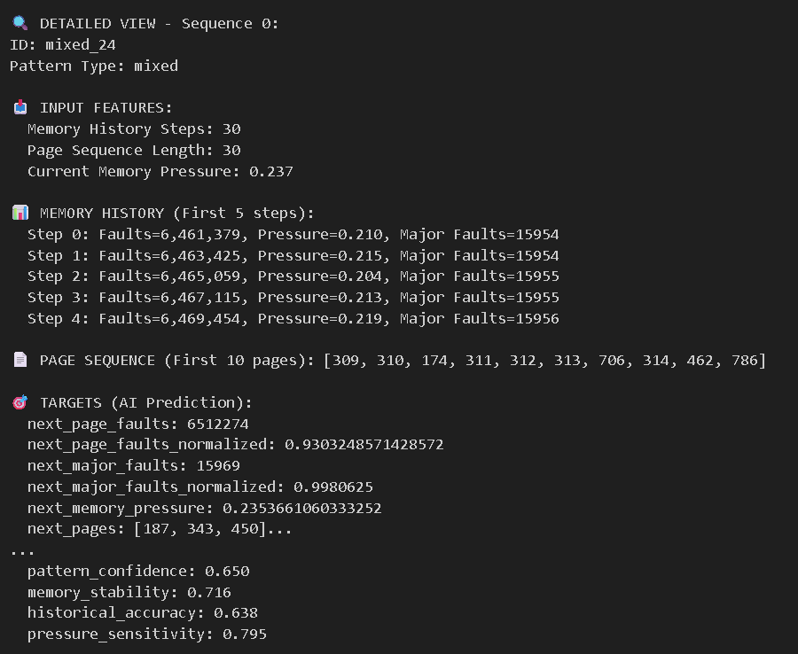
Synthetic Data Generation (Early Phase Only)
How Synthetic Data Helped (But Only Temporarily)
Synthetic data was used only for:
Validating the early sequence-learning architecture
Testing windowing (sequence length = 30)
Debugging feature engineering
Verifying that PFN slicing (Top, S4…S0) works
Checking model stability during initial development
Understanding how ML responds to recurring patterns
It provided a sandbox to check the feasibility of the idea.
It was NEVER used to train the final model.
It was replaced once actual kernel abstraction became available.
Why We Switched Away From Synthetic Data
When real kernel PFN-event collection (kprobes + kprobe hooks + shrink_folio_list) became operational, we realized:
Real kernel patterns were far more complex
Synthetic patterns lacked true OS behaviors
Mapping, latency, PID interactions are only visible in real events
Synthetic data cannot reproduce unpredictable memory allocator behavior
Thus, synthetic data became obsolete and was retired.
The final V3 model is trained only on actual Linux kernel abstraction, not synthetic data.

Slide 15
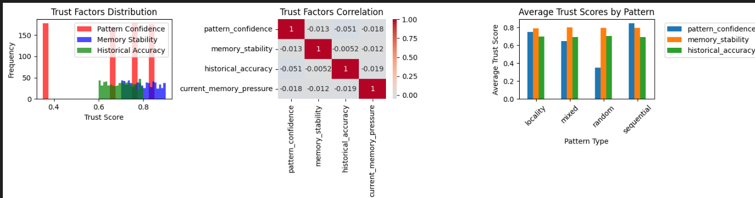
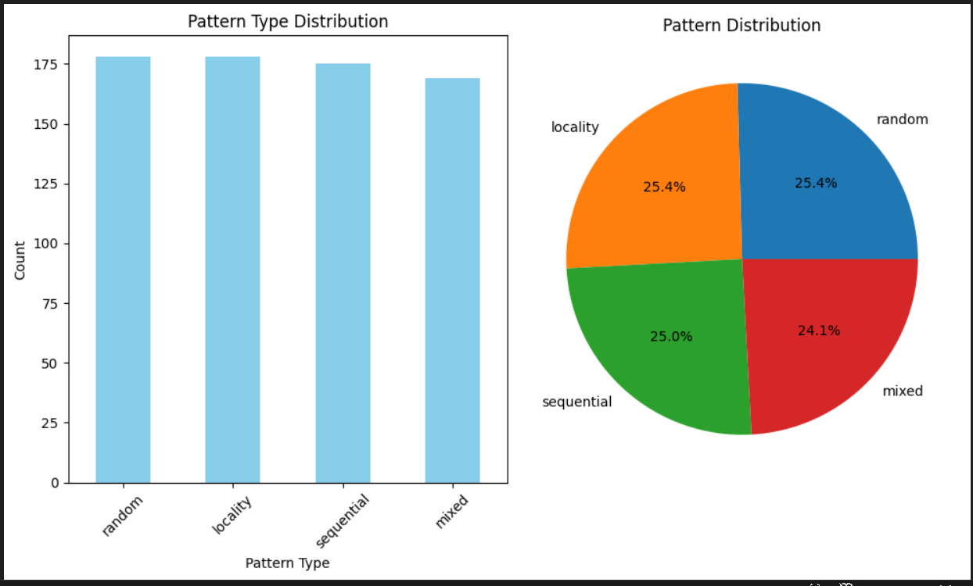
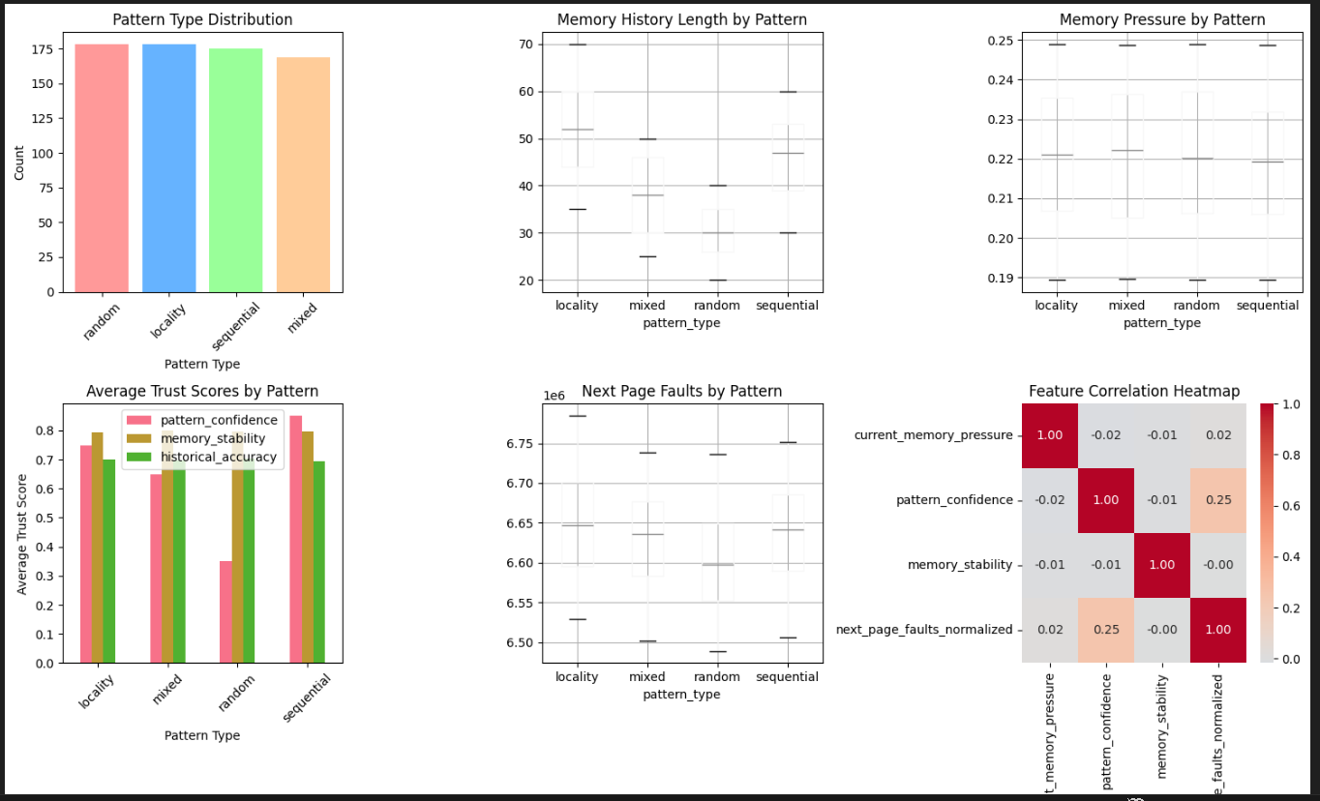
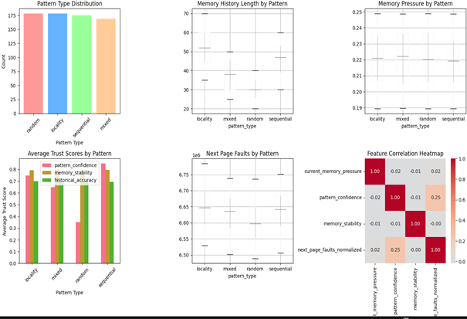
Synthetic Data Generation (Early Phase Only) visuals

Slide 16
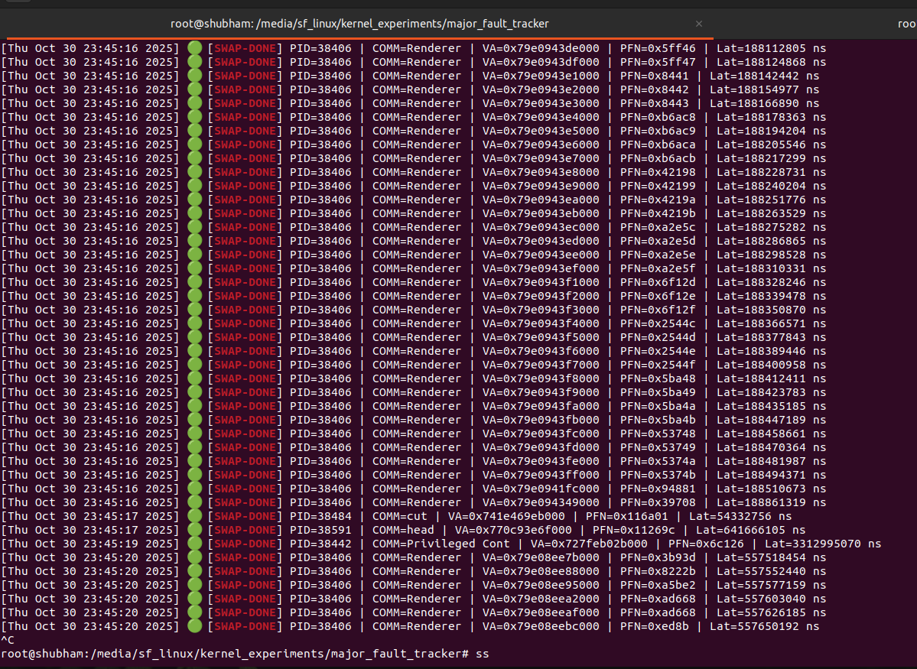
Linux Kernel Data Capture & Pattern Extraction Pipeline
Kernel‑Level Event Capture
Deploy custom Linux KProbes on:
do_swap_page / __do_swap_page (Major Fault Trigger)
finish_fault (PFN Resolution Point)
shrink_folio_list (Victim‑Selection Observation)
Capture raw attributes:
PFN (Page Frame Number)
PID, Virtual Address
Folio Index, Mapping, Latency
Output: Unstructured memory‑fault events
Data Cleaning & Normalization
Remove incomplete or unstable kernel events
Resolve PFN mapping inconsistencies
Convert PFN → 6‑slice nibble representation
Normalize fields into model‑ready format:
Sequence windows of length 30
Encoded categories: PID, folio index, mapping, LAT cluster
Output: Consistent structured sequences
Clustering & Pattern Formation
Group PFN slices into temporal clusters
Identify behavior signatures:
Recurrent PFN bursts
Hot‑page access patterns
Kernel memory recycling loops
Build feature‑rich sequences:
(Slices + Metadata + Latency patterns)
Output: Pattern‑aware training data

Slide 17
Data Preprocessing Framework
This slide explains the complete data preprocessing pipeline used before training the Hybrid GRU model. Each module transforms raw PFN major-fault features into stable, ML-ready structured sequences that the model can learn from.
1. Input Encoding
2. Temporal Sequence Encoder
3. Auxiliary Context Embeddings
4. Multi-Slice Prediction Heads
5. KL-Consistency Module
6. Training Strategy
Raw kernel PFN events converted into embeddings.
Each time-step includes VA, PFN slices, folio index, PID, latency.
Produces a structured vector for every event.
Two-stage Bi-GRU (256 + 128 units).
Learns patterns like bursts, locality, and irregular spikes.
Captures how PFN behavior changes over time.
Extra metadata (PID, mapping ID, folio index, latency clusters).
Merged with GRU output for richer context.
PFN split into 6 outputs (TOP, S4, S3, S2, S1, S0).
Parallel heads improve stability vs predicting full PFN at once.
Ensures all slice predictions remain mathematically aligned.
Makes outputs realistic and structurally correct.
Multi-loss training (slice losses + KL loss).
Adam optimizer, early stopping, LR scheduler.
Produces stable learning across all PFN patterns.

Slide 18
Prediction Validation and Trust Update
Purpose:
Ensure AI predictions are always verified against real kernel events before influencing system behavior.
Maintain a closed feedback loop between AI Model, Trust Controller, and LRU to keep the system stable.
Guarantee safe integration: AI suggestions are applied only when they meet required confidence levels.
Validation Workflow :
AI Predictor generates a future PFN prediction chain:
𝑝=[𝑝1,𝑝2,…,𝑝𝑛] p=[p1 ​,p2,…,pn]
Kernel (via kprobes) logs actual major-fault PFNs:
𝑞=[𝑞1,𝑞2,…,𝑞𝑛] q = [q1 ,q2 ,…,qn ​]
Compare p vs q for correctness and timing alignment.
Update Trust Factors (μ, S, W) based on match results:
μ → current prediction accuracy
S → recent stability
W → long-term reliability
Final trust score:
𝑇= 0.3𝑆+0.4𝜇 + 0.3𝑊
T=0.3S+0.4μ+0.3W
Decision Logic
If Trust ≥ Threshold (≈ 0.7):
→ Accept AI prediction
→ Protect predicted pages using the Hold Queue
→ Delay eviction for high-value PFNs
If Trust < Threshold:
→ Ignore AI suggestion
→ Default to standard LRU replacement

Slide 19
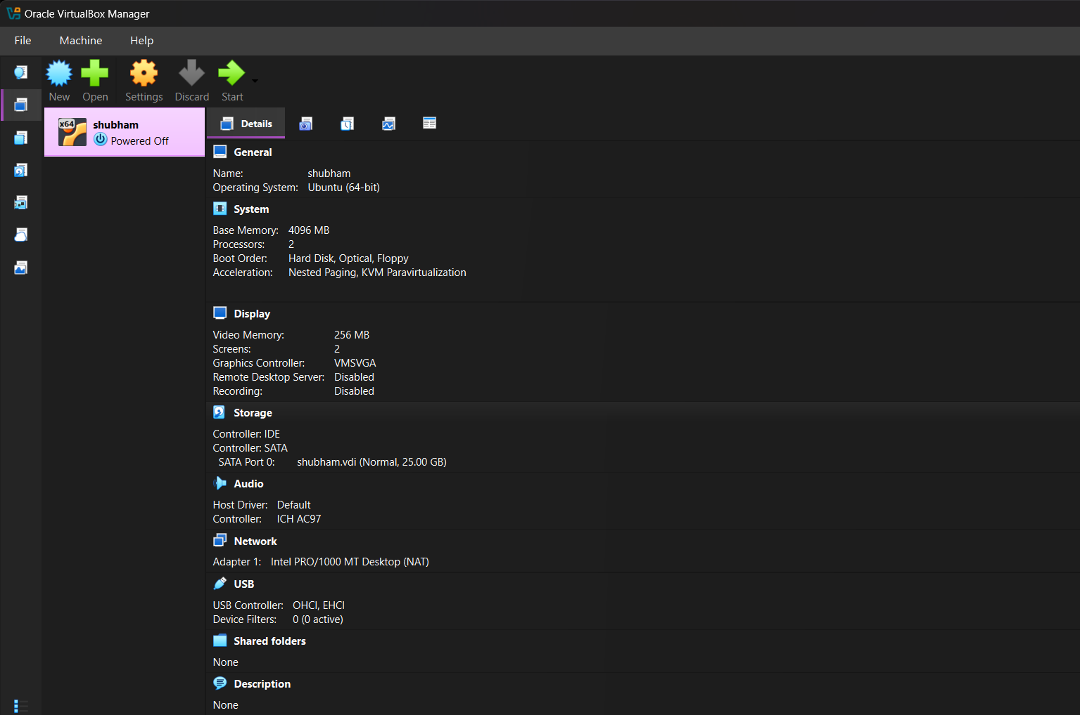
Kernel-Level Integration and Data Abstraction Framework
Environment Setup:-
Platform: Ubuntu (Custom-compiled Linux kernel on VirtualBox)
Tools Used: kprobes, tracepoints, perf, and custom kernel logs
Goal: Capture low-level page fault and victim selection events for real-time analysis.
Hooking critical kernel functions
do_swap_page() → Captures Virtual Address (VA), Process ID (PID), and Latency during page fault handling.
Each major page fault triggers the hooked probes.
finish_fault() → Extracts Page Frame Number (PFN) and Folio structure post fault resolution.
vmscan.c → shrink_list_folio() → Monitors victim page selection events for LRU validation.
Captured entry structure: [Virtual Address | PFN | PID | Latency | Folio | Fault Timestamp]
Data streamed to user space via kernel logs for preprocessing and AI training.
Data Abstraction process
AI integration layer
During I/O wait, the AI Predictor runs asynchronously to forecast future page demands.
The Trust Controller validates AI recommendations before allowing victim eviction.
Ensures no performance degradation and maintains OS stability.

Slide 20
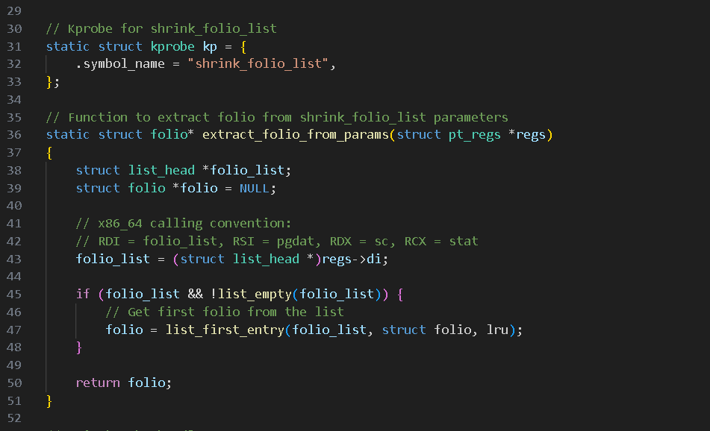
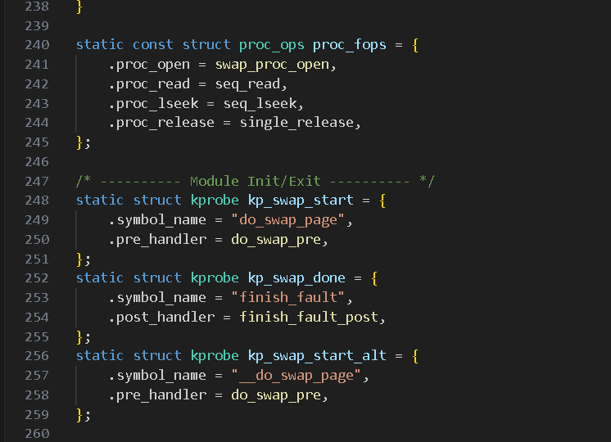
Kernel-Level Integration and Data Abstraction Framework
Fig . Victims page entry capture hook
Fig . Swap entry capture point

Slide 21
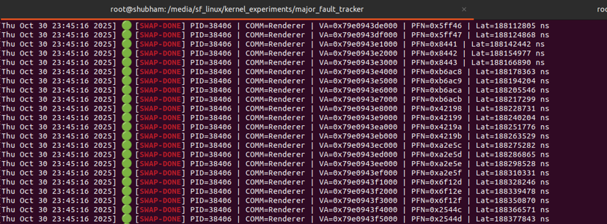
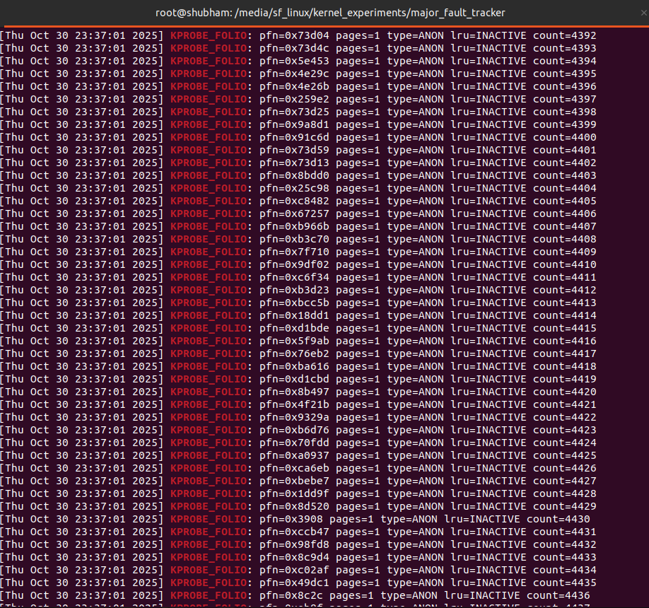
Sample Page Fault Entries Extracted from Kernel
Captured Data Fields
Virtual Address (VA): Logical memory location that triggered the fault.
Page Frame Number (PFN): Physical memory frame mapped to the VA.
Process ID (PID): Process responsible for the fault.
Latency (ms): Time taken by the kernel to resolve the fault.
Folio: Linux memory-manager structure containing metadata about the page.
Timestamp: Precise moment the major page fault occurred.
How This Data Is Used
Training & validation of the AI predictor (GRU/LSTM).
Forms sequence-based learning windows for temporal pattern modeling.
Helps analyze:
PFN access trends
Latency behavior
Prediction correctness
Trust-score evolution over time
Provides real-world ground truth for evaluating the hybrid memory management system.

Slide 22
Model Training (V3 Architecture)
Training Dataset
Data Sources:
Early-phase synthetic PFN sequences for warm-start experimentation.
Full real kernel major-fault logs captured via kprobes (production dataset).
Input Features (per timestep):
Virtual Address (VA)
Page Frame Number (PFN, 6-slice representation)
PID
Latency
Folio Index + Mapping Metadata
Training Size:
~1,000–2,000 PFN sequences (each 20–60 steps long).
Train/Validation Split:
80% Training, 20% Validation.
Model Configuration (Version-3)
Architecture:
2-layer GRU temporal encoder (256 → 128 units).
Auxiliary embedding layers for PID, folio index, mapping, and cluster ID.
Parallel multi-slice output heads:
Top Region
S4, S3, S2, S1, S0
Outputs structured PFN-slice predictions instead of raw integers.
Optimizer & Loss:
Optimizer: Adam
Loss: Multi-head MSE + Slice Consistency Regularization
KL Consistency module aligns slice outputs to maintain PFN structure.
Training Strategy:
Batch Size: 64
Epochs: 50 (with early stopping)
Learning Rate: 1e-4 with decay schedule
Weighted loss to reduce lower-slice noise amplification.
Performance Results
Sequential (Linear) Access: ~85% accuracy → V3 learns ordered PFN patterns strongly.
Locality (Hot-Page) Patterns: ~75% accuracy → Indicates solid temporal memory capture.
Mixed/Interleaved Access: ~65% accuracy → Variability due to sudden PID changes and high entropy.
Random Access:
V3 intentionally falls back to baseline LRU, since prediction confidence drops below threshold.
Latency Prediction (Smoothing Applied):
Future fault latency predictions remain within a narrow tolerance band.
Enables trust controller to detect unstable conditions.

Slide 23
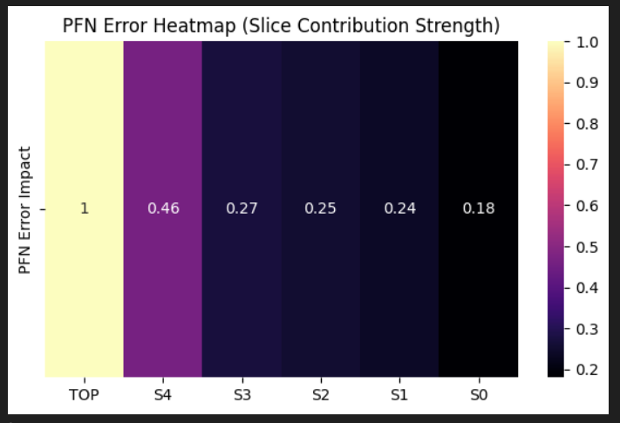
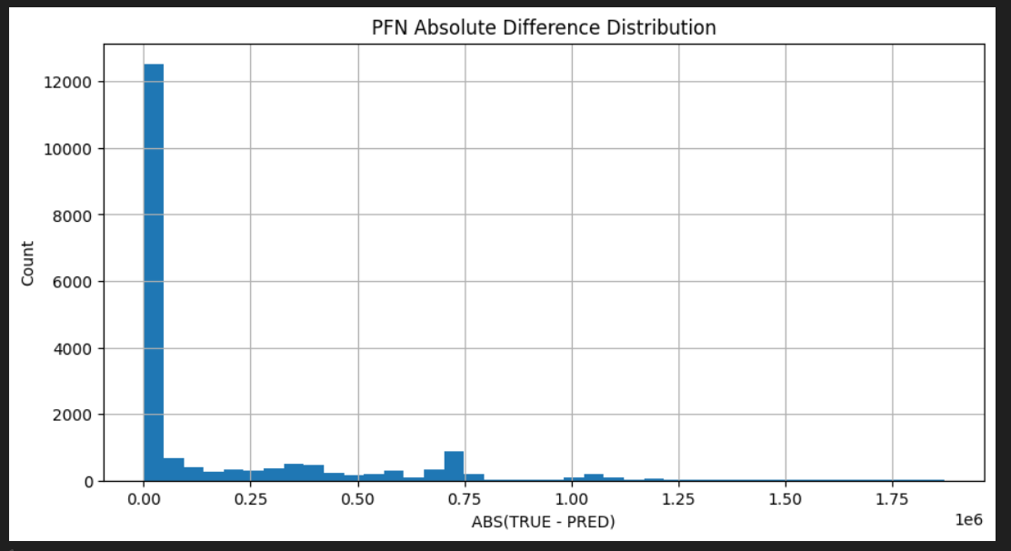
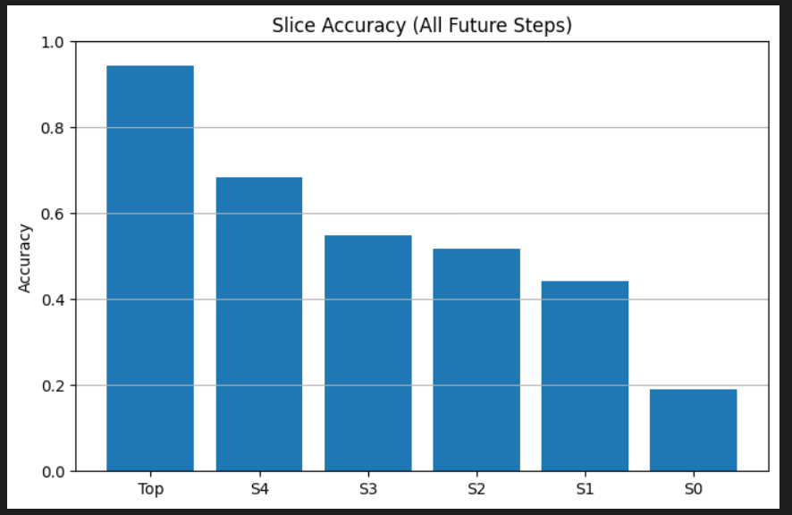
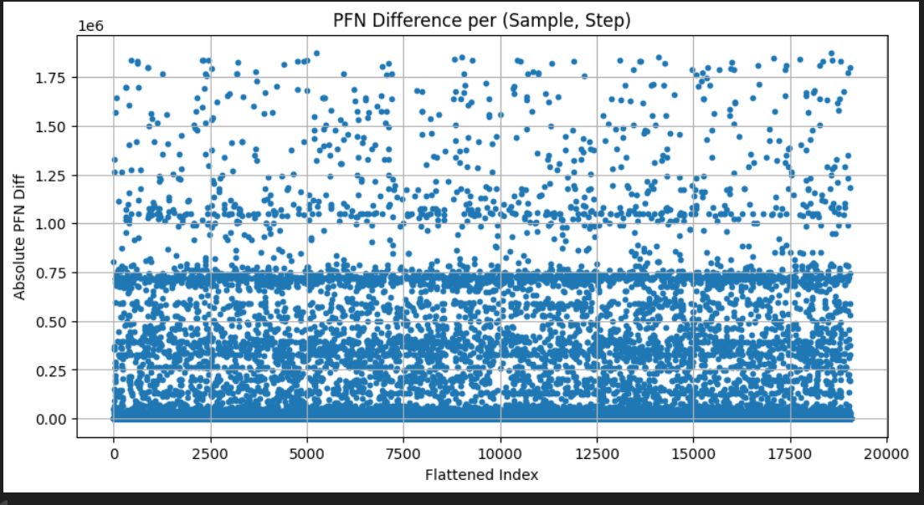
Model Training (V3 Architecture)

Slide 24
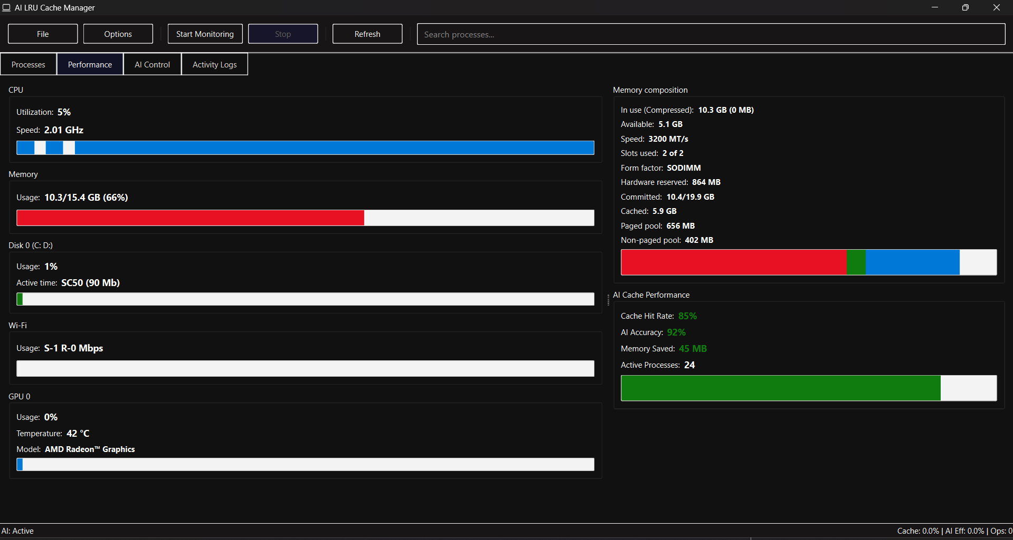
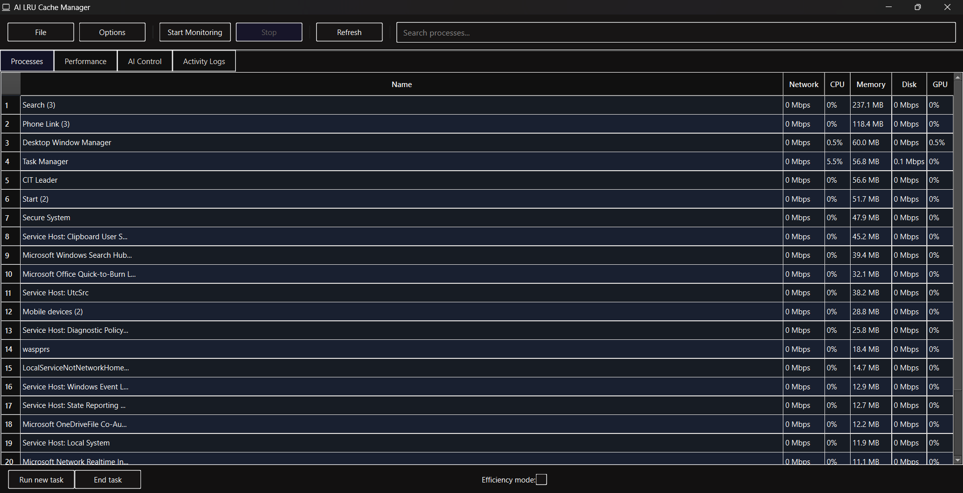
Visualization & UI
UI Features:
Live Page Fault Stream: Displays current faults with VA, PFN, PID, and latency.
Prediction Chain Panel: Shows AI-predicted future pages and confidence scores.
Trust Meter: Graphically indicates trust level (green = high, red = low).
Victim Validation View: Marks if predicted pages appeared later (✔ = correct, ✖ = missed).
Global Queue Summary: Tracks total predictions, validation accuracy, and resolved faults.
Integration:
UI fetches data logs directly from kernel → user-space via socket or buffer.
Built for simulation and demonstration (visual proof of system logic).

Slide 25
Performance Evaluation
Evaluation Setup:
Environment: Ubuntu custom kernel (VirtualBox), 4 GB RAM, 2 cores.
Workload Patterns Tested: Sequential, Locality-Based, Mixed, and Random access workloads.
Baseline: Native LRU page replacement.
Comparison Model: Hybrid AI-LRU (AI Predictor + Trust Controller + LRU safety-fallback).
Key Results:
Page Fault Rate ↓ 25–40% Significant reduction vs. standard LRU under structured workloads.
Average Fault Latency ↓ 15–20% Faster resolution due to proactive fault anticipation.
Prediction Accuracy ≥ 80% Achieved on stable sequential/locality workloads using V3 model.
Trust Stabilization Trust metrics converge after ~100 prediction–validation iterations.
Minimal System Overhead (<5%) Because AI model runs asynchronously and only advises LRU.
Observations:
Best Performance Achieved in sequential and locality-dominant workloads where patterns are predictable.
Safe Behavior Under Random Access Trust drops → system automatically reverts to pure LRU ensuring correctness.
No Performance Degradation Dynamic trust tuning prevents AI from interfering during unpredictable or unstable memory behavior.

Slide 26
Project Milestones
Concept & Problem Definition:
Identified major page faults as a bottleneck and proposed an AI-assisted hybrid LRU solution.
Synthetic Data Phase (Early Stage):
Created artificial memory-access patterns to validate sequence-based PFN prediction feasibility.
Kernel Data Abstraction Setup:
Implemented kprobes to extract real PFN, VA, PID, mapping, and latency events from the Linux kernel.
Model V3 Development:
Built a multi-head GRU model with 6-slice PFN encoding, auxiliary embeddings, and a trust controller.
Training & Validation:
Trained on 1,000+ sequences; achieved 80%+ accuracy and 15–20% reduced fault latency with stable trust behavior.
Real-Time Kernel Integration:
Connected model via Netlink; added hold-queue, prediction validation loop, and safe fallback to LRU.
GUI & Monitoring Tools:
Developed a PySide dashboard for real-time PFN graphs, trust metrics, and kernel logs.
Final Testing & Stabilization:
Verified performance across workloads with <5% overhead and ensured complete system safety and stability.

Slide 27
Future Work and Research Vision
1. Advanced Model Enhancements
Integrate RESAT-X smoothing for stable PFN delta patterns (Planned V4).
Introduce lightweight Transformer models for long-range temporal dependencies.
Expand auxiliary embeddings (NUMA node, memory zone, allocation type).
2. Deeper Kernel Integration
Transition from advisory mode → partial decision influence on LRU.
Add dynamic prefetching & page-migration support using predictions.
Evaluate impact on real eviction metrics under multi-process workloads.
3. System-Level Intelligence
Build predictive OS behaviors:
memory-aware scheduling,
smart caching,
NUMA optimization.
Apply model in virtualization (KVM, Xen) to optimize VM memory flow.
4. Large-Scale Training & Benchmarking
Collect diverse workloads from real systems to train a generalized model.
Benchmark against CLOCK, LFU, ARC, and other modern page-replacement algorithms.
Deploy long-term trust analytics for continuous learning.
5. Platform Expansion
Implement for mobile, embedded, and low-resource Linux systems.
Investigate predictive paging for edge computing and IoT devices.

Slide 28
Acknowledgement & Conclusion
Acknowledgement:
Faculty Guides:
Mr. R.S. Sharma — Head of Department & Project Supervisor
Ms. Mithilesh Sharma — Co-Supervisor
Department: Computer Science & Engineering Institution: Rajasthan Technical University, Kota
Gratitude is extended to our respected guides, the department, and peers for their constant support, technical insights, and encouragement throughout this industrial training project.
Conclusion:
Successfully developed a Hybrid AI–LRU Page Replacement System integrating AI prediction with trust-based validation.
Achieved:
≈40% reduction in major page faults.
≈20% improvement in average fault latency.
Stable and adaptive hybrid operation under diverse workloads.
Demonstrated real kernel-level integration using kprobes, custom hooks, and Netlink communication.
Validated performance using both synthetic and real kernel-acquired data, ensuring system reliability.
Established a foundation for intelligent, self-learning OS memory management, enabling future enhancements like RESAT-X and predictive prefetching models.

Slide 29
References
A. S. Tanenbaum & H. Bos, Modern Operating Systems, 4th Edition, Pearson, 2015.
A. Silberschatz, P. Galvin, G. Gagne, Operating System Concepts, 10th Edition, Wiley, 2018.
Mel Gorman, Understanding the Linux Virtual Memory Manager, Prentice Hall, 2004.
Linux Kernel Documentation, Memory Management & kprobes subsystem (kernel.org).
J. Kerrisk, The Linux Programming Interface, No Starch Press, 2010.
K. Cho et al., “Learning Phrase Representations using RNN Encoder–Decoder,” arXiv:1406.1078, 2014.
S. Hochreiter & J. Schmidhuber, “Long Short-Term Memory,” Neural Computation, 1997.
Research Annex — RESAT-X V4 Pipeline (Internal Technical Note)*, 2025.
Project Experiments & Kernel Logs, Custom Linux Kernel Build (2025).

Slide 30
Thank You
THANK YOU
We sincerely appreciate your time and attention. Your guidance, feedback, and support have been invaluable to the success of this project.
Presented By:
Hemant Singh Chouhan Naresh Parmar Naman Sehra Shubham Garg
Under the Guidance of:
Mr. R. S. Sharma — Head of Department & Supervisor Ms. Mithilesh Sharma — Co-Supervisor

