Slide 1
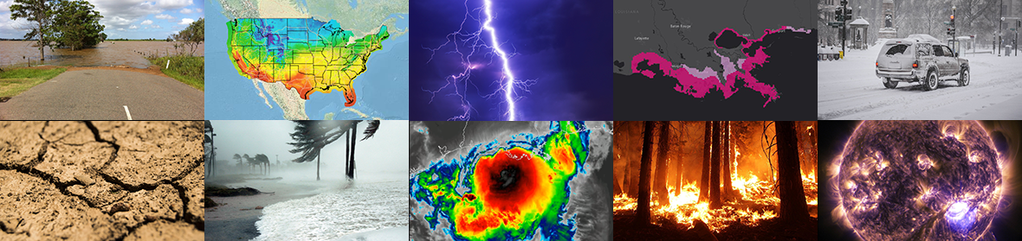
Workshop on Correctness and Reproducibility for Climate and Weather Software 11/9-10/2023
Correctness and reproducibility in UFS weather model CI
Jun Wang^{1*}, Denise Worthen², Dusan Jovic², Sadegh Tabas², Arun Chawla³
¹NOAA/NWS/NCEP/EMC, ²LYNKER@NOAA/NWS/NCEP/EMC, ³TOMORROWIO

Slide 2
Outline
Challenges in UFS weather model CI
Verify correctness and reproducibility of code updates
Future work

Slide 3
UFS weather model: fully coupled earth modeling system
The UFS weather model is open source software supporting both research and operational developments. It contains:
17 authoritative repositories
9 major flagship model components
Community mediator and 9 sharable NUOPC caps
Model infrastructure has been developed as the foundation to build the unified system:
Coupled model prototypes
GFSv17/GEFSv13
RRFSv1
AQMv7
HAFSv1
FV3/JEDI
Marine DA forecast model
UFS driver
HYCOM
WW3
NoahMP
FV3ATM
CICE
CMEPS
FV3dycore
wgc
CCPP
wgc
MOM
CDEPS
GOCART
CMAQ

Slide 4

UFS weather model: Open Source and Open Develop with community
https://github.com/ufs-community/ufs-weather-model
~215 forks
~150 developers
~2000 issues and pull requests
>10K files
4.3M LoC
Support operational and R&D platforms including laptops and Cloud
Close collaboration with entities in UFS community
Courtesy: Sam Trahan

Slide 5
Challenges in UFS Weather model continuous integration (CI)
How to verify the code updates committed to the repository are correct?
Significant amount of code updates every day
UFS applications are built upon shared components, incorrect code changes/bugs can propagate to many applications
Testing framework is incomplete
Missing critical components: unit test, component testing, etc
Heavily relying on regression testing
Implementing and communicating standard codecommit procedure are challenging
Very limited resources

Slide 6
Ensure correctness in UFS Weather model CI
Ensure correctness: code changes/updates produce results scientifically and technically verified
Testing is the key to validate correctness
Three categories of code changes:
Code updates do not change results:
Variable name change, Asynchronous IO, log info …
Verify the results do not change with the code updates
Code changes alter results
Science update/bug fix, technical: compiler/library updates, rewriting code…
Scientific: scientific experiments to verify results are expected
Technical: confirm updates do not change climatology
New features
Implemented as options to minimize impact to other features
Set up new test with feature turned on

Slide 7
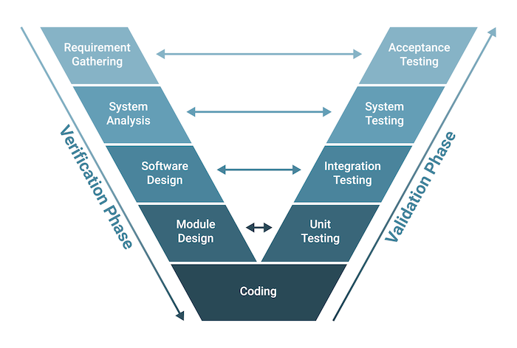
Ensure correctness in UFS Weather model CI (cont.)
Hierarchical testing framework
Major components: unit test, integration test, system test, acceptance test
4 components:
test data generation
test manager
test execution
test monitoring
UFS CI:
Most regression tests are system test
Very limited integration test
Some components have unit test
Acceptance test is delayed to application workflow

Slide 8
UFS Weather model regression test
Test data generation:
Input data for canned cases of all supported applications are saved on Tier-1 platforms and cloud
Results from current regression tests with different compilers are saved as baselines for scientific and technical sanity check
Test manager:
Regression test script to manage all the tests
Test execution:
CI pipelines to automate the RT test on supported platforms
Test monitoring:
Regression test log files for each code integration are committed in the repo
New baselines are saved for next code commit

Slide 9
Supplemental tests for correctness in UFS Weather model CI
Code robustness test (also called ORT/OpnReqTests)
https://github.com/ufs-community/ufs-weather-model/tree/develop/tests/opnReqTests
Debug test: uninitialized variable, NaN, warning message, etc
Reproducibility test: the following tests need to reproduce baseline
Baseline test (run to run reproducibility)
Threading test for computational efficiency
Domain decomposition tests
MPI task test (mini scalability test)
Restart test
The robustness test is applied to existing and new feature tests

Slide 10
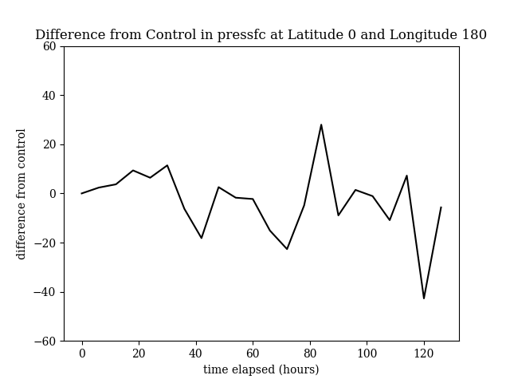
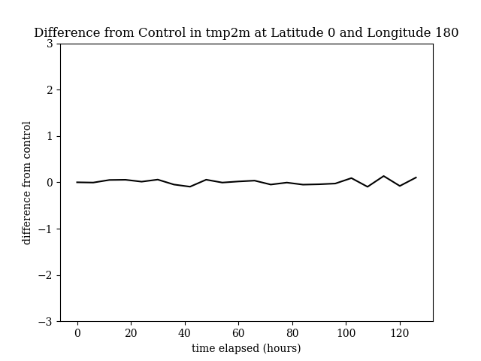
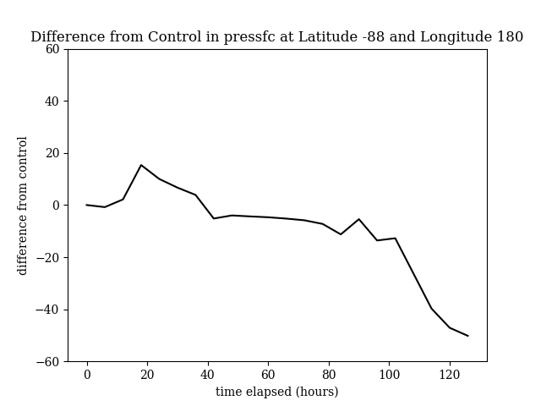
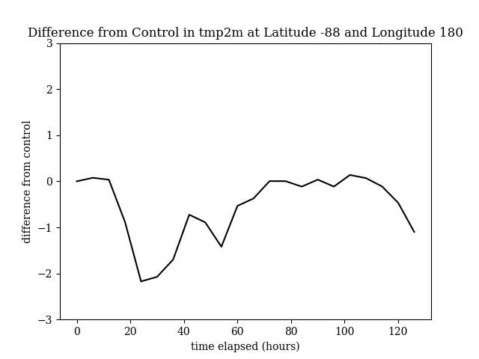
Supplemental tests for correctness in UFS Weather model CI (Cont.)
To verify technical changes that changes results (category 2)
Example: rewriting code, compiler/library updates, platform porting
Butterfly test
Perturb the last bit of the lowest model level temperature IC on a single point
Climatology does not change
PSFC
T2m
near the “butterfly”
far from the “butterfly”

Slide 11
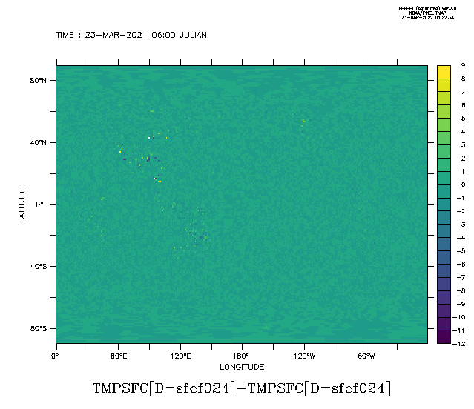
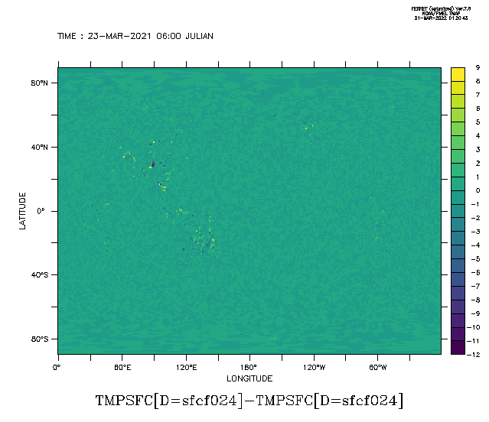
Butterfly test: transition to Intel 2022
Intel2022-cpld_control_p8
Minimum value: -12.169, Maximum value: 9.1198
Mean value: -2.2347E-04, Standard deviation: 0.2563
Butterfly-cpld_control_p8
Minimum value: -12.151, Maximum value: 8.9265
Mean value: -6.1779E-04, Standard deviation: 0.27347

Slide 12
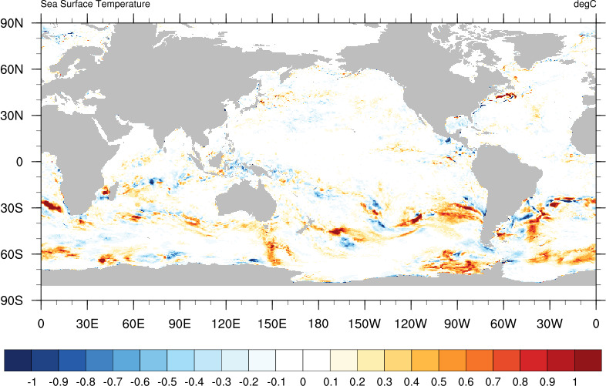
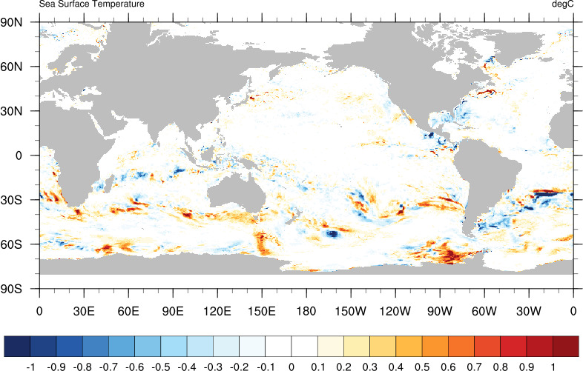
Transition to CMEPS
Transition from in-house NEMS Mediator to CMEPS
Code was rewritten
All the functionalities are maintained in CMEPS
Developed and tested in several earth systems with community
Correctness is verified by comparing the difference between NEMS and CMEPS with the difference between two well tested platforms. Helps ensure robustness across multiple applications
SST difference from NEMS on two platforms
SST difference between CMEPS and NEMS
Notes:
10 day forecast

Slide 13
Verifying the correctness of new features
New feature needs to be tested before the pull request is made
Scientific innovations:
scientific hierarchical testing: SCM test, component test, coupled test
Resolution tests (scale-aware), stability test
Long forecast/extreme event experiments and evaluation using verification tools (METPlus)
End to end system testing in workflow with DA
Technical innovations:
Usually does not require long forecast experiments
Resolution tests, scalability test
May require special tools for evaluation
No change in climatology
Code robust reproducibility test is required

Slide 14
Future work
Co-management UFS weather model with EPIC
Develop Hierarchical test
Unit test
Component test
Integration test
Bridging workflow for acceptance test
Apply Machine Learning to verify code updates that alter results
Unsupervised ML to catch patterns in the control baselines for major prototypes
Verify results from code updates by comparing the patterns and the loss values

Slide 15
Questions?

