Slide 1

DECODE SIH 2026
CITIZENOS
What We Are Building & Why It Matters
TEAM: CTRL+INNOVATE

Slide 2
THE PROBLEM WE
ARE SOLVING
2,000+
THE CORE CHALLENGE
GOVERNMENT SCHEMES
(FRAGMENTED PORTALS)
Citizens — especially in rural areas — cannot find, understand, or apply for the schemes they are eligible for.
65%
They face fragmented portals, complex bureaucratic language, manual eligibility checks, and a complete lack of personal guidance.
RURAL POPULATION
(TARGET AUDIENCE)
Citizens need a personal guide, not a search engine.
35%
RURAL INTERNET
PENETRATION

Slide 3

WHY EXISTING
SOLUTIONS FALL SHORT
MYSCHEME
UMANG
BHASHINI
CITIZENOS
A filter-based search portal.
A mobile app aggregating 1,200+ services.
A translation API framework.
Our proposed solution.
Combines all three capabilities into one intelligent system.
■
×
×
×
Users must manually read eligibility criteria and guess if they qualify.
It is a service launcher, not an advisor.
Translates text and voice, but does not understand government schemes.
Active AI navigator that executes the full citizen journey.
×
■
No eligibility matching logic.
×
×
No personalized scoring.
×
No eligibility engine.
No voice support for non-readers.
×
×
No document intelligence.
No roadmap generation.
Personalized, multilingual, and document-aware.
■

Slide 4
OUR VISION
CITIZENOS
THE CORE VISION
THE PARADIGM SHIFT
CitizenOS is an AI-powered multilingual digital citizen operating system. It acts as a personal government officer for every Indian citizen.
Instead of citizens navigating dozens of fragmented government websites, the AI navigates the systems. The citizen only talks naturally.
WHAT THE AI HANDLES
Detects Language
Verifies Eligibility
Extracts Data via OCR
Explains in Simple Regional Language
Generates Step-by-Step Roadmaps
Locates Nearest CSC
Tracks Application Progress
Drafts Complaints if Needed

Slide 5
HOW IT WORKS
THE CORE PIPELINE
STEP 1
STEP 2
STEP 3
STEP 4
Citizen speaks or types in any language (Hindi, Tamil, Bengali, etc.)
AI detects the language and translates to English for processing.
Hybrid RAG searches 2,000+ schemes using both keywords and meaning.
Knowledge Graph evaluates eligibility across 15+ parameters.
STEP 5
STEP 6
STEP 7
STEP 8
Eligibility Engine scores every applicable scheme with match percentages.
Document Intelligence reads uploaded Aadhaar/PAN and flags issues.
Roadmap Generator creates a step-by-step application plan.
Response is translated back to the citizen's language and spoken aloud.

Slide 6
KEY FEATURES
OVERVIEW
01
02
03
04
VOICE ASSISTANT
INTERACTIVE ELIGIBILITY
DOCUMENT INTELLIGENCE
LIFE EVENT TRACKING
12+ Indian languages via BHASHINI APIs for fully accessible voice interaction.
AI interviews you and scores 2,000+ schemes with personalized match percentages.
OCR reads your documents and automatically flags missing or expired items.
On marriage, birth, or graduation, the system auto-recommends necessary ID updates.
05
06
07
08
ROADMAP GENERATOR
SCAM DETECTOR
OFFLINE MODE
WHATSAPP & IVR
Creates a step-by-step execution plan to the nearest Common Service Centre.
Verifies URLs against official government domains to protect against phishing.
Works with poor internet connectivity, specifically designed for rural areas.
Allows interaction via familiar channels. No dedicated app install needed.

Slide 7
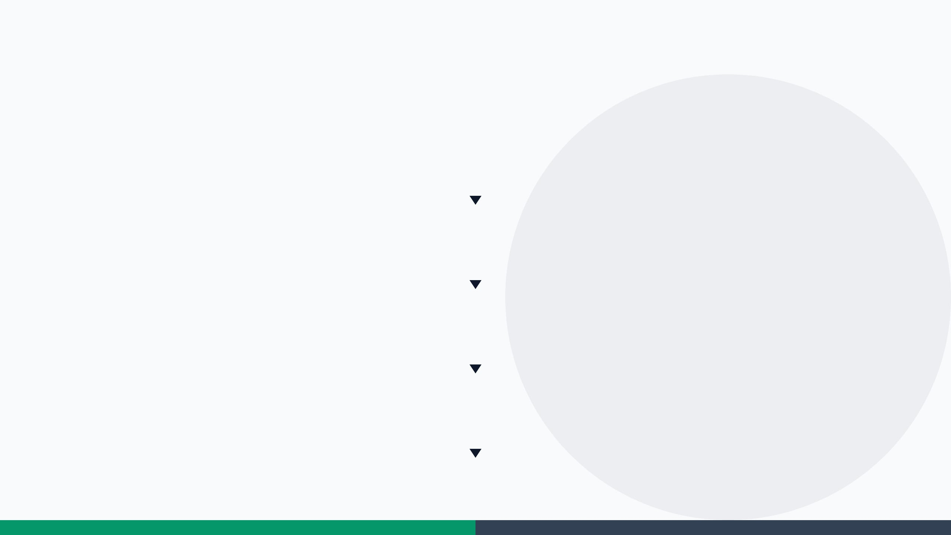
ARCHITECTURE
AT A GLANCE
LAYER 1 — USER INTERFACE
Web App
WhatsApp Bot
SMS Mode
LAYER 2 — AI GATEWAY
Voice Input
BHASHINI ASR
Language Detection
Translation
LAYER 3 — INTELLIGENCE CORE
Hybrid RAG
Knowledge Graph
Eligibility Engine
PaddleOCR
LAYER 4 — OUTPUT
Recommendations
Roadmap
Scam Detection
Voice Response
LAYER 5 — DATA
PostgreSQL
Qdrant
Government Knowledge Graph
Infrastructure: Vercel | Railway / Render | Docker

Slide 8
THE FARMER'S JOURNEY
(DEMO SCENARIO)
1
Voice Input: A farmer named Ramesh from Rajasthan speaks in Hindi: "I am a farmer, what help can I get?"
2
AI Processing: The AI detects Hindi, identifies PM-KISAN and crop insurance eligibility.
Document Intelligence: Ramesh uploads his Aadhaar card. The AI extracts details and detects a missing income certificate.
3
Guided Action: The AI explains the process in simple Hindi and locates the nearest Common Service Centre (CSC).
4
Comprehensive Support: The AI creates a checklist. Later, when Ramesh has a billing issue, the AI drafts a complaint to the correct department.
5
This is one complete journey — and CitizenOS handles all of it.

