Slide 1

DECODE SIH 2026
CITIZENOS
Technical Architecture & Implementation Guide
FOR DEVELOPMENT TEAM & DOCUMENTATION TEAM
Team: Ctrl+Innovate

Slide 2
SYSTEM OVERVIEW
Voice/Text
Input
Language
Detection
Translation
Hybrid
RAG
Knowledge
Graph
Eligibility
Engine
Roadmap
Generator
Voice/Text
Response
→
→
→
→
→
→
→
CitizenOS is an AI-powered multilingual digital citizen operating system. It acts as a personal government officer for every Indian citizen, handling scheme discovery, eligibility verification, document intelligence, application guidance, and progress tracking across 2,000+ government schemes.

Slide 3
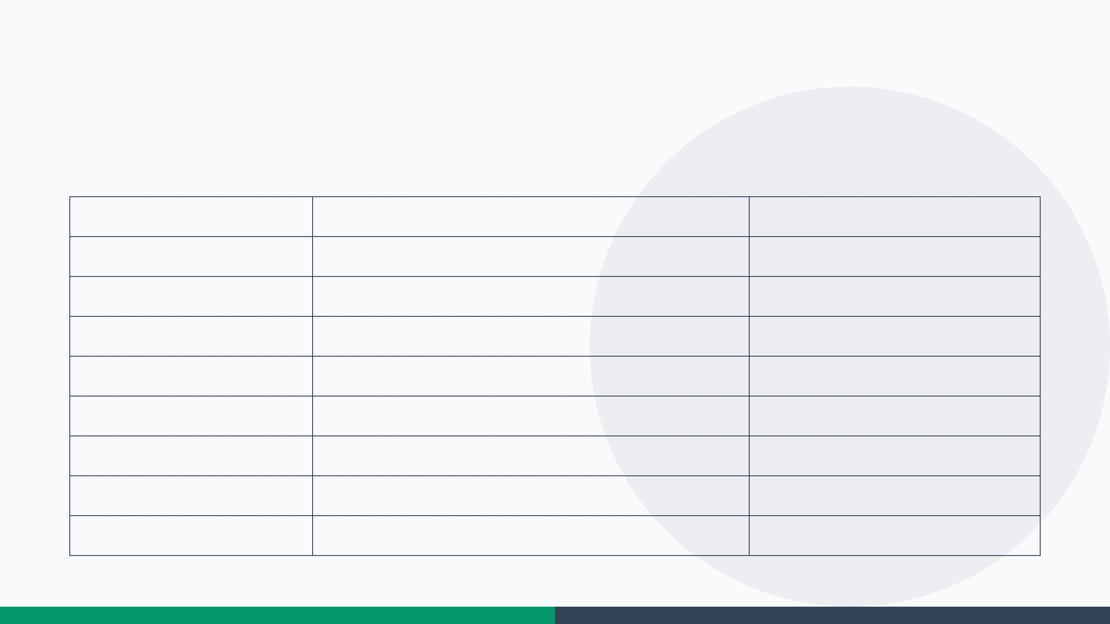
TECHNOLOGY STACK
COMPONENT
TECHNOLOGY
PURPOSE
Frontend
Next.js, TypeScript, Tailwind CSS, shadcn/ui
Responsive UI, accessible design
Backend
FastAPI (Python)
High-performance AI integration
Database
PostgreSQL + Qdrant
Relational + vector storage for RAG
AI Orchestration
LangGraph + LangChain
Agent pipelines, state machines
LLM
Gemini 2.5 / GPT-4
Complex reasoning for eligibility
Embeddings
BGE-M3
100+ languages, 8192 token context
OCR
PaddleOCR 3.0
96.3% accuracy, 80+ languages
Translation
BHASHINI APIs
Gov-backed ASR/TTS/Translation
Deployment
Vercel + Railway/Render + Docker
Scalable cloud infrastructure

Slide 4
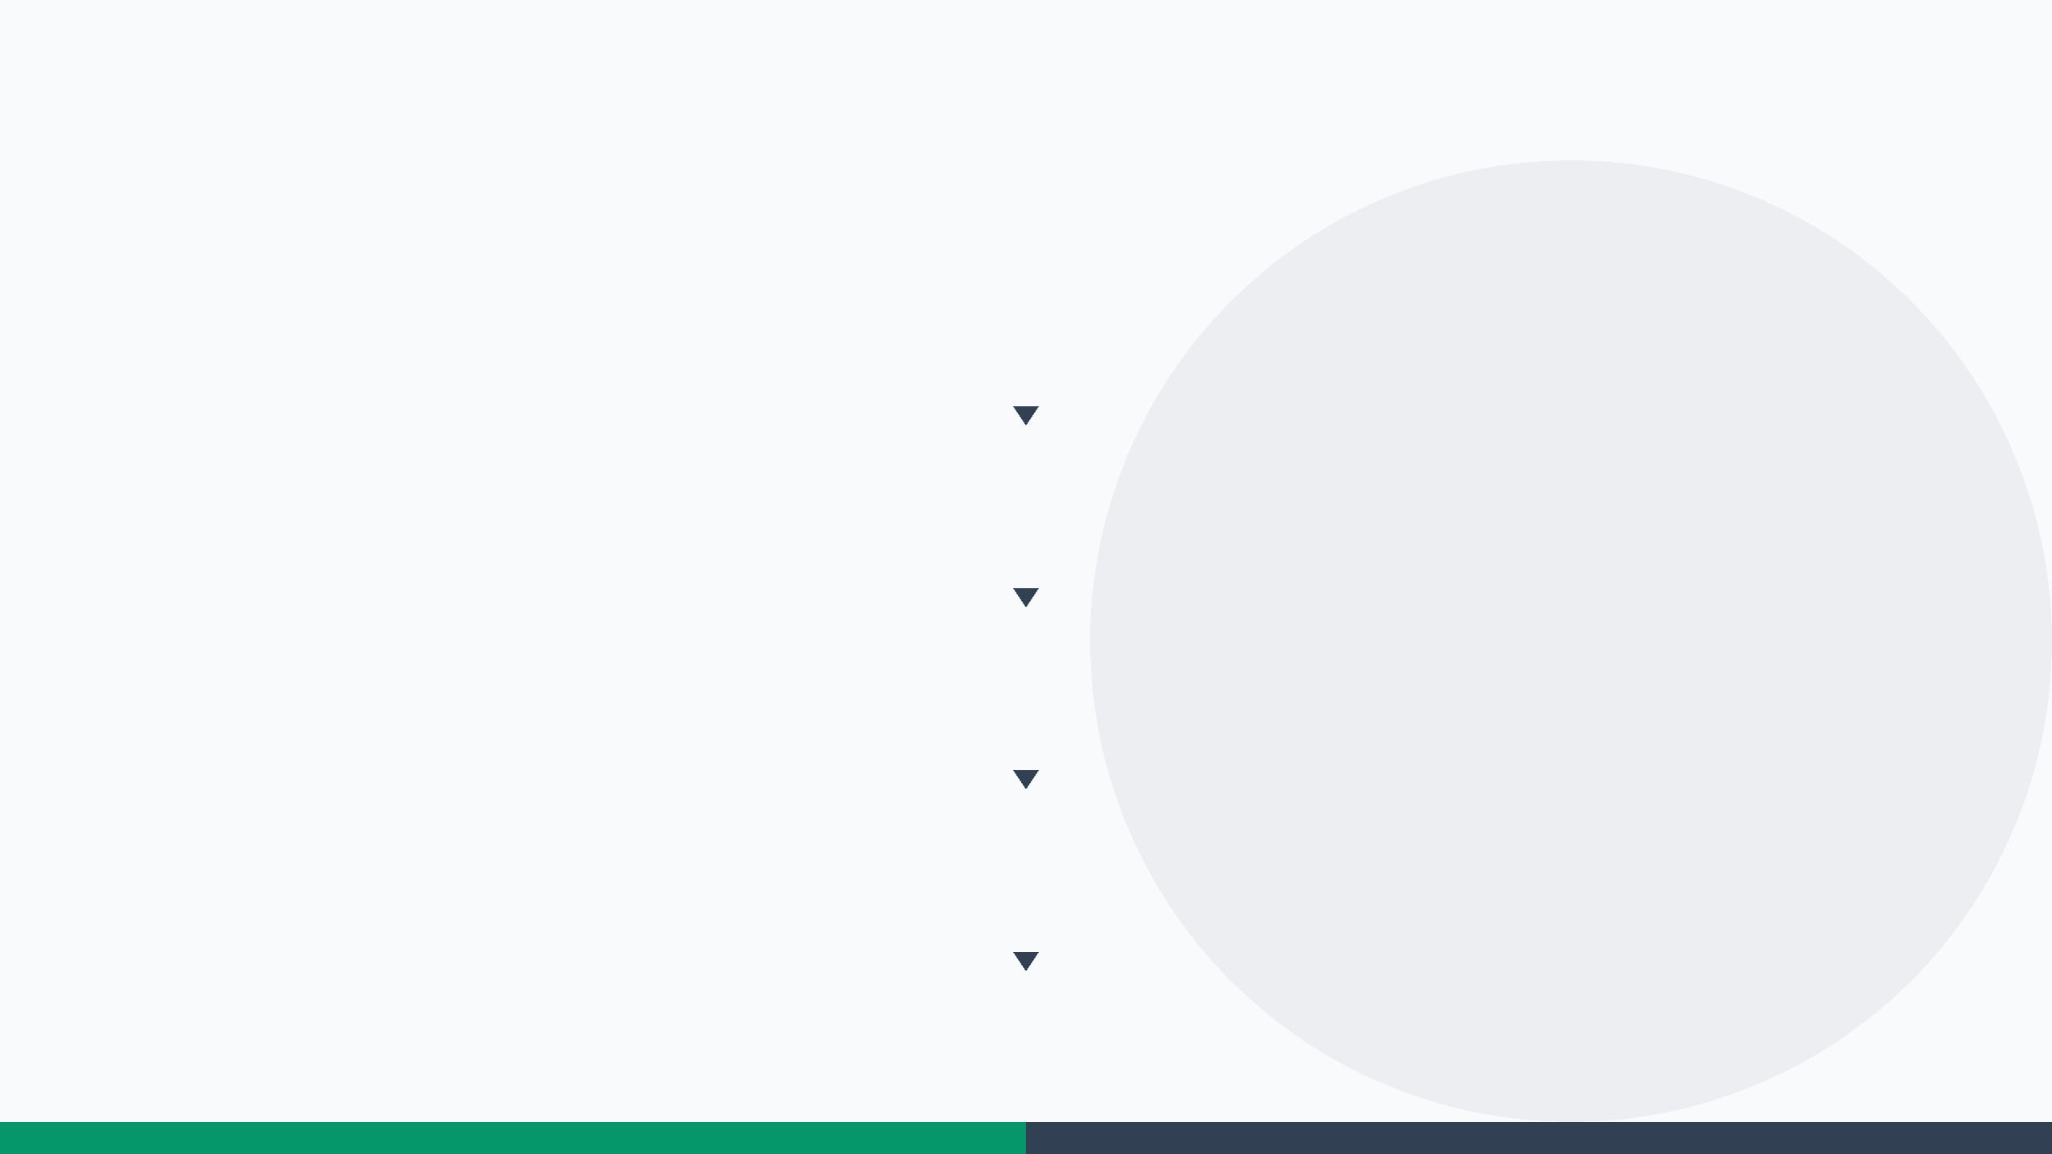
ARCHITECTURE FLOW
LAYER 1 — USER INTERFACE
Web App (Next.js)
WhatsApp Bot
IVR Phone Line
Offline SMS Mode
LAYER 2 — AI GATEWAY
Voice Input
Whisper / BHASHINI ASR
Language Detection
BHASHINI Translation
LAYER 3 — INTELLIGENCE CORE
Hybrid RAG Engine
Qdrant Vector DB
Knowledge Graph
Eligibility Engine
PaddleOCR
LAYER 4 — OUTPUT & ACTION
Personalized Recommendations
Step-by-Step Roadmap
Scam Detection
Complaint Drafting
BHASHINI TTS
LAYER 5 — DATA LAYER
PostgreSQL
Qdrant
Govt Knowledge Graph
Infrastructure: Vercel CDN | Railway / Render | Docker Containers

Slide 5
CORE AI MODULES
PART 1: KNOWLEDGE & RAG
GOVERNMENT KNOWLEDGE GRAPH
HYBRID RAG ENGINE
Every scheme converted to a structured object with 15+ attributes (Name, Description, Eligibility, Income Limit, Age, State, Documents, Benefits, Deadline, Department, FAQs, Application Process).
Vector Search: Uses BGE-M3 embeddings for semantic similarity.
■
■
Metadata Filtering: Filters by State, Department, and Category before retrieval.
■
Enables relational querying and inferencing across complex criteria.
■
Knowledge Graph Integration: Combines structured data with unstructured text retrieval.
■
Allows the AI to reason over data relationships rather than just matching keywords.
■
Eliminates LLM hallucinations.
DEV IMPLEMENTATION FLOW
■
PaddleOCR (Extract Scheme PDFs) → LangChain (Text Splitter) → BGE-M3 (Embedding) → Qdrant (Storage) → LangGraph (Retrieval Chain)

Slide 6
CORE AI MODULES
PART 2: IMPLEMENTATION
ELIGIBILITY ENGINE
DOCUMENT INTELLIGENCE
Conducts a multi-turn conversational interview with the citizen.
Uses PaddleOCR to extract data from uploaded documents (Aadhaar, PAN, Income Certificate).
■
■
Captures 8+ parameters: Age, Income, Occupation, Category, Gender, Education, Disability, State.
Detects missing documents required for specific schemes.
■
■
Evaluates the profile against all 2,000+ schemes in the Knowledge Graph.
Identifies expired certificates, blurry scans, or wrong formats.
■
■
Outputs personalized match percentages (e.g., PM-KISAN: 98%).
Auto-populates form fields based on extracted data.
■
■
DEV IMPLEMENTATION
DEV IMPLEMENTATION
Needs a backend endpoint for file upload, processing pipeline, and field mapping logic.
Requires a state machine to manage the multi-turn conversation context.
Document upload endpoint → PaddleOCR extraction → Field mapping → Validation rules engine
LangGraph state machine with multi-turn conversation nodes → Rule engine evaluation → Score generation

Slide 7
CORE AI MODULES
PART 3: IMPLEMENTATION
ELI10 & VOICE TRANSLATION
LIFE EVENT ENGINE
Translates complex bureaucratic language to simple regional language.
Creates a holistic "Family Wallet" profile.
■
■
On life event (marriage, birth, graduation), recommends ID updates and new schemes.
■
Provides optional voice explanations for non-readers.
■
Dev: LLM prompt with strict tone constraint (e.g., "Explain like I'm 10").
Dev: Event-triggered rule engine monitoring user profile changes.
ROADMAP GENERATOR
SCAM DETECTOR
Generates step-by-step execution plans (e.g., Visit CSC → Carry docs → Fill form).
URL verification against official government domain database.
■
■
Locates the nearest application center.
Protects users from phishing and fake portals.
■
■
Dev: Templated workflow generator based on scheme metadata.
Dev: Domain whitelist check + regex pattern matching.

Slide 8
ADVANCED DELIVERY
CHANNELS
VOICE ASSISTANT
WHATSAPP & IVR
Tech: BHASHINI APIs (ASR & TTS)
Tech: WhatsApp Webhooks + Twilio IVR integration.
■
■
Feature: Full support for 12+ Indian languages.
Feature: No app install needed.
■
■
Target: Accessible for illiterate or visually impaired citizens.
Target: Crucial for non-smartphone users.
■
■
OFFLINE MODE
NEARBY OFFICE FINDER
Tech: Service Worker + IndexedDB.
Tech: Geo-location + Google Maps API.
■
■
Feature: Cached scheme data + offline eligibility checks.
Feature: Locates CSCs, Aadhaar Centers, Tehsil offices.
■
■
Target: Designed for rural areas with poor connectivity.
Target: Guides users to the nearest physical application point.
■
■
DIGILOCKER INTEGRATION
IMPLEMENTATION STRATEGY
Tech: OAuth2 token flow + API fetch.
Build a unified API layer on the backend.
■
■
Feature: Auto-verifies documents without manual upload.
All channels must share the same RAG and Eligibility engines.
■
■
Target: Reduces friction in the application process.
■
Ensure consistent state management across web, WhatsApp, and IVR.
■

Slide 9
DOCUMENTATION
REQUIREMENTS
MODULE & API DOCUMENTATION
DATA SCHEMA
Module Docs: Each AI module needs a separate doc page with input/output specs, error codes, and example payloads.
Knowledge Graph Schema: Document the 15+ attributes per scheme (Name, Eligibility, Income Limit, etc.).
■
■
User Profile Schema: Define the fields for age, income, occupation, etc.
■
API Docs: REST endpoints for all services (eligibility, OCR, translation, roadmap, scam detection).
■
Family Wallet Schema: Structure for multi-generational household profiles.
■
Format: OpenAPI/Swagger format for easy integration.
■
USER GUIDE
CONTRIBUTOR GUIDE
Primary Walkthrough: The "Farmer's Journey" scenario must be documented step-by-step.
Instructions on how to add new government schemes to the Knowledge Graph.
■
■
Include screenshots or UI mockups for each step of the user journey.
Procedures for updating eligibility criteria and application links.
■
■
Highlight key features like Voice Input, Document Upload, and Roadmap Generation.
Steps to add new language support via BHASHINI integration.
■
■
Guidelines for maintaining data accuracy and avoiding hallucinations.
■

Slide 10
IMPLEMENTATION
ROADMAP
PHASE 1
(WEEK 1-2)
Setup repo & boilerplate
Deploy FastAPI + Next.js
Integrate BHASHINI APIs
■
■
■
PHASE 2
(WEEK 3-4)
Build Knowledge Graph pipeline
Implement Hybrid RAG
Setup Qdrant vector DB
■
■
■
PHASE 3
(WEEK 5-6)
Eligibility Engine (LangGraph)
Document Intelligence (PaddleOCR)
Multi-turn state machines
■
■
■
PHASE 4
(WEEK 7-8)
Advanced channels (WhatsApp, IVR)
Offline Mode & Nearby Finder
Life Event & Scam Detector
■
■
■
PHASE 5
(WEEK 9-10)
UI polish & UX testing
Deployment (Vercel + Railway)
Final code optimization
■
■
■
DOC TEAM
Phase 1: Start API docs (OpenAPI/Swagger)
Phase 3: Module docs (Inputs, Outputs, Errors)
Phase 5: User Guide (Farmer's Journey)
PARALLEL
■
■
■

