Slide 1
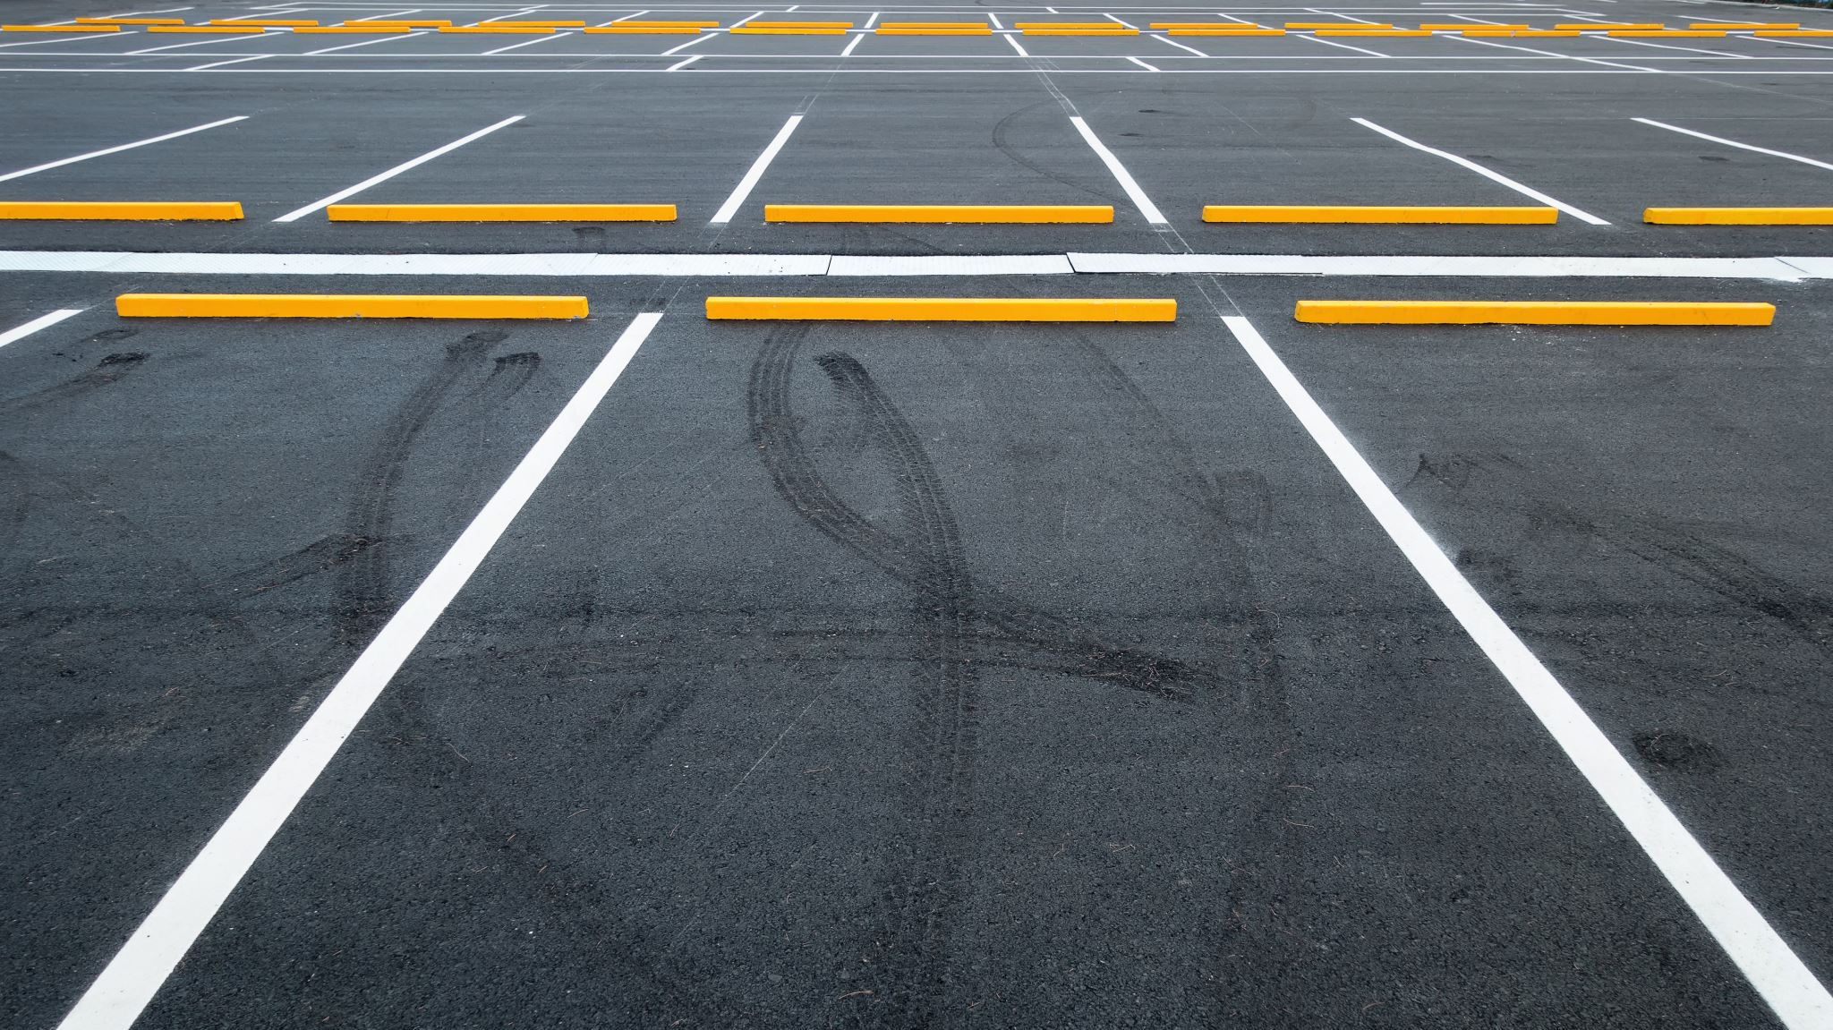
Automated Car Parking Ssytem
Presented By: Haider Ali

Slide 2
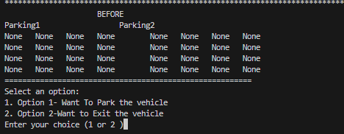
Automatic Car Parking System
Overview
The Automatic Car Parking System is designed to efficiently manage vehicle parking and exiting within a parking lot. The codebase consists of Python scripts leveraging JSON data for parking slot management.
The system is designed for two parking lots i.e., Parking1 and Parking2. Each of the Parking lots consists of 16 slots in 4X4 format.
Two Options are available in this Parking System:
Entrance Mood
Exit Mood
The Last Row of Parking1 and Parking2 can only be utilized in the Exit Mood.
No Car can Enter in the last Row of Parking1 and Parking2 in the Entrance Mood
1. Loading and Displaying Parking Data:
The code begins by loading parking data from a JSON file and displaying it in a tabular format. This provides an overview of the current parking status before any operations are performed.
2. Displaying Menu Options:
The display_menu() function presents the user with options to either park a vehicle or exit a vehicle from the parking lot.

Slide 3
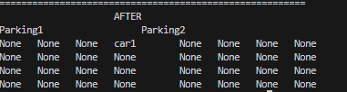
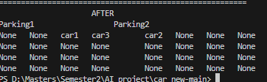

Parking a Vehicle
Calculate the total empty slots in Parking 1 and Parking 2 and Check the Total No. of Empty slots greater than “3”
1st car entry
Row:1
Row:2
Checking Empty values Row wise in Parking1 and Parking 2.
Row:3
Row:4
Checking Row is not the last Row.
^{3rd} car entry
^{2nd} car entry
Checking in which Parking(1 or 2) Row wise, Empty Slot is greater.
Insert the vehicle in that Row of parking(1 or 2) and move the other vehicles to one step(index)

Slide 4
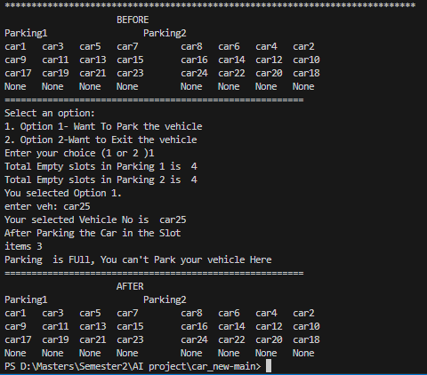
When parking is Full

Slide 5
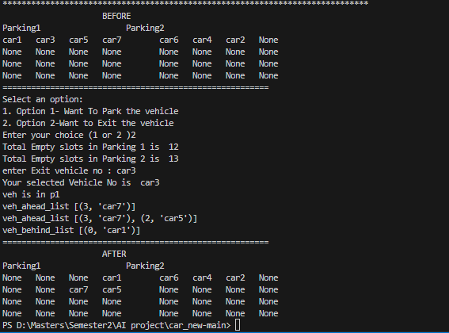
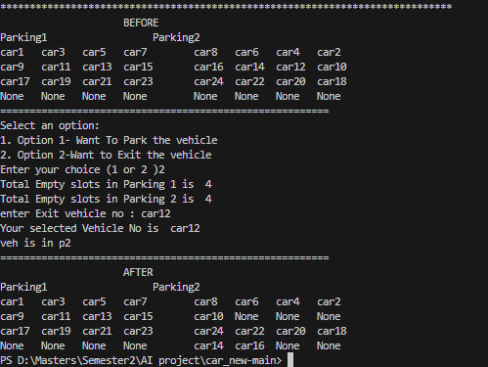
Exit a Vehicle
Checking the vehicle No. and Indexes, ahead and Behind the Required Vehicles to be Removed and stored in two separate list
Yes
Checking the Exit Vehicle’s Index is equal to the First Index for Parking1 and last Index for Parking2
v
Remove the Vehicle
No
Finding the Location of Vehicle. i.e., Parking lot No, Row No, and Column No
Moving the Remaining vehicle in that Row one step Behind in case of Parking2
and In case of Parking1, one step ahead
Vehicles need to move to Empty slot
vehicle wants to Exit
Iteration Over the length of Vehicle list Behind in Case of Parking2
e.g car16 and car14
Empty Slots where car14 and car16 will be moved
Finding the Nearest Empty position. i.e., Parking lot No. , and Row No
Moving the Remaining vehicle in that Row in case of Parking2
Remove/Exit the Vehicle
Inserting the vehicles in the Vehicle list Behind into the available Empty slots found in the previous step

Slide 6

Thank You

Slide 7
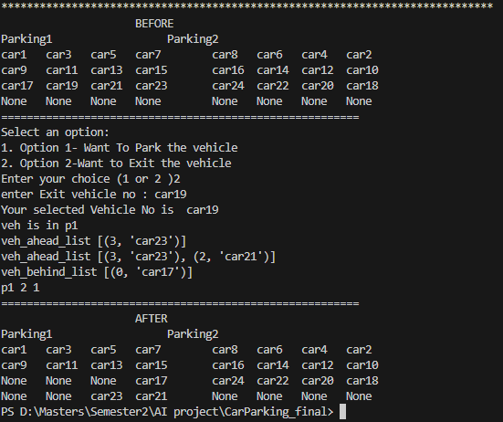

Slide 8
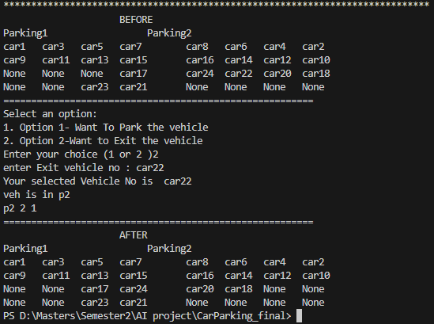

Slide 9
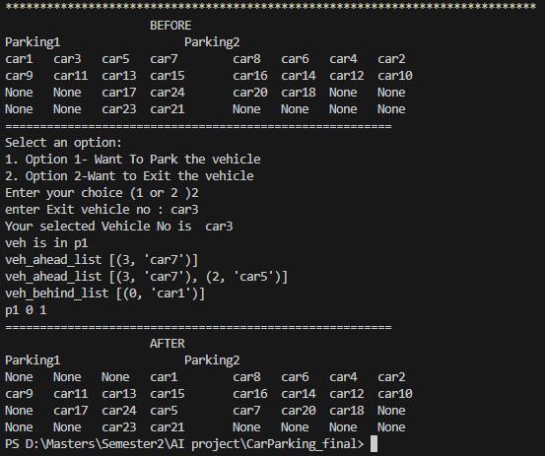

Slide 10
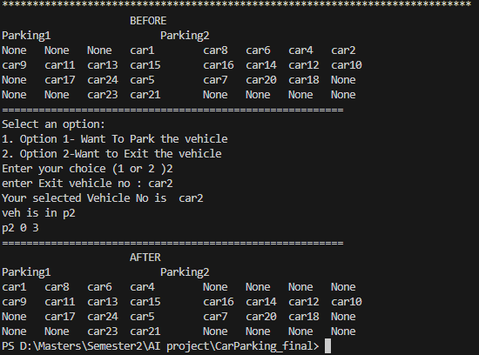

Slide 11
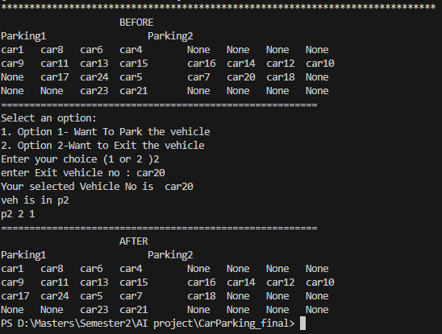

Slide 12
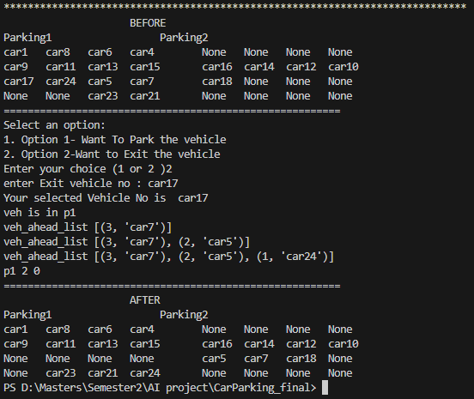

Slide 13
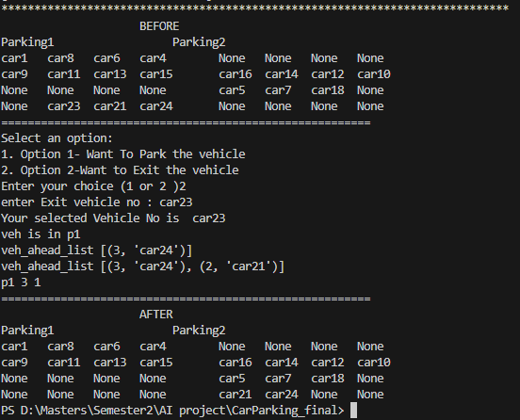

Slide 14
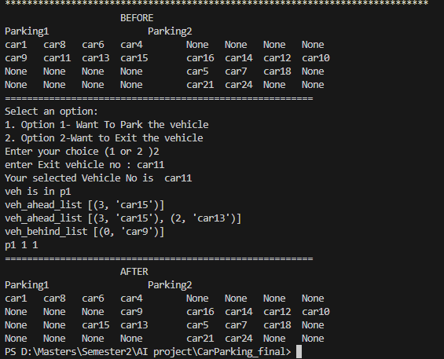

Slide 15
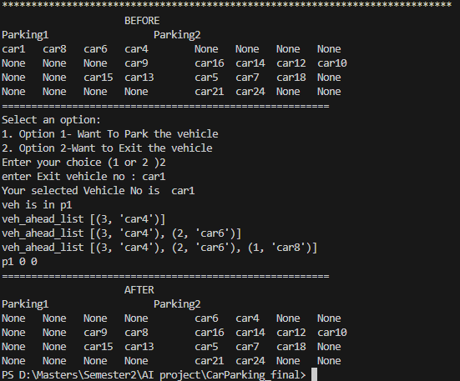

Slide 16
