Slide 1
Chapter 21
Multicast
Routing

Slide 2
    21-1 INTRODUCTION
In this section, we first discuss,
General ideas behind unicasting, multicasting, and broadcasting.
Some basic issues in multicast routing.
multicasting routing protocols in the Internet.
IGMP
21.<number>
Notes:
21.#

Slide 3
221.21.1 Unicasting
In unicasting, there is one source and one destination network. The relationship between the source and the destination network is one to one. Each router in the path of the datagram tries to forward the packet to one and only one of its interfaces.
21.<number>
Notes:
21.#

Slide 4
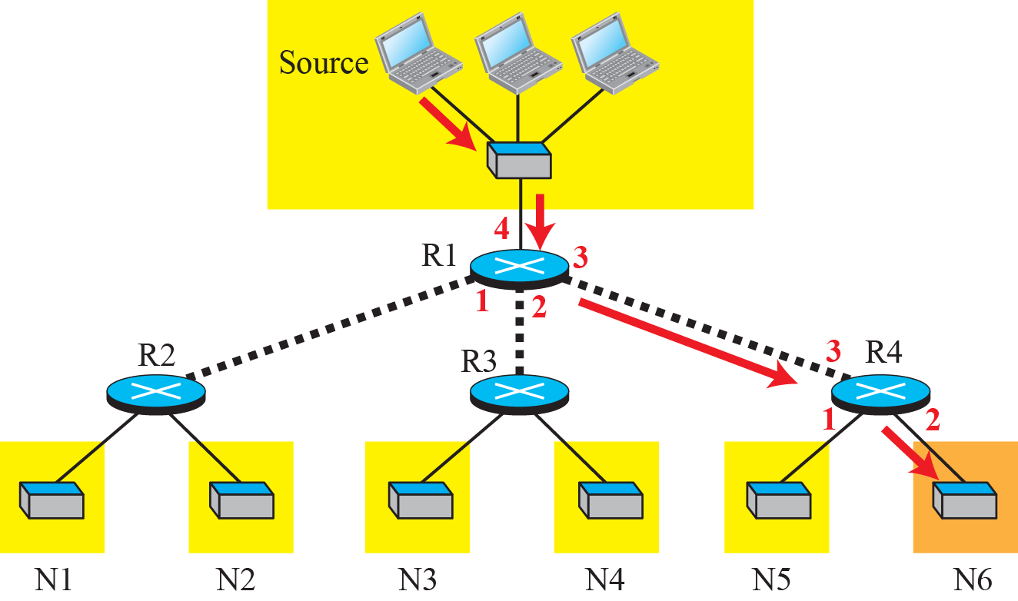
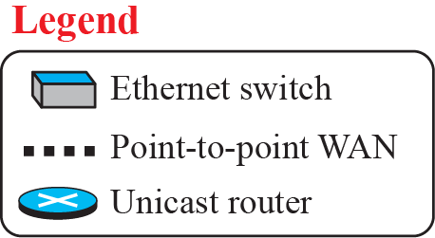

Figure 221.1: Unicasting
21.<number>
Notes:
21.#

Slide 5
20.21.2 Multicasting
In multicasting, there is one source and a group of destinations. The relationship is one to many.
In this type of communication, the source address is a unicast address, but the destination address is a group address, a group of one or more destination networks in which there is at least one member of the group that is interested in receiving the multicast datagram.
The group address defines the members of the group.
21.<number>
Notes:
21.#

Slide 6
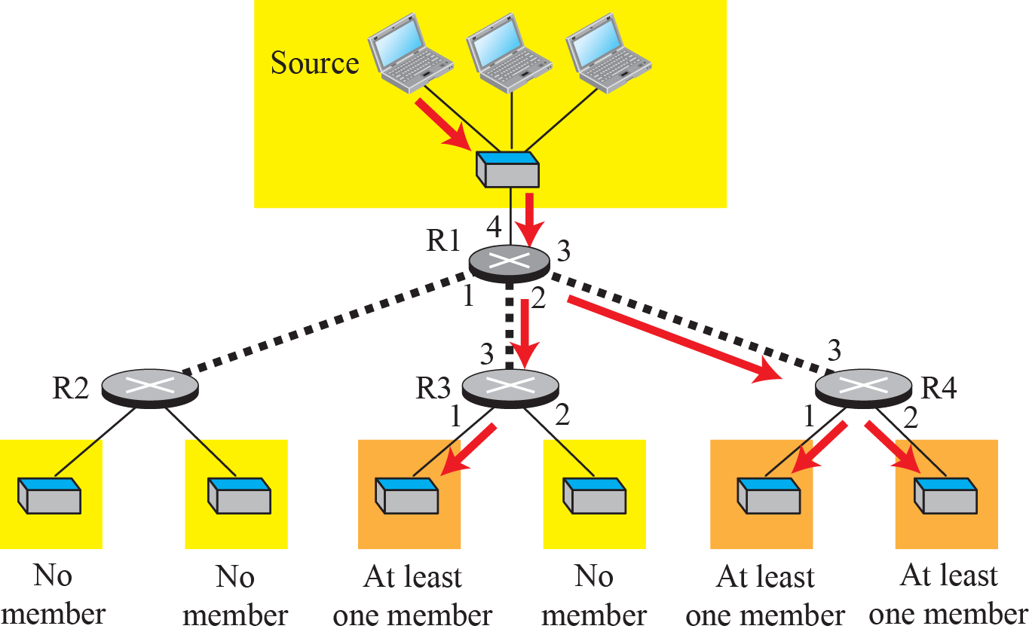
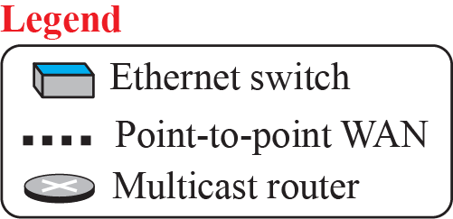
Figure 221.2: Multicasting
21.<number>
Notes:
21.#

Slide 7
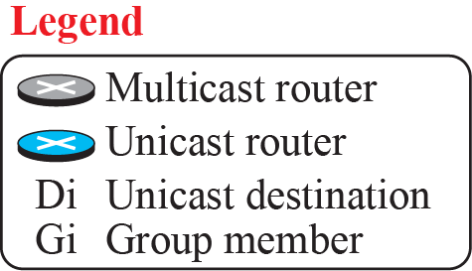
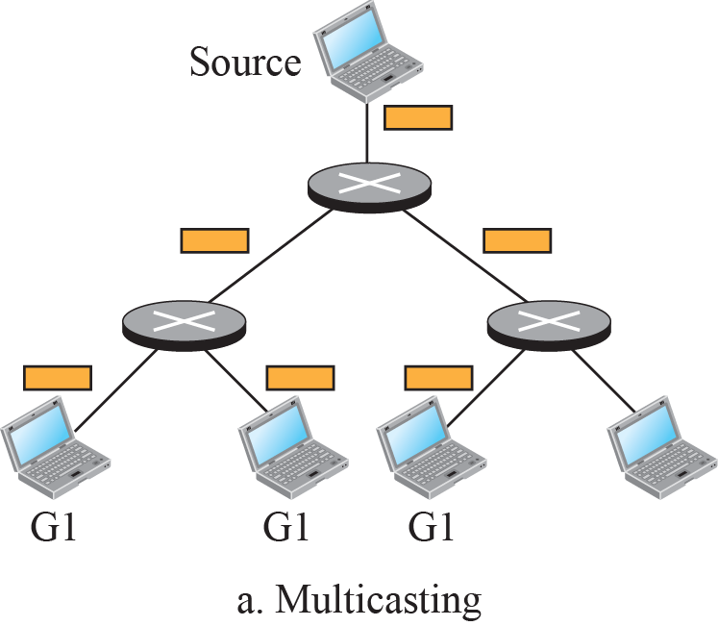
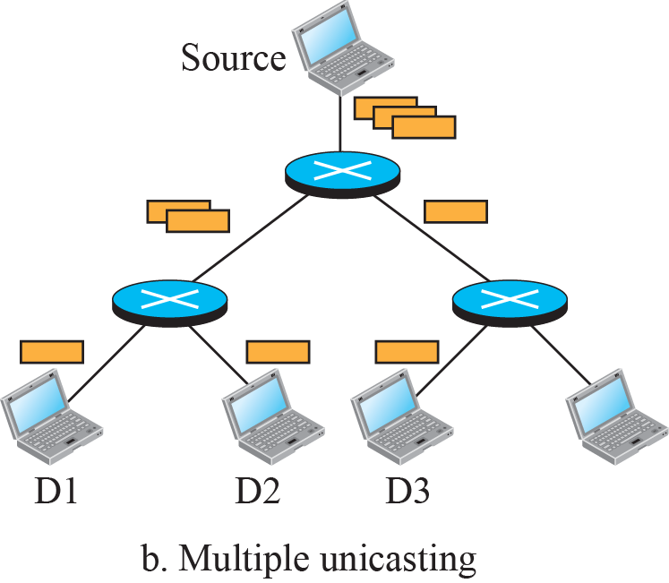
Figure 221.3: Multicasting versus multiple unicasting
21.<number>
Notes:
21.#

Slide 8
    21-1 MULTICAST BASICS
Before discussing multicast routing protocols in the Internet, we need to discuss some multicasting basics: multicast addressing, collecting information about multicast groups, and multicast optimal trees.
21.<number>
Notes:
21.#

Slide 9
221.2.1 Multicast Addresses
In multicast communication, the sender is only one, but the receiver is many, sometimes thousands or millions spread all over the world. It should be clear that we cannot include the addresses of all recipients in the packet.
The destination address of a packet, as described in the Internet Protocol (IP) should be only one. For this reason, we need multicast addresses.
A multicast address defines a group of recipients, not a single one. In other words, a multicast address is an identifier for a group.
21.<number>
Notes:
21.#

Slide 10
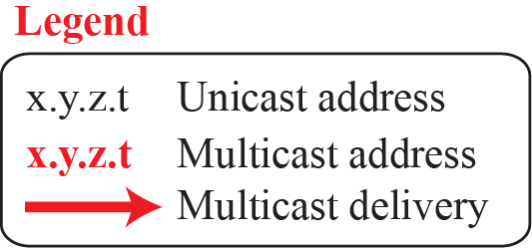
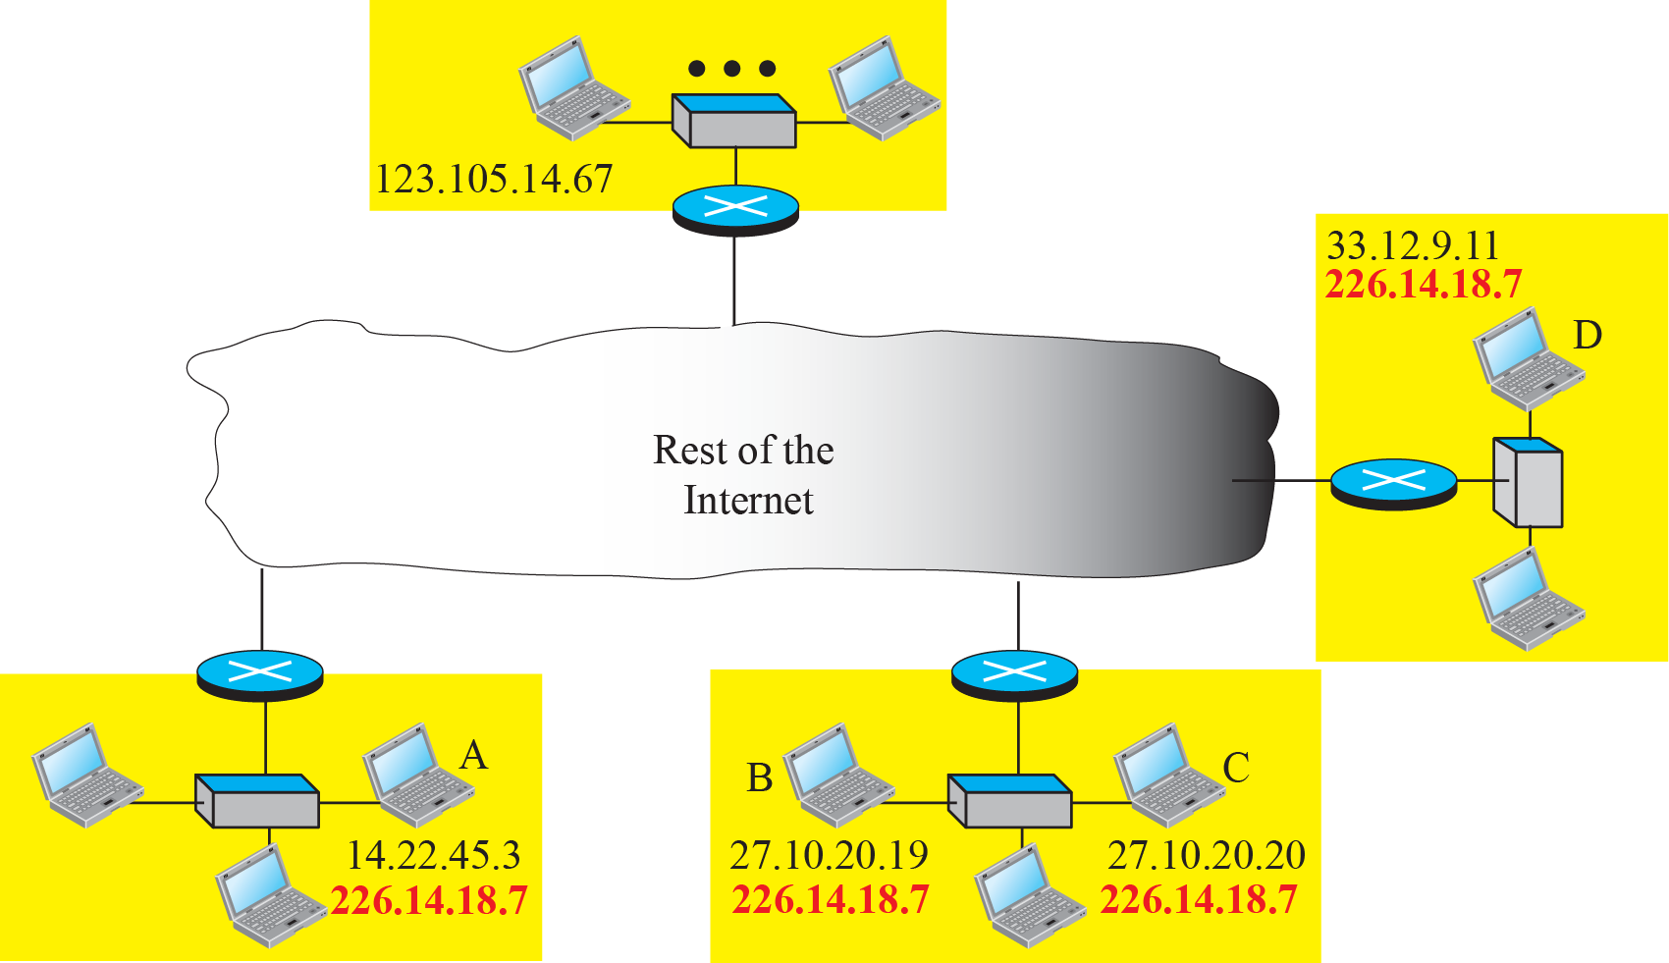
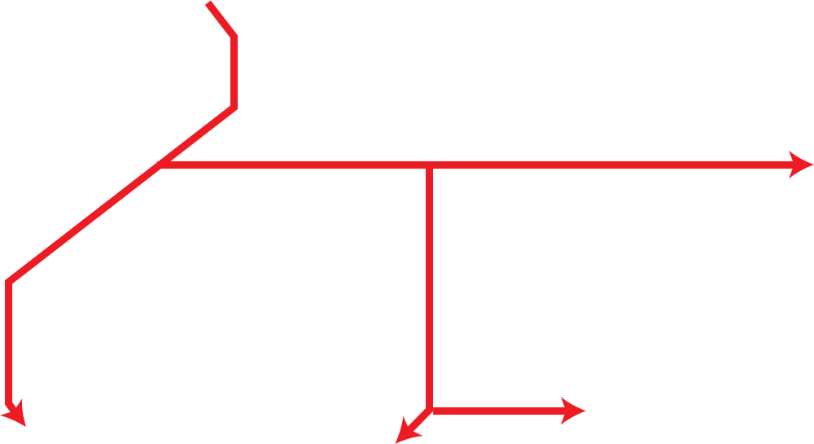
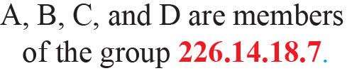
Figure 221.4: Needs for multicast addresses
21.<number>
Notes:
21.#

Slide 11

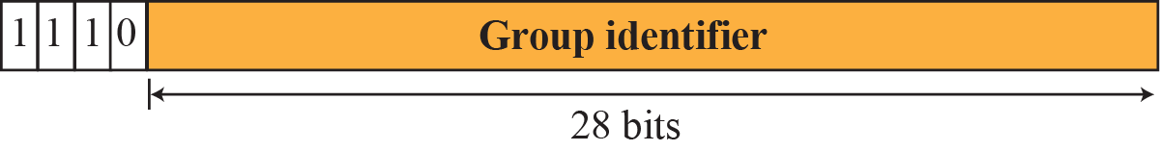
Figure 221.5: A multicast address in binary
21.<number>
Notes:
21.#

Slide 12
Delivery at Data Link Layer
Corresponding ARP protocol cannot find corresponding multicast MAC Address to forward a multicast packet at data link layer.
It depends on underlying data link layer supports physical multicast addresses.
21.<number>

Slide 13
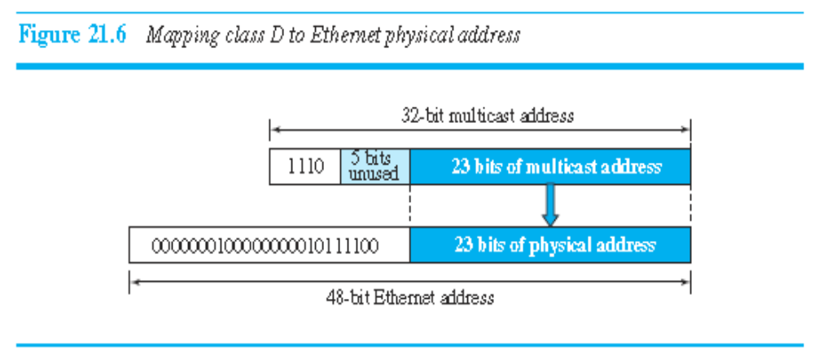
Network with Multicast Support
An Ethernet multicast physical address is in the range
01:00:5E:00:00:00 to 01:00:5E:7F:FF:FF
21.<number>

Slide 14
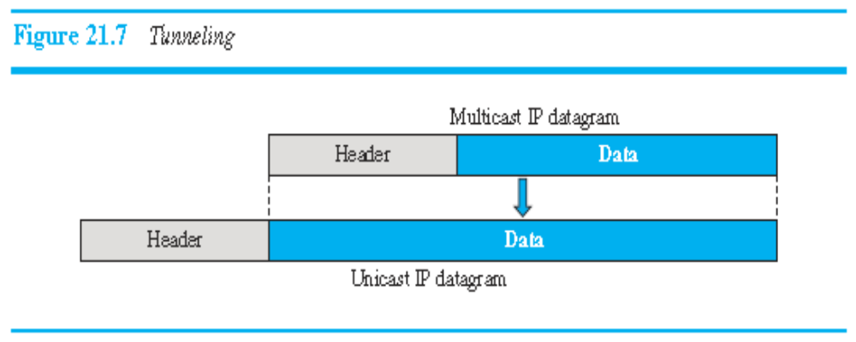
Network with No multicast Support
21.<number>

Slide 15
221.2.3 Collecting Information
Creation of forwarding tables in both unicast and multicast routing involves two steps:
A router needs to know to which destinations it is
connected.
2. Each router needs to propagate information obtained in the first step to all other routers so that each router knows to which destination each other router is connected.
21.<number>
Notes:
21.#

Slide 16
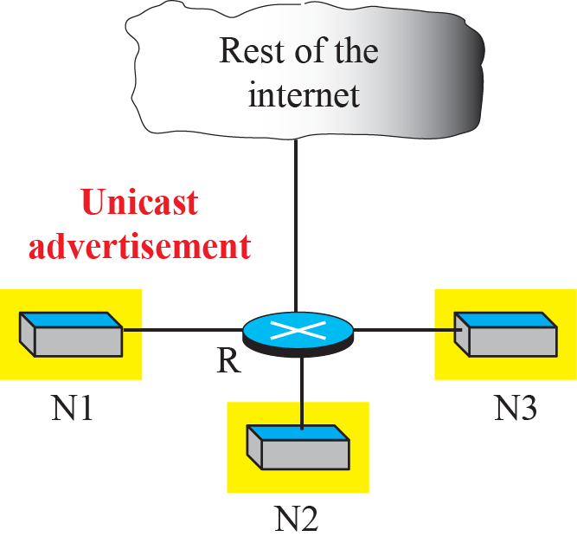
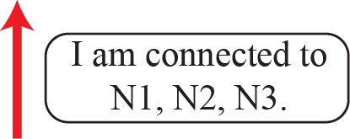
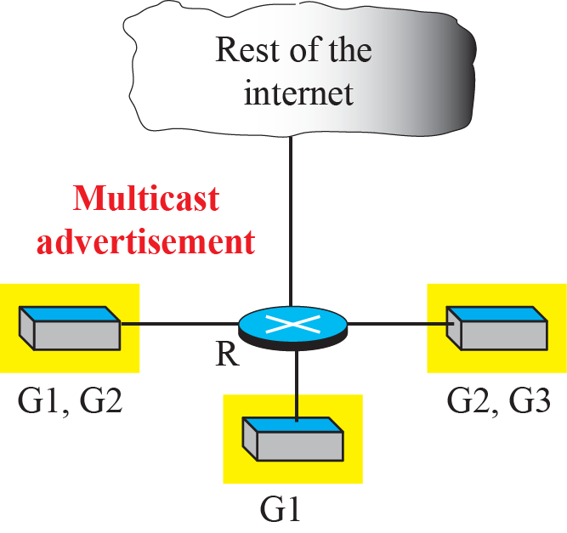
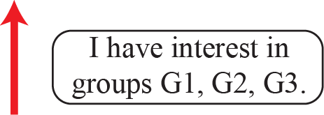
Figure 221.8: Unicast versus multicast advertisement
21.<number>
Notes:
21.#

Slide 17
221.2.4 Multicast Forwarding
Another important issue in multicasting is the decision a router needs to make to forward a multicast packet. Forwarding in unicast and multicast communication is different.
21.<number>
Notes:
21.#

Slide 18
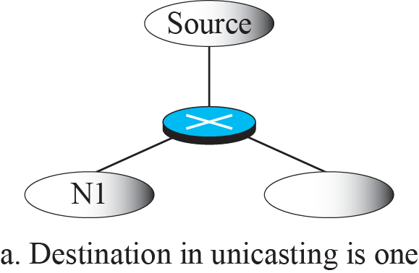


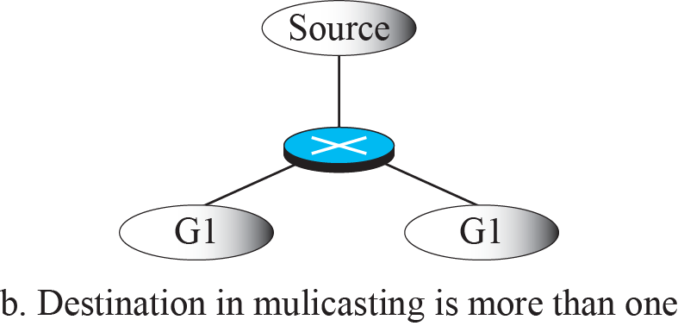

Figure 221.9: Destination in unicasting and multicasting
21.<number>
Notes:
21.#

Slide 19
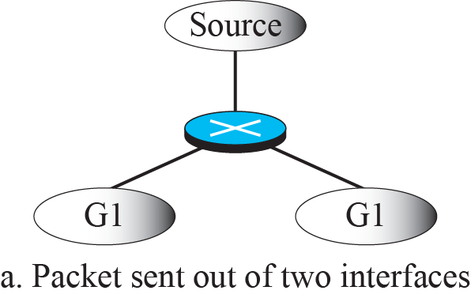



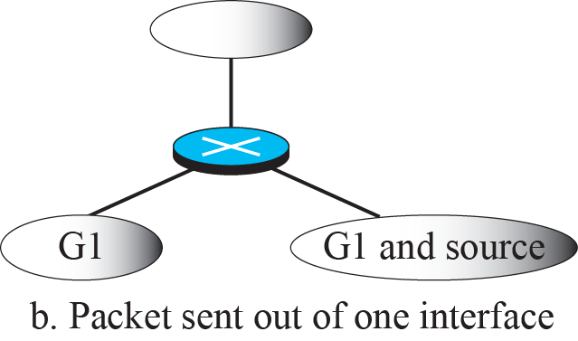

Figure 221.10: Forwarding depends on the destination and the source
21.<number>
Notes:
21.#

Slide 20
221.2.5 Two Approaches to Multicasting
In multicast routing, as in unicast routing, we need to create routing trees to optimally route the packets from their source to their destination. However, as we discussed before, the multicast routing decision at each router depends not only on the destination of the packet, but also on the source of the packet. The involvement of the source in the routing process makes multicast routing much more difficult than unicast routing. For this reason, two different approaches in multicast routing have been developed: routing using source-based trees and routing using group-shared trees.
21.<number>
Notes:
21.#

Slide 21
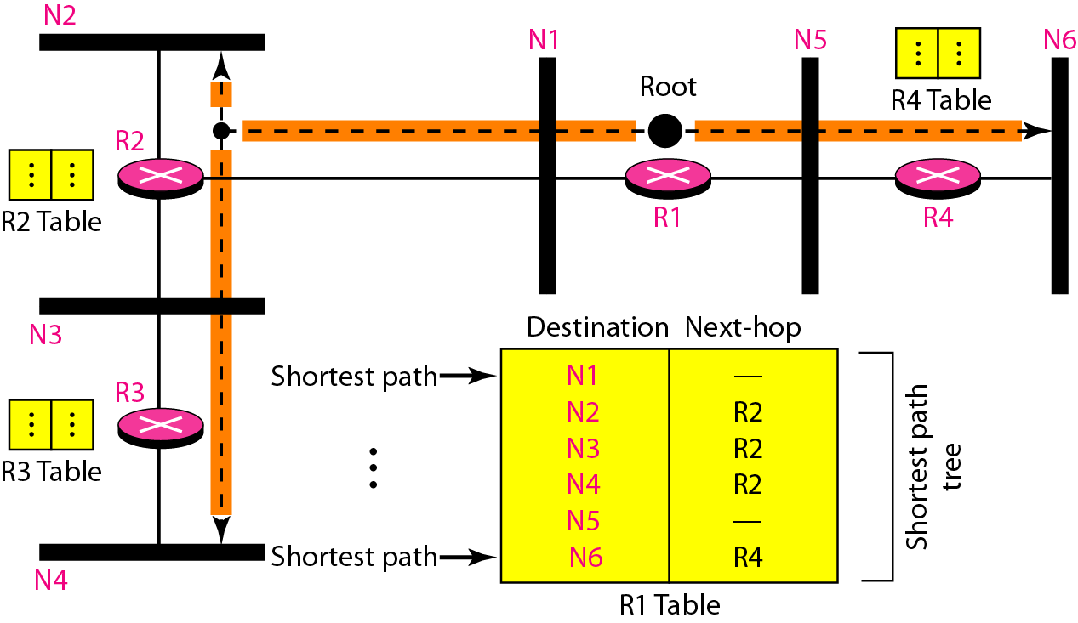
Shortest path tree in unicast routing
22.<number>

Slide 22
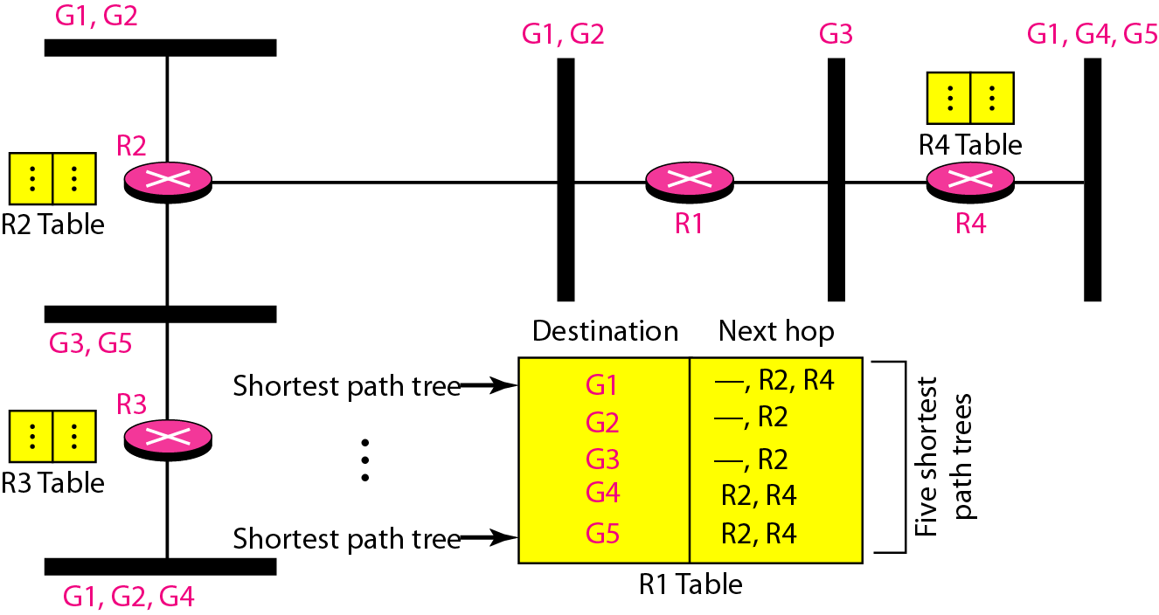
Source-based tree approach
22.<number>

Slide 23
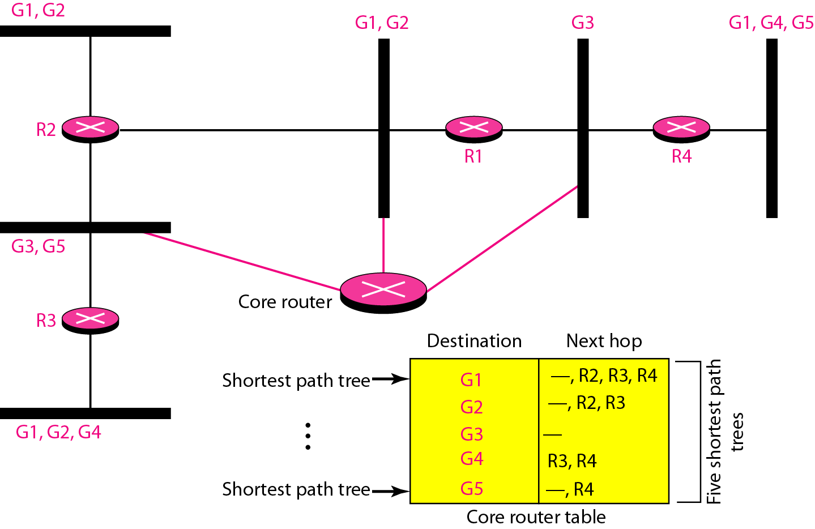
Group-shared tree approach
22.<number>

Slide 24
    21-3 INTRADOMAIN PROTOCOLS
During the last few decades, several intradomain multicast routing protocols have emerged. In this section, we discuss three of these protocols. Two are extensions of unicast routing protocols (RIP and OSPF), using the source-based tree approach; the third is an independent protocol which is becoming more and more popular.
21.<number>
Notes:
21.#

Slide 25
221.3.1 DVMRP
The Distance Vector Multicast Routing Protocol (DVMRP) is the extension of the Routing Information Protocol (RIP) which is used in unicast routing. It uses the source-based tree approach to multicasting. It is worth mentioning that each router in this protocol that receives a multicast packet to be forwarded implicitly creates a source-based multicast tree in three steps:
  Flooding
  RPF
  RPB
  RPM
21.<number>
Notes:
21.#

Slide 26
Flooding
router receives a packet and without even looking at the destination group address, sends it out from every interface except the one from which it was received.
Flooding accomplishes the first goal of multicasting: every network with active members receives the packet.
a broadcast, not a multicast
it creates loops
21.<number>

Slide 27
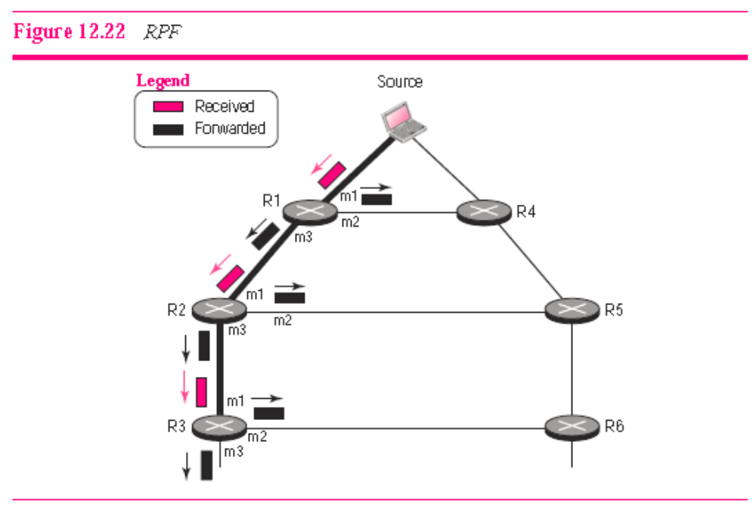
Reverse Path Forwarding
21.<number>

Slide 28
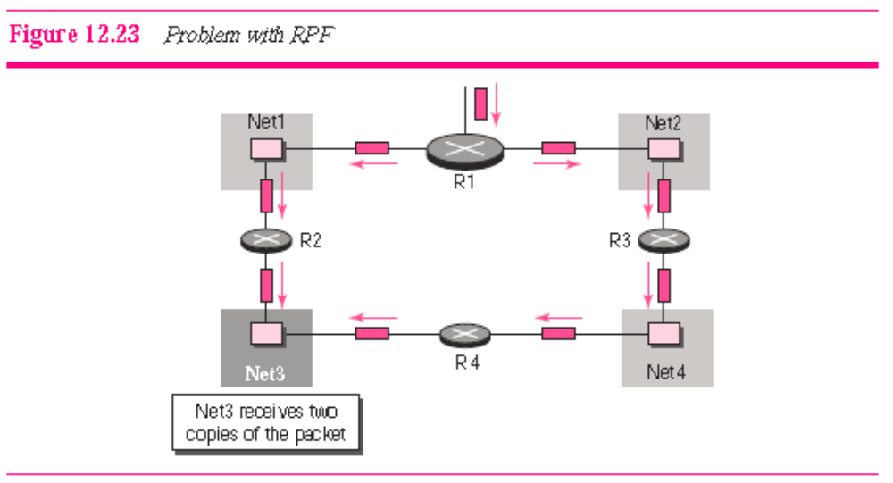
Reverse Path Broadcasting
21.<number>

Slide 29
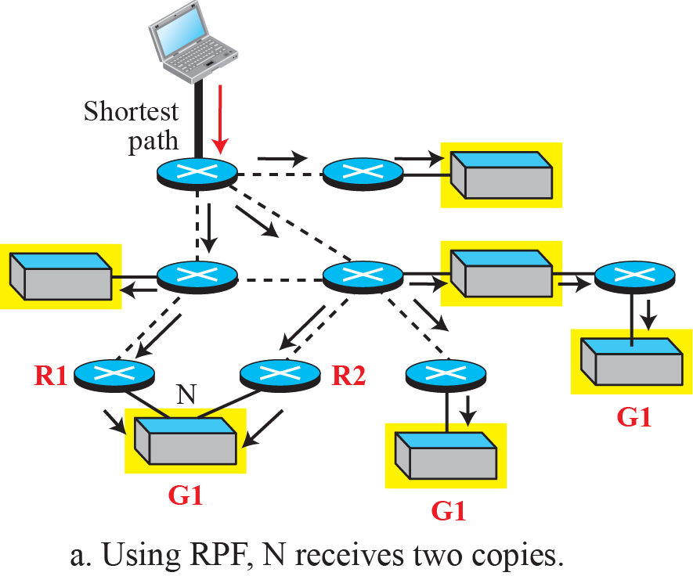
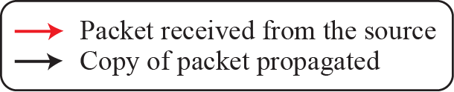
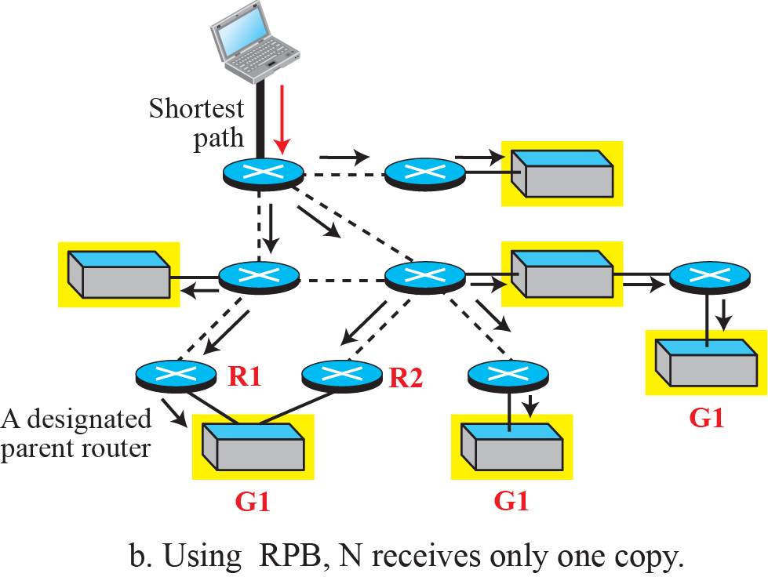
Figure 221.11: RPF versus RPB
21.<number>
Notes:
21.#

Slide 30
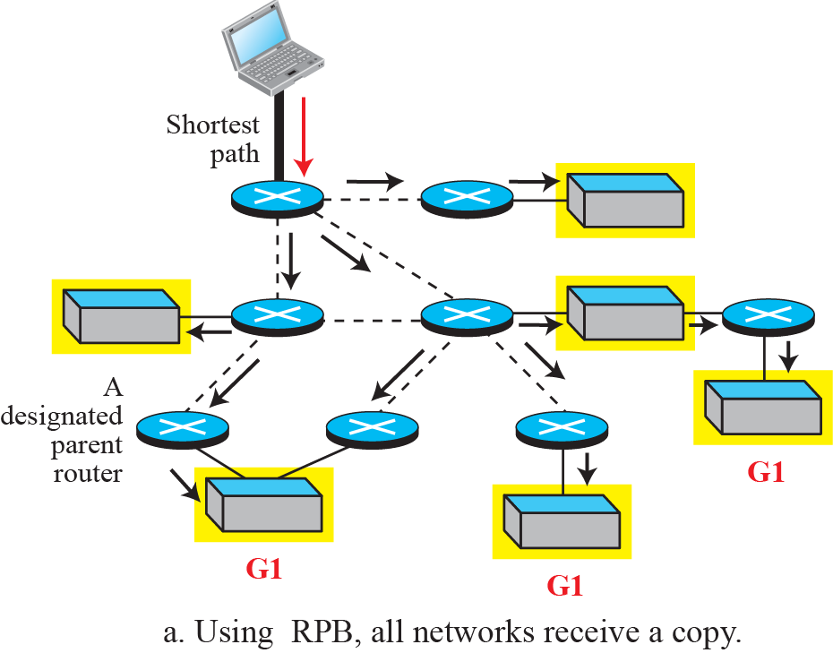

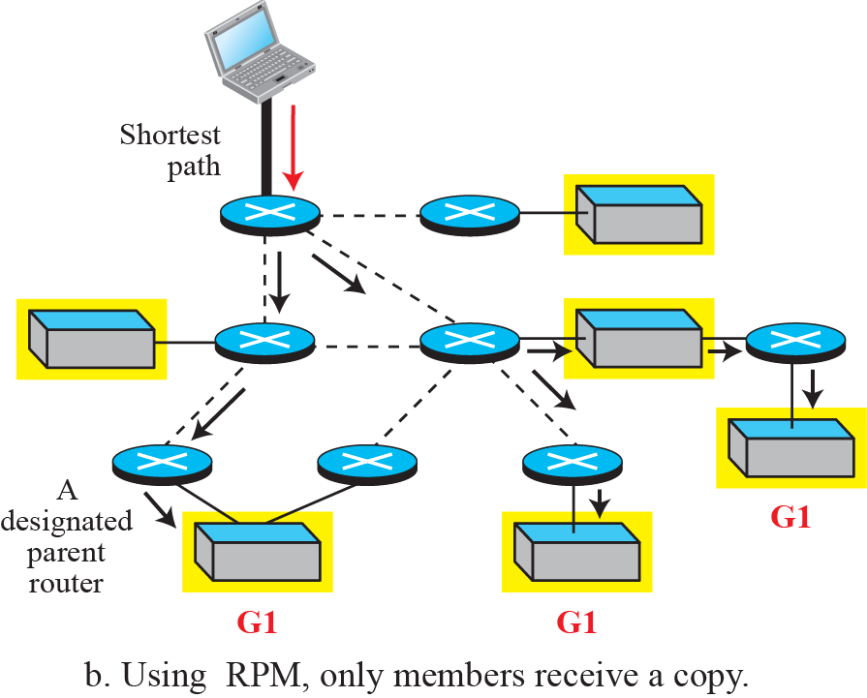
Figure 221.12: RPB versus RPM
21.<number>
Notes:
21.#

Slide 31
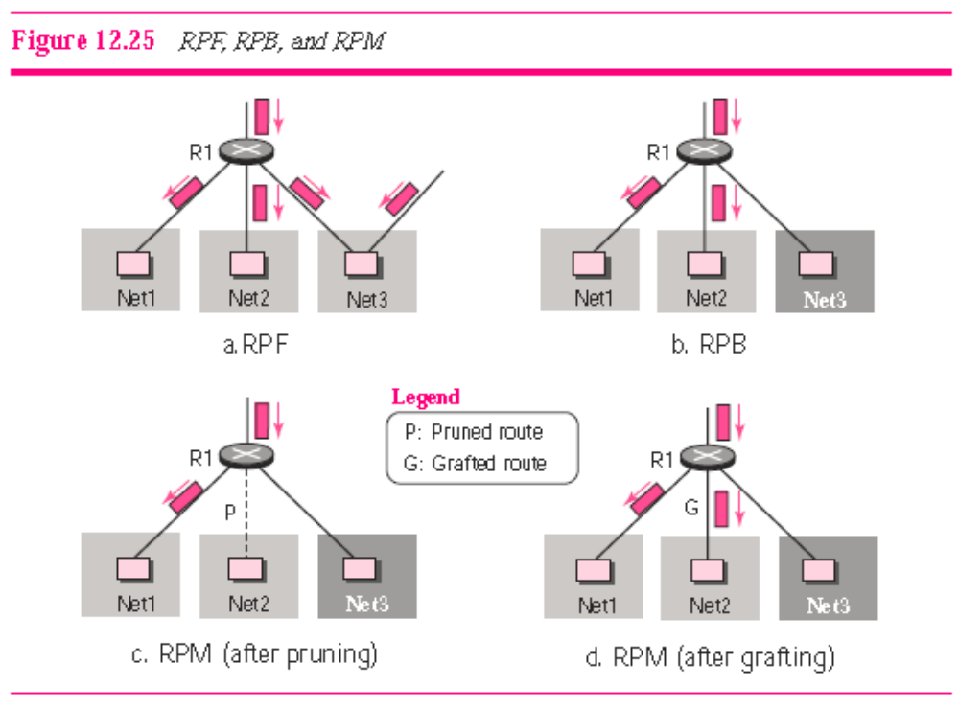
RPF vs RPB vs RPM
21.<number>

Slide 32
221.3.2 Multicast Link State (MOSPF)
Multicast Open Shortest Path First (MOSPF) is the extension of the Open Shortest Path First (OSPF) protocol, which is used in unicast routing. It also uses the source-based tree approach to multicasting. If the internet is running a unicast link-state routing algorithm, the idea can be extended to provide a multicast link-state routing algorithm. To extend unicasting to multicasting, each router needs to have another database, as with the case of unicast distance-vector routing, to show which interface has an active member in a particular group.
21.<number>
Notes:
21.#

Slide 33
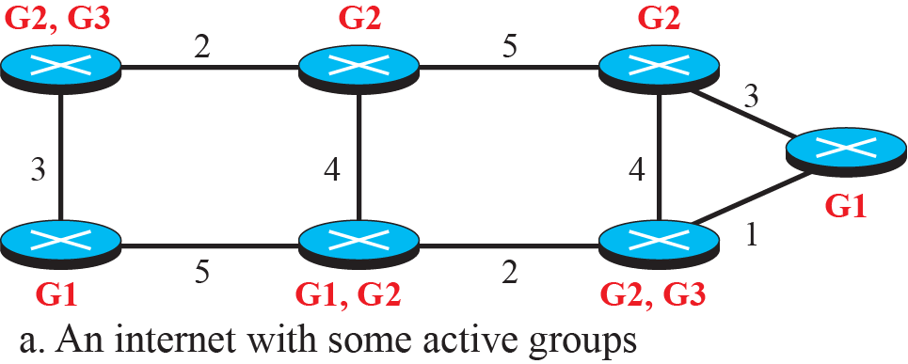
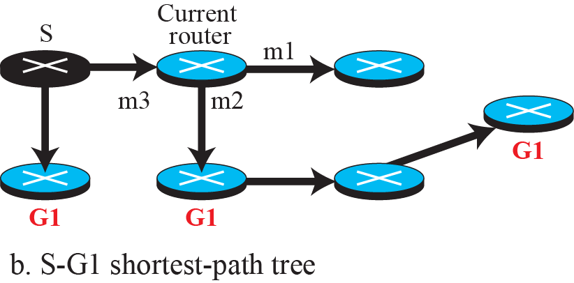
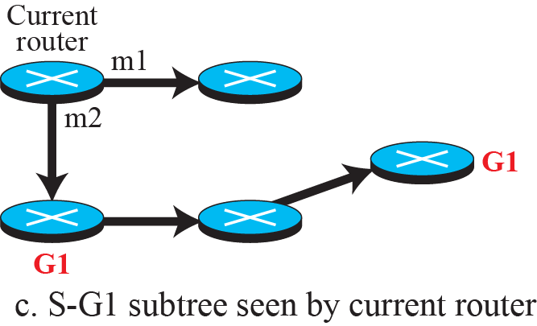
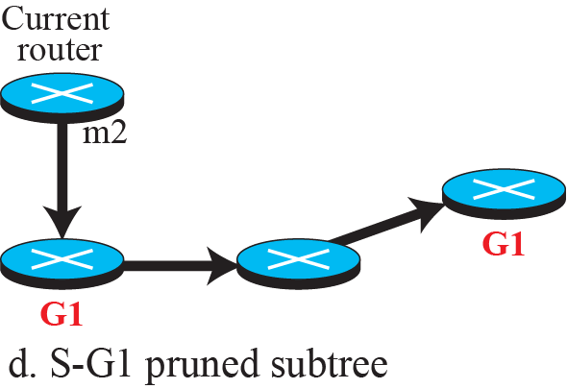
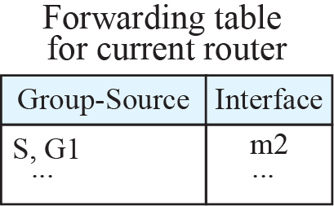
Figure 221.13: Example of tree formation in MOSPF
21.<number>
Notes:
21.#

Slide 34
Internet Group Management Protocol
Multicast communication means that a sender sends a message to a group of recipients that are members of the same group.
each multicast router needs to know the list of groups that have at least one loyal member related to each interface.
multicast routers need to collect information about members and share it with other multicast routers.
21.<number>

Slide 35
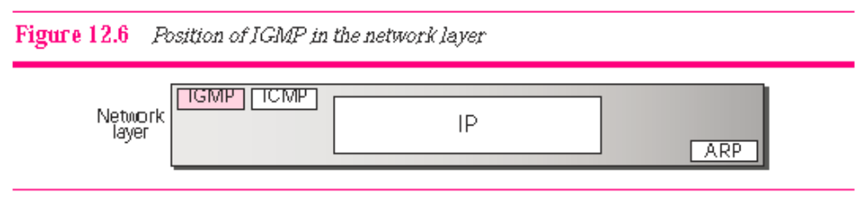
Position of IGMP
IGMP is a group management protocol. It helps a multicast
router create and update a list of loyal members related to
each router interface.
21.<number>

Slide 36
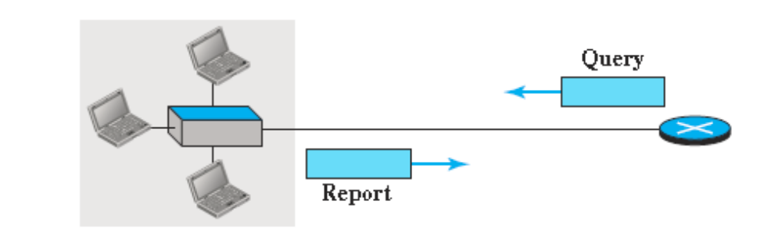
IGMP Operation
A query message is periodically sent by a router to all hosts attached to it to ask them to report their interests about membership in groups.
A report message is sent by a host as a response to a query message.
21.<number>

Slide 37
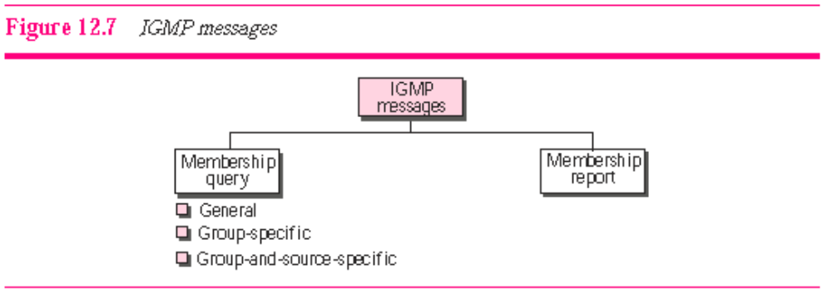
IGMP Messages
21.<number>

Slide 38
Membership Query messages
In a general query message, the querier router probes each neighbor to report the whole list of its group membership (interest in any multicast group).
In a group-specific query message, the querier router probes each neighbor to report if it is still interested in a specific multicast group.
In a group-and-source-specific query message, the querier router probes each neighbor to report if it is still in a specific multicast group, x.y.z.t, coming from any of the N sources whose unicast addresses are defined in this packet.
21.<number>

Slide 39
Membership Report Message
sent by a host as a response to a query message.
The report message contains list of records which contains:
  identifier of the corresponding group (multicast address)
  addresses of all sources that the host is interested in receiving messages.
  the source addresses from which the host does not desire to receive a group message (exclusion).

Slide 40
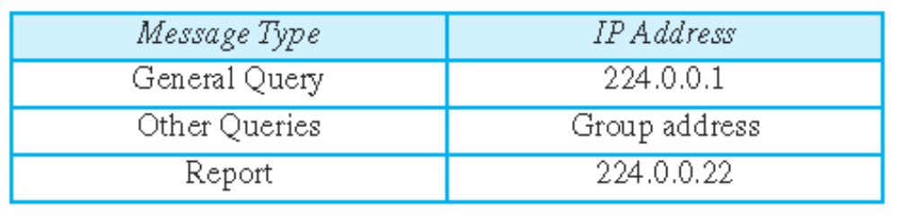
Encapsulation
The IGMP message is encapsulated in an IP datagram with the value of the protocol field set to 2 and the TTL field set to 1.
The destination IP address of the datagram, however, depends on the type of message
21.<number>

