Slide 1


JPMC Code For Good 2k17
IandEye Sharing vision
Team Members:
Nidhi
Sindhu
jeevana
navya
sainath

Slide 2
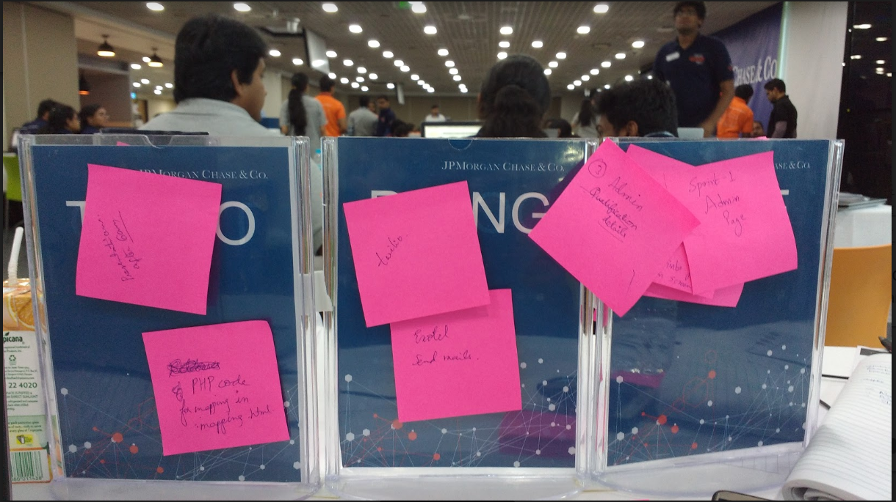
Sowing the seeds!
Agile Methodology
A short-cut implementation of scrum model
Division of tasks and sprint planning

Slide 3



Project Anatomy
We divided the project into 3 modules
Student
Volunteer
Admin

Slide 4


Solution
We bridged the gap between student and scribe by providing a common platform
User friendly portal for visually impaired and scribes
Scribe selection based on criteria
SMS/Email Alert facility
Facility provided to Admin to add students
Report generation for analysis
I2EYE APP

Slide 5
Technology Stack
Html 5
CSS
Javascript
Bootstrap
PHP
Twilio- Cloud Communication Platform
XAMPP
Mysql Database
Github

Slide 6
Features to be implemented in the future
Tracing location of student and scribe on the day of examination.
An option for the type of exam i.e academic or competitive
and to take start and end dates.
Availability of backup if the primary scribe drops in the last moment.
Administrator to be given an option to switch as a volunteer whenever required .
THANK YOU!!!☺

