Slide 1
FAB
Team - 20
Dattamber Jukanti
Saiyana Ramisetty
Chandana Rayini
Dattamber Jukanti
Saiyana Ramisetty
Chandana Rayini

Slide 2
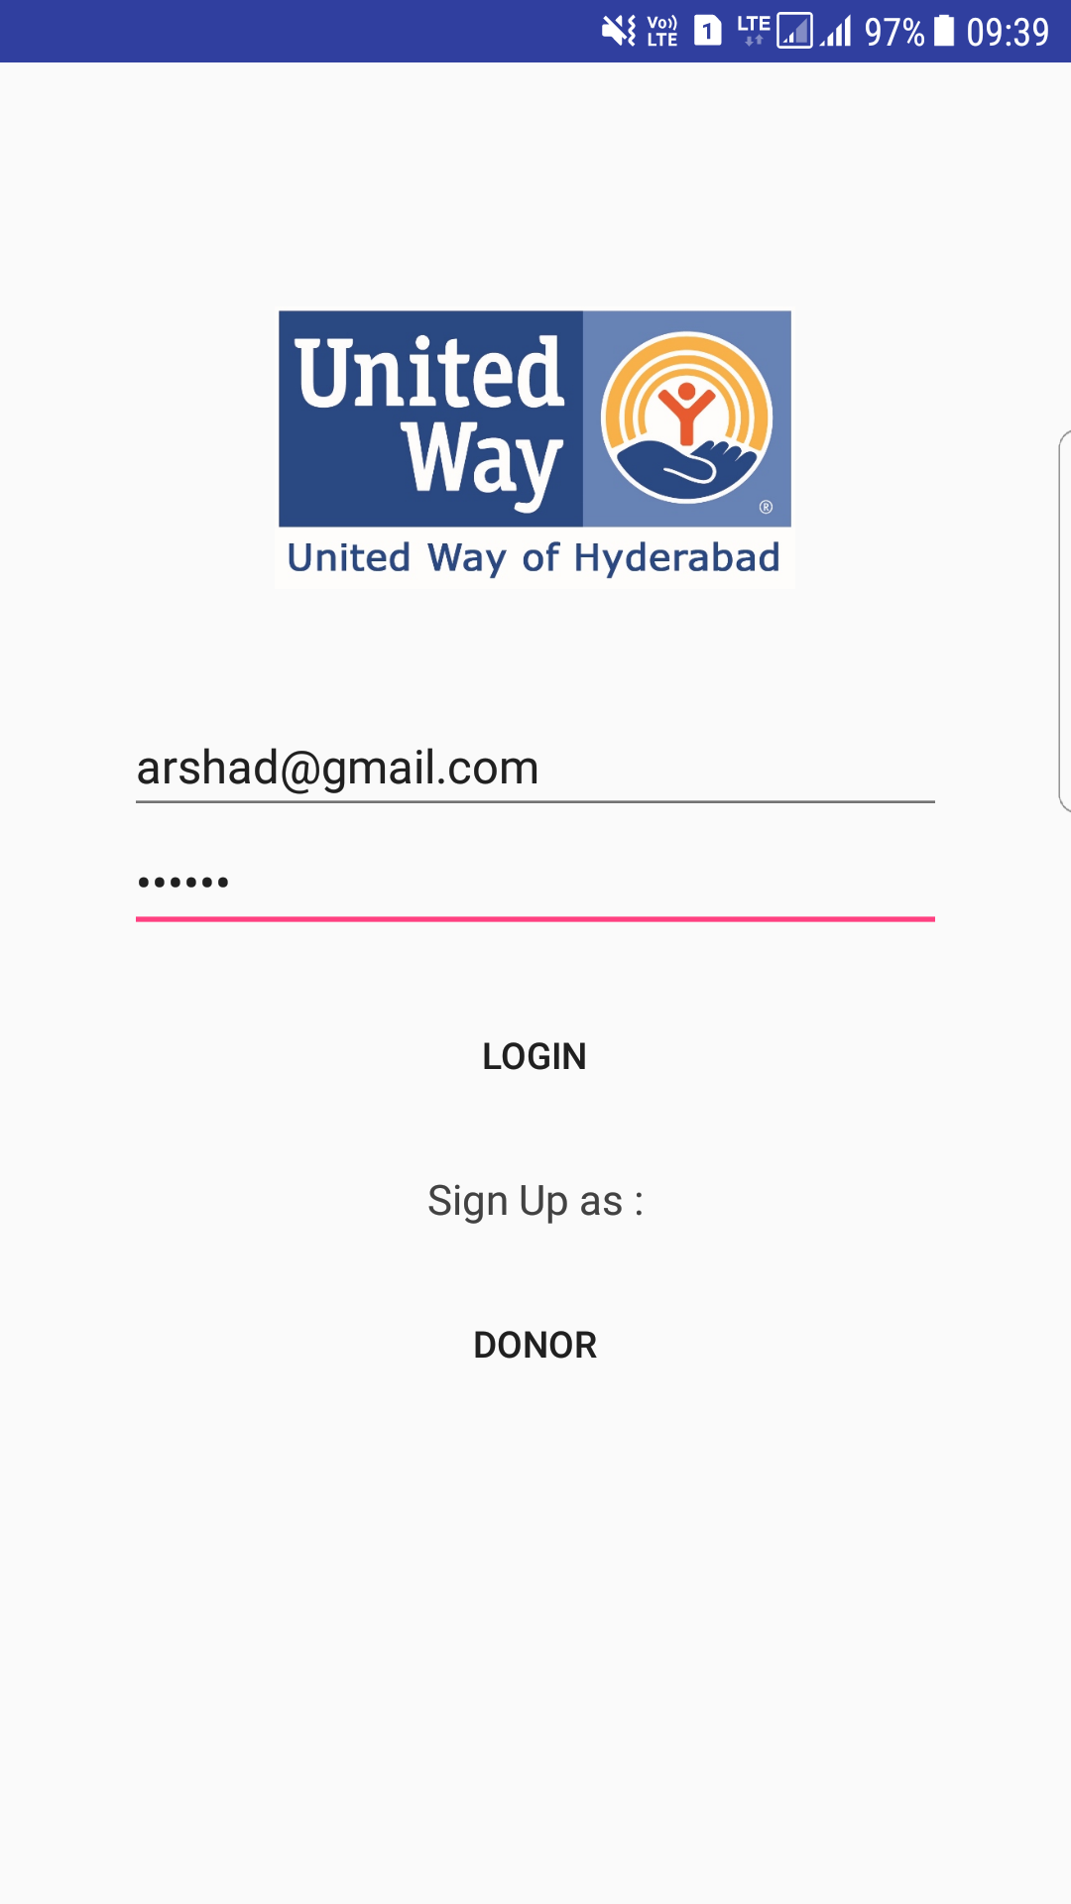
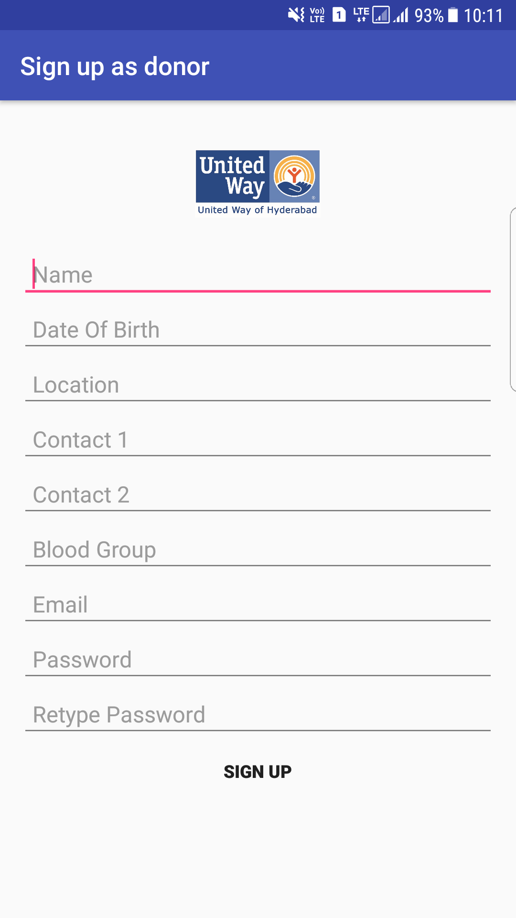
FAB

Slide 3
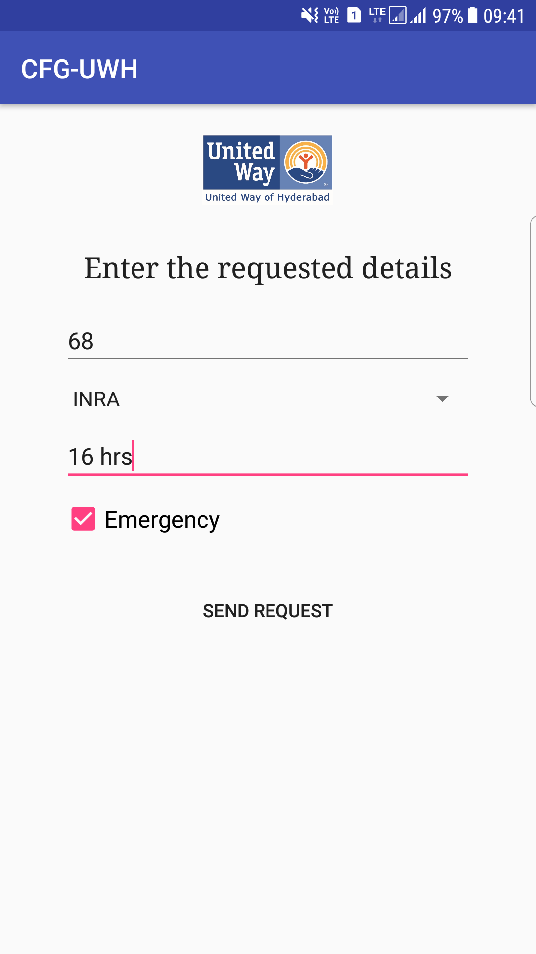
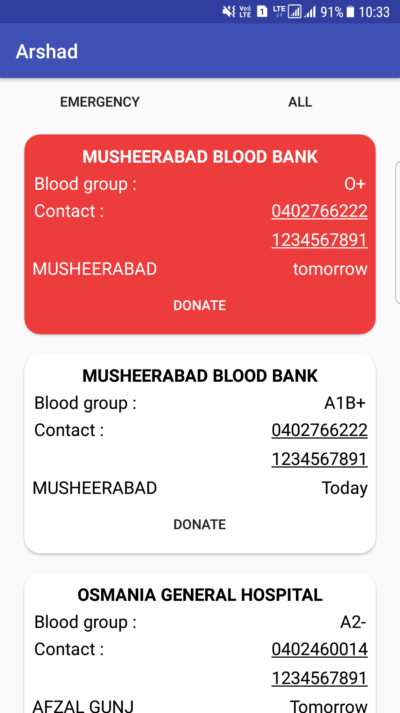
FAB

Slide 4
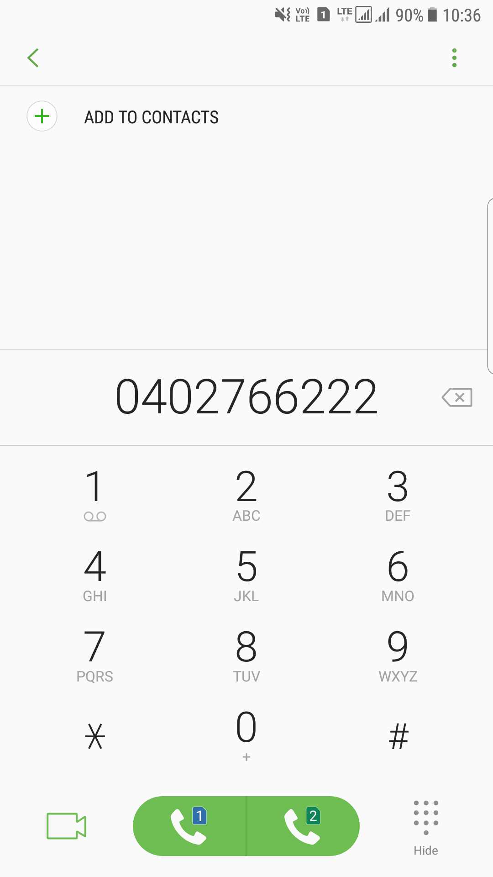
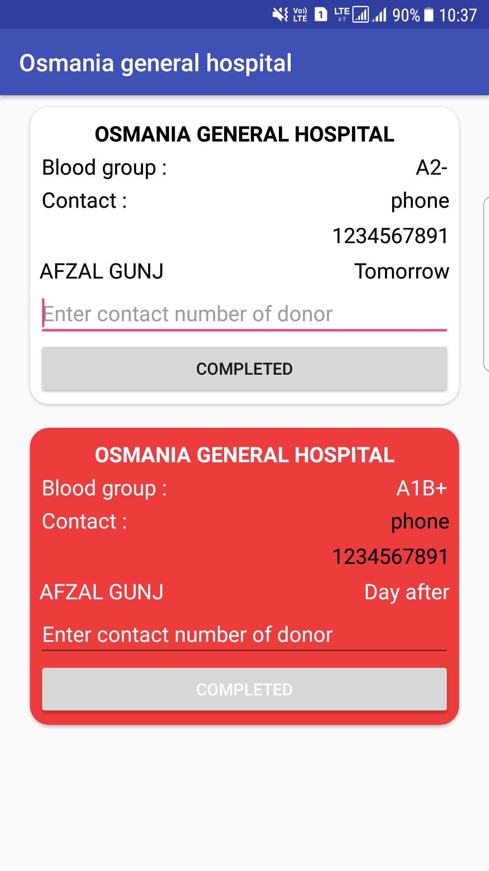
FAB

Slide 5
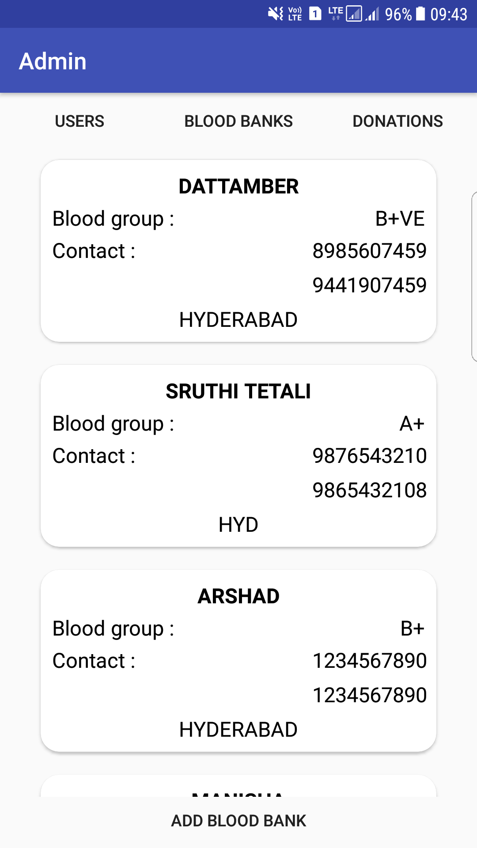
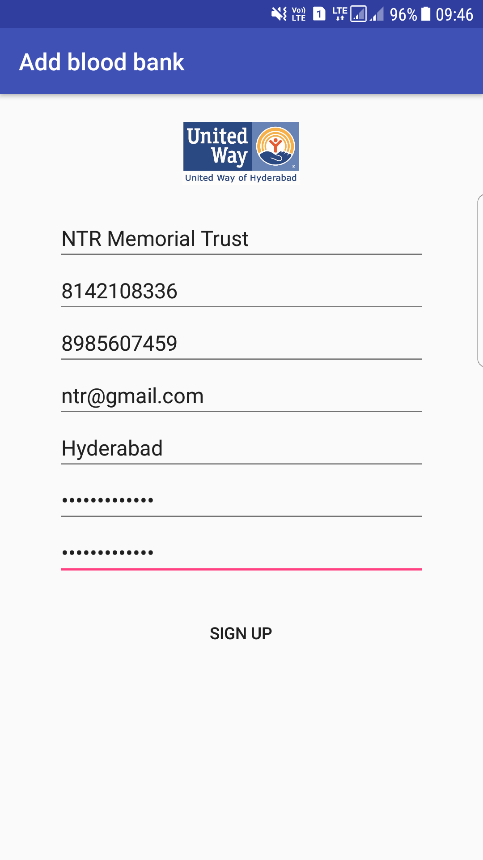
FAB

Slide 6


Technology Stack

Slide 7
Future Scope
Sorting the Donation Requests based on the distance between the Donor and the Blood Bank (Recipient Institution).
Multiple donors accepting the same request.
Donations History
Credits based on Donation History

