Slide 1
TEAM 05 16-07-2017 Code For Good

Slide 2
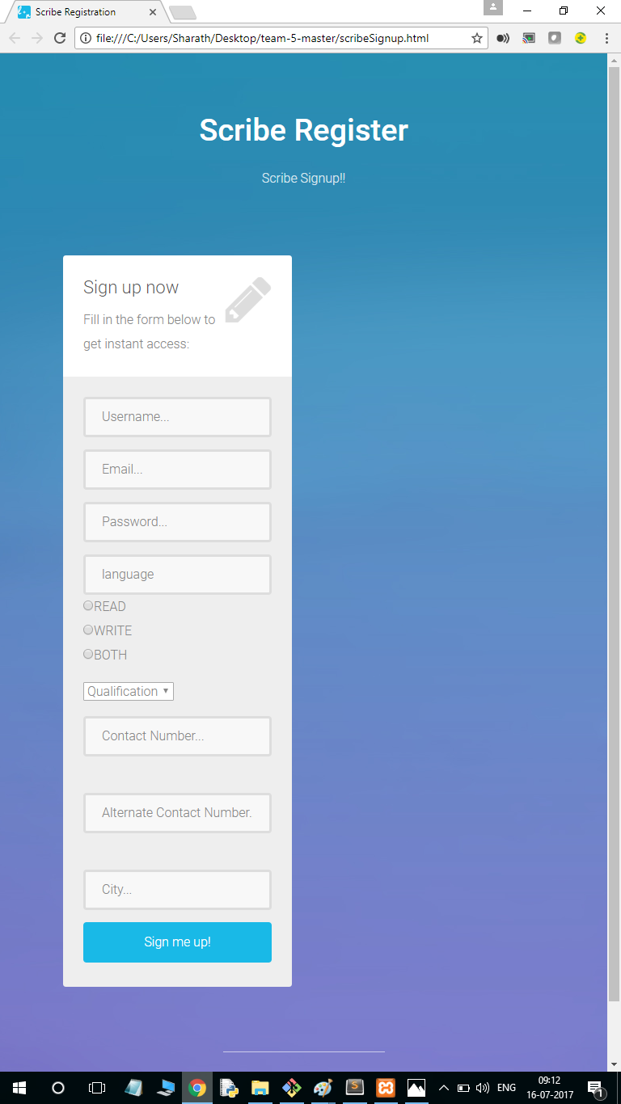
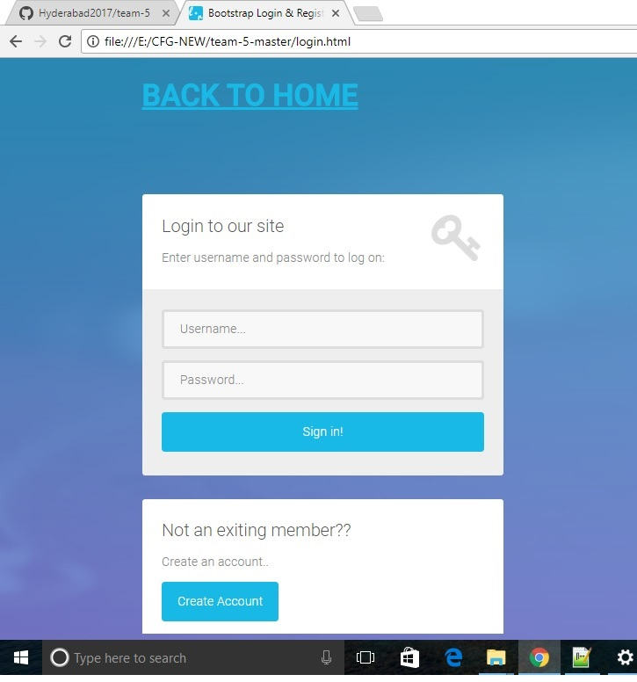
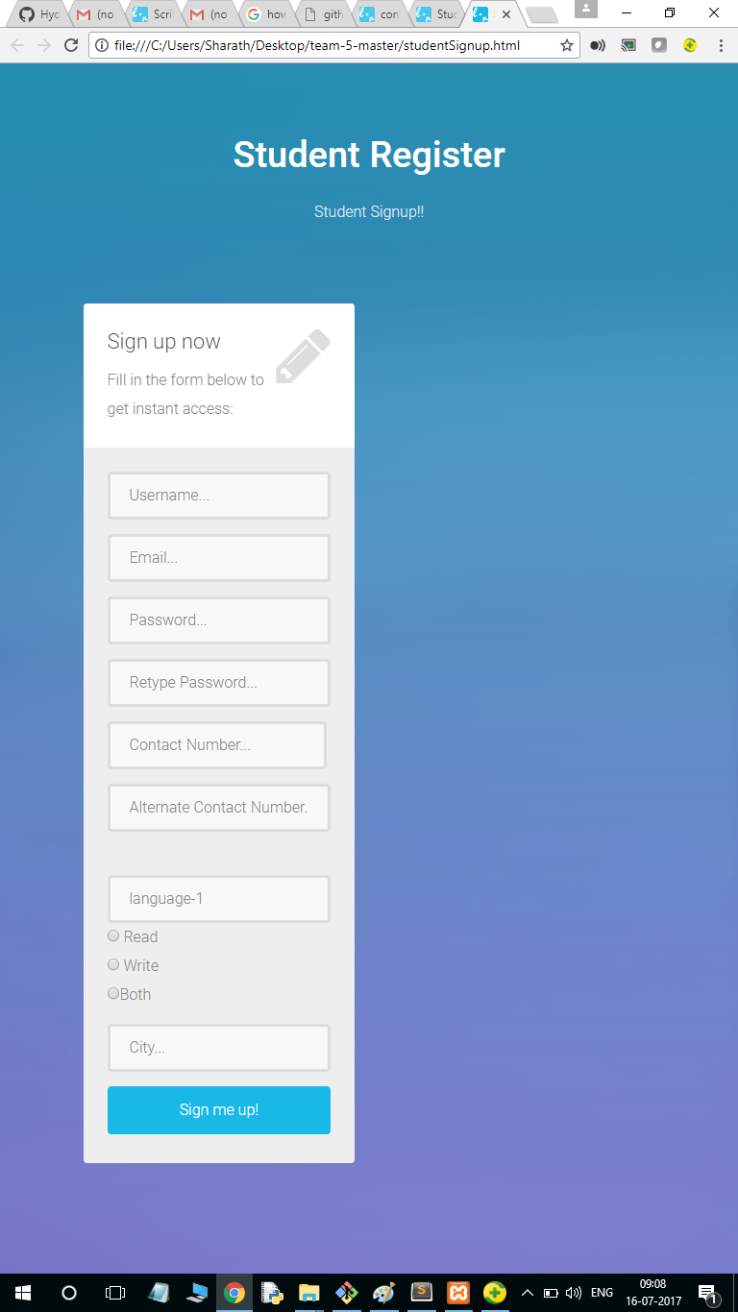
What we are doing??
I & Eye mobile application to search scribes to assist into exams
Student module
Scribe module
Admin module

Slide 3
how we are doing??
Web application
Mobile application
Technologies used:
HTML,CSS
Javascript
Bootstrap
PHP
Twilio
MySql
Firebase
Build PhoneGap

Slide 4
BENEFITS
Seamless Communication
Timely notifications
Contingency preparation
Automatic Notification
Compatible Solutions

Slide 5
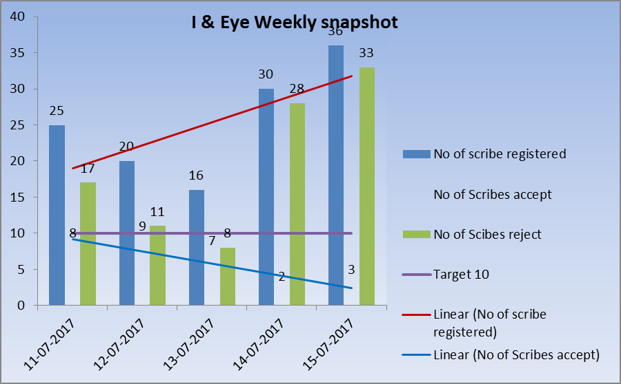
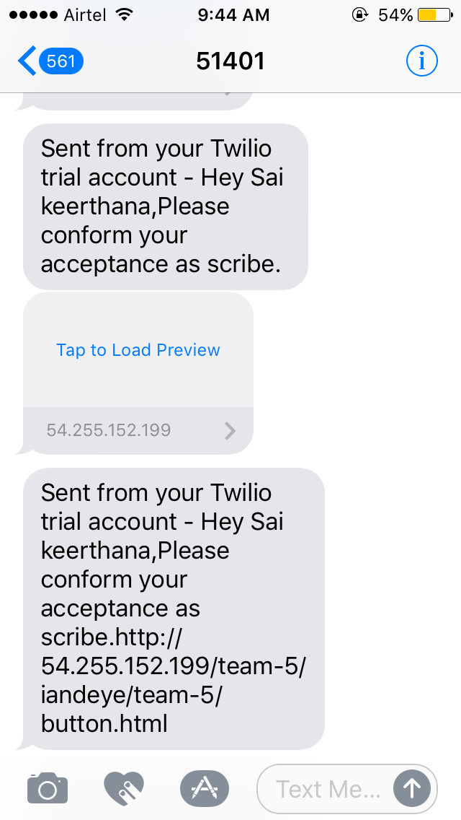
OUR CONTRIBUTION..
Unique messaging module ,easily adaptable with minimal customization
Weekly snap shot analysis

Slide 6
WAY TO GO…
Priority based Scribe-Student Matching
GPS tracking of Scribe & student
Calendar Implementation with alerts

Slide 7
How Team 05 Can Help you???

