Slide 1
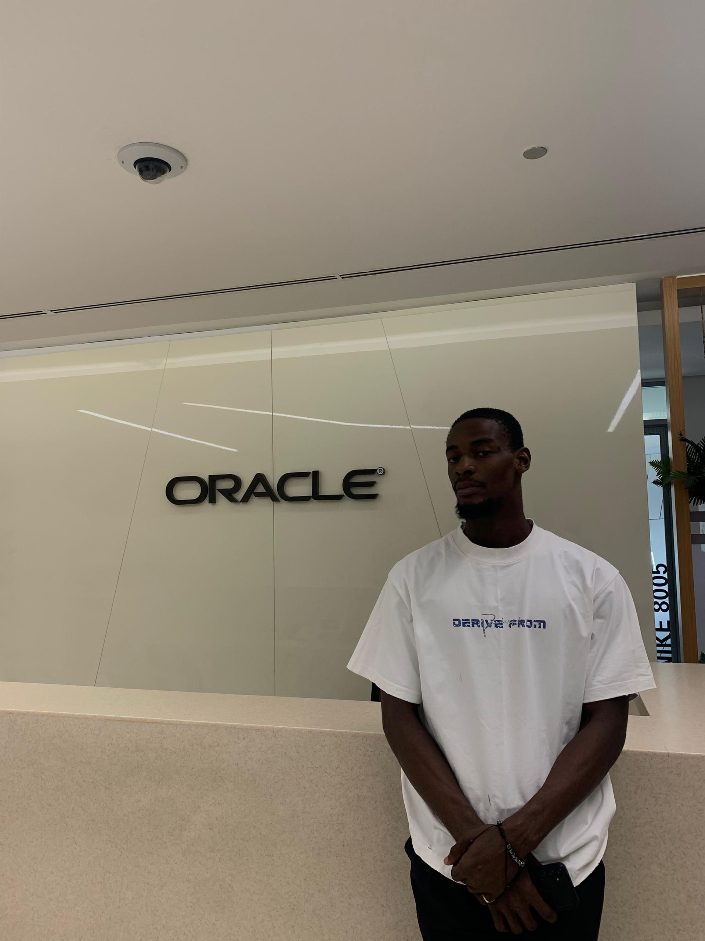

Welcome & Roadmap
WEEK 1 · SESSION 1
Your 16-week journey to becoming a Full-Stack Web Developer.
hydes_syde
Full-Stack Bootcamp · Week 1
IGBANESI MICHAEL .E. (JAMAR)
Notes:
Welcome everyone. Introduce yourself, then explain that today covers three things: what the program is, where it is going, and how to use AI well. Keep the mood relaxed; many students are nervous.

Slide 2
Welcome to the program
16
4
1
weeks of guided, hands-on learning
months, each ending in a graded project
deployed full-stack capstone
Notes:
Frame the program: 16 weeks, four months, each ending in a project. Stress that it is a build-first program. Be honest that it prepares them for internships and junior roles and does not guarantee a job.

Slide 3




How we will learn together
Build, don't just watch
Work in pairs
Every concept comes with a hands-on task you can show to others.
Pair programming and rotating teams: you help and get helped.
Ask in public
A steady weekly rhythm
Questions in the group chat and GitHub Issues help the whole class.
Mon: Learn Day.
Wed: Learn and Build Day.
Fri: Build and Review.
Notes:
Explain the weekly rhythm: Monday to Wednesday concept sessions with live coding and labs, Thursday build day, Friday demos. Encourage pairing and asking questions publicly.

Slide 4




Your 16-week roadmap
MONTH 1
MONTH 2
MONTH 3
MONTH 4
Foundations
JavaScript
Frontend
Backend + capstone
Weeks 1 to 4
Weeks 5 to 8
Weeks 9 to 12
Weeks 13 to 16
Computers, the web, Git, Html and Css
The language, the DOM, and API consumption
HTML and CSS, React, deployment
Node, Express, MongoDB.
Notes:
Walk left to right. Month 1 builds foundations (today's week), Month 2 is the JavaScript language, Month 3 is frontend with React, Month 4 is backend and the capstone. Each month ends with a project.

Slide 5
What you will build
Month 1
A personal profile page published on GitHub Pages
1
Month 2
A pesonal portfolio or an app that consumes a public API
2
Month 3
A deployed multi-page React app
3
Month 4
A full-stack capstone with login, a database and a live demo day
4
Notes:
Show that every month ends with something tangible they can put on GitHub. The capstone is the centre of the program, so mention it early and often.

Slide 6





The tech we will use
HTML
CSS
JavaScript
React
The structure of every web page
Style, colour and layout
The language of the web
Build interactive interfaces
Node.js
MongoDB
Git & GitHub
VS Code
JavaScript on the server
Store your app's data
Track and share your code
Where you write code
Notes:
Do not dwell on any one tool. The point is that they will meet each one in order. Everything is JavaScript, which keeps the learning curve manageable.

Slide 7


How the pieces fit together
Frontend
Backend
Database
HTML, CSS, React
Node.js and Express
MongoDB
What users see and click
Rules, logic and the API
Where data is stored
The toolbox: Git, GitHub, VS Code and npm help you build, track and ship every layer.
Notes:
A full-stack app has three layers. The frontend is what users see, the backend holds the rules, the database stores the data. The toolbox underneath is what we use to build and ship all of it.

Slide 8
Working with AI
A powerful tutor and a risky shortcut
Notes:
Move into the AI topic. Set the tone: AI is now part of how developers work, so the goal is to use it well, not to hide from it.

Slide 9




What AI is and is not
AI
Machine learning
Generative AI
Software that does tasks that normally need human intelligence.
Systems that learn patterns from data instead of fixed rules.
Models that create text, code or images from your prompt.
Language models predict likely text. They sound confident even when they are wrong, so always test what they give you.
Notes:
Keep definitions simple. The key takeaway is the strip at the bottom: language models predict likely text and can be confidently wrong, so we always verify.

Slide 10


AI as a tutor, not a shortcut
Do
Don't
Ask it to explain an error message
Paste the assignment and submit its answer
Ask for a hint, not the full answer
Use code you cannot explain line by line
Have it quiz you on today's topic
Trust output you have not run and tested
Ask it to review your own code
Share passwords, keys or private data
Notes:
Read a few examples aloud. The test: if you cannot explain it, you did not learn it. Also warn about sharing passwords, API keys or personal data in prompts.

Slide 11
Questions?
THANK YOU
Next session: how computers and the internet work
Full-Stack JavaScript Bootcamp · Week 1
Notes:
Take questions. Remind everyone of the checklist and the group chat.

